Slide 1
WILSON LAB
VES041 activation
csChrimson behavioral data
Turning, forward motion and pivot-like events
Experiments: Sophia Renauld and Victoria Rockwell
Local-data reanalysis / 13 October 2026
Notes:
This deck uses local exported numeric data and original source figures. It contains 15 main slides and 6 appendix slides. No server access is required. The 84-fly archived summaries and 81-fly pulse-derived analysis are different views of overlapping data, not independent replications. All newly plotted points are observed fly-level measurements.
Sources:
S1: /Users/sophiarenauld/Downloads/Wilson Lab/Chrimson Data(Included) (3).csv
S2: /Users/sophiarenauld/Documents/GitHub/Wilson_Thesis/Behavior_analysis/smp544_pivot_results/presentation_metrics.csv
S3: /Users/sophiarenauld/Downloads/Wilson Lab/lab_meeting_plus_extra/labmeeting_9.pptx
S9: /Users/sophiarenauld/Downloads/Wilson Lab/Blinded_csChrim_behavior.pptx
Reproduction: analyze_ves041.py and replot_ves041.R in the accompanying reproducibility package. Analysis date: 13 October 2026.

Slide 2
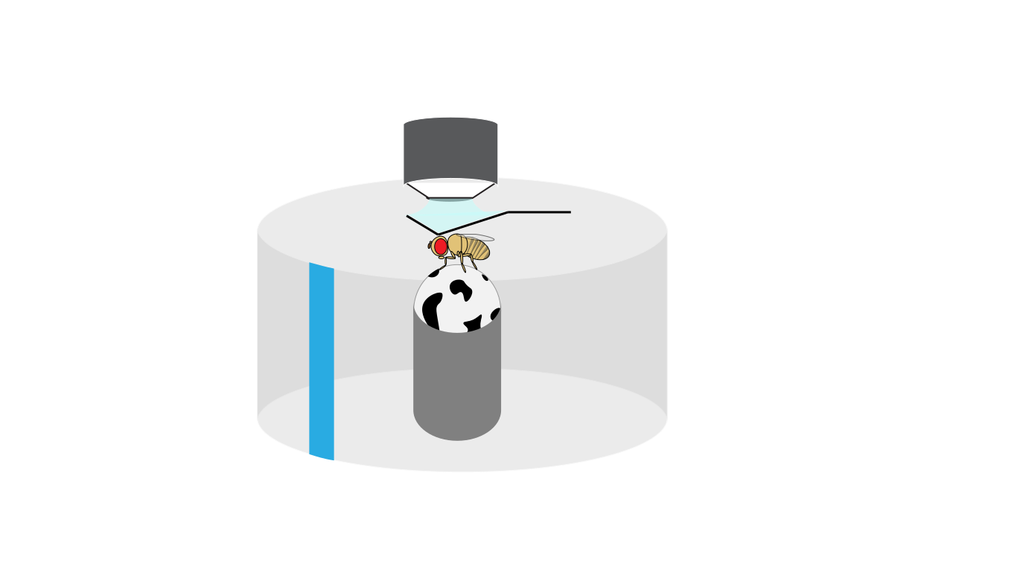
EXPERIMENT
Brief activation during closed-loop walking
Later blinded cohort: two VES041 split lines and three control genotypes
1 s light pulse
Every 14.5 s during a 20 min trial
Closed-loop visual bar
VES041 line 1 and line 2 × csChrimson
Matched line × GFP controls
Empty-split × csChrimson control
Protocol and schematic: labmeeting_9, slide 18.
02
Notes:
Protocol transcribed from labmeeting_9 slide 18: 1 s optogenetic stimulation every 14.5 s, 20 min trials, closed-loop bar. The intended n=15 in that source is a recruitment target; actual counts are reported on slide 3. Schematic copied without alteration to its content; transparent surrounding whitespace is cropped for layout. Earlier pilot protocols are separated in the appendix.
Sources:
S3: /Users/sophiarenauld/Downloads/Wilson Lab/lab_meeting_plus_extra/labmeeting_9.pptx
S9: /Users/sophiarenauld/Downloads/Wilson Lab/Blinded_csChrim_behavior.pptx
Reproduction: analyze_ves041.py and replot_ves041.R in the accompanying reproducibility package. Analysis date: 13 October 2026.

Slide 3
DATA COVERAGE
Local data cover 84 flies, with pulse metrics for 81
The pulse dataset contains 80 stimuli per fly, for 6,480 stimulation events
Genotype | Archived summary | Pulse analysis | Stimuli
Line 1 + csChrimson | 18 | 18 | 1440
Line 2 + csChrimson | 17 | 16 | 1280
Line 1 + GFP | 16 | 16 | 1280
Line 2 + GFP | 16 | 16 | 1280
Empty + csChrimson | 17 | 15 | 1200
Fly IDs 1, 6 and 39 are absent from the pulse-derived results.
All available pulse records remain in the analysis. No outlier removal or imputation.
S1, S2, S5, S11. These are overlapping cohorts. Do not add their sample sizes.
03
Notes:
Genotype mapping parsed directly from cschrim_behaviorcrunch.R. 84 archived flies: line1-Chrimson18, line2-Chrimson17, line1-GFP16, line2-GFP16, empty-Chrimson17. Pulse analysis: 18,16,16,16,15 respectively. Source extraction lists omit IDs1 and6; ID39 appears in recording_manifest.csv but has no extracted pulses. Extractor documents skipping a legacy non-HDF5 control file, but the specific failure for ID39 cannot be independently established from local exports. No new exclusion is introduced.
Sources:
S1: /Users/sophiarenauld/Downloads/Wilson Lab/Chrimson Data(Included) (3).csv
S2: /Users/sophiarenauld/Documents/GitHub/Wilson_Thesis/Behavior_analysis/smp544_pivot_results/presentation_metrics.csv
S5: /Users/sophiarenauld/Documents/GitHub/Wilson_Thesis/Behavior_analysis/Behavior_Crunch/cschrim_behaviorcrunch.R
S6: /Users/sophiarenauld/Documents/GitHub/Wilson_Thesis/Behavior_analysis/analyze_smp544_pivots.py
S11: /Users/sophiarenauld/Documents/GitHub/Wilson_Thesis/Behavior_analysis/smp544_pivot_results/recording_manifest.csv
Reproduction: analyze_ves041.py and replot_ves041.R in the accompanying reproducibility package. Analysis date: 13 October 2026.

Slide 4
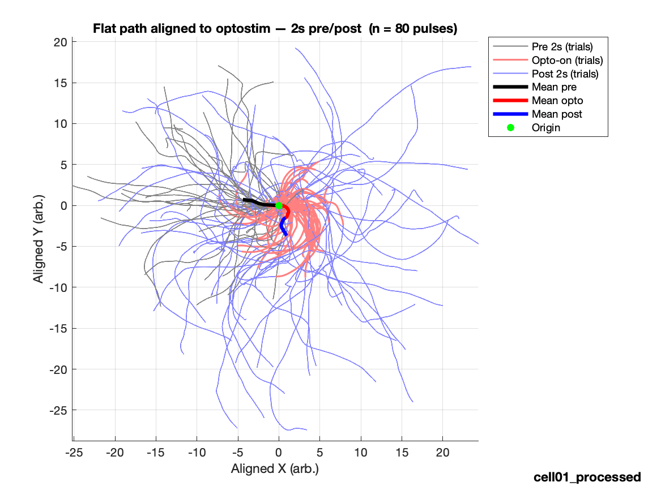
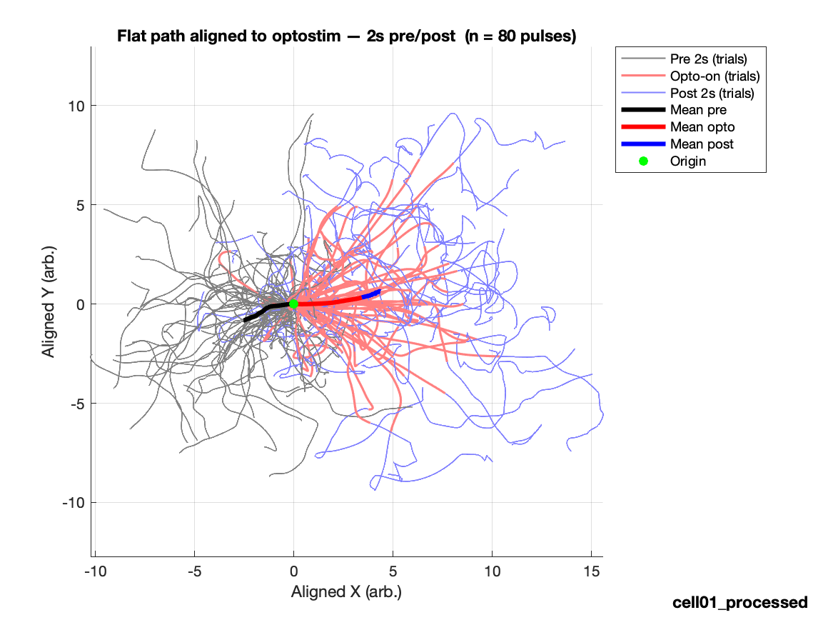
OBSERVED EXAMPLES
Example paths show variable responses
Source-labeled examples, each with 80 aligned stimulation events
VES041 × csChrimson
Empty-split × csChrimson
S3, slide 22. Original figures with source arbitrary units. Fly IDs are unavailable.
04
Notes:
Original unaltered image32.png (left, VES041 × csChrimson) and image31.png (right, empty × csChrimson) from slide22 of labmeeting_9. Assignment checked against image relationships and label positions. Each source plot shows80 pulses. These examples are illustrative, not a random sample or the basis of inference. Their original axes read arbitrary units, so they are not used to validate the 2mm pivot threshold.
Sources:
S3: /Users/sophiarenauld/Downloads/Wilson Lab/lab_meeting_plus_extra/labmeeting_9.pptx
Reproduction: analyze_ves041.py and replot_ves041.R in the accompanying reproducibility package. Analysis date: 13 October 2026.

Slide 5
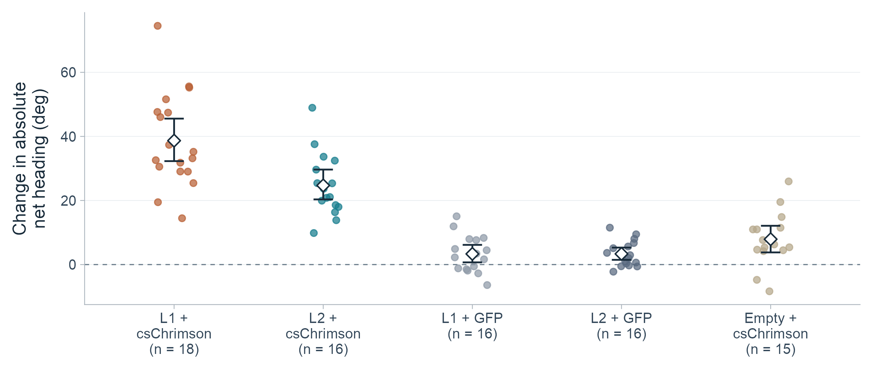
PULSE-DERIVED RESULTS
Activation increases absolute heading change
Mean within-fly increase: 38.7° in line 1 and 24.7° in line 2
S2. During minus preceding 1 s. Points: flies; diamonds: means; bars: 95% fly-bootstrap CIs.
05
Notes:
Mean of 80 pulses per fly. During = first 1 s of stimulation, baseline = preceding 1 s. Delta = during - baseline. Equal fly weight. No imputation/outlier exclusion. CIs = percentile fly bootstrap, not simultaneous. Two-sided random-label permutation tests, 100000 shuffles with plus-one correction. BH FDR across 12 exploratory genotype contrasts (3 metrics x 4 comparisons). Absolute net heading = absolute unwrapped end-to-start heading difference within each1s window. This is not cumulative turning. 18 line1 and16 line2 activation flies.
Sources:
S2: /Users/sophiarenauld/Documents/GitHub/Wilson_Thesis/Behavior_analysis/smp544_pivot_results/presentation_metrics.csv
S5: /Users/sophiarenauld/Documents/GitHub/Wilson_Thesis/Behavior_analysis/Behavior_Crunch/cschrim_behaviorcrunch.R
S6: /Users/sophiarenauld/Documents/GitHub/Wilson_Thesis/Behavior_analysis/analyze_smp544_pivots.py
Reproduction: analyze_ves041.py and replot_ves041.R in the accompanying reproducibility package. Analysis date: 13 October 2026.

Slide 6
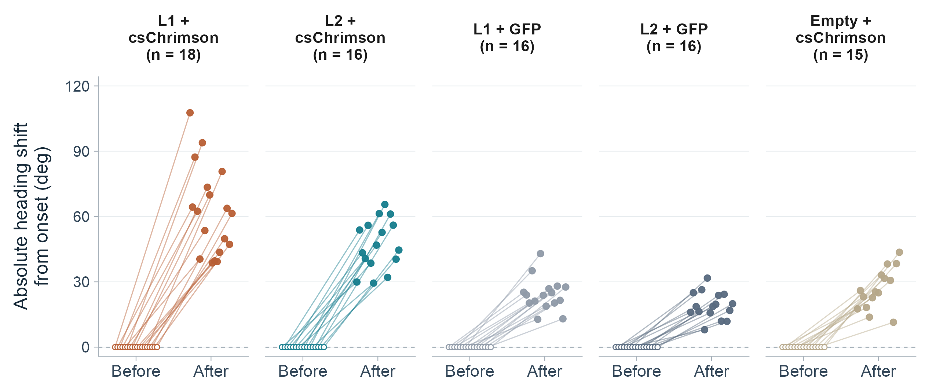
HEADING FROM A ZERO REFERENCE
Absolute heading shift from stimulation onset
Before = 0° for each fly. After = mean absolute endpoint shift across its 80 pulses.
Negative pulse shifts are reflected above 0° before averaging within each fly.
S2. Onset defines 0°. Endpoint: last sample in the first 1 s of light. Horizontal offsets separate flies.
06
Notes:
Starting heading is defined as0deg separately for every pulse. Source signed_net_heading_deg_opto_1s equals unwrapped heading at the last sample in the first1s light window minus heading at the first sample at light onset. The local extractor uses indices start through start+round(rate)-1. At the saved sample rate666.6667Hz, endpoints are about0.999s apart. For each pulse, reflect a negative endpoint across the horizontal0deg axis by taking its absolute value; positive endpoints remain positive. Then average the80 absolute pulse shifts within each fly. After = mean_pulses(abs(theta_end-theta_onset)); this is not abs(mean_pulses(theta_end-theta_onset)), so opposite directions do not cancel across pulses. This is an onset-referenced net displacement magnitude, not cumulative turning or subtraction of the amount of turning in the preceding second. The zero is a coordinate reference, not an observed absence of baseline movement or an imputed observation. Each fly has one zero-reference point connected to its mean absolute endpoint shift. No new paired significance test is applied to these defined zero baselines. Genotype counts18,16,16,16,15 give81flies and162plotted reference/endpoint points. Fixed horizontal offsets follow Fly ID within genotype and are identical at both endpoints; vertical numeric values are unchanged after the explicitly documented absolute-value transformation. The signed version remains in the code package for reference. Exact paired data are in heading_pairs81.csv and heading_pairs_long81.csv, and descriptive summaries in heading_paired_summary81.csv.
Sources:
S2: /Users/sophiarenauld/Documents/GitHub/Wilson_Thesis/Behavior_analysis/smp544_pivot_results/presentation_metrics.csv
S5: /Users/sophiarenauld/Documents/GitHub/Wilson_Thesis/Behavior_analysis/Behavior_Crunch/cschrim_behaviorcrunch.R
S6: /Users/sophiarenauld/Documents/GitHub/Wilson_Thesis/Behavior_analysis/analyze_smp544_pivots.py
Reproduction: analyze_ves041.py and replot_ves041.R in the accompanying reproducibility package. Analysis date: 13 October 2026.

Slide 7
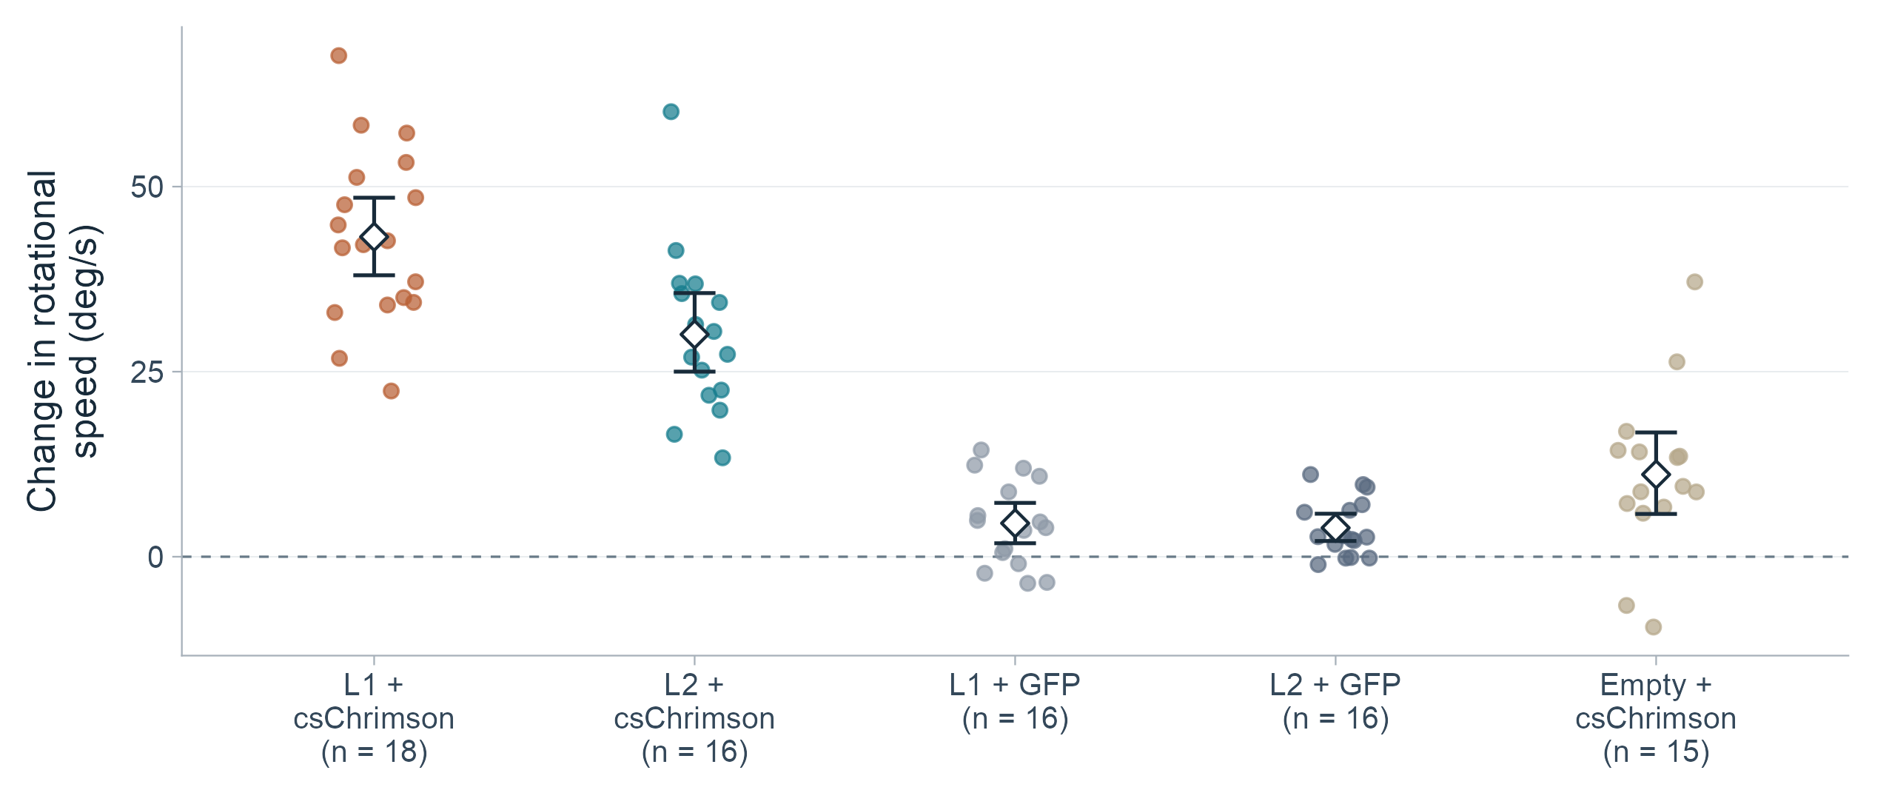
PULSE-DERIVED RESULTS
Rotational speed increases in both split lines
Mean change: +43.2 deg/s in line 1 and +30.0 deg/s in line 2
S2. Points: flies; diamonds: means; bars: 95% fly-bootstrap CIs. Uses archived smoothed angular velocity.
07
Notes:
Mean of 80 pulses per fly. During = first 1 s of stimulation, baseline = preceding 1 s. Delta = during - baseline. Equal fly weight. No imputation/outlier exclusion. CIs = percentile fly bootstrap, not simultaneous. Two-sided random-label permutation tests, 100000 shuffles with plus-one correction. BH FDR across 12 exploratory genotype contrasts (3 metrics x 4 comparisons). Mean rotational speed is mean absolute smoothedangularVelocity in the archived extraction. Smoothing precedes absolute-value averaging; this differs from the raw angularVelocity_raw used by the legacy summary pipeline. No rescaling was applied.
Sources:
S2: /Users/sophiarenauld/Documents/GitHub/Wilson_Thesis/Behavior_analysis/smp544_pivot_results/presentation_metrics.csv
S6: /Users/sophiarenauld/Documents/GitHub/Wilson_Thesis/Behavior_analysis/analyze_smp544_pivots.py
Reproduction: analyze_ves041.py and replot_ves041.R in the accompanying reproducibility package. Analysis date: 13 October 2026.

Slide 8
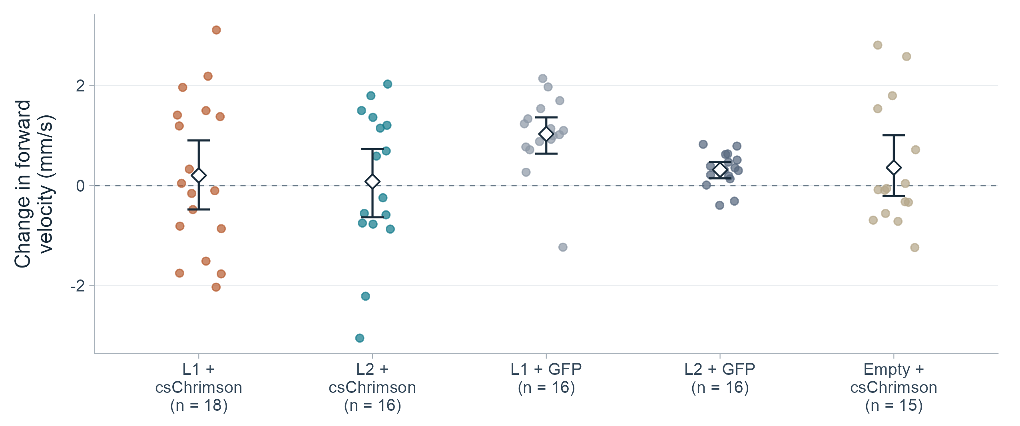
PULSE-DERIVED RESULTS
All-pulse averages do not establish slowing
Mean forward-velocity change: +0.20 mm/s in line 1 and +0.08 mm/s in line 2
S2. All four forward-speed genotype contrasts have BH q ≥ 0.078. Points: flies; bars: 95% fly-bootstrap CIs.
08
Notes:
Mean of 80 pulses per fly. During = first 1 s of stimulation, baseline = preceding 1 s. Delta = during - baseline. Equal fly weight. No imputation/outlier exclusion. CIs = percentile fly bootstrap, not simultaneous. Two-sided random-label permutation tests, 100000 shuffles with plus-one correction. BH FDR across 12 exploratory genotype contrasts (3 metrics x 4 comparisons). Every available pulse is included, regardless of baseline forward velocity. The near-zero within-group means and nonsignificant contrasts do not establish equivalence or absence of every possible speed effect. All four comparisons are with the matched GFP or empty-split control.
Sources:
S2: /Users/sophiarenauld/Documents/GitHub/Wilson_Thesis/Behavior_analysis/smp544_pivot_results/presentation_metrics.csv
S5: /Users/sophiarenauld/Documents/GitHub/Wilson_Thesis/Behavior_analysis/Behavior_Crunch/cschrim_behaviorcrunch.R
S6: /Users/sophiarenauld/Documents/GitHub/Wilson_Thesis/Behavior_analysis/analyze_smp544_pivots.py
Reproduction: analyze_ves041.py and replot_ves041.R in the accompanying reproducibility package. Analysis date: 13 October 2026.

Slide 9
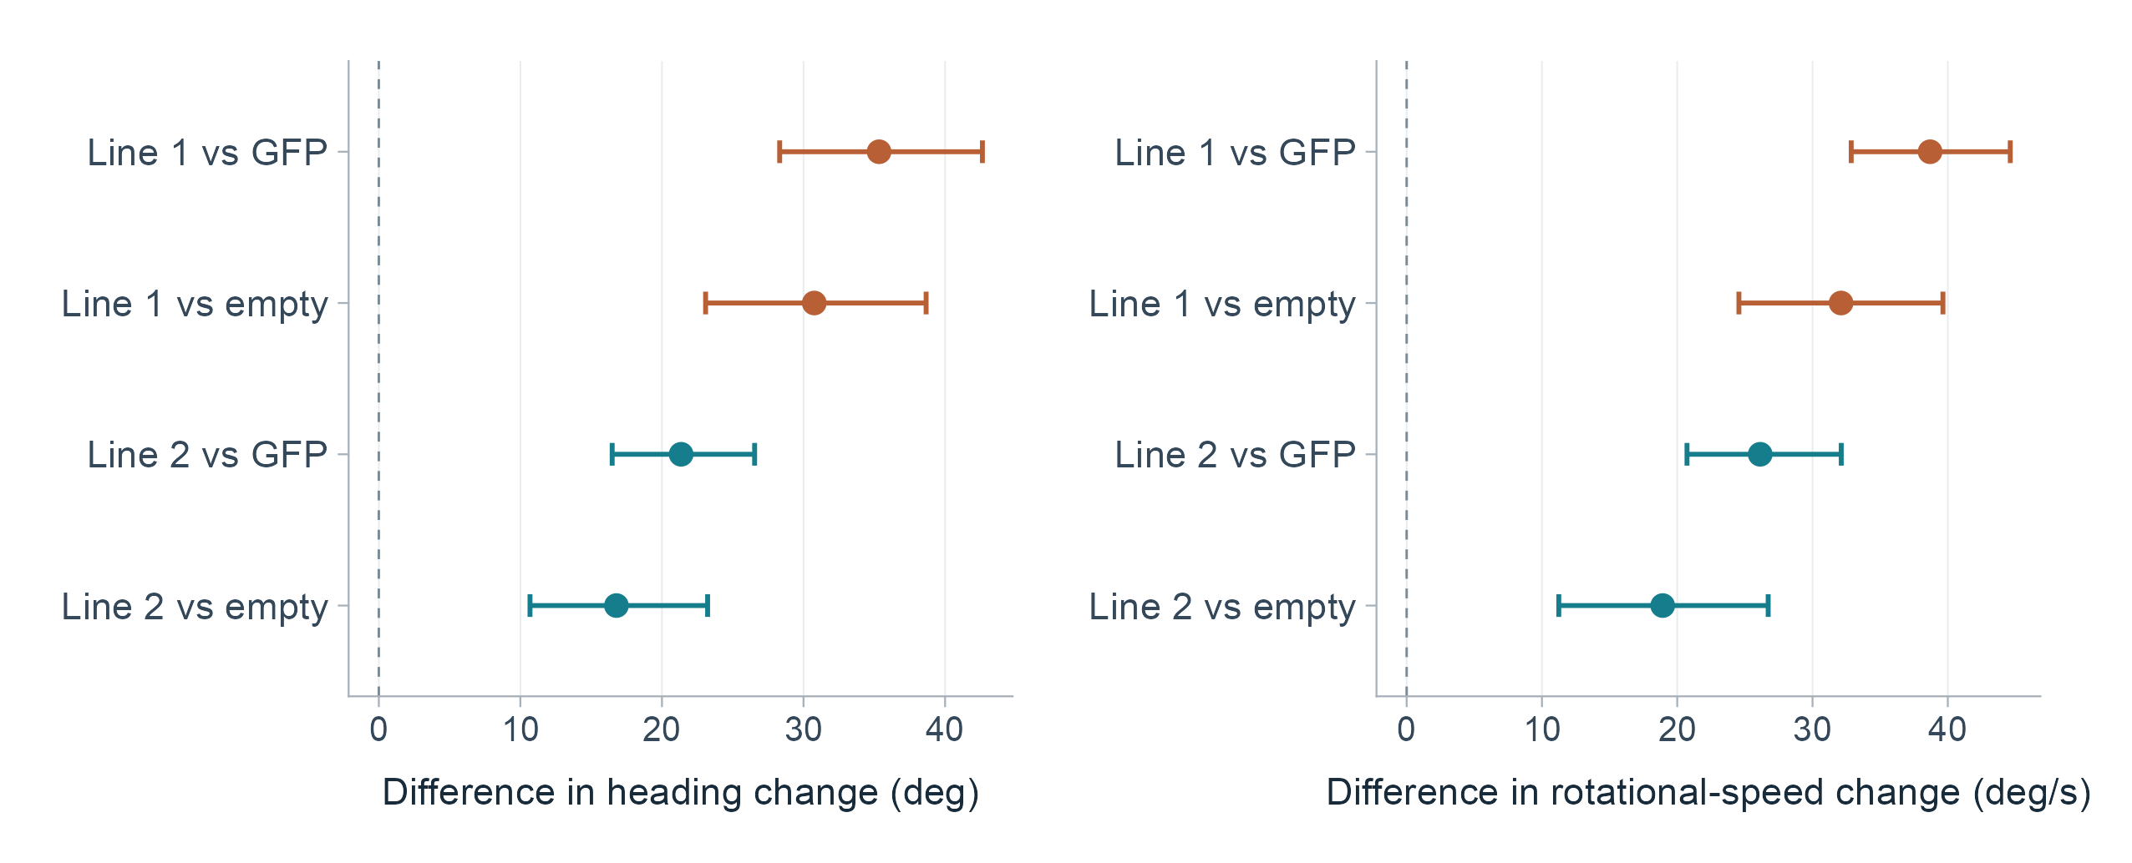
CONTROL COMPARISONS
Turning effects exceed both control comparisons
Differences in within-fly changes, with 95% bootstrap confidence intervals
Matched GFP and empty-split controls give the same direction of effect.
S2. Exploratory two-sided fly-label permutation tests; all eight turning contrasts have BH q < 0.001.
09
Notes:
Mean of 80 pulses per fly. During = first 1 s of stimulation, baseline = preceding 1 s. Delta = during - baseline. Equal fly weight. No imputation/outlier exclusion. CIs = percentile fly bootstrap, not simultaneous. Two-sided random-label permutation tests, 100000 shuffles with plus-one correction. BH FDR across 12 exploratory genotype contrasts (3 metrics x 4 comparisons). Forest panels show experimental mean delta minus control mean delta. Horizontal intervals are pointwise95% percentile bootstrap CIs and are not simultaneous/FDR-adjusted intervals. q-values are BH-adjusted across12 exploratory contrasts: heading, rotational speed and forward velocity, each tested for line1-vs-GFP, line1-vs-empty, line2-vs-GFP, line2-vs-empty. These analyses are retrospective, not preregistered. Exact estimates and tests are in derived/exploratory_tests81.csv.
Sources:
S2: /Users/sophiarenauld/Documents/GitHub/Wilson_Thesis/Behavior_analysis/smp544_pivot_results/presentation_metrics.csv
S5: /Users/sophiarenauld/Documents/GitHub/Wilson_Thesis/Behavior_analysis/Behavior_Crunch/cschrim_behaviorcrunch.R
S6: /Users/sophiarenauld/Documents/GitHub/Wilson_Thesis/Behavior_analysis/analyze_smp544_pivots.py
Reproduction: analyze_ves041.py and replot_ves041.R in the accompanying reproducibility package. Analysis date: 13 October 2026.

Slide 10
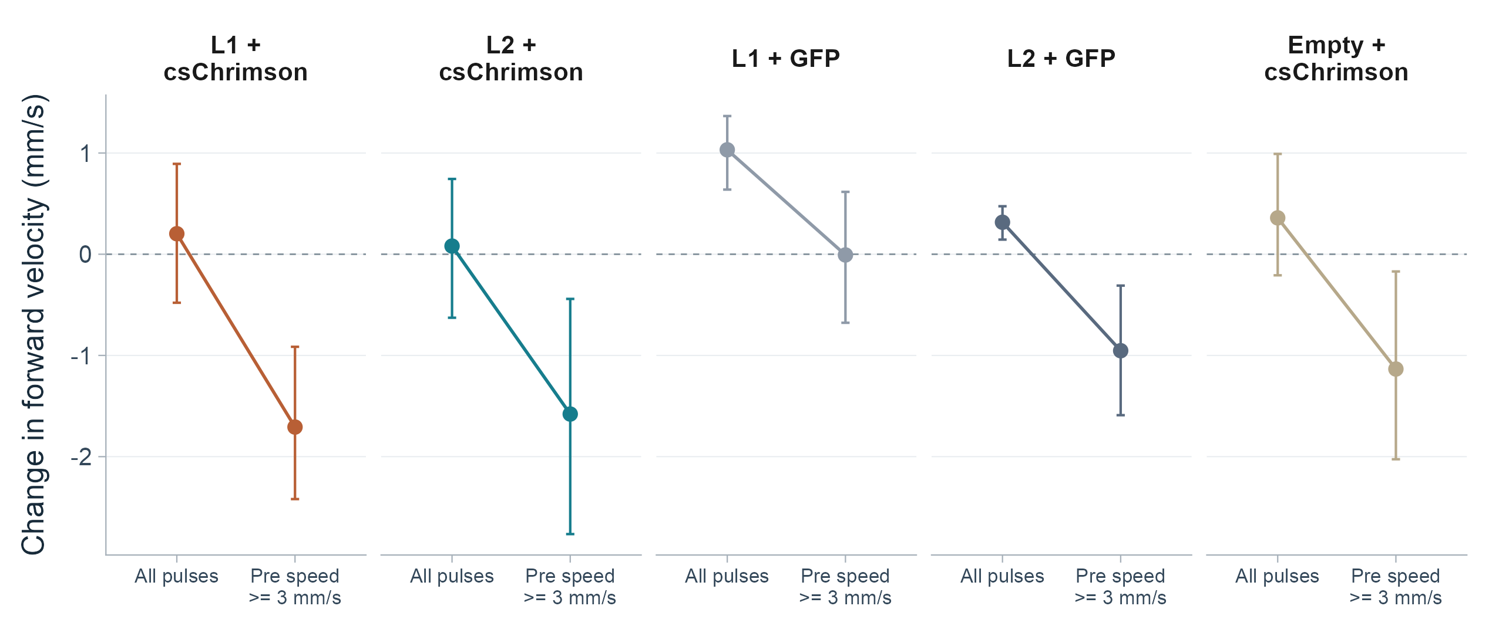
PULSE SELECTION
Baseline walking changes the speed estimate
The existing 3 mm/s cutoff retains 2,140 of 6,480 pulses; all 81 flies contribute
S2, S8, S10. Descriptive sensitivity analysis. Controls also slow after selection. Bars: 95% fly-bootstrap CIs.
10
Notes:
New descriptive sensitivity analysis. Select pulses with preceding1s mean forward velocity >=3mm/s, using the movement cutoff minVel=3 in master_behavior_analysis.m. Then average selected pulses within each fly, followed by equal fly weighting. Counts by genotype:620,513,348,306,353 pulses, retaining18,16,16,16,15 flies. A baseline-conditioned change can be affected by selection/regression-to-mean, so control groups are essential and this slide is not a new causal test. This sensitivity resembles the legacy slowdown pattern but does not prove exactly which historical preprocessing produced the84-fly table.
Sources:
S2: /Users/sophiarenauld/Documents/GitHub/Wilson_Thesis/Behavior_analysis/smp544_pivot_results/presentation_metrics.csv
S8: /Users/sophiarenauld/Documents/GitHub/Wilson_Thesis/Behavior_analysis/plotExpt_sliced_opto_velocity.m
S10: /Users/sophiarenauld/Documents/GitHub/Wilson_Thesis/Behavior_analysis/master_behavior_analysis.m
Reproduction: analyze_ves041.py and replot_ves041.R in the accompanying reproducibility package. Analysis date: 13 October 2026.

Slide 11
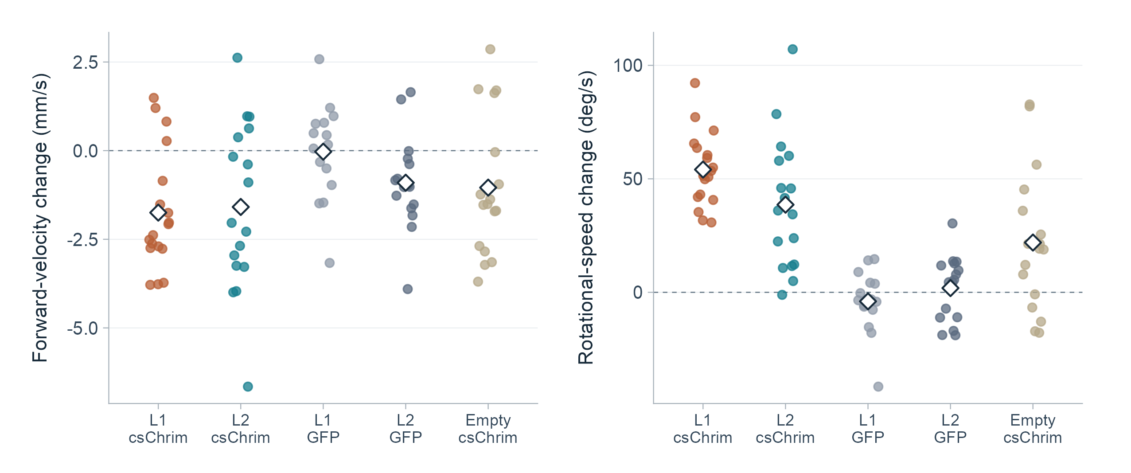
ARCHIVED SUMMARY
The archived summaries show slowing and turning
84 flies, reproduced directly from the local summary table
S1. Points: archived fly values; diamonds: means. Pulse-selection metadata is absent, so these values are kept separate.
11
Notes:
Archived numeric table plotted without correcting, imputation or replacing any values. Delta=Opto On minus Pre Opto. The archived summary lacks explicit per-pulse inclusion/filtering metadata. Current source code has a moving-only summary path and uses raw velocity fields, while the81-fly event extractor includes all pulses and smoothedangularVelocity. These differences in estimand and processing mean the two tables are not pooled. Forward changes:line1 -1.748mm/s,line2 -1.588mm/s; rotational changes:+54.086,+38.607deg/s respectively. No significance stars are inherited from old slides.
Sources:
S1: /Users/sophiarenauld/Downloads/Wilson Lab/Chrimson Data(Included) (3).csv
S5: /Users/sophiarenauld/Documents/GitHub/Wilson_Thesis/Behavior_analysis/Behavior_Crunch/cschrim_behaviorcrunch.R
S8: /Users/sophiarenauld/Documents/GitHub/Wilson_Thesis/Behavior_analysis/plotExpt_sliced_opto_velocity.m
Reproduction: analyze_ves041.py and replot_ves041.R in the accompanying reproducibility package. Analysis date: 13 October 2026.

Slide 12
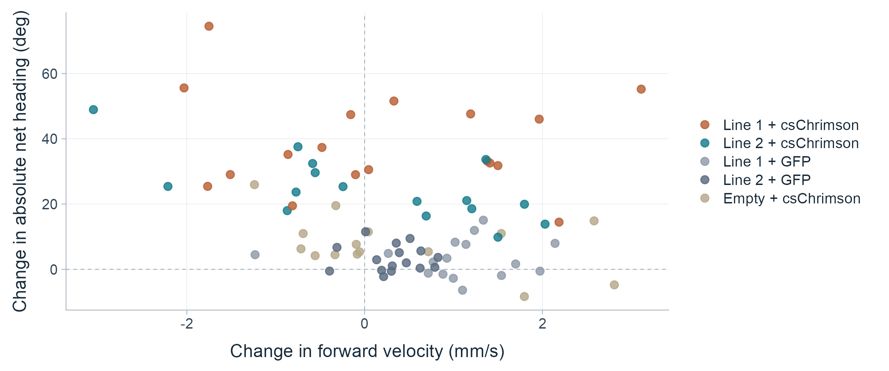
JOINT RESPONSE
Reorientation spans different forward-speed changes
Each point is one fly, averaged across its 80 stimuli
S2. All pulses; no correlation model or responder cutoff is imposed.
12
Notes:
Within-fly mean opto-minus-pre forward velocity on x; mean opto-minus-pre absolute net heading on y. Each fly appears once. Genotype colors match all previous plots. Both left and right of zero forward-speed change occur among activation flies. No trajectory or temporal trace is inferred from these window summaries.
Sources:
S2: /Users/sophiarenauld/Documents/GitHub/Wilson_Thesis/Behavior_analysis/smp544_pivot_results/presentation_metrics.csv
S6: /Users/sophiarenauld/Documents/GitHub/Wilson_Thesis/Behavior_analysis/analyze_smp544_pivots.py
Reproduction: analyze_ves041.py and replot_ves041.R in the accompanying reproducibility package. Analysis date: 13 October 2026.

Slide 13
OPERATIONAL PIVOT DEFINITION
Pivot-like events increase under activation
A strict joint definition combines turning, translation and directionality
Within the first second
Absolute net turn ≥ 45°
Net displacement ≤ 2 mm
Turn directionality ≥ 0.7
+2.98 percentage points
Activation-minus-control difference
in the pre-to-during change
Saved permutation p = 0.00019
S2, S7. Pooled means give each fly equal weight. Per-genotype fly values appear in the appendix.
13
Notes:
Pivot event = absolute net heading>=45deg AND net displacement<=2mm AND directionality>=0.7. Directionality=absolute net heading divided by total unwrapped heading change. Identical rule applied to preceding1s and first1s of optogenetic stimulation. Averaged per fly before pooling. Activation1.360294% pre to4.816176% during (delta3.455882pp), controls2.074468% to2.553191% (delta0.478723pp), difference2.977159pp. These values exactly reproduce the saved fly_level_summary. Saved permutation test p=0.0001899981, BH q=0.0001899981, adjusted over the6 metrics in its original saved analysis. Do not confuse that family with the12 new exploratory contrasts elsewhere in this deck. Pooled controls combine different genotypes, so per-genotype plots are also supplied.
Sources:
S2: /Users/sophiarenauld/Documents/GitHub/Wilson_Thesis/Behavior_analysis/smp544_pivot_results/presentation_metrics.csv
S6: /Users/sophiarenauld/Documents/GitHub/Wilson_Thesis/Behavior_analysis/analyze_smp544_pivots.py
S7: /Users/sophiarenauld/Documents/GitHub/Wilson_Thesis/Behavior_analysis/smp544_pivot_results/ves041_activation_tests.csv
Reproduction: analyze_ves041.py and replot_ves041.R in the accompanying reproducibility package. Analysis date: 13 October 2026.

Slide 14
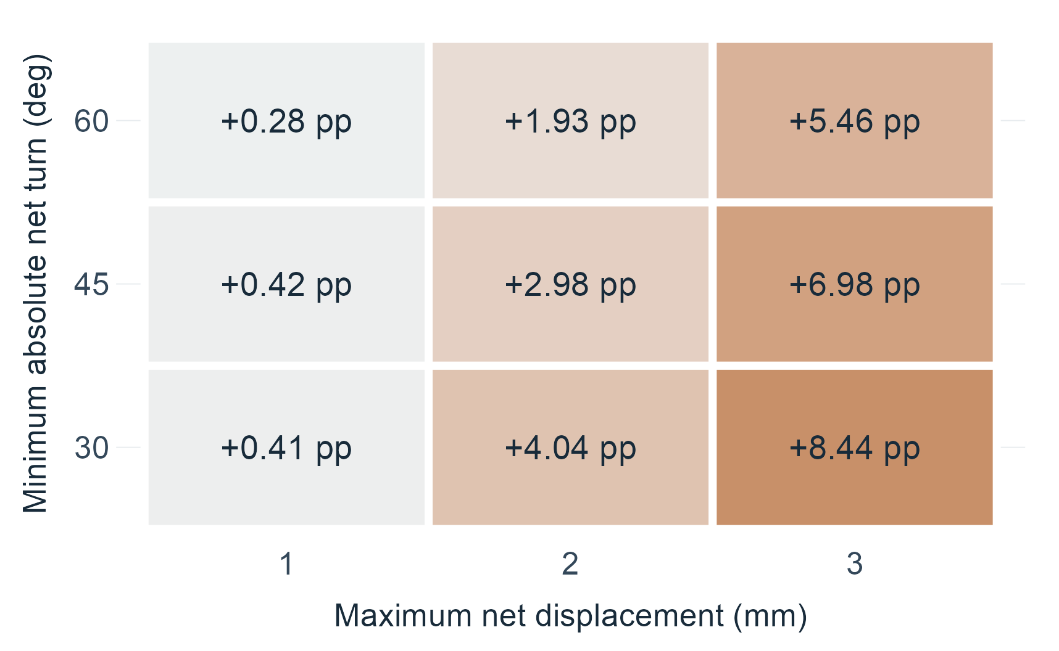
THRESHOLD SENSITIVITY
The pivot effect depends on the chosen thresholds
Activation-minus-control difference in pre-to-during pivot-rate change
0.28 to 8.44 pp
Range across the tested
turn and displacement cutoffs
Default: 45° and 2 mm
Effect: +2.98 pp
S2. Descriptive sensitivity; directionality remains ≥ 0.7. Positive values occur at all nine tested settings.
14
Notes:
Recomputed directly from local pulse data at turn thresholds30,45,60deg and displacement thresholds1,2,3mm; directionality>=0.7 fixed. Each fly receives equal weight. No p-values are computed for this exploratory sensitivity grid. Small positive values at strict1mm thresholds should not be presented as uniformly large effects. Operational pivot prevalence is definition-dependent and is much lower than the prevalence of any increase in turning.
Sources:
S2: /Users/sophiarenauld/Documents/GitHub/Wilson_Thesis/Behavior_analysis/smp544_pivot_results/presentation_metrics.csv
S6: /Users/sophiarenauld/Documents/GitHub/Wilson_Thesis/Behavior_analysis/analyze_smp544_pivots.py
Reproduction: analyze_ves041.py and replot_ves041.R in the accompanying reproducibility package. Analysis date: 13 October 2026.

Slide 15
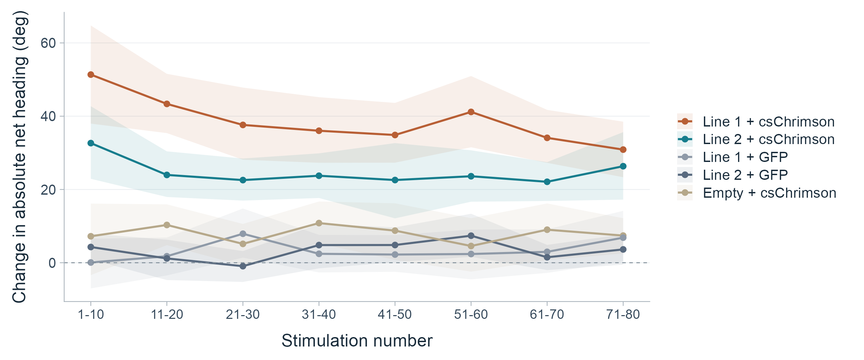
STIMULATION ORDER
Heading responses across the stimulation sequence
Consecutive bins of 10 pulses; mean within each fly, then mean across flies
S2. Lines: genotype means; ribbons: pointwise 95% fly-bootstrap CIs. No habituation model is fitted.
15
Notes:
80 pulses per fly, binned1-10 through71-80. Each plotted point is the mean of fly-specific within-bin mean deltas, with a percentile bootstrap over flies for the pointwise interval. Bands are not simultaneous confidence bands. This descriptive plot reports pulse order, not an inferred continuous time course, response onset latency, or formal habituation result.
Sources:
S2: /Users/sophiarenauld/Documents/GitHub/Wilson_Thesis/Behavior_analysis/smp544_pivot_results/presentation_metrics.csv
S6: /Users/sophiarenauld/Documents/GitHub/Wilson_Thesis/Behavior_analysis/analyze_smp544_pivots.py
Reproduction: analyze_ves041.py and replot_ves041.R in the accompanying reproducibility package. Analysis date: 13 October 2026.

Slide 16
INTERPRETATION
VES041 activation promotes reorientation
The clearest result is increased turning in both split lines
Turning
Heading change and rotational speed increase beyond
both matched GFP and empty-split controls.
Forward motion
The slowdown estimate depends on baseline movement
and pulse selection. All-pulse results do not establish slowing.
Pivots
Strict pivot-like events become more frequent, but remain
a small fraction of stimulation events at the default threshold.
Interpretation of local exported data. Detailed methods, cohort differences and sources follow in the appendix.
16
Notes:
The causal wording is limited to behavioral effects of activation in the reported genotypes under this protocol and control design. This experiment alone does not prove suppression of central-complex output, recruitment of a specific downstream pathway, or a change in internal goal. The source decks discuss circuit hypotheses, but those are not treated as newly demonstrated by the activation data. State-dependent forward-speed estimates are shown rather than a universal slowing claim.
Sources:
S1: /Users/sophiarenauld/Downloads/Wilson Lab/Chrimson Data(Included) (3).csv
S2: /Users/sophiarenauld/Documents/GitHub/Wilson_Thesis/Behavior_analysis/smp544_pivot_results/presentation_metrics.csv
S3: /Users/sophiarenauld/Downloads/Wilson Lab/lab_meeting_plus_extra/labmeeting_9.pptx
S6: /Users/sophiarenauld/Documents/GitHub/Wilson_Thesis/Behavior_analysis/analyze_smp544_pivots.py
S7: /Users/sophiarenauld/Documents/GitHub/Wilson_Thesis/Behavior_analysis/smp544_pivot_results/ves041_activation_tests.csv
Reproduction: analyze_ves041.py and replot_ves041.R in the accompanying reproducibility package. Analysis date: 13 October 2026.

Slide 17
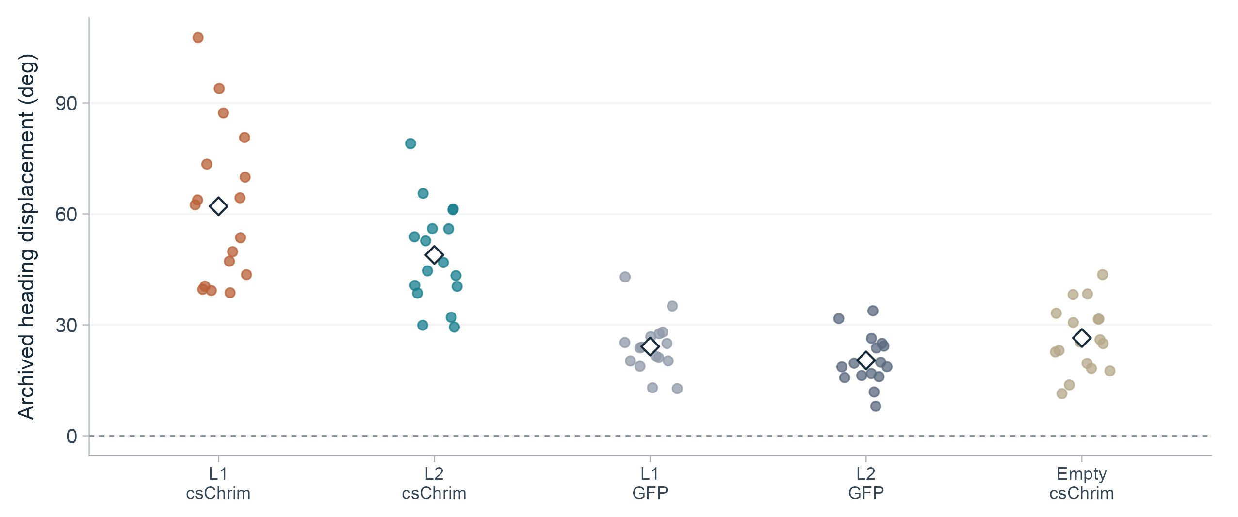
APPENDIX / ARCHIVED HEADING
Archived heading measurements agree in direction
The 84-fly export also separates both activation groups from the controls
S1. Archived heading-displacement values, not opto-minus-pre differences. Points: flies; diamonds: means.
17
Notes:
Plots the column Net Heading Displacement (deg) exactly as stored. This column contains one value per fly and has no matched baseline heading column. Therefore no baseline subtraction is performed. It must not be numerically equated to the event-derived heading delta in the main results. Statistical annotations from older PowerPoint plots are not copied.
Sources:
S1: /Users/sophiarenauld/Downloads/Wilson Lab/Chrimson Data(Included) (3).csv
S5: /Users/sophiarenauld/Documents/GitHub/Wilson_Thesis/Behavior_analysis/Behavior_Crunch/cschrim_behaviorcrunch.R
Reproduction: analyze_ves041.py and replot_ves041.R in the accompanying reproducibility package. Analysis date: 13 October 2026.

Slide 18
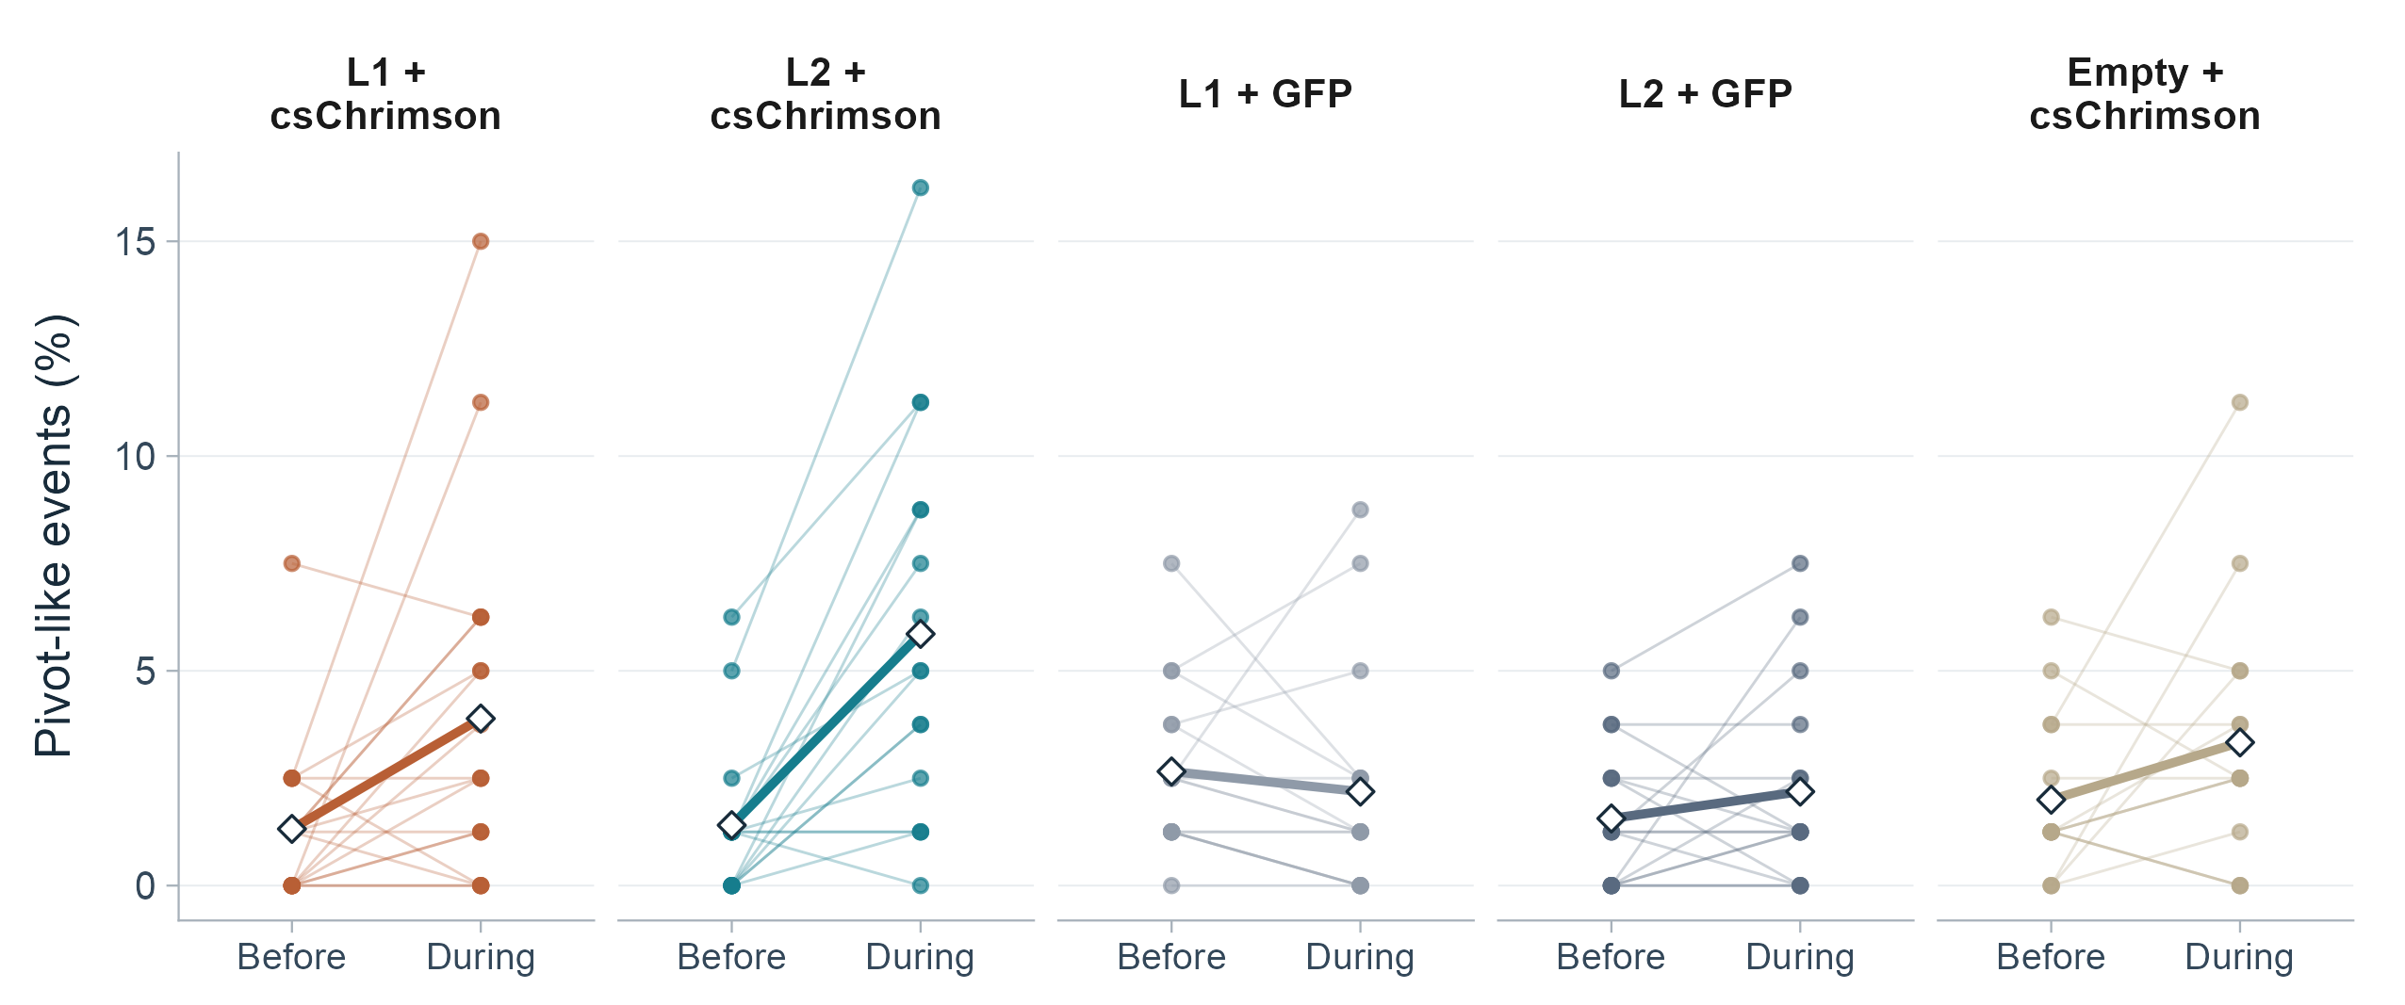
APPENDIX / PIVOT RATES
Pivot rates vary across flies and genotypes
Thin lines connect the same fly before and during stimulation
S2. Thick lines: genotype means. Full fly distributions accompany the pooled comparison on slide 13.
18
Notes:
Strict pivot rule45deg/2mm/directionality0.7. Each fly has80 pulses; rates are in increments of1.25percentage points. Values include zeros. Individual fly lines are connected pre/during measures, not independent samples. Source counts18,16,16,16,15. These plots show why pooling controls and averaging experimental lines does not describe every individual fly.
Sources:
S2: /Users/sophiarenauld/Documents/GitHub/Wilson_Thesis/Behavior_analysis/smp544_pivot_results/presentation_metrics.csv
S6: /Users/sophiarenauld/Documents/GitHub/Wilson_Thesis/Behavior_analysis/analyze_smp544_pivots.py
Reproduction: analyze_ves041.py and replot_ves041.R in the accompanying reproducibility package. Analysis date: 13 October 2026.

Slide 19
APPENDIX / PROTOCOL HISTORY
Pilot and blinded protocols remain separate
The early experiment used different controls and shorter trials
Feature | Earlier pilot | Later blinded cohort
Pulse duration | 0.5 or 1 s | 1 s
Trial length | 6 min | 20 min
Visual setting | Closed-loop bar | Closed-loop bar
Controls | ISOD1 crosses | GFP crosses; empty-split × csChrimson
Source presentation | labmeeting8_20260306 | labmeeting_9
The pilot source reports a startle response across genotypes.
S4 slide 18; S3 slide 18. Pilot data supply context and are not pooled into the main cohort.
19
Notes:
Pilot labmeeting8_20260306 slide18 lists0.5(or1)s stimulation every14.5s for6min and ISOD1 controls. Slide21 reports a startle reflex across genotypes. The later protocol in labmeeting_9 slide18 lists1s every14.5s for20min, GFP controls for both lines and empty-split × csChrimson. Do not infer a shared baseline, identical controls, or independent replication from repeated source figures.
Sources:
S3: /Users/sophiarenauld/Downloads/Wilson Lab/lab_meeting_plus_extra/labmeeting_9.pptx
S4: /Users/sophiarenauld/Downloads/Wilson Lab/lab_meeting_plus_extra/labmeeting8/labmeeting8_20260306.pptx
S9: /Users/sophiarenauld/Downloads/Wilson Lab/Blinded_csChrim_behavior.pptx
Reproduction: analyze_ves041.py and replot_ves041.R in the accompanying reproducibility package. Analysis date: 13 October 2026.

Slide 20
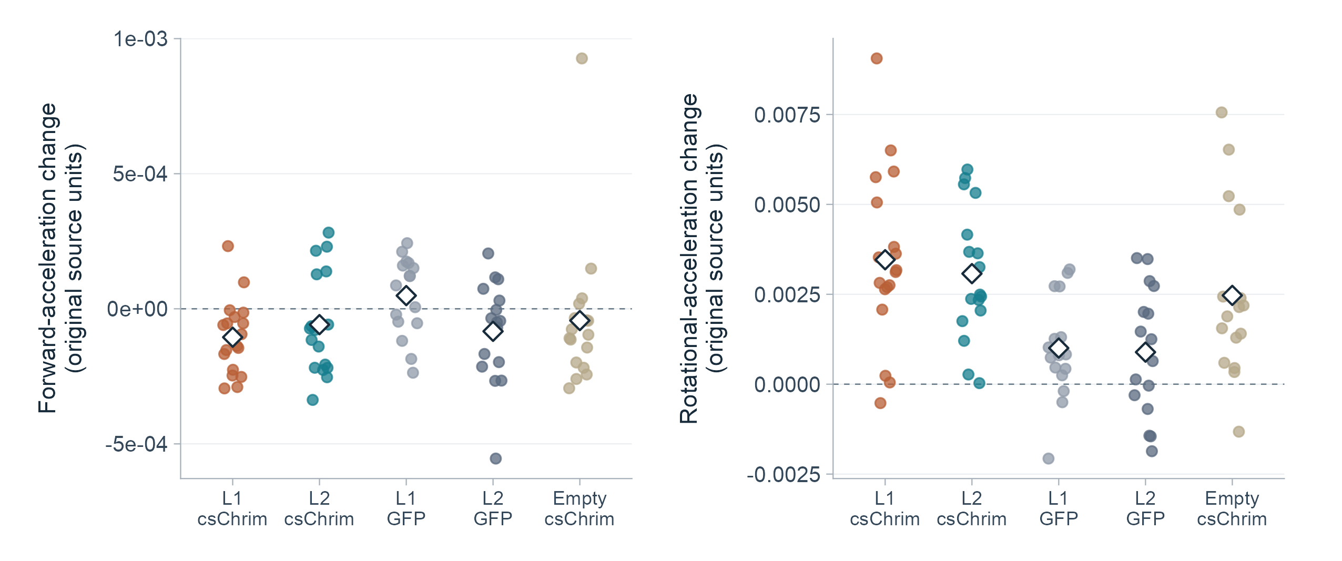
APPENDIX / ACCELERATION
Acceleration values retain their original scaling
The archive contains acceleration fields, but their calibration is not established
S1, S8. Source units only. These values are not used for the biological conclusions.
20
Notes:
The original acceleration values are plotted without multiplying or dividing by an assumed sample rate. Current analysis code contains a correction from mean(diff(velocity)) to mean(diff(velocity))*rate. The84-fly archive does not document which revision or scaling generated its acceleration columns. Accordingly, the y-axes state original source units, no physical acceleration unit is claimed, and no inferential tests or biological claim are based on these values.
Sources:
S1: /Users/sophiarenauld/Downloads/Wilson Lab/Chrimson Data(Included) (3).csv
S8: /Users/sophiarenauld/Documents/GitHub/Wilson_Thesis/Behavior_analysis/plotExpt_sliced_opto_velocity.m
Reproduction: analyze_ves041.py and replot_ves041.R in the accompanying reproducibility package. Analysis date: 13 October 2026.

Slide 21
APPENDIX / METHODS
Analysis uses flies as the unit of inference
All newly calculated comparisons are exploratory
Analysis choice | Implementation
Window | Preceding 1 s vs first 1 s of light
Independent unit | Mean across stimuli within each fly
Uncertainty | 20,000 fly-bootstrap replicates; pointwise 95% intervals
New tests | 100,000 two-sided label permutations; plus-one correction
Multiple comparisons | BH FDR across 12 genotype contrasts
Data handling | Fixed seed 20261013; no imputation or outlier removal
The deck starts from local exports. Raw acquisition and upstream preprocessing are not re-run.
Complete numeric outputs, input checksums and runnable Python/R scripts accompany this deck.
21
Notes:
Mean of 80 pulses per fly. During = first 1 s of stimulation, baseline = preceding 1 s. Delta = during - baseline. Equal fly weight. No imputation/outlier exclusion. CIs = percentile fly bootstrap, not simultaneous. Two-sided random-label permutation tests, 100000 shuffles with plus-one correction. BH FDR across 12 exploratory genotype contrasts (3 metrics x 4 comparisons). Seed20261013. Original inputs preserved with SHA256 checksums. Assertions verify84unique summaryflies,81pulseflies,80pulses/fly,6480pulses,genotype mapping and reproduction of archived fly-level pivot/heading summaries. R plots show actual observations; x-jitter is used only for legibility and never changes y-values. Summary data were not pooled with the differently processed pulse table. Scientific figures have reproducible vector SVG exports; the pivot overview chart and tables are native editable PowerPoint objects.
Sources:
S1: /Users/sophiarenauld/Downloads/Wilson Lab/Chrimson Data(Included) (3).csv
S2: /Users/sophiarenauld/Documents/GitHub/Wilson_Thesis/Behavior_analysis/smp544_pivot_results/presentation_metrics.csv
S5: /Users/sophiarenauld/Documents/GitHub/Wilson_Thesis/Behavior_analysis/Behavior_Crunch/cschrim_behaviorcrunch.R
S6: /Users/sophiarenauld/Documents/GitHub/Wilson_Thesis/Behavior_analysis/analyze_smp544_pivots.py
S7: /Users/sophiarenauld/Documents/GitHub/Wilson_Thesis/Behavior_analysis/smp544_pivot_results/ves041_activation_tests.csv
S8: /Users/sophiarenauld/Documents/GitHub/Wilson_Thesis/Behavior_analysis/plotExpt_sliced_opto_velocity.m
Reproduction: analyze_ves041.py and replot_ves041.R in the accompanying reproducibility package. Analysis date: 13 October 2026.

Slide 22
APPENDIX / SOURCES
Source record
Local data, original figures and analysis code
Source | Role in this presentation
Chrimson Data(Included) (3).csv | 84 archived fly summaries
presentation_metrics.csv | 81 flies; 6,480 exported stimulation windows
labmeeting_9.pptx | Later protocol, schematic and original path examples
Blinded_csChrim_behavior.pptx | Cohort labels and individual-fly source context
labmeeting8_20260306.pptx | Earlier pilot protocol and startle context
R / MATLAB / Python source scripts | Genotype mapping and metric definitions
No synthetic observations or reconstructed raw traces are included.
Full source paths and slide-specific methods are recorded in speaker notes.
22
Notes:
S1 andS2 are overlapping datasets, not independent replications. S7 supplies the previously saved pooled-pivot test; the newly computed12-contrast family is documented separately. Exact originals in Downloads and Wilson_Thesis are unchanged. The accompanying source_data snapshots preserve the numeric inputs and relevant scripts. The original path images are unchanged PNG media extracted from S3 slide22. Older duplicated decks and the inhibition/imaging datasets are not counted as additional activation experiments.
Sources:
S1: /Users/sophiarenauld/Downloads/Wilson Lab/Chrimson Data(Included) (3).csv
S2: /Users/sophiarenauld/Documents/GitHub/Wilson_Thesis/Behavior_analysis/smp544_pivot_results/presentation_metrics.csv
S3: /Users/sophiarenauld/Downloads/Wilson Lab/lab_meeting_plus_extra/labmeeting_9.pptx
S4: /Users/sophiarenauld/Downloads/Wilson Lab/lab_meeting_plus_extra/labmeeting8/labmeeting8_20260306.pptx
S5: /Users/sophiarenauld/Documents/GitHub/Wilson_Thesis/Behavior_analysis/Behavior_Crunch/cschrim_behaviorcrunch.R
S6: /Users/sophiarenauld/Documents/GitHub/Wilson_Thesis/Behavior_analysis/analyze_smp544_pivots.py
S7: /Users/sophiarenauld/Documents/GitHub/Wilson_Thesis/Behavior_analysis/smp544_pivot_results/ves041_activation_tests.csv
S8: /Users/sophiarenauld/Documents/GitHub/Wilson_Thesis/Behavior_analysis/plotExpt_sliced_opto_velocity.m
S9: /Users/sophiarenauld/Downloads/Wilson Lab/Blinded_csChrim_behavior.pptx
S10: /Users/sophiarenauld/Documents/GitHub/Wilson_Thesis/Behavior_analysis/master_behavior_analysis.m
S11: /Users/sophiarenauld/Documents/GitHub/Wilson_Thesis/Behavior_analysis/smp544_pivot_results/recording_manifest.csv
Reproduction: analyze_ves041.py and replot_ves041.R in the accompanying reproducibility package. Analysis date: 13 October 2026.

