Slide 1
SMP544 activity across behavioral contexts
Imaging summary • locomotion, turning, and heat

Slide 2
SMP544 is recruited by locomotion and heat
Bilateral activity rises with forward walking in the strongest dark trial
Heat produces a sustained bilateral elevation beyond simple speed effects
Pivoting usually coincides with excitation, not inhibition
Slowdown-associated decreases are inconsistent across dark recordings
Interpretation: a context-dependent locomotor / arousal-state signal

Slide 3
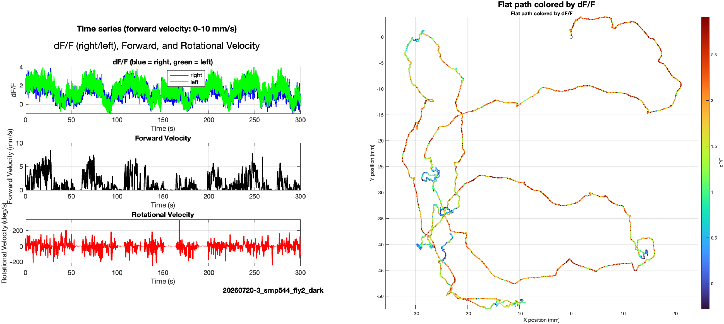
20260720-3 | dark fly 2
Best dark trial
Moving: 51.5%
Forward r: 0.48 right, 0.50 left
Bilateral activity follows repeated running bouts.

Slide 4
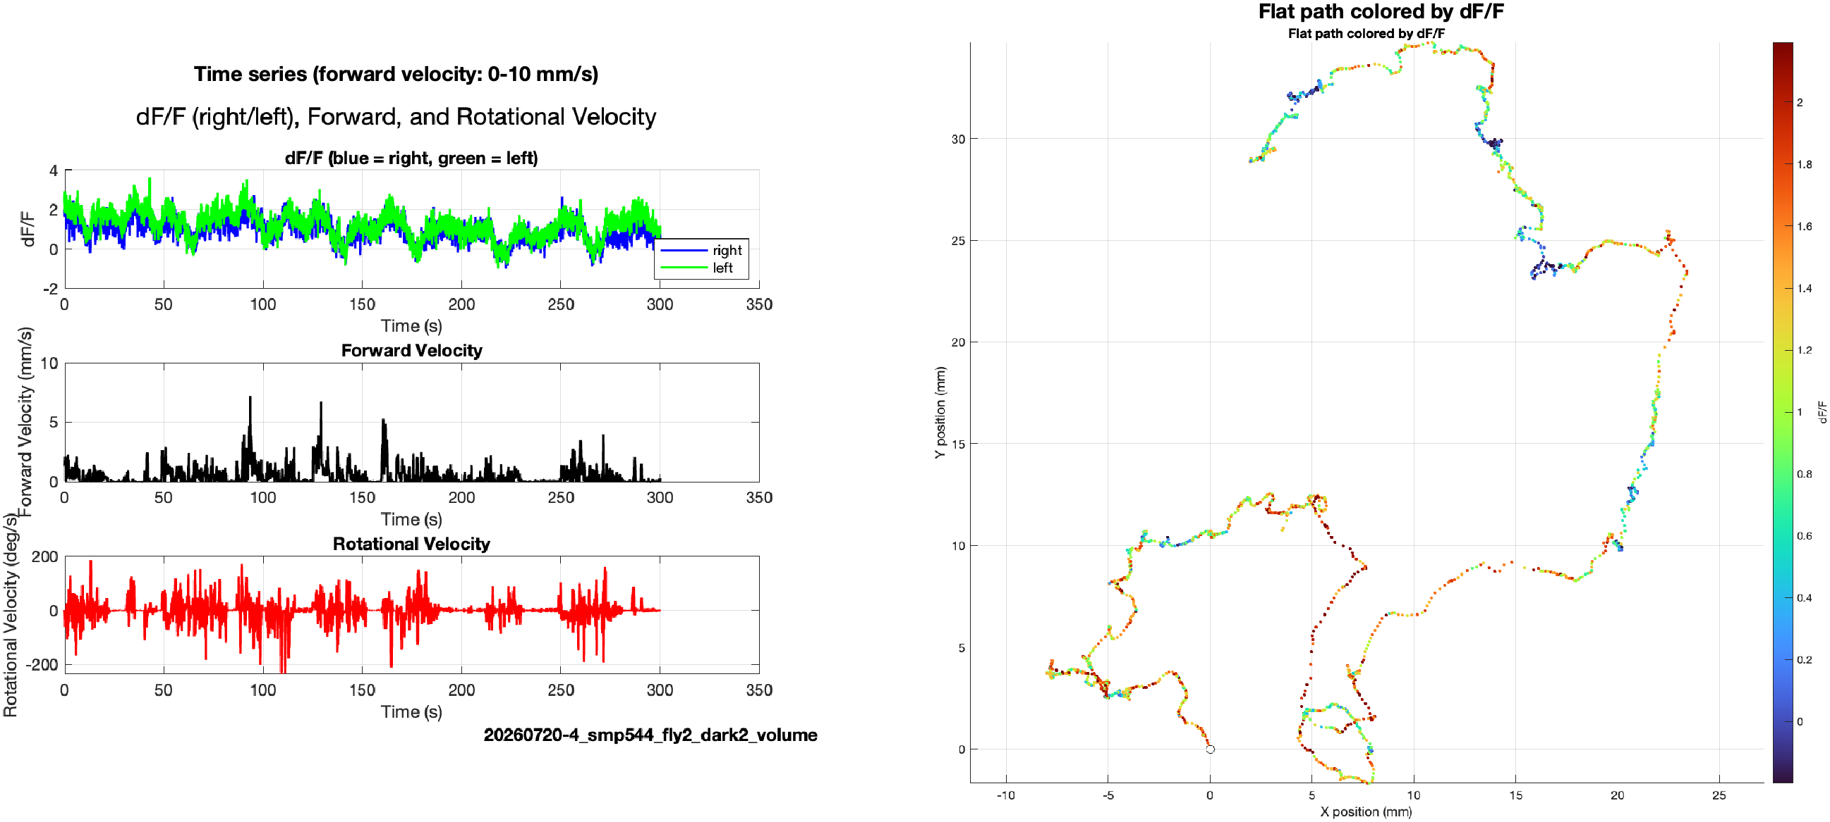
20260720-4 | dark fly 2, volume
Acceptable behavior
Moving: 30.5%
Forward r: 0.22 right, 0.20 left
Weaker locomotor relationship; no clear slowdown inhibition.

Slide 5
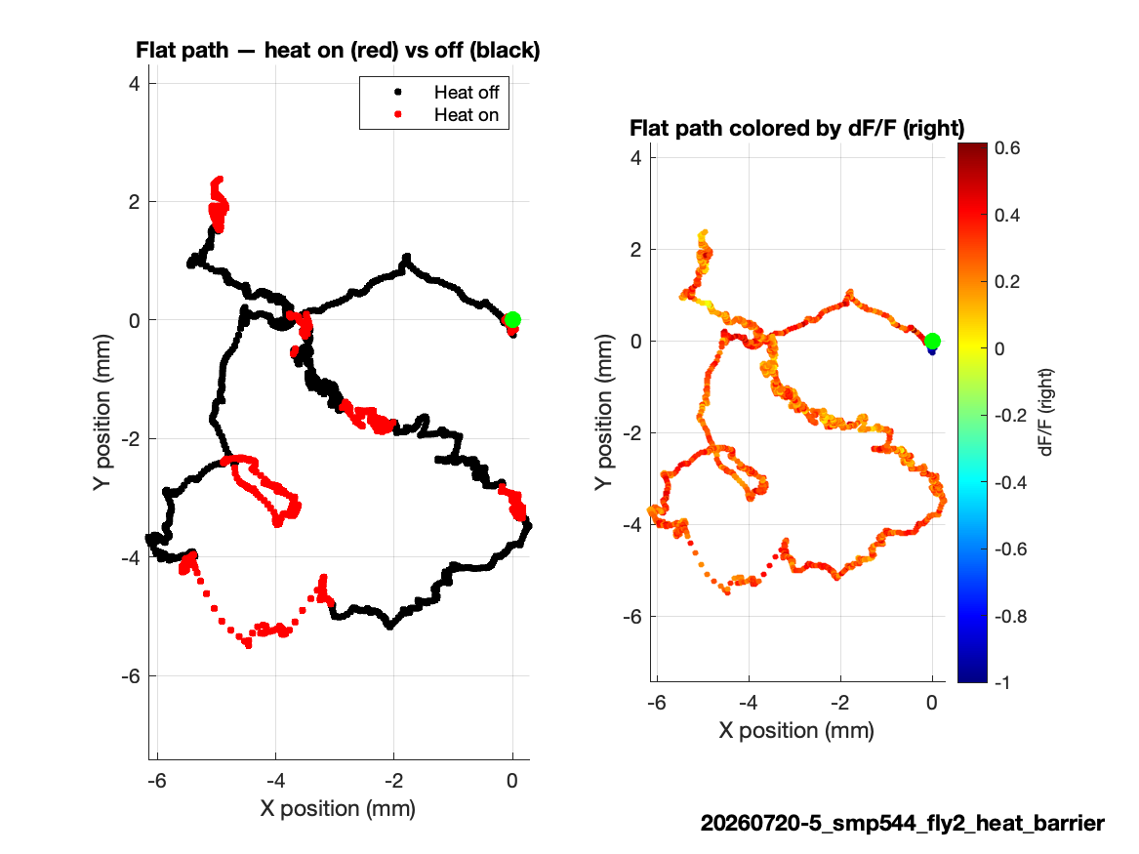
20260720-5 | heat barrier, repaired
First 3,555 synchronized volumes only
Imaging was cropped to the DAQ interval.
Heat-active path is analyzable without extrapolating behavior.

Slide 6
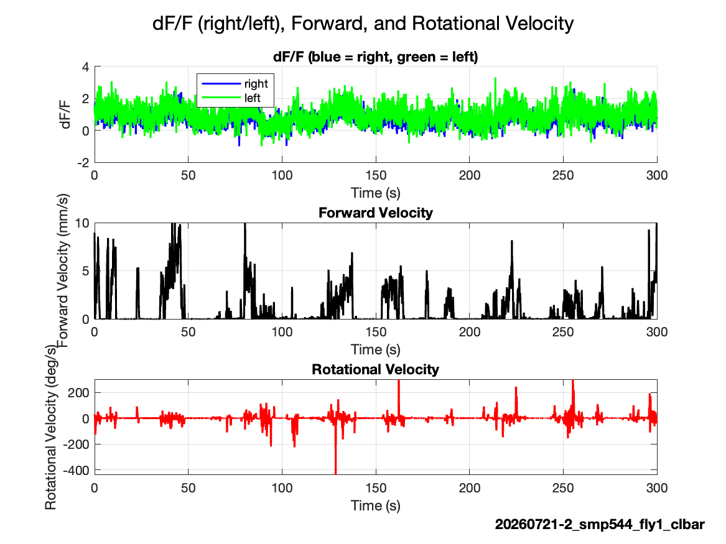
20260721-2 | closed-loop bar
Acceptable behavior
Moving: 28.4%
Forward r: 0.35 right, 0.27 left
Moderate locomotor encoding with relatively low bilateral coupling.

Slide 7
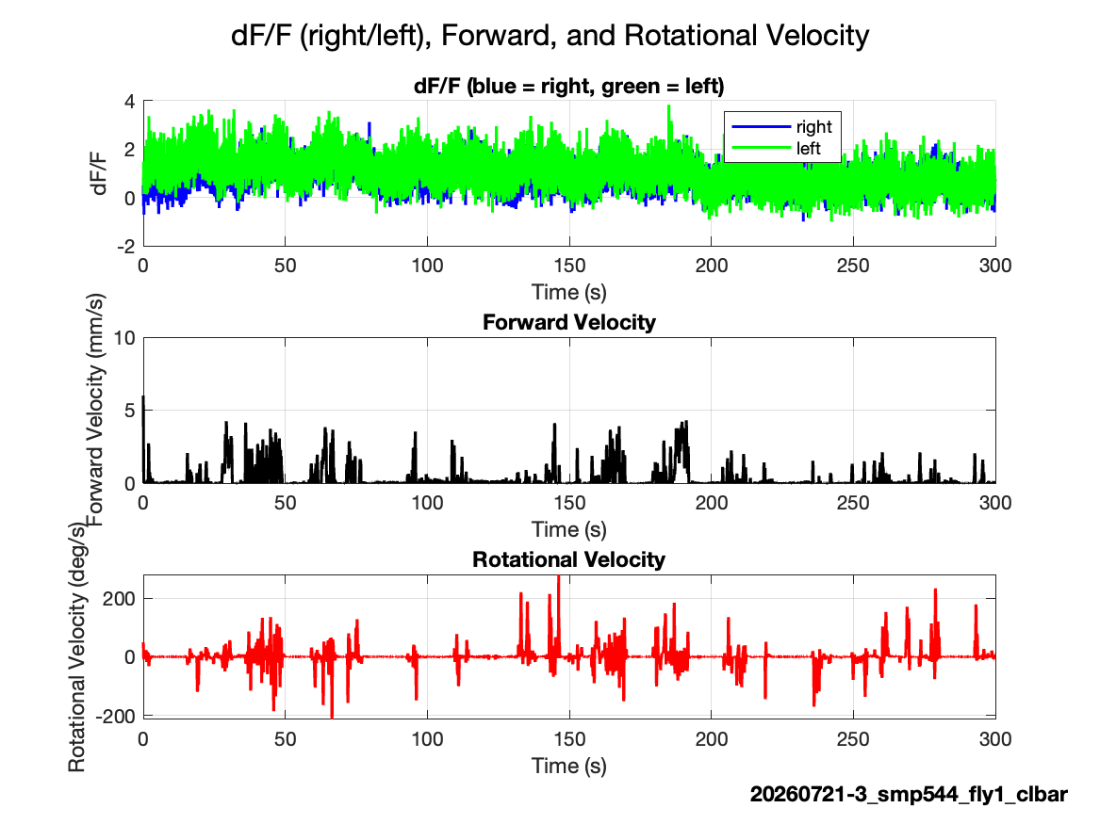
20260721-3 | closed-loop bar
Marginal behavior
Moving: 15.5%
Forward r: 0.14-0.15
Retain cautiously; weak and delayed kinematic relationships.

Slide 8
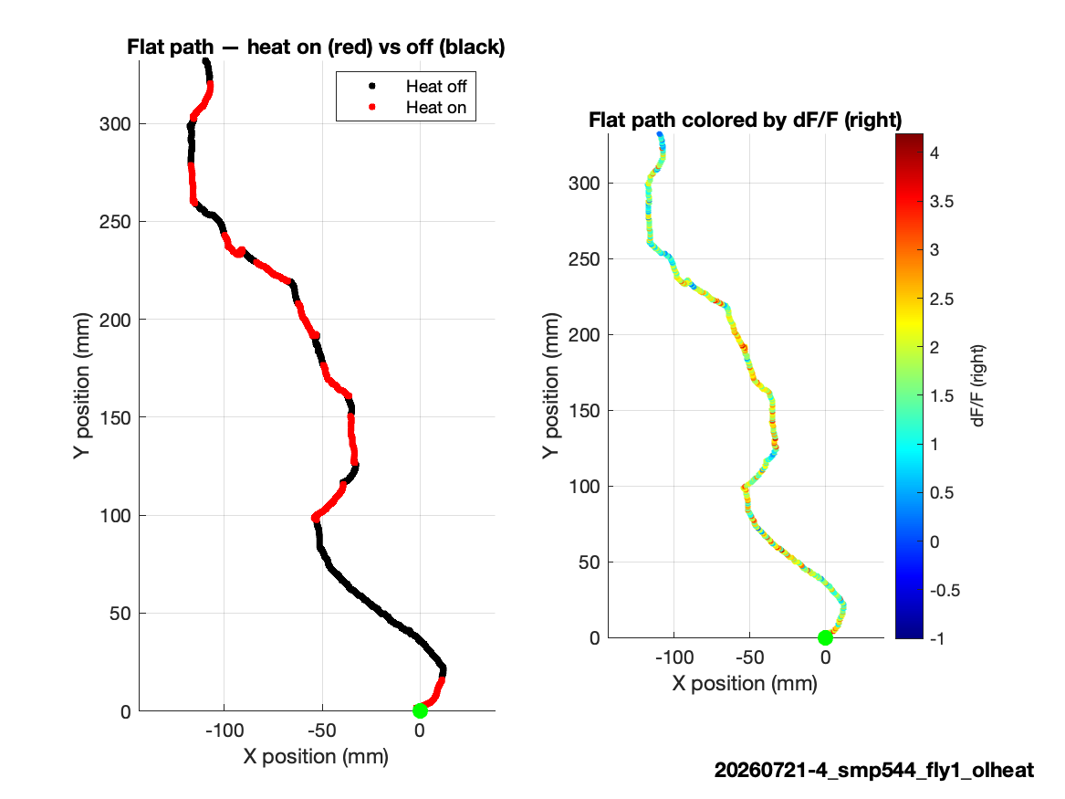
20260721-4 | open-loop heat
Strong heat-associated elevation
Moving: 37.4%
Heat: 15.0% of samples
Mean dF/F rises bilaterally during heat, beyond simple speed effects.

Slide 9
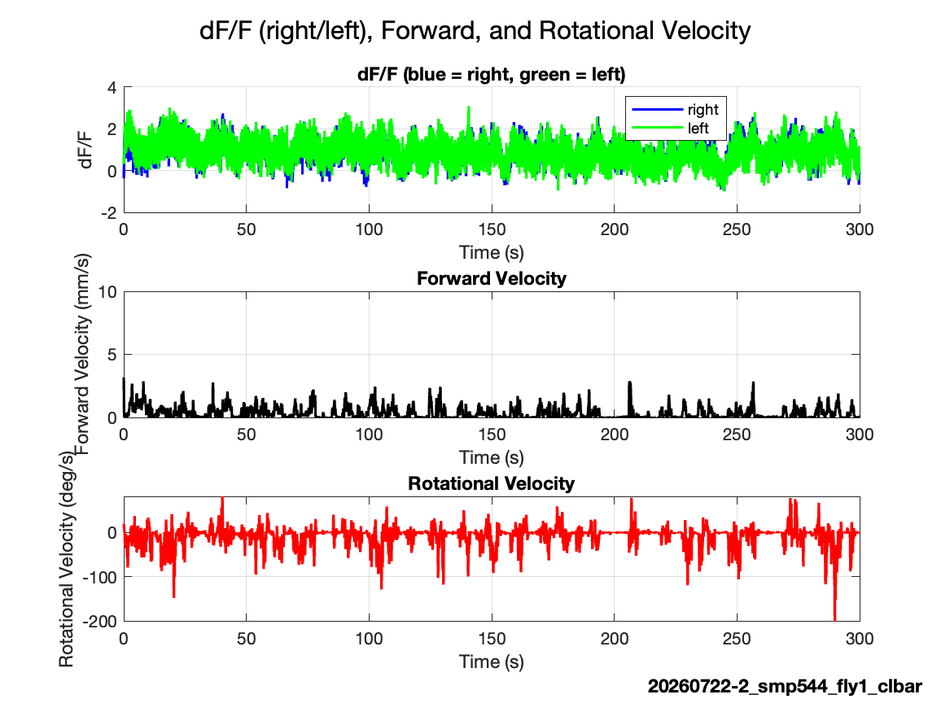
20260722-2 | closed-loop bar
Acceptable behavior
Moving: 28.0%
Forward r: 0.25-0.28
Rotational speed r: 0.33-0.34
Both forward and turning intensity contribute.

Slide 10
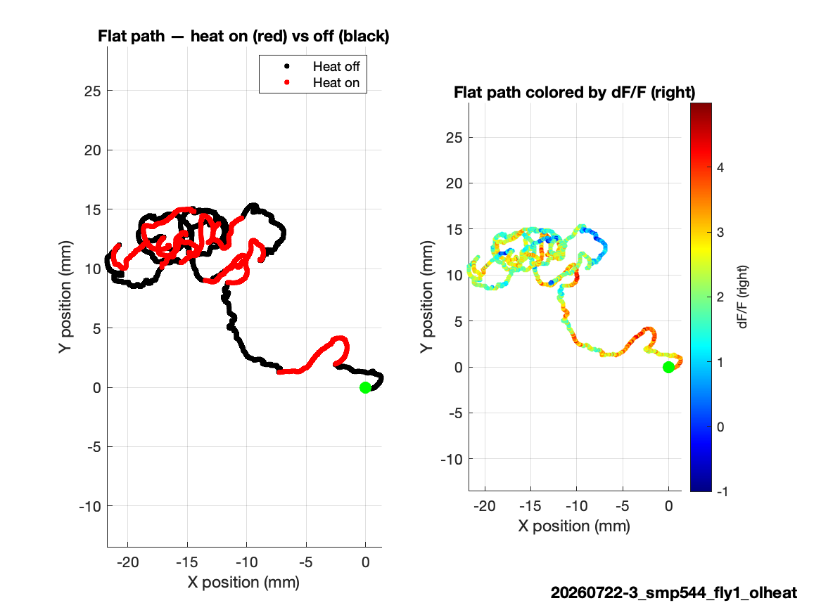
20260722-3 | open-loop heat
Strongest bilateral heat trial
Moving: 20.2%
Right-left r: 0.80
Heat and vigorous movement coincide with high bilateral activity.

