Slide 1
DNa03
Bilateral imaging analysis | representative results

Slide 2
Methods | bilateral DNa03 imaging analysis
Input and alignment: img.filtDFF.left/right were cropped to their shared imaging length; FicTrac variables were linearly interpolated to img.t without endpoint extrapolation.
Artifact rejection: points with dF/F > 10, local-median residual > 25 robust SD, or frame jump > 25 robust SD were masked with ±30 ms padding; source MAT files were unchanged.
Behavior: forward, lateral, signed yaw velocity, yaw speed, total speed, x/y position; positive yaw follows the local convention for rightward turns.
Bilateral states: each side was robustly z-scored; both-high required left and right z ≥ 1, both-low required z ≤ -1; states lasted ≥200 ms and gaps ≤100 ms were merged.
Coordination: centered 1 s rolling Pearson correlation; strongly coordinated epochs required r ≥ 0.6 and lasted ≥200 ms.
Event analysis: behavior was aligned to state entry from -3 to +3 s; pre/post forward comparisons used -1 to -0.2 s and +0.2 to +1 s.
Turn removal: each side was regressed on signed yaw velocity and yaw speed; residual dF/F was correlated with all kinematic variables.
Movement QC: percent moving was the fraction of FicTrac samples with total speed ≥ 3.

Slide 3
DNa03 carries a robust lateralized turning signal
Right-minus-left activity correlates with signed yaw in 21/21 trials (mean r = -0.266)
Left and right copies show opposite-signed yaw relationships
Cross-correlations peak near zero lag in representative trials
Bilateral-high epochs also show greater yaw speed than bilateral-low epochs
Forward-speed effects remain mixed across trials and events
Interpretation: a strong directional component plus weaker common-mode modulation

Slide 4
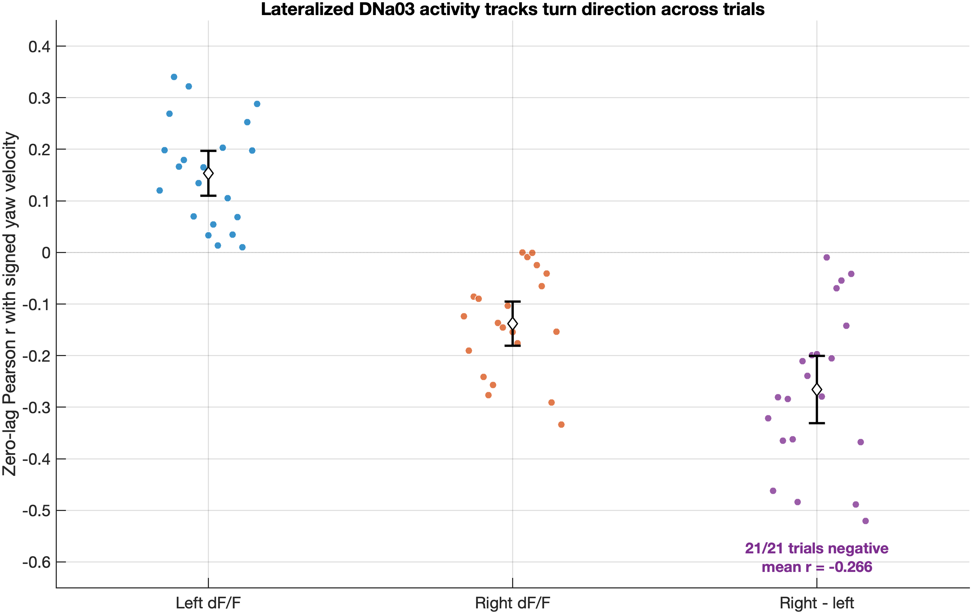
Right–left DNa03 difference tracks signed yaw in every trial
Method: Zero-lag Pearson r with signed yaw; dots are trials (n=21).
Notes:
[Sources]
- Local analysis: pData_DNa03/preliminary_bilateral_analysis/trial_correlations.csv
[/Sources]

Slide 5
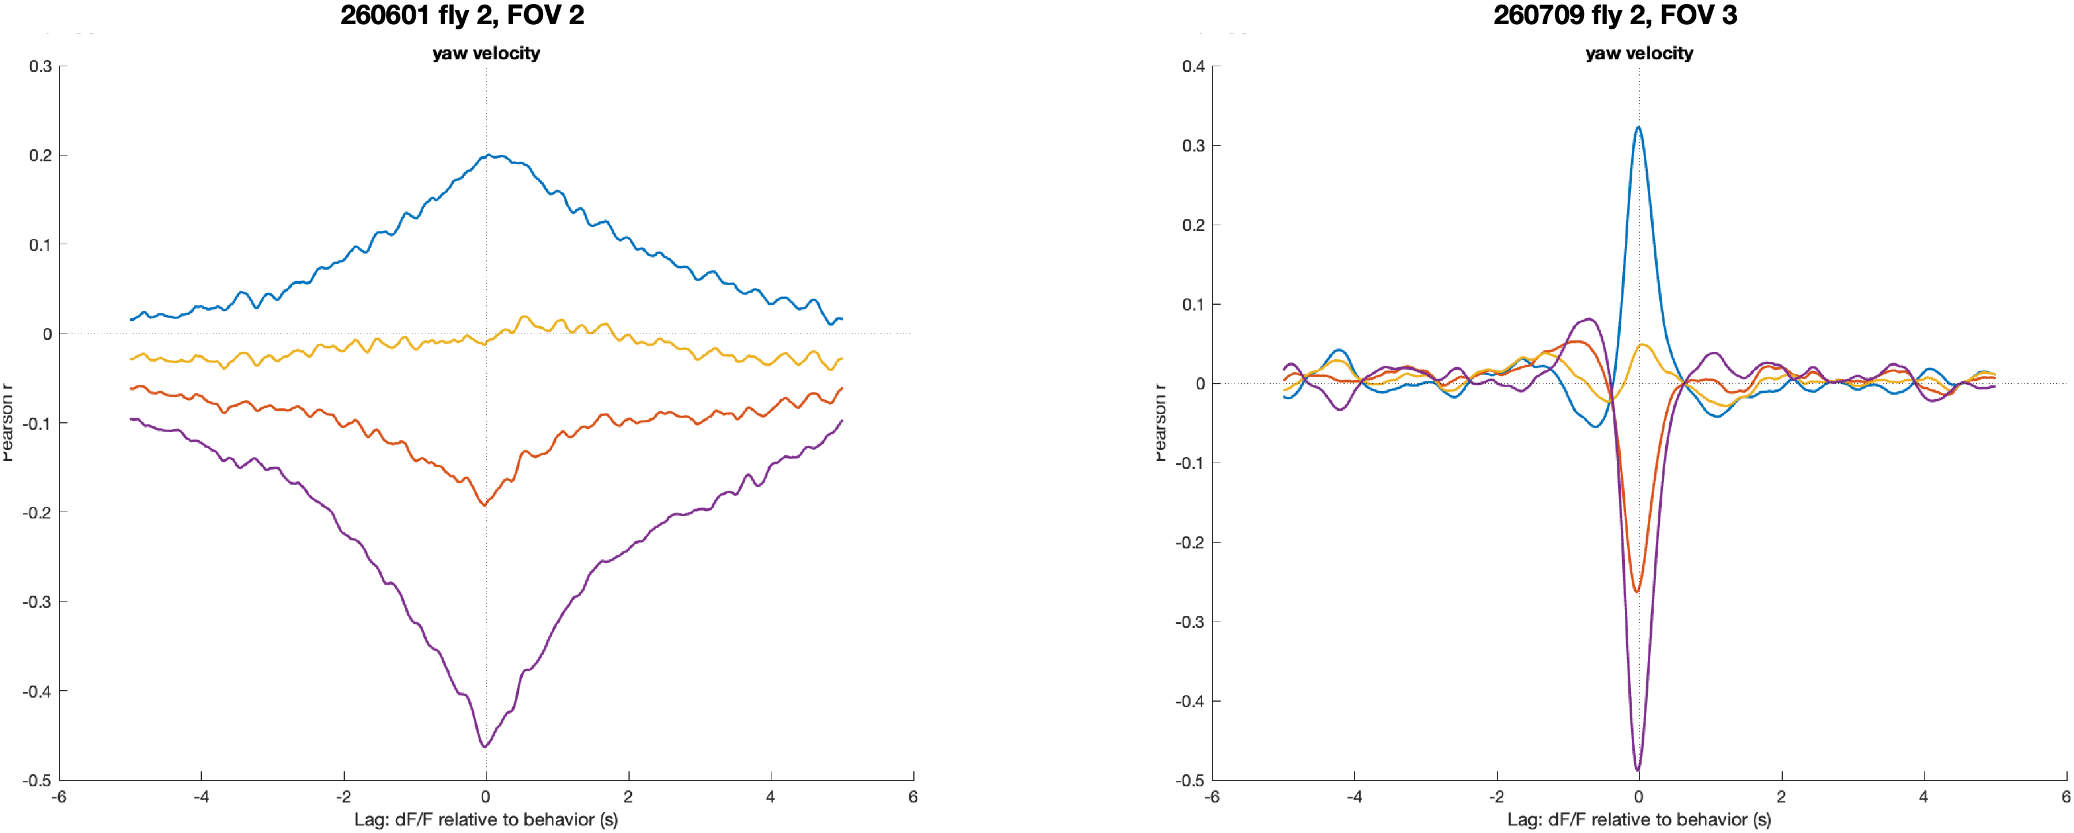
The lateralized turning signal is strongest near zero lag
Method: Cross-correlation with signed yaw (±5 s); purple = right-minus-left dF/F.
Notes:
[Sources]
- Local analysis: 260601_fly02_fov02_trial01_lag_correlations.png
- Local analysis: 260709_fly02_fov03_trial01_lag_correlations.png
[/Sources]

Slide 6
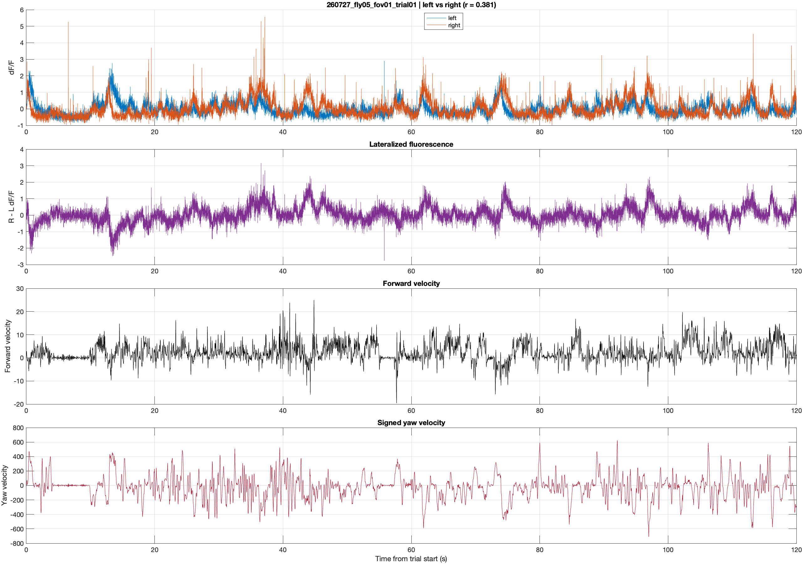
Representative bilateral activity and behavior
Protocol: Left and right dF/F were robustly z-scored separately. Both-high = left and right z ≥ 1; both-low = z ≤ 1. States shorter than 200 ms were removed and gaps ≤100 ms merged. Kinematics were averaged from 3 to +3 s around each state entry.
Protocol: Artifact-masked left/right dF/F and FicTrac forward/yaw signals were aligned to img.t. This 120 s diagnostic displays left, right, rightleft, forward velocity, and signed yaw to assess signal quality, bilateral synchrony, and behavioral alignment.

Slide 7
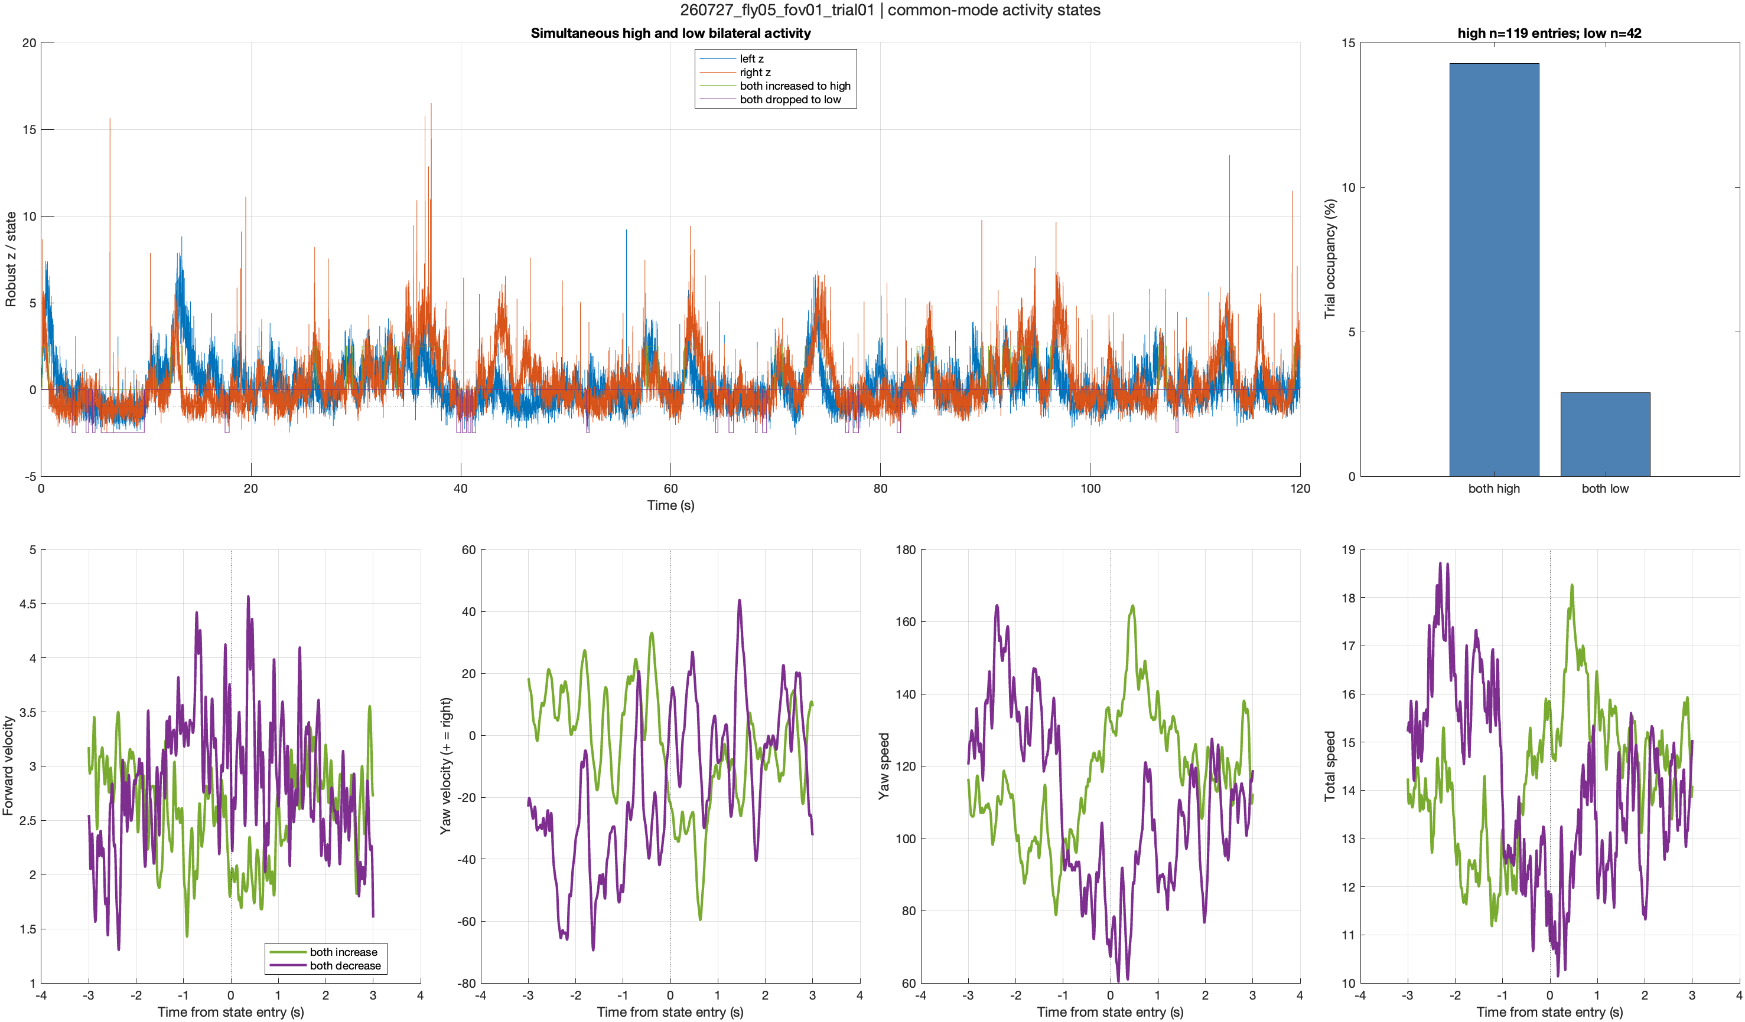
Bilateral activation can accompany turning and slowing

Slide 8
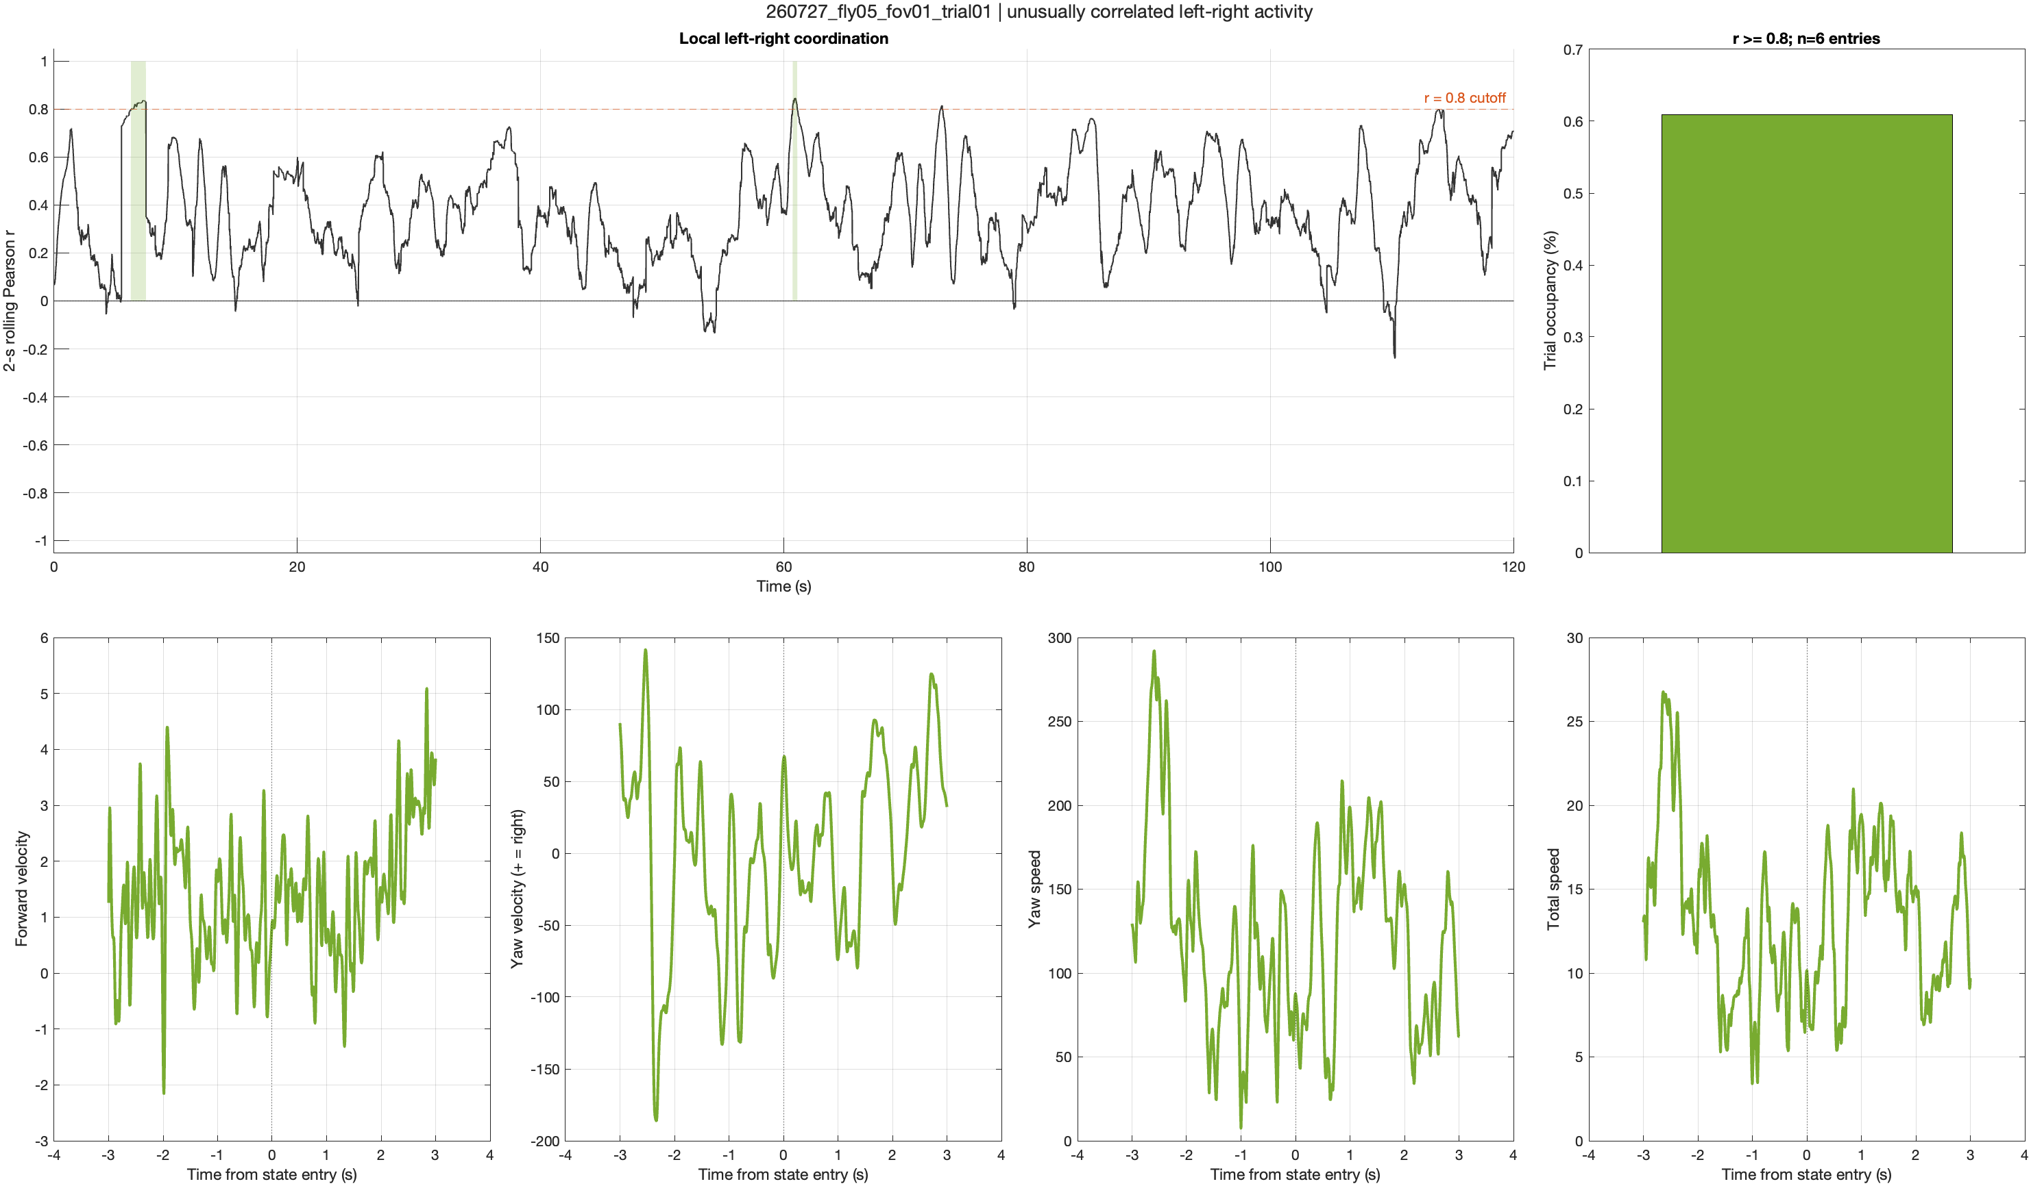
Strong bilateral coordination occupies brief trial epochs
Protocol: Bilateral coordination was calculated as centered 2 s rolling Pearson r using pairwise-valid artifact-masked samples. Highlighted epochs required r ≥ 0.8 for ≥200 ms. Forward, signed yaw, yaw speed, and total speed were aligned from 3 to +3 s around epoch entry.

Slide 9
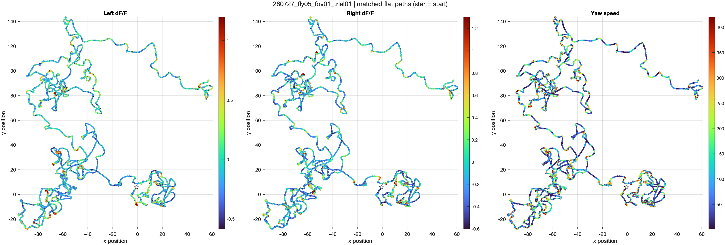
Spatial activity patterns differ across the two sides
Protocol: FicTrac x/y position was interpolated to imaging time. All three panels use exactly the same finite samples and spatial limits. Color shows artifact-masked left dF/F, right dF/F, or yaw speed; display colors are clipped to each signal’s 2nd–98th percentiles only.

Slide 10
Turn-residualized activity reveals a small lateral signal
Turning model: signed yaw velocity + yaw speed
Variance explained: 6.3% left; 5.0% right
Residual forward-speed correlations remain weak (r = 0.03 left; 0.02 right)
Residual lateral velocity is small but consistent:
Left: r = +0.039 in 20/21 trials
Right: r = 0.042 in 20/21 trials
Interpretation requires confirmation of ROI identity and yaw sign

Slide 11
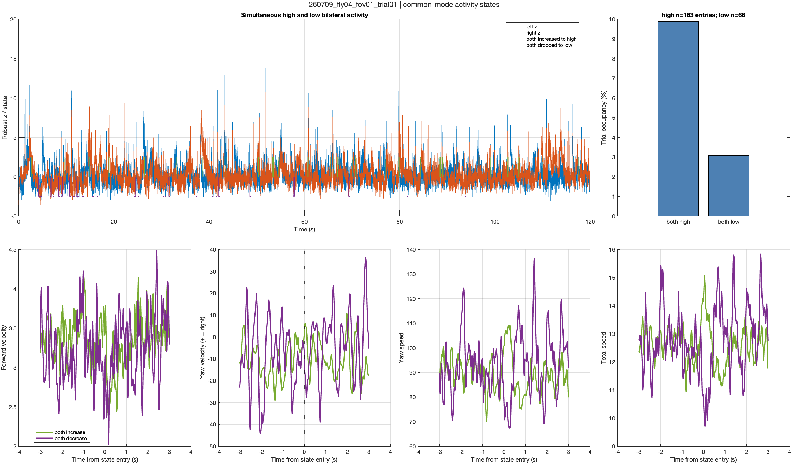
Fly 4: bilateral increases accompany a modest slowdown
Protocol: Fly 4 (260709, FOV1; 94.5% moving). Bilateral high/low states used robust-z thresholds ±1, ≥200 ms duration, and ≤100 ms gap merging. Curves show mean behavior ±3 s around state entry; green denotes entry into both-high activity.

Slide 12
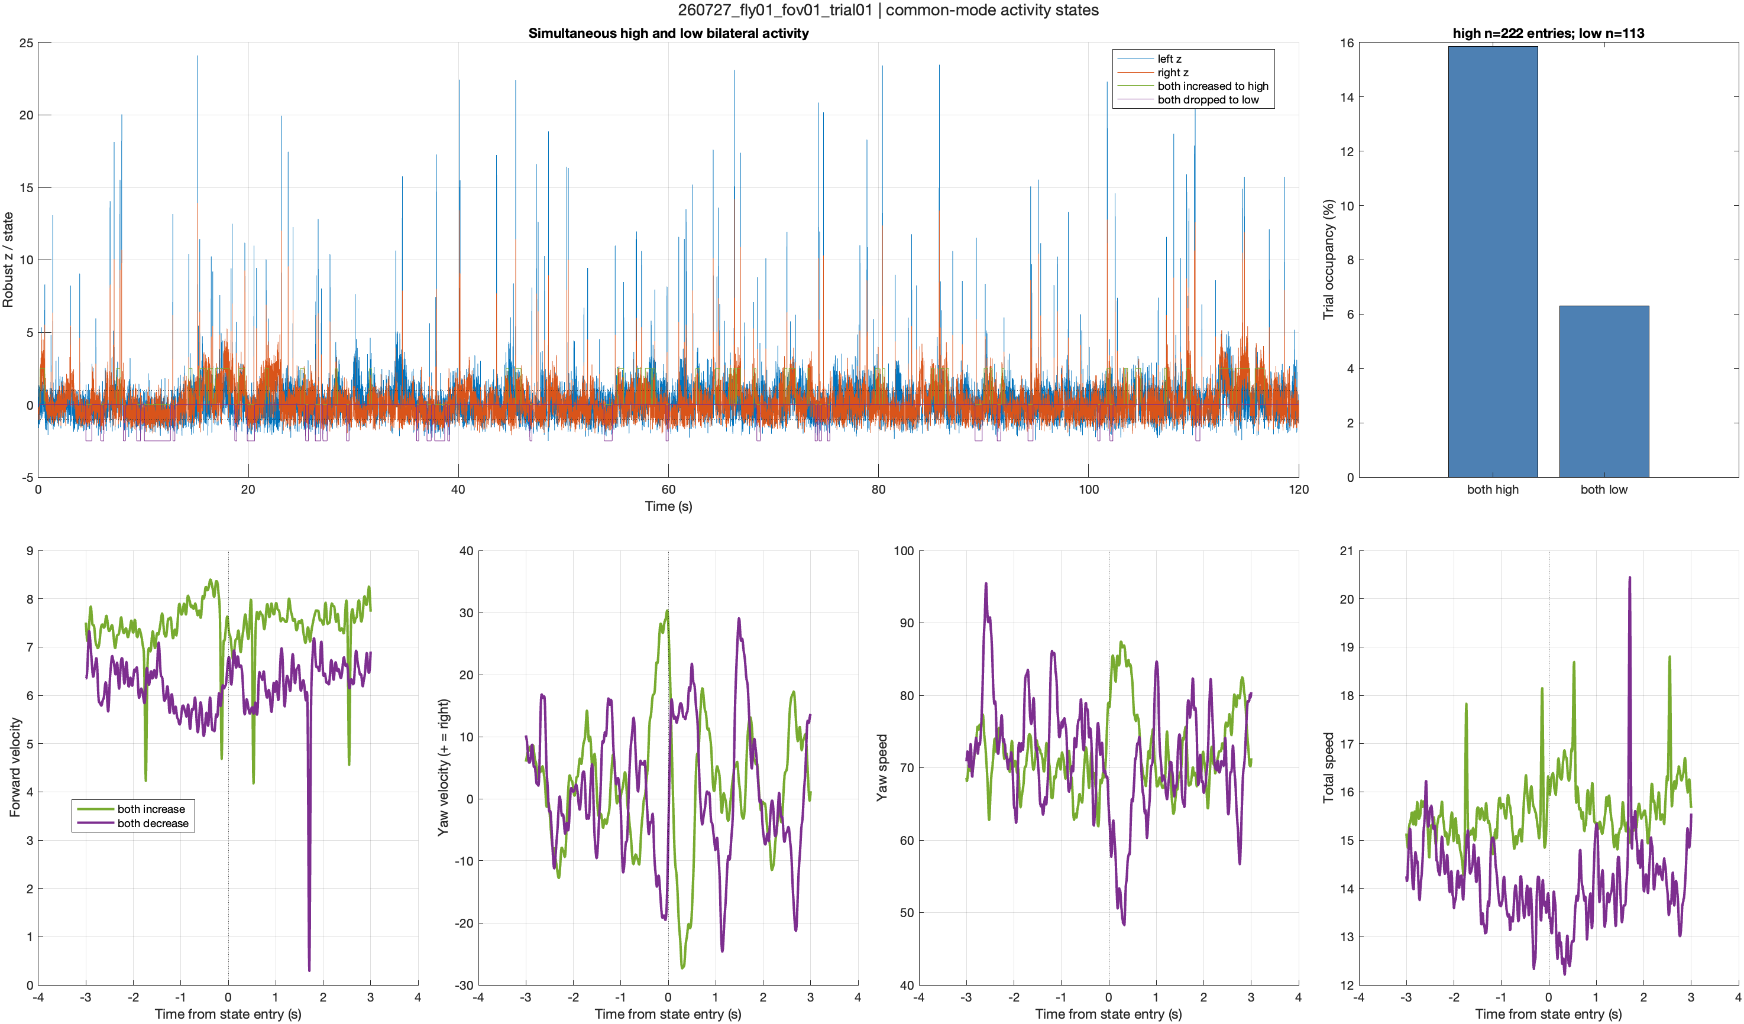
Fly 1: forward slowing is clearer than directional turning
Protocol: Fly 1 (260727, FOV1; 94.4% moving). State detection and temporal cleaning match the dataset-wide analysis. Event-triggered means span ±3 s; forward slowing is evaluated around entry into both-high activity, with the same aligned yaw-speed and total-speed traces shown for context.

Slide 13
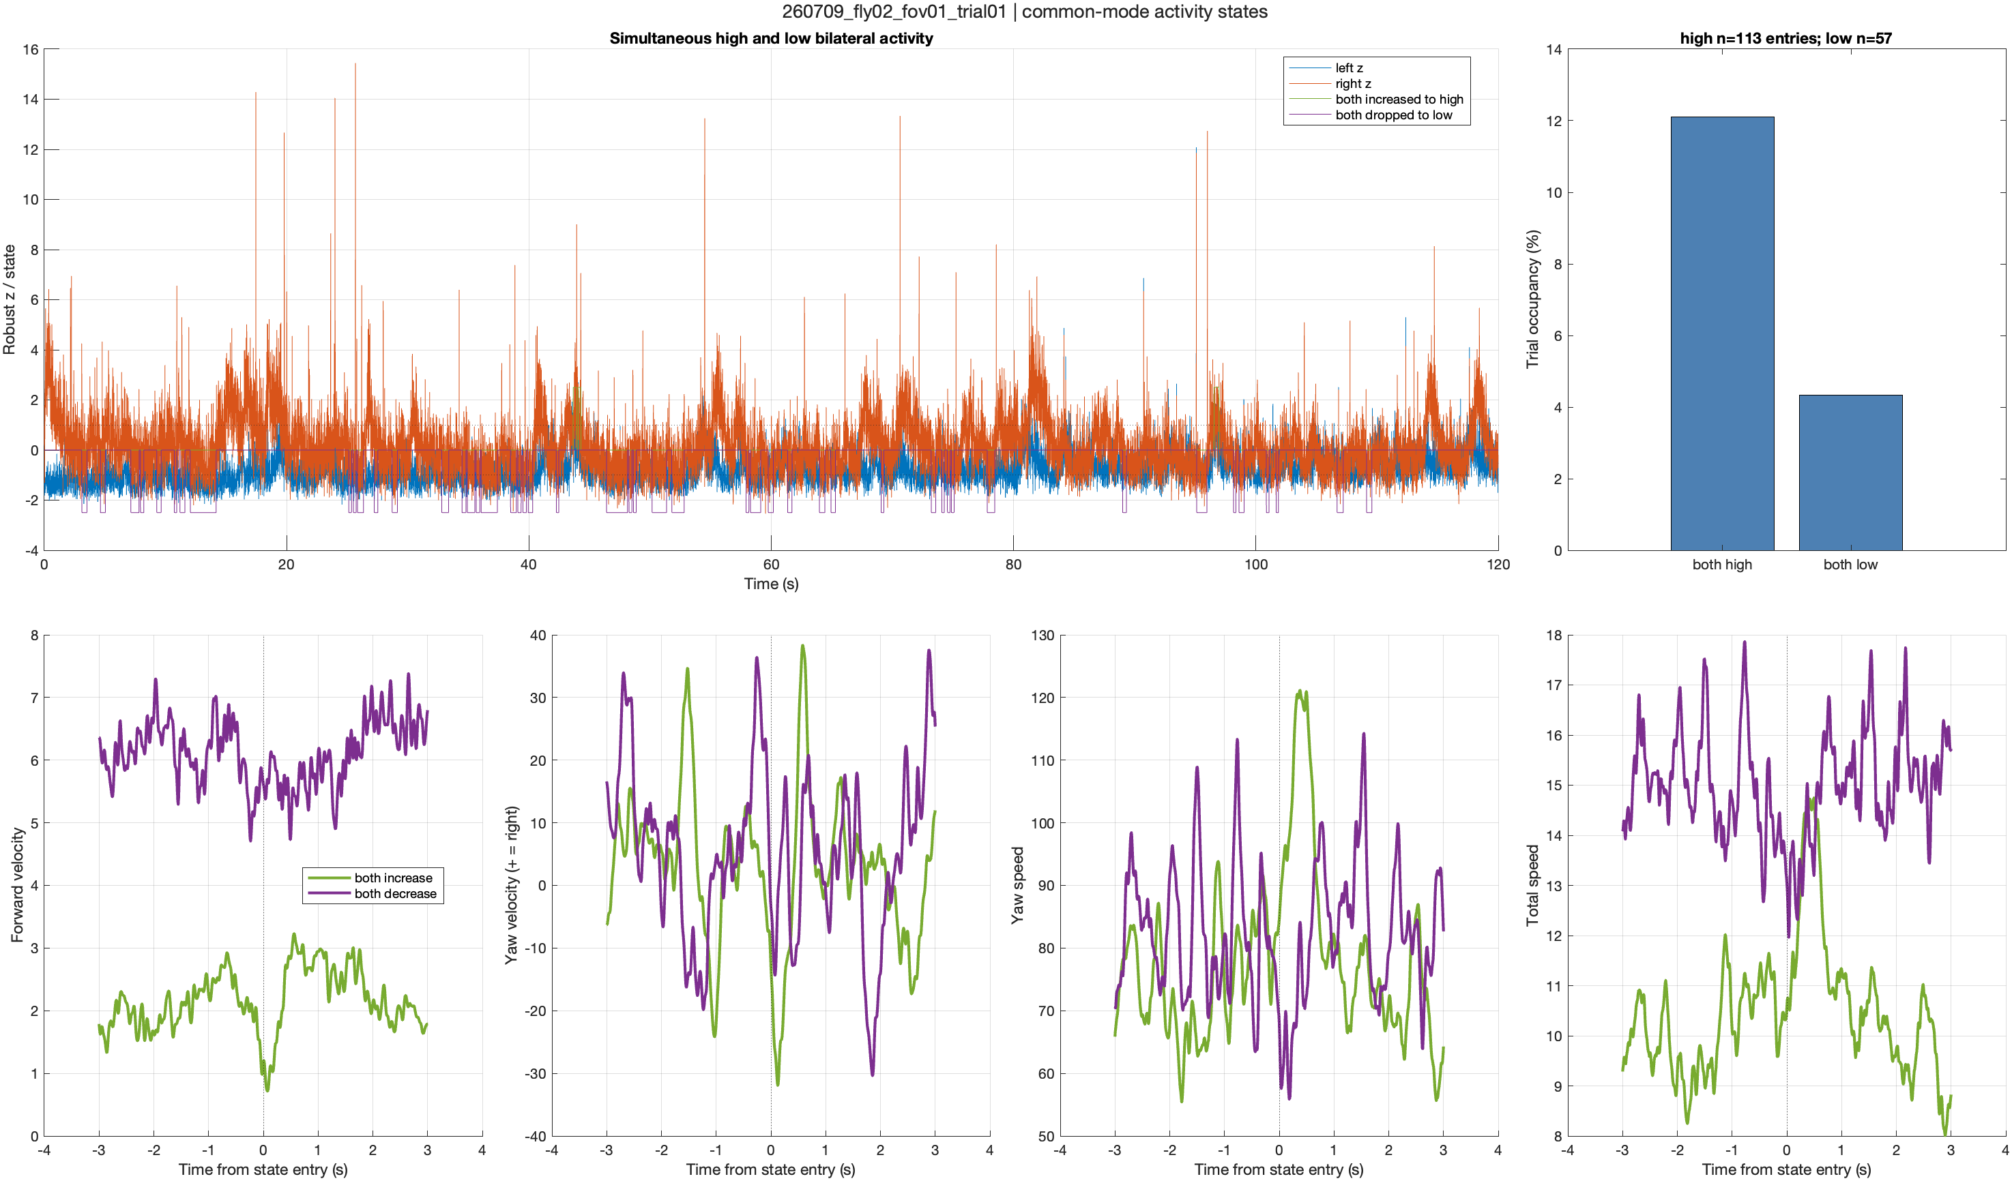
Fly 2: activation aligns with a transient stop and recovery

