Slide 1
DNa03
Bilateral imaging analysis | representative results

Slide 2
Bilateral DNa03 activity accompanies behavioral transitions
Bilateral-high epochs show greater yaw speed than bilateral-low epochs
This comparison does not establish that activation drives pivot turns
Forward-speed effects are mixed across trials and individual events
Several representative trials suggest activation can accompany slowing
Turning explains only ~5–6% of instantaneous dF/F variance
Working interpretation: a broader movement-transition signal

Slide 3
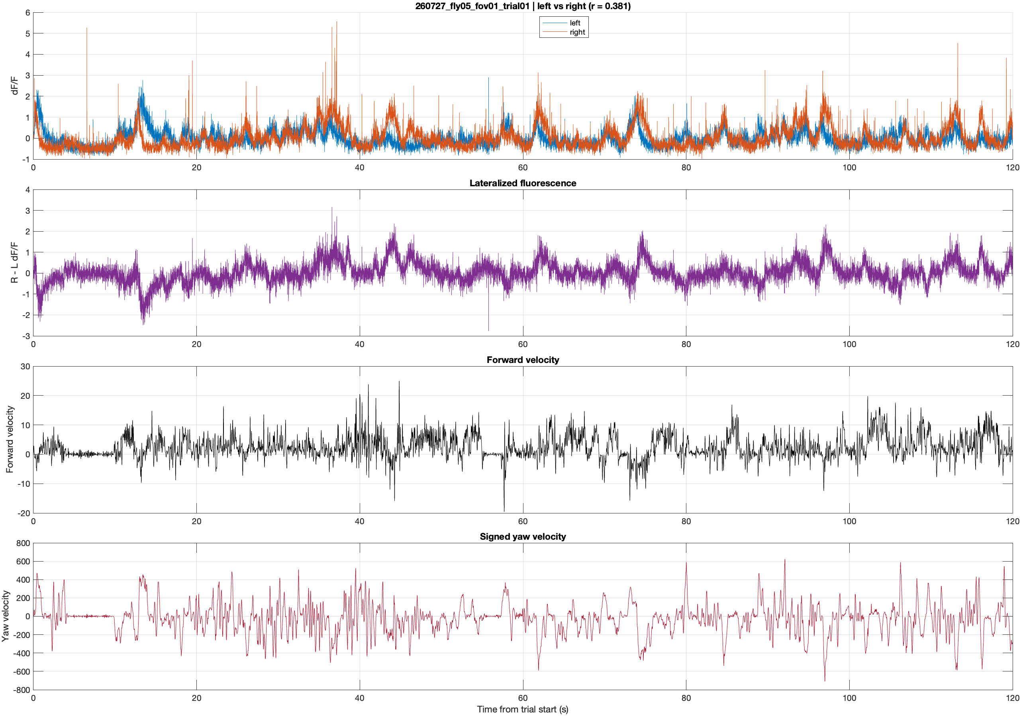
Representative bilateral activity and behavior

Slide 4
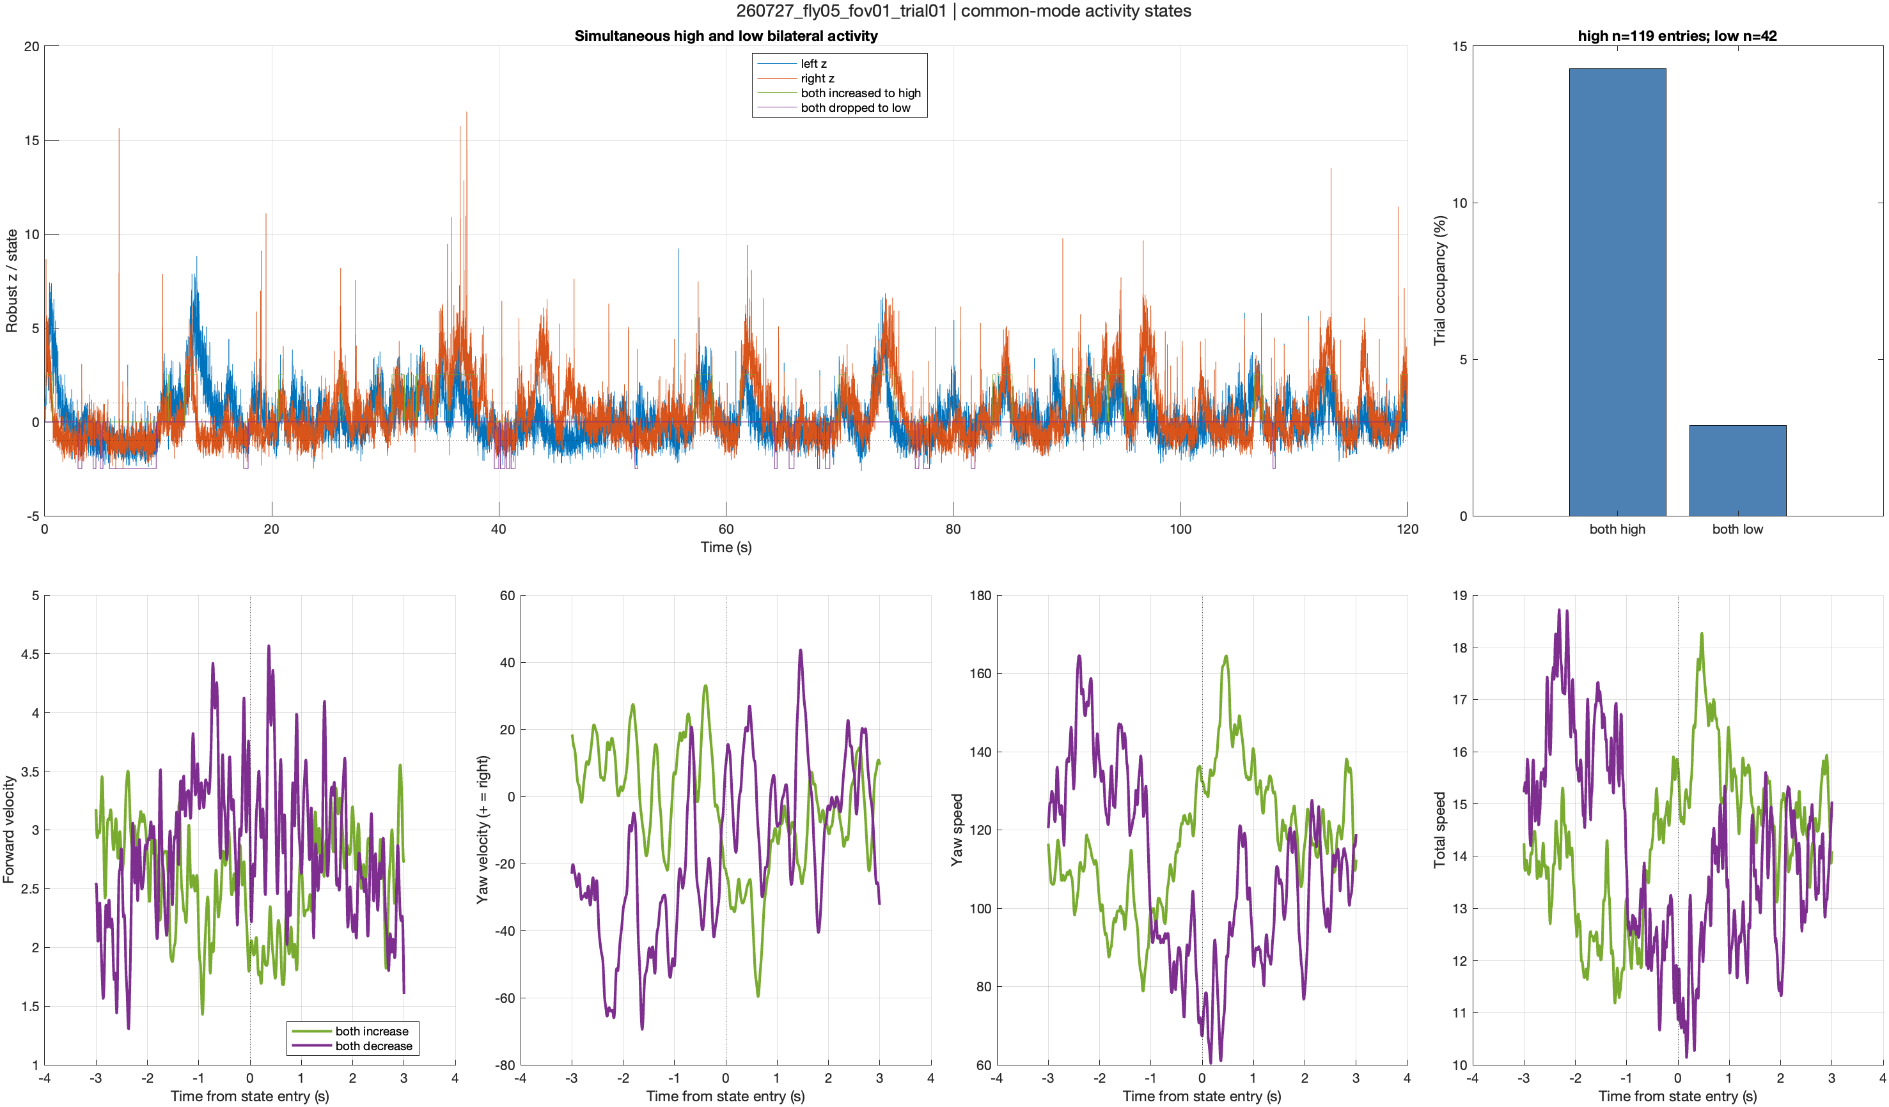
Bilateral increases coincide with pivot turns

Slide 5
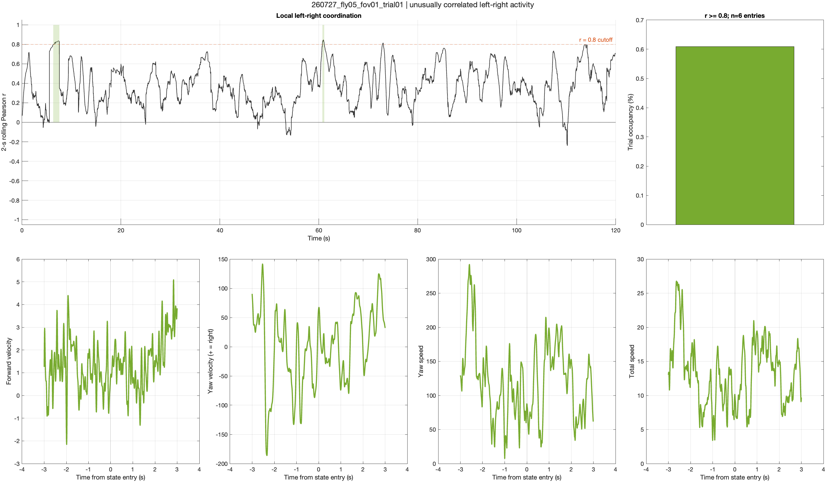
Strong bilateral coordination occupies brief trial epochs

Slide 6
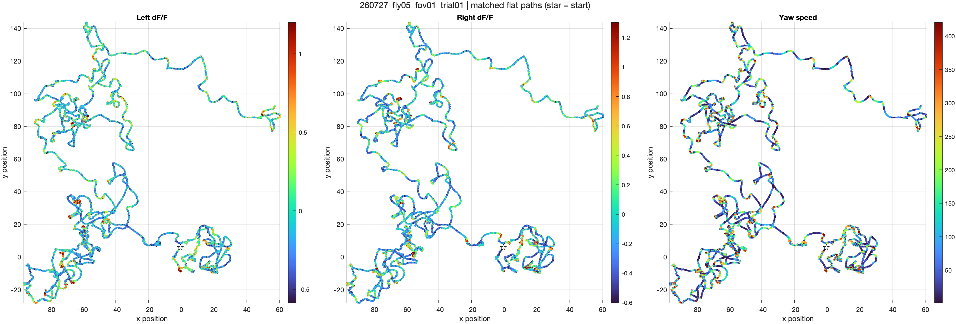
Spatial activity patterns differ across the two sides

Slide 7
Turn-residualized activity reveals a small lateral signal
Turning model: signed yaw velocity + yaw speed
Variance explained: 6.3% left; 5.0% right
Residual forward-speed correlations remain weak (r = 0.03 left; 0.02 right)
Residual lateral velocity is small but consistent:
Left: r = +0.039 in 20/21 trials
Right: r = 0.042 in 20/21 trials
Interpretation requires confirmation of ROI identity and yaw sign

