Slide 1
SMP544 activity across heat & no heat
Imaging summary 8.2026

Slide 2
SMP544 is recruited by locomotion and heat
R & L copies have similar properties
+ response to heat
Pivoting often coincides with inhibition
Many trials have low SNR/motion artifacts
Somewhat similar to what we might have expected, though more needed.

Slide 3
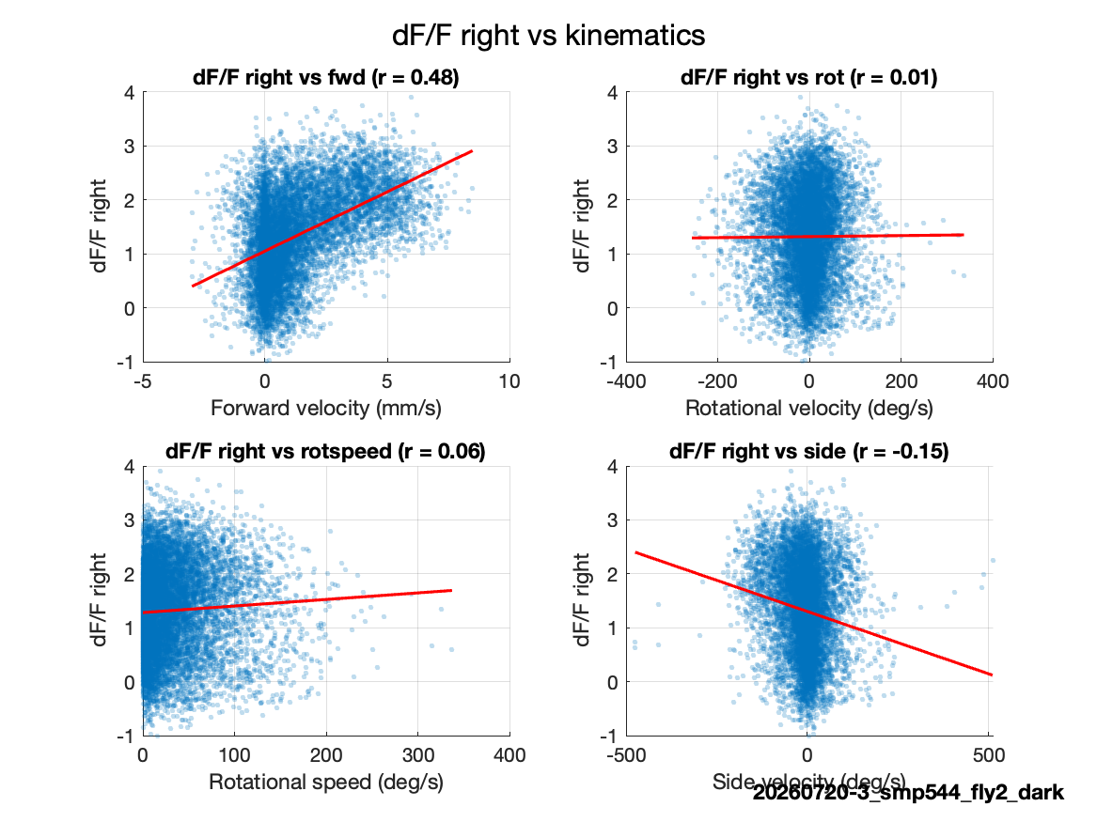
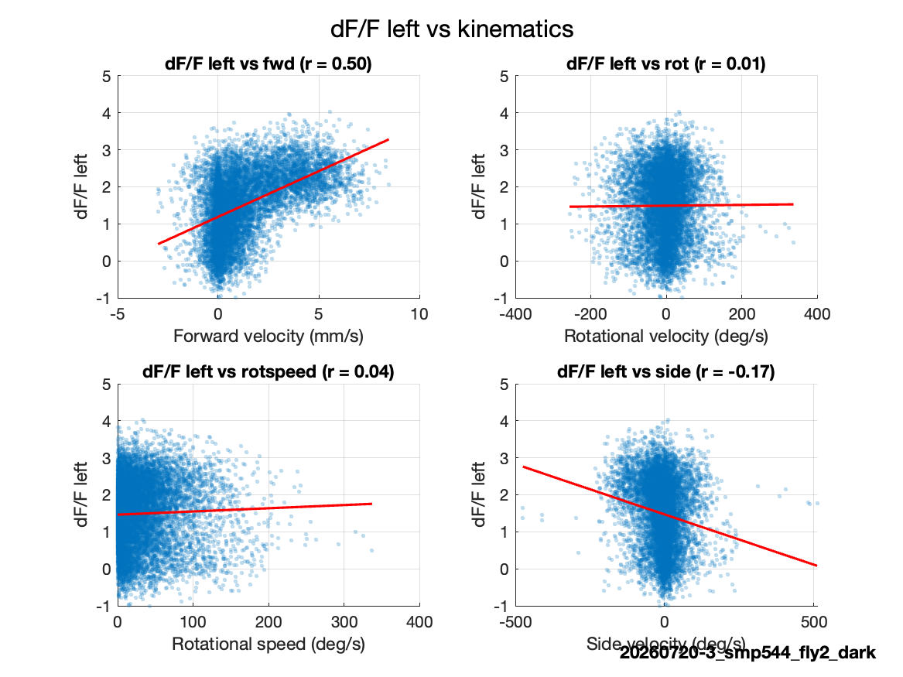
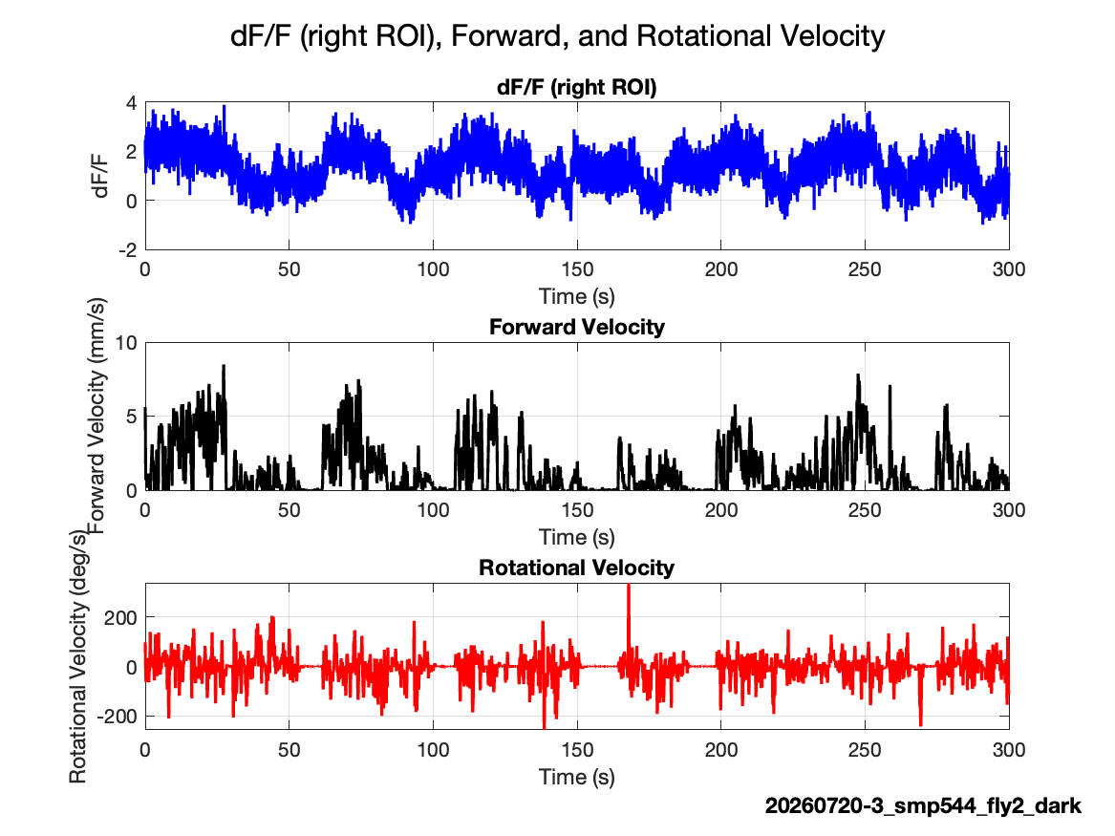
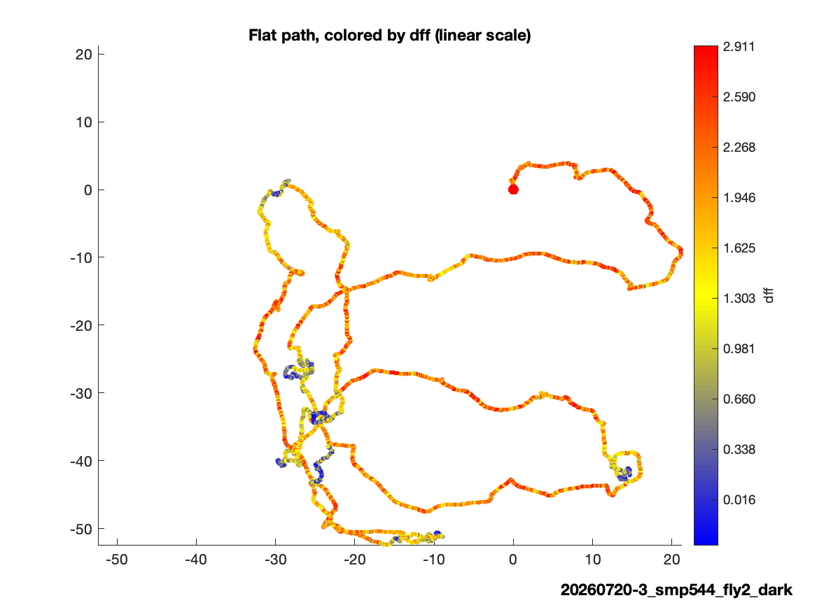
20260720-3 | dark fly 2

Slide 4
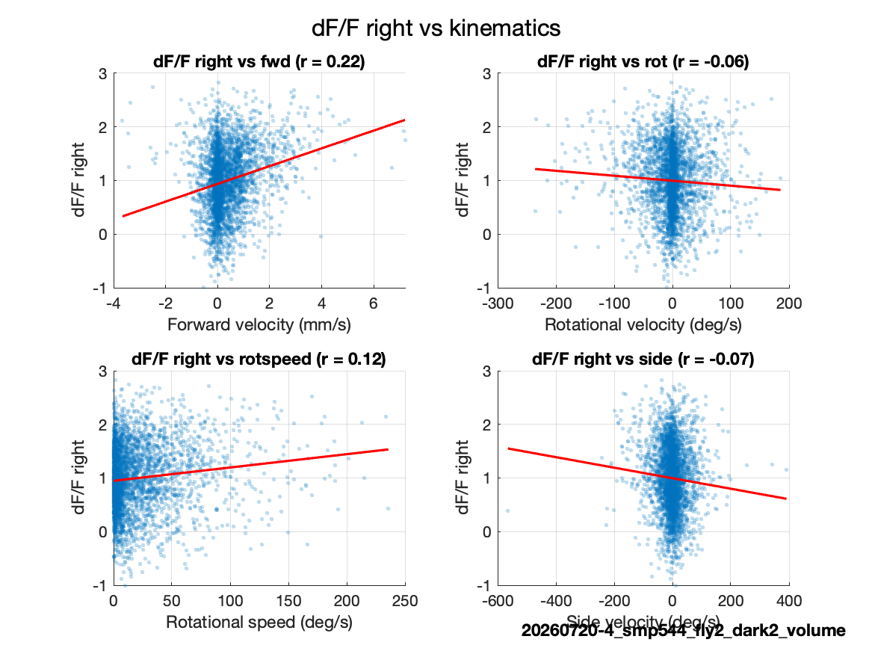
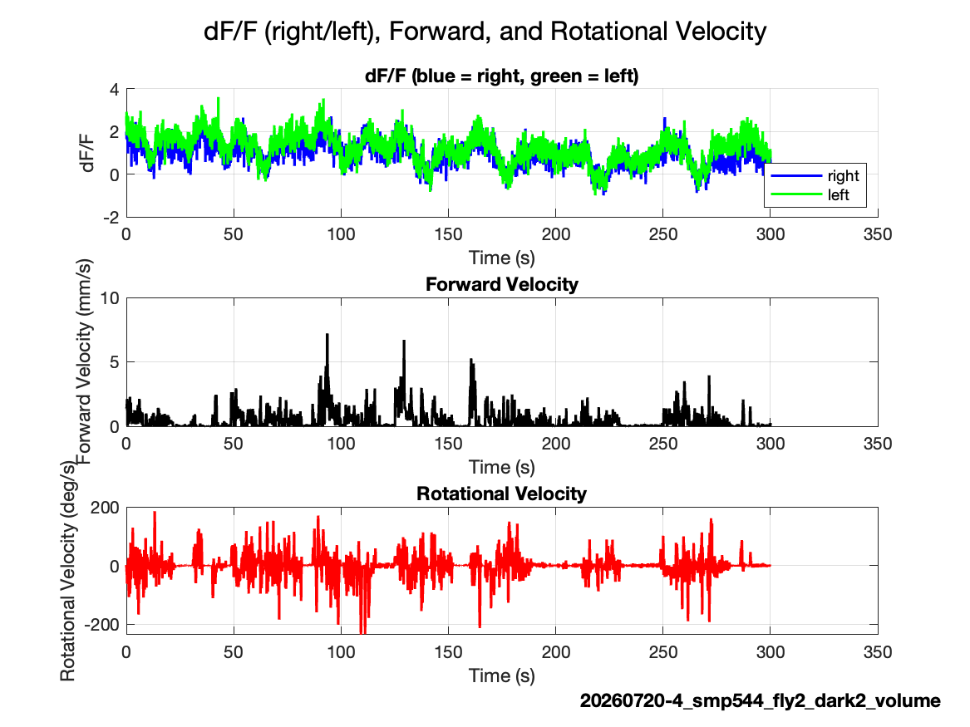
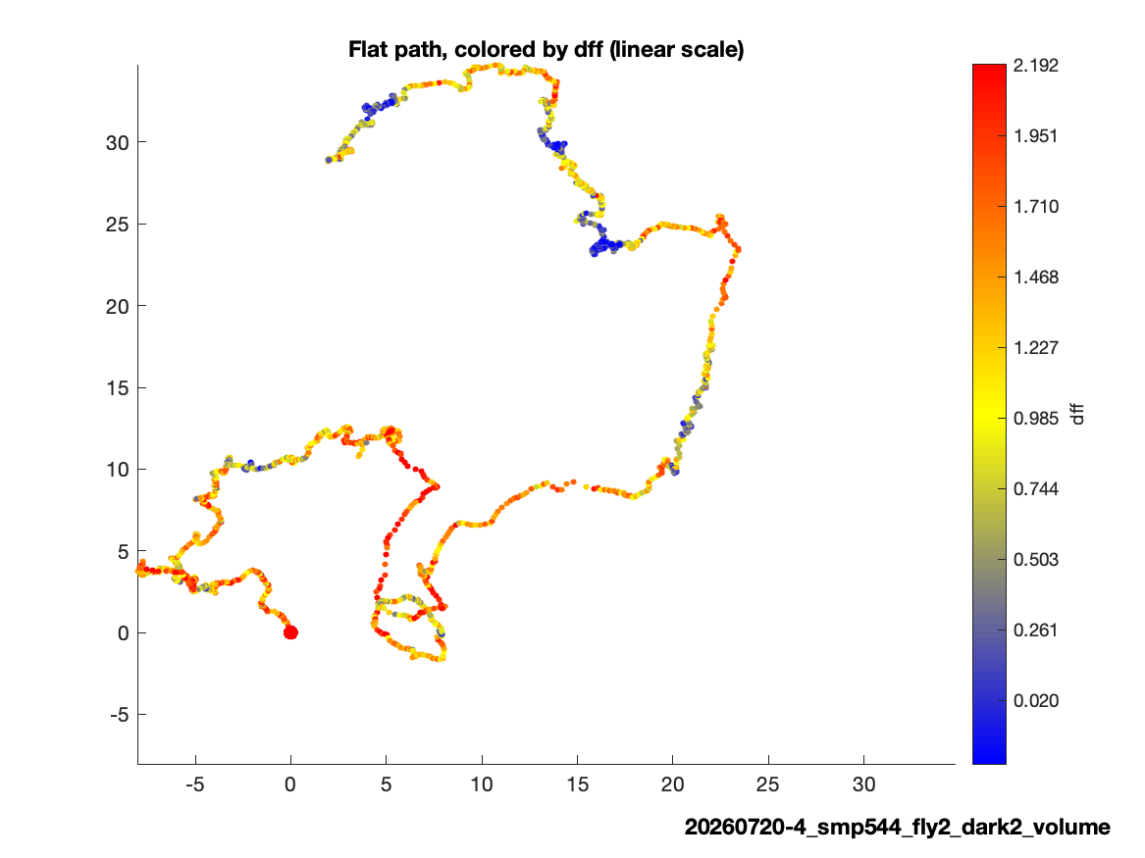
20260720-4 | dark fly 2, volume

Slide 5
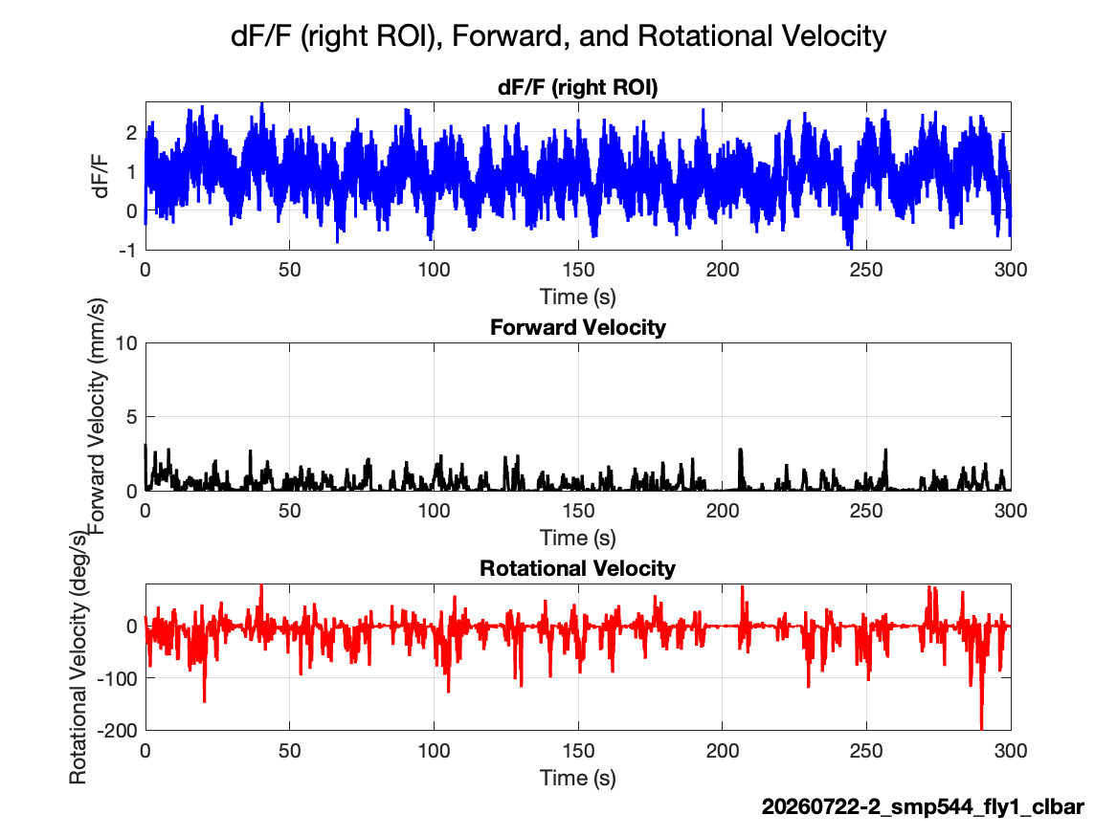
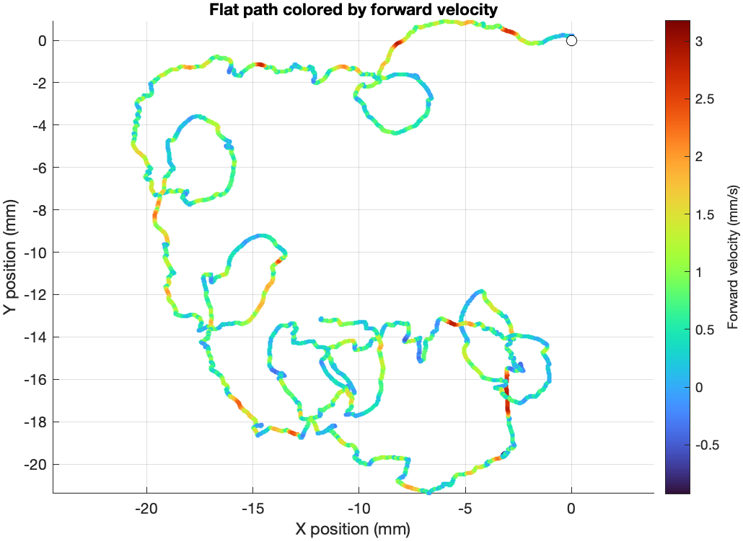
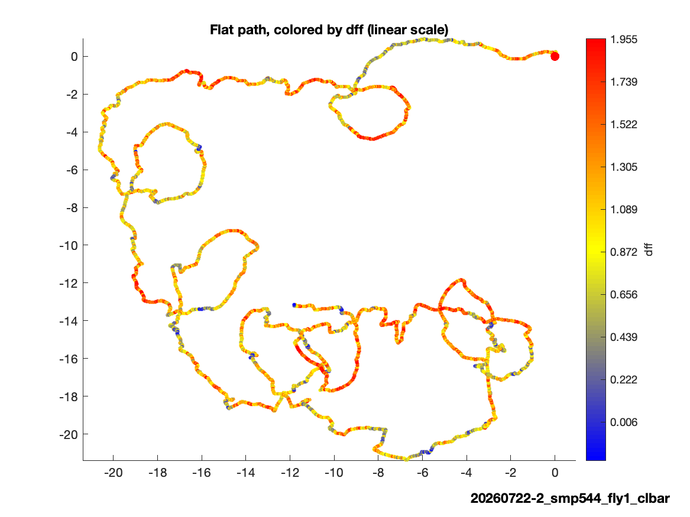
20260722-2 | closed-loop bar

Slide 6
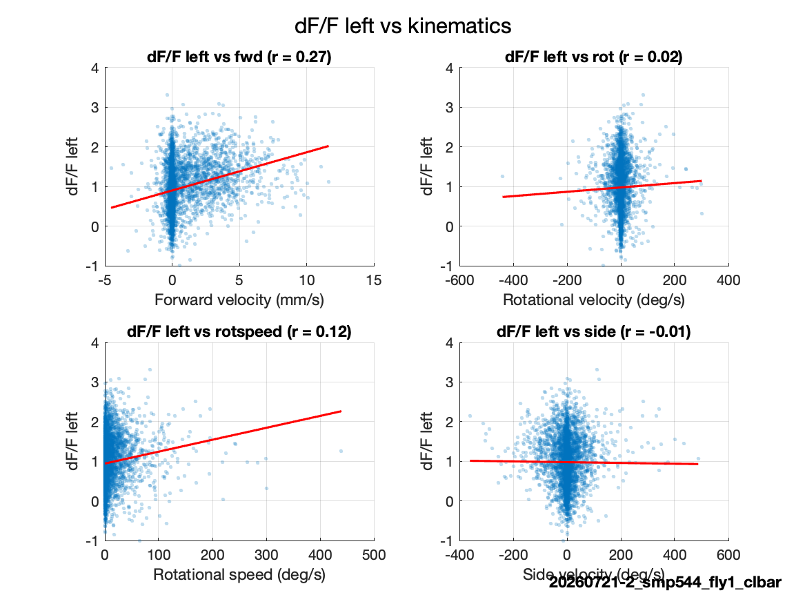
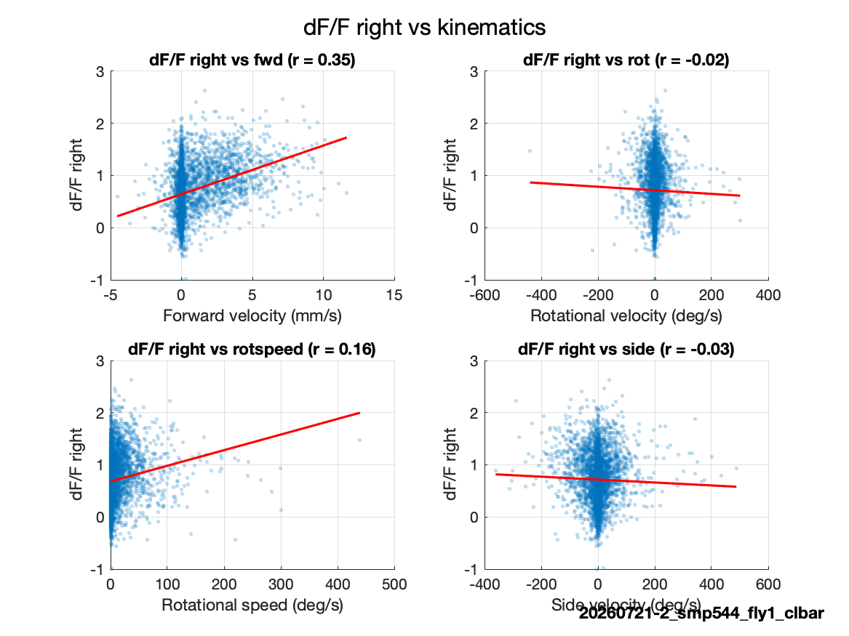
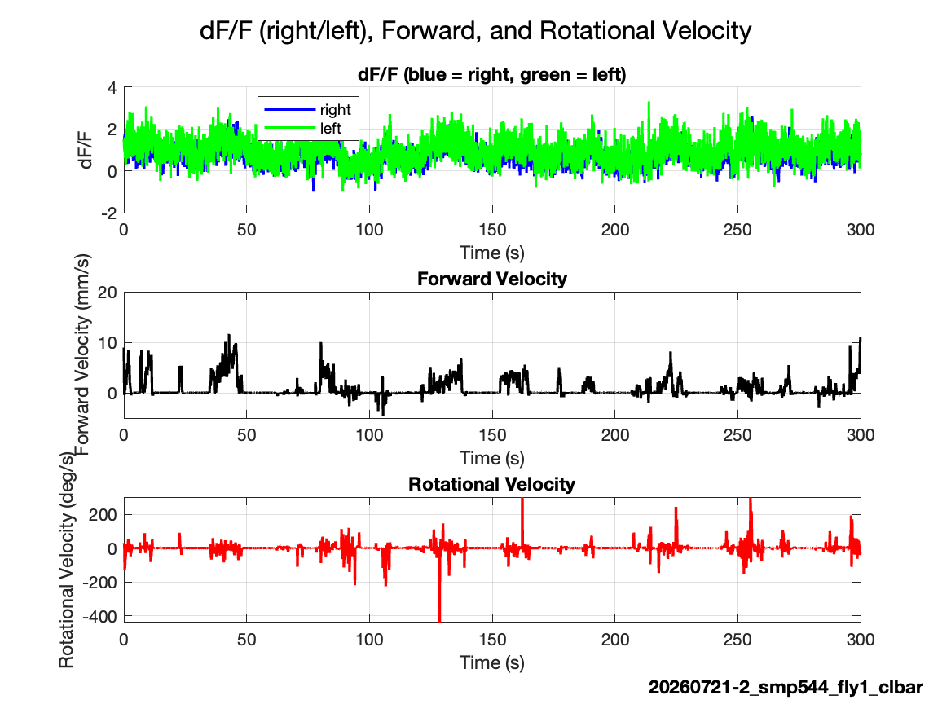
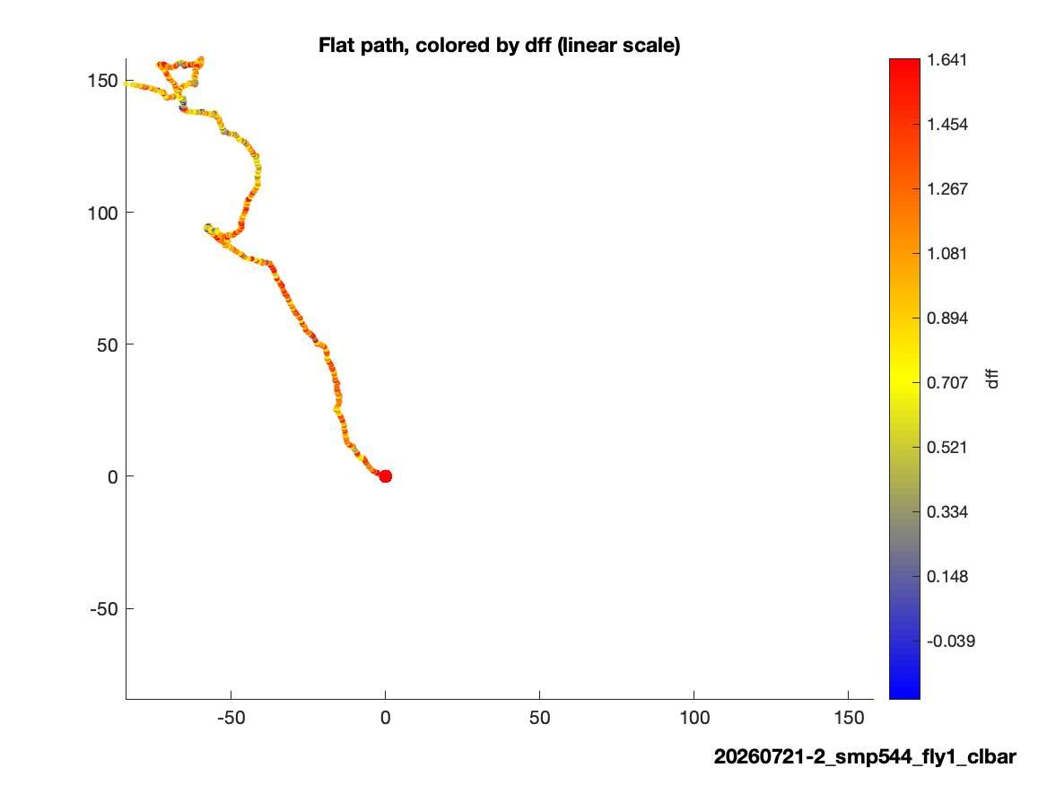
20260721-2 | closed-loop bar

Slide 7
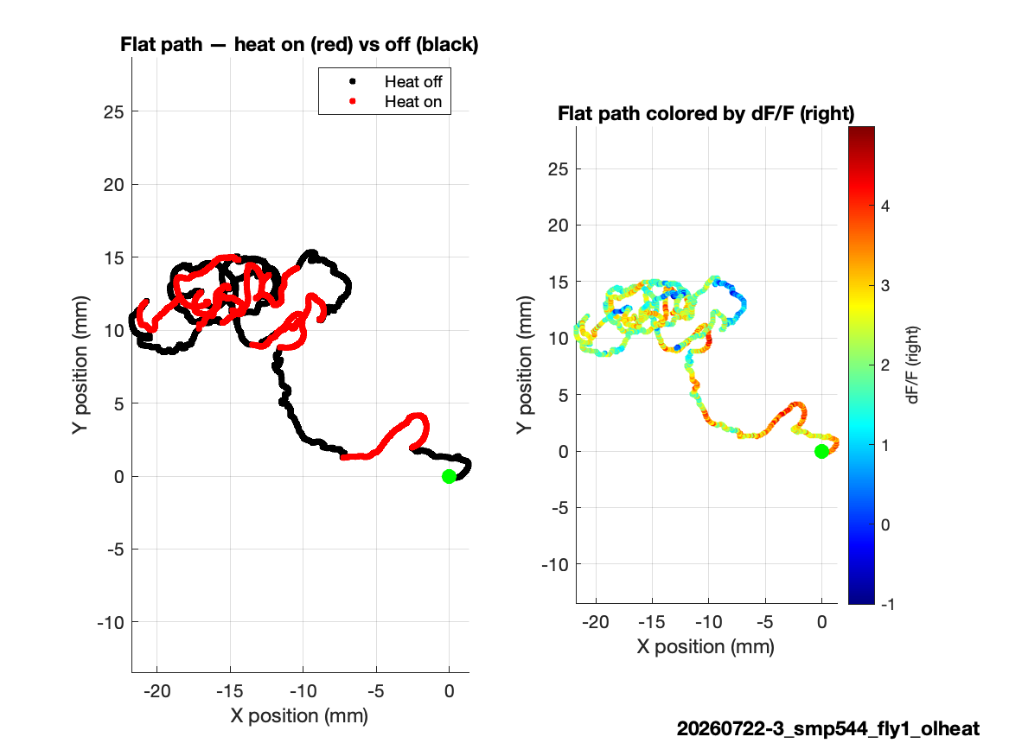
20260722-3 | open-loop heat
Strongest bilateral heat trial
Moving: 20.2%
Right-left r: 0.80
Heat and vigorous movement coincide with high bilateral activity.

Slide 8
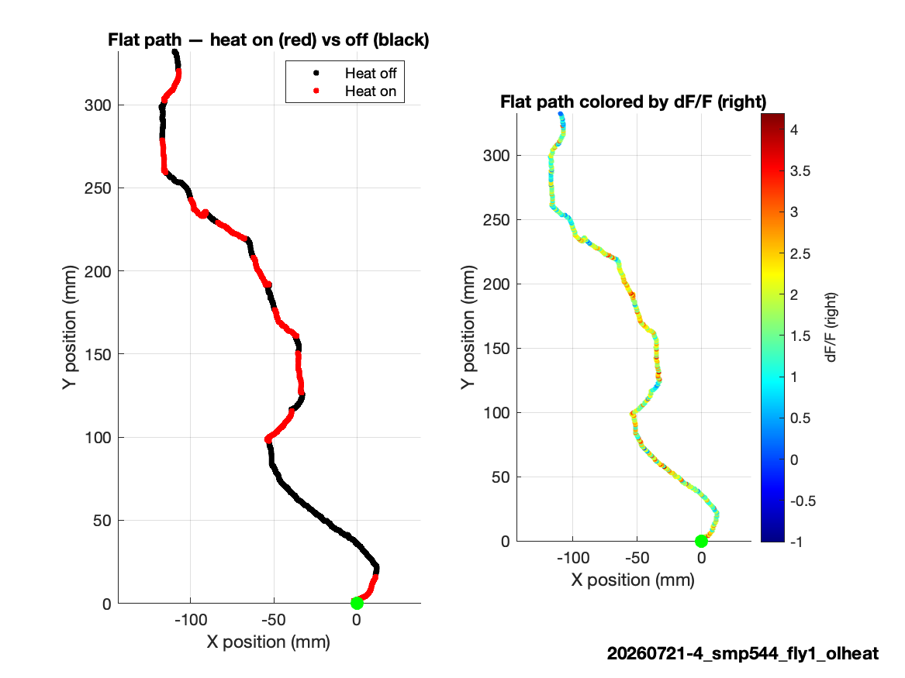
20260721-4 | open-loop heat
Strong heat-associated elevation
Moving: 37.4%
Heat: 15.0% of samples
Mean dF/F rises bilaterally during heat

Slide 9
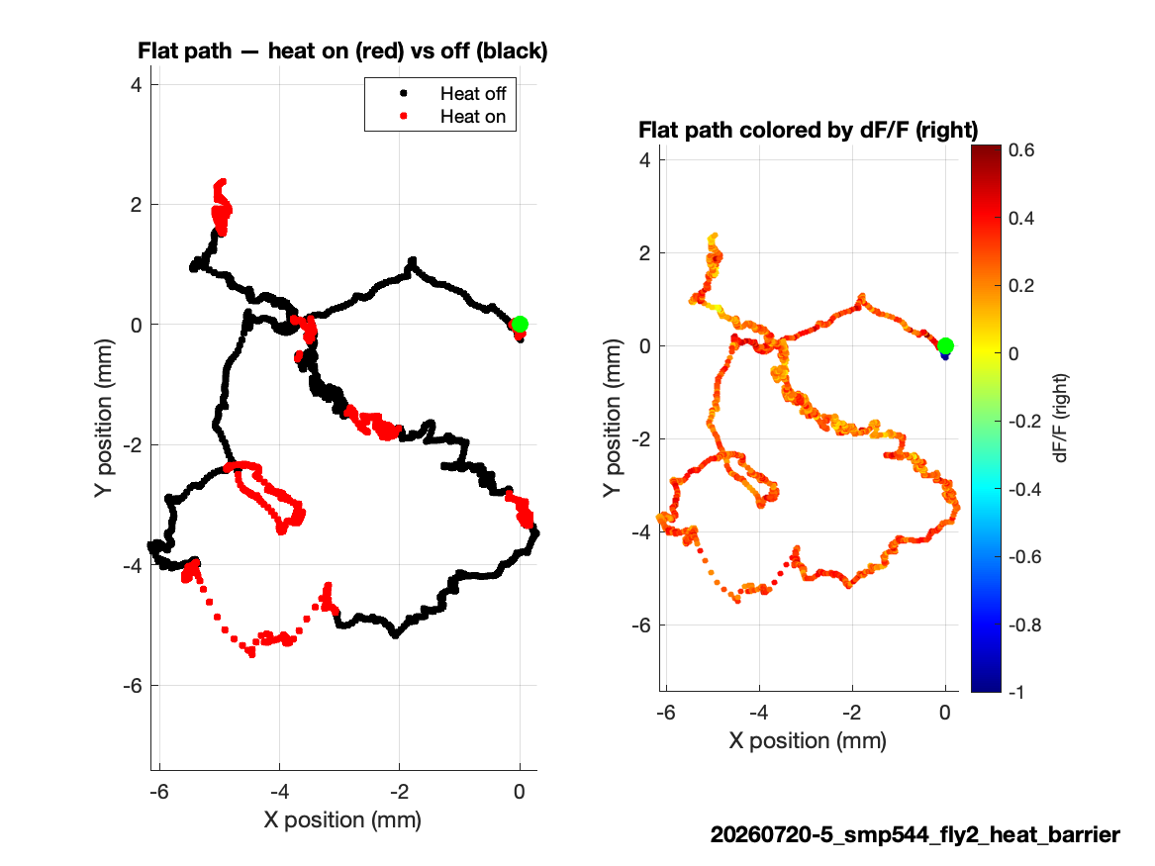
20260720-5 | heat barrier, repaired
First 3,555 synchronized volumes only
Imaging was cropped to the DAQ interval.
Heat-active path is analyzable without extrapolating behavior.

Slide 10
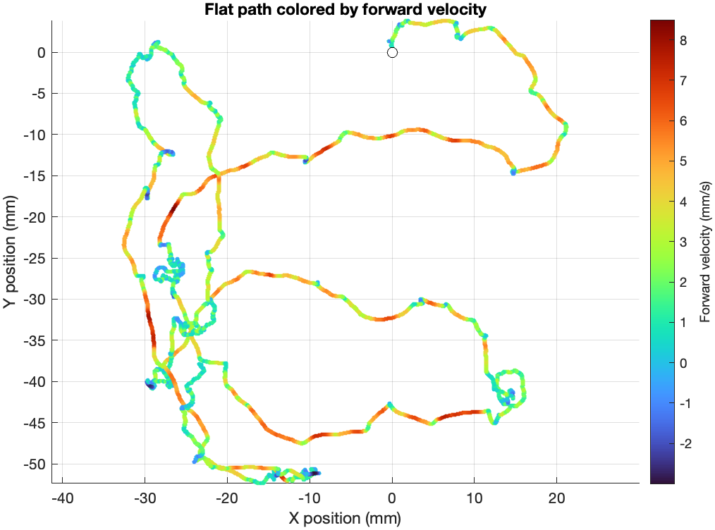
SMP544

Slide 11
SMP544

Slide 12
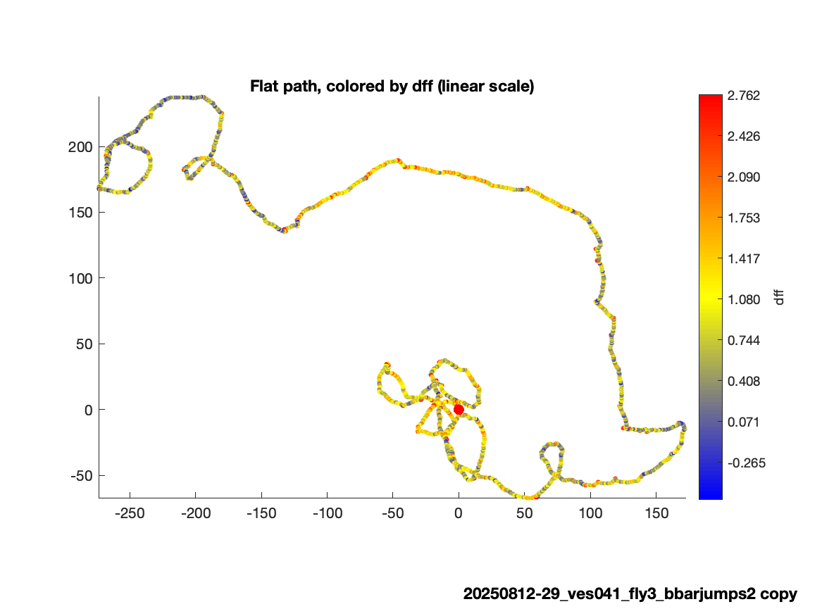
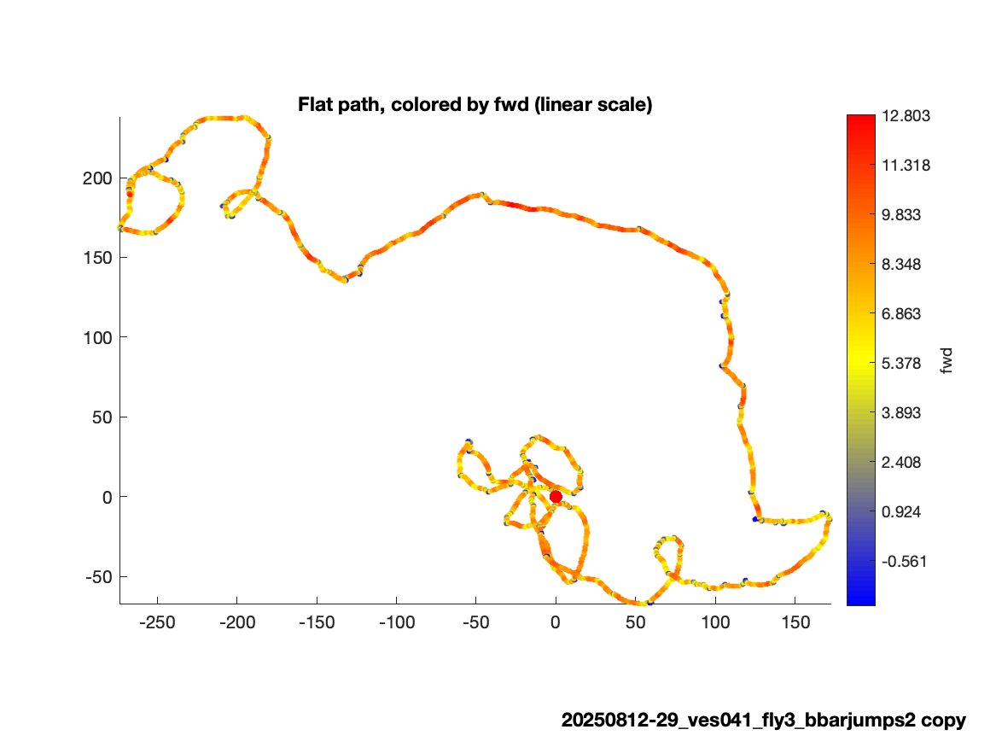
VES041

Slide 13
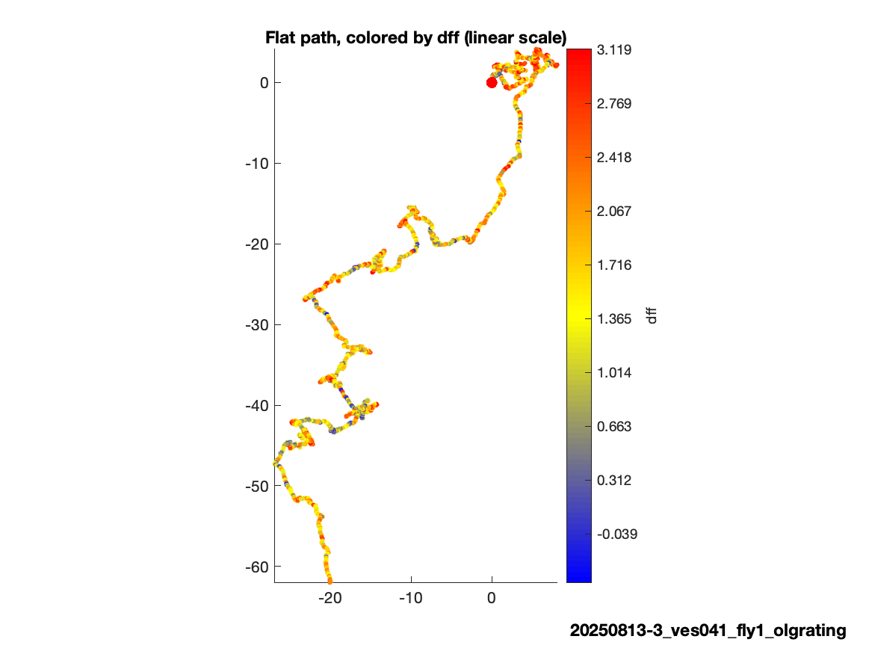
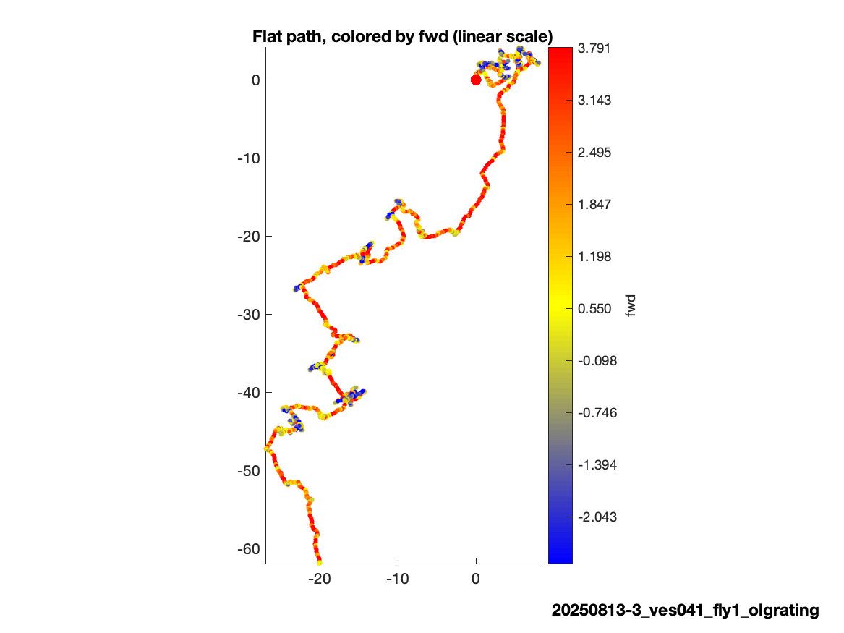

Slide 14
