Slide 1


Forest Fire Risk Prediction
Using Random Forest and Gradient-Boosted Trees — B.Tech 2nd Year ML Project
Student: Sreshta Paladugu

Slide 2

Introduction & Problem Statement
Forest fires are driven by meteorological and fire-weather indicators. The goal of this project is to build supervised classifiers that predict whether a given forest observation corresponds to Fire (1) or Not Fire (0). Two models — Random Forest (RF) and Gradient Boosting (GB) — are trained on the same dataset and compared using standard performance metrics.

Slide 3

Dataset & Features
Dataset: Algerian Forest Fires Dataset. Regions included: Bejaia and Sidi-Bel Abbes. Target: binary class (Fire / Not Fire).
Core meteorological features: Temperature, Relative Humidity (RH), Wind speed (Ws), Rain
Fire-weather indices: FFMC, DMC, DC, ISI, BUI, FWI
Additional categorical feature: Region

Slide 4

Data Preprocessing & Feature Engineering
Key preprocessing steps and engineered features used to improve signal and model performance.
Data cleaning: handle missing values, check for duplicates, consistent types
Target encoding: Fire = 1, Not Fire = 0
Engineered features:
  Dryness = 100 − RH (humidity-derived dryness)
  Temp_Wind = Temperature × Ws (interaction term)
  Rain_Flag = 1 if Rain > 0, else 0 (binary precipitation indicator)
Train/test split: 80% training, 20% testing (stratified by class to preserve class ratios)

Slide 5

Machine Learning Models
Two ensemble-based supervised classifiers were implemented and tuned using the same input features:
Random Forest
Gradient Boosting
Bagging ensemble of decision trees; reduces variance via bootstrap aggregation and random feature selection per split.
Sequential additive trees where each tree corrects residual errors; focused on reducing bias with learning-rate regularization.

Slide 6


Model Training & Prediction Workflow
Prepare dataset → apply preprocessing and feature engineering
Split data (80/20) with stratification
Train Random Forest and Gradient Boosting on identical training folds
Generate class predictions and predicted probabilities on the test set
Use identical test set for fair comparison
Hyperparameters were tuned via cross-validation; both models output class labels and probability estimates for the Fire class.

Slide 7

Evaluation Metrics
We assess classification performance with metrics that capture both overall accuracy and behaviour on the positive (Fire) class:
Accuracy = (TP + TN) / Total
Precision = TP / (TP + FP) — reliability of predicted fires
Recall = TP / (TP + FN) — sensitivity to actual fires
F1 Score = 2 × (Precision × Recall) / (Precision + Recall)
ROC-AUC = area under ROC curve for class-separation ability
Confusion Matrix = counts of TP, TN, FP, FN for detailed error analysis

Slide 8
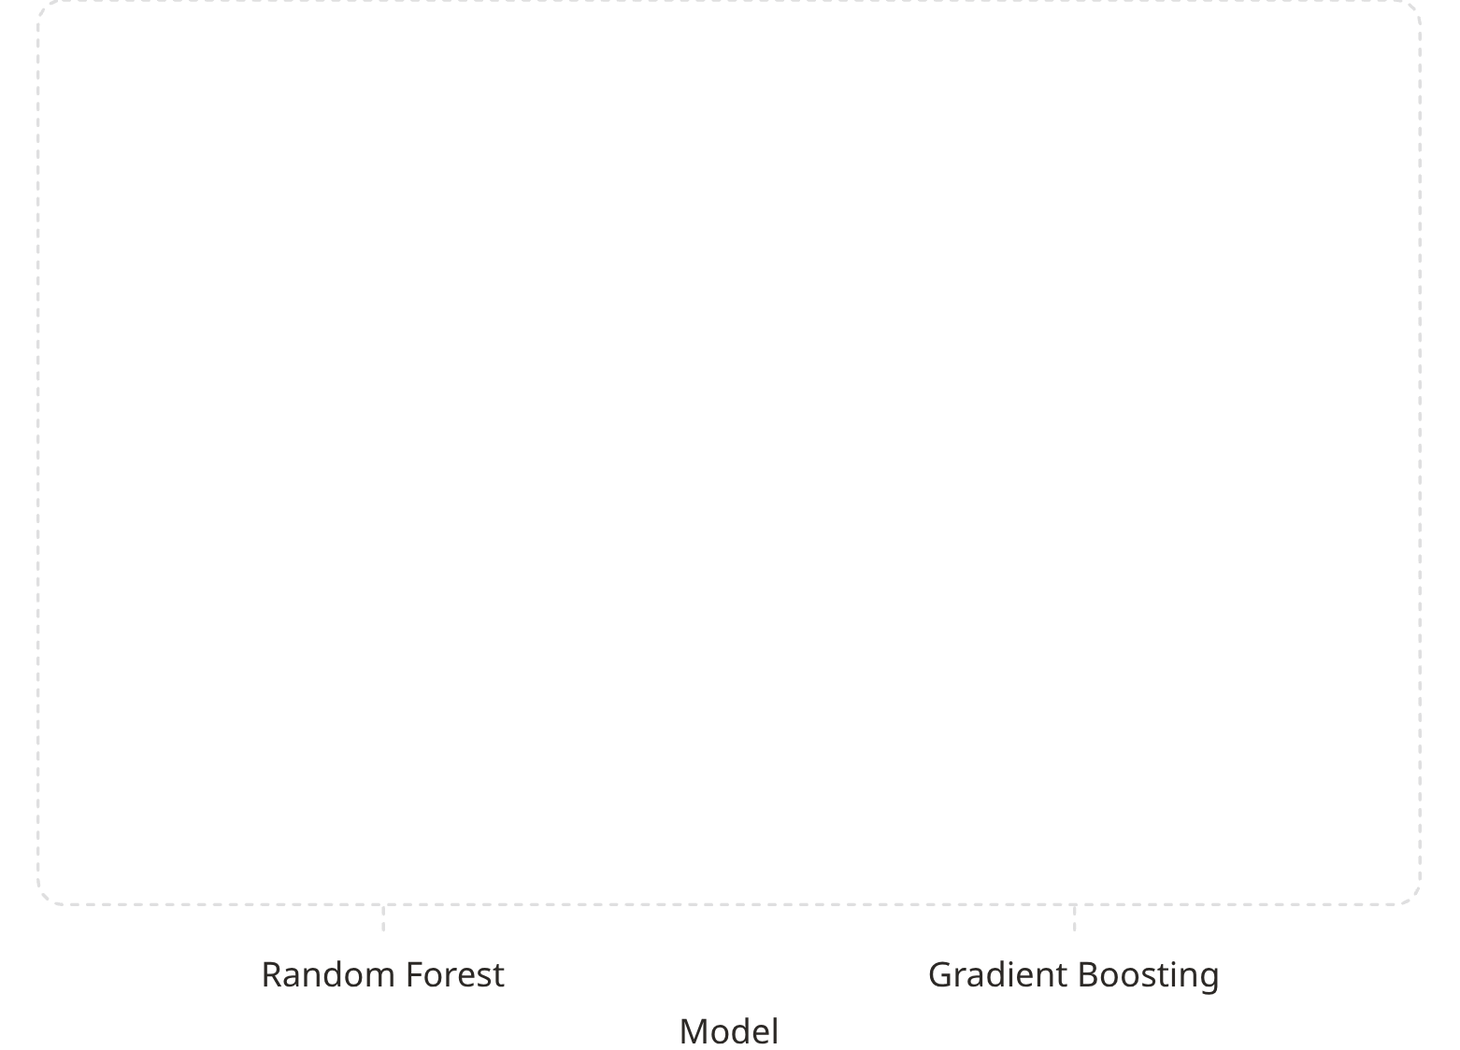

Model Comparison (Instructions)
This card shows a comparison chart for Accuracy. Replace the zero values above with the exact numeric test accuracies obtained from your Colab run. Do not invent numbers — use measured results.
Also prepare a small results table (in your notebook) listing Accuracy, Precision, Recall, F1, and ROC-AUC for both RF and GB. Use the same test split for both models.
Action required: insert the Colab-derived metrics into the chart/data and into the final comparison table before presentation.

Slide 9


Model Selection & New Data Prediction
Selection rule: choose the model with higher test-set Accuracy as the final production model. If accuracies are close, consider F1 and ROC-AUC to prioritize detection of fire (recall) or precision depending on operational cost of false alarms.
Apply both models to identical new environmental observations
Each model returns: predicted class (Fire / Not Fire) and probability of fire
Report both predictions side-by-side for transparency:
RF Prediction: [result] | GB Prediction: [result]
Before deployment, calibrate probabilities if necessary (e.g., Platt scaling) and validate on out-of-sample data or temporal holdout.

Slide 10

Conclusion & Future Scope
This project demonstrates classification of forest-fire risk using Random Forest and Gradient Boosting trained on the Algerian Forest Fires dataset. Models were evaluated with accuracy-focused criteria and deeper metrics (precision, recall, F1, ROC-AUC) to understand operational trade-offs.
Key takeaway
Use identical data and metrics for fair comparison; choose model based on accuracy plus class-specific metrics aligned to operational priorities.
Future work
Integrate real-time weather feeds and temporal validation
Scale training with larger, multi-region datasets
Develop GIS-based visualization and early-warning pipelines
Consider cost-sensitive learning or threshold optimization for deployment

Slide 11
THANK YOU

