Slide 2
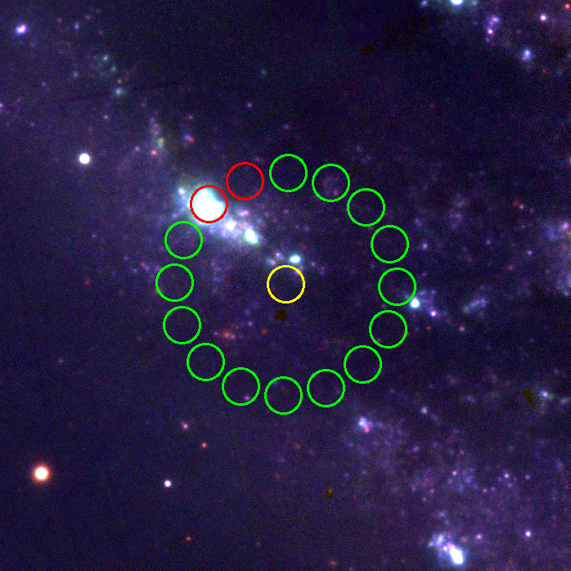
3
4
5
2
6
1
SN 2023ixf
7
16
8
15
9
14
10
13
12
11

Slide 3
