Slide 1
IIS Hosting
"A Beginner’s Guide to Understanding IIS Hosting"
Presentation by:
Bibek Thapa [Roll.No- 4]
Animesh Shakya [Roll No- 1]
Bishowdeep Shrestha [Roll No- 7]

Slide 2
What is IIS?
IIS (Internet Information Services) is a tool by Microsoft that helps you host and manage websites or web applications.
Think of it as the "bridge" between your website and the internet.
Notes:
It is used to host websites, web applications, and other web services on Windows-based servers. Think of it as the "bridge" between your website and the internet

Slide 3
If you host your website using IIS, its availability depends on how you configure the hosting environment:
Default Behavior:
When you first set up IIS and host a website, it is usually configured to run locally, meaning only your device (where IIS is installed) can access it.
URL Example: http://localhost or http://127.0.0.1
Notes:
No one else on the internet can access it because it’s not connected to the internet.

Slide 4
Now To Host Globally using IIS
you need to configure a few things:
1) Public IP Address: Make sure your computer has a public IP address so others can find it.
2) Open Ports: Adjust your router and firewall to allow external access to your website. This usually involves opening ports like 80 for HTTP or 443 for HTTPS.
3} Domain Name: To make it easier for people, you can connect your website to a domain name, like www.mywebsite.com.

Slide 5
Can You Use Any Domain Name?
No, you cannot just write any domain name in IIS and expect it to work.
Why?
Domain names are unique and managed by the DNS system.
If you use a name that’s already registered, the DNS will point to the server of the registered owner, not your IIS-hosted website.
Purchase a Domain: From registrars like GoDaddy or Namecheap.

Slide 6
Why Use External Hosting Instead of IIS?
IIS on your computer has limitations:
Your computer must stay on 24/7.
It may not handle a lot of visitors.
External hosting providers offer better speed, reliability, and security.
While IIS is great for testing websites or small personal projects, external hosting providers are necessary for websites that need to handle large traffic,

Slide 7
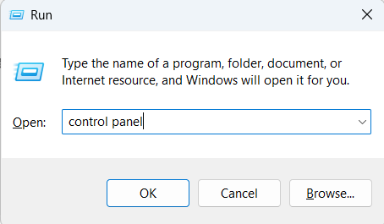
How to setup IIS
On Windows 10 / Windows Server:
Open Control Panel:
Press Windows + R, type control panel, and hit Enter.

Slide 8
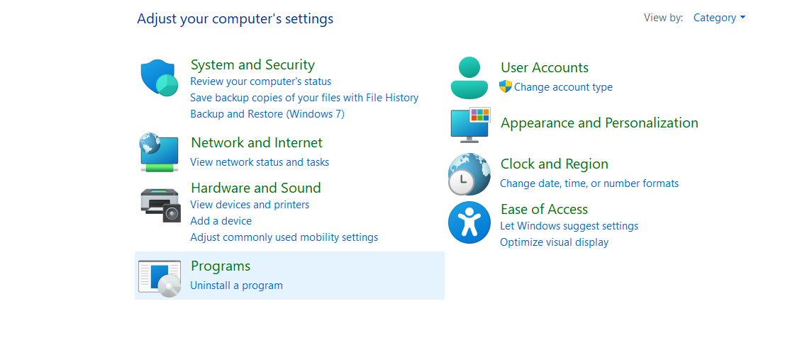
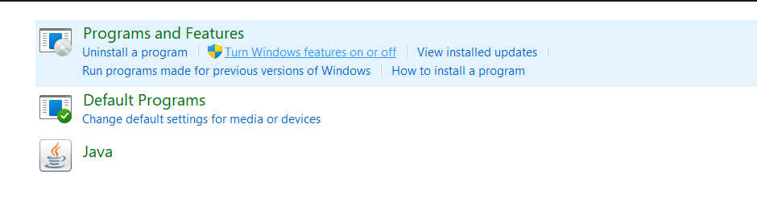



Go to Programs and Features:
Click Turn Windows features on or off on the left sidebar.

Slide 9
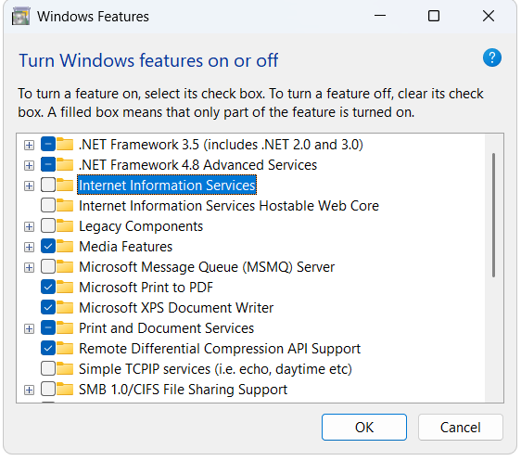


Enable IIS:
In the Windows Features dialog, scroll down and check the box next to Internet Information Services.

Slide 10
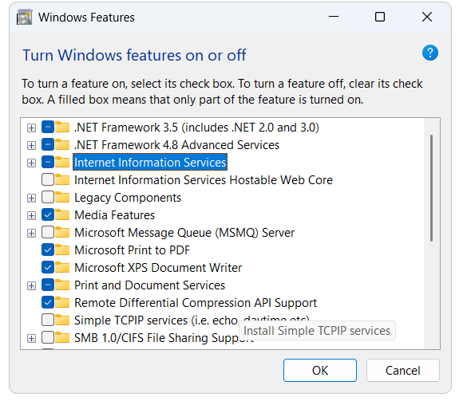


Click OK to install IIS and wait for the installation to complete.

Slide 11
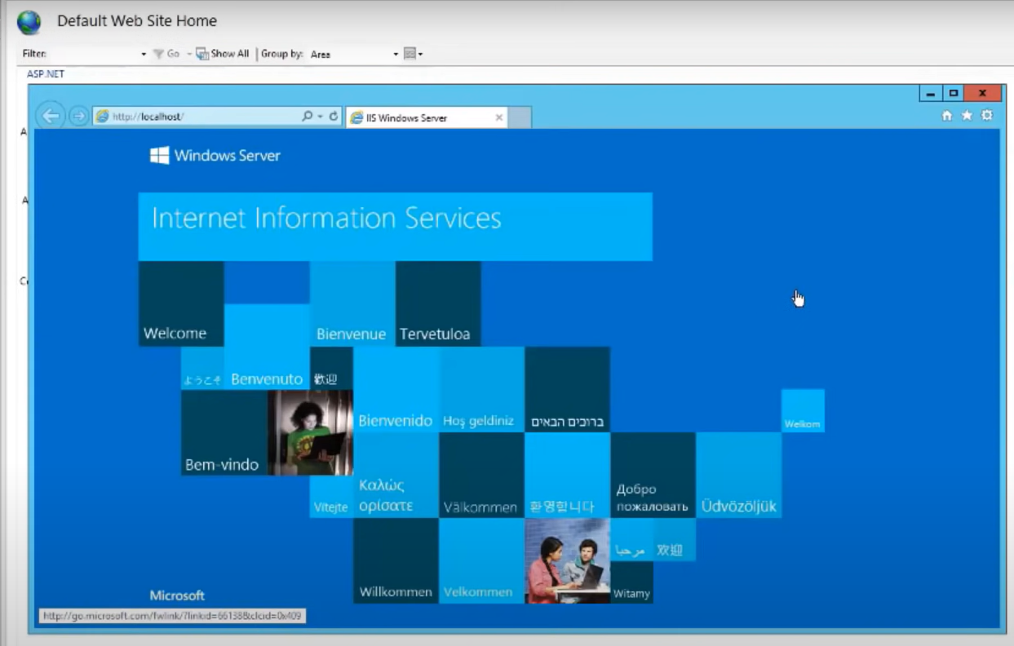
After installation, you can verify IIS is working by opening a browser and navigating to http://localhost. You should see the default IIS landing page.

Slide 12
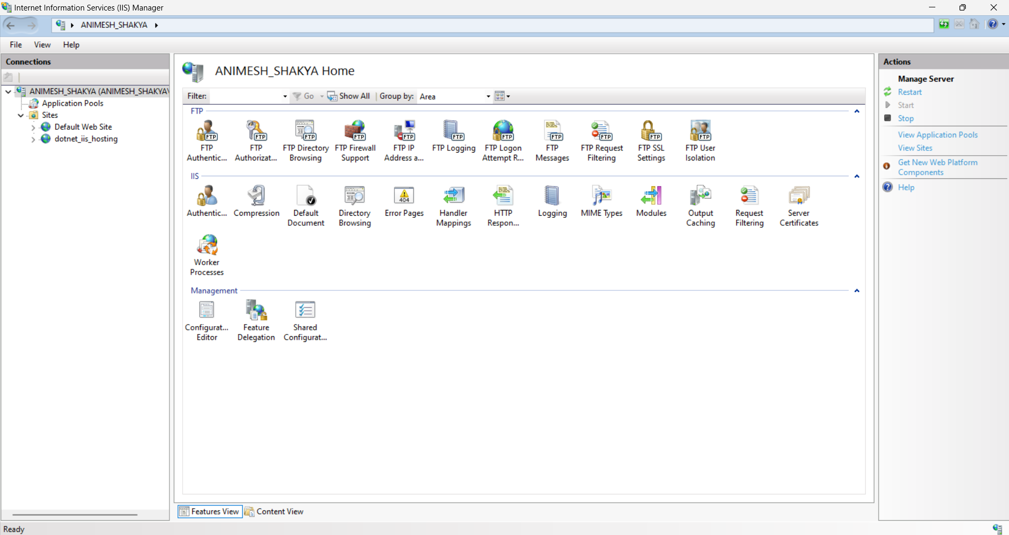
IIS Management console:

Slide 13
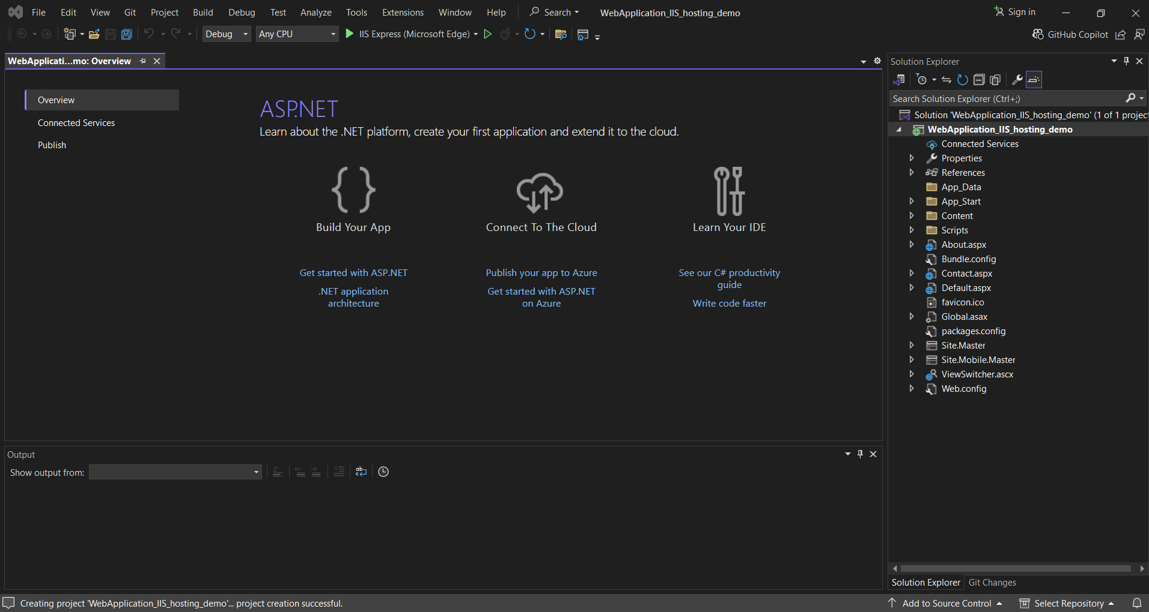
How to Host a website in IIS
First we need a running web application.

Slide 14
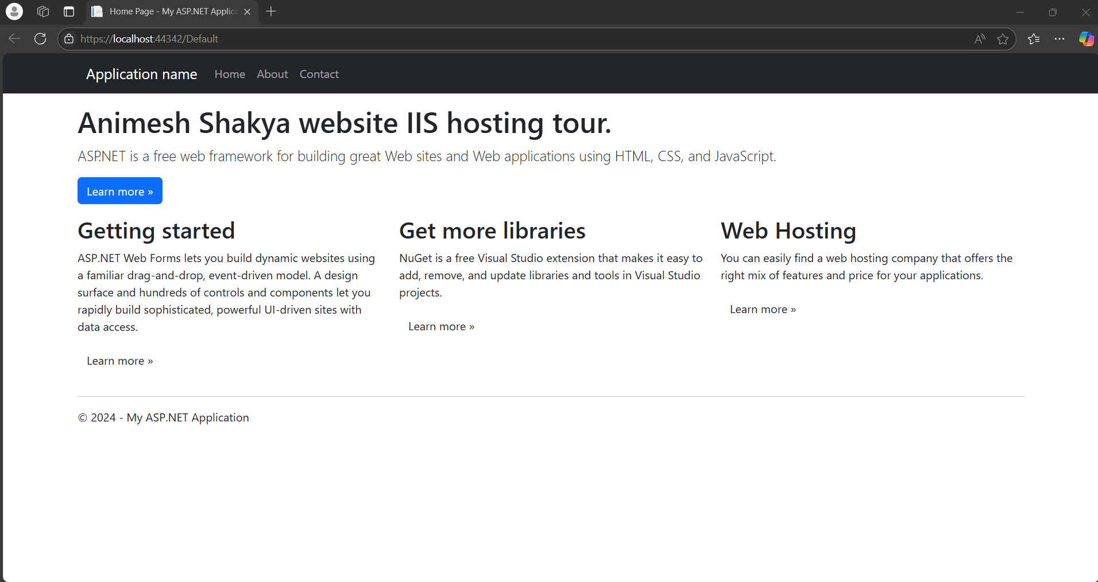
Running website

Slide 15
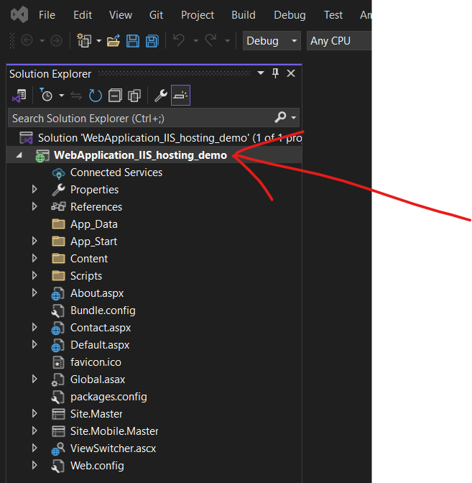
left click on root folder

Slide 16
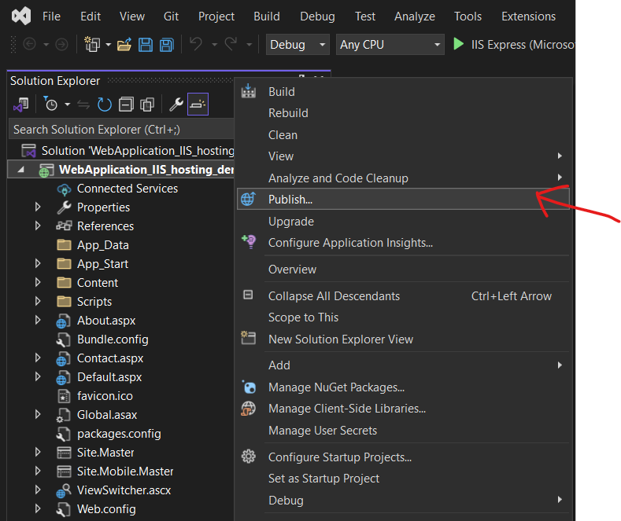
Now press publish

Slide 17
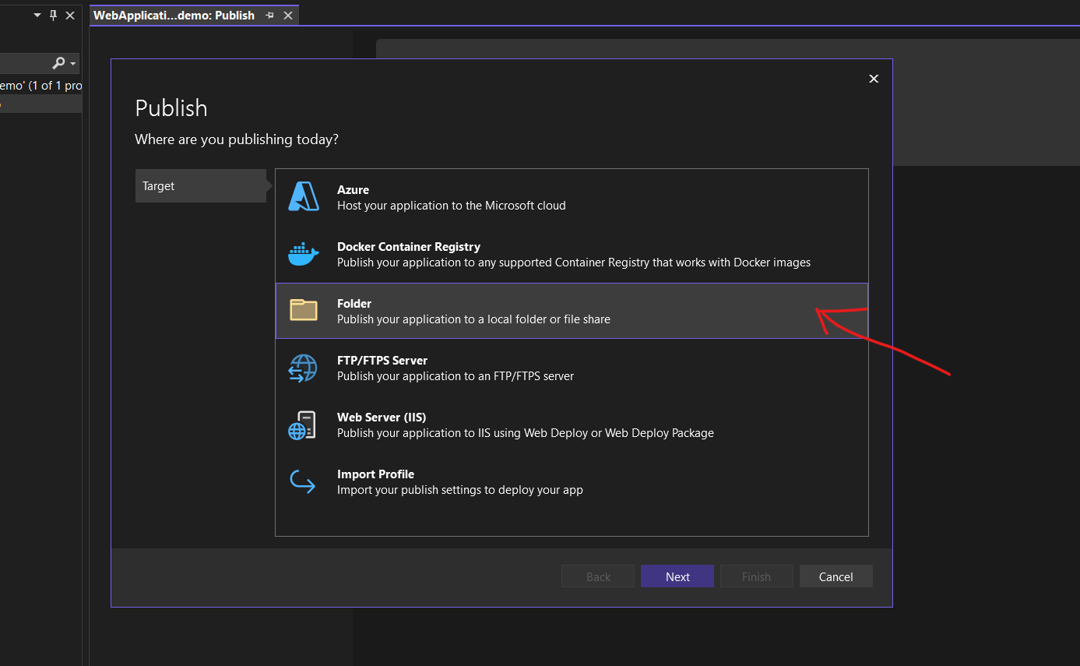
now select the folder option and then next

Slide 18
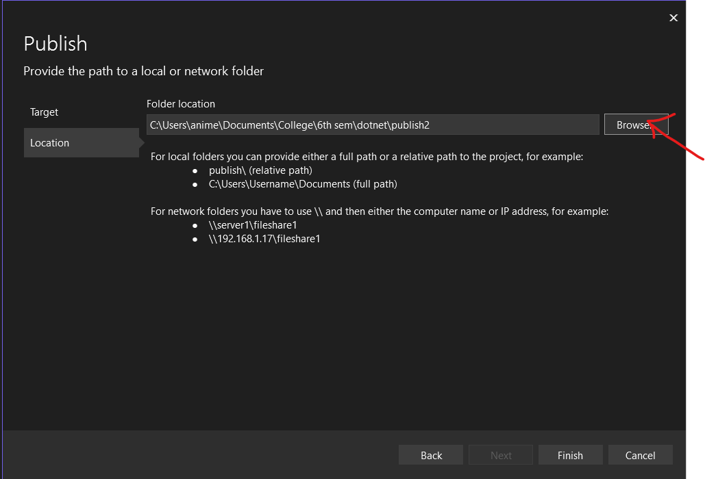
select the location and then press finish

Slide 19
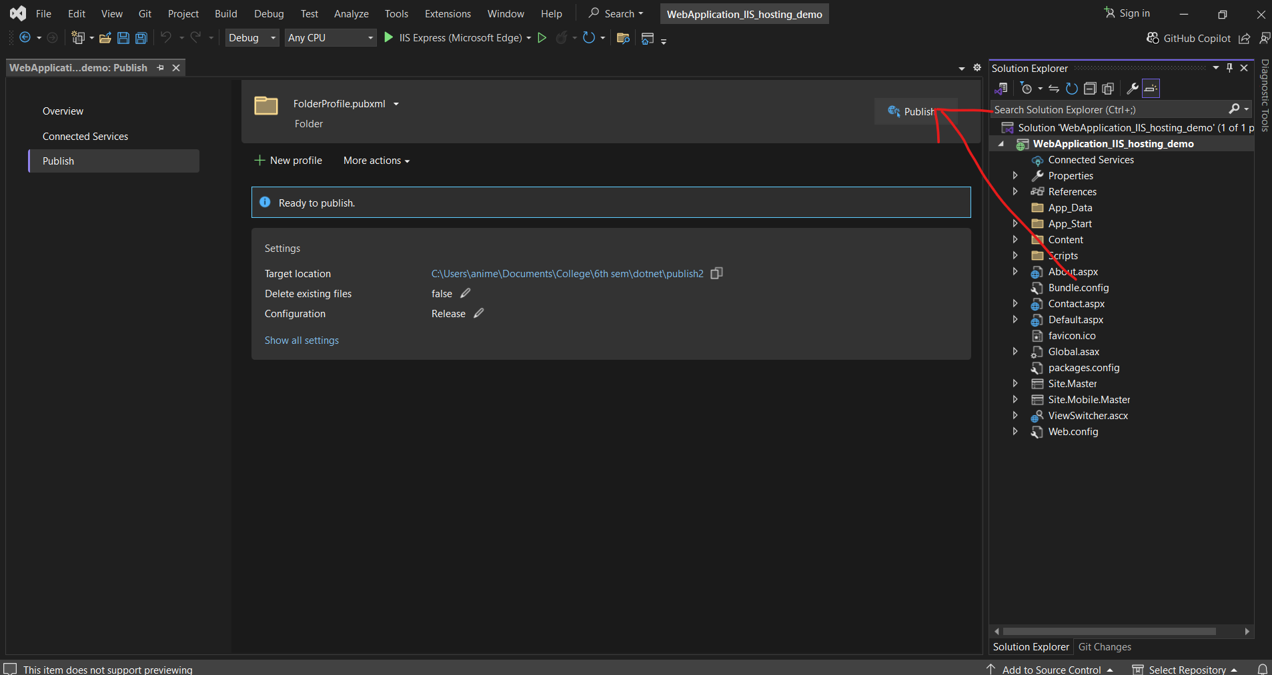
now press the publish button.

Slide 20
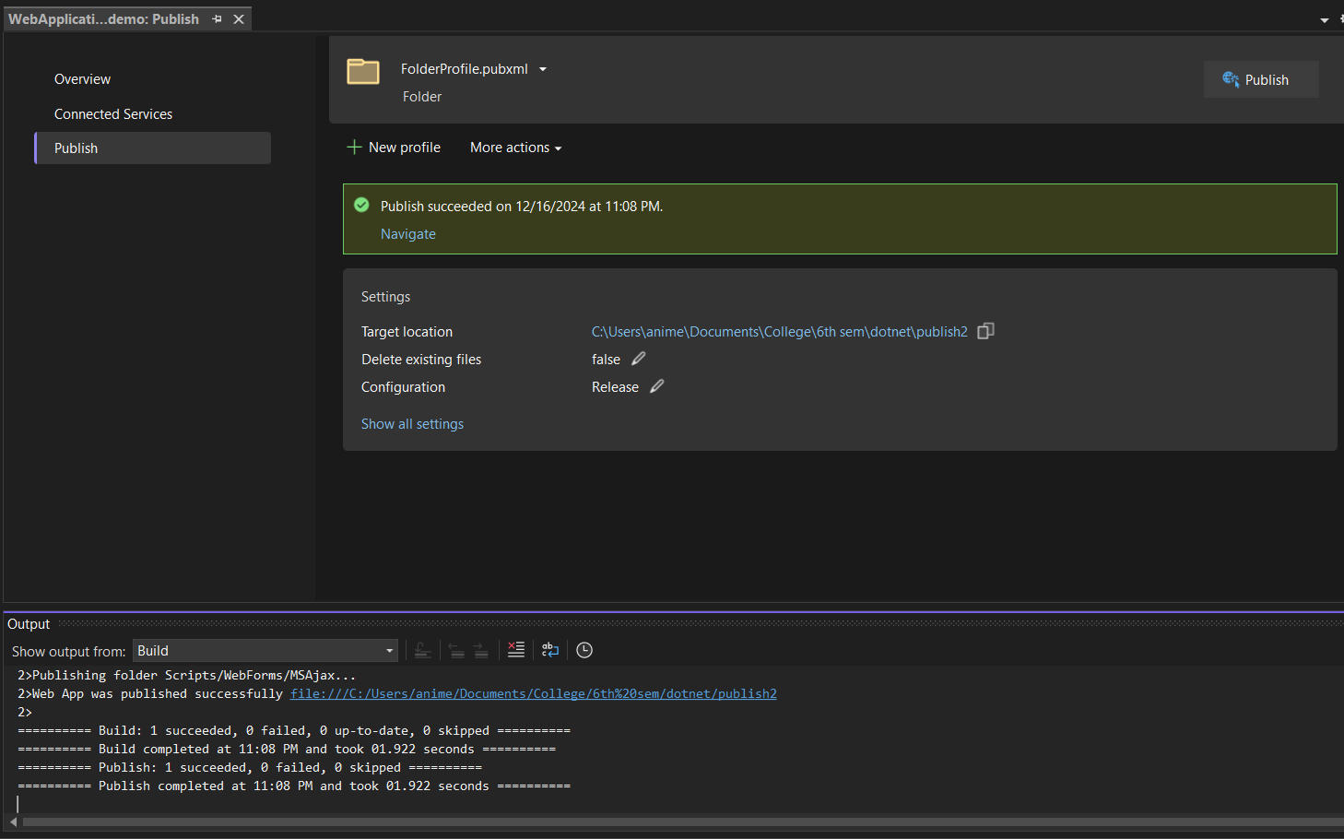
Publish succeeded message appears if there is no error in the code.

Slide 21
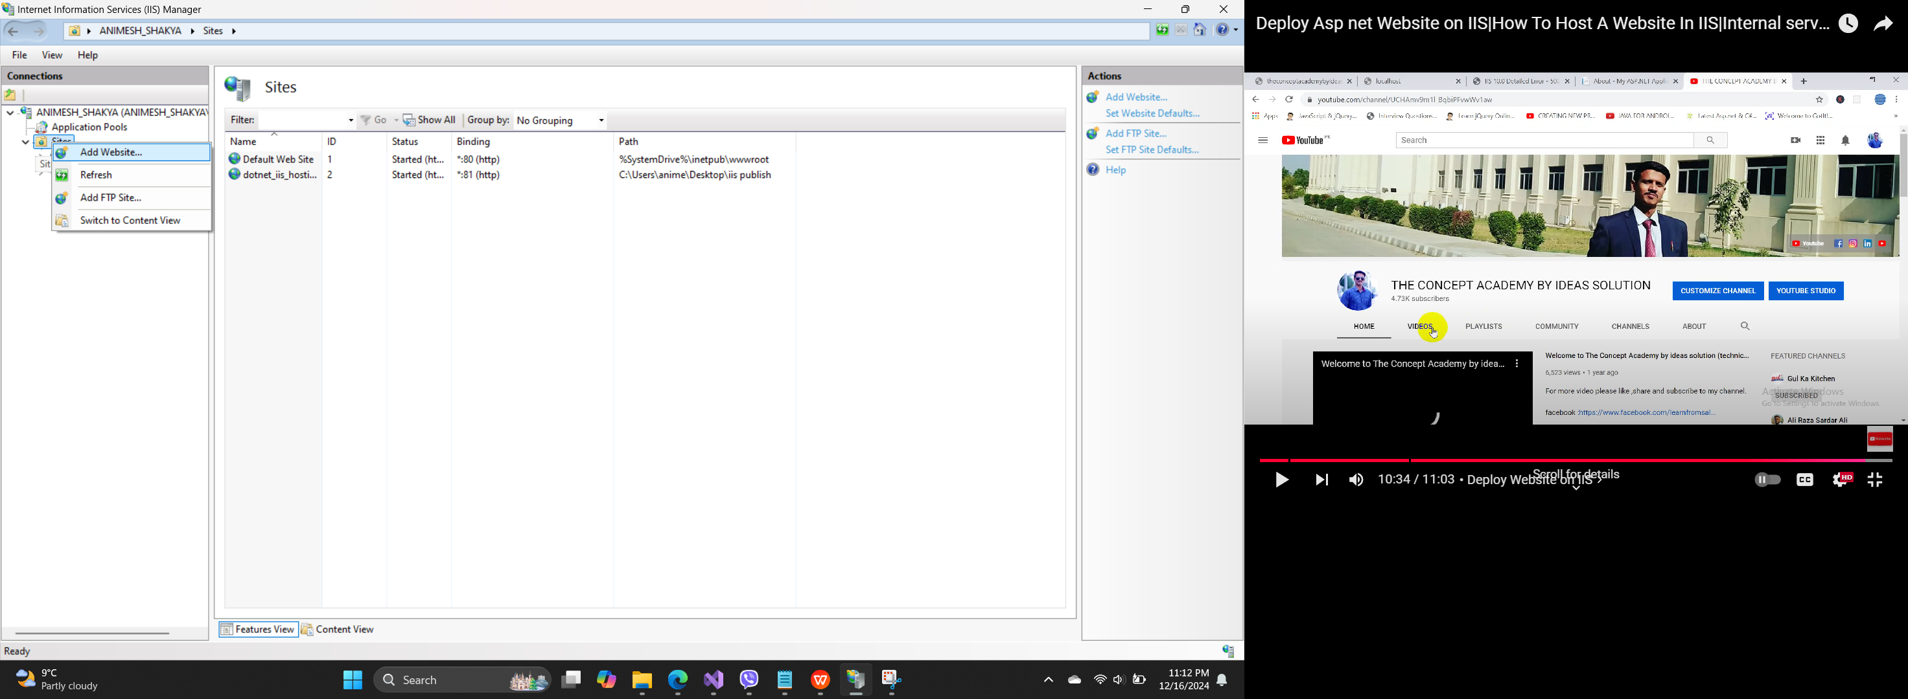
now in IIS manager right click on sites and press add websites

Slide 22
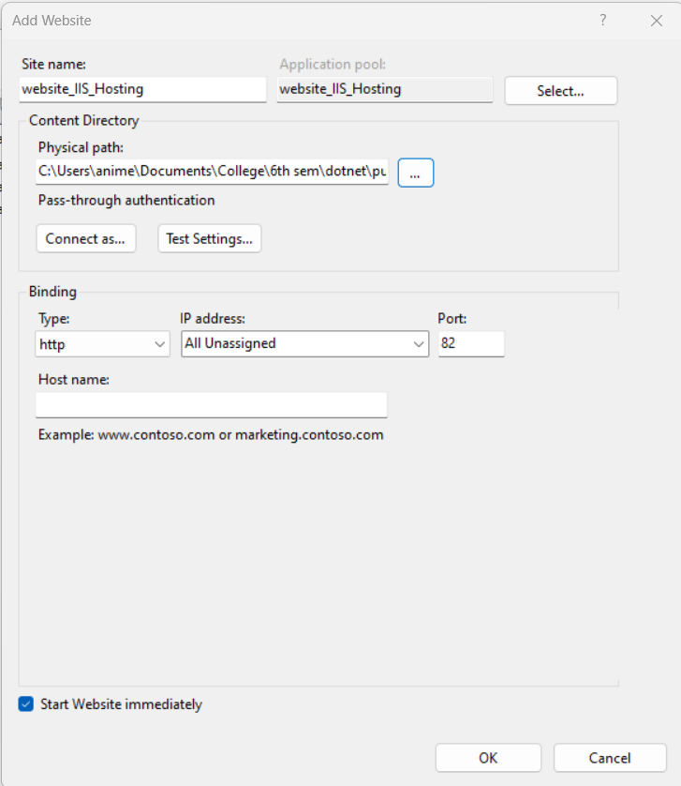
in the add website window enter sitename and select the physical path.

Slide 23
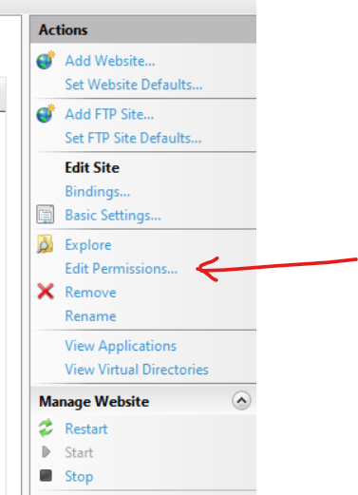
now at the right ribbon of iis manager select edit permissions.

Slide 24
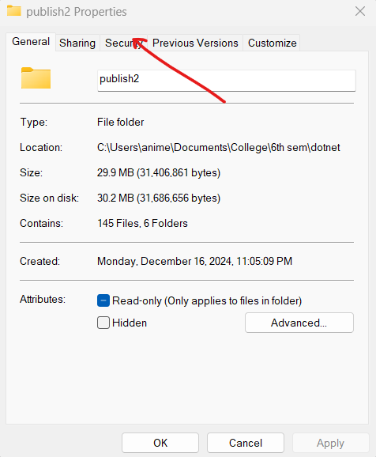
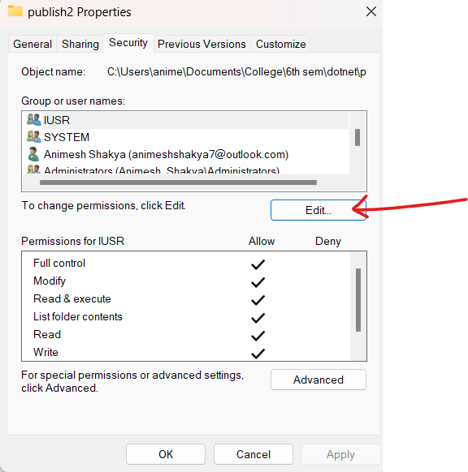
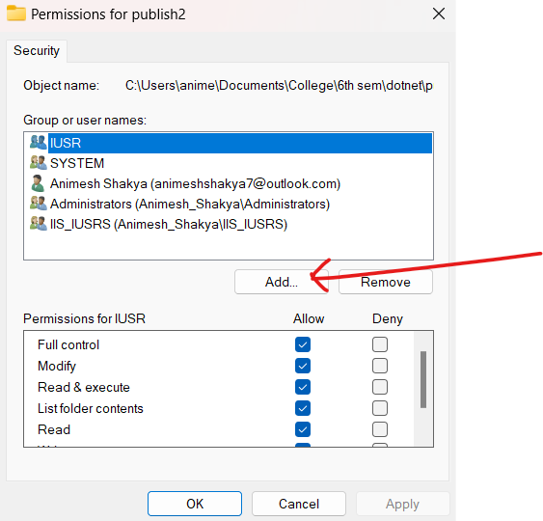
now follow these steps

Slide 25
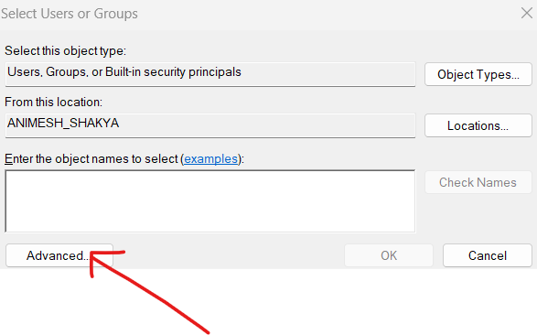
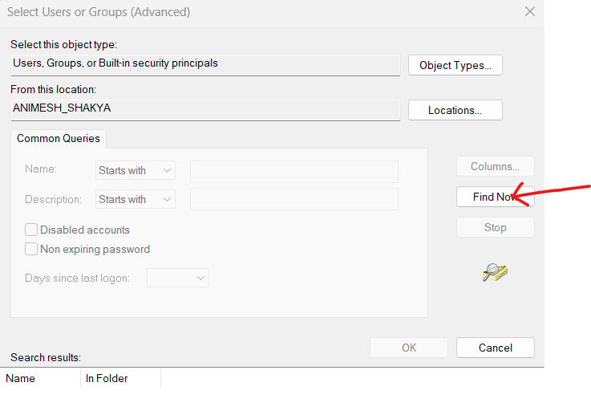
follow these steps

Slide 26
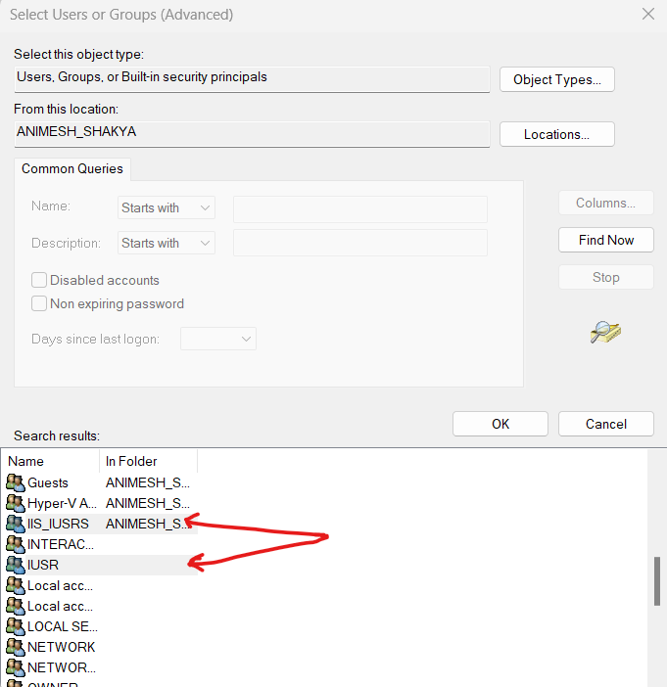
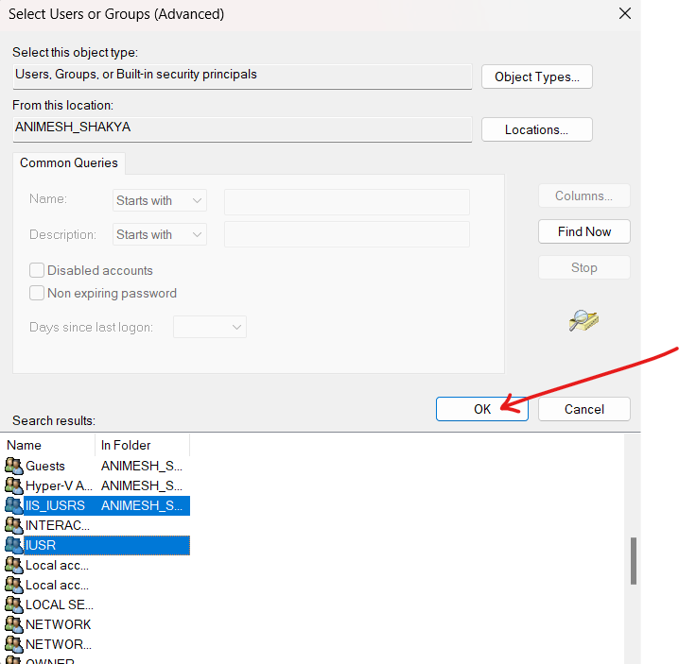
select IIS_USER and IUSER and click ok button

Slide 27
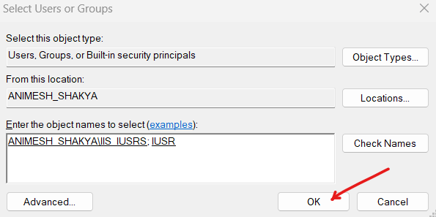
object name appears

Slide 28
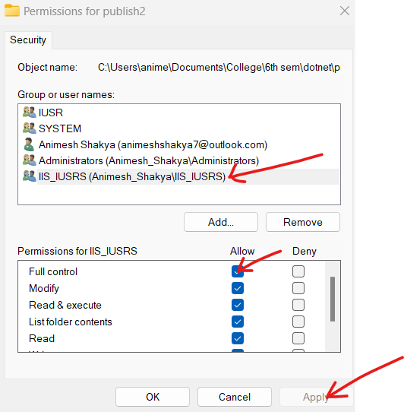
now give full control permission to IUSER and IIS_user and press apply

Slide 29
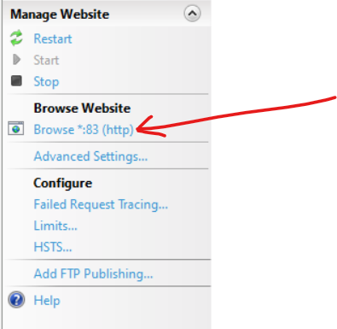
finally browse the website

Slide 30
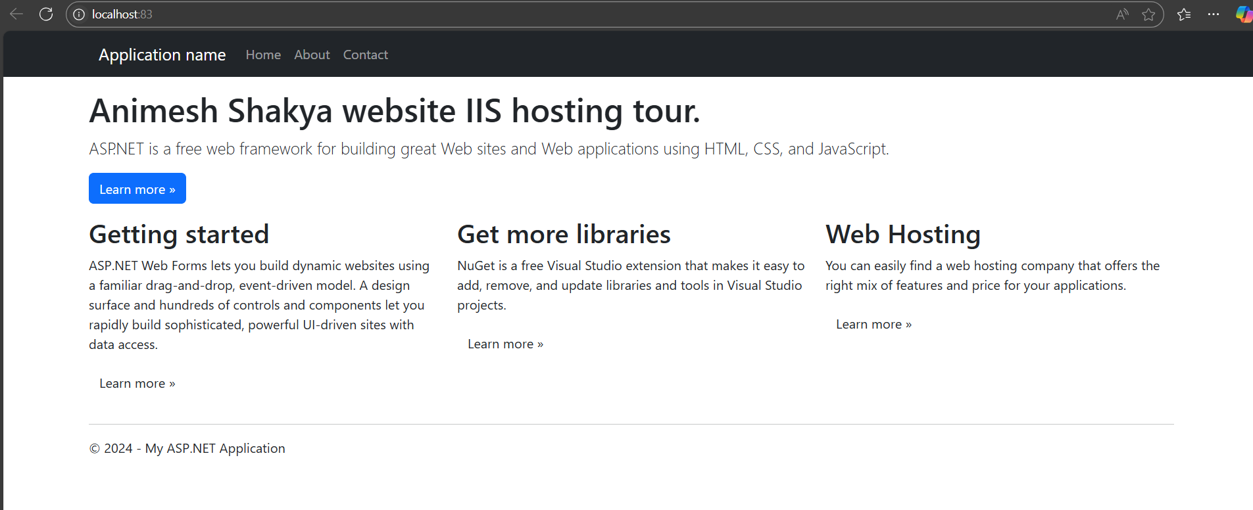
Here we have the IIS hosted website

Slide 31
Thanks for listening
Feel free to ask if any question.

