Slide 1
ABC
Groceries
Marketing strategy for “Delivery Club”

Slide 2
Objective
To evaluate the effectiveness of two different promotional mailers on customer sign-up rates for the "Delivery Club".
To determine if there is a significant difference in sign-up rates between the cheaper basic mailer and the more expensive colorful mailer.

Slide 3
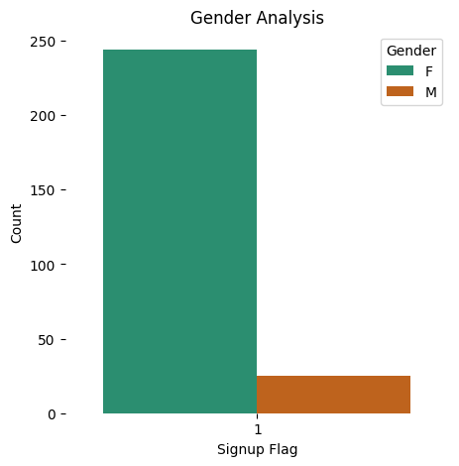
Gender Analysis
The female category exhibits a significantly higher sign-up count than male category.

Slide 4
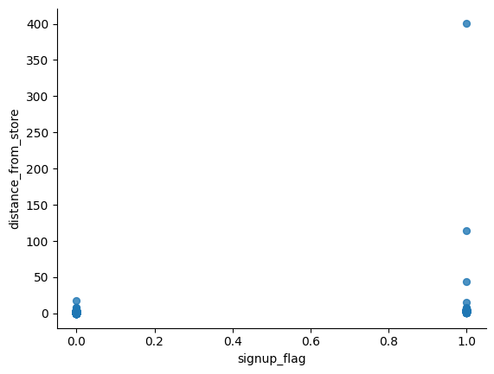
Distance Analysis
Customers both near and far from the store sign up at similar rates.
The presence of sign-ups from significant distances indicates that factors other than distance also influence the decision to sign up, as shown by outliers on the plot.

Slide 5
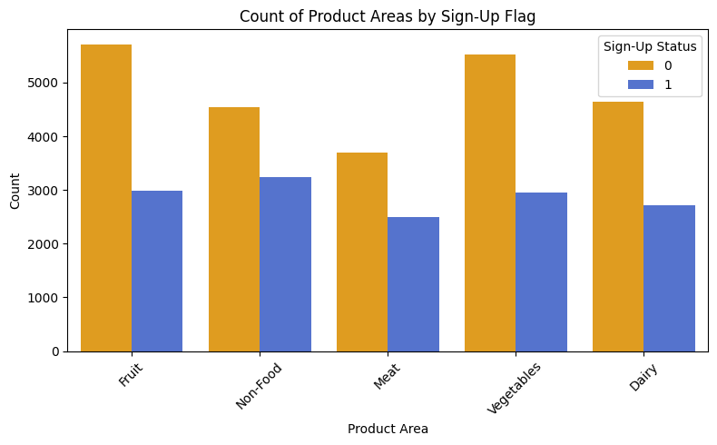
Product Area Insights
Across all product areas, there are consistently more customers who did not sign up compared to those who did.
This is most apparent in the Vegetables and Fruit categories, suggesting these areas might have a larger base of non-sign-up customers.
The Meat category has the lowest counts overall but still follows the same pattern of non-sign-ups outnumbering sign-ups.

Slide 6

Data Filtering
Campaign Analysis
Removed control group.
Sign-Up Rates
Mailer 1: 32.8%
Mailer 2: 37.8%
The findings show that Mailer 2, which is pricier and more visually appealing, leads to higher signup rates than the cheaper, basic Mailer 1. To confirm these results are statistically significant, a chi-squared test for proportions is needed.

Slide 7
Statistical Analysis
Chi-Square Test
Chi-square statistic = 1.9414468614812481
p-value = 0.16351152223398197
Degrees of freedom = 1

Slide 8
Conclusion and
Recommendation
There is no significant difference in sign-up rates between Mailer 1 and Mailer 2.
Given that the signup rates are not significantly different, evaluate the costs associated with each mailer.
If Mailer 2 is substantially more expensive, it might not be worth the additional cost given the lack of significant difference in signup rates.

Slide 9

Thank You
Pampati Sreya

