Slide 1
Amazon
Sales Analysis Project
By Beeravelli Sreya

Slide 2

PROJECT DESCRIPTION
Amazon a company currently performing well. The stakeholders wish to maintain this level of performance and seek improvement. For this purpose, they want to devise new strategies. You are part of a team exploring new ways to benefit customers, such as offering more discounts and Prime membership perks. Could you suggest additional methods to identify and reward customers and enhance their shopping experience.

Slide 3
DATA DESCRIPTION
OrderDate: The date when the order was placed.
OrderID: A unique identifier for each order.
Delivery Date: The date when the order is scheduled to be delivered.
CustomerID: A unique identifier for each customer.
Customer Age: The age of the customer.
Customer Gender: The gender of the customer (M for male, F for female).
Location: The geographical area where the customer is located.
Zone: Specific zone within the location for delivery purposes.
Delivery Type: The method by which the order is delivered (e.g., Express, Standard).
Product Category: The broad category to which the product belongs.
SubCategory: A more specific classification within the product category.
Product: The name or description of the product ordered.
Unit Price: The price per unit of the product.
Shipping Fee: The fee charged for shipping the product.
Order Quantity: The quantity of the product ordered.
Sale Price: The total sale price of the order.
Status: Current status of the order (e.g., Delivered, Returned).
Reason: The reason for the return or an empty field if delivered.
Rating: Customer rating for the order on a scale (e.g., 1 to 5).

Slide 4
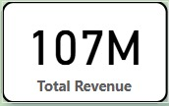
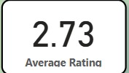
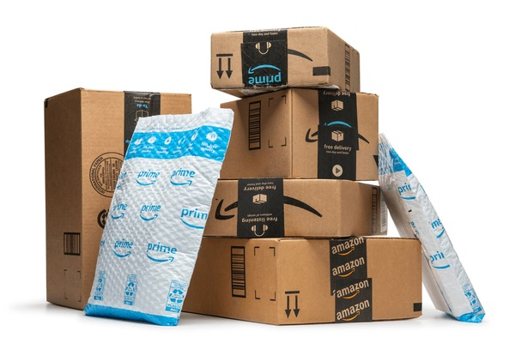
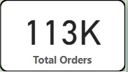
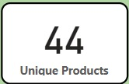
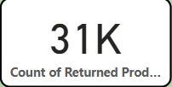

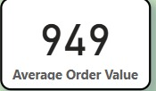
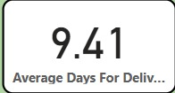
KEY METRICS

Slide 5
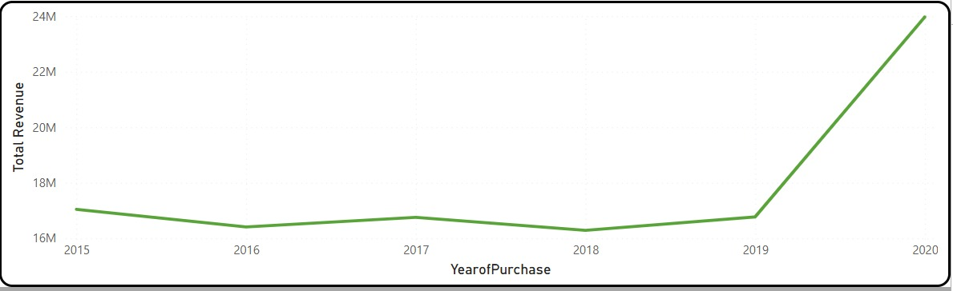
TOTAL REVENUE BY YEAR
2015–2019: Revenue fluctuated around 16–17M.
2020: Sharp increase to 24M, possibly due to expanded online orders, promotions, or pandemic-driven demand.

Slide 6
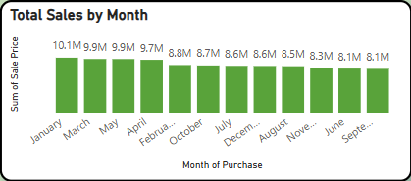
TOTAL SALES BY MONTH
January recorded the highest sales with ₹10.1 million+, likely driven by New Year promotions and holiday shopping.
March and May closely follow January, with each month crossing ₹9.8 million, reflecting strong early-year buying trends.
The months from July to December show steady performance, each maintaining over ₹8.5 million in sales.

Slide 7
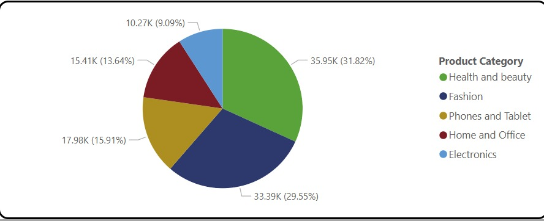
ORDERS COUNT BY PRODUCT CATEGORY
Health and Beauty leads all categories with 35,953 orders, showing strong customer interest in wellness products.
Fashion follows closely with 33,388 orders, highlighting consistent consumer preference for clothing and accessories.
Phones and Tablets rank third with 17,978 orders, reflecting the ongoing demand for personal tech devices.
Home and Office and Electronics together account for over 25,000 orders, indicating stable performance in lifestyle and gadget segments.

Slide 8
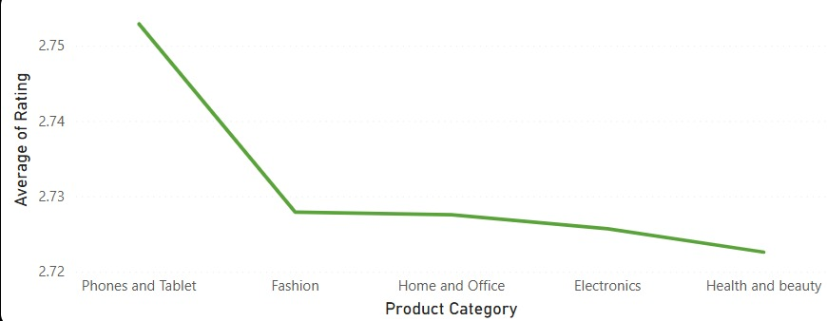
AVERAGE RATING BY PRODUCT CATEGORY
Phones and Tablets received the highest average rating of 2.75, slightly above all other categories.
Fashion, Electronics, and Home & Office all share a consistent average rating of 2.73, showing steady customer satisfaction.
Health and Beauty had the lowest average rating at 2.72, indicating room for improvement.

Slide 9
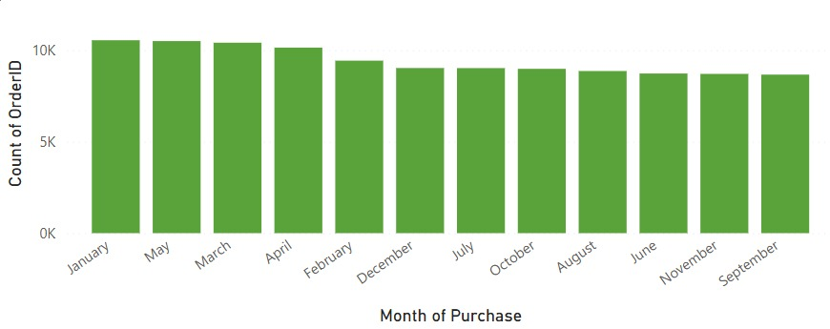
COUNT OF ORDERS BY MONTH
January leads with the highest number of orders (10,543), followed closely by May and March — indicating peak shopping periods.
Lowest order volumes were recorded in September (8,665) and November (8,725), suggesting possible seasonal slowdowns.
Order counts remain fairly stable throughout the year, with only a ~2,000 order difference between the highest and lowest months.

Slide 10
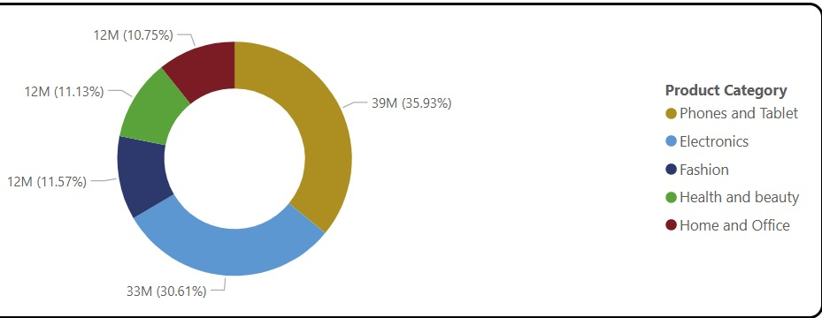
TOTAL SALES BY PRODUCT CATEGORY
Phones and Tablets generated the highest revenue with over ₹38.5 million, followed by Electronics at ₹32.8 million.
Fashion, Health & Beauty, and Home & Office had similar revenue levels, each around ₹11–12 million.
The data shows that tech categories dominate sales, accounting for more than 60% of total revenue.

Slide 11
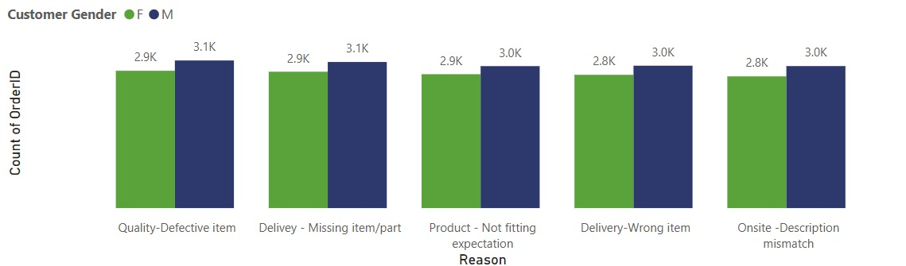
COUNT OF RETURNS FOR EACH REASON
Quality - Defective item had the highest number of cases across both FM and another channel, with 2923 and 3142 complaints respectively.
Missing parts and wrong items delivered together account for over 11,800 cases, highlighting a major concern in logistics.
Product not meeting expectations and description mismatch also show high volumes, suggesting a need for better product information and images.

Slide 12
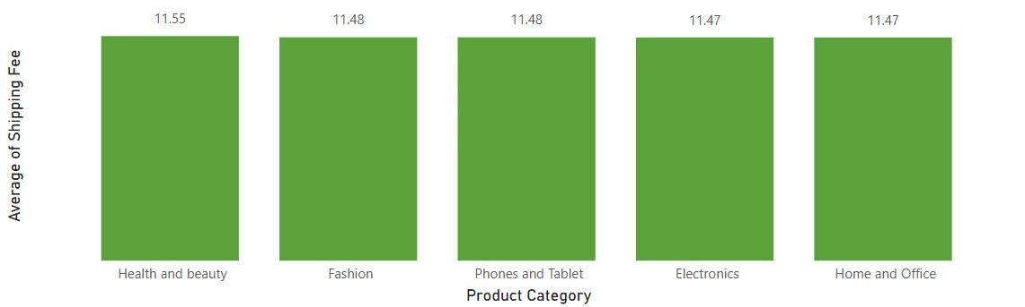
AVERAGE OF SHIPPING FEE BY PRODUCT CATEGORY
Health and Beauty products have the highest average shipping fee at 11.55, slightly above other categories.
Fashion and Phones/Tablets share the same average fee of 11.48, indicating consistent pricing across popular categories.
Electronics and Home & Office have the lowest average shipping fee at 11.47, showing minimal variation across categories.

Slide 13
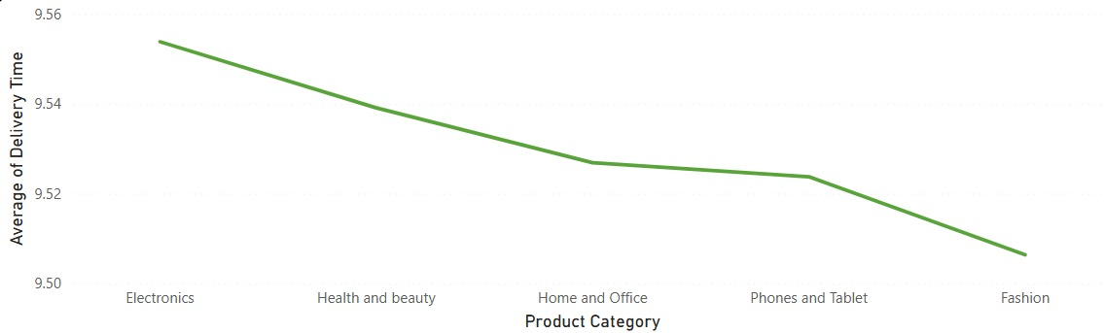
AVERAGE OF DELIVERY TIME BY PRODUCT CATEGORY
Electronics have the longest average delivery time at 9.55 days, though only slightly above other categories.
Fashion is delivered the fastest, averaging 9.51 days, suggesting better logistics or lighter packaging.
The overall delivery time is consistent across categories, with a very narrow range of just 0.04 days, indicating efficient delivery operations.

Slide 14
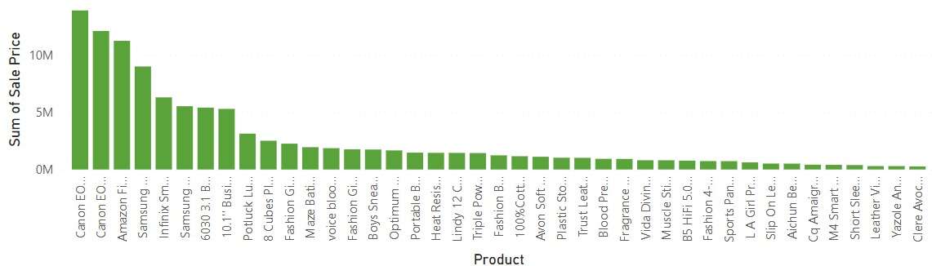
SALES BY PRODUCT
Canon EOS 600D Camera is the product that generated highest revenue.
Bundle low-selling items with high-selling ones (e.g., discounts on accessories).
Run targeted promotions or discounts during seasonal periods.

Slide 15
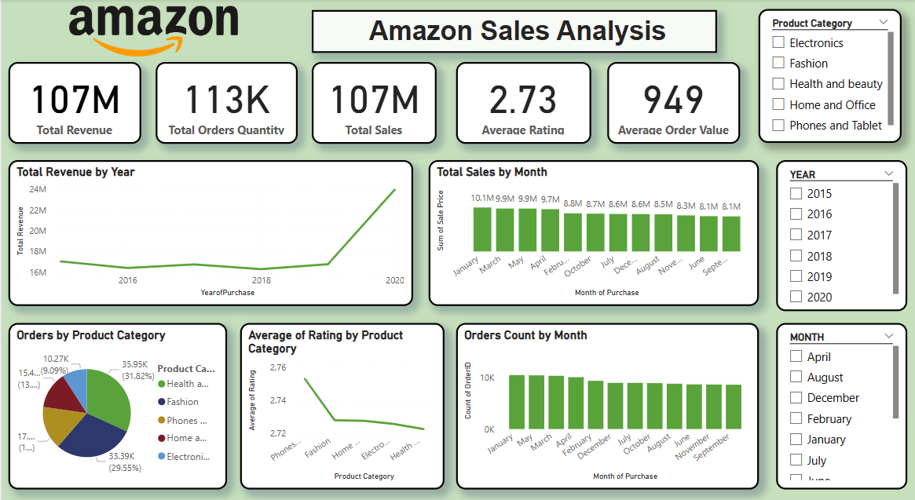

Slide 16
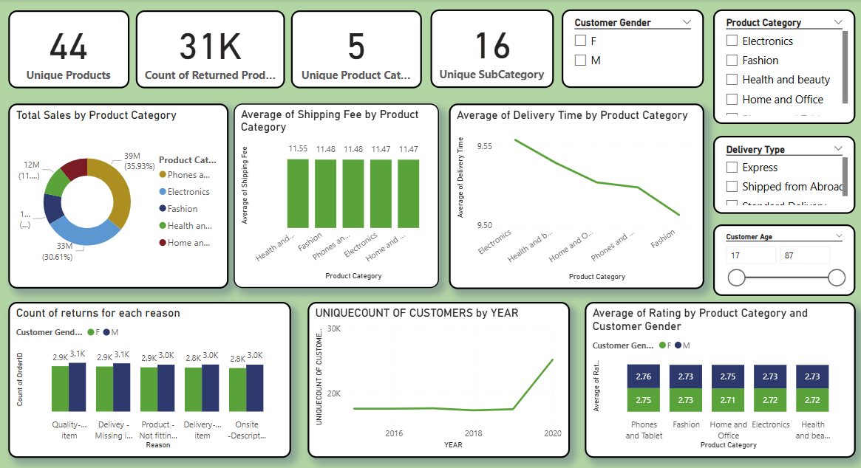
PRODUCT

Slide 17
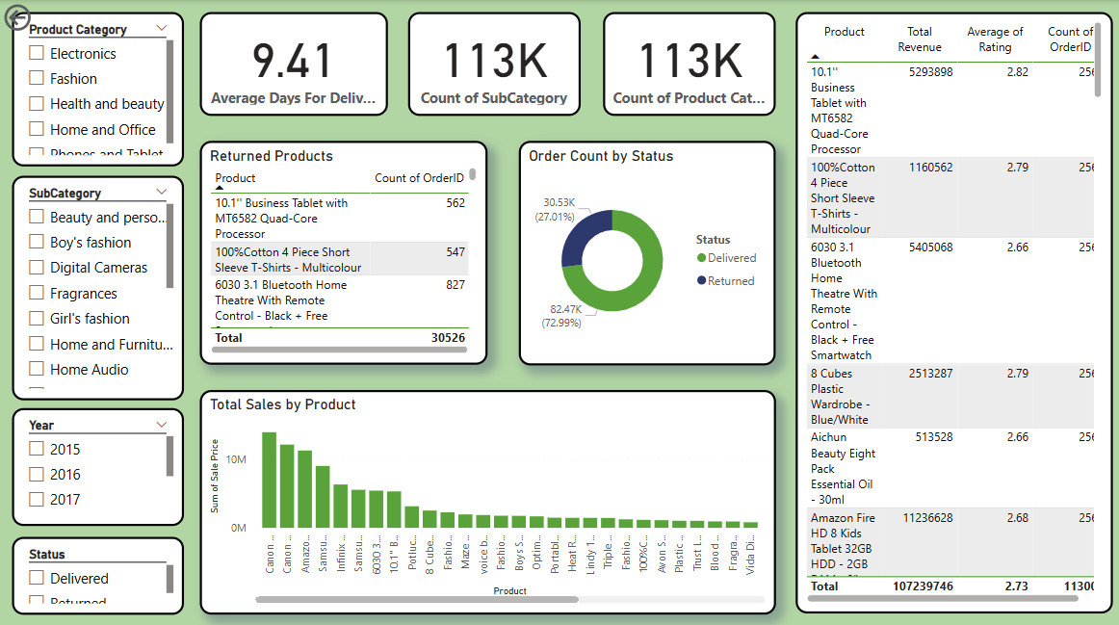
INDIVIDUAL PRODUCT

Slide 18
RECOMMENDATIONS
Apply targeted discounts and bundle offers on high-priced, low-selling products to increase purchase intent.
Enhance product descriptions, images, and specifications to reduce customer confusion and return rates.
Encourage use of express delivery for premium orders and ensure clear communication for overseas shipping.
Introduce loyalty tiers (Platinum, Gold, Silver, Basic) with escalating benefits to retain and reward customers.
Allocate more resources to high-performing regions like Greater Accra and Ashanti for maximum ROI.
Address return reasons such as defects, wrong items, and missing parts through better QC and packaging.
Track trends in sales, returns, and ratings to iteratively improve product, logistics, and marketing performance.

Slide 19
CONCLUSION
Revenue shows year-on-year growth, with a major spike in 2020, likely due to increased online adoption.
Products like Canon EOS 600D, Fashion, and Electronics dominate revenue, but high-ticket underperformers need targeted promotions.
Delivery experience directly impacts ratings, especially for products shipped from abroad—transparency and speed are key levers here.
Customer segmentation and regional trends present actionable strategies to enhance marketing, logistics, and inventory management.
Returns data is a goldmine: address packaging, listing accuracy, and fulfillment processes to reduce return volume.

Slide 20
Thanks!

