Slide 1
CHINOOK PROJECT
By Beeravelli Sreya

Slide 2

PROJECT DESCRIPTION
To analyze music record sales data to gain insights and make recommendations for the company's strategy in the physical music market.

Slide 3


Chinook Music Store
Chinook is a digital music platform where customers can effortlessly explore and buy tracks and albums.
Its extensive music collection covers a broad range of genres, making it easy for users to find both popular hits and hidden gems.

Slide 4
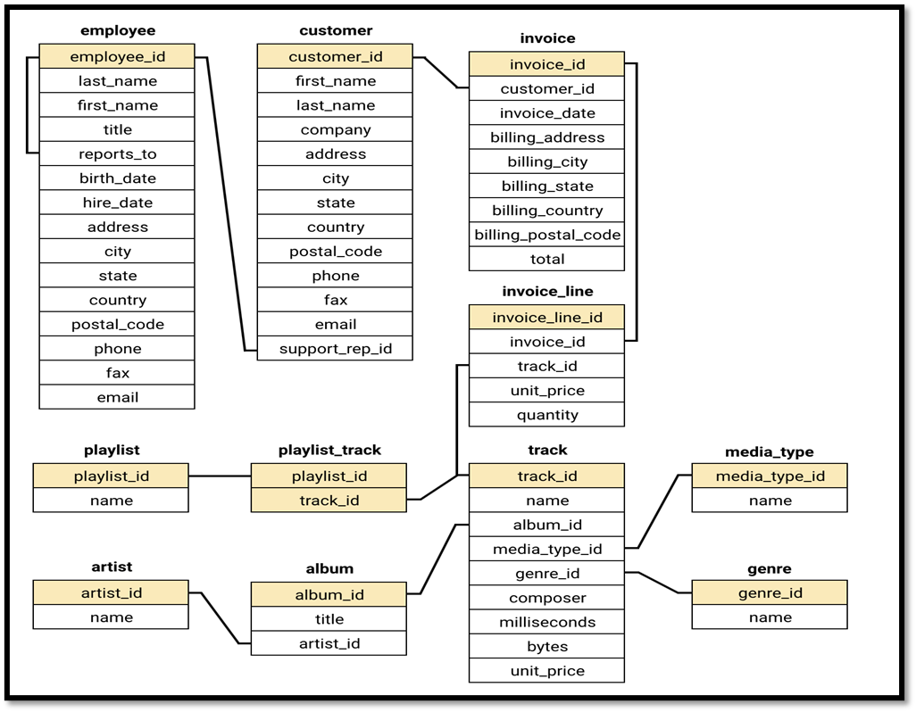
Database Schema

Slide 5
Data description
Customer :
Customer id: Unique identifier assigned to each customer.
First name: The given name or first name of a customer.
Last name: The surname or family name of a customer.
company: The name of the company associated with a customer.
address: The street address of a customer's location.
city: The city where a customer is located.
state: The state or province where a customer is located.
country: The country where a customer is located.
Postal code: The postal or zip code of a customer's address.
phone: The phone number of a customer.
fax: The fax number associated with a customer.
email: The email address of a customer.
Support rep id: The employee ID of the support representative assigned to a customer.

Slide 6
Invoice :
Invoice id: Unique identifier assigned to each invoice.
Customer id: The customer ID associated with the invoice.
Invoice date: The date when the invoice was generated or issued.
Billing address: The street address used for billing purposes.
Billing city: The city used for billing purposes.
Billing state: The state or province used for billing purposes.
Billing country: The country used for billing purposes.
Billing postal code: The postal or zip code used for billing purposes.
total: The total amount due on the invoice.

Slide 7
Invoice line:
Invoice line id: Unique identifier assigned to each line item on an invoice.
Invoice id: The invoice ID to which the line item belongs.
Track id: The ID of the track or product included in the line item.
Unit price: The price per unit for the line item.
quantity: The quantity of units for the line item.
Playlist :
Playlist id: Unique identifier assigned to each playlist.
name: The name or title of the playlist.
Playlist track:
Playlist id: The ID of the playlist to which the track belongs.
Track id: The ID of the track included in the playlist.

Slide 8
Track :
Track id: Unique identifier assigned to each track or song.
name: The title or name of the track.
Album id: The ID of the album to which the track belongs.
Media type id: The ID of the media type associated with the track.
Genre id: The ID of the genre associated with the track.
composer: The name of the composer or artist who composed the track.
milliseconds: The duration of the track in milliseconds.
bytes: The file size of the track in bytes.
Unit price: The price per unit for the track.
Album :
Album id: Unique identifier assigned to each album.
title: The title or name of the album.
Artist id: The ID of the artist associated with the album.

Slide 9
Artist :
Artist id: Unique identifier assigned to each artist.
name: The name of the artist.
Media type :
Media type id: Unique identifier assigned to each media type.
name: The name or description of the media type (e.g., MPEG audio file, AAC audio file).
Genre :
Genre id: Unique identifier assigned to each genre.
name: The name or description of the genre (e.g., rock, pop, classical).

Slide 10
DATA CLEANING AND PROCESSING
Systematic Null Value Review:
Performed a comprehensive review across tables to locate fields with missing information, ensuring no critical data points were overlooked.
Updating Incomplete Records:
Utilized the UPDATE statement along with IS NULL conditions to directly replace empty fields with appropriate placeholder values like "N/A" and "Unknown" for unspecified states.
Maintaining Data Reliability:
Checked all tables for possible duplicates in key columns to confirm data uniqueness, strengthening the integrity of the database for analytical use.
Improved Data Readiness:
Filled gaps in the dataset thoughtfully, enhancing quality and completeness without altering the original structure—making the data more reliable for downstream insights.

Slide 11
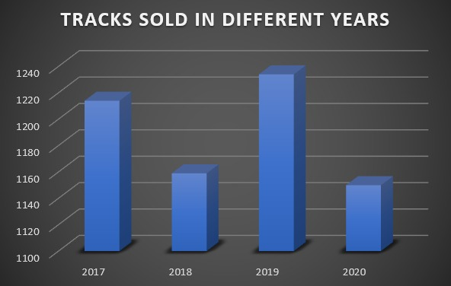
Yearly track sales analysis
2019 recorded the highest sales, reaching 1,234 tracks.
2020 experienced the lowest sales, dropping to 1,150 tracks.
Sales remained relatively consistent, with annual variation under 100 tracks.
2017 and 2018 showed moderate performance, with 1,214 and 1,159 tracks sold respectively.

Slide 12
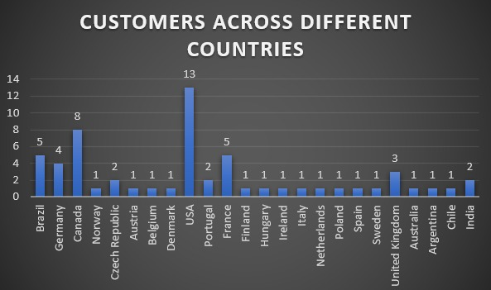
Customers count across countries
Strongest Market Presence in the USA with 13 customers, the USA leads in customer count, indicating a strong user base and potential for localized growth strategies.
Canada (8 customers) and Brazil (5 customers) follow closely, suggesting these countries have healthy adoption and could benefit from focused retention efforts.

Slide 13
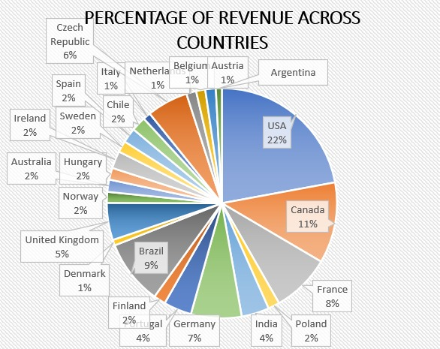
Percentage of total revenue across countries
USA leads in total revenue, contributing $1040.49(22%), which is significantly higher than any other country, showing a strong and engaged customer base.
Canada and France follow as the next top contributors with $535.59(11%) and $389.07(8%), indicating substantial engagement and purchasing power.
Brazil and Germany perform well, bringing $427.68(9%) and $334.62 (7%) respectively, representing key international markets.

Slide 14
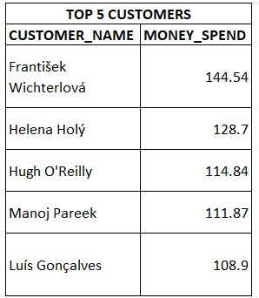
Top 5 Customers
Frantisek Wichterlova is the top spender, with a total spend of $144.54, highlighting a highly engaged and valuable customer.
Helena Holý and Hugh O'Reilly follow closely, spending $128.70 and $114.84 , showing consistent purchasing behavior.
Manoj Pareek and Luís Gonçalves also rank among the top 5, each spending over $100, indicating strong customer loyalty.
These high-value customers represent prime targets for exclusive offers, loyalty rewards, or personalized marketing to encourage continued engagement.

Slide 15
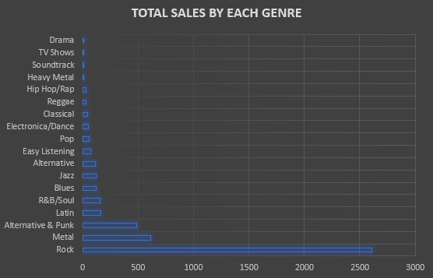
Total Sales by Genre
Rock dominates sales with a total revenue of $2,608.65, significantly outperforming other genres.
Metal and Alternative & Punk follow as strong contributors, generating $612.81 and $487.08 respectively.
Genres like Latin, R&B/Soul, and Blues show moderate sales between $120 and $165, indicating niche but steady audiences.
Several genres such as Heavy Metal, Soundtrack , contribute minimally to sales, reflects limited market demand.

Slide 16
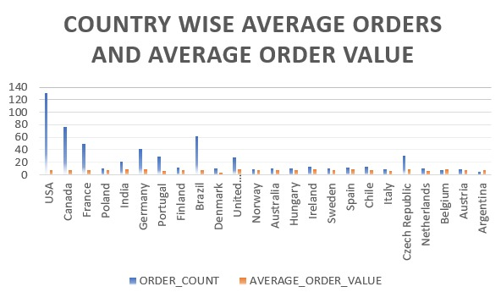
Average Orders and Average
Order Value
USA leads in order volume with 131 orders, followed by Canada (76) and Brazil (61), indicating strong customer activity in North America.
Countries like India, UK, and Ireland show both moderate order counts and relatively high average order values, suggesting valuable customer segments.

Slide 17
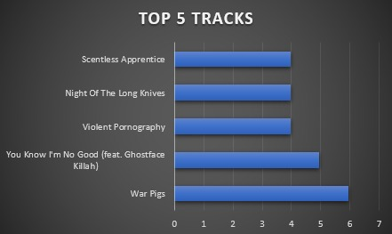
Top 5 tracks by Sales
"War Pigs" received the highest rating of 5.94.
"You Know I'm No Good" (feat. Ghostface Killah) scored 4.95, ranking second.
Three songs "Violent Pornography", "Night Of The Long Knives", and "Scentless Apprentice” each have a rating of 3.96.
The data shows a mix of highly rated classics and consistently rated tracks.

Slide 18
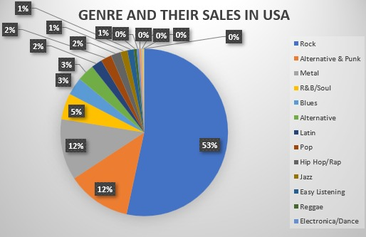
Genre contribution in USA Sales
Rock dominates with the highest total sales of 555.39 units, far surpassing all other genres.
Alternative & Punk and Metal follow distantly, with 128.7 and 122.76 units respectively.
R&B/Soul, Blues, and Alternative show moderate popularity, ranging between 34–52 units.
Genres like Classical, Heavy Metal, Soundtrack, and TV Shows have the lowest sales, each under 4 units.

Slide 19
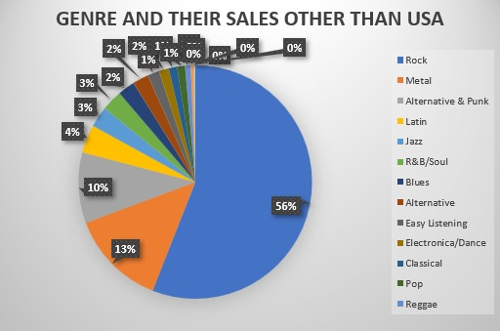
Genre contribution in sales other than USA
Rock leads overwhelmingly with total sales of 2053.26, making it the most dominant genre.
Metal (490.05) and Alternative & Punk(358.38) are strong secondary genres in terms of sales.
Latin, Jazz, and R&B/Soul hold mid-tier positions, each with 100+ or near -100 unit sales.
Genres like Hip Hop/Rap, Heavy Metal, Soundtrack, Drama, and TV Shows show minimal sales, each below 15 units.

Slide 20
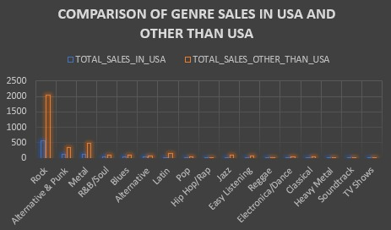
Sales comparison between USA and other than USA
Rock is globally dominant, with much higher sales outside the USA.
Hip Hop/Rap and R&B/Soul perform better in the US, showing domestic appeal.
Classical and Electronica/Dance thrive more abroad, hinting at different listening preferences.

Slide 21
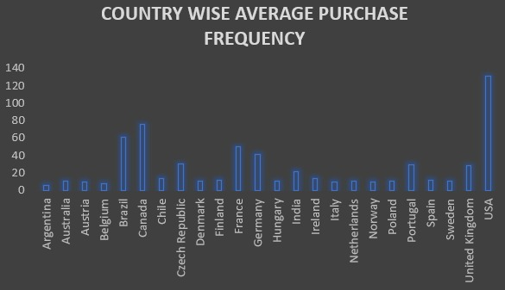
Average Purchase Frequency
USA and Canada appear most frequently, showing strong regional engagement or user base.
European countries like France, Germany, and the UK have consistently high frequencies, indicating a solid presence in the market.

Slide 22
INSIGHTS
Focus on High-Potential Markets
Prioritize marketing efforts in USA, Canada, Brazil, and Czech Republic where user engagement is highest to maximize sales impact.
2. Align Genre Promotion with Regional Preferences
Promote Latin and Jazz genres internationally (e.g., Brazil, France) to leverage their stronger global sales outside the USA.
3. Global Expansion Strategies
Build partnerships with local artists and influencers in growing markets like India and Germany to increase brand presence.
4. Data-Driven Product Enhancements
Use regional genre popularity data to personalize playlists and recommendations for better user engagement and sales.
5. Digital Marketing & Engagement
Launch targeted social media campaigns in top countries focusing on regionally popular genres to boost awareness and conversions.

Slide 23
CONCLUSION
By strategically focusing on high-engagement markets, tailoring genre promotions to regional preferences, expanding through local partnerships, and leveraging data-driven personalization, we can effectively boost global music sales. Targeted digital marketing will further enhance audience reach, ensuring sustained growth across diverse markets worldwide.

Slide 24



