Slide 1

ZOMATO RESTAURANT ANALYSIS
BEERAVELLI SREYA 23-02-2025

Slide 2
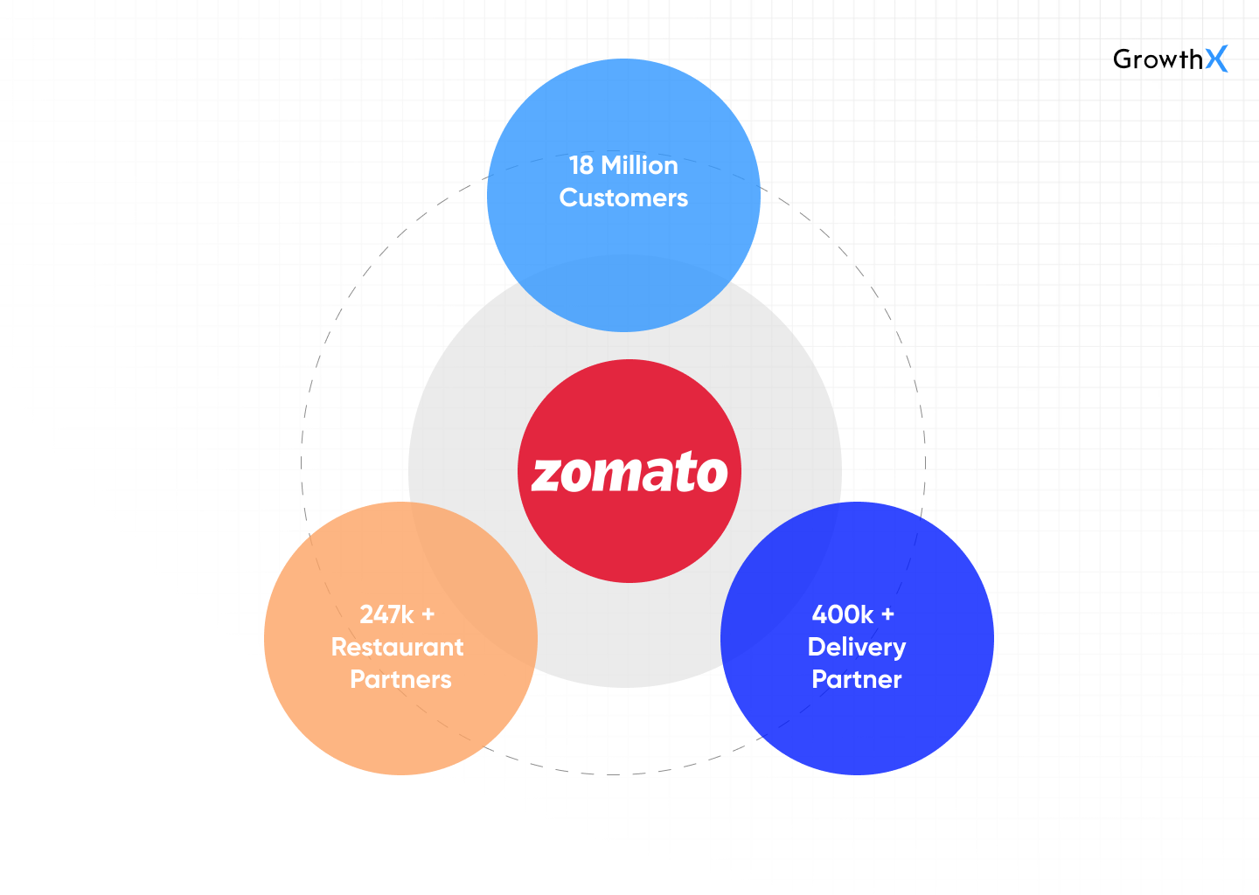
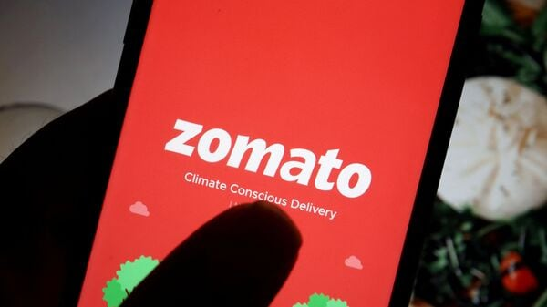
ABOUT ZOMATO
Zomato is an online platform that provides restaurant discovery, food delivery, and reviews. It connects users with eateries, helping them explore menus, read reviews, and order food online.

Slide 3
PROBLEM STATEMENT
Zomato aims to expand its restaurant network by identifying high-potential locations based on customer demand, market gaps, and economic feasibility. The objective is to use data-driven insights to determine optimal areas, cuisine preferences, and restaurant types. This will help maximize profitability, enhance customer experience, and ensure sustainable growth.

Slide 4
ZOMATO DATA SNAPSHOT
Total Number of Restaurants: 9542 across 15 Countries and 140 Cities.
Data cleaning and processing
No duplicates present in the dataset.
Number of Cuisines: 1852 reflecting the wide range of tastes onboard.
Removed rows with missing values in the "Cuisine" column.
Successfully running with a robust feedback system, receiving over 1.4 million votes.
Converted country codes to full country names for better clarity.
Cleaned data ensuring consistency and completeness across all columns.

Slide 5
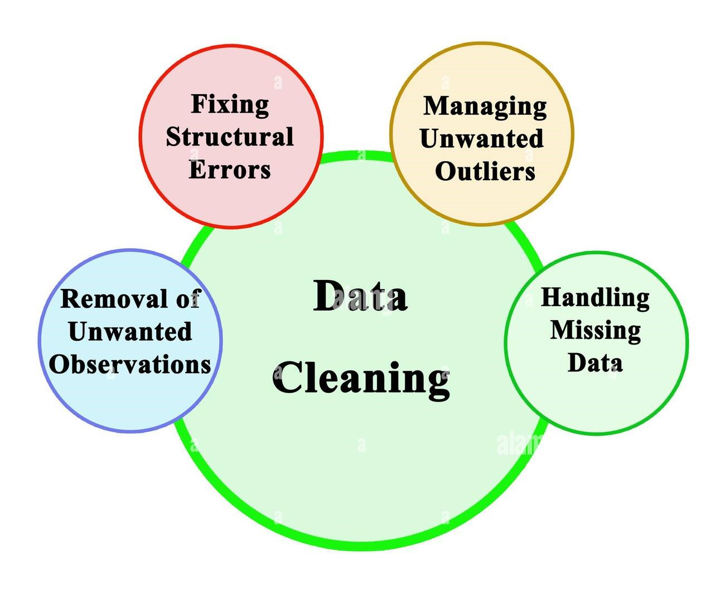
Analytical Approach and Tools
Data Cleaning: Utilized functions like TRIM, Remove Duplicates and Missing values to ensure data accuracy.
Data Enrichment: Enhanced the dataset with additional variables using XLOOKUP to cross-reference external data sources and to connect tables across workbook/s.
Descriptive Analysis: Employed PivotTables for summarizing key metrics and identifying average order value across different regions and different cuisines.
Visualization: Created dynamic charts and dashboards for data representation, enabling Interactive data exploration and for creating best story around the opening of restaurants

Slide 6
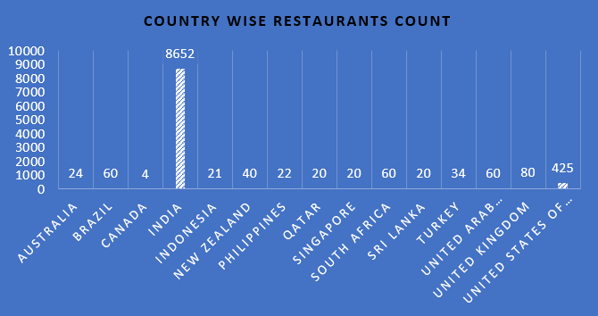
Restaurants count in Different Countries
India has 8,652 restaurants, which is significantly higher than any other country on the list.
There is a huge difference in the restaurants count across the countries

Slide 7
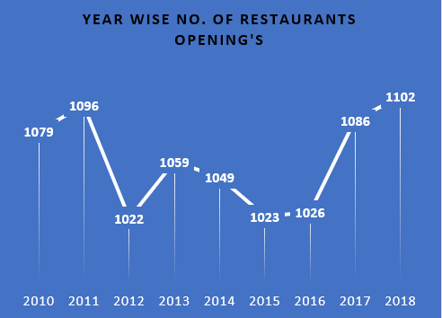
Restaurants opened in every year 2010-2018
The number of restaurant openings fluctuates over the years, with periods of both growth and decline.
Since 2016 to 2018 there is a change in trend of opening restaurants increasing constantly.

Slide 8
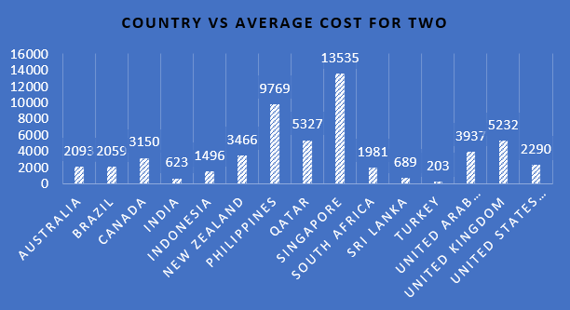
Average Cost for Two across Countries
Singapore has the highest average cost for two people at 13,535, followed by Philippines at 9,769.
The Average Cost for Two is affordable in very few countries and they are Asian countries .

Slide 9
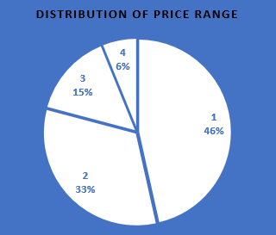
Distribution of Price range among Countries
In the above tells us that how people spending money on food
The mass market share is distributed in price range 1 and price range 2 and rest is under premium category.

Slide 10
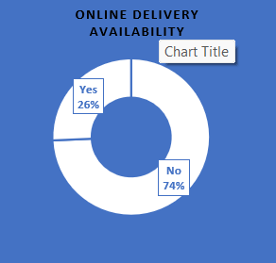
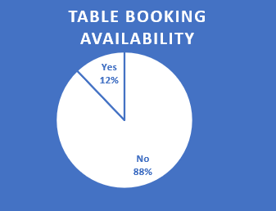
Online Delivery and Table Booking Availability
The above two pie charts explains how the online food penetration among the people
There is a lot of scope for online food delivery business and also there is no table booking availability in big scale.

Slide 11
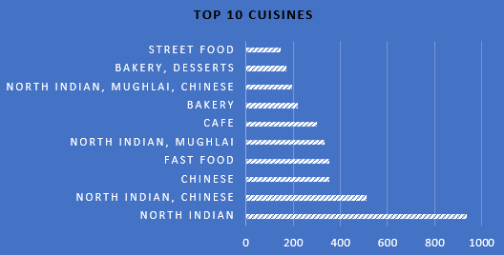
Top 10 Cuisines
North Indian Cuisine tops the list in Most restaurants , with North Indian Chinese
Coming as a second choice.

Slide 12
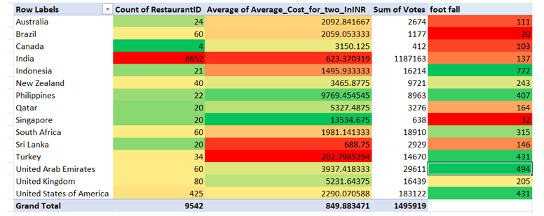
Here we analyzed the total restaurants in country, Avg expenditure on food for two persons in a country and Avg foot fall of a restaurant
We prefer a country with lesser restaurants count , good amount of foot fall and better expenditure on food , so that there we can start a new restaurants

Slide 13
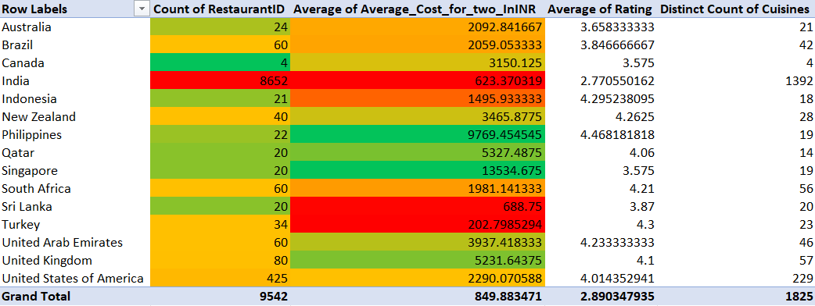
For opening a new restaurant main KPI’s are Restaurant count, Average expenditure on food ratings and number of cuisines in that Country.
Conditions for KPI’s: 1) Lesser restaurant count 3) Comparable number of cuisines 2) Good expenditure on food 4) Good foot fall for better feedback

Slide 14
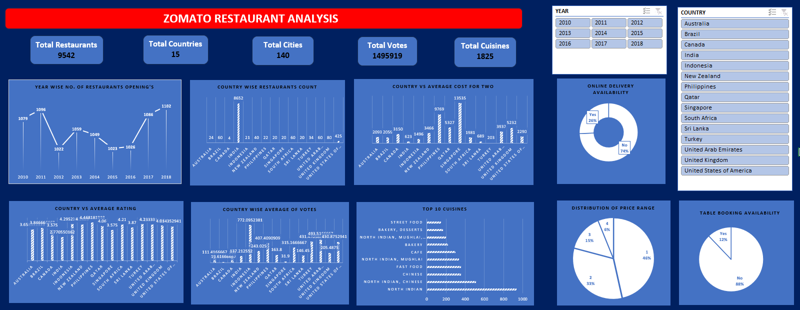
VISUALIZATION

Slide 15
RECOMMENDATIONS
The ideal countries for opening new restaurants with lower competition are Indonesia, Philippines, New Zealand, and the United Arab Emirates, as they have fewer existing restaurants, reducing market saturation.
These locations show high footfall per restaurant, indicating strong dining demand and potential customer engagement.
The average cost for two is high, ensuring better revenue generation and profitability.

Slide 16
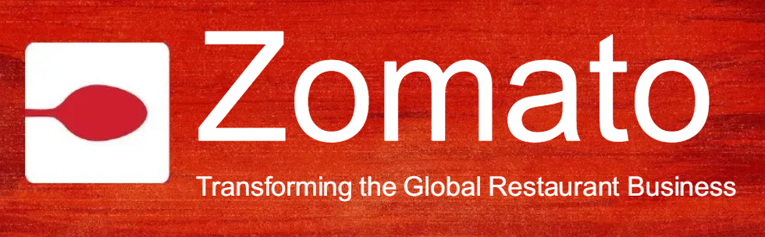
CONCLUSION
Market Penetration: Identified top Countries for starting new restaurants and expansion opportunities.
Customer Engagement: Analyzed customer taste and purchasing power. Advocating for improve ratings
Our in-depth analysis of Zomato's marketplace data unveils key opportunities for expanding its restaurant network, optimizing menu offerings, and enhancing customer dining experiences. These insights go beyond raw data—they serve as a roadmap for Zomato's next phase of growth, enabling strategic restaurant openings in high-demand areas, improving operational efficiency, and elevating partner and customer satisfaction.

Slide 17
REFERENCES
[1] Newton School, Refining Data Based on Newton School Guidelines, Lecture Notes
[2] Newton School, Data Cleaning Methods Based on Classes Given by Newton School, Lecture Notes
[3] Microsoft Corporation, Microsoft Excel: Data Visualization and Dashboard Creation, Software

