Slide 1

MINI PROJECT FINAL EVALUATION PRESENTATION · OCTOBER 2026
DEPARTMENT OF COMPUTER APPLICATION
KMCT INSTITUTE OF EMERGING TECHNOLOGY AND MANAGEMENT
Affiliated to APJ Abdul Kalam Technological University, Kerala
DoseTrack
Medication Reminder & Adherence Monitoring System
A centralized digital platform designed to help users organize medication regimens, configure dosage schedules, receive timely automated reminders, track dose adherence, and access doctor contact information.
PROJECT TEAM MEMBERS (BCA S5)
FACULTY SUPERVISION & COORDINATION
• Mefa Rahiman
• Shabana
• Sreya S Jeevan
• Gopika Babu
Project Guide:
Ms. ANSHA MK (Assistant Professor)
Project Coordinator: Prof. Kavitha G. Nair
Head of Department: Thejas Mon P
Notes:
Respected guide Ms. Ansha MK, coordinator Prof. Kavitha G. Nair, Head of Department Thejas Mon P, and respected evaluators: Good morning. We are presenting our BCA S5 Mini Project titled 'DoseTrack – Medication Reminder & Adherence Monitoring System'. Team: Mefa Rahiman, Shabana, Sreya S Jeevan, Gopika Babu, KMCT IETM, affiliated to APJ KTU.

Slide 2
PROJECT OVERVIEW
DoseTrack · BCA S5 · KMCT IETM (KTU)
Project Abstract
Digital medication management, automated reminder engine, and adherence audit history.
Core Capabilities of DoseTrack
The Problem with Traditional Approaches
• Medication Information Management: Store drug names, dosages, frequencies, treatment durations, and special intake instructions.
• Dosage Scheduling: Configure exact intake timings (e.g. 08:00 AM, 08:30 PM) and daily administration frequencies.
• Automated Reminders: Notifications generated at specified times to prevent forgotten or delayed doses.
• Adherence Tracking & History: Mark doses as Taken or Missed, updating an organized audit history in MySQL.
• Doctor Contact Directory: Quick access to physician profiles, specialties, clinic hours, and contact options.
✗ Memory-Based Tracking: High risk of forgotten doses, delayed intakes, or accidental double-dosing.
✗ Disconnected Notes & Alarms: Mobile alarms lack medicine names, dosage strengths, and meal instructions.
✗ Multi-Medicine Confusion: Managing multiple prescriptions with differing timings creates significant cognitive burden.
✗ No Centralized History: Neither patients nor healthcare providers have a structured record of past compliance.
✗ Scattered Medical Contacts: Emergency clinic contact details are stored in separate paper files or phonebooks.
CORE SYSTEM INFORMATION FLOW: Medication Entry → Schedule Config → Automated Reminder → Dose Status (Taken/Missed) → Adherence History
Notes:
DoseTrack is a centralized web application designed to help users manage medication details, configure dosage schedules, receive timely automated reminders, record Taken or Missed dose statuses, and review their historical adherence.

Slide 3
PROBLEM FORMULATION
DoseTrack · BCA S5 · KMCT IETM (KTU)
Problem Statement
Clinical and daily challenges associated with manual medication management.
Forgetfulness & Skipped Doses
Multiple Medicines Complexity
Scattered Reminders & Notes
Patients frequently forget scheduled medication timings, leading to interrupted therapeutic cycles.
Prescriptions with differing timings, frequencies, and meal instructions cause frequent confusion.
Relying on memory or basic clock alarms leaves data uncoordinated with no contextual instructions.
Absence of Adherence History
Isolated Healthcare Contacts
Risk of Health Complications
No reliable chronological log to verify taken or missed doses, hindering clinical reviews.
Doctor contact info and clinic consultation hours are stored separately from daily medication schedules.
Irregular medication intake diminishes treatment effectiveness and can cause preventable health issues.
CORE NEED: A centralized, accessible system that unifies medication details, schedules, reminders, basic tracking, and doctor contacts in one platform.
Notes:
Users forget medication timings, especially when taking multiple medicines or following repeated schedules. Traditional notes and separate alarms leave information scattered with no simple way to see what has been taken and what has been missed.

Slide 4
PROJECT SCOPE
DoseTrack · BCA S5 · KMCT IETM (KTU)
Project Objectives
Six key functional objectives formulated for DoseTrack.
OBJ 1
OBJ 2
OBJ 3
Efficient Medication Management
Automated Medication Reminders
Monitor & Track Adherence
Create a centralized platform to store, add, update, delete, and view medication details (names, dosages, frequency, duration, and instructions).
Implement a reliable reminder engine that notifies patients precisely when scheduled medication doses become due.
Record scheduled doses as Taken or Missed, storing events in MySQL and displaying historical adherence patterns.
OBJ 4
OBJ 5
OBJ 6
User-Friendly Dashboard
Easy Doctor-Contact Access
Organized Data Management
Provide a centralized graphical dashboard displaying upcoming doses, completed doses, missed doses, and recent adherence activities.
Develop a dedicated module allowing patients to access doctor profiles, specializations, clinic details, availability, and contact options.
Develop a structured relational MySQL database to securely store user credentials, medication details, schedules, and adherence logs.
Notes:
Chapter 2 specifies six specific project objectives: Efficient medication management, automated reminder system, adherence monitoring, user-friendly dashboard, doctor-contact access, and organized MySQL data management.

Slide 5
LITERATURE REVIEW
DoseTrack · BCA S5 · KMCT IETM (KTU)
Literature Survey & Existing Approaches
Comparative analysis of existing adherence technologies from Chapter 4 of the report.
Study / Approach | Technology Used | Key Strengths | Limitations Identified
Moshnyaga et al. (2016) Dementia Adherence Monitoring | Kinect sensor, vocal guidance & caregiver alerts | Actively monitors medication-taking activities rather than relying only on alarms. | Specialized sensing equipment increases cost and implementation complexity.
Rajan et al. (2021) Smart Pill Box with Auto-Fill | Arduino, GSM communication, IoT & Blynk App | Automated physical notifications and medicine supply monitoring. | Hardware equipment, ongoing maintenance, and continuous connectivity dependencies.
Srinivas et al. (2018) Intelligent Medicine Box | IoT hardware, vital sign sensors & Android App | Integrates reminders with abnormal vital sign alerts to guardian. | Sensor-based systems increase hardware dependencies and maintenance points.
Mason et al. (2022) Adherence Technology Review | Electronic pill boxes, bottles, sensors & self-reporting | Comprehensive review of usability, cost, and implementation factors. | Recording hardware activity does not always confirm actual medicine consumption.
MOTIVATION FOR DOSETRACK:
“Need for an accessible, practical software-based solution that combines medication management, reminders, adherence tracking, and doctor-contact information in one system without requiring specialized monitoring hardware.”
Notes:
In Chapter 4, we reviewed related works: Moshnyaga et al. (2016) used Kinect sensors for dementia patients; Rajan et al. (2021) designed an Arduino IoT pill box; Srinivas et al. (2018) added vital sensors; Mason et al. (2022) surveyed adherence technologies. These highlight the need for an accessible software solution without costly hardware.

Slide 6
PROPOSED ARCHITECTURE
DoseTrack · BCA S5 · KMCT IETM (KTU)
Proposed System – DoseTrack
Centralized platform integrating medication management, reminders, and adherence monitoring.
User Management
Reminder Engine
Secure registration, login & profile context
Automated alerts triggered at scheduled times
DoseTrack Core System
Centralized Web Application
& Relational MySQL Database
• Automated Schedule Engine
• Immutable Adherence Log
• Doctor Contact Directory
Medication Management
Adherence Tracking
CRUD operations for drugs, dosages & units
Taken/Missed recording & 30-day history log
Schedule Management
Doctor-Contact Access
Exact dose times, frequency & duration
Physician profiles, clinic hours & contacts
Overview Dashboard: Daily routines, adherence stats & vitals
Notes:
Chapter 5 describes the proposed DoseTrack system. It functions as a centralized hub connecting user management, medication cabinet, schedule configuration, reminder engine, adherence tracking, dashboard, and doctor contacts.

Slide 7
DEVELOPMENT METHODOLOGY
DoseTrack · BCA S5 · KMCT IETM (KTU)
Project Methodology
Structured eight-phase engineering lifecycle followed during DoseTrack development.
01
02
03
04
Requirement Analysis
System Design
Database Design
Frontend Development
Identified challenges in manual medicine tracking and clinical adherence needs.
Defined the 3-layer architecture, module responsibilities, and interaction contracts.
Created relational schema with users, medications, schedules, and dose events.
Crafted responsive, accessible UI using semantic HTML5, CSS3, and JavaScript.
05
06
07
08
Application Logic
Reminders & Tracking
Testing & Verification
Final Integration
Programmed backend routing, authentication validation, and medication CRUD logic.
Engineered schedule time-matching, notification dispatch, and dose logging.
Conducted unit and functional testing of auth, CRUD operations, and DB updates.
Unified presentation, logic, and data tiers into a coherent web application.
Notes:
Section 6.1 defines our methodology: Requirement Analysis, System Design, Database Design, Frontend Development, Application Logic, Reminder & Adherence Implementation, Testing, and Final Integration.

Slide 8
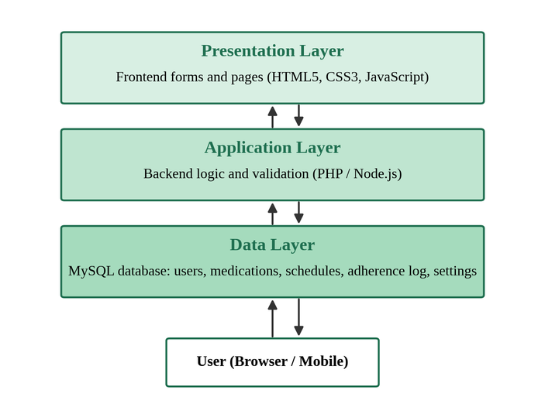
ARCHITECTURE SPECIFICATION
DoseTrack · BCA S5 · KMCT IETM (KTU)
System Architecture
Three-layer architecture connecting Presentation, Application Logic, and Relational Data.
1. Presentation Layer (HTML5, CSS3, JavaScript)
Frontend forms, daily overview dashboard, modal dialogs, schedule configuration forms, real-time alert banners, and doctor contact cards accessed via desktop/mobile browsers.
2. Application / Logic Layer (Node.js / PHP)
Backend business logic and validation checking every request before storage; handles user authentication, medication CRUD operations, schedule matching, and adherence recording.
3. Data Layer (MySQL Relational Database)
Structured MySQL database managing tables for users, medications, dosage schedules, adherence event logs, doctor contact details, and notification settings with foreign key integrity.
Notes:
Figure 5.1 in Chapter 6 illustrates our 3-Layer Architecture. Presentation Layer handles user interaction, Application Layer checks every request and runs business logic, and Data Layer persists records in MySQL.

Slide 9
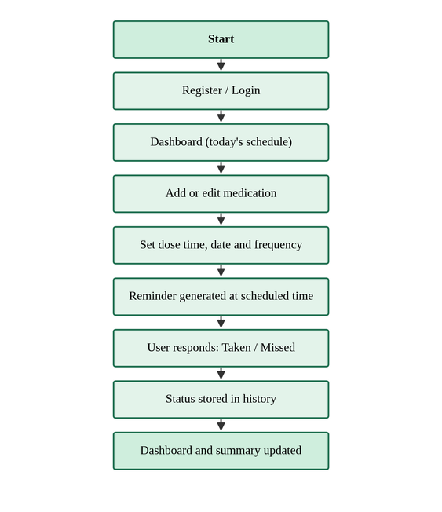
OPERATIONAL FLOWCHART
DoseTrack · BCA S5 · KMCT IETM (KTU)
Application Workflow
End-to-end user journey flowchart from Chapter 6 (Figure 5.3).
1
Register / Login — Patient registers and logs in securely; session associates medication data with user account.
2
Dashboard Overview — Displays todays scheduled medication doses, adherence progress counter, and vitals snapshot.
3
Add / Edit Medication — User inputs medicine name, dosage strength, quantity, frequency, and treatment duration.
4
Configure Schedule — Sets specific dose timings (e.g. 08:00 AM, 08:30 PM) directly linked to the medication record.
5
Automated Reminder Generated — When current time matches schedule, system alerts the patient that a dose is due.
6
User Responds: Taken / Missed — Patient marks dose status directly from the reminder or daily dashboard.
7
Status Stored in MySQL History — Event is committed to database; adherence compliance metrics update instantly.
Notes:
Figure 5.3 shows the complete workflow: Register/Login -> Dashboard -> Add Medication -> Set Schedule -> Reminder Generated -> User responds Taken/Missed -> Status Stored in History -> Dashboard Updated.

Slide 10
APPLICATION LOGIC
DoseTrack · BCA S5 · KMCT IETM (KTU)
Algorithms & Core Logic
Deterministic rule-based workflows powering authentication, CRUD, reminders, and adherence monitoring.
1. Authentication & Session Logic
2. Medication CRUD Logic
• Input: User email & password credentials.
• Step 1: Query users table for unique registered email.
• Step 2: Verify submitted password against stored secure hash.
• Step 3: Initialize authenticated session binding user ID to all data requests.
• Create: Insert medication row with user_id, dosage & instructions.
• Read: Retrieve active medicines where start_date <= NOW() <= end_date.
• Update: Validate and update dosage, frequency, or instructions.
• Delete: Cascade delete associated dosage schedules and alert logs.
3. Reminder Triggering Logic
4. Adherence Evaluation Logic
• Input: Active schedules S = {dose_time, active}.
• Step 1: Compare current system time T_now with dose_time.
• Step 2: Check if an event already exists in dose_events for today.
• Step 3: If T_now >= dose_time and not recorded, trigger dashboard alert.
• User Action: Patient selects Taken or Missed.
• Commit: Insert record into dose_events with timestamp.
• Formula: Adherence Rate (%) = (Total Taken / Total Scheduled) * 100%
• Update: Refreshes daily progress (e.g. 2/4 doses) and adherence history.
Notes:
DoseTrack uses deterministic rule-based algorithms rather than AI: Authentication verification, Medication CRUD logic, Reminder schedule-matching logic, and Adherence percentage formula.

Slide 11
MODULE ARCHITECTURE
DoseTrack · BCA S5 · KMCT IETM (KTU)
Modules Developed
Core interconnected subsystems documented in Table 5.1 of the report.
1. User Management
2. Medication Management
Registration, secure login, profile information, and account context.
Add, edit, view, and delete medication records and instructions.
3. Schedule Management
4. Reminder System
Configure exact dose timings, daily frequencies, and treatment dates.
Scheduled notifications alerting users when medicines become due.
5. Adherence Tracking
6. Dashboard Module
Records Taken or Missed status with persistent event timestamps.
Centralized display of upcoming doses, compliance rates, and vitals.
7. Settings Module
8. Doctor-Contact Module
Reminder preferences, notification configurations, and display options.
Physician profiles, clinic locations, hours, and appointment requests.
Notes:
Table 5.1 in Chapter 6 details the seven core modules: User Management, Medication, Schedule, Reminder, Tracking, Dashboard, and Settings, plus Doctor Contact module.

Slide 12
TECHNICAL ENVIRONMENT
DoseTrack · BCA S5 · KMCT IETM (KTU)
Technology Stack
Standard web, backend, and relational database technologies referenced in the report.
Frontend Tier
Application Tier
Data Tier & Tools
User Interface & Presentation
Business Logic & API Routing
Persistent Storage & Tooling
• HTML5:
Semantic page structure, responsive forms, and accessible modal views.
• CSS3:
Modern clinical color scheme, card components, flexbox/grid layouts, and status badges.
• JavaScript (ES6+):
Dynamic DOM updates, asynchronous fetch API calls, and client-side form validation.
• Node.js / Express:
RESTful API routing, business logic orchestration, and reminder schedule daemons.
• PHP Support:
Backend application logic and request validation cited in Chapter 6.
• Security & Validation:
Secure password hashing, input sanitization, and session state management.
• MySQL Database:
Relational data management with InnoDB engine, ACID compliance, and foreign keys.
• Git Version Control:
Distributed version control tracking features, commits, and codebase history.
• Standards & Manuals:
MDN Web Docs standards compliance and MySQL Reference Manual.
Notes:
DoseTrack uses standard technologies from the report: HTML5, CSS3, JavaScript on frontend; Node.js/PHP on backend; MySQL for database; Git for version control.

Slide 13
DATA MANAGEMENT
DoseTrack · BCA S5 · KMCT IETM (KTU)
Database & Data Management
Structured relational MySQL schema ensuring data integrity and audit logging.
users (Primary Account Entity)
Relational Architecture Benefits
id (PK), full_name, email (UQ), phone, password_hash, created_at
• Centralized Storage: Consolidates scattered paper notes and uncoordinated alarms into an organized relational schema.
• Cascading Integrity: Deleting a medication automatically cleans up associated dosage schedules and alert logs (ON DELETE CASCADE).
• Adherence Audit Trail: Every taken or missed response is saved with an immutable timestamp for clinical reviews.
• Performance Indexing: Optimized indexes (idx_med_user_dates, idx_schedule_user_active) ensure fast dashboard queries.
medications (Medication Records (FK -> users.id))
id (PK), user_id (FK), name, dosage, quantity, frequency, instructions, start_date, end_date
schedules (Dose Timings (FK -> medications.id))
id (PK), medication_id (FK), user_id (FK), dose_time, active, created_at
dose_events (Adherence Audit History Log)
id (PK), schedule_id (FK), medication_id (FK), user_id (FK), scheduled_for, status (taken/missed), recorded_at
doctors (Doctor & Clinic Directory)
id (PK), user_id (FK), name, specialization, clinic_name, phone, email, availability, clinic_address
Notes:
DoseTrack utilizes MySQL to organize data into relational entities: users, medications, schedules, dose_events, and doctors with foreign key cascading.

Slide 14
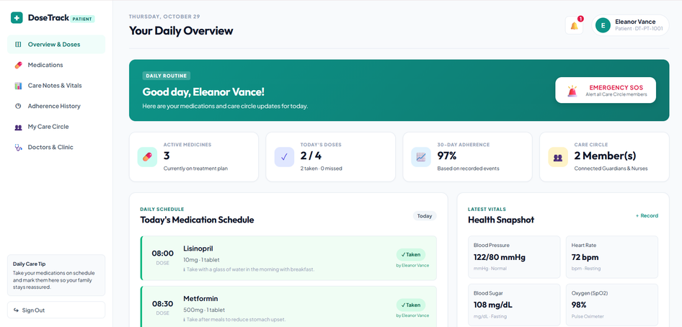
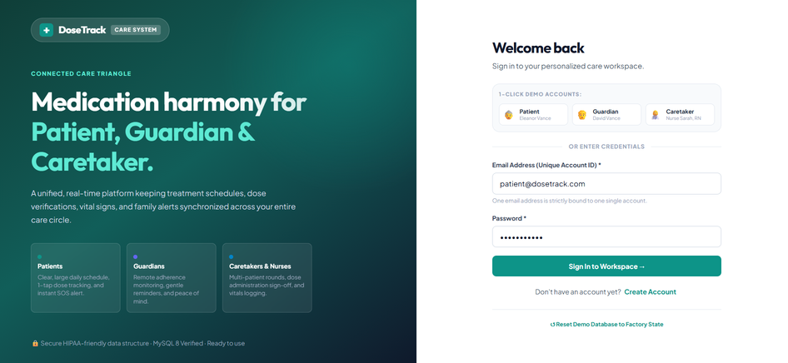
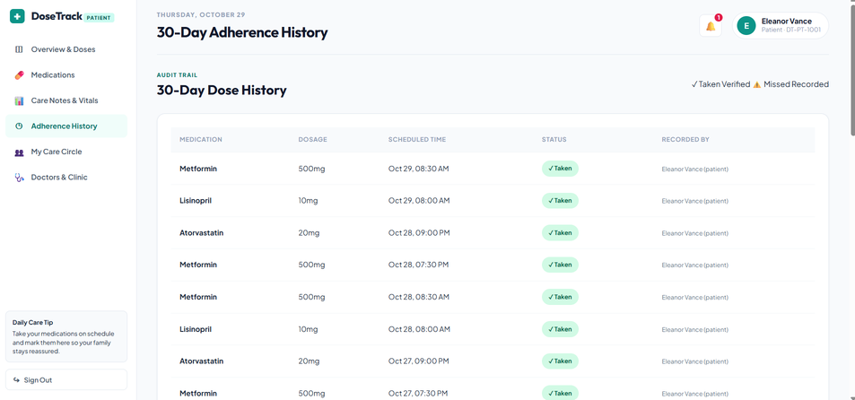
USER INTERFACES · PART 1
DoseTrack · BCA S5 · KMCT IETM (KTU)
Application Interfaces – Core Patient Experience
Actual interface screenshots from Appendices (Pages 21–22) of the project report.
01. Login & Authentication
02. Daily Overview Dashboard
03. Medication Cabinet
Secure role-aware entry point with credentials validation and workspace sign-in.
Active medicines, today doses (2/4), 30-day adherence (97%), and schedule action cards.
Prescription list with dosage units, timings, ongoing dates, and Edit/Delete controls.
Notes:
Slide 14 presents real screenshots from Appendices: Login Page, Daily Overview Dashboard, and Medication Cabinet.

Slide 15
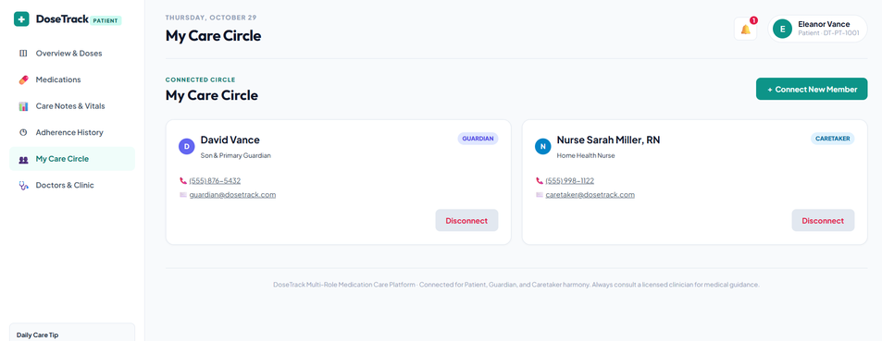
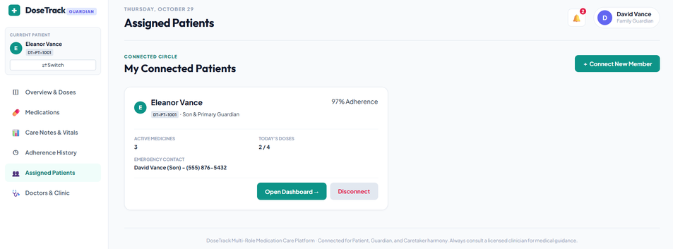
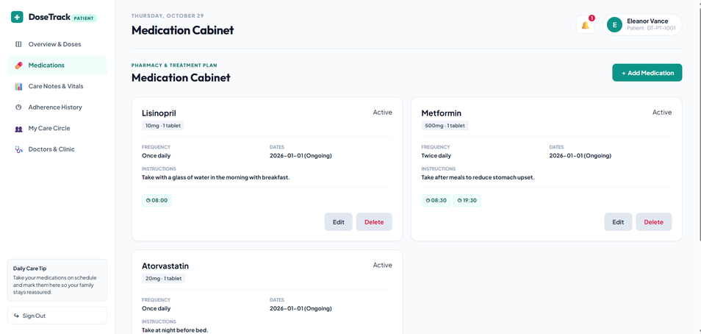
USER INTERFACES · PART 2
DoseTrack · BCA S5 · KMCT IETM (KTU)
Application Interfaces – Adherence & Healthcare
Adherence audit trail, doctor contacts, and care circle screens from Report Appendices.
04. 30-Day Adherence History
05. Doctor & Clinic Contacts
06. Care Circle Collaboration
Audit log table recording medication name, dosage strength, scheduled time, and Taken/Missed status.
Physician directory with specialties, clinic hours, phone numbers, and appointment requests.
Connected family guardian and caretaker profiles to support patient adherence oversight.
Notes:
Slide 15 shows Adherence History audit log, Doctor Contacts directory, and My Care Circle from Report Appendices.

Slide 16
FEATURE VERIFICATION
DoseTrack · BCA S5 · KMCT IETM (KTU)
Implementation & Key Functionalities
Summary of implemented features verified in the working prototype.
1. User Registration & Authentication
✓ Implemented
2. Medication Record Management
✓ Implemented
Secure user login, password hashing, and session management associating patient records.
Full CRUD operations to store drug names, dosage strengths, units, instructions, and dates.
3. Medication Schedule Configuration
✓ Implemented
4. Automated Medication Reminders
✓ Implemented
Configurable dosage timings (e.g. 08:00 AM, 08:30 PM), intake frequencies, and active flags.
Automated notification engine alerting patients precisely when scheduled doses become due.
5. Taken / Missed Dose Tracking
✓ Implemented
6. Adherence History & Audit Trail
✓ Implemented
Interactive response buttons allowing users to record dose outcomes with real-time logging.
Structured chronological table of dose events providing an auditable record of compliance.
7. Daily Overview Dashboard
✓ Implemented
8. Doctor Contacts & MySQL Storage
✓ Implemented
Centralized graphical dashboard visualizing todays doses, adherence stats, and pending alerts.
Physician directory with clinic timings, appointment options, and relational MySQL persistence.
Notes:
Slide 16 confirms all implemented features: user authentication, medication management, scheduling, automated reminders, dose tracking, adherence history, dashboard, doctor contacts, and MySQL storage.

Slide 17
RESULTS EVALUATION
DoseTrack · BCA S5 · KMCT IETM (KTU)
Results & Functional Analysis
Functional verification of implemented outcomes against project objectives.
Expected Outcome (Objectives) | Implemented Result in DoseTrack | Status
Centralized Medication Management | Stores medicine details, dosage, frequency, and instructions in one unified cabinet. | Implemented
Medication Scheduling | Allows configuring custom dose timings and frequencies linked directly to medicines. | Implemented
Automated Reminders | Reminder engine triggers visual alert notifications when dose times become due. | Implemented
Dose Adherence Tracking | Allows patients to record whether scheduled doses were Taken or Missed. | Implemented
Adherence History Log | Maintains an auditable 30-day chronological record of dose events in MySQL. | Implemented
Interactive Dashboard | Centralizes todays medication routine, progress counter, and compliance percentage. | Implemented
Doctor-Contact Access | Provides stored doctor profiles, clinic hours, phone numbers, and appointment options. | Implemented
REPORT FUNCTIONAL ANALYSIS:
“The developed prototype demonstrates the core workflow of medication management, scheduled reminders, dose-status recording, and adherence history tracking. The system organizes medication tasks into an accessible digital routine.”
Notes:
In Slide 17, we present results as functional outcomes based on the implemented features and screenshots without inventing fake numbers.

Slide 18
CRITICAL APPRAISAL
DoseTrack · BCA S5 · KMCT IETM (KTU)
Limitations & Future Scope
Current operational boundaries and planned technical enhancements from Chapter 7.
Current System Limitations
Future Scope & Planned Enhancements
✗ User Input Dependency:
System depends on the user correctly entering medicine names, dosages, and schedules.
✗ Notification Environment:
Reminder delivery depends on active browser session, device permissions, and volume.
✗ Self-Reported Adherence:
Dose status is recorded based on user input; system cannot physically verify pill ingestion.
✗ Non-Diagnostic Boundary:
DoseTrack does not diagnose, prescribe, or provide medical advice; all clinical decisions stay with doctors.
✗ Deployment Scope:
Phase 1 operates as a responsive web system with scope for wider native mobile deployment.
✓ Mobile Application with Push Alerts:
Dedicated Android & iOS app with native background push notifications and alarm daemons.
✓ QR / Barcode Medicine Entry:
Scan medicine packaging or prescription codes for automated drug name and dosage entry.
✓ Medicine Refill Alerts:
Automated supply tracking that alerts patients when medication inventory is running low.
✓ Caregiver & Family Access:
Real-time alerts sent to designated family members when critical doses are missed.
✓ Exportable Clinical Reports:
One-click PDF generation of 30-day adherence logs for consultation with doctors.
Notes:
Chapter 7 notes current limitations: user data entry reliance, browser notification dependencies, self-reported adherence, non-diagnostic scope. Future scope: mobile app with push notifications, QR barcode scanning, refill alerts, caregiver access, and exportable reports.

Slide 19
PROJECT CONCLUSION
DoseTrack · BCA S5 · KMCT IETM (KTU)
Conclusion & Discussion
Project summary and evaluator viva discussion.
Project Conclusion
DoseTrack successfully delivers a centralized, accessible digital solution that resolves the persistent challenges of forgotten medication doses and scattered routines. By harmonizing medication scheduling, automated reminders, real-time Taken/Missed dose recording, adherence audit history, and direct doctor contact access, the application demonstrates that a practical web-based system can significantly improve daily treatment consistency and patient peace of mind.
THANK YOU
Questions & Discussion
PRESENTED BY TEAM MEMBERS
INSTITUTION & AFFILIATION
Mefa Rahiman • Shabana • Sreya S Jeevan • Gopika Babu
Department of Computer Application · BCA S5
KMCT Institute of Emerging Technology and Management, Mukkam
Affiliated to APJ Abdul Kalam Technological University (KTU)
Notes:
In conclusion, DoseTrack provides a centralized approach to medication management, scheduled reminders, adherence monitoring, and doctor contact access. We thank our guide Ms. Ansha MK and the Department of Computer Application. We now invite your questions and discussion.

