Slide 1
Revolutionizing Supply Chain Financing: Leveraging Blockchain Technology to Enhance Efficiency and Timeliness of Payments.

Slide 2

Introduction
In today's fast-paced business environment,
supply chain ﬁnancing plays a critical role in ensuring timely payments to suppliers.
However, traditional ﬁnancing methods are often slow, inefﬁcient, and prone to errors. This is where blockchain technology comes in, offering a secure and transparent way to streamline supply chain ﬁnancing and enhance efﬁciency.

Slide 3
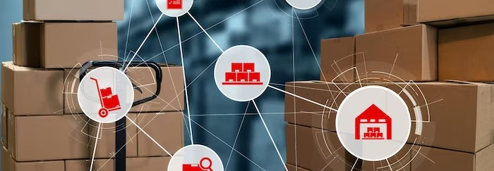
Supply chain ﬁnancing is a ﬁnancial service that helps businesses optimize their cash ﬂow by providing early payment to suppliers. This allows suppliers to receive payment earlier than the agreed-upon payment terms, while buyers can extend their payment terms and improve their working capital.
However, traditional supply chain ﬁnancing can be slow and inefﬁcient, with a lack of transparency and high transaction costs.

Slide 4

What is Blockchain Technology?
Blockchain technology is a decentralized digital ledger that records transactions in a secure and transparent manner. Each transaction is veriﬁed by a network of computers, or nodes, and added to the ledger as a block. Once a block is added, it cannot be altered or deleted, ensuring the integrity of the data.
Blockchain technology has the potential to revolutionize supply chain ﬁnancing by providing a secure and transparent way to record and verify transactions.

Slide 5
Benefits of Blockchain Technology for Supply Chain Financing
Blockchain technology offers several beneﬁts for supply chain ﬁnancing, including:
Transparency: All parties involved in the transaction can view and verify the transaction in real-time.
Security: Transactions are secured through cryptography and cannot be altered or deleted. Efﬁciency: Transactions can be processed faster and with lower transaction costs.
Traceability: The entire transaction history is recorded on the blockchain, providing a complete audit trail.
These beneﬁts can help streamline supply chain ﬁnancing and improve efﬁciency and timeliness of payments.

Slide 6

Blockchain technology can be used in various ways to enhance supply chain ﬁnancing, including:
Smart Contracts: Self-executing contracts that automatically trigger payments based on predeﬁned conditions.
Supply Chain Visibility: Real-time tracking of goods and inventory levels, enabling more accurate ﬁnancing decisions. Invoice Financing: Streamlining the invoice ﬁnancing process by verifying and recording invoices on the blockchain. These use cases can help businesses optimize their supply chain ﬁnancing and improve cash ﬂow.

Slide 7

Challenges of Implementing Blockchain in Supply Chain Financing
While blockchain technology offers several beneﬁts for supply chain ﬁnancing, there are also challenges to consider, including:
Integration: Integrating blockchain technology with existing systems and processes can be complex and time-consuming.
Regulatory Compliance: Ensuring compliance with existing regulations and standards can be challenging.
Data Privacy: Ensuring the privacy and security of
sensitive data can be a concern.
These challenges must be addressed to
successfully implement blockchain technology in supply chain ﬁnancing.

Slide 8

Case Study: IBM and Walmart
IBM and Walmart have partnered to use blockchain technology to enhance supply chain ﬁnancing. They have implemented a blockchain- based system to track the origin and movement of food products, enabling faster and more accurate tracing of contaminated products. This has helped reduce food waste and improve food safety, while also streamlining the supply chain ﬁnancing process.
This case study demonstrates the potential of
blockchain technology to revolutionize supply chain ﬁnancing and improve business operations.

Slide 9

Future Outlook for Blockchain in Supply Chain Financing
As blockchain technology continues to evolve, its potential for supply chain ﬁnancing will only increase. In the future, we can expect to see more widespread adoption of blockchain- based supply chain ﬁnancing solutions, as businesses seek to enhance efﬁciency and timeliness of payments.
However, there are also challenges to overcome, such as regulatory compliance and data privacy concerns. It will be important for businesses to address these challenges to fully realize the beneﬁts of blockchain technology.

Slide 10

Key Takeaways
In conclusion, blockchain technology has the potential to revolutionize supply chain ﬁnancing by providing a secure and transparent way to record and verify transactions. While there are challenges to consider, such as integration and regulatory compliance, the beneﬁts of blockchain technology are signiﬁcant.
By leveraging blockchain technology, businesses can enhance efﬁciency and timeliness of payments, optimize their cash ﬂow, and improve their overall operations.

Slide 11
Thanks!

