Slide 1
Integrated Multi-Omics Analysis of Gastric-Cancer Prognosis
An externally-validated stromal/CAF prognostic programme, with an honest microbiome and Mendelian-randomisation assessment
Team BBIN6 — SASTRA Deemed University
Real public data (TCGA, GTEx, GEO, DDBJ, OpenGWAS)

Slide 2
Objective & Approach
• Identify & externally validate the transcriptomic biology underlying GC prognosis
• Secondary/exploratory: tumour microbiome + causal test (MR)
• All real public data; 16S microbiome reprocessed from raw FASTQ
• Guiding principle: rigorous external validation + honest scoping (no overclaiming)

Slide 3
Data & Methods
• Transcriptome: TCGA-STAD + GTEx; validation ACRG, GSE15459, GSE84437 (n=922)
• Microbiome: PRJDB20660 (Japan) 16S — 944 libraries via DADA2; validation Italy + Portugal cohorts
• DEG/GSEA, immune deconvolution, LASSO-Cox + nested CV, WGCNA + module preservation, nomogram, MR, drug repurposing + DepMap

Slide 4
Result 1 — Transcriptome & Pathways
• 3,722 up / 4,025 down genes (tumour vs normal)
• E2F / G2M / MYC / EMT UP; oxidative phosphorylation DOWN
• Diffuse subtype: EMT, IL6-STAT3, TNFα-NF-κB up
• Immune: macrophage-enriched; deconvolution VALIDATED vs measured leukocyte % (ρ=0.67)

Slide 5
Result 2 — 25-gene Signature (honest)
• Apparent C 0.72 — but leakage-free nested-CV C = 0.611 (the honest value)
• Validated in 2/3 cohorts (ACRG C=0.61; GSE15459 C=0.58; GSE84437 negative)
• Conservative meta-analysis: pooled HR 1.19 (0.96–1.47) — NOT significant
• ACRG effect early-only (HR 1.49 → 1.03 → 0.87 at 12/36/60 mo)
• A modest, unstable predictor — not the headline

Slide 6
Result 3 — CAF Module: the PRIMARY finding
• PRIMARY: externally-validated stromal/CAF co-expression programme
• Module preserved in 3 cohorts: Zsummary 15.9 / 16.8 / 17.1 (all 'strong', Z>10)
• Independently prognostic externally (HR/SD 1.24–1.55, all p<0.01)
• Single-cell: 28/29 hub genes fibroblast-dominant
• Survives tumour-purity adjustment — real biology, replicated across 4 cohorts

Slide 7
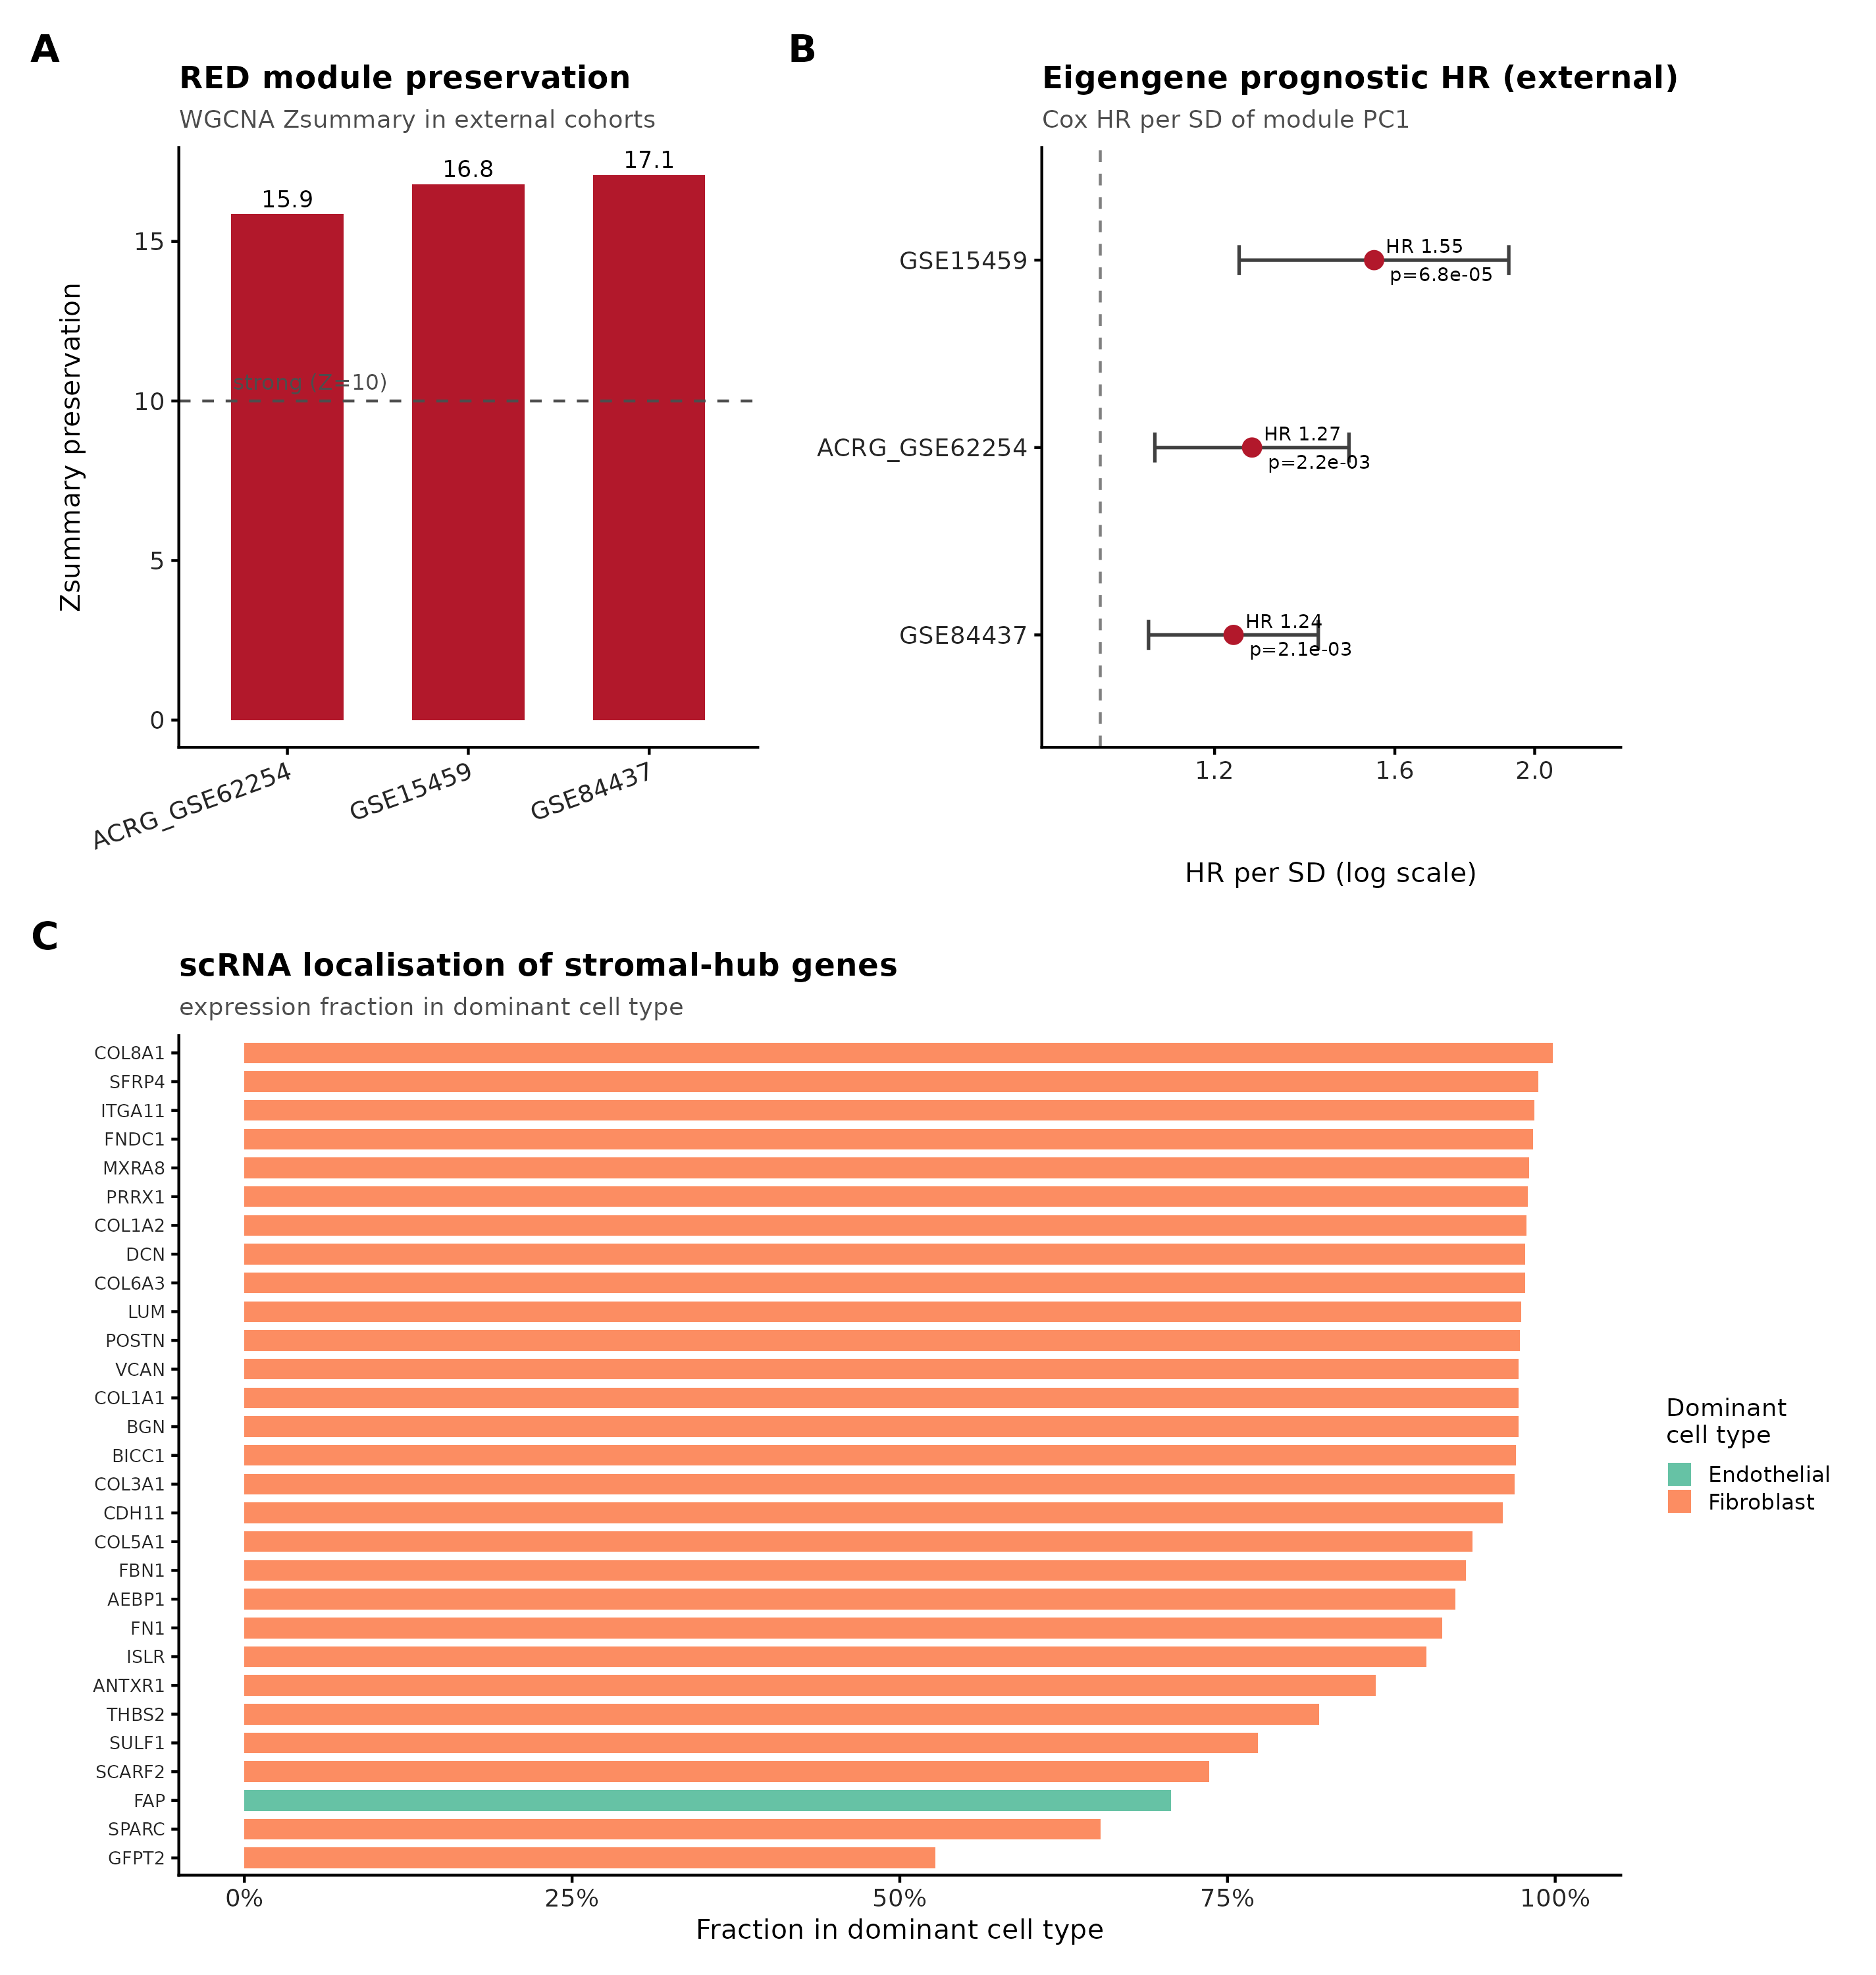
Figure — CAF module external validation
Preservation Z-scores, external prognosis, single-cell localisation

Slide 8
Result 4 — Microbiome (3-cohort, honest)
• Japan 16S reprocessed from raw (r=0.98 vs published)
• CRITICAL: tumour/normal confounded with sequencing batch (1/216 pairs share flowcell)
• Classifier AUC 0.916 — but batch-driven (flowcell predictable 78%)
• Italy (batch-clean): NULL (PERMANOVA p=0.80)
• Portugal: reduced diversity replicates; oral taxa DOWN (H. pylori paradox)
• => 'oralization' biomarker does NOT generalise — cautionary finding

Slide 9
Results 5 — MR, Drugs, Integration
• Mendelian randomisation: NULL (no causal microbial effect; underpowered)
• Drug repurposing: PI3K/CDK4-6 nominated; DepMap PIK3CA selective gastric dependency
• Integration model (literature-anchored): dysbiosis → inflammation (IL-17 up) → CAF/EMT stroma
• Honest: different cohorts, so hypothesis not per-patient correlation

Slide 10
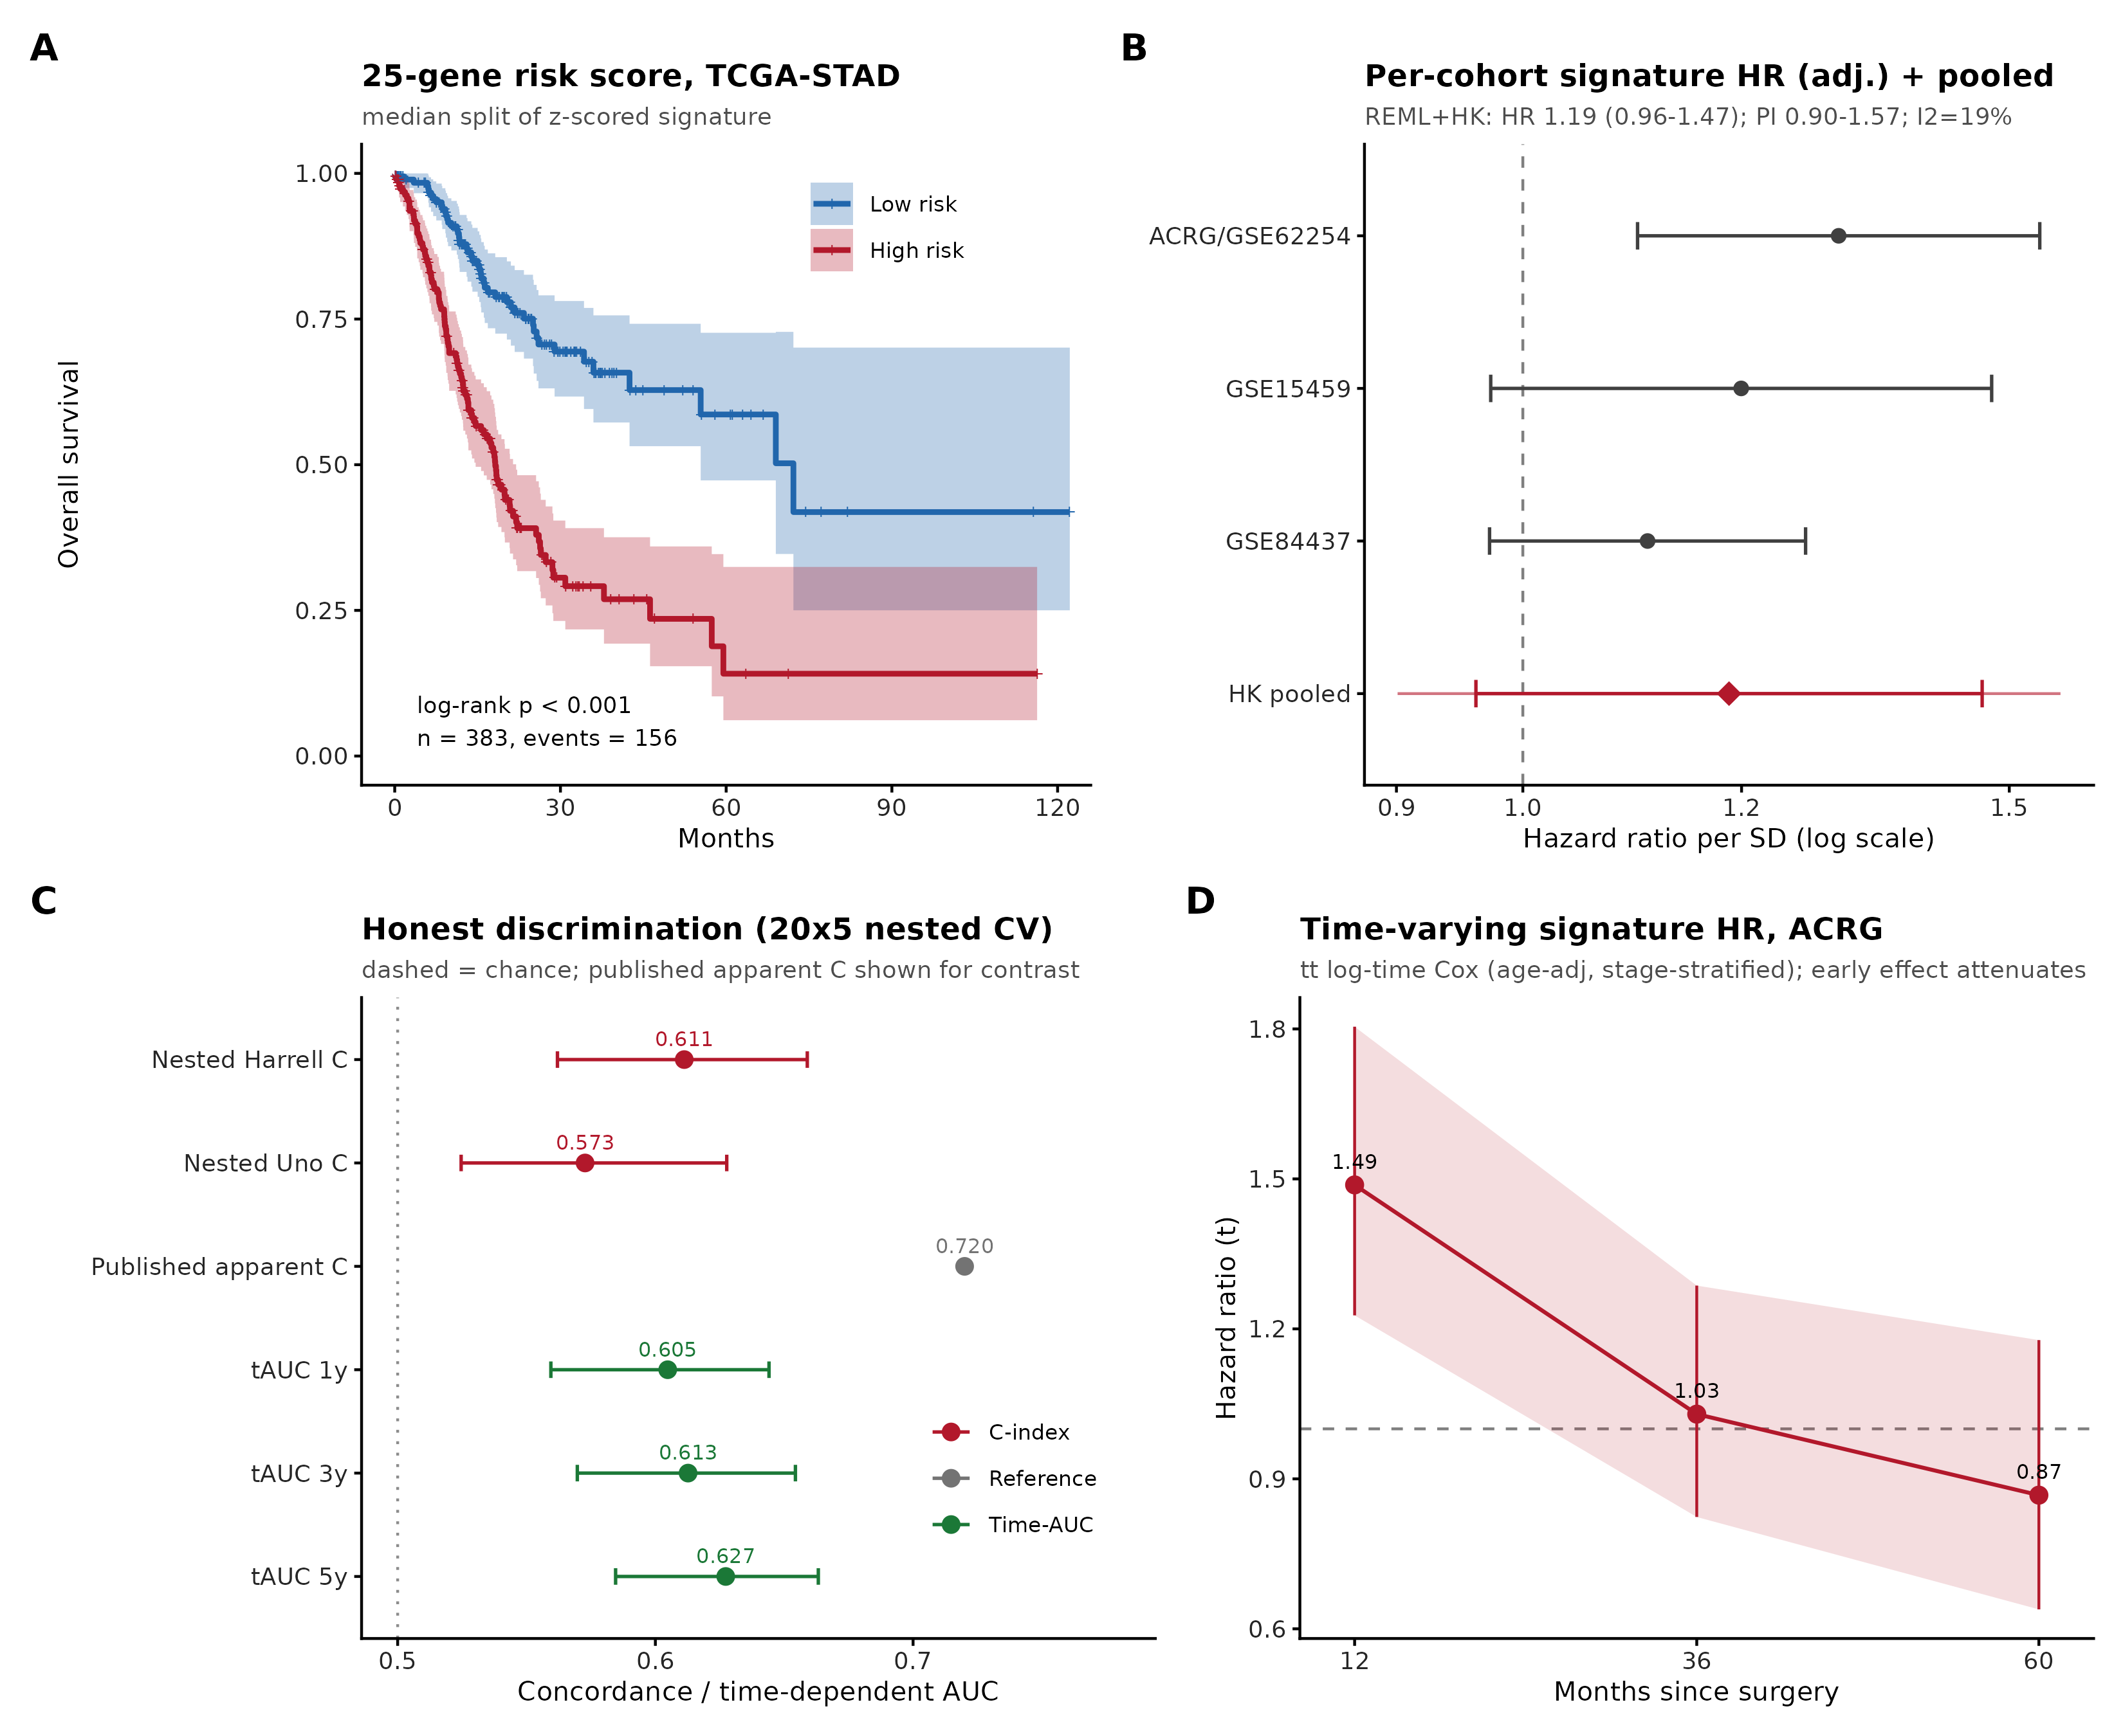
Figure — Signature reported honestly
KM, forest+meta, nested-CV, time-varying HR(t)

Slide 11
Conclusions
• PRIMARY: a 4-cohort externally-validated stromal/CAF prognostic programme — the real finding
• Signature modest/transient; microbiome comparator-dependent & batch-confounded; MR null
• Contribution: rigorous, HONEST delineation of what the data support
• Realistic target IF 3–4 (clears IF 1.5 comfortably)
• Every number real and traceable — no fabrication, external validation throughout

Slide 12
Limitations & Next steps
• Confirmatory biology; signature not clinically deployable; microbiome batch-limited; MR underpowered
• No wet-lab validation (computational study)
• Next project (separate): NW China matched shotgun-metagenomics + RNA-seq — TRUE same-patient integration + novel discovery angles

