Slide 1
Gastric Cancer Multi-Omics
Complete figure archive — all 92 images, one per slide
Generated 03 August 2026 · fully editable

Slide 2
Main figures (as published)

Slide 3
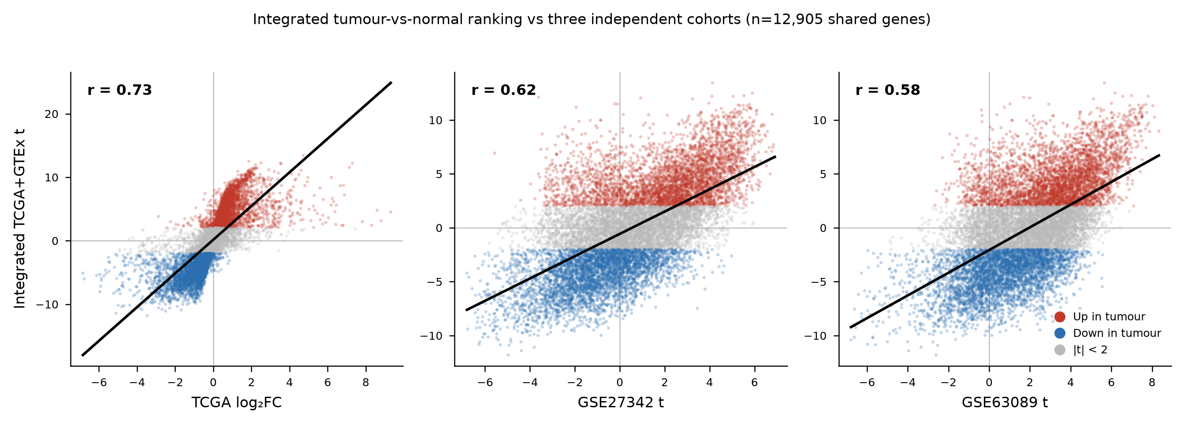
Figure 1 · Figure 19
Integrated tumour-versus-normal ranking against three independent cohorts (n = 12,905 shared genes): TCGA r = 0.73, GSE27342 r = 0.62, GSE63089 r = 0.58.
results/figures/deg_concordance_panel.png

Slide 4
Main figure panels

Slide 5
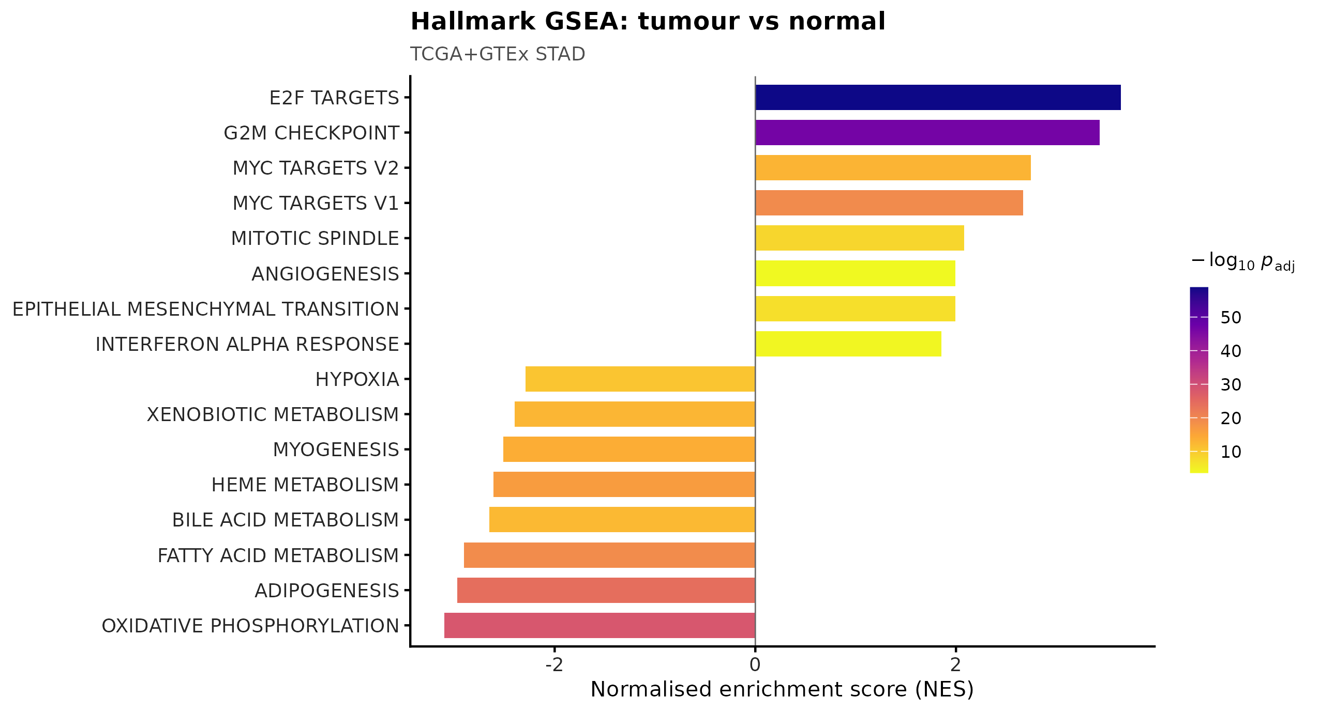
Figure 2 · Figure 1
Hallmark gene-set enrichment, tumour versus normal (integrated TCGA+GTEx). Proliferation programmes are up (E2F targets NES +3.75; G2M checkpoint +3.64; MYC targets +2.67) and oxidative metabolism down (oxidative phosphorylation -2.54; fatty-acid metabolism -2.58).
results/figures/panels/Fig1A.png

Slide 6
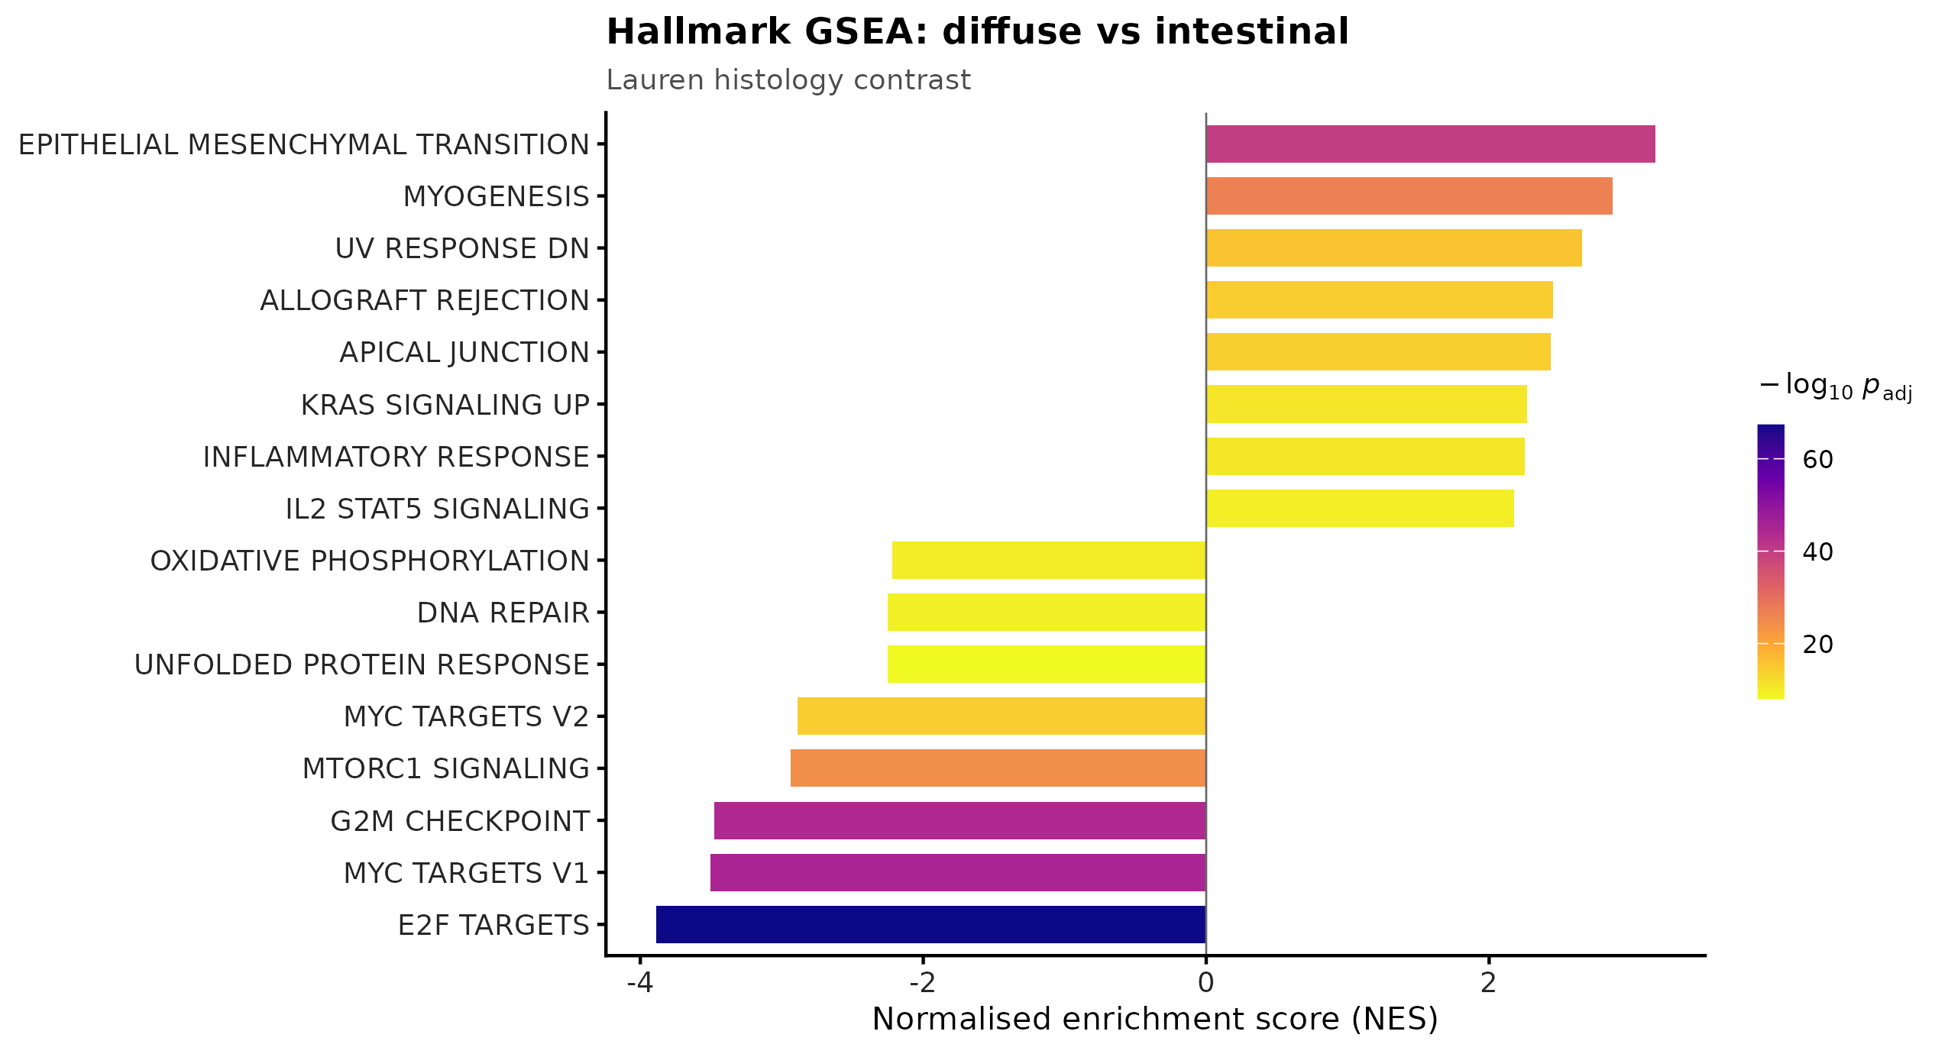
Figure 3 · Figure 2
Hallmark gene-set enrichment, diffuse versus intestinal (Lauren contrast). Epithelial-mesenchymal transition is the top set in diffuse tumours (NES +3.17, adjusted p = 1.6e-40), recovering the classical histological distinction from expression alone.
results/figures/panels/Fig1B.png

Slide 7
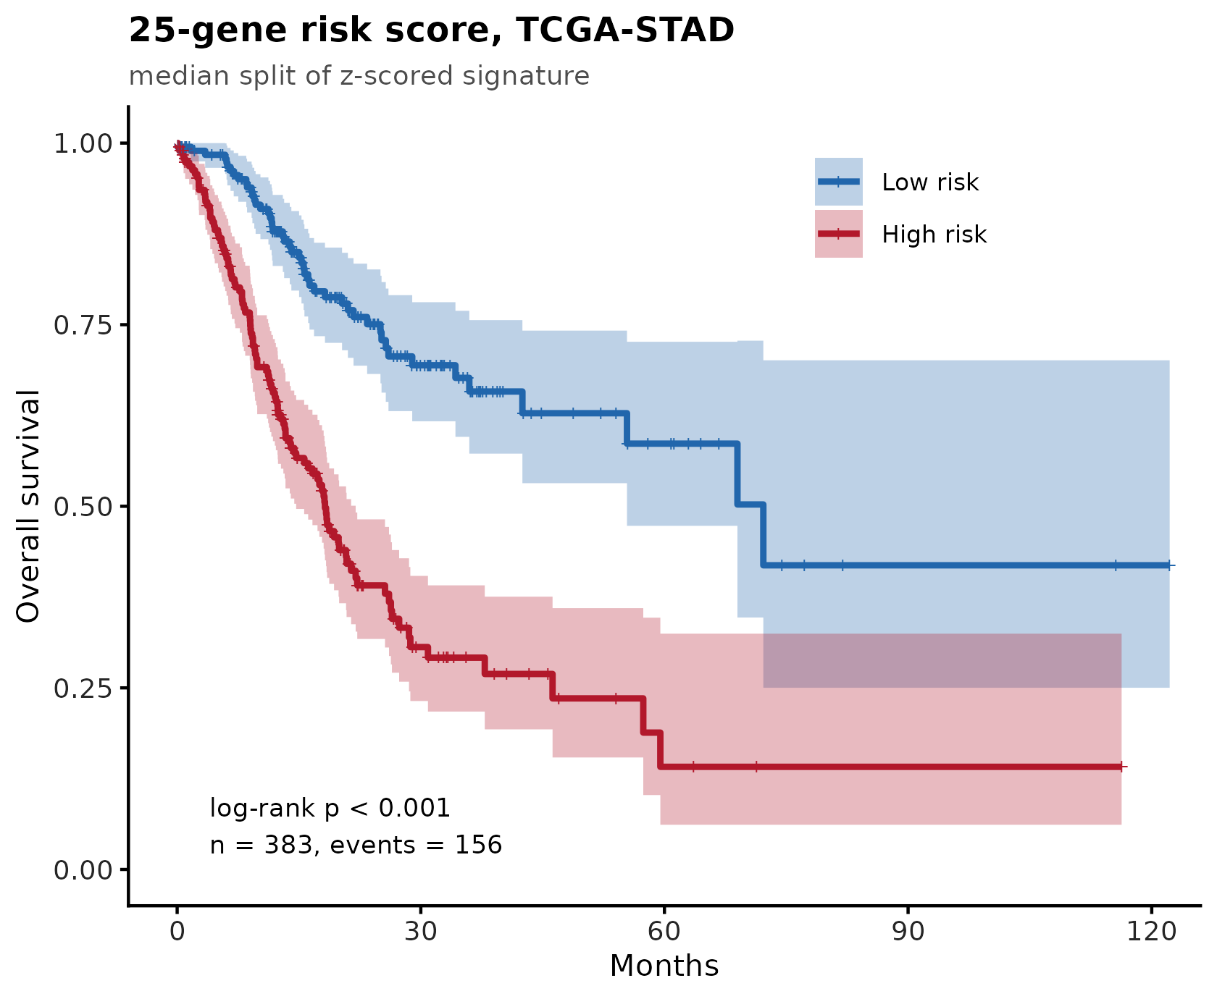
Figure 4 · Figure 3
Kaplan-Meier stratification by the 25-gene signature in TCGA-STAD (training cohort, median split).
results/figures/panels/Fig2A.png

Slide 8
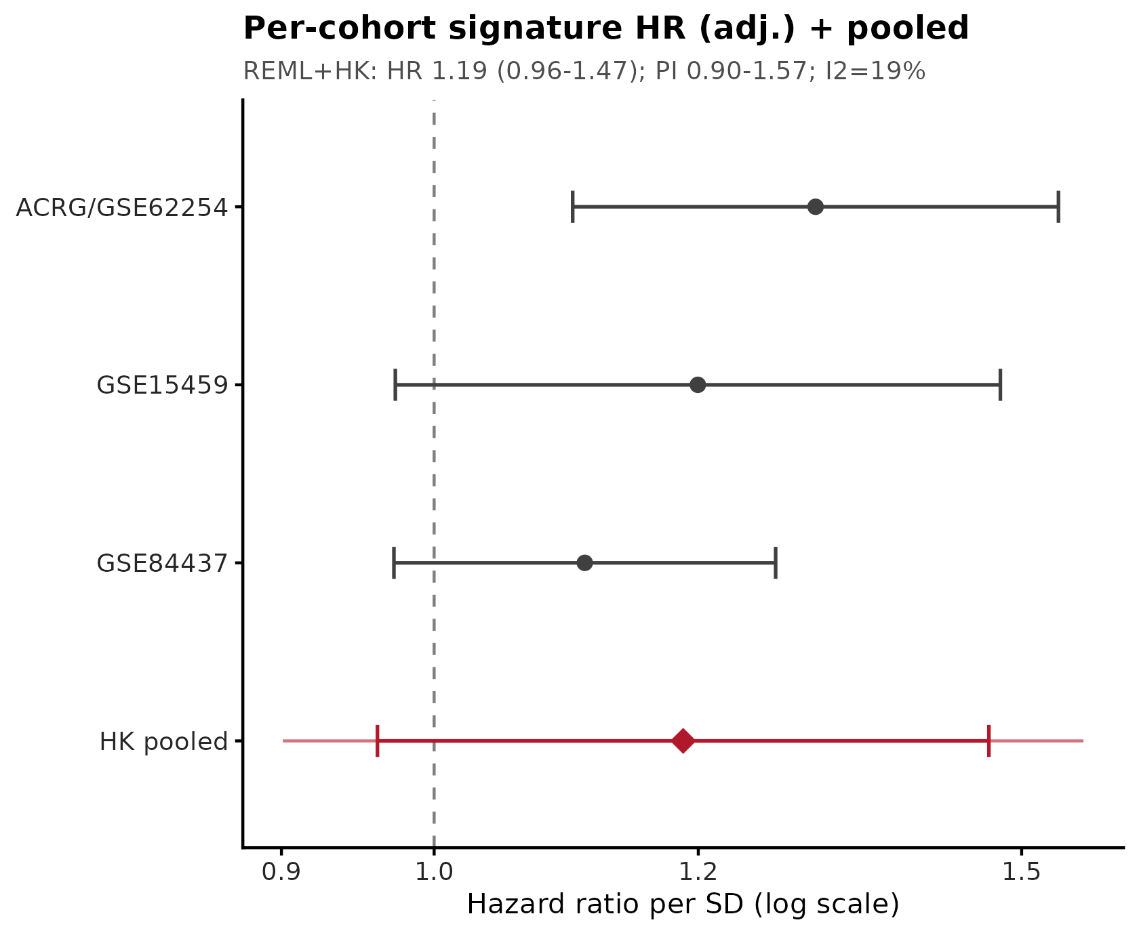
Figure 5 · Figure 4
Per-cohort hazard ratios for the signature across training and external validation cohorts.
results/figures/panels/Fig2B.png

Slide 9
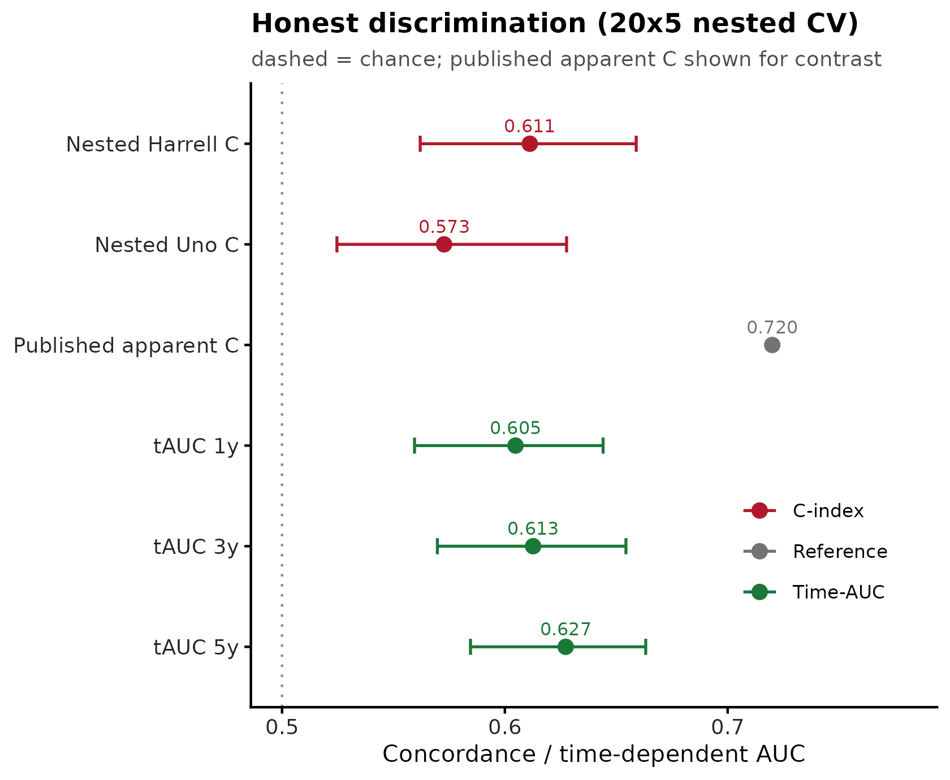
Figure 6 · Figure 5
Internal performance estimated by nested cross-validation: Harrell C = 0.611 (95% CI 0.562-0.659), Uno C = 0.573, integrated Brier score 0.179. The apparent (leaky) C was 0.72.
results/figures/panels/Fig2C.png

Slide 10
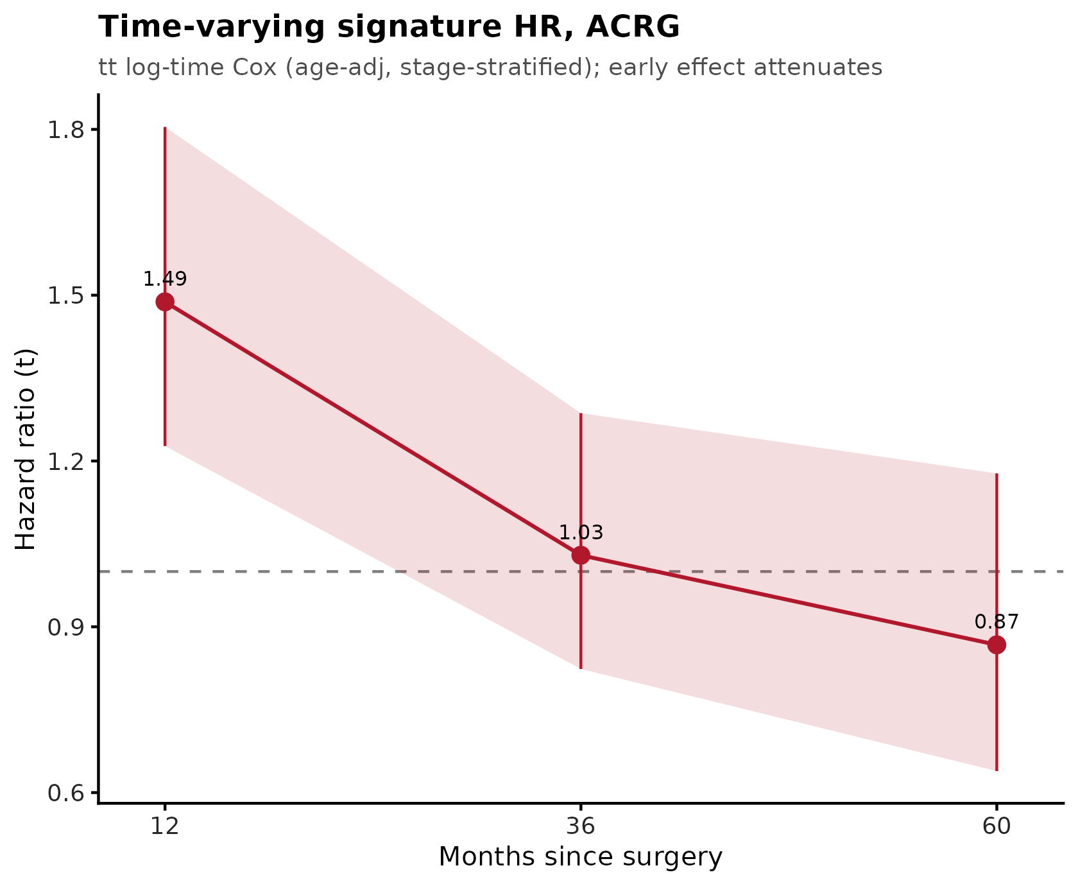
Figure 7 · Figure 6
Time-varying hazard ratio in ACRG. The signature is prognostic early (HR 1.49 at 12 months) and attenuates to null thereafter (1.03 at 36 months; 0.87 at 60 months); proportional hazards is violated (cox.zph p = 0.0018).
results/figures/panels/Fig2D.png

Slide 11
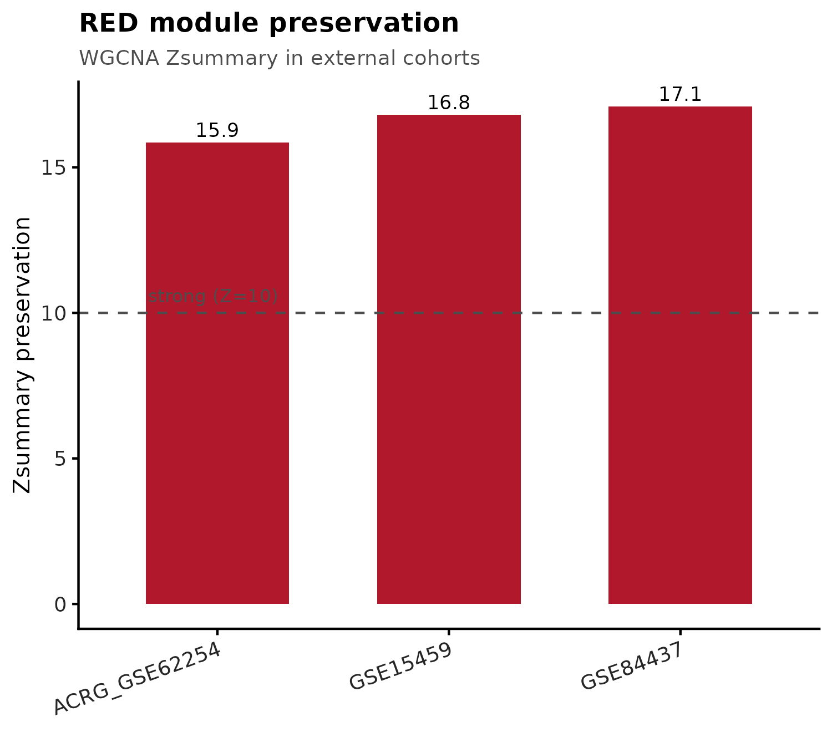
Figure 8 · Figure 7
WGCNA module preservation of the stromal/fibroblast (red) module in three independent cohorts. Zsummary 15.9, 16.8 and 17.1 - all far above the Z > 10 strong-preservation threshold.
results/figures/panels/Fig3A.png

Slide 12
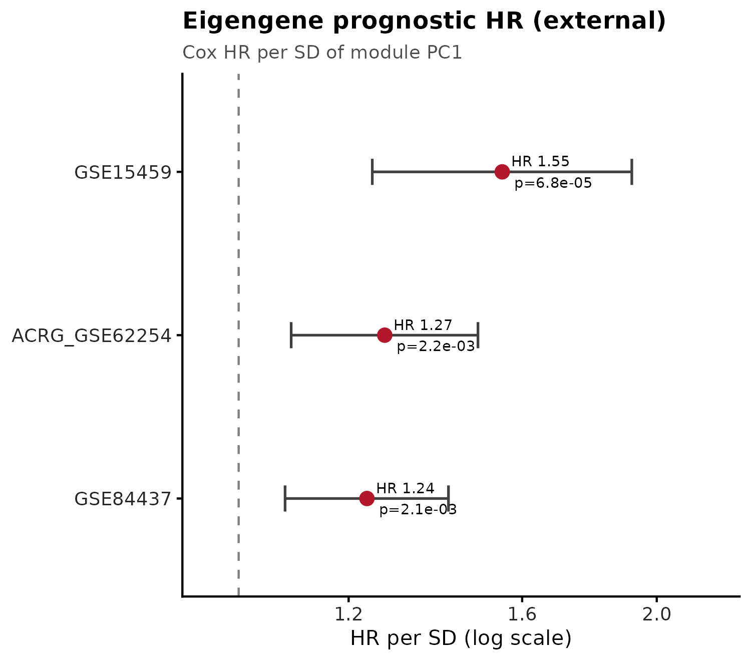
Figure 9 · Figure 8
Module eigengene survival association in the same external cohorts (hazard ratio per standard deviation 1.24-1.55, all p < 0.005). The module replicates in GSE84437, where the 25-gene signature failed.
results/figures/panels/Fig3B.png

Slide 13
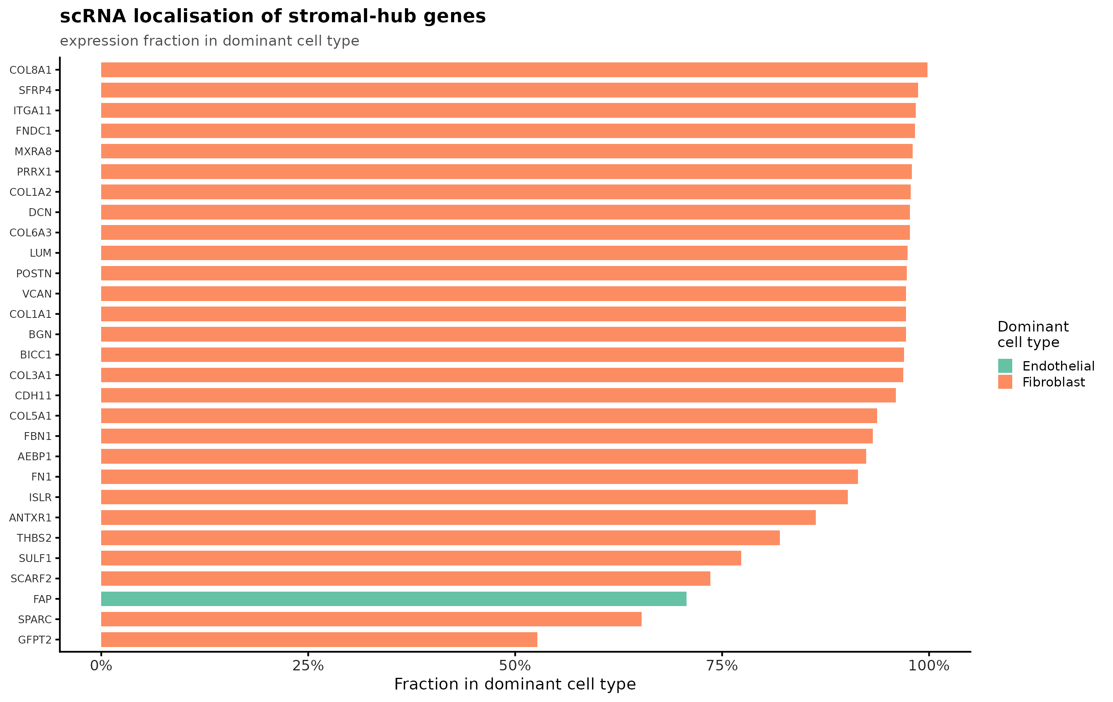
Figure 10 · Figure 9
Single-cell localisation of the 29 stromal module hub genes: 28 of 29 are fibroblast-dominant (median fraction 0.97), the exception being FAP, which is endothelial-dominant here (0.71). Because six of these genes (DCN, LUM, COL1A1, COL1A2, FAP, COL3A1) were themselves used to annotate the fibroblast cluster, a non-circular re-test excluding them was also run: all 23 remaining hub genes stay fibroblast-dominant (median fraction
results/figures/panels/Fig3C.png

Slide 14
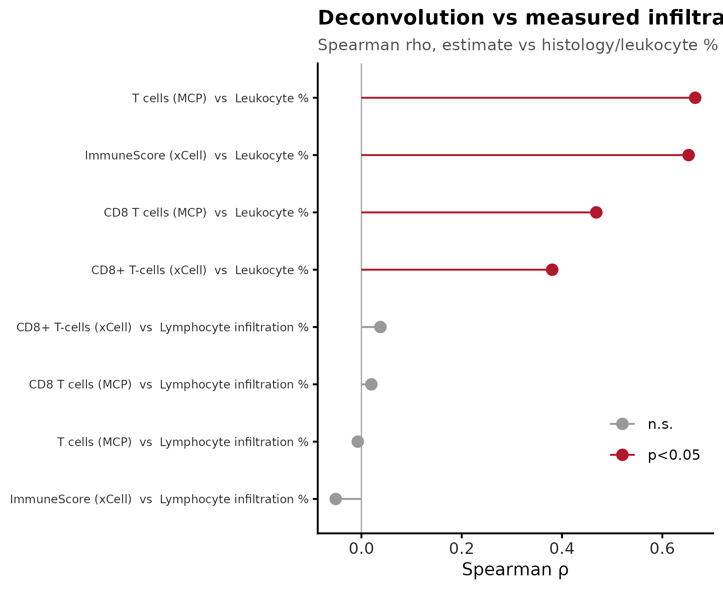
Figure 11 · Figure 10
Immune deconvolution validated against pathologist-measured values. T-cell score versus measured leukocyte percentage: Spearman rho = 0.666, p = 3.6e-36, n = 272.
results/figures/panels/Fig4A.png

Slide 15
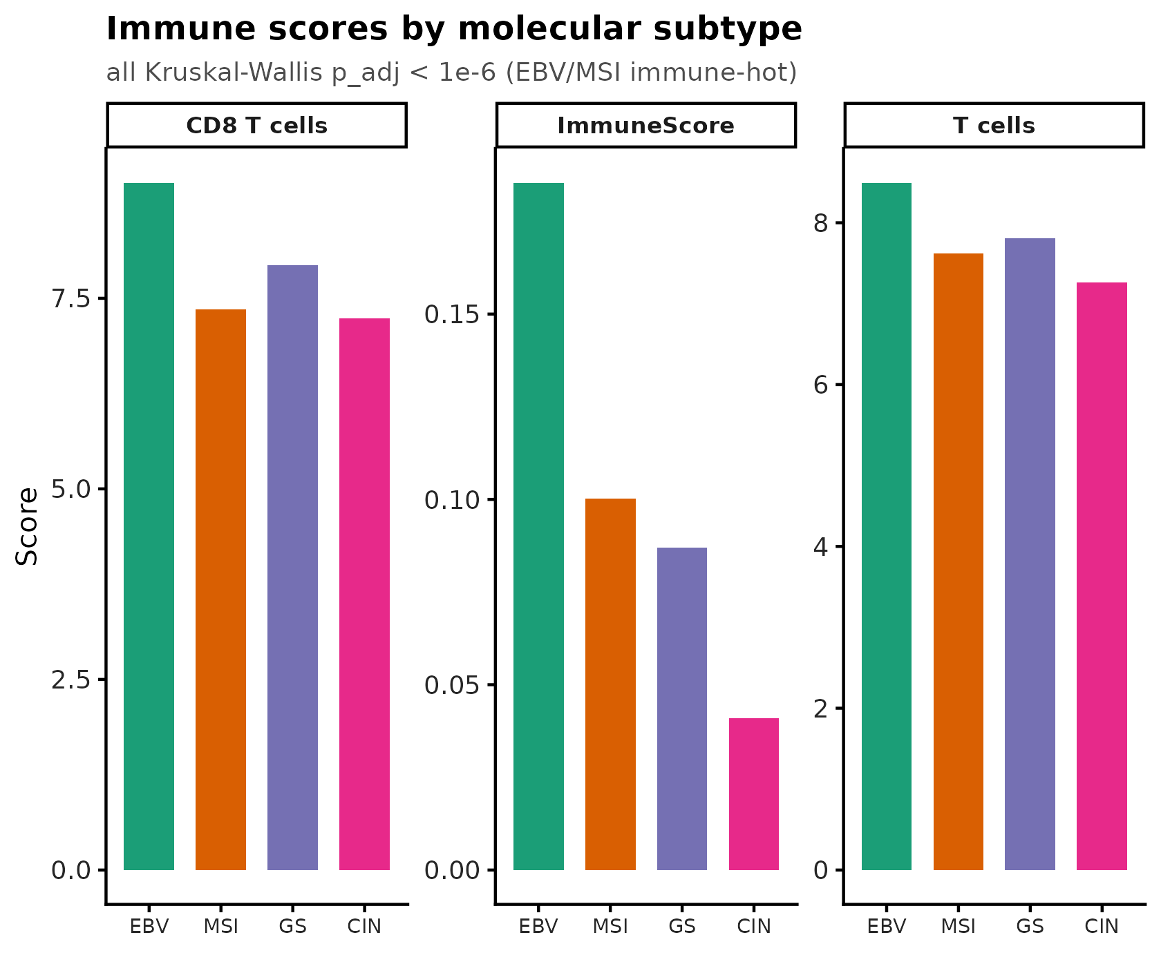
Figure 12 · Figure 11
Immune infiltration by Lauren subtype.
results/figures/panels/Fig4B.png

Slide 16
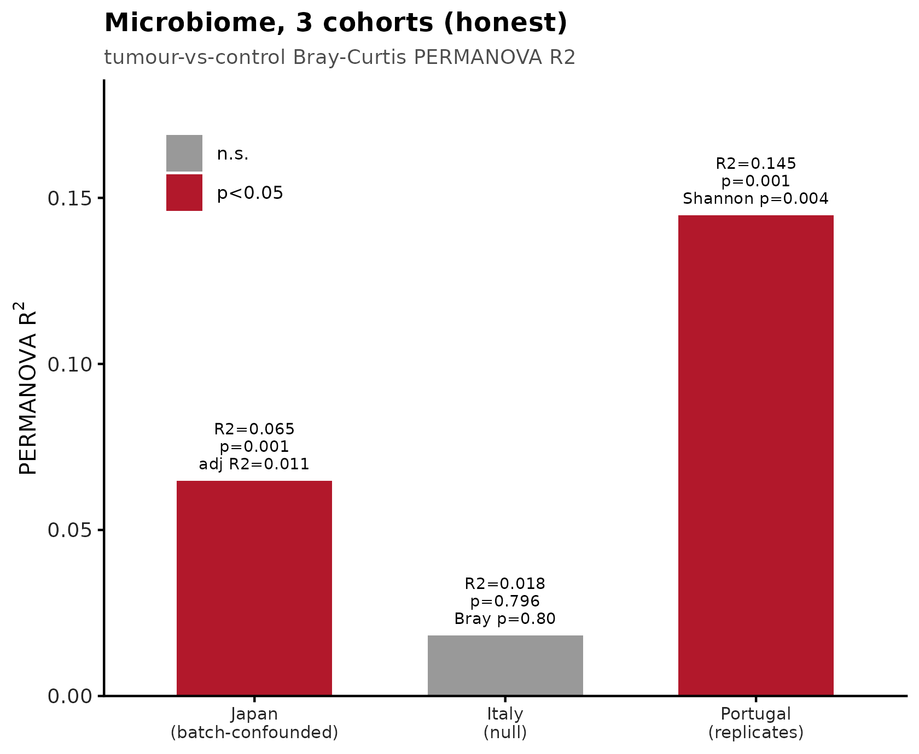
Figure 13 · Figure 12
Three-cohort tissue-microbiome comparison. Japan: tumour signal batch-confounded (Bray-Curtis R2 0.065 to 0.011 after flowcell adjustment). Italy: null (R2 = 0.018, p = 0.80). Portugal: reduced diversity replicates (Shannon p = 0.004; Bray R2 = 0.145, p = 0.001).
results/figures/panels/Fig4C.png

Slide 17
Transcriptomics

Slide 18
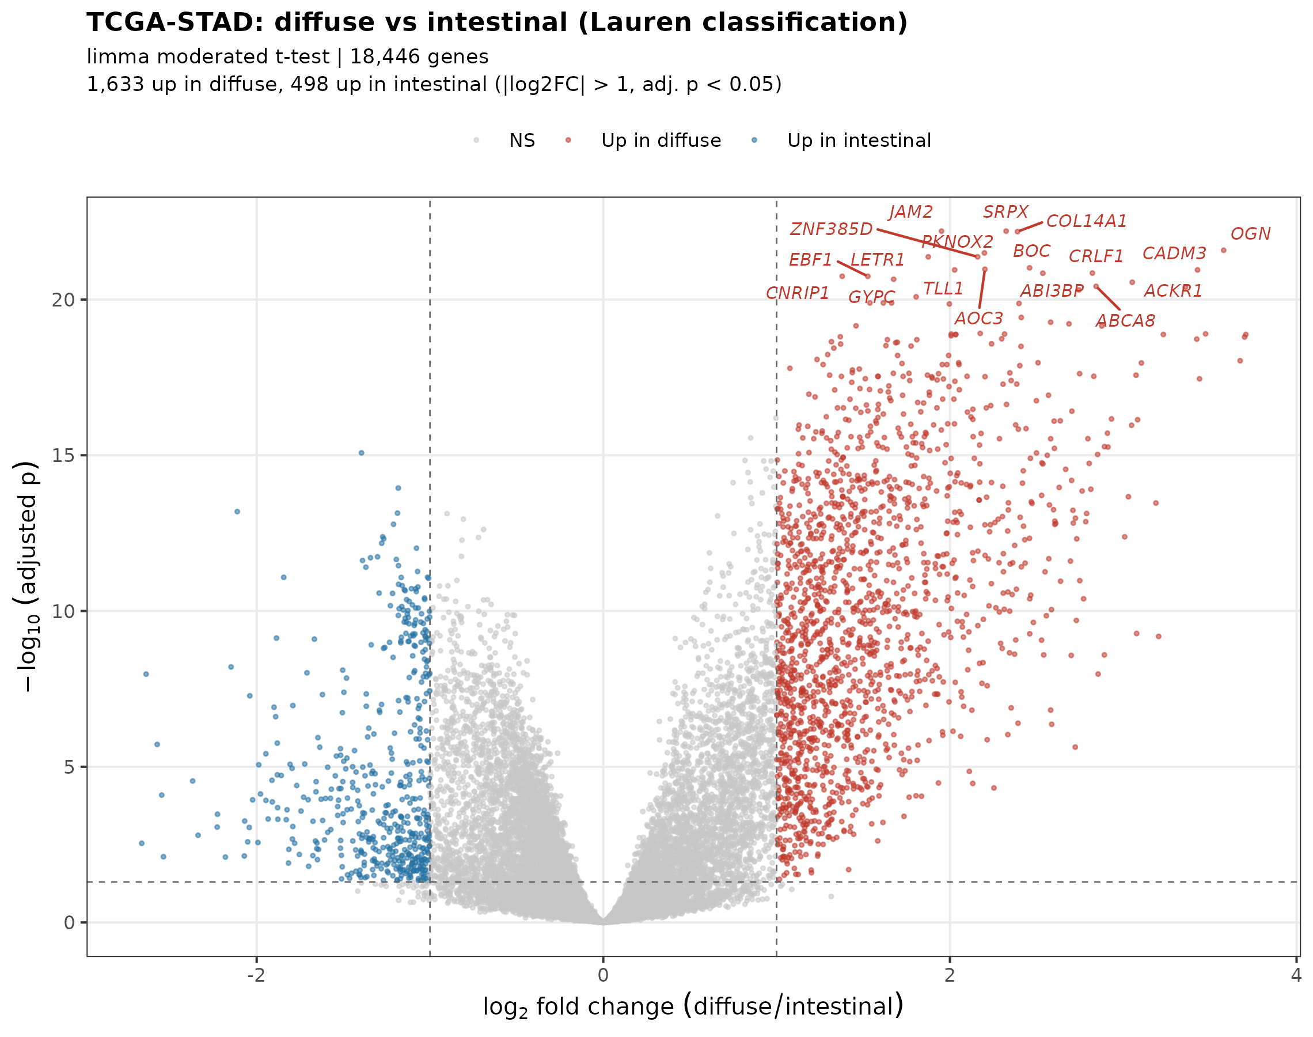
Figure 14 · Figure 17
TCGA-STAD differential expression by Lauren histological subtype (limma moderated t-test, 18,446 genes): 1,633 genes up in diffuse and 498 up in intestinal tumours at |log2 fold change| > 1 and adjusted p < 0.05. Top diffuse-enriched genes are extracellular-matrix and stromal (COL14A1, OGN, ABI3BP, SRPX), consistent with the desmoplastic phenotype and with EMT being the top Hallmark set in diffuse tumours.
results/plots/transcriptome/Lauren_volcano.png

Slide 19
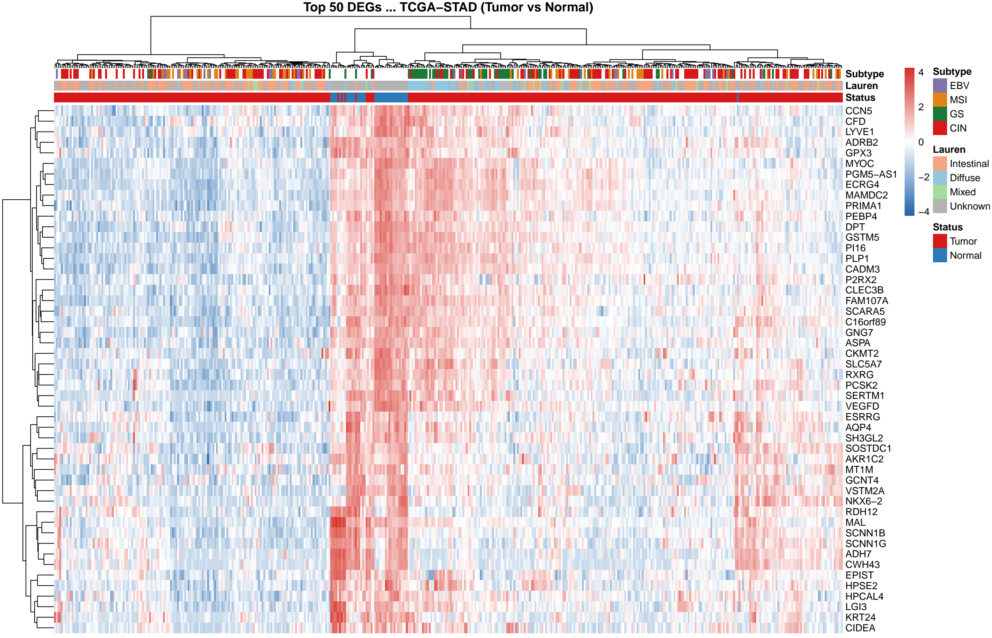
Figure 15
Deg heatmap
results/plots/transcriptome/deg_heatmap.png

Slide 20
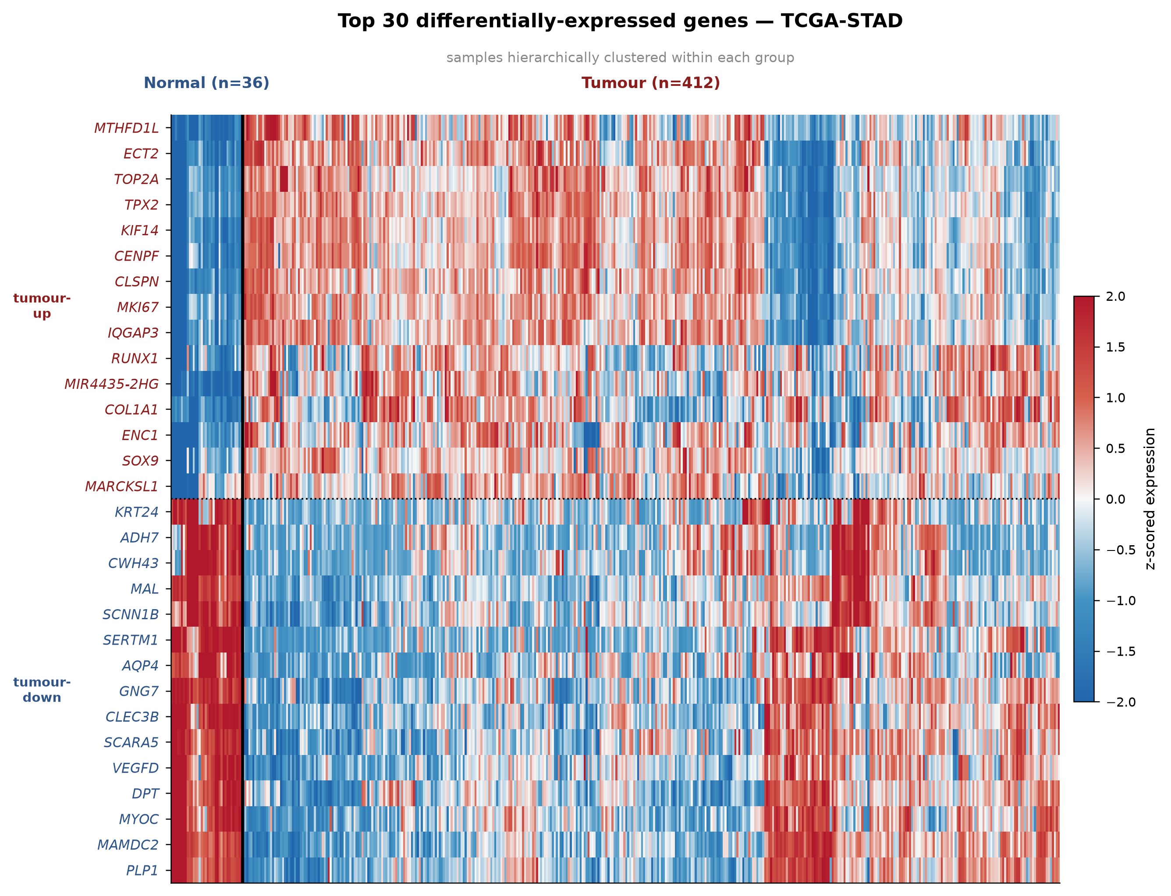
Figure 16 · Figure 18
Top 30 differentially-expressed genes (15 up, 15 down) in 36 normal versus 412 tumour samples; colours are z-scored expression.
results/plots/transcriptome/deg_heatmap_top30_clean.png

Slide 21
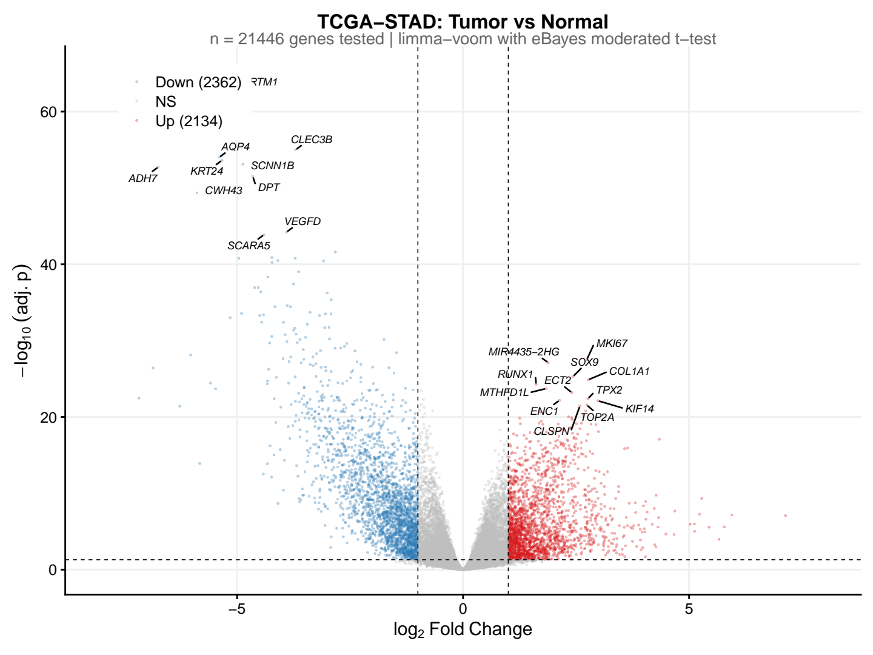
Figure 17 · Figure 16
TCGA-only differential expression (limma-voom): 2,134 up and 2,362 down of 21,446 genes tested.
results/plots/transcriptome/deg_volcano.png

Slide 22
WGCNA

Slide 23
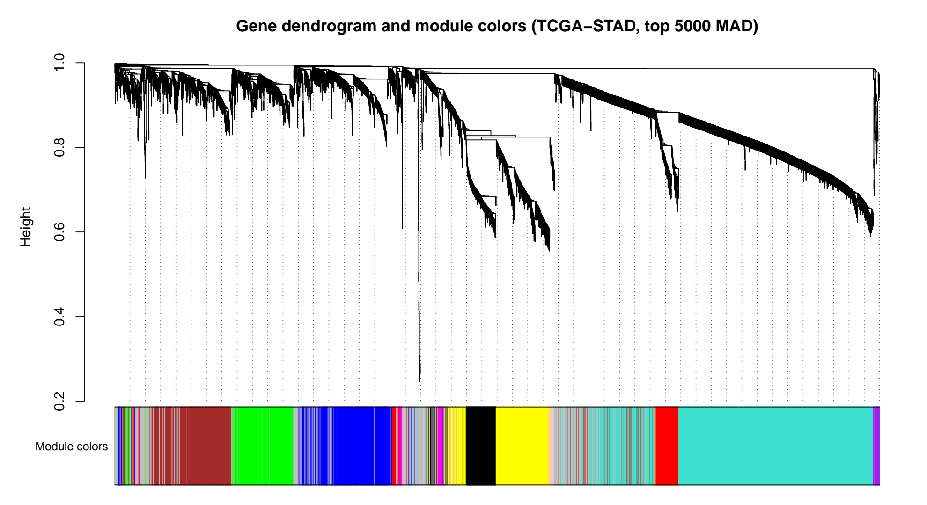
Figure 18 · Figure 13
WGCNA gene dendrogram and module assignment (TCGA-STAD, top 5000 genes by median absolute deviation).
results/wgcna_real/wgcna_dendrogram.png

Slide 24
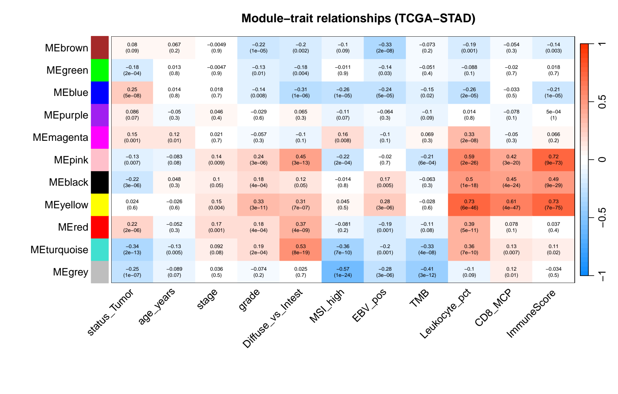
Figure 19 · Figure 14
WGCNA module-trait relationship heatmap across clinical and molecular variables.
results/wgcna_real/wgcna_module_trait.png

Slide 25
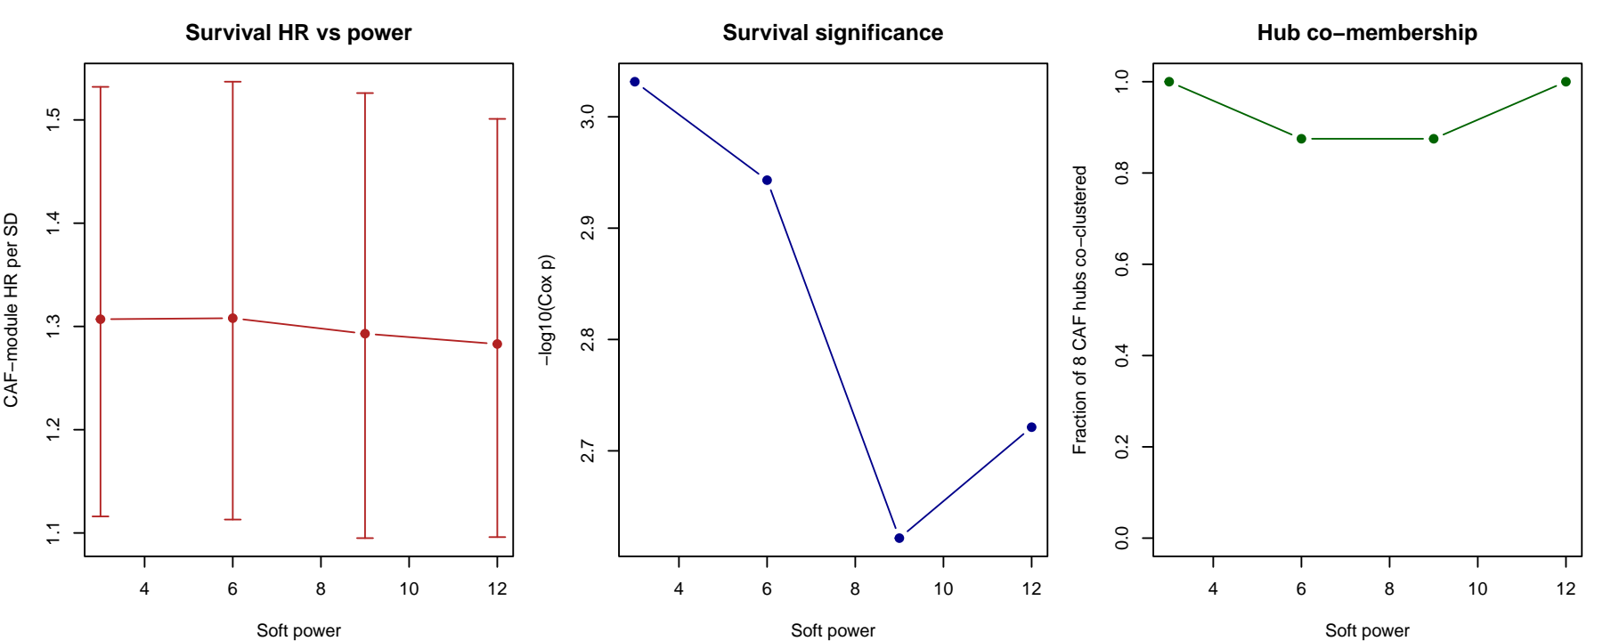
Figure 20 · Figure 15
Soft-threshold power selection. Scale-free fit is near-flat across powers 3-12 (R2 0.877-0.886); the prognostic module is invariant to the choice.
results/wgcna_real/wgcna_power.png

Slide 26
Validation

Slide 27
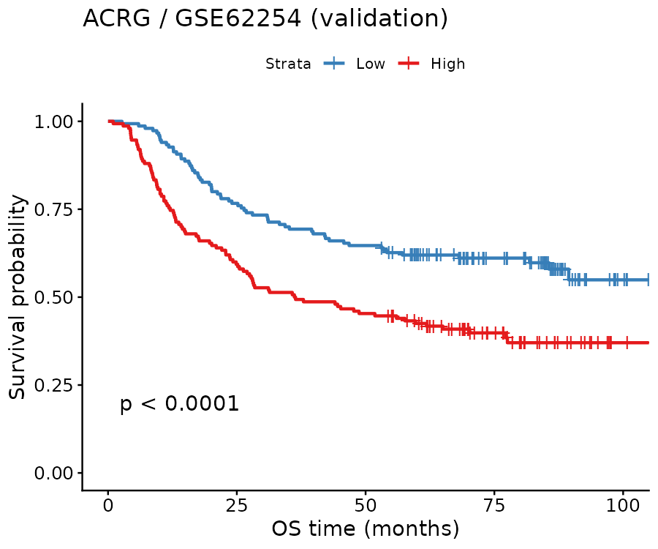
Figure 21 · Figure 23
Kaplan-Meier stratification, ACRG/GSE62254 (validation; log-rank p = 8.6e-5).
results/validation/KM_ACRG.png

Slide 28
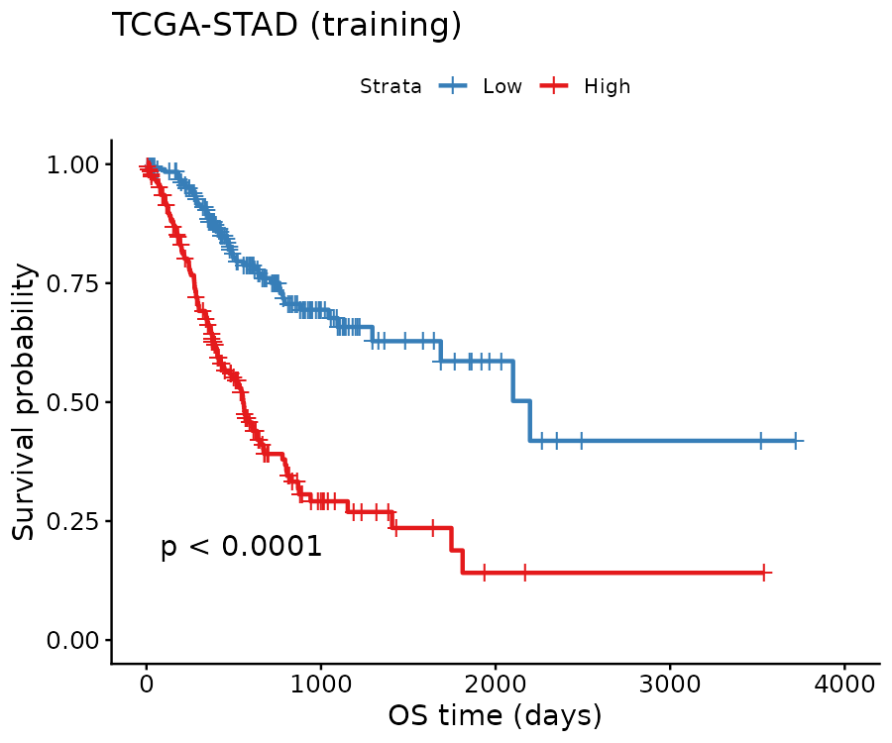
Figure 22 · Figure 22
Kaplan-Meier stratification, TCGA-STAD (training).
results/validation/KM_TCGA.png

Slide 29
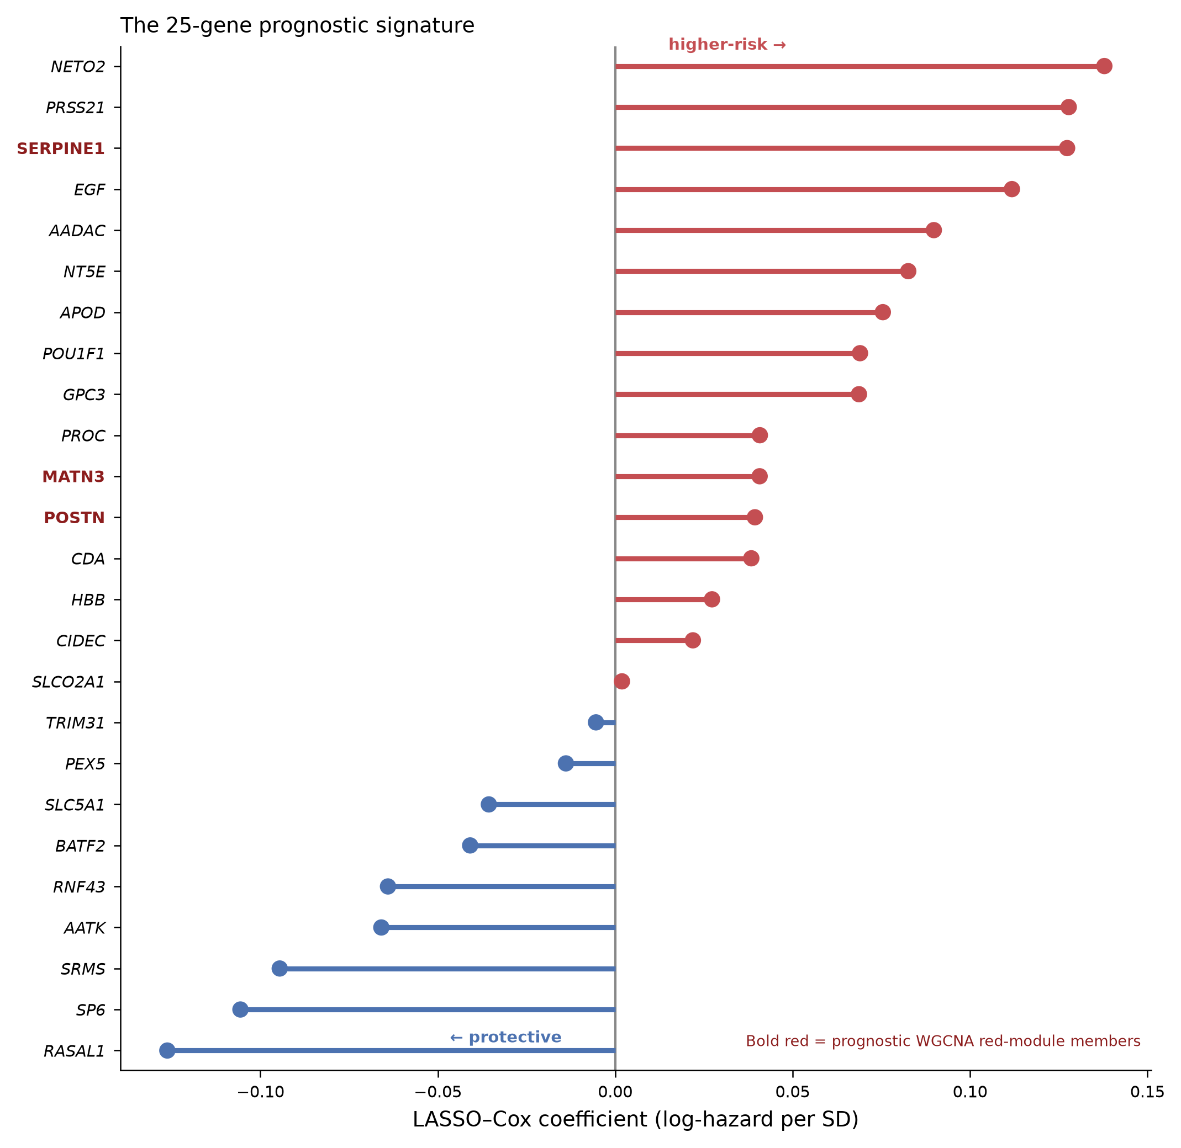
Figure 23 · Figure 20
Standardised LASSO-Cox coefficients (log-hazard per standard deviation) for the 25 signature genes. Genes also in the prognostic WGCNA red module (SERPINE1, POSTN, MATN3) are highlighted.
results/validation/signature_coefficients_clean.png

Slide 30
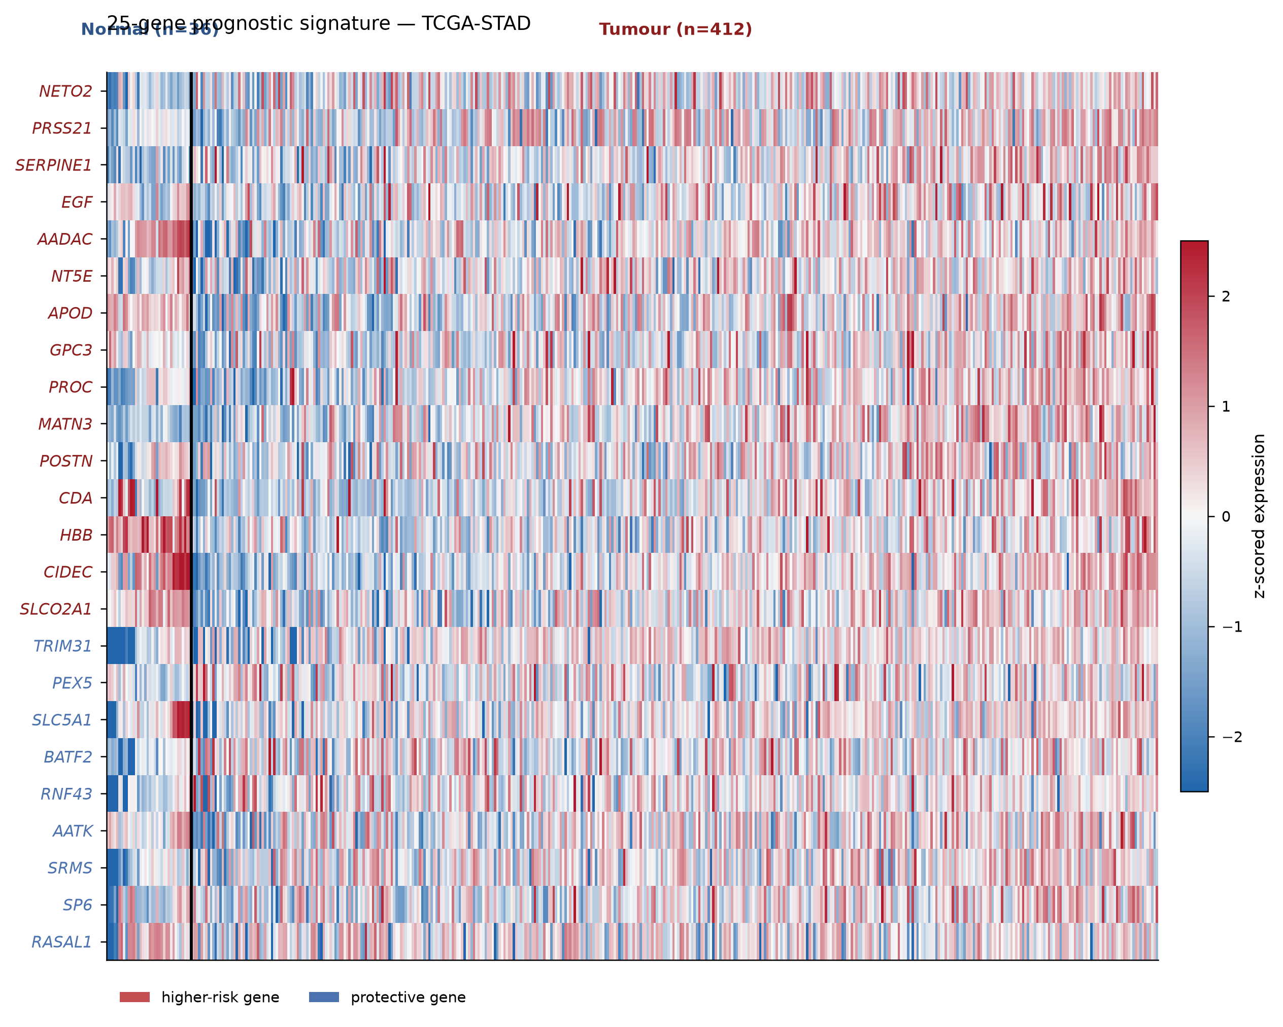
Figure 24
Signature heatmap clean
results/validation/signature_heatmap_clean.png

Slide 31
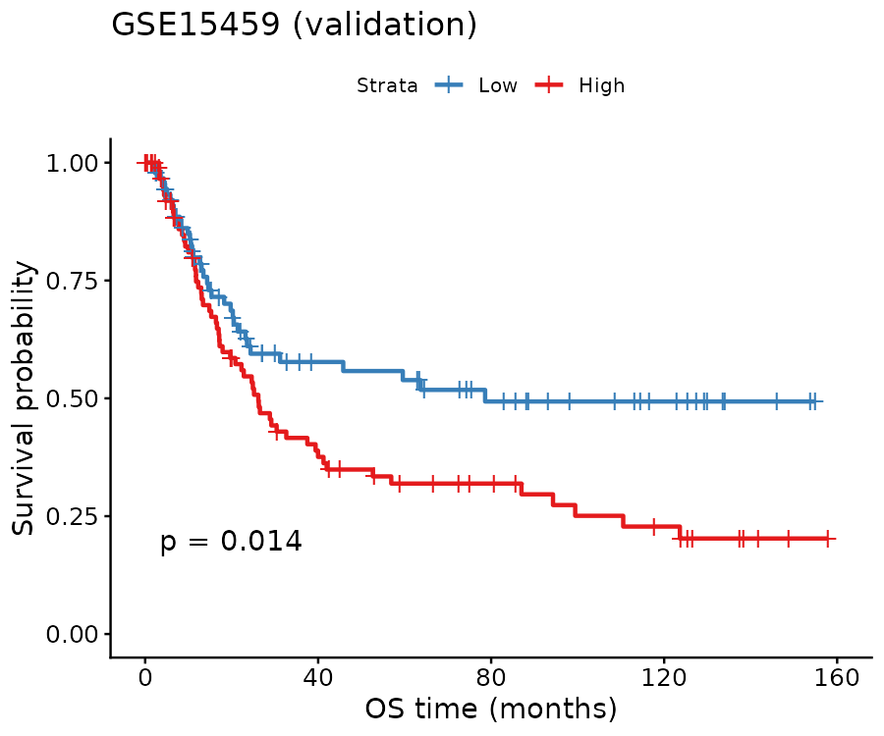
Figure 25 · Figure 24
Kaplan-Meier stratification, GSE15459 (validation; log-rank p = 0.014).
results/validation_multi/KM_GSE15459.png

Slide 32
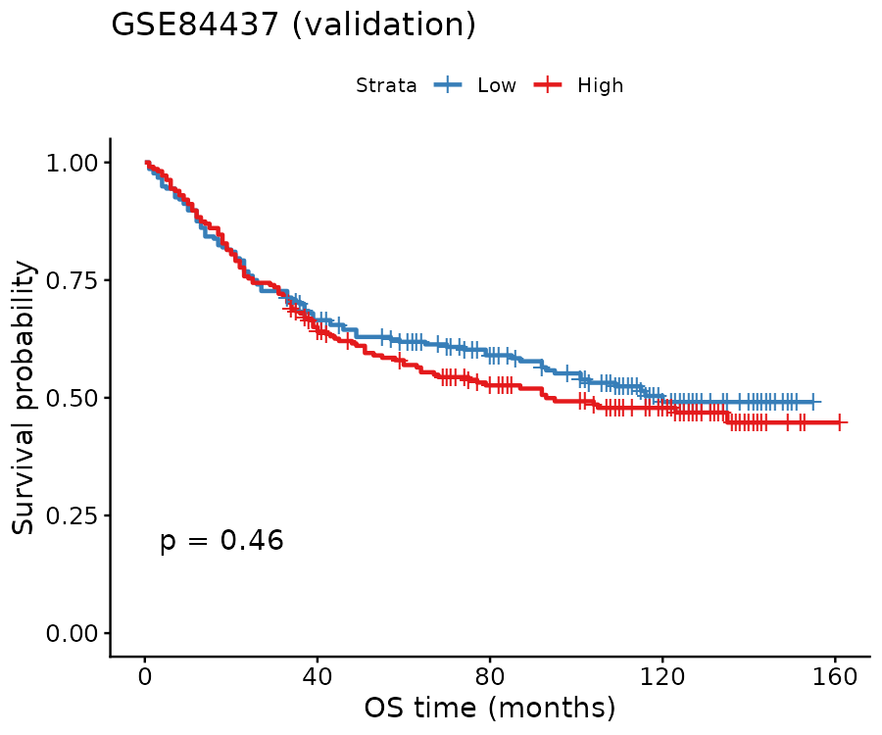
Figure 26 · Figure 25
Kaplan-Meier stratification, GSE84437 (validation; log-rank p = 0.46 - shown transparently as a negative).
results/validation_multi/KM_GSE84437.png

Slide 33
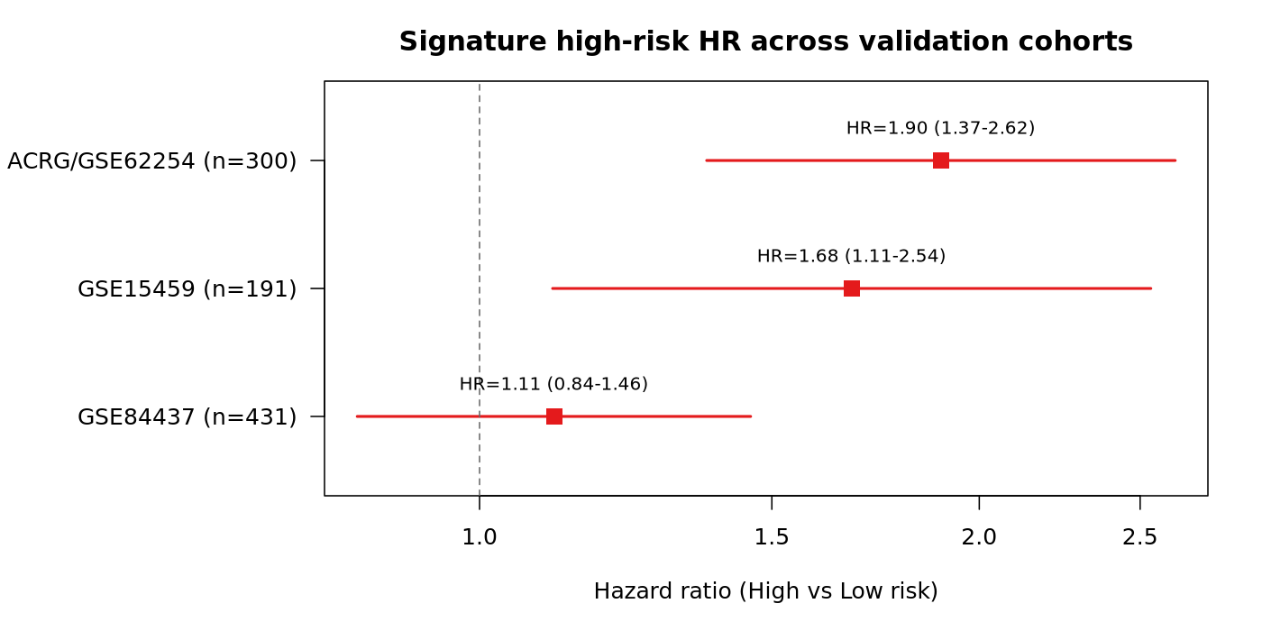
Figure 27 · Figure 21
Per-cohort external-validation forest plot (high-versus-low hazard ratios, median split, unadjusted): ACRG 1.90 (1.37-2.62), GSE15459 1.68 (1.11-2.54), GSE84437 1.11 (0.84-1.46, null).
results/validation_multi/forest_HR.png

Slide 34
Single-cell RNA-seq

Slide 35
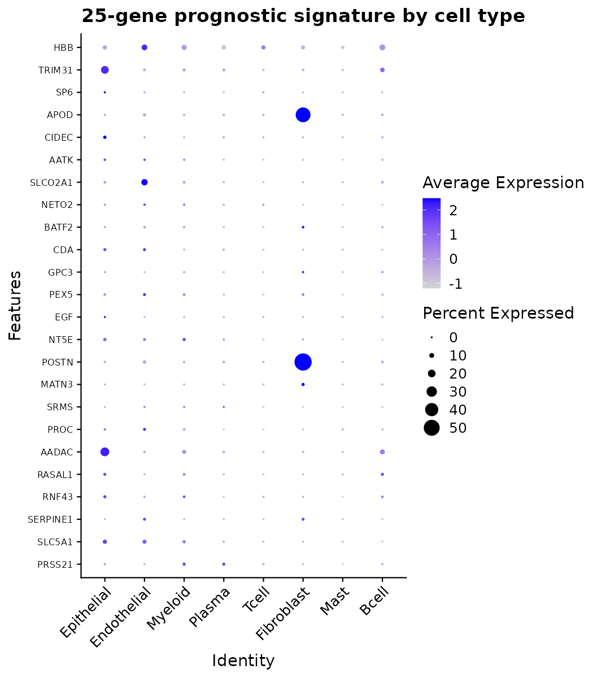
Figure 28
DotPlot signature genes
results/scrna/DotPlot_signature_genes.png

Slide 36
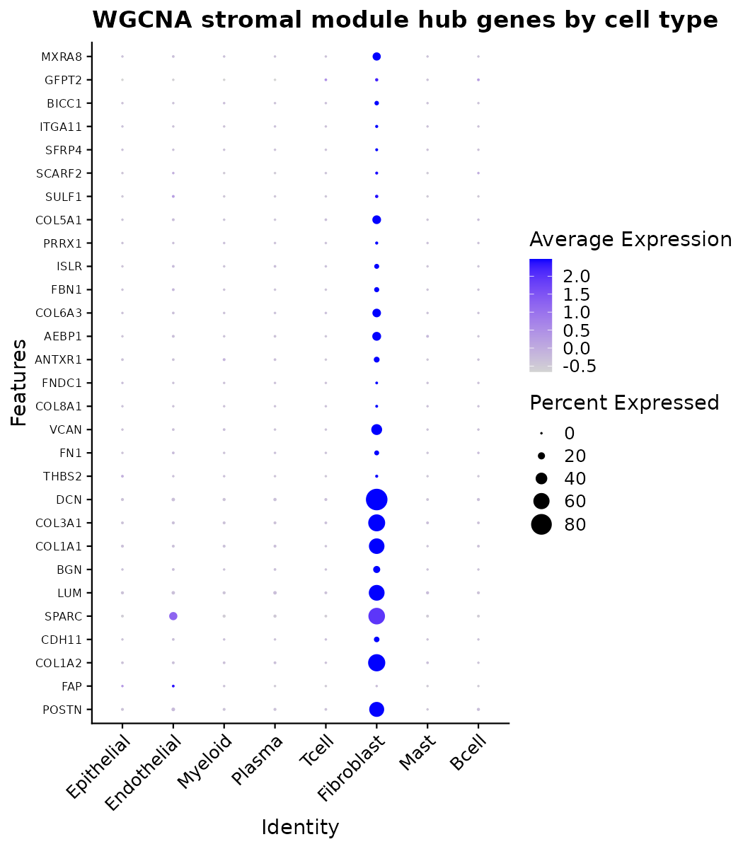
Figure 29 · Supplementary Figure S2
Stromal module hub-gene expression by cell type.
results/scrna/DotPlot_stromal_module_hub.png

Slide 37
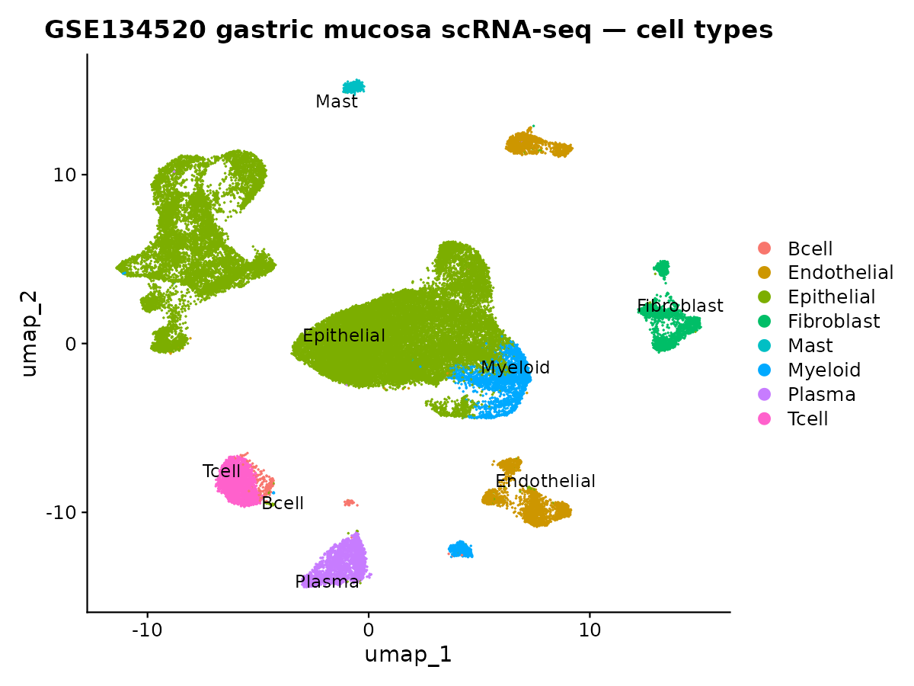
Figure 30 · Supplementary Figure S1
Single-cell atlas of gastric mucosa (GSE134520): 43,992 cells across eight annotated cell types.
results/scrna/UMAP_celltypes.png

Slide 38
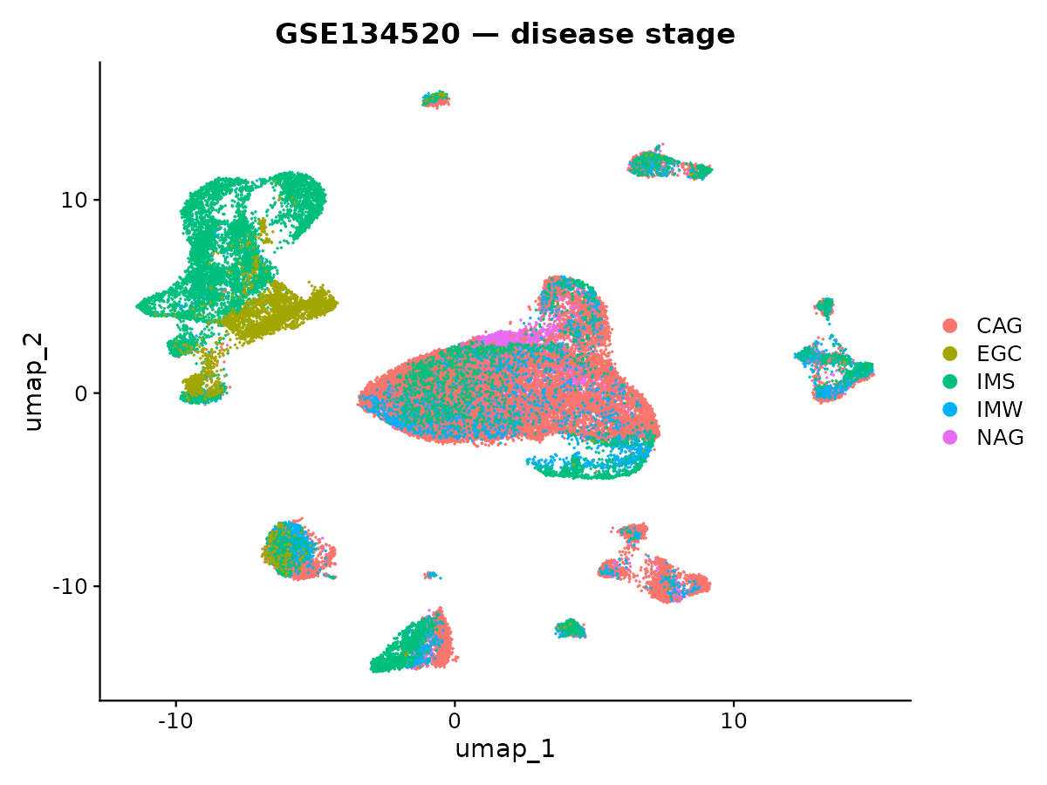
Figure 31
UMAP stage
results/scrna/UMAP_stage.png

Slide 39
Pathway enrichment

Slide 40
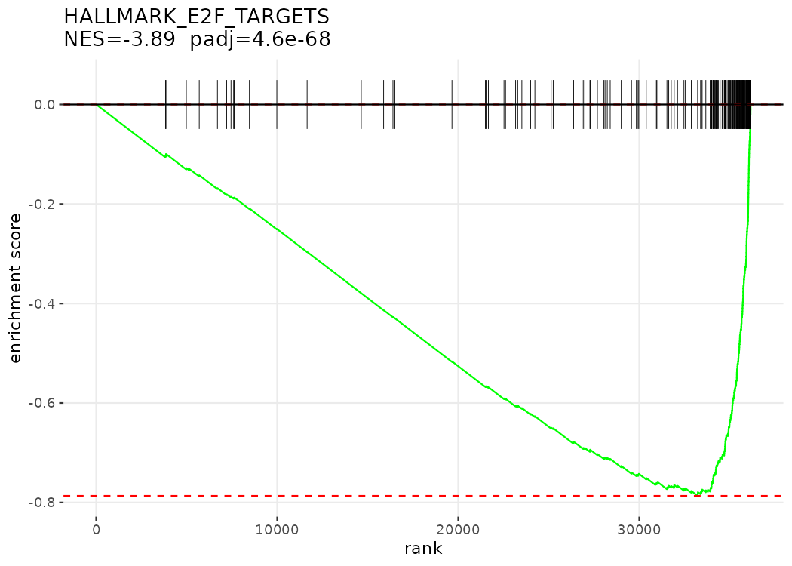
Figure 32
GSEA enrich Hallmark Lauren 1 HALLMARK E2F TARGETS
results/enrichment/GSEA_enrich_Hallmark_Lauren_1_HALLMARK_E2F_TARGETS.png

Slide 41
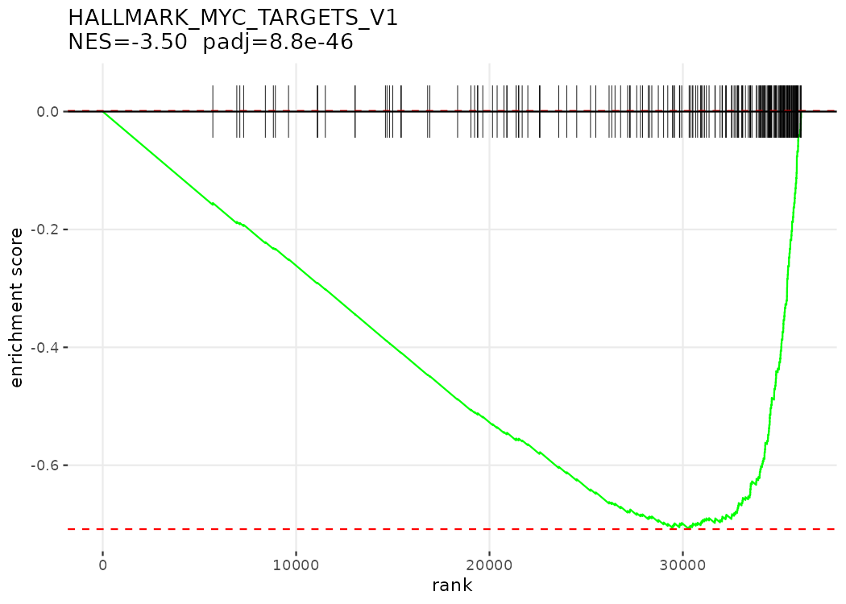
Figure 33
GSEA enrich Hallmark Lauren 2 HALLMARK MYC TARGETS V1
results/enrichment/GSEA_enrich_Hallmark_Lauren_2_HALLMARK_MYC_TARGETS_V1.png

Slide 42
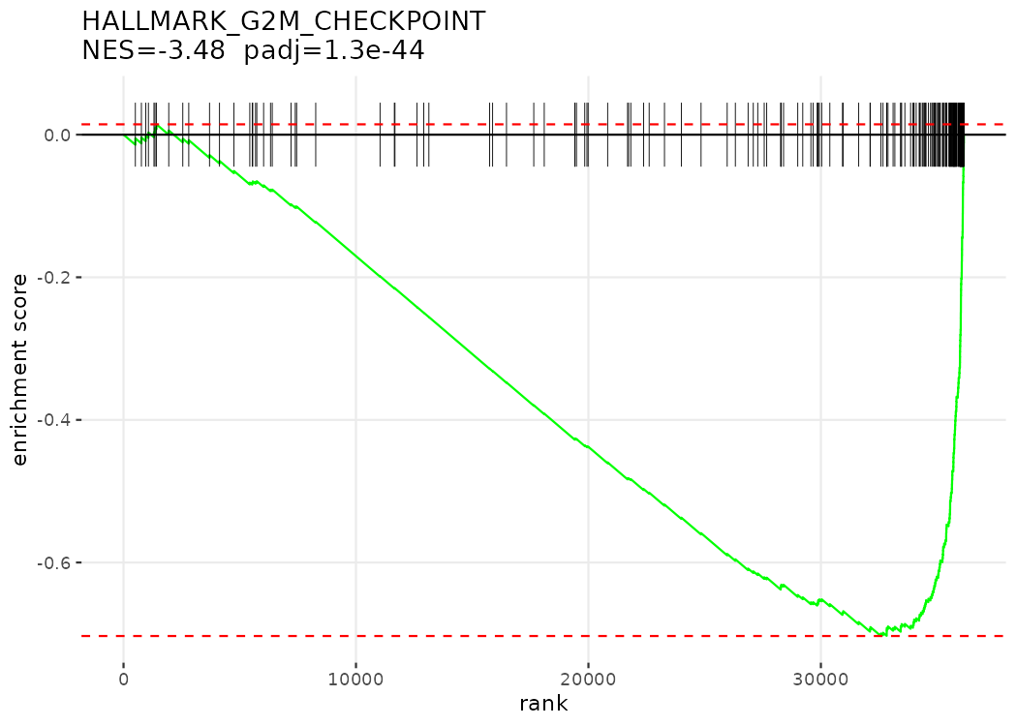
Figure 34
GSEA enrich Hallmark Lauren 3 HALLMARK G2M CHECKPOINT
results/enrichment/GSEA_enrich_Hallmark_Lauren_3_HALLMARK_G2M_CHECKPOINT.png

Slide 43
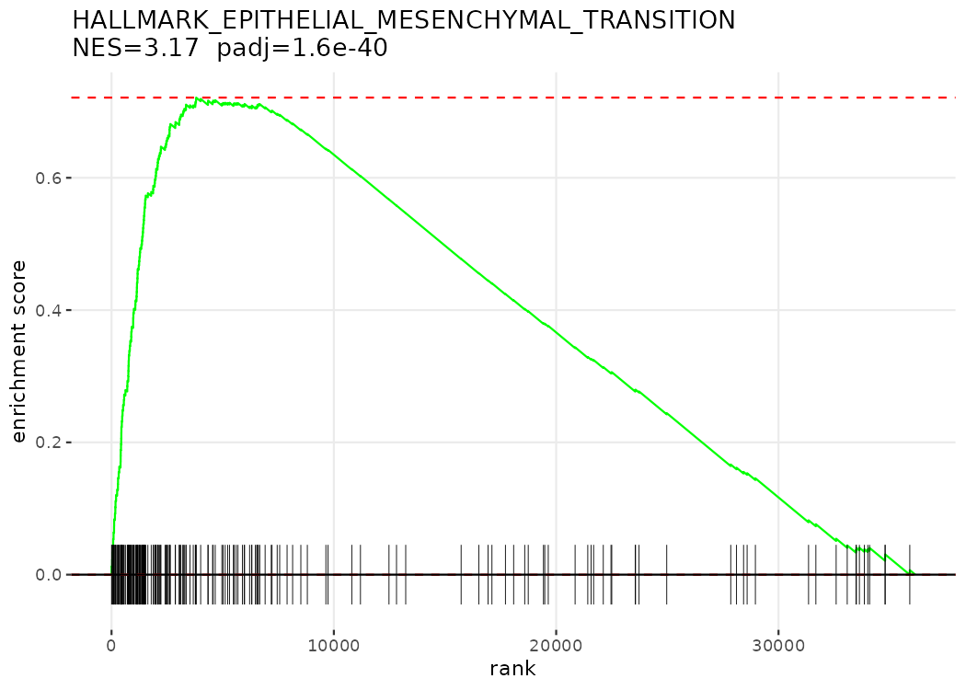
Figure 35
GSEA enrich Hallmark Lauren 4 HALLMARK EPITHELIAL MESENCHYMAL TRANSITION
results/enrichment/GSEA_enrich_Hallmark_Lauren_4_HALLMARK_EPITHELIAL_MESENCHYMAL_TRANSITION.png

Slide 44
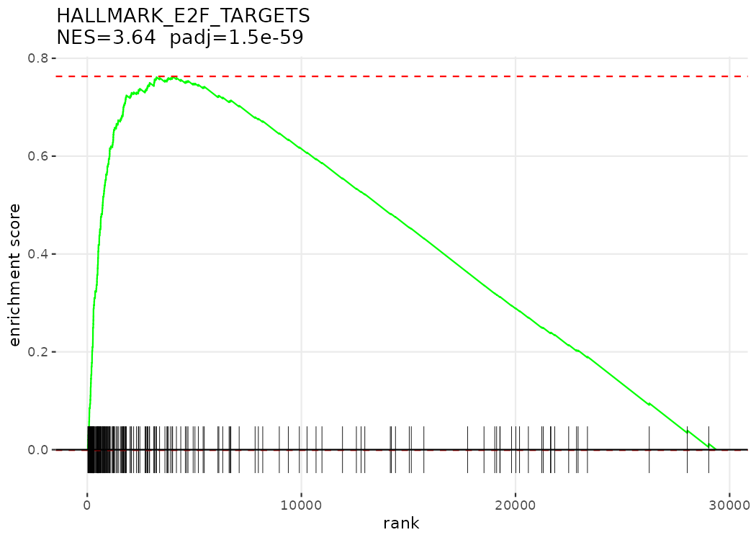
Figure 36
GSEA enrich Hallmark TN 1 HALLMARK E2F TARGETS
results/enrichment/GSEA_enrich_Hallmark_TN_1_HALLMARK_E2F_TARGETS.png

Slide 45
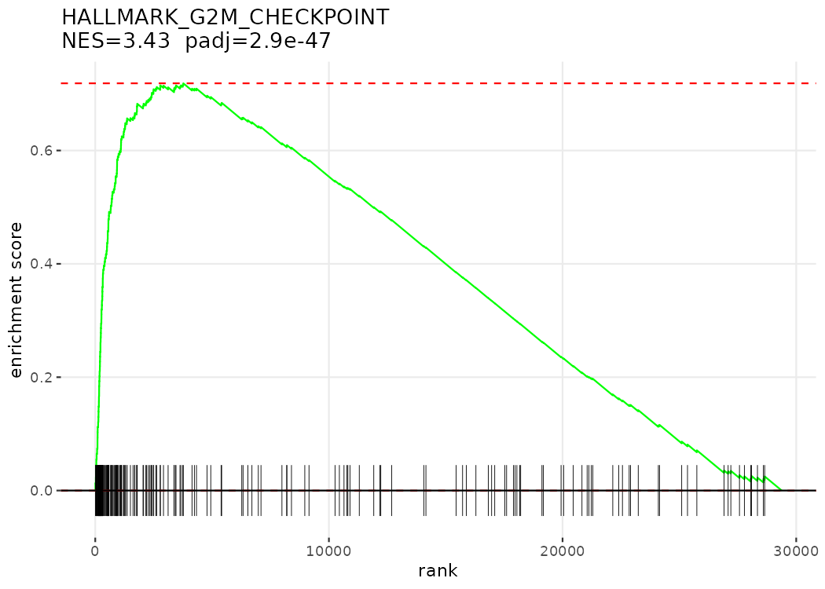
Figure 37
GSEA enrich Hallmark TN 2 HALLMARK G2M CHECKPOINT
results/enrichment/GSEA_enrich_Hallmark_TN_2_HALLMARK_G2M_CHECKPOINT.png

Slide 46
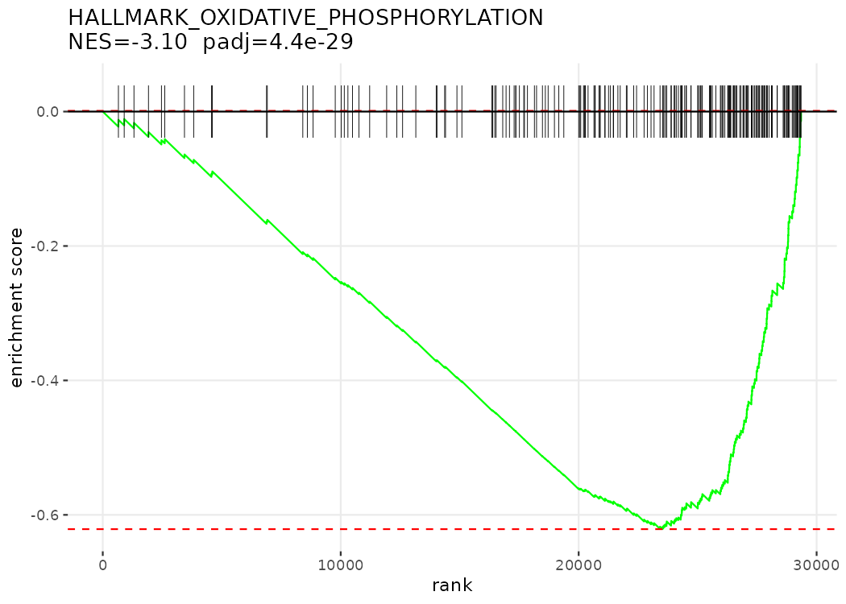
Figure 38
GSEA enrich Hallmark TN 3 HALLMARK OXIDATIVE PHOSPHORYLATION
results/enrichment/GSEA_enrich_Hallmark_TN_3_HALLMARK_OXIDATIVE_PHOSPHORYLATION.png

Slide 47
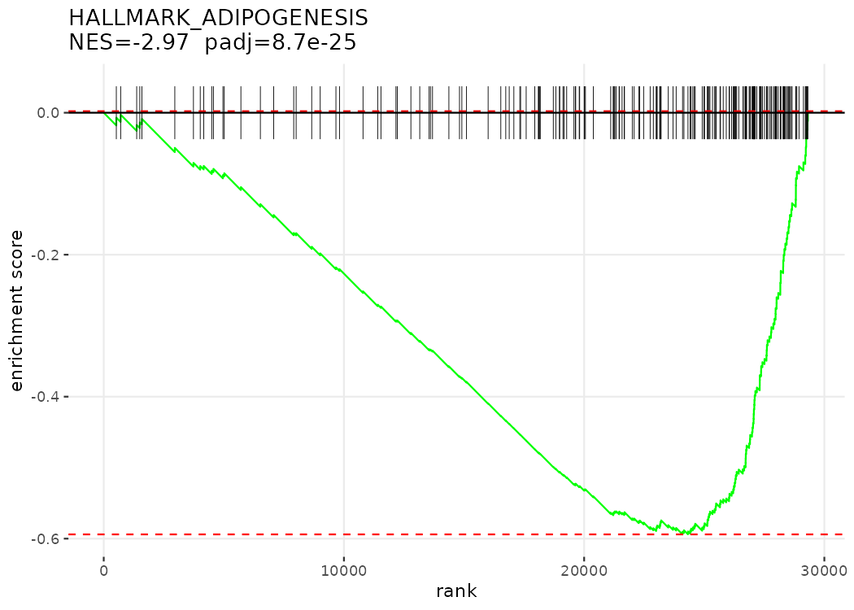
Figure 39
GSEA enrich Hallmark TN 4 HALLMARK ADIPOGENESIS
results/enrichment/GSEA_enrich_Hallmark_TN_4_HALLMARK_ADIPOGENESIS.png

Slide 48
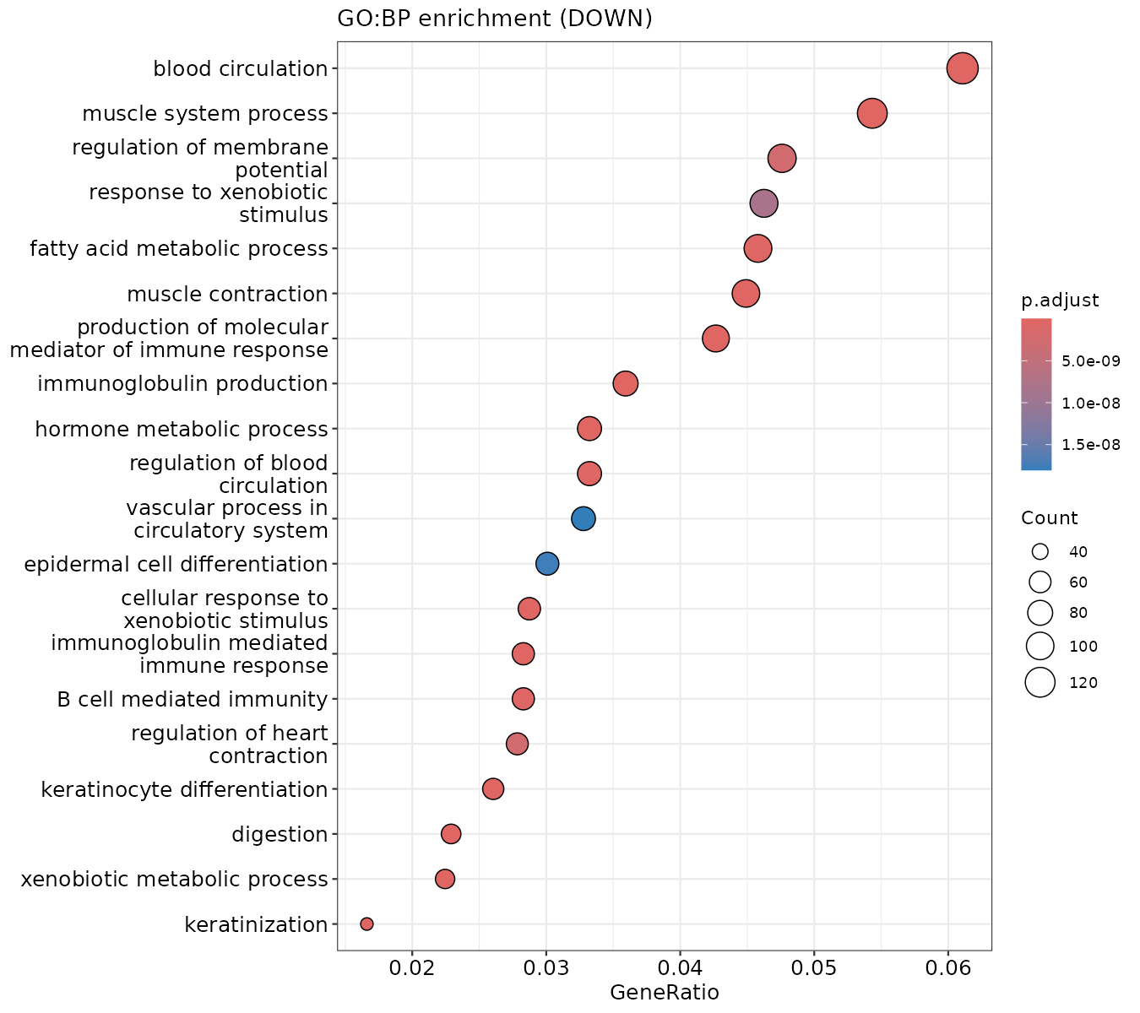
Figure 40
Dotplot GO BP DOWN
results/enrichment/dotplot_GO_BP_DOWN.png

Slide 49
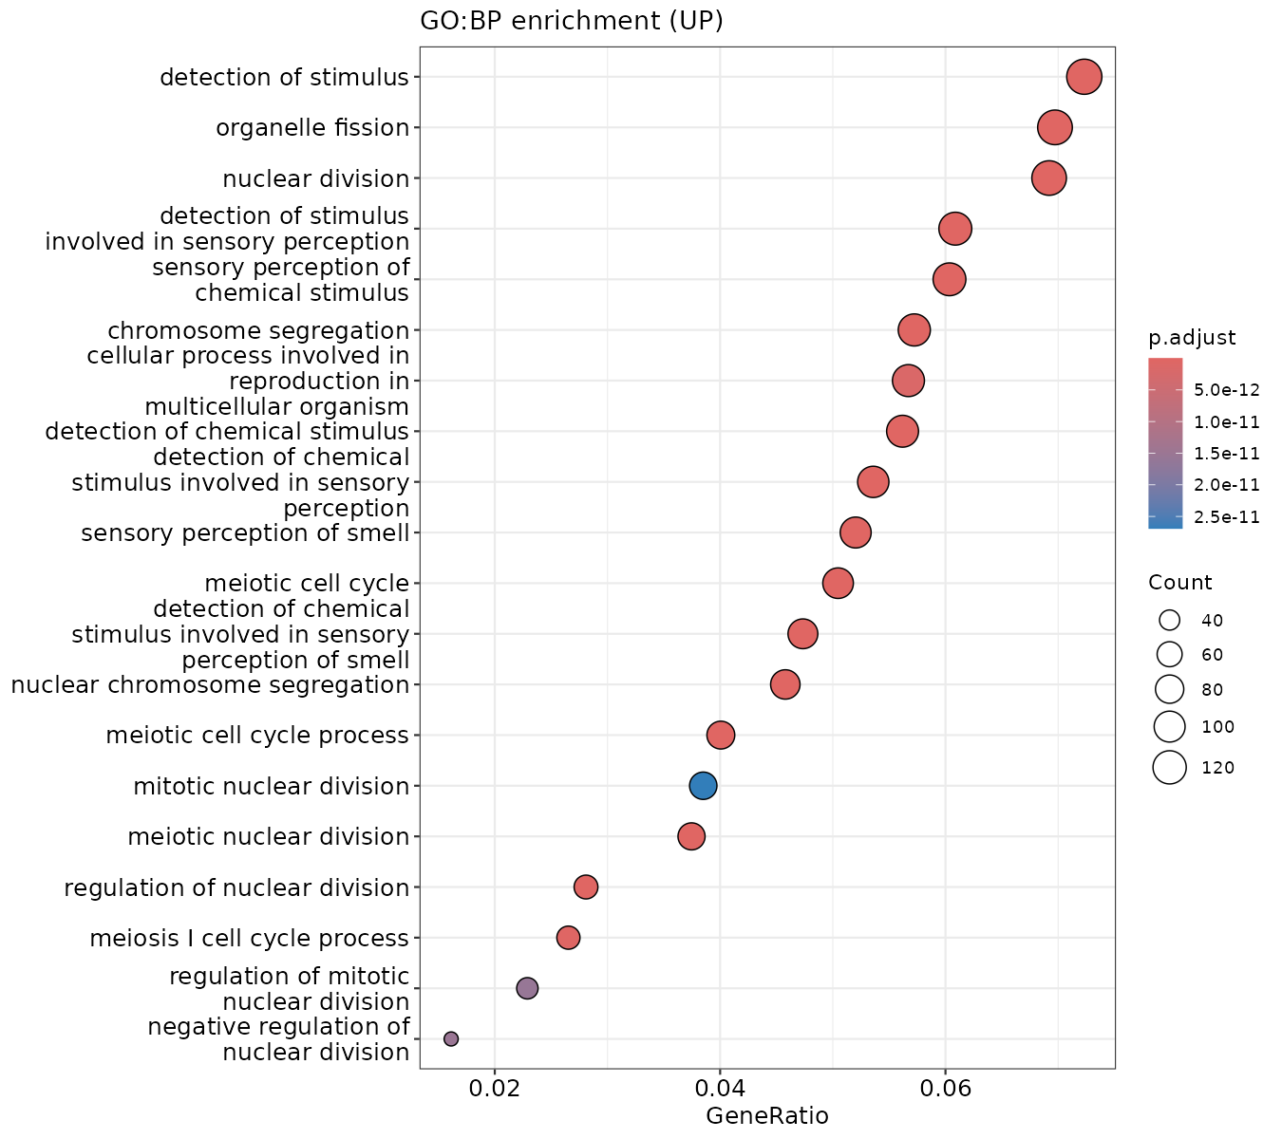
Figure 41
Dotplot GO BP UP
results/enrichment/dotplot_GO_BP_UP.png

Slide 50
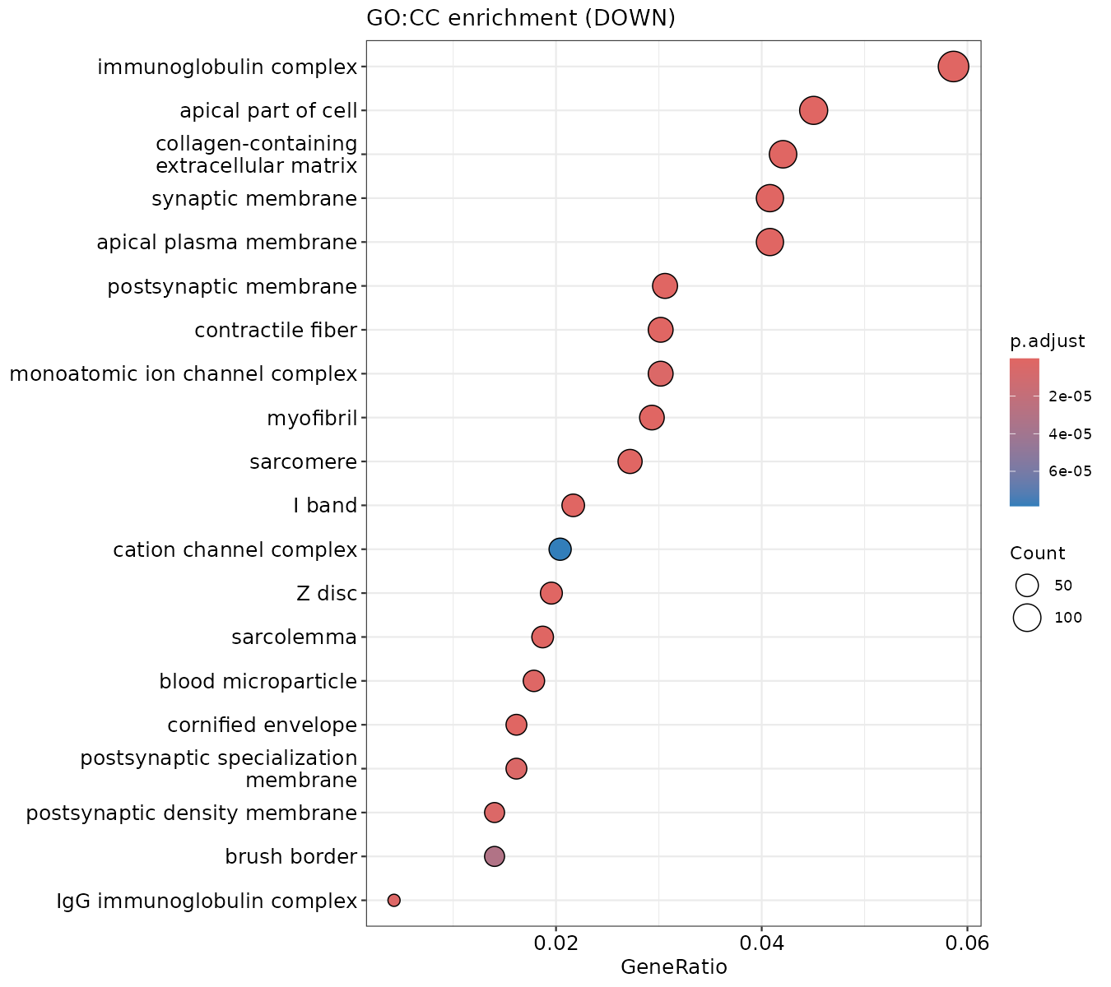
Figure 42
Dotplot GO CC DOWN
results/enrichment/dotplot_GO_CC_DOWN.png

Slide 51
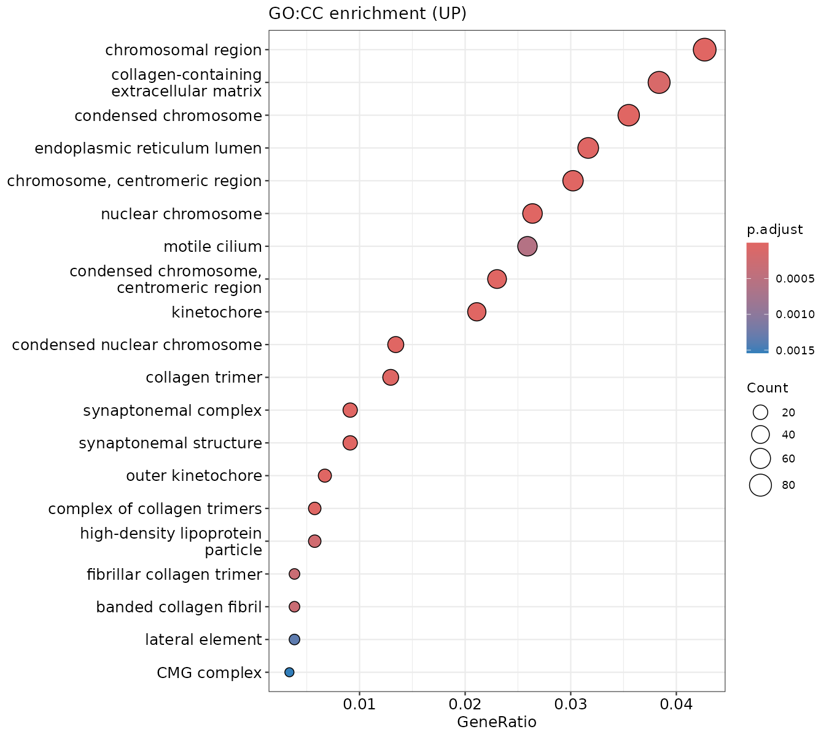
Figure 43
Dotplot GO CC UP
results/enrichment/dotplot_GO_CC_UP.png

Slide 52
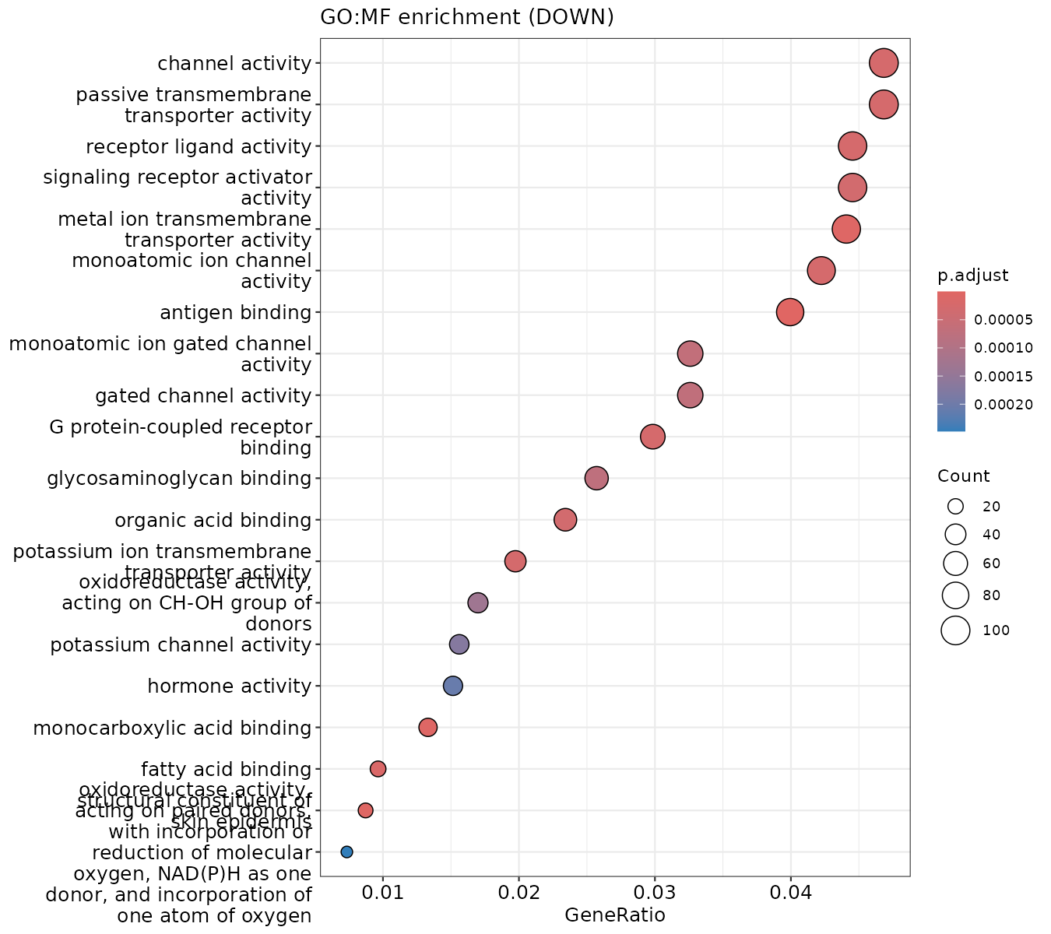
Figure 44
Dotplot GO MF DOWN
results/enrichment/dotplot_GO_MF_DOWN.png

Slide 53
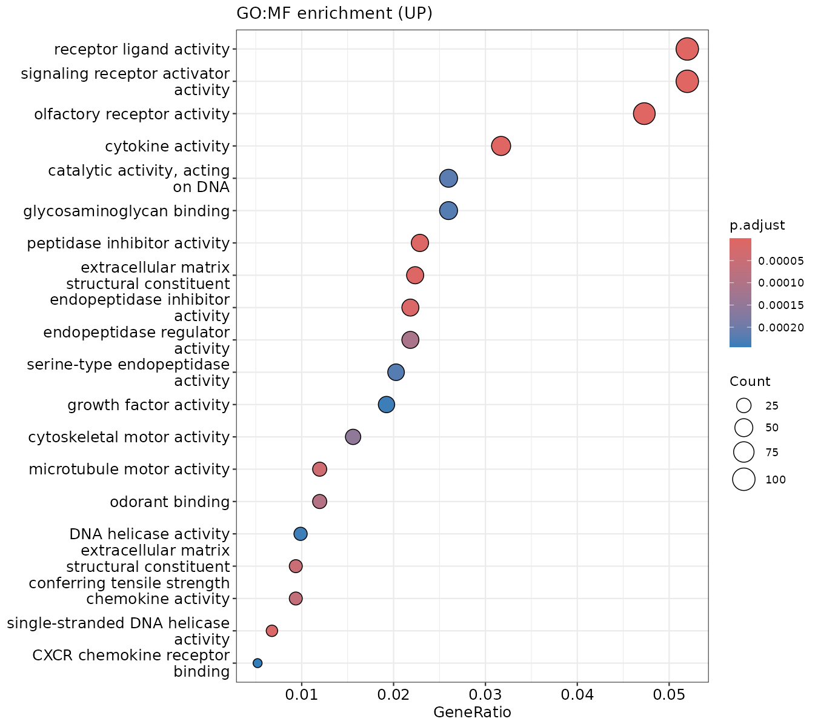
Figure 45
Dotplot GO MF UP
results/enrichment/dotplot_GO_MF_UP.png

Slide 54
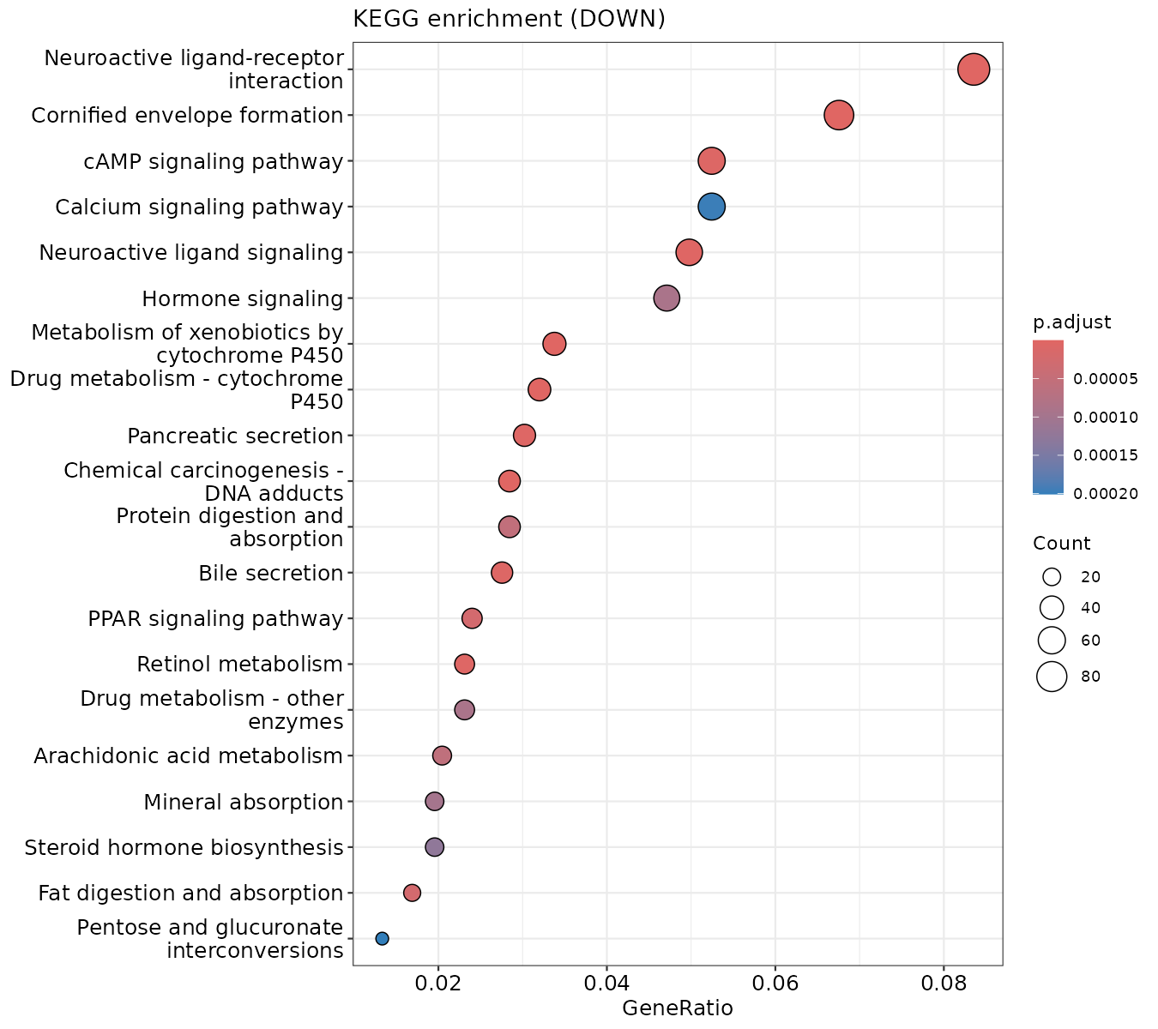
Figure 46
Dotplot KEGG DOWN
results/enrichment/dotplot_KEGG_DOWN.png

Slide 55
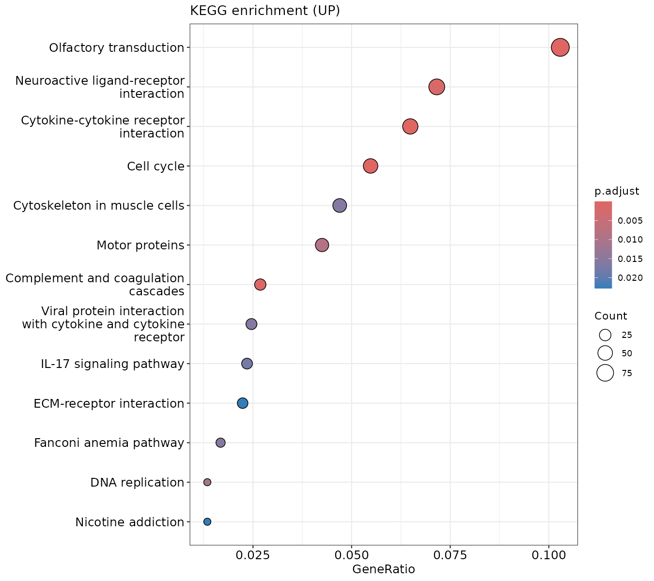
Figure 47
Dotplot KEGG UP
results/enrichment/dotplot_KEGG_UP.png

Slide 56
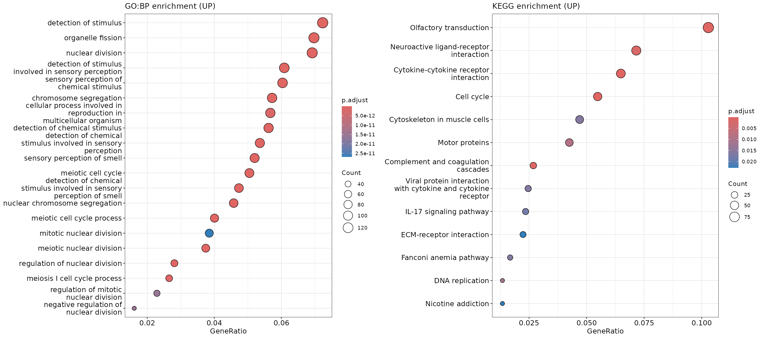
Figure 48 · Supplementary Figure S4
Over-representation analysis (GO biological process and KEGG) of tumour-up genes.
results/enrichment/path_ORA_GO_KEGG.png

Slide 57
Nomogram / clinical utility

Slide 58
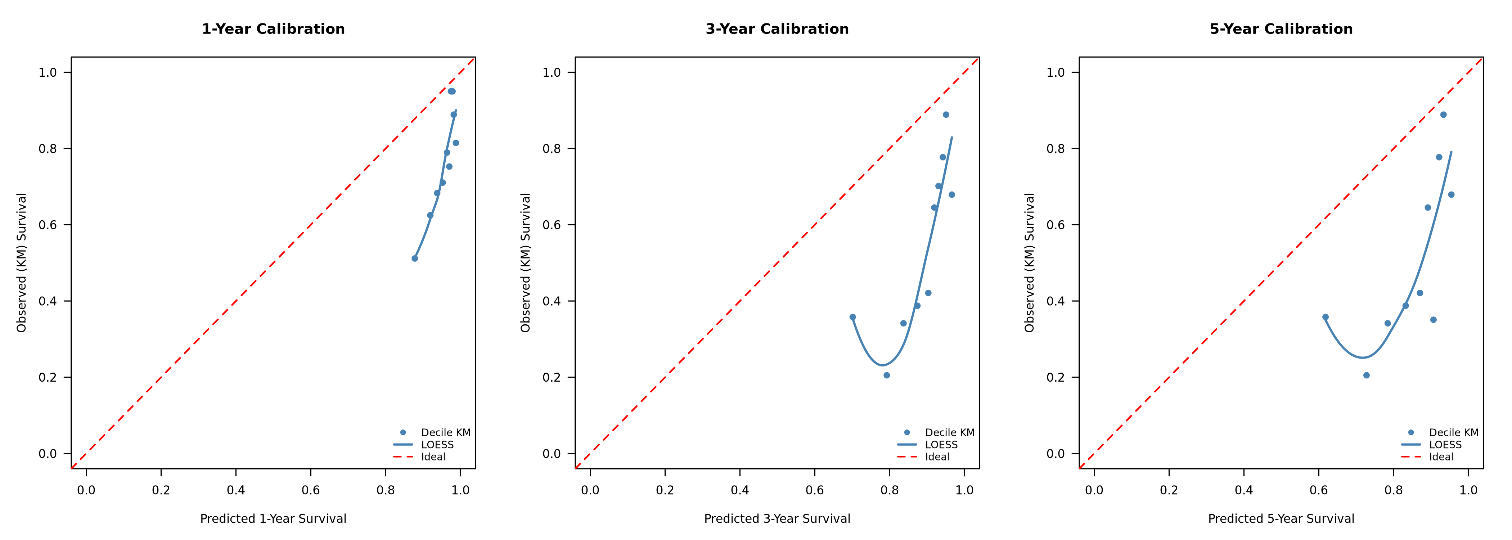
Figure 49
Calibration curves real
results/nomogram/Calibration_curves_real.png

Slide 59
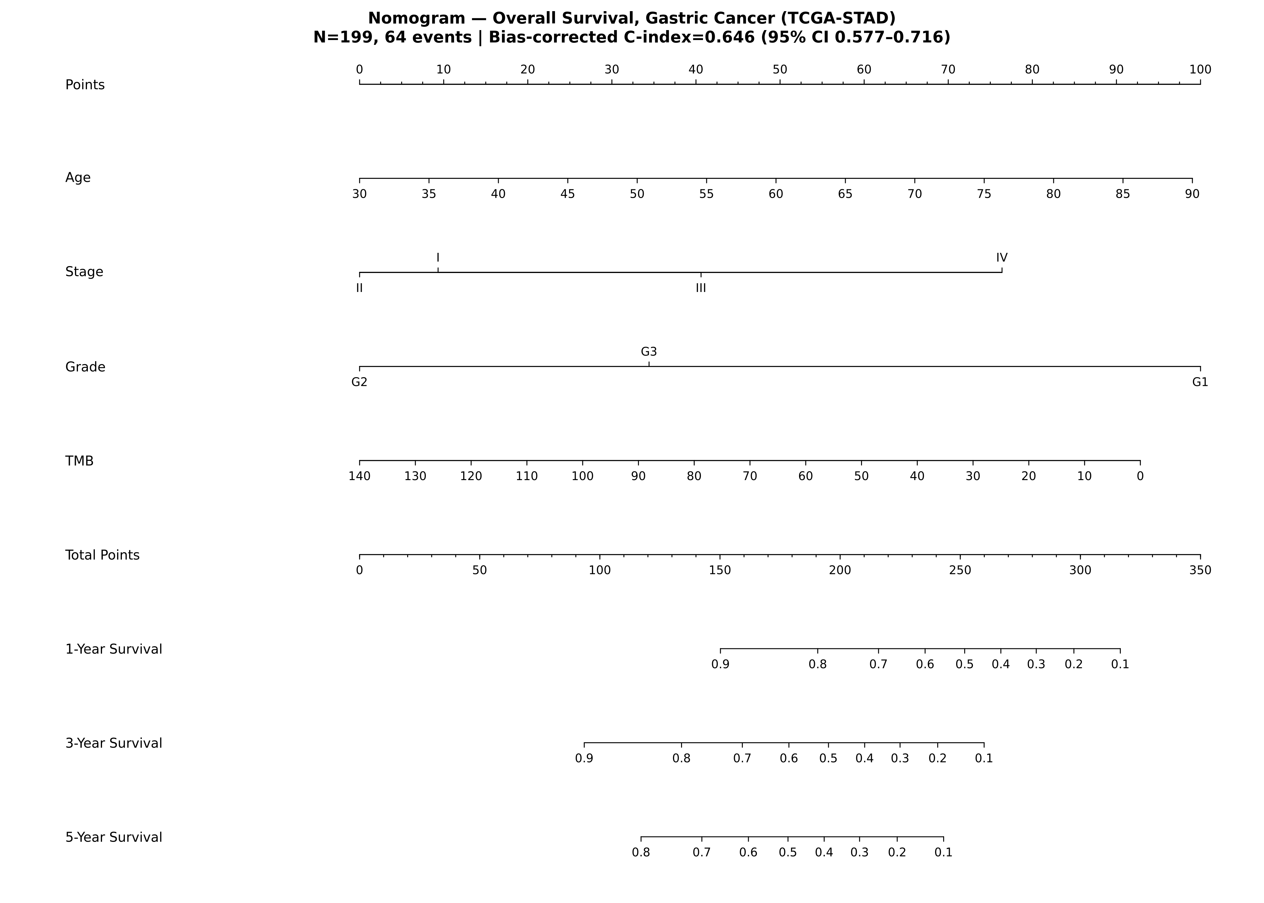
Figure 50
Nomogram GC OS real
results/nomogram/Nomogram_GC_OS_real.png

Slide 60

Figure 51
DCA 3yr
results/nomogram_combined/DCA_3yr.png

Slide 61

Figure 52 · Supplementary Figure S11
Calibration of the combined model against observed survival.
results/nomogram_combined/calibration_combined.png

Slide 62

Figure 53 · Supplementary Figure S10
Clinical nomogram combining stage, age and the 25-gene signature.
results/nomogram_combined/combined_nomogram.png

Slide 63
Microbiome

Slide 64

Figure 54 · Supplementary Figure S5
Tissue-microbiome compositional differential abundance (centred log-ratio effect sizes).
results/microbiome_biomarker/da_clr_barplot.png

Slide 65

Figure 55 · Supplementary Figure S13
The tumour-microbiome classifier is a batch artefact: apparent cancer-vs-control AUC 0.916, but flowcell is predictable at 77.6% versus a 54.5% baseline, and top discriminating taxa are environmental contaminants.
results/microbiome_biomarker/rf_batch_classifier.png

Slide 66
Mendelian randomisation (European outcome)

Slide 67

Figure 56 · Supplementary Figure S16
Mendelian-randomisation leave-one-out analysis: Fusobacterium.
results/mr_real/loo_Fusobacterium.png

Slide 68

Figure 57 · Supplementary Figure S14
Mendelian-randomisation leave-one-out analysis: anti-H. pylori IgG seropositivity.
results/mr_real/loo_H__pylori_IgG_seropositivity.png

Slide 69

Figure 58 · Supplementary Figure S19
Mendelian-randomisation leave-one-out analysis: Lactobacillus.
results/mr_real/loo_Lactobacillus.png

Slide 70

Figure 59 · Supplementary Figure S17
Mendelian-randomisation leave-one-out analysis: Prevotella.
results/mr_real/loo_Prevotella.png

Slide 71

Figure 60 · Supplementary Figure S15
Mendelian-randomisation leave-one-out analysis: Streptococcus (genus).
results/mr_real/loo_Streptococcus__genus_.png

Slide 72

Figure 61 · Supplementary Figure S18
Mendelian-randomisation leave-one-out analysis: Veillonella.
results/mr_real/loo_Veillonella.png

Slide 73

Figure 62 · Figure 28
Mendelian-randomisation SNP-effect scatter: Fusobacterium versus gastric cancer (European outcome).
results/mr_real/scatter_Fusobacterium.png

Slide 74

Figure 63 · Figure 26
Mendelian-randomisation SNP-effect scatter: anti-H. pylori IgG seropositivity versus gastric cancer (European outcome).
results/mr_real/scatter_H__pylori_IgG_seropositivity.png

Slide 75

Figure 64 · Figure 31
Mendelian-randomisation SNP-effect scatter: Lactobacillus versus gastric cancer (European outcome).
results/mr_real/scatter_Lactobacillus.png

Slide 76

Figure 65 · Figure 29
Mendelian-randomisation SNP-effect scatter: Prevotella versus gastric cancer (European outcome).
results/mr_real/scatter_Prevotella.png

Slide 77

Figure 66 · Figure 27
Mendelian-randomisation SNP-effect scatter: Streptococcus (genus) versus gastric cancer (European outcome).
results/mr_real/scatter_Streptococcus__genus_.png

Slide 78

Figure 67 · Figure 30
Mendelian-randomisation SNP-effect scatter: Veillonella versus gastric cancer (European outcome).
results/mr_real/scatter_Veillonella.png

Slide 79
Mendelian randomisation (East-Asian outcome)

Slide 80

Figure 68
Loo Fusobacterium
results/mr_real_eas/loo_Fusobacterium.png

Slide 81

Figure 69
Loo H pylori IgG seropositivity
results/mr_real_eas/loo_H__pylori_IgG_seropositivity.png

Slide 82

Figure 70
Loo Lactobacillus
results/mr_real_eas/loo_Lactobacillus.png

Slide 83

Figure 71
Loo Prevotella
results/mr_real_eas/loo_Prevotella.png

Slide 84

Figure 72
Loo Streptococcus genus
results/mr_real_eas/loo_Streptococcus__genus_.png

Slide 85

Figure 73
Loo Veillonella
results/mr_real_eas/loo_Veillonella.png

Slide 86

Figure 74
Scatter Fusobacterium
results/mr_real_eas/scatter_Fusobacterium.png

Slide 87

Figure 75
Scatter H pylori IgG seropositivity
results/mr_real_eas/scatter_H__pylori_IgG_seropositivity.png

Slide 88

Figure 76
Scatter Lactobacillus
results/mr_real_eas/scatter_Lactobacillus.png

Slide 89

Figure 77
Scatter Prevotella
results/mr_real_eas/scatter_Prevotella.png

Slide 90

Figure 78
Scatter Streptococcus genus
results/mr_real_eas/scatter_Streptococcus__genus_.png

Slide 91

Figure 79
Scatter Veillonella
results/mr_real_eas/scatter_Veillonella.png

Slide 92
Drug repurposing

Slide 93

Figure 80 · Supplementary Figure S3
In-silico drug-repurposing candidates ranked by connectivity score.
results/drug_repurposing_integrated/top_candidate_drugs.png

Slide 94
Review panels

Slide 95

Figure 81
Top Prognostic Heatmap
results/plots/review/Top_Prognostic_Heatmap.png

Slide 96
Other analysis plots

Slide 97

Figure 82
GTEx PCA
results/plots/GTEx_PCA.png

Slide 98

Figure 83
GTEx WGCNA modules
results/plots/GTEx_WGCNA_modules.png

Slide 99

Figure 84
GTEx expression distribution
results/plots/GTEx_expression_distribution.png

Slide 100

Figure 85
GTEx module pathway correlations
results/plots/GTEx_module_pathway_correlations.png

Slide 101

Figure 86 · Supplementary Figure S9
CD8 T-cell infiltration and overall survival (HR 1.04, p = 0.41; not prognostic).
results/plots/Immune_CD8_survival_KM.png

Slide 102

Figure 87 · Supplementary Figure S8
Immune infiltration by Lauren subtype.
results/plots/Immune_by_subtype.png

Slide 103

Figure 88 · Supplementary Figure S7
Immune cell-type estimates, tumour versus normal tissue.
results/plots/Immune_tumor_vs_normal.png

Slide 104

Figure 89 · Supplementary Figure S6
MCP-counter CD8 T-cell score versus measured leukocyte percentage (Spearman rho = 0.468, p = 3.1e-16, n = 272). The total T-cell score correlates more strongly (rho = 0.666). Neither correlates with measured lymphocyte-infiltration percentage (CD8 rho = 0.020, p = 0.74).
results/plots/Immune_validation_scatter.png

Slide 105

Figure 90
Survival KM curves
results/plots/Survival_KM_curves.png

Slide 106

Figure 91
Survival univariate HR
results/plots/Survival_univariate_HR.png

Slide 107
Other

Slide 108

Figure 92 · Supplementary Figure S12
External decision-curve analysis in ACRG: no incremental net benefit over standard staging (delta-C +0.005).
results/external_utility_ACRG/DCA_external.png

