Slide 2
Project Title
Minor Project Synopsis Presentation
An AI-Driven System for Automated Requirements Engineering from
Unstructured Stakeholder Communication
SUBMITTED BY:-
Name-Sreyas Sharma, Roll Nos.-R2142230271, Branch-B.Tech CSE DevOps
Name-Shreyash Shivhare, Roll Nos.-R2142231555, Branch-B.Tech CSE DevOps
Name-Shivang Mangal, Roll Nos.-R2142230269, Branch-B.Tech CSE DevOps
Name-Devanshi Jain, Roll Nos.-R2142230278, Branch-B.Tech CSE DevOps
MENTORED BY:-
Dr.Mitali Chugh -Associate Professor and Program Lead DevOps

Slide 3
Abstract
Modern software projects struggle with managing requirements dispersed across unstructured sources like emails, chats, and documents.
This dispersion makes manual requirements engineering inefficient and error-prone.
The project proposes an AI-driven automated requirements engineering system.
The system uses natural language processing (NLP) and machine learning (ML) techniques.
Key functions: extract, classify, cluster, prioritize, and summarize stakeholder requirements.
Benefits: enables accurate and scalable requirement analysis.
(Source: Umar & Lano, 2024)

Slide 4
Introduction
RE Challenges: Requirements scatter in agile across emails/chats; causes delays, overruns, failures.
AI Solution: Desktop system automates extraction, classification, clustering, prioritization, summarization via NLP/ML.
Extraction: Linguistic patterns + NER.
Advanced Processing: Classify functional/non-functional; cluster with TF-IDF + K-Means; prioritize by importance.
Tech Stack: Electron UI, Spring Boot backend, Flask AI service.
Integrations: Gmail, Telegram; scalable & privacy-focused.
Benefits: Accurate, efficient RE for better stakeholder insights.
(Source: Umar & Lano, 2024)

Slide 5
Objectives
Automatically extract requirements from unstructured text sources.
Classify requirements into functional and non-functional categories.
Cluster similar requirements to detect redundancy.
Prioritize requirements using importance indicators.
Generate concise summaries for stakeholder insights.
Minimize manual effort while boosting RE accuracy.

Slide 6
Methodology
Development Approach: Agile-based modular design.
Data Handling: Collects unstructured stakeholder data and preprocesses it via backend.
Analysis Techniques: Applies NLP and ML for requirement extraction, classification, clustering, prioritization, and summarization.
Delivery: Presents processed results through cross-platform desktop interface.
(Source: Siddeshwar et al., 2024; Voria et al., 2025)

Slide 7
Tools and Technologies
Layer | Tools/Frameworks | Purpose
Frontend | Electron, React.js, Vite | Cross-platform desktop app with native-like UI, component-based interface, fast builds.
Backend | Spring Boot | API orchestration, authentication, data fetching/preprocessing from emails/chats.
AI/NLP | Flask (Python), scikit-learn (implied), spaCy/NLTK (for NER) | Microservice for extraction (rules/NER), classification (ML), clustering (TF-IDF/K-Means), prioritization, summarization.
Integrations | Gmail API/IMAP, Telegram Bot API | Secure data ingestion from emails, messages, attachments (PDF/DOCX).
Development | Agile Scrum + Kanban | Iterative sprints, task visualization.
Deployment | Docker, GitHub Actions (CI/CD), AWS | Automated Security scanning and secure and smooth deployment.

Slide 8
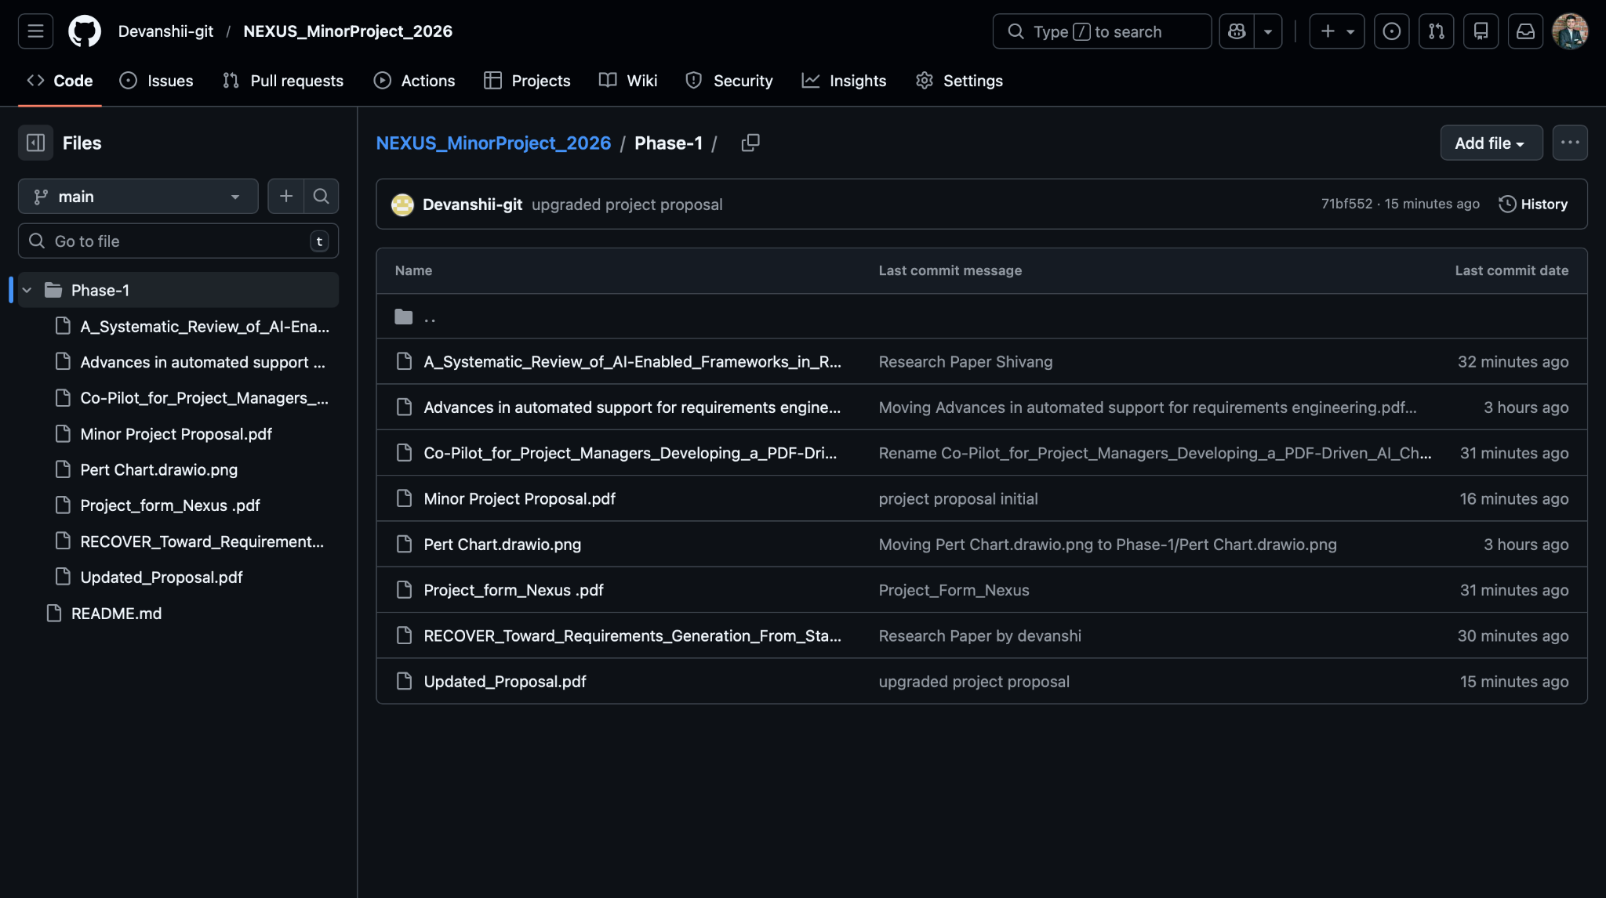
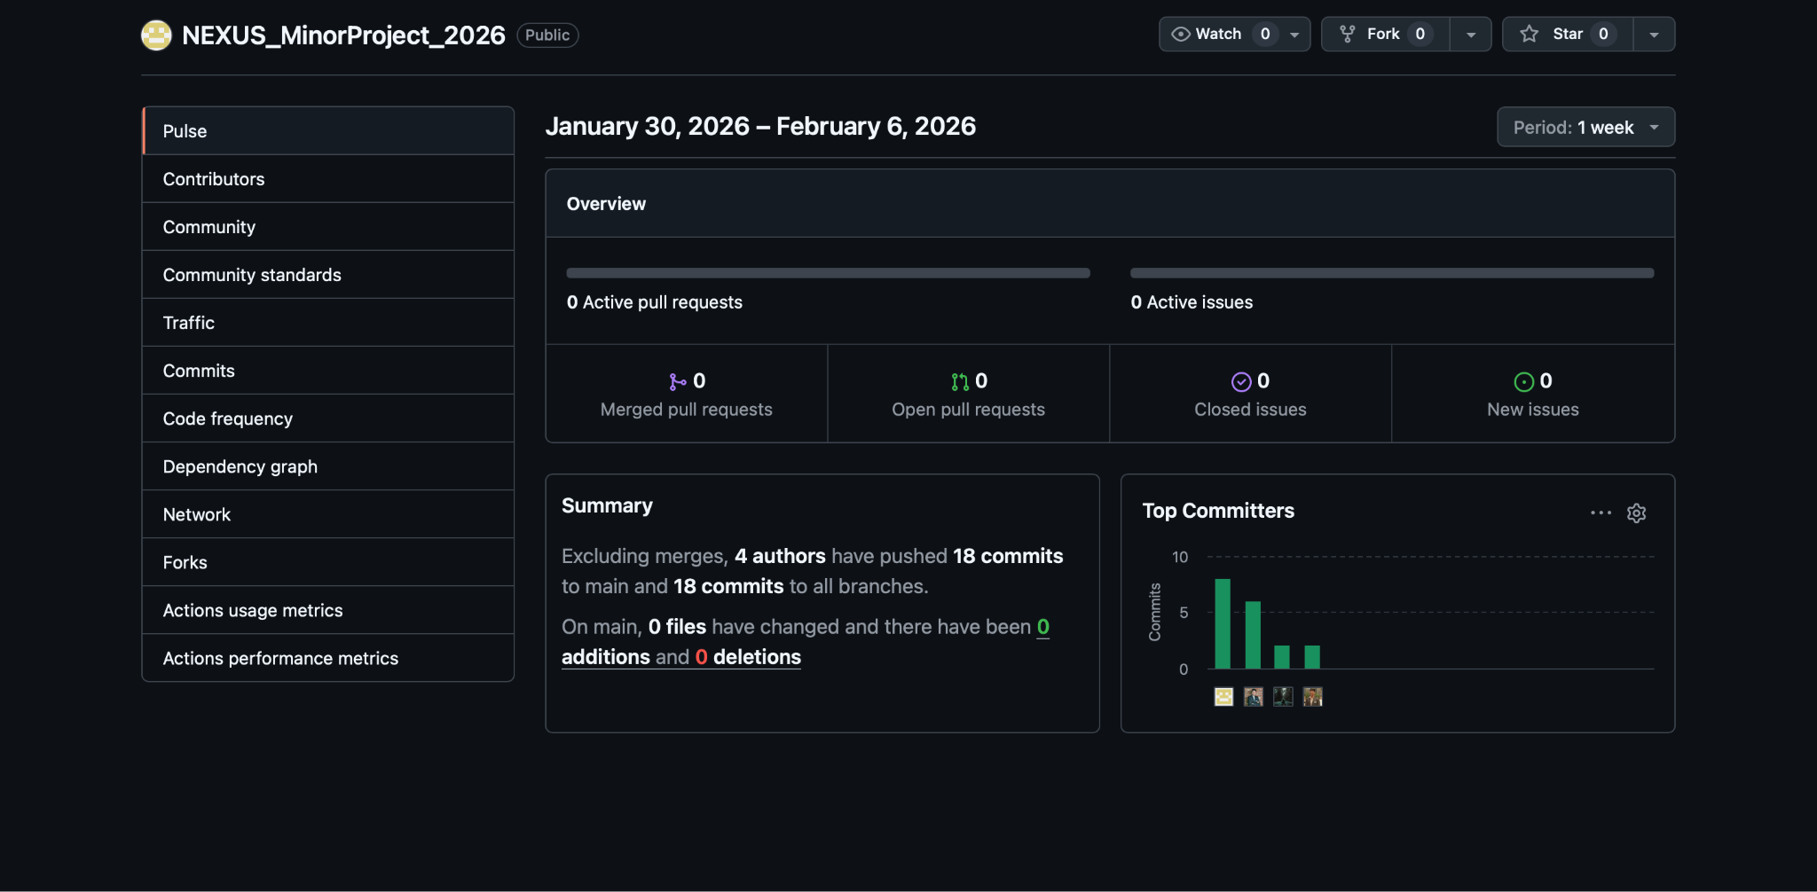
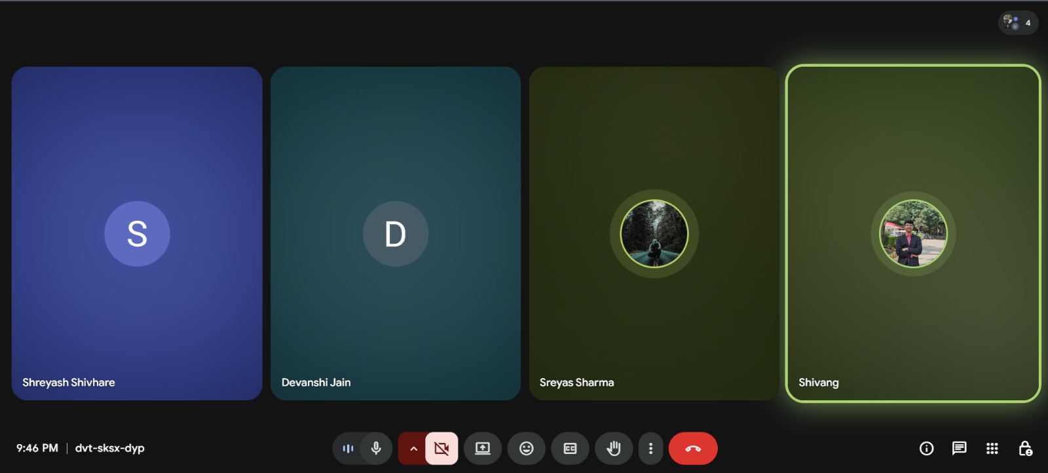
Screenshots

Slide 9
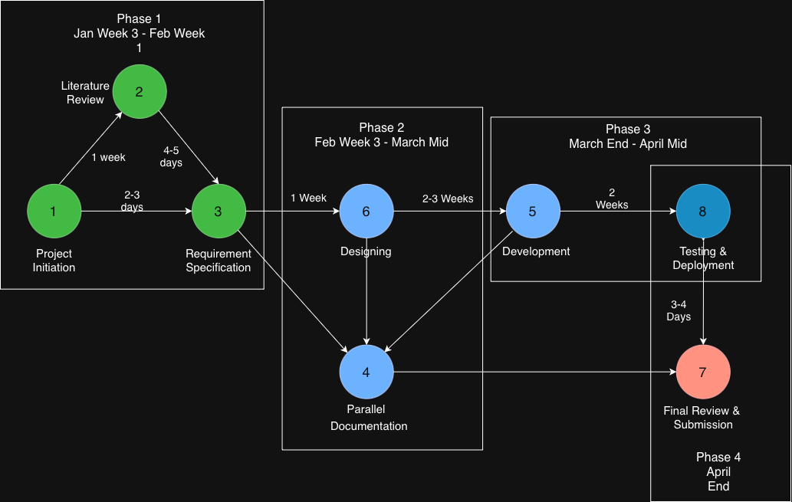
Pert Chart

Slide 10
References
[1] K. Lam, M. H. Bhuiyan, M. S. Islam, A. H. Chowdhury, Z. A. Bhuiyan, and S. Ahmmed, “Co-pilot for project managers: Developing a PDF-driven AI chatbot for facilitating project management,” IEEE Access, vol. 13, pp. 43079–43096, 2025, doi: 10.1109/ACCESS.2025.3548519.
[2] V. Siddeshwar, S. Alwidian, and M. Makrehchi, “A systematic review of AI-enabled frameworks in requirements elicitation,” IEEE Access, vol. 12, pp. 154310–154328, 2024, doi: 10.1109/ACCESS.2024.3475293.
[3] M. A. Umar and K. Lano, “Advances in automated support for requirements engineering: A systematic literature review,” Requirements Engineering, vol. 29, pp. 177–207, 2024, doi: 10.1007/s00766-023-00411-0.
[4] G. Voria, F. Casillo, C. Gravino, G. Catolino, and F. Palomba, “RECOVER: Toward requirements generation from stakeholders’ conversations,” IEEE Transactions on Software Engineering, vol. 51, no. 6, pp. 1912–1927, 2025, doi: 10.1109/TSE.2025.3572056.

