Slide 1
Predicting monthly sales of the Hyundai Elantra in the United States
A report by Sreyasee Choudhury

Slide 2
Data
The data used is the sale of Elantra in the US from the January 2010 to February 2014.
The variables in the dataset are as follows:
Month = the month of the year for the observation (1 = January, 2 = February, 3 = March, ...).
Year = the year of the observation.
ElantraSales = the number of units of the Hyundai Elantra sold in the United States in the given month.
Unemployment = the estimated unemployment percentage in the United States in the given month.
Queries = a (normalized) approximation of the number of Google searches for "hyundai elantra" in the given month.
CPI_energy = the monthly consumer price index (CPI) for energy for the given month.
CPI_all = the consumer price index (CPI) for all products for the given month; this is a measure of the magnitude of the prices paid by consumer households for goods and services (e.g., food, clothing, electricity, etc.)

Slide 3
Objective
To predict the monthly sales of the car, Elantra, by the South-Korean car manufacturing company, Hyundai, in the United States.

Slide 4
Methodology
For predicting the monthly sales of Hyundai Elantra, we have used a multiple linear regression model. Estimating the multiple linear regression model using the R software, we have predicted the monthly sales of the Hyundai Elantra in the United States. We have also made an attempt to identify the components and factors that affect the monthly sales.

Slide 5
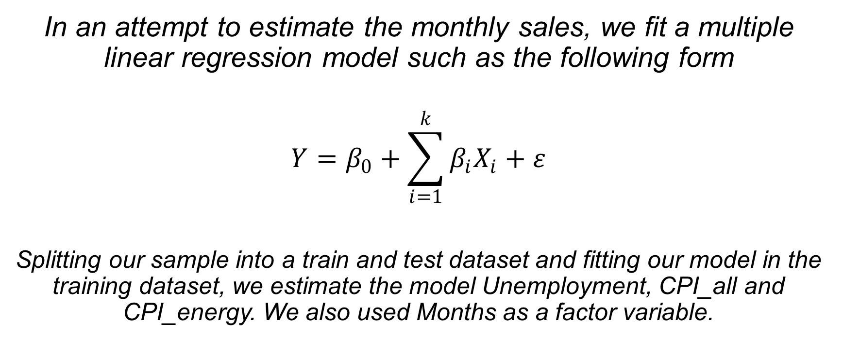
The Model
In an attempt to estimate the monthly sales, we fit a multiple linear regression model such as the following form
$$Y=β_{0}+\sum_{i=1}^{k}{β_{i}X_{i}}+ε$$
Splitting our sample into a train and test dataset and fitting our model in the training dataset, we estimate the model Unemployment, CPI_all and CPI_energy. We also used Months as a factor variable.

Slide 6
Interpretation

Slide 7
Months
Since we are predicting monthly sales, it is theoretically evident that we use Months as one of the variables
However, using Months as an independent variable yielded a model which was not a good fit. So, we considered Months as a factor variable.
Using Months as a factor variable also helps us compare the predicted sales of Elantra with January.
According to our fitted model, July has the highest sales and has around 9602.72 units greater sales than January on an average.
Considering our base month, since our estimated model yielded positive coefficients for all other months, we can claim that January is likely to have the least monthly sales during the year.

Slide 8
Unemployment
Our estimated model shows a negative relation between Unemployment and ElantraSales.
The monthly sales of Elantra is likely to fall by 7971.34 units for an unit increase in the unemployment percentage of the US.

Slide 9
CPI_energy
The Consumer Price Index for energy for a particular month in the US also has a positive effect on the Monthly Sales of Elantra according to our model.
The model shows that for an unit rise in the consumer price index for energy, the monthly sales is likely to rise by 268.03 units.

Slide 10
CPI_all
Considering the consumer price index is a necessary step for estimating sales as consumer price index is a great indicator for inflation.
Our model shows a negative relationship between CPI_all and ElantraSales.
In other words, according to our model, for every unit rise in the consumer price index, the monthly sales of Elantra is likely to fall by 1377.58 units.
Thus, it shows that an inflation is harmful for the monthly sales of Elantra. The model shows that if there is an inflation, the monthly sales is likely to see a steep decline.

Slide 11
Queries
Although we run a regression considering queries as an independent variable but the p-value shows that Queries is not statistically significant at the 10% level of significance.
In other words, according to our model, the number of google searches for Elantra in a month is not a good estimator of the monthly sales, i.e., it is not likely to impact the monthly sales.

Slide 12
Conclusion
Our model aims at predicting the monthly sales of Hyundai Elantra in the US. In an attempt to do so, we framed a model including variables like unemployment, cpi_energy and cpi_all. We also considered Months as a factor variable and finally could see a relationship between each of the variables and monthly sales. Thus, having done a study on the model, in order to boost the monthly sales, the company must keep in mind the levels of unemployment, cpi_energy and cpi_all and in case of high unemployment and cpi_all , the company might try giving discounts to boost their sales. On the other hand, since the sales is highest during the month of July and June, it would not be helpful for the company to give discounts during these periods. Rather, giving discounts during the months of January, February, October and November might help in boosting the sales of these months.

Slide 13
Thank You

