Slide 1
Lifelong Reinforcement Learning
Sreyash Mohanty

Slide 2
Overview
Introduction to Reinforcement Learning
Hierarchical Reinforcement Learning
Hierarchical Bayesian Lifelong Reinforcement Learning
Approaches to Continual Reinforcement Learning
Challenges and Open Problems

Slide 3
What is Reinforcement Learning ?
How an agent behaves in an environment to maximize some reward.
Agent learning through Rewards and Punishments.
Learns through trial and error as well as feedback.
(e.g.) Control Systems, Pavlogs Dog

Slide 4
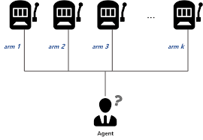
Bandit Optimization Problem
Multi-Armed Bandit Problem: Maximize the expected return from a machine.

Slide 5
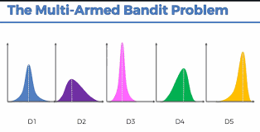
Probability Distributions of Expected Return

Slide 6
Upper Confidence Bound
Uncertainty in action-value estimates for balancing exploration and exploitation.
UCB uses uncertainty in the estimates to drive exploration.
Q_{t}(a) is the current estimate for action a at time t.
Action with highest estimated action-value + upper-confidence bound exploration term.

Slide 7
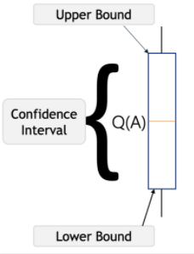
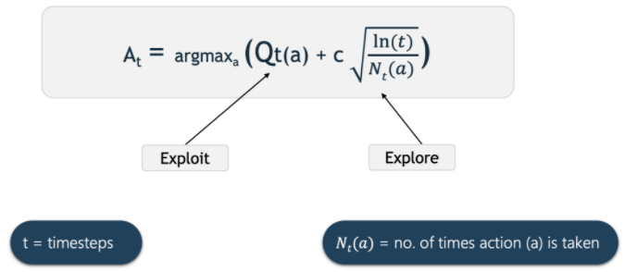
Upper Confidence Bound

Slide 8
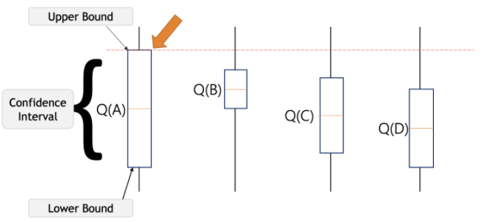
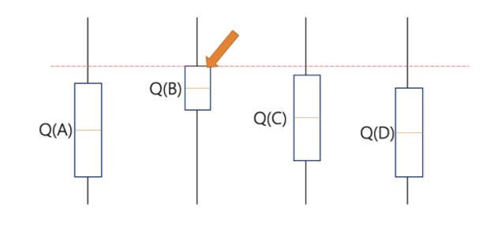
Iteration-1 and 2

Slide 9
Thompson Sampling (Posterior Sampling)
All machines assumed to have uniform distribution of the probability of success.
For each observation, based on the reward a new distribution is generated with probabilities of success.
Observations made based on prior probabilities obtained on each round.
Updates the success distributions.
Success distribution with it can help choosing machines wisely to get the max rewards.

Slide 10
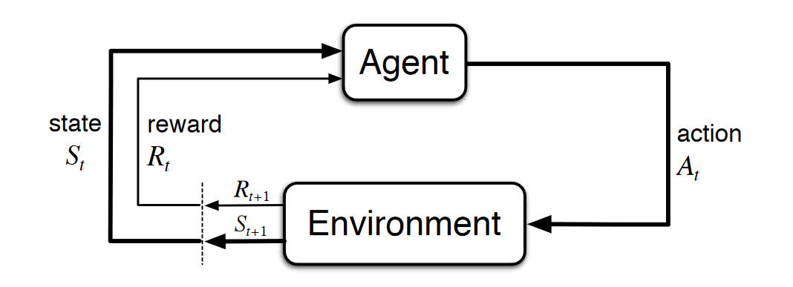
Markov Decision Processes (MDPs)
Components of a MDP:
Agent
Environment
State (S)
Action (A)
Rewards (R)

Slide 11
What does a MDP mean?
An agent, that interacts with the environment it's placed in.
Each time step, the agent will get representation of the environment's state.
Given this representation, the agent selects an action to take.
Environment transitions into a new state, the agent is given a reward as a for the previous action.

Slide 12
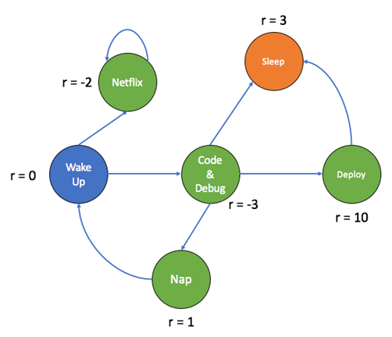
A MDP of a RL agent – Human connection

Slide 13
Procedure
At time t, the environment is in state S_{t}.
The agent observes the current state and selects action A_{t}.
The environment transitions to state S_{t+1} and grants the agent reward R_{t+1}.
This process then starts over for the next time step, t+1.

Slide 14

Concept of Expected Return
The goal of an agent in an MDP is to maximize its cumulative rewards.
Concept of the expected return of the rewards at a given time step.
Sum of future rewards. Mathematically, we define the return G at time t as G_{t}=R_{t+1}+R_{t+2}+R_{t+3}+⋯+R_{T}, where T is the final time step.
It is the agent's goal to maximize the expected return of rewards.

Slide 15
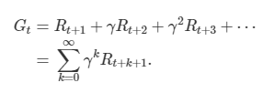
Discounted Return
Discount rate, γ, to be a number between 0 and 1.
Our agent will care more about the immediate reward over future rewards.
More influence when it comes to the agent making a decision about taking a particular action.

Slide 16

Cumulative discounted return (G)

Slide 17
Policy(π) and Value functions
How probable is it for an agent to select any action from a given state?
– Policy
How good is a specific action or a specific state for the agent?
– Value Function
NOTE: Help the agent to maximize return if it knows the policy and value functions beforehand.
A function that maps a given state to probabilities of selecting each possible action from that state.
We will use the symbol π to denote a policy.

Slide 18
Value functions
Value function → Expected return → The way the agent acts → Policy
Functions of states, or of state-action pairs.
Estimate how good it is for an agent to be in a given state, or how good it is for the agent to perform a given action in a given state.
Types of value-functions:
f(States) – State-value function:

Slide 19
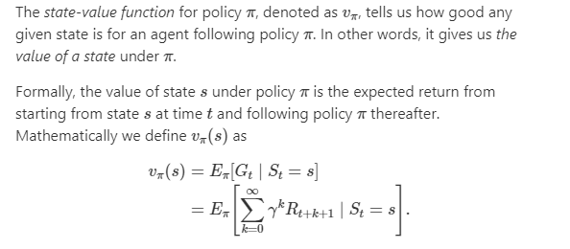
Value functions

Slide 20
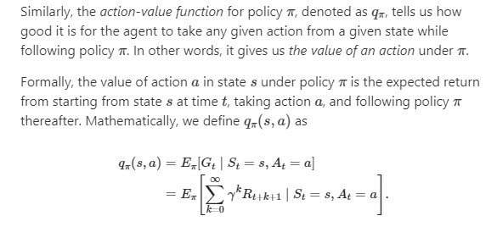
Q-value function-Basis for RL optimization algos
f(State, Action) – Action-value function

Slide 21
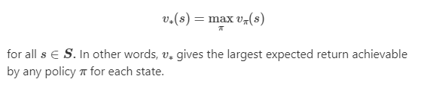
Optimality and Optimal policies/value functions
Find a policy that will yield a lot of rewards for the agent.
A policy that will yield more return to the agent than all other policies.
Optimal policy –Policy yields a larger expected return compared to all other policies, then the policy is said to be optimal.
Optimal state-value function: Every optimal policy has an associated optimal state function with it.

Slide 22
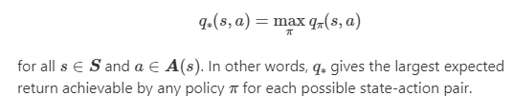
Optimal policies/value functions
Optimal action-value function:
How can we determine whether an action-value function is optimal?
For any state-action pair, the function produces the expected reward for taking that action plus the maximum discounted return thereafter.

Slide 23

Bellman Optimality Equation (Optimal Q-value function) - Target
One fundamental property of q∗ is that it must satisfy the following equation.
Use Bellman equation to find q∗.
Once we have q∗, we can determine the optimal policy.
With q∗, for any state s, a reinforcement learning algorithm can find the action a that maximizes q∗(s,a).

Slide 24
Q-Learning - A RL technique
Q-Learning, an algo used to find the optimal policy by learning the Q-values for each state-action pair.
Iteratively updates the Q-values of each state-action pair using the Bellman equation.
Until converges to an optimal Q-function (q*).
This is also called as Value-iteration.

Slide 25
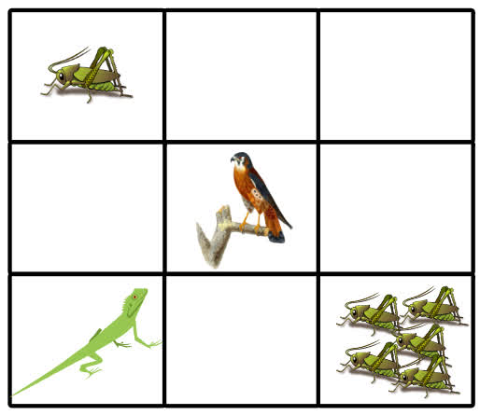
The Lizard Game

Slide 26
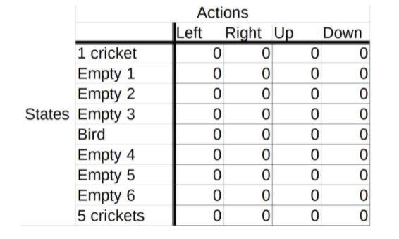
Q-table

Slide 27
Exploration-Exploitation Trade-off (Epsilon-Greedy Strategy)
Define an exploration rate ϵ initially set to 1.
Exploration rate is the probability that our agent will explore.
With ϵ=1, 100% certain that the agent will start out by exploring.
ϵ will decay by some rate that we, the likelihood of exploration becomes less.
The agent learns more and more about the environment.
Becomes “greedy” in terms of exploiting the environment.

Slide 28
How this works?
We generate a random number between 0 and 1.
Number is greater than epsilon, agent will choose its next action via exploitation.
Choose the action with the highest Q-value for its current state from the Q-table.
Otherwise, its next action will be chosen via exploration.

Slide 29
Updating the Q-value
New Q-value is equal to a weighted sum of old value and the learned value.
Learned value is the reward received from moving from the starting state plus the discounted estimate.
Entire learned value is then multiplied by learning rate.

Slide 30

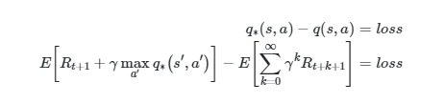
Updating the Q-value

Slide 31
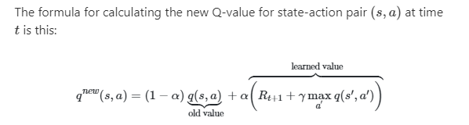
Formula for new Q-value

Slide 32
What happens when we solve a comparatively larger problem(s) (or) solve for multiple MDPs?

Slide 33
Overview
Introduction to Reinforcement Learning
Hierarchical Reinforcement Learning
Hierarchical Bayesian Lifelong Reinforcement Learning
Approaches to Continual Reinforcement Learning
Challenges and Open Problems

Slide 34
Towards Hierarchical Reinforcement Learning
What happens when we solve a comparatively larger problem (or) solve for multiple MDPs?
The answer to this question lies with Hierarchical Reinforcement Learning.
Hierarchical reinforcement learning (HRL) - learning to operate on different levels of temporal abstraction.

Slide 35
Reinforcement Learning- A hierarchical approach
Example: Recipe for vegetable stew
Recipe for vegetable stew, the cutting process of vegetable is a temporally extended action.
Can take different numbers of steps to complete depending on the required cutting fineness.
Idea of temporal abstraction, converts it into Hierarchical Reinforcement Learning (HRL).

Slide 36
Breakthrough in Reinforcement Learning
Sample efficiency:
Data generation is often a bottleneck and current RL methods are data inefficient.
With HRL, sub-tasks and abstract actions can be used in different tasks on the same domain.
Scaling up:
The application of classic RL to the problems with large action and/or state space is infeasible.
HRL aims to decompose large problems into smaller ones.

Slide 37
Breakthrough in Reinforcement Learning
Generalization:
Trained agents can solve complex tasks.
Transfer their experience to new environments, most state of the art RL algorithms will fail.
Abstraction:
State and temporal abstractions allow to simplify the problem.
Sub-tasks can effectively be solved by RL approaches.

Slide 38
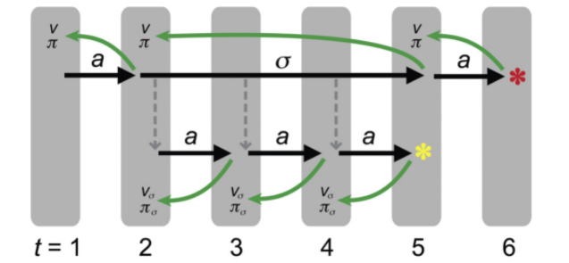
Hierarchical Learning Dynamics

Slide 39
Advantages
The promise of HRL:
Long-term credit assignment: Faster learning and better generalization.
Structured exploration: Explore with sub-policies rather than primitive actions.
Transfer learning: Different levels of hierarchy can encompass different knowledge and allow for better transfer.

Slide 40
Overview
Introduction to Reinforcement Learning
Hierarchical Reinforcement Learning
Hierarchical Bayesian Lifelong Reinforcement Learning
Approaches to Continual Reinforcement Learning
Challenges and Open Problems

Slide 41
Hierarchical Bayesian Lifelong Learning
MDP tasks are chosen randomly from a fixed distribution.
Shared aspects may help the agent quickly learn optimal policy for new MDP task.
Goal: Given knowledge from previous MDP tasks and small amount of experience in new MDP task, agent exploits the knowledge to explore the new MDP environment efficiently.

Slide 42
Hierarchical Bayesian Lifelong Reinforcement Learning
Considering a sequence of MDPs instead of working on one MDP in isolation – Multi Task Reinforcement Learning.
Key idea of MTRL is to use the Hierarchical Bayesian approach to model “classes” of MDPs.
Each class has some shared structure – shared knowledge and its transferred to a new MDP of the same class.
Efficient learning.

Slide 43
Addition of Class factor – Inspiration from Bayesian Approach
The assumption is that MDP tasks within the same class assignment are similar to each other.
The MDP tasks with different class assignments are very different from each other.
Intuition: The addition of the class layer makes the model hierarchical.
Knowledge in class can be transferred to a MDP task within the same class.

Slide 44
MTRL (Multi-Task Reinforcement Learning Algorithm)
Applying knowledge learned from previous MDP tasks to learn approximate MDP.
Update old knowledge to generate new knowledge, after considering the new task.

Slide 45
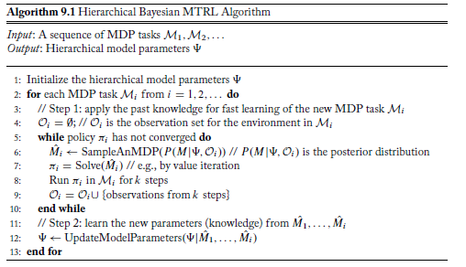
Pseudo-code Snippet

Slide 46
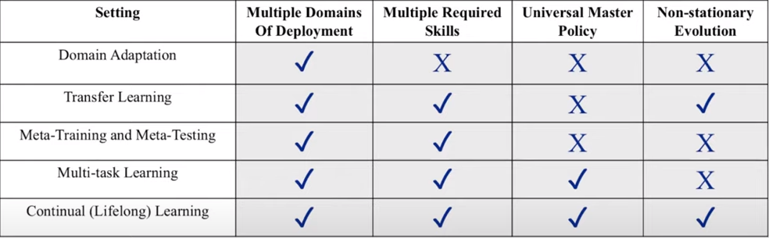
Spectrum – Continual Learning

Slide 47
Why is Reinforcement Learning a good setting for Continual Learning?
Agent must care about present and future (rewards).
A portion of future will be similar to past.
How should the agent prioritize current experience (vs) past experience?
Stability-Plasticity Tradeoff
Continual Reinforcement Learning: Observed data is explicitly time dependent.

Slide 48
Overview
Introduction to Reinforcement Learning
Hierarchical Reinforcement Learning
Hierarchical Bayesian Lifelong Reinforcement Learning
Approaches to Continual Reinforcement Learning
Challenges and Open Problems

Slide 49
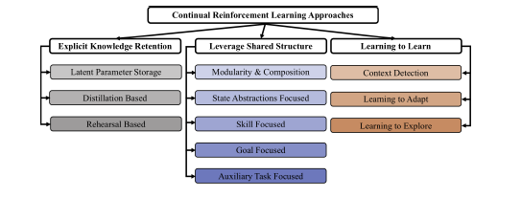
Continual Reinforcement Learning Approaches

Slide 50
Continual Reinforcement Learning Approaches
Explicit Knowledge Retention
Leverage Shared Structure
Learning to Learn

Slide 51
Explicit Knowledge Retention
Shared parameters:
Shared representations across tasks.
Single representation for agent throughout its lifetime.
Learn a prior on how each parameter is used in the past.
Distillation:
One network as a target for other neural network, encourages stability.

Slide 52
Explicit Knowledge Retention
Rehearsal Based:
Experience Replay – Storage of past experiences to use for current learning)
Generative Experience Replay

Slide 53
Leveraging Shared Structure
Modularity and Composition:
Train neural network modules which can be composed for each task.
Challenge is to learn modules and learn to combine them.
State Abstractions:
Map the default state into a different state representation.
Should encapsulate important, shared state information.

Slide 54
Leveraging Shared Structure
Skill focused:
Learn macro-actions which control lower level actions.
Challenge is to encourage skill reusability,combining skills.
Goal focused:
Goal could mean desired state,reward,termination of skill.
Policies condition themselves on a goal.

Slide 55
Learning to learn
Context Detection:
MDP is stationary, but agent cannot fully observe the true state.
Uses notion of a task state.
Lots of work on reformulating the MDP into an MDP that explicitly models the task state.
Recent work on context detection, which is to discover task states.
Changepoint Detection:
How to detect changepoints/boundaries between switches in tasks/distribution?

Slide 56
Learning to learn
Learning to adapt:
Agent learns to change optimization process based on its learning experience.
Meta-learning approach: Use of two loops - Inner adaptation learning,outer learning to learn to optimize.
Learning to explore:
Unsupervised reward functions.

Slide 57
Benchmarks for Continual Reinforcement Learning
Benchmarks of varying difficulty:
Different levels/sources of non-stationarity
Metrics:
Measures of levels of catastrophic forgetting
Skill reusability
Skill composition
Planning
Forward and Backward Transfer RL

Slide 58
Overview
Introduction to Reinforcement Learning
Hierarchical Reinforcement Learning
Hierarchical Bayesian Lifelong Reinforcement Learning
Approaches to Continual Reinforcement Learning
Challenges and Open Problems

Slide 59
Challenges and Open problems
Inductive Biases:
Importance of inductive biases in agents to leverage learning from a prior to use knowledge.
Agent-Environment Boundary:
Multi-agent setting, many agents simultaneously interacting with environment.
In non-stationarity, transition dynamics of the environment, agent-environment boundary may evolve over time.

Slide 60
Challenges and Open problems
Experiment Design and Evaluation:
Studying full non-stationarity on entirety is a problem faced by Continual RL agents.
Finding the appropriate design of experiments to systematically train the agent over all tasks.
Difficult to test data-driven agent as agent isn’t sure of whether the tasks it has learnt previously, are going to help in future as well.

Slide 61
Challenges and Open problems
Interpreting discovery:
Need to introspect on different scales rather than just future rewards during training.
Learning at Scale:
Learning to be done on scale, than large data in one compute or for training.

Slide 62
References
Second Edition – Lifelong Machine Learning (2018) by Zhiyuan Chen and Bing Liu
Towards Continual Reinforcement Learning: A Review and Perspectives (CL-RL Review -2020) by Khimya Kheterpal, Mathew Riemer, Irina Irish, Doina Precup

Slide 63
Thank you

