Slide 1

Summary
P_{v} = Probability that each VNF v ∈ Vs is reliable.
1-P_{v} = Probability that VNF v ∈ Vs is not reliable.
(1-P_{v})^b = If there are b number of backups. Then Probability that none of the backups are reliable.
Note: (For one VNF only one backup is available, for example for VNF 1 only backup 1 is available .)[ref: Fig 3.1]
So, 1 - Probability that the entire system is going down/entire system is
unreliable:-
The above is equivalent to the reliability of each VNF.

Slide 2

Each VNF v ∈ V can be associated with only one SFC s ∈ S in order to avoid multiple SFC failures (due to VNF sharing).
The summation of the response(both waiting and processing) times of each VNF should be less than equal to the delay constraint of a particular service request Ψs of SFC ‘s’. Because multiple VNF's together form an SFC which must serve a particular service request within the given time constraint(delay constraint).
Thus If an SFC s provides a service for a service request which has delay constraint of Ψs, then

Slide 3
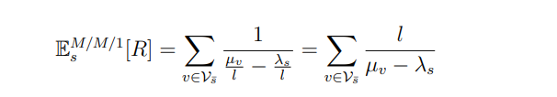
Now, consider an SFC which is divided into l subchains. As every packet traverses one of the subchains, say s¯, the expected response time of the SFC can be calculated as:-

Slide 4
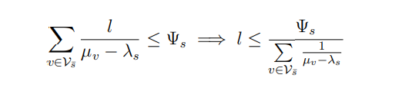
As every SFC s has the delay constraint of Ψs, the delay incurred in an SFC with subchains should not exceed Ψs. Therefore:-
So we see that the expected response time is linearly increasing with the number of subchains l.

Slide 5
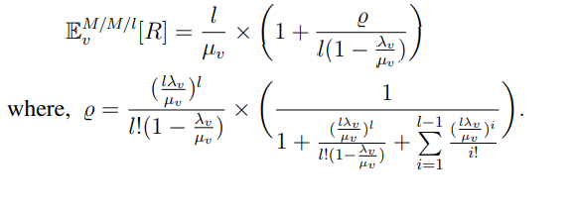
So we propose to have a common scheduler for every VNF instead of having an individual scheduler for each VNFs.
If a VNF is divided into l smaller VNFs, then the expected response time of a VNF v can be calculated as:-

Slide 6
the reliability in eRESERV settings increases with increase in number of subchains.
M/M/m setting matches the reliability offered by the SCB setting, but consumes way less resources when compared to SCB setting.
Thus M/M/m is more efficient and more reliable and takes less response time than M/M/1.
Note: The response time needs to be minimized as much as possible keeping in mind that the service request has a delay constraint that must also be satisfied.

Slide 7
The response time of both E_{S}^{M/M/1} [R] and E_{S}^{M/M/l}[R] <= Ψs
E_{S}^{M/M/l}[R] is most reliable.

Slide 8
Questions
Given the delay constraint Ψs is it necessary or is there any requirement for minimizing the response time E_{S}[R] , if so how much?
Is the system following hard real time systems or soft real time systems?

Slide 9
Hard real time systems vs soft real time systems
Hard real time is a system whose operation becomes incorrect if results are not produce according to time constraint. For example: Air traffic control, Medical system
Soft real time system is a system whose operation degrades if results are not produce according to the specified timing requirement. For example: Multimedia transmission and Reception, Computer Games

Slide 10
Observations
If there is a reward associated with each service request then soft real time systems are useful.
As we know for every service request there is a deadline(here Ψs), so if we try to minimize response time then it might increase the reward.
If the response time increases with time then based on certain functions the reward decreases.
Note: The VNF resource requirements can be heterogenous. It is seen that if the same system is made to run the second time the probability of the system producing incorrect results is minimized or in other words the system may run properly in the second pass.

Slide 11
Probable problems
Q1: Given the hardware resources and their constraints how do I maximize the reliability of the given system without increasing hardware resources?
Q2: How much is the limit of Ψs or what is the probable constraint value?
Q3: Given the delay constraint Ψs is there any requirement for minimizing the response time E_{S}[R] , if so how much?
Q4: Final relation of Ψs with E_{S}[R].

