Slide 1


2026
BagGuard AI
An Intelligent Computer Vision Framework for Airport Baggage Damage Prevention, Handling Analytics, and Automated Claim Verification
“From Check-in to Claim—Every Bag Protected by AI."
Team Emora
Sreyas Linith & Theertha Suran V
Vidya Academy of Science And Technology,Thrissur

Slide 2

Problem Statement
  Millions of baggage damage complaints annually
  High airline compensation costs
  Manual claim investigation
  Lack of digital evidence
  Passenger dissatisfaction
  No predictive monitoring

Slide 3
Problem Statement
Current Challenges
  Passenger Problems
  Damaged luggage
  No proof of damage
  Slow claim processing
  Airport Problems
  Expensive compensation
  Manual investigations
  Fraudulent claims
  Poor operational visibility
Current systems detect damage after it occurs instead of preventing it.

Slide 4

Proposed Solution
  Smart Check-in Scan
  Real-Time Monitoring
  Automated Damage Detection
  Digital Claim Verification
  Predictive Analytics Dashboard

Slide 5

Why BagGuard AI?
  Prevents baggage damage before it occurs
  Generates digital evidence automatically
  Uses predictive analytics to improve airport operations

Slide 6
Existing Solutions vs Our Solution
Existing Technology
  Barcode Tracking - Only track location.
  RFID - No damage intelligence
  CCTV - Manual review
  Manual Inspection - Slow and inconsistent
  Claim Management - Reactive process
Our Solution
  Digital Baggage Passport
  Continuous AI Monitoring
  Rough Handling Detection
  Automated Damage Assessment
  Predictive Risk Analytics
  Fraud Detection
  AI Decision Support
  Airport Performance Analytics

Slide 7
Market Opportunity
Aviation Industry Trends
  Smart Airport Transformation
  AI Adoption
  Digital Aviation
  Passenger Experience
  Airport Automation
Potential Customers
  Airports
  Airlines
  Ground Handling Companies
  Aviation Authorities

Slide 8
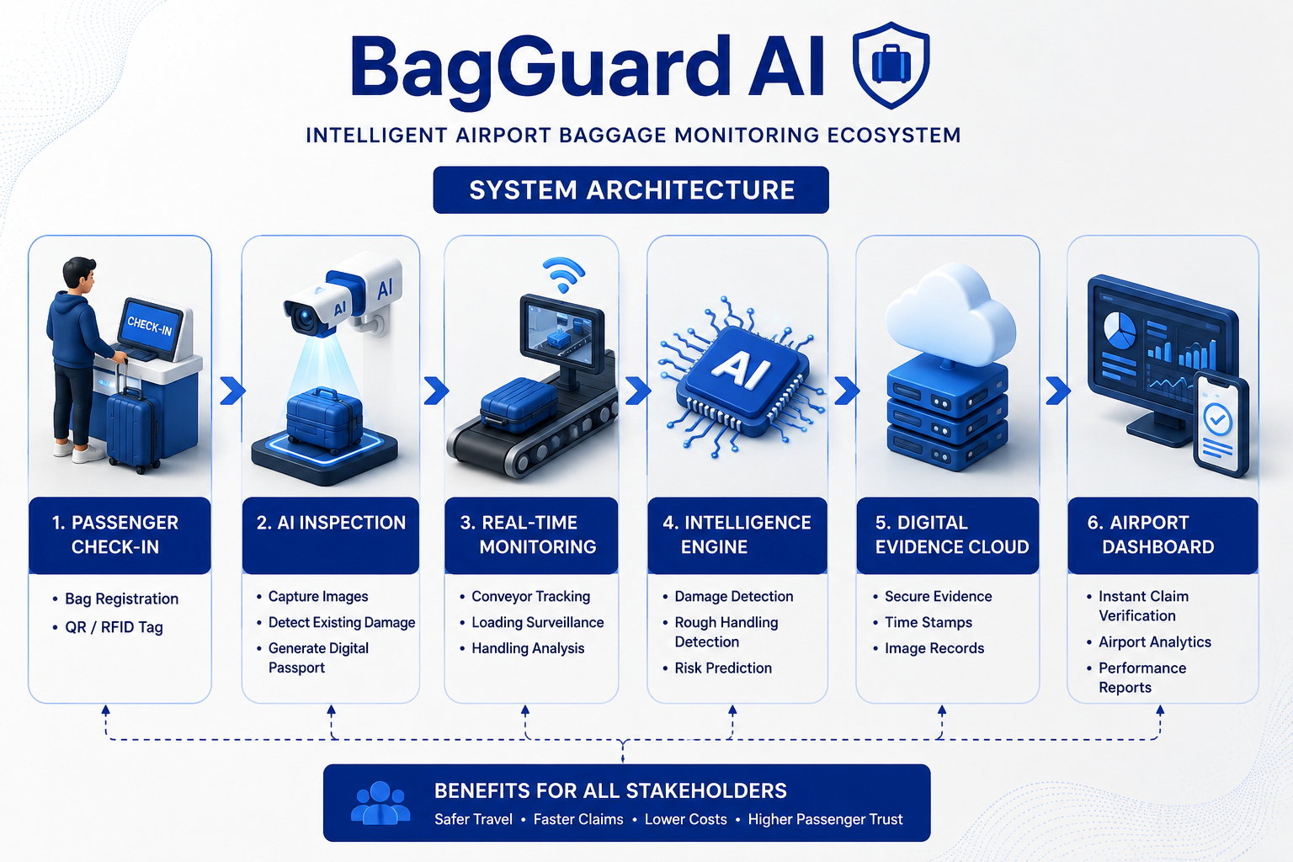

Slide 9

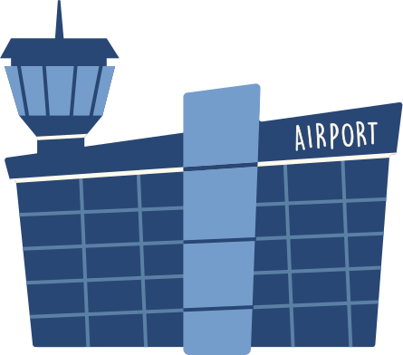
Impact & Future Vision
Economic Impact
  Lower operational costs
  Reduced compensation expenses
  Improved airport efficiency
Social Impact
  Passenger trust
  Transparency
  Better travel experience

Slide 10
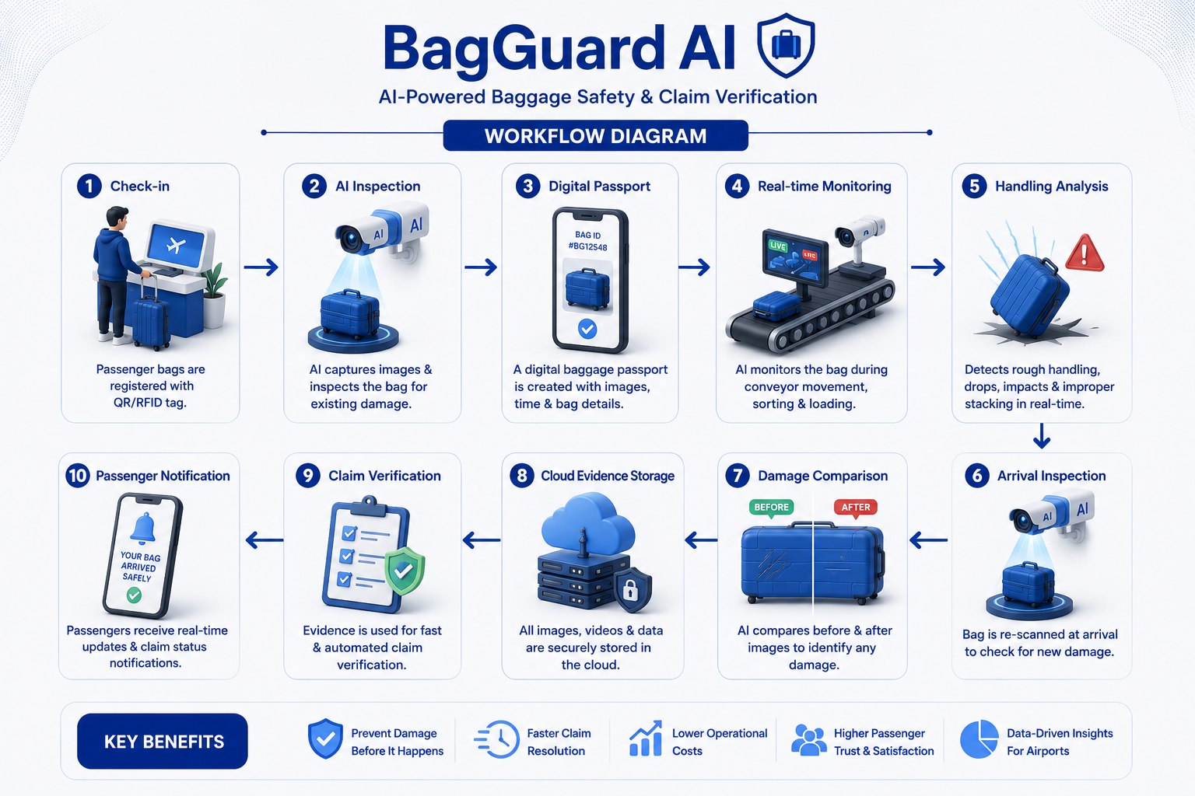

Slide 11
Technology Stack
AI Layer
  YOLO
  CNN
  Computer Vision
  Image Similarity
Data Layer
  Cloud Storage
  Database
  RFID
  QR
Deployment
  Airport Cameras
  Conveyor
  Cloud
  Mobile Dashboard

Slide 12
Revenue Model & Cost Estimation
Revenue Sources
  Airport Software License
  AI Monitoring Subscription
  Cloud Analytics Dashboard
  Annual Maintenance & Support
Potential Annual Revenue per Airport: ₹21–34 Lakhs
Development Cost
  AI Model Development
  Dashboard & Backend
  Cloud Infrastructure
  System Integration & Testing
Total Estimated Development Cost: ≈ ₹6 Lakhs

Slide 13
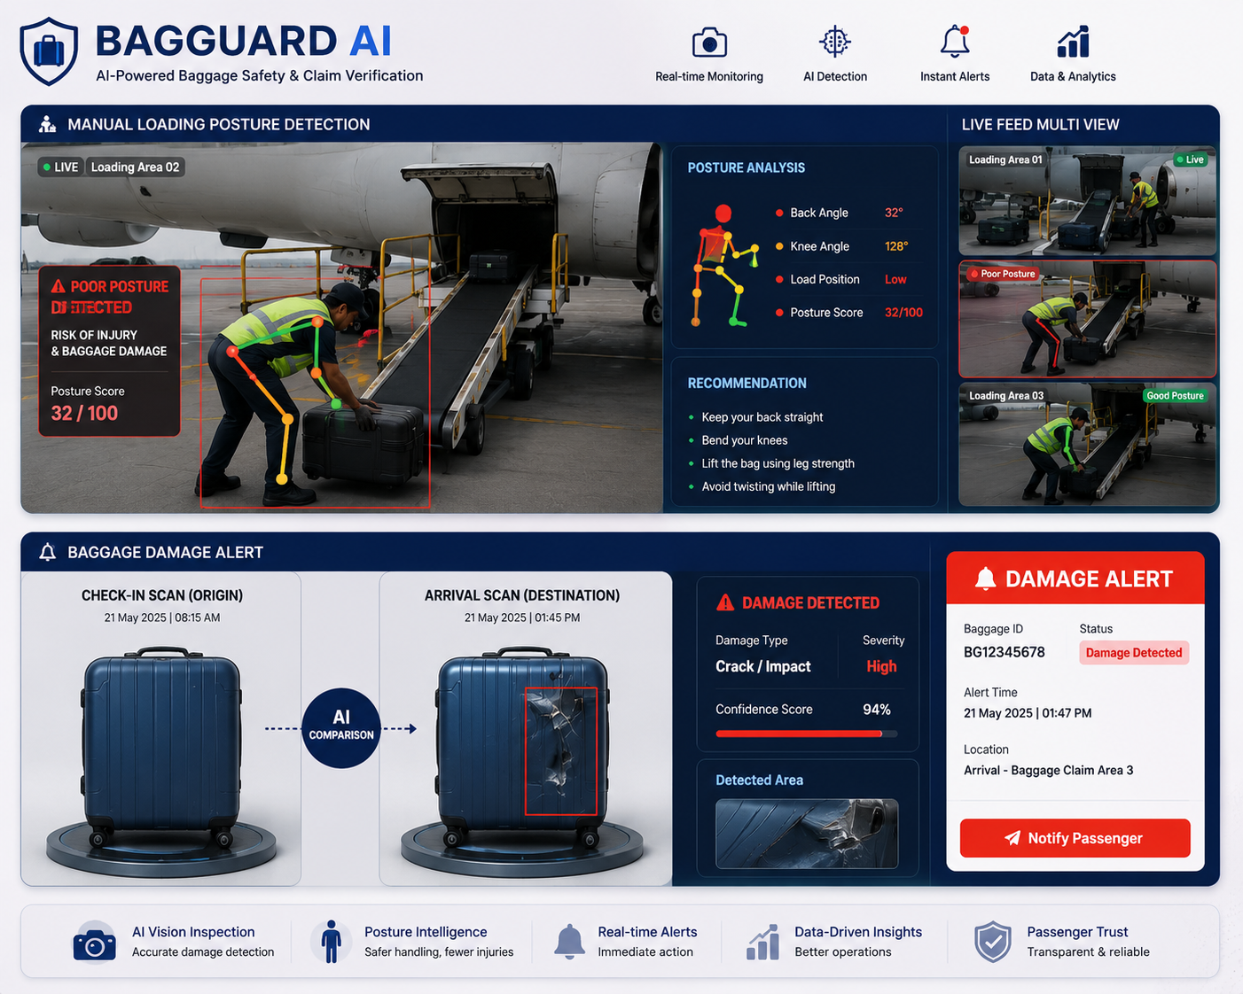

Slide 14
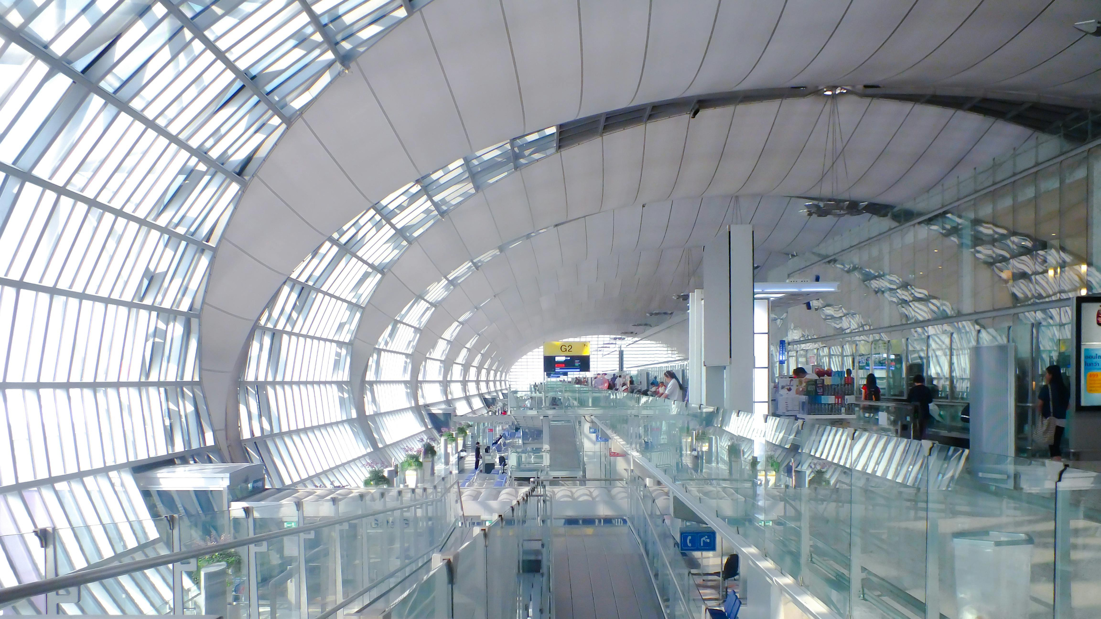

Thank You!

