Slide 1
Healthcare Dataset
Source: https://www.kaggle.com/datasets/prasad22/healthcare-dataset?resource=download
This dataset is synthetic data that’s designed to mimic real-world healthcare data.
There are several privacy/security issues when using and testing healthcare data. By using common attributes found in regular datasets allows for proper practice in implementing this data into ML systems, ensuring its results are produced based on necessary data without risking a patient’s personal data.

Slide 2
Columns
Name: Patient's name -- NOMINAL
Age: Age of the patient at admission (years) – CONTINUOUS
Gender: Patient’s gender (Male/Female) -- NOMINAL
Blood Type: Patient’s blood type (e.g., A+, O-, etc.) -- NOMINAL
Medical Condition: Primary diagnosis (e.g., Diabetes, Asthma) -- NOMINAL
Date of Admission: Admission date -- ORDINAL
Doctor: Doctor responsible for the patient -- NOMINAL
Hospital: Healthcare facility of admission -- NOMINAL
Insurance Provider: Patient’s insurance provider (e.g., Aetna, Medicare) -- NOMINAL
Billing Amount: Total cost of healthcare services -- CONTINUOUS
Room Number: Patient’s assigned room -- NOMINAL
Admission Type: Type of admission (Emergency, Elective, Urgent) -- ORDINAL
Discharge Date: Patient’s discharge date -- ORDINAL
Medication: Medications prescribed during admission -- NOMINAL
Test Results: Results of medical tests (Normal, Abnormal, Inconclusive) -- ORDINAL

Slide 3
Problem Statement
Problem: Predicting the likelihood of a patient being readmitted to the hospital based on medical history and healthcare received during admission.
Goal: Reducing hospital admission rates by identifying high-risk patients and preventative care strategies.

Slide 4
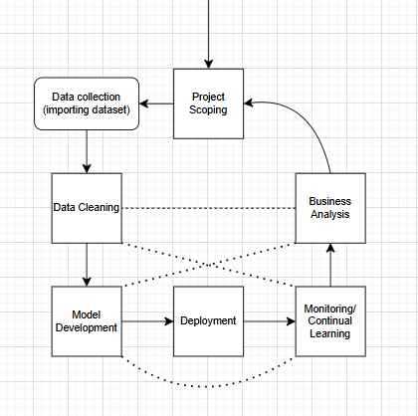
MLS System

Slide 5
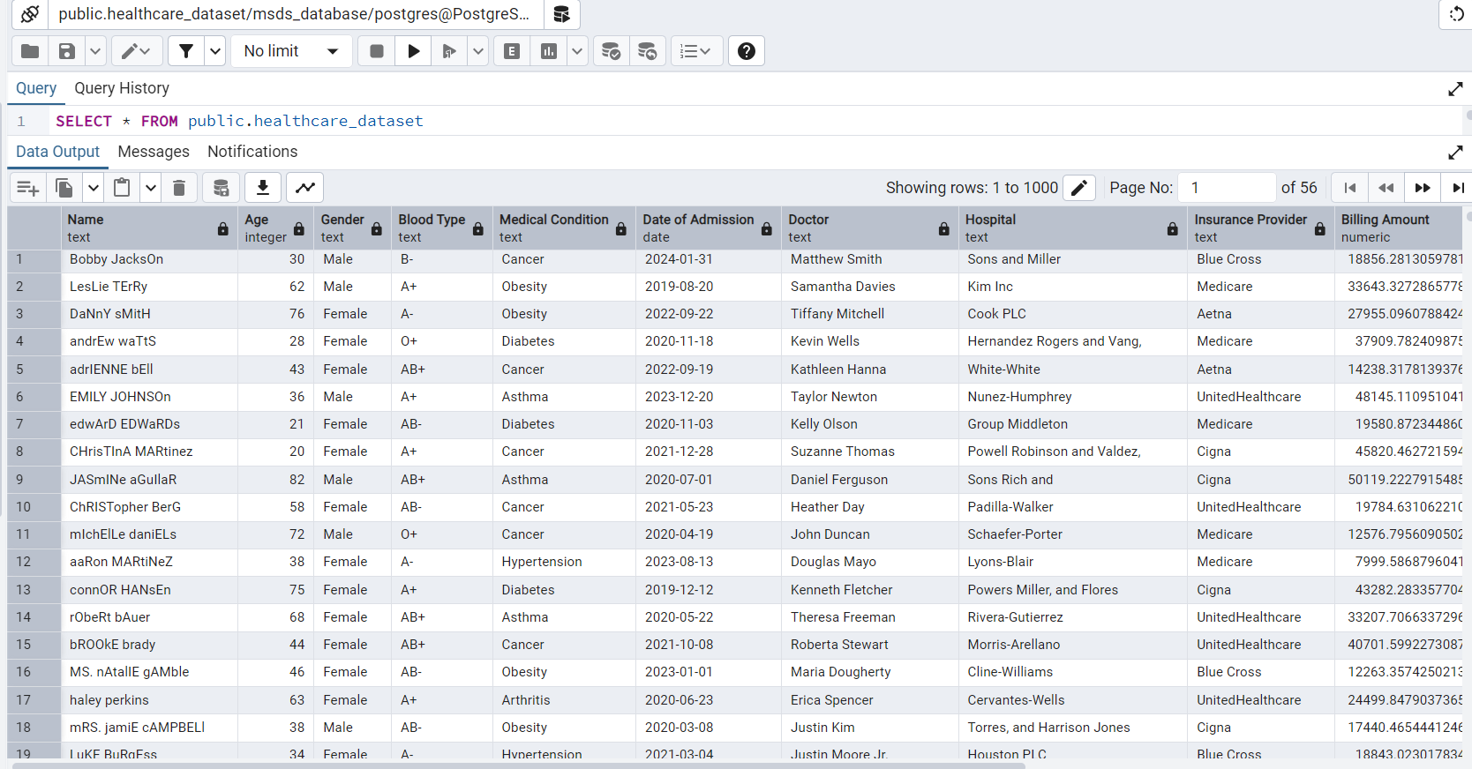
PostgreSQL Data

