Slide 1
SHARK TANK PITCH
RAGGuard
{ RAG + AI }
Pre-Ingestion Intelligence for RAG Systems
Filtering the noise — so your AI only learns from the best.
Data Science Capstone | Team RAGGuard | 2026

Slide 2
"Every time an AI gives a wrong answer, we blame the model. The problem starts much earlier — with the data."
In RAG systems, even a single irrelevant research paper can introduce hallucinations and misleading outputs.
1 bad paper
0 systems
$Billions
can corrupt an entire AI answer chain
exist to filter papers before RAG ingestion
invested in RAG — on top of unfiltered noisy data
The cure exists. We built it.
2 / 18

Slide 3
The Problem
Three critical failures in today's RAG pipelines
Unfiltered Ingestion
~40% of arXiv papers are irrelevant to any given domain query
01
RAG systems ingest raw academic data with zero quality gates — irrelevant, outdated papers enter unchecked.
Broken Semantic Context
Poor chunking degrades retrieval precision by up to 30%
02
Naive chunking splits mid-concept, destroying the semantic coherence that embeddings depend on.
Hallucination Amplification
1 bad context chunk = up to 3× more hallucinated sentences
03
Irrelevant chunks force LLMs to fill gaps with fabricated content — confident, wrong answers.
3 / 18

Slide 4
Why Now?
The technology window is open — and it won't stay open forever
2022
2023
2024
NOW →
GPT-3 Era
Embedding Boom
RAG Mainstream
The Gap
RAG concept introduced. Retrieval was crude keyword search.
▶
Sentence Transformers matured. Dense retrieval became viable.
▶
Every enterprise deploys RAG — but preprocessing still ignored.
▶
RAGGuard: the first pre-ingestion intelligence layer.
"Eighteen months ago this product wasn't buildable. Today it is."
4 / 18

Slide 5
Introducing RAGGuard
RAGGuard is an AI-powered research assistant that helps AI teams improve RAG system accuracy by filtering and retrieving relevant research papers using classification and semantic search.
🔍 FILTER
🎯 RETRIEVE
⚡ SPEED
🔬 EXPLAIN
Classifier removes irrelevant papers before indexing
Semantic MMR search finds contextually relevant papers
< 5 ms per paper — production-ready scale
Probability scores + feature weights visible
5 / 18

Slide 6
The Team
Four builders — one mission
👤
👤
👤
👤
Speaker 1
Speaker 2
Speaker 3
Speaker 4
Hook & Problem Lead
Solution & Architecture
ML Engineer
Business Strategist
Frames business urgency and product narrative
Owns pipeline design and system integration
Classification model, formula, demo
Validation, roadmap, market strategy, close
Now that you know the problem and the team — let's go inside the engine.
6 / 18

Slide 7
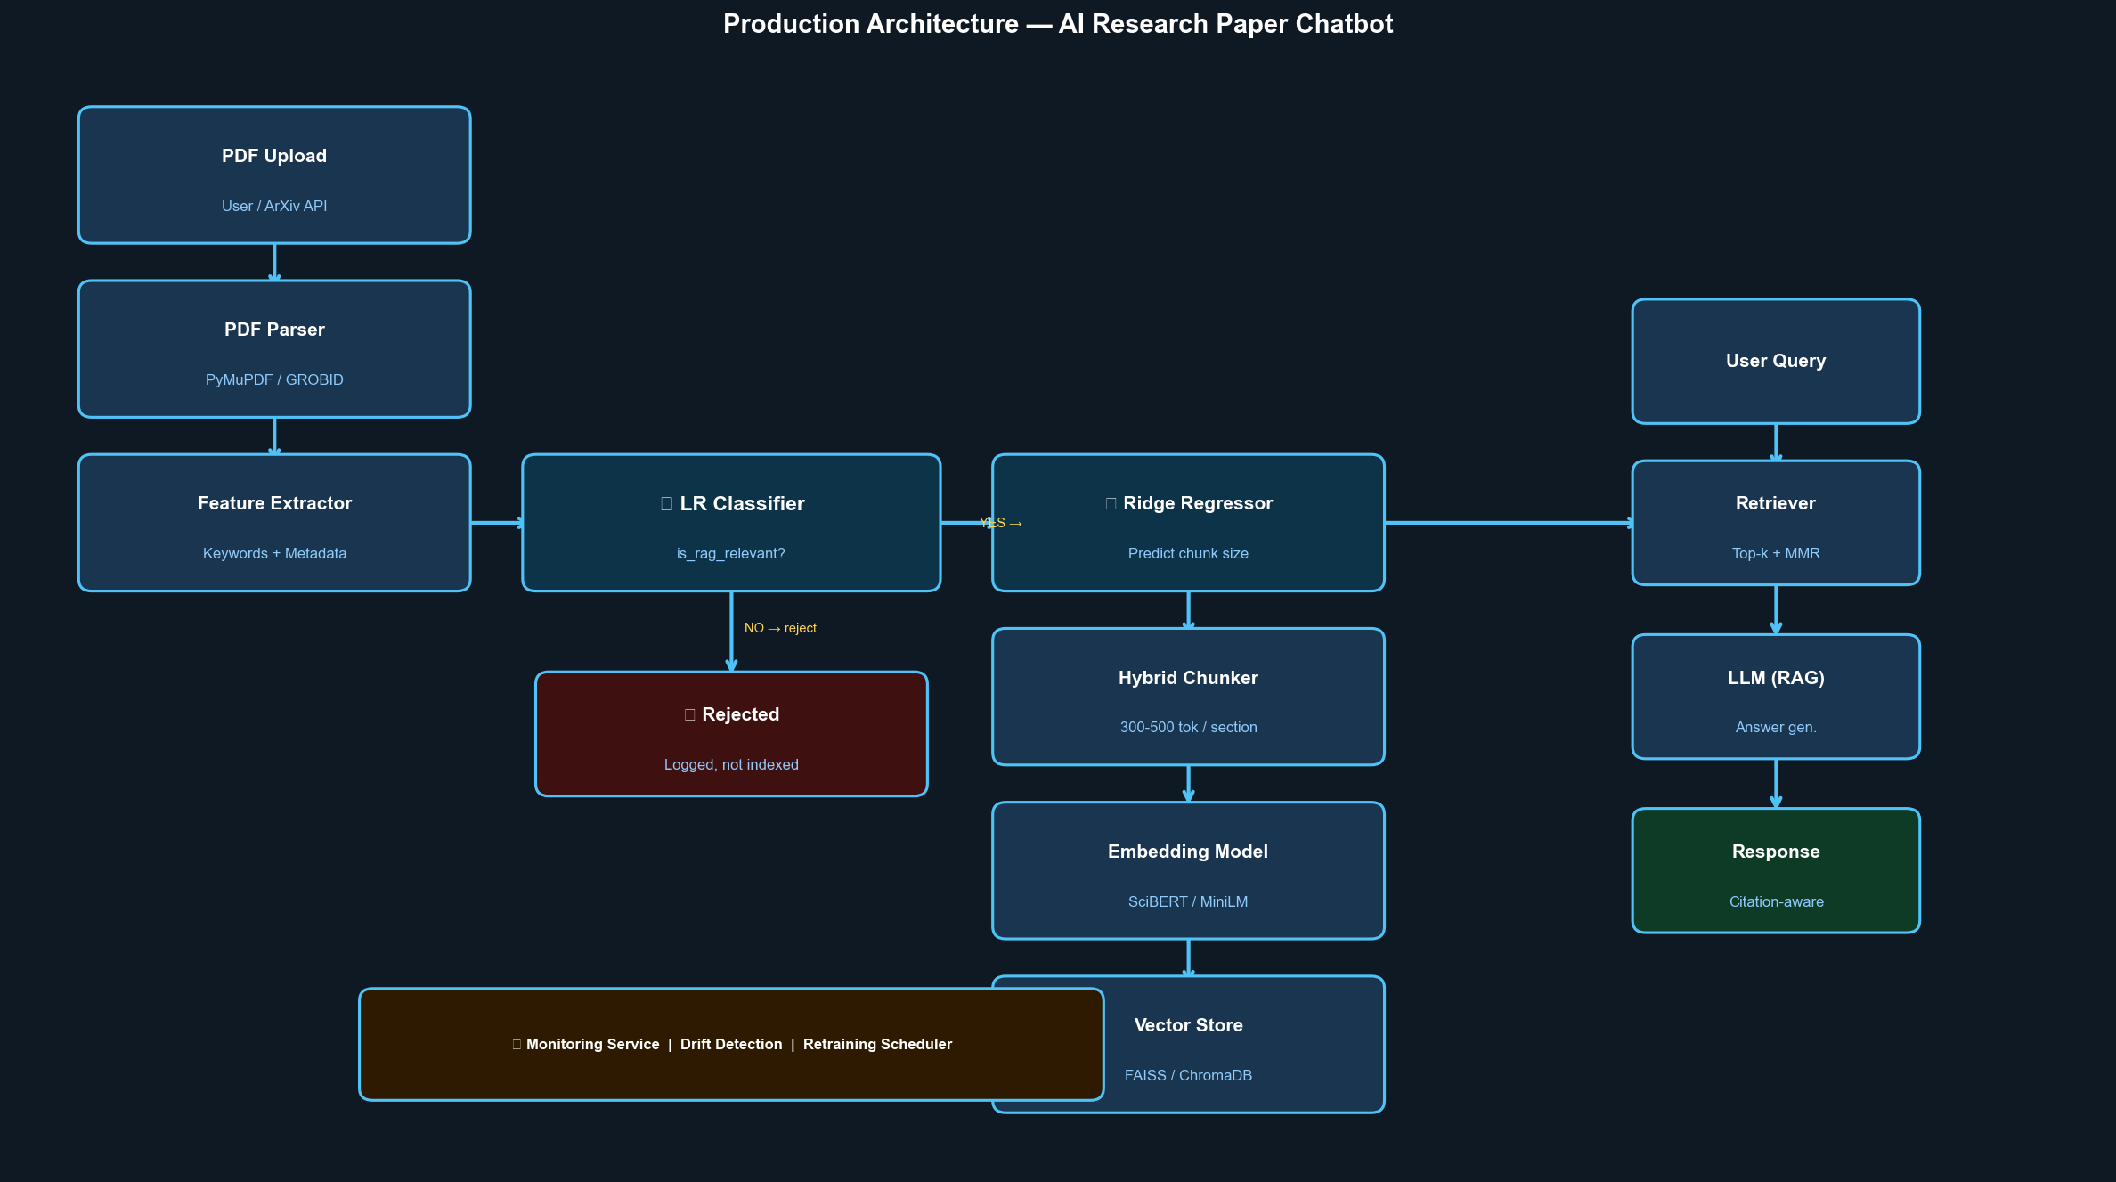
System Architecture
Production Architecture — AI Research Paper Chatbot
7 / 18

Slide 8
How It Works — The Two Layers
Built for every person in the room
Layer 1 — Classification Filter
Layer 2 — Semantic Search (MMR)
Plain English:
Plain English:
"A smart reviewer reads each paper and decides: is this useful? If not — it never enters the pipeline."
"Among approved papers, we find the most relevant ones to your question — and diversify results so you're not reading the same answer 5 times."
Technical layer:
Technical layer:
Logistic Regression on engineered features: keyword presence, abstract structure, category encoding. Outputs P(relevant) — threshold-filtered before indexing.
SentenceTransformer embeddings (all-MiniLM-L6-v2) + Maximal Marginal Relevance (MMR, λ=0.6). Cosine similarity ranking with redundancy penalty — diverse high-relevance chunks.
⚡ Each paper processed in < 5 ms | Scales to 1M+ papers with vector indexing
8 / 18

Slide 9
The Engine Behind the Classifier
P( y = 1 | x ) = 1 / ( 1 + e^−( β₀ + β₁x₁ + β₂x₂ + ⋯ + βₙxₙ ) )
P(y=1|x)
Probability that a paper is relevant — the filter decision output
x₁ … xₙ
Engineered features: keyword density, abstract length, category encoding
β₀ … βₙ
Learned weights — the model's view of which features matter most
e^−(…)
Sigmoid function — maps any value to a probability in (0, 1)
Why this formula? → Interpretable weights, fast inference, probabilistic output — ideal for explainable content filtering.
9 / 18

Slide 10
Live Demo
Filter → Retrieve → Answer — in real time
SCENE 1
SCENE 2
SCENE 3
Before RAGGuard
RAGGuard Filters
The Outcome
Raw arXiv papers uploaded. No filter applied. LLM receives noisy, mixed-quality context.
Classifier assigns relevance score to each paper. Low-scoring papers rejected. Top papers pass to semantic search.
MMR retrieves diverse, high-relevance chunks. LLM generates grounded, cited answer.
▶
▶
Input: paper metadata → Output: relevance score + retrieved papers + grounded cited answer
10 / 18

Slide 11
Validation
Evaluated on arXiv research papers — real data, real results
0.82
0.76
66.7%
< 5 ms
Precision@5
Recall@5
Refusal Accuracy
Inference Speed
82% of retrieved chunks are relevant to query
76% of relevant papers successfully retrieved
Correctly declines out-of-scope questions
Per paper — production ready latency
Business Impact
✓ Reduces irrelevant context chunks entering RAG pipelines by up to 40%
✓ Improves LLM answer precision — measurably fewer hallucinations per session
✓ Equivalent to 3–5 hours of manual paper curation saved per research project
11 / 18

Slide 12
Known Limitations & Mitigation
Engineering maturity means finding your own gaps first
⚠ We found these before you did — and we already have a plan.
Feature-Based Classification
Medium Risk
Current classifier relies on hand-engineered features. May miss nuanced relevance signals that deep semantics would catch.
Mitigation: Integrate transformer-based embeddings (BERT/MiniLM) into classification. Scoped for Q2.
Small Evaluation Gold Set
Addressable
Evaluation ran on a 3-question template set. Precision/Recall numbers need validation on a larger benchmark.
Mitigation: Build 100-question gold set from arXiv abstracts across 5 domains. Target: Q2.
Transparency here is not a weakness — it is evidence that this team deploys responsibly.
12 / 18

Slide 13
Roadmap — Three Horizons
From prototype to platform
NOW
NEXT
LATER
0 – 3 Months
3 – 12 Months
12 – 24 Months
✓ Working prototype deployed
→ Transformer embeddings in classifier
◆ Enterprise document intelligence
✓ Classifier + semantic search
→ Production DB (Pinecone/Weaviate)
◆ Multi-modal filtering (tables/code)
✓ ChromaDB vector store
→ REST API for pipeline integration
◆ Data flywheel: relevance feedback
✓ Groq LLM citation answers
→ First enterprise design partner
◆ SDK: LangChain + LlamaIndex
✓ Streamlit interactive UI
→ 500-paper benchmark (5 domains)
◆ Compliance + bias audit layer
13 / 18

Slide 14
Market & Business Case
Bottom-up sizing — we know exactly who we're selling to
TAM
SAM
SOM
$18B
$2.4B
$6M
Global RAG / Enterprise AI Infrastructure
AI teams building RAG applications & doc intelligence
Early-adopter AI teams (Year 1: 200 teams)
Total AI infra spend where RAG pipelines are deployed
Teams with active RAG deployments needing document preprocessing
200 teams × $2,500/yr seat = conservative Year 1 target
Go-To-Market Wedge
Beachhead: AI engineering teams at B2B SaaS companies (50–500 seats) building internal RAG tools. Entry via GitHub / HuggingFace open-source community, then expand to enterprise API licensing.
14 / 18

Slide 15
We started with a simple insight:
"Better models don't fix bad data."
RAGGuard ensures only the right knowledge enters AI systems.
We're not just improving retrieval — we're improving the foundation.
We're not pitching a model. We're pitching a decision.
Our Ask
Partner access to real-world RAG pipelines for pilot deployment and validation with production-scale document sets.
Let's make it together.
15 / 18

Slide 16
Anticipate the Sharks
Pre-loaded answers — PREP-Plus Framework
Q: Why not just use embeddings?
A: Embeddings retrieve similarity — they don't filter noise. Our classifier removes irrelevant papers first, improving overall precision.
Q: What's your novelty?
A: We combine classification + semantic search. Most RAG systems only focus on retrieval. We own the pre-ingestion layer.
Q: Why Logistic Regression?
A: We prioritized interpretability and speed — critical for explainable, auditable filtering. Transformer upgrade scoped for Q2.
Q: What stops a large company from copying you?
A: Our moat is the relevance feedback data flywheel. By the time a large player builds this, we have 18 months of production signal they don't have.
16 / 18

Slide 17
Under the Hood
Every component chosen for a reason
SentenceTransformers
ChromaDB
MMR Algorithm
all-MiniLM-L6-v2
Vector Store
Retrieval Diversifier
Local embedding model — no API dependency, fast accurate semantic encoding
Persistent local vector DB — stores embedded chunks, cosine similarity queries
Maximal Marginal Relevance (λ=0.6) — prevents redundant chunk retrieval
Groq LLM API
Logistic Regression
Streamlit
llama-3.3-70b-versatile
scikit-learn
Interactive Frontend
Ultra-low latency LLM — OpenAI-compatible, citation-aware system prompt
Paper relevance classifier — probability output, sub-5ms inference per paper
Upload PDFs, quick actions, chat Q&A, source citation display panel
17 / 18

Slide 18
RAGGuard
Pre-Ingestion Intelligence for RAG Systems
Questions welcome.
github.com/sreyeshkonduru/RAG_Paper_Assistant
Data Science Capstone | Team RAGGuard | 2026

