Slide 1


Database course
Episode 3 – GROUP BY-UNION-INTERSECT

Slide 2

Quiz
Prepare your flash cards and… be ready to vote !

Slide 3
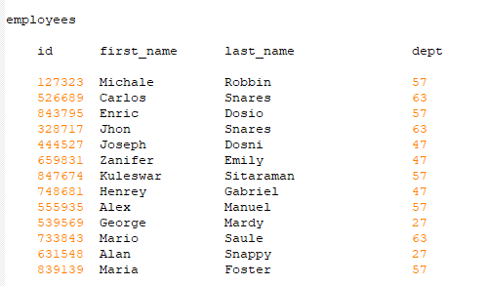
2
Display all the data of employees whose first name start with J
Database
A
SELECT *
FROM employees
WHERE first_name LIKE “J%”;
SELECT *
FROM employees
WHERE first_name= “J%”;
C
SELECT *
FROM employees
WHERE first_name LIKE “%J”;
SELECT *
FROM employees
WHERE first_name STARTS “J”;
B
D

Slide 4
2
Display all the data of employees whose first name start with J
Database
A
SELECT *
FROM employees
WHERE first_name LIKE “J%”;
SELECT *
FROM employees
WHERE first_name= “J%”;
C
SELECT *
FROM employees
WHERE first_name LIKE “%J”;
SELECT *
FROM employees
WHERE first_name STARTS “J”;
B
D

Slide 5
2
Display all the data of employees whose first name ends with J
Database
A
SELECT *
FROM employees
WHERE first_name LIKE “J%”;
SELECT *
FROM employees
WHERE first_name= “J%”;
C
SELECT *
FROM employees
WHERE first_name LIKE “%J”;
SELECT *
FROM employees
WHERE first_name STARTS “J”;
B
D

Slide 6
2
Display all the data of employees whose first name ends with J
Database
A
SELECT *
FROM employees
WHERE first_name LIKE “J%”;
SELECT *
FROM employees
WHERE first_name= “J%”;
C
SELECT *
FROM employees
WHERE first_name LIKE “%J”;
SELECT *
FROM employees
WHERE first_name STARTS “J”;
B
D

Slide 7
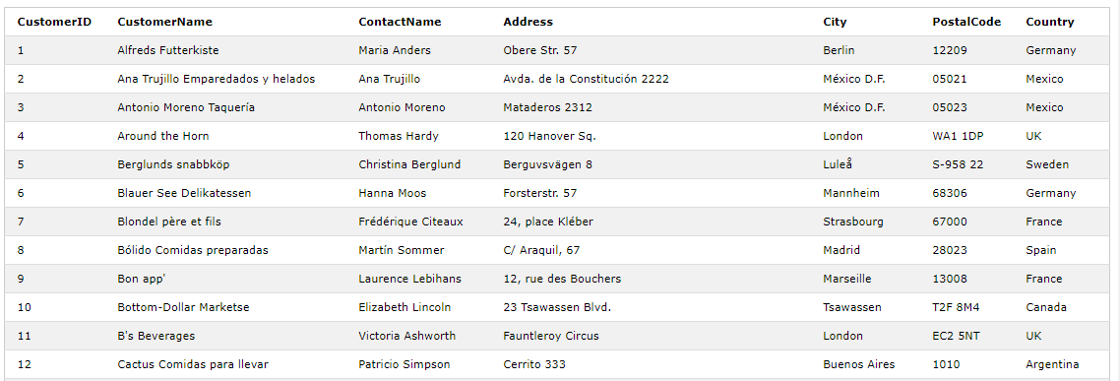
2
Display the different countries the customers come from
A
DISTINCT SELECT Country
FROM Customers
SELECT Country
FROM Customers
DISTINCT
C
SELECT DISTINCT (Country)
FROM Customers
B
Team don t know
D

Slide 8
2
Display the different countries the customers come from
A
DISTINCT SELECT Country
FROM Customers
SELECT Country
FROM Customers
DISTINCT
C
SELECT DISTINCT (Country)
FROM Customers
B
Team don t know
D

Slide 9
What you know
What you will learn here
SELECT - WHERE ... OR ...AND...
ORDER BY
IN ...
DISTINCT
LIKE “%xxxx”
GROUP BY
AVG
SUM
COUNT

Slide 10
Group By
Groups a set of rows
into a set of summary rows
by values of columns

Slide 11
Group By
Is often used with an aggregate function
SUM
AVG
MIN

Slide 12
Group By / Order By
SELECT
FROM
WHERE
GROUP BY
ORDERBY

Slide 13
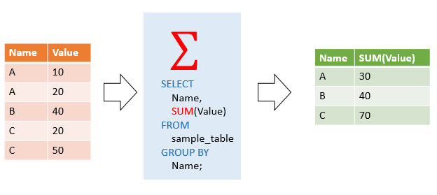
Group By

Slide 14
Demo
https://www.w3schools.com/sql/trysql.asp?filename=trysql_op_in
Using the SUPPLIER table :
Display the number of suppliers per countries
Notes:
SELECT COUNT(SupplierID) AS "Number of suppliers", Country FROM Suppliers GROUP BY Country;

Slide 15
Google classroom
Challenge PART 2
SUBMIT !

