Slide 1
Expected result
What will be the result of this query
Customers
Database
Id Name Country
1 Felipe Italy
2 Ronan France
3 Ronan Cambodia
4 Rith Cambodia
SELECT Id FROM Customers
WHERE Name = "Ronan"
UNION
SELECT Id FROM Customers
WHERE Country = "Cambodia"
A
B
C
D
Id
1
2
3
4
Id
3
Id
2
3
3
4
Id
2
3
4

Slide 2
Expected result
What will be the result of this query
Customers
Database
Id Name Country
1 Felipe Italy
2 Ronan France
3 Ronan Cambodia
4 Rith Cambodia
SELECT Id FROM Customers
WHERE Name = "Ronan"
UNION
SELECT Id FROM Customers
WHERE Country = "Cambodia"
A
B
C
D
Id
1
2
3
4
Id
3
Id
2
3
3
4
Id
2
3
4

Slide 3
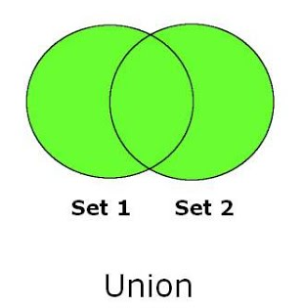
UNION
combines two or more result sets
to a single result set.

Slide 4
Expected result
What will be the result of this query
Customers
Database
Id Name Country
1 Felipe Italy
2 Ronan France
3 Ronan Cambodia
4 Rith Cambodia
SELECT Id FROM Customers
WHERE Name = "Ronan"
UNION
SELECT Id, Name FROM Customers
WHERE Country = "Cambodia"
A
B
C
Id Name
1 Felipe
2 Ronan
3 Ronan
4 Rith
Id
1
2
3
4
Error in execution

Slide 5
UNION
The select columns of each result shall be the same
SELECT Id FROM Customers
WHERE Name = "Ronan"
UNION
SELECT Id FROM Employees
WHERE Country = "Cambodia“
UNION
SELECT Id FROM Students
WHERE City= “Paris"

Slide 6
Expected result
What will be the result of this query
Customers
Database
Id Name Country
1 Felipe Italy
2 Ronan France
3 Ronan Cambodia
4 Rith Cambodia
SELECT Id FROM Customers
WHERE Name = "Ronan"
UNION ALL
SELECT Id FROM Customers
WHERE Country = "Cambodia"
A
B
C
D
Id
1
2
3
4
Id
3
Id
2
3
3
4
Id
2
3
4

Slide 7
Expected result
What will be the result of this query
Customers
Database
Id Name Country
1 Felipe Italy
2 Ronan France
3 Ronan Cambodia
4 Rith Cambodia
SELECT Id FROM Customers
WHERE Name = "Ronan"
UNION ALL
SELECT Id FROM Customers
WHERE Country = "Cambodia"
A
B
C
D
Id
1
2
3
4
Id
3
Id
2
3
3
4
Id
2
3
4

Slide 8
UNION VS UNION ALL
UNION ALL display duplicated rows.

