Slide 1


Database course
Episode 2 – RETRIEVE FROM TABLES

Slide 2

This is an active learning class

Slide 3
Evaluation of this course
20 %
30 %
Mid Term Exam
Exercises & Participation
50 %
Final exam

Slide 4
Road map of today
SELECT - WHERE ... OR ...AND...
ORDER BY
LIKE
IN ...
DISTINCT
AVG

Slide 5

Quiz
Prepare your flash cards and… be ready to vote !
TAKE NOTE !!!

Slide 6
1
Display the sum of two numbers 10 and 15
Database
Expected result
?column?
25
A
SUM 10 + 15;
B
AVG 10 + 15;
C
SELECT 10 + 15;
D
Team don’t know

Slide 7
1
Display the sum of two numbers 10 and 15
Database
Expected result
?column?
25
A
SUM 10 + 15;
B
AVG 10 + 15;
C
SELECT 10 + 15;
D
Team don’t know

Slide 8
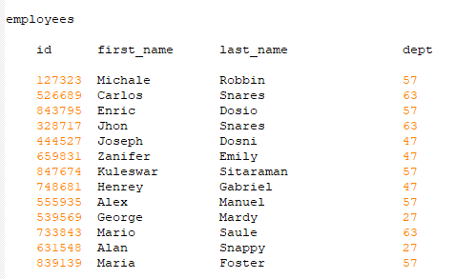
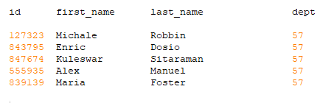
2
Display all the data of employees that work in the department 57
Database
Expected result
A
C
SELECT *
FROM employees
WHERE dept= 57;
SELECT *
OF employees
WHERE dept == 57;
B
D
SELECT *
OF employees
WHERE dept= 57;
SELECT *
WHERE dept = 57;

Slide 9
2
Display all the data of employees that work in the department 57
Database
Expected result
A
C
SELECT *
FROM employees
WHERE dept= 57;
SELECT *
OF employees
WHERE dept == 57;
B
D
SELECT *
OF employees
WHERE dept= 57;
SELECT *
WHERE dept = 57;

Slide 10

3
Find the first + last name of employees whose last name is Snares
Database
Expected result
SELECT *
FROM employees
WHERE last_name= 'Snares';
SELECT *
IN employees
WHERE last_name= 'Snares';
A
C
SELECT * OF first_name , last_name
FROM employees
WHERE last_name= 'Snares';
SELECT first_name , last_name
FROM employees
WHERE last_name= 'Snares';
B
D

Slide 11
3
Find the first + last name of employees whose last name is Snares
Database
Expected result
SELECT *
FROM employees
WHERE last_name= 'Snares';
SELECT *
IN employees
WHERE last_name= 'Snares';
A
C
SELECT * OF first_name , last_name
FROM employees
WHERE last_name= 'Snares';
SELECT first_name , last_name
FROM employees
WHERE last_name= 'Snares';
B
D

Slide 12

4
What to change in this query to display columns as expected ?
Expected result
SELECT first_name , last_name
FROM employees
WHERE last_name= 'Snares';
SELECT first_name
FROM employees
WHERE last_name= 'Snares‘
AS “FIRST”, “LAST”;
SELECT first_name
FROM employees
WHERE last_name= 'Snares‘
LIKE “FIRST”, “LAST”;
A
C
SELECT first_name AS “FIRST”, last_name AS “LAST”
FROM employees
WHERE last_name= 'Snares';
D
SELECT first_name LIKE “FIRST”, last_name LIKE “LAST”
FROM employees
WHERE last_name= 'Snares';
B

Slide 13
4
What to change in this query to display columns as expected ?
Expected result
SELECT first_name , last_name
FROM employees
WHERE last_name= 'Snares';
SELECT first_name
FROM employees
WHERE last_name= 'Snares‘
AS “FIRST”, “LAST”;
SELECT first_name
FROM employees
WHERE last_name= 'Snares‘
LIKE “FIRST”, “LAST”;
A
C
SELECT first_name AS “FIRST”, last_name AS “LAST”
FROM employees
WHERE last_name= 'Snares';
D
SELECT first_name LIKE “FIRST”, last_name LIKE “LAST”
FROM employees
WHERE last_name= 'Snares';
B

Slide 14

5
Display all the data of employees that work in department 63
but exclude employee whose last name is 'Snares'.
Database
Expected result
SELECT *
FROM employees
WHERE dept= 57
AND last_name != 'Snares';
SELECT *
FROM employees
WHERE dept= 57
AND last_name = 'Snares';
A
C
63
63
SELECT *
FROM employees
WHERE dept= 57
EXCLUDES last_name = 'Snares';
SELECT *
FROM employees
WHERE dept= 57
OR last_name != 'Snares';
B
D
63
63

Slide 15
5
Display all the data of employees that work in department 63
but exclude employee whose last name is 'Snares'.
Database
Expected result
SELECT *
FROM employees
WHERE dept= 57
AND last_name != 'Snares';
SELECT *
FROM employees
WHERE dept= 57
AND last_name = 'Snares';
A
C
63
63
SELECT *
FROM employees
WHERE dept= 57
EXCLUDES last_name = 'Snares';
SELECT *
FROM employees
WHERE dept= 57
OR last_name != 'Snares';
B
D
63
63

Slide 16
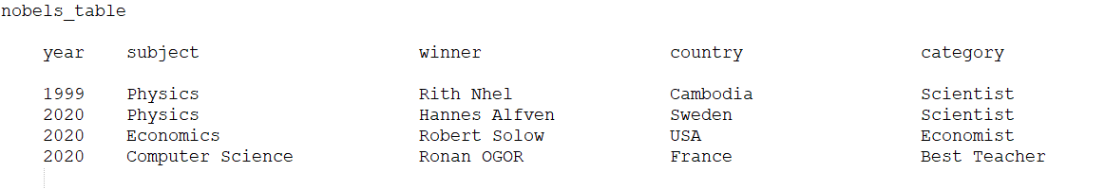
Puzzle
Given this table
Database
Put in order the query on board

Slide 17
To sum up
SELECT
FROM
WHERE

Slide 18
Google classroom
Challenge PART 1

Slide 19
To sum up
SELECT
FROM
WHERE
ORDERBY

Slide 20

CODE REVIEW

