Slide 1

ACTIVITY 1
10 MIN
STUDENT
ENROLMENT
COURSE
Student ID | Student Name | Date of birth | Province
1001 | Mengyi | xxx | xxx
1002 | Tim | xxx | xxx
1003 | Narong | xxx | xxx
1004 | Nork | xxx | xxx
1005 | Sophim | xxx | xxx
Enrolment ID | Student ID | Course ID
10011001 | 1001 | 1002
10021002 | 1002 | 1002
10031002 | 1003 | 1002
10031001 | 1003 | 1001
10041001 | 1004 | 1001
10051001 | 1005 | 1001
10011004 | 1001 | 1004
10021004 | 1002 | 1004
Course ID | Course name | Teacher | Department
1001 | JavaScript | Clément | WEP
1002 | Oral comprehension | Sokhom | English
1003 | Algorithm | Ronan | WEP
1004 | Drawing | Him | Art
What courses follows Mengyi?
Who are the students that follow the Javascript course?
How many students follow the Drawing course?
Notes:
Complete the tables with examples

Slide 2
ACTIVITY 2
10 MIN
PARENT
parent_id gender last_name job_name
STUDENT_PARENT
parent_id student_id
STUDENT
student_id gender last_name shool_name
1
many
many
1
What is the relation between Students and Parents?
The table Student_Parents is called an Intersection table or an Associative table or is it just a normal table? Explain why.

Slide 3
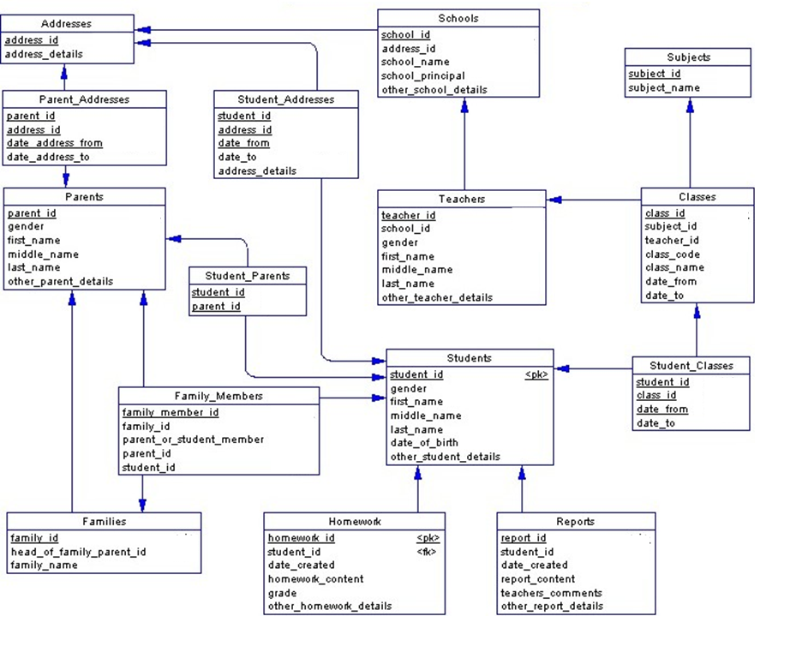
ACTIVITY 3
10 MIN
Complete the model to precise for each id if they are a Primary Key (PK) or a Foreign Key (FK)
EXAMPLE
PK
PK FK
PK
FK
FK
FK
FK
FK
PK
PK
PK
FK
FK
FK
FK
FK
PK
FK
PK
FK
FK
FK
FK
PK
FK
PK
PK
FK
FK

Slide 4
ACTIVITY 4
10 MIN
STUDENT
student_id gender name province
COURSE
coure_id course_name departement
many
many
Add a new table to manage the MANY to MANY relation ship
For each attribute, write the TYPE and for the keys, specify PK or FK

Slide 5
ACTIVITY 4
10 MIN
STUDENT
student_id gender name province
Student_Couruse
student_id FK coure_id FK
COURSE
coure_id course_name departement
1
many
1
many
Intersection
Add a new table to manage the MANY to MANY relation ship
For each attribute, write the TYPE and for the keys, specify PK or FK

