Slide 1
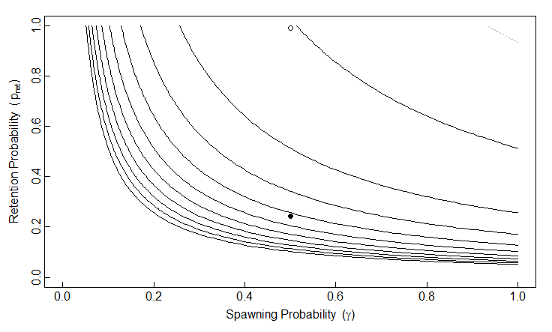




$$φ_{0,MR}=0.00011$$
$$φ_{0,MR}=0.0002$$
$$φ_{0,MR}=0.0004$$
$$φ_{0,MR}=0.002$$

