Slide 1
Pallid Sturgeon Demographic Population Model
Draft Analysis of Fort Peck Flow Scenarios
Presented to the Management Team
10/11/2019
Sara Reynolds
sara.reynolds@huskers.unl.edu

Slide 2
Outline
Overarching Modeling Framework
Demographic Population Model Methodology
Structure
Parameterization
Analysis & Results
Long-Term Population Growth Rate
Sensitivity and Elasticity Values
Long-Term Growth-Decline Boundaries
Population Growth Rate Across the POR & More
Discussion & Questions

Slide 3
HEC-ResSim
Overarching Modeling Framework
Hydrology
Integrated Temperature, Drift, & Development Model
Spawning Model
Spawning Probability
Retention Probability
Pallid Sturgeon Demographic Population Model
Reproductively-Ready Period
Age-0
Survival
Given Retention
Age-Specific
Fertility
Age-Specific
Maturation
Population Metrics
Long-Term Population Growth Rate
Age-Specific
Survival
Age-Specific
Fecundity
Age-Specific
Reproduction
Maximum Age
Sex Ratio

Slide 4
HEC-ResSim
Overarching Modeling Framework
Hydrology
Integrated Temperature, Drift, & Development Model
Spawning Model
From Craig Fischenich
Spawning Probability
Retention Probability
Pallid Sturgeon Demographic Population Model
Reproductively-Ready Period
Age-0
Survival
Given Retention
Age-Specific
Fertility
Age-Specific
Maturation
Population Metrics
Long-Term Population Growth Rate
Age-Specific
Survival
Age-Specific
Fecundity
Age-Specific
Reproduction
Maximum Age
Sex Ratio

Slide 5
HEC-ResSim
Overarching Modeling Framework
Hydrology
Integrated Temperature, Drift, & Development Model
Includes a flow threshold: 20kcfs
Expected to include a temperature threshold: 16C—under development; not implemented
Default value: 50% of reproductively-ready females spawn up the Missouri River given thresholds are met
Spawning Model
Spawning Probability
Retention Probability
Pallid Sturgeon Demographic Population Model
Reproductively-Ready Period
Age-0
Survival
Given Retention
Age-Specific
Fertility
Age-Specific
Maturation
Population Metrics
Long-Term Population Growth Rate
Age-Specific
Survival
Age-Specific
Fecundity
Age-Specific
Reproduction
Maximum Age
Sex Ratio

Slide 6
HEC-ResSim
Overarching Modeling Framework
Hydrology
Focus of today’s presentation
Model structure & parameterization
Long-term population growth rate (lambda) results
Caveat: Changes or updates to outside models or their results (e.g., spawning model) will require updated population model results
Integrated Temperature, Drift, & Development Model
Spawning Model
Spawning Probability
Retention Probability
Pallid Sturgeon Demographic Population Model
Reproductively-Ready Period
Age-0
Survival
Given Retention
Age-Specific
Fertility
Age-Specific
Maturation
Population Metrics
Long-Term Population Growth Rate
Age-Specific
Survival
Age-Specific
Fecundity
Age-Specific
Reproduction
Maximum Age
Sex Ratio

Slide 7
HEC-ResSim
Overarching Modeling Framework
Hydrology
Integrated Temperature, Drift, & Development Model
Spawning Model
Spawning Probability
3 main components of the model structure
Age-specific fertilities are broken down into underlying parameters
Retention Probability
Pallid Sturgeon Demographic Population Model
Reproductively-Ready Period
Age-0
Survival
Given Retention
Age-Specific
Fertility
Age-Specific
Maturation
Population Metrics
Long-Term Population Growth Rate
Age-Specific
Survival
Age-Specific
Fecundity
Age-Specific
Reproduction
Maximum Age
Sex Ratio

Slide 8
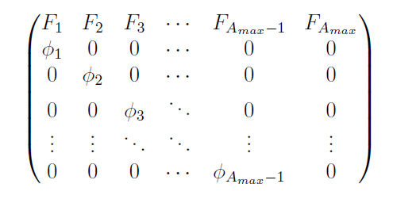
Methodology: Demographic Population Model
Matrix Size
Age-Structured Projection Matrix (Leslie Matrix)
Entries associated with females
maximum age
Age-Specific Fertilities
Matrix Entries
Age-Specific Survivals

Slide 9
HEC-ResSim
Overarching Modeling Framework
Hydrology
Integrated Temperature, Drift, & Development Model
Age-specific fertility is comprised of two main components
Age-specific reproduction
Age-0 survival
Each of these components are broken down further into meaningful parameters
Spawning Model
Spawning Probability
Retention Probability
Pallid Sturgeon Demographic Population Model
Reproductively-Ready Period
Age-0
Survival
Given Retention
Age-Specific
Fertility
Age-Specific
Maturation
Population Metrics
Long-Term Population Growth Rate
Age-Specific
Survival
Age-Specific
Fecundity
Age-Specific
Reproduction
Maximum Age
Sex Ratio

Slide 10
Methodology: Demographic Population Model
expected number of age-1 female recruits produced by an age-$i$ females
Age-specific fertilities are specified in terms of:
age-specific reproduction
maturation age
period of time between years of reproductive-readiness
probability of spawning in the Missouri River below Fort Peck Dam
age-specific expected fecundities (number of eggs released)
sex ratio
age-0 survival

Slide 11
Methodology: Demographic Population Model
Age-specific fertilities are specified in terms of:
age-specific reproduction
maturation age
period of time between years of reproductive-readiness
probability of spawning in the Missouri River below Fort Peck Dam
age-specific expected fecundities (number of eggs released)
sex ratio
age-0 survival
Assuming a worst case lake survival scenario where Lake Sakakawea survival is 0:
Age-0 Survival =
(Missouri River Age-0 Survival Given Retention)*(Retention Probability)
+ (Lake Sakakawea Age-0 Survival)*(1-Retention Probability)

Slide 12
Methodology: Demographic Population Model
Age-specific fertilities are specified in terms of:
age-specific reproduction
maturation age
period of time between years of reproductive-readiness
probability of spawning in the Missouri River below Fort Peck Dam
age-specific expected fecundities (number of eggs released)
sex ratio
age-0 survival
Assuming a worst case lake survival scenario where Lake Sakakawea survival is 0:
Age-0 Survival =
(Missouri River Age-0 Survival Given Retention)*(Retention Probability)

Slide 13
Methodology: Demographic Population Model
Age-specific fertilities are specified in terms of:
age-specific reproduction
maturation age
period of time between years of reproductive-readiness
probability of spawning in the Missouri River below Fort Peck Dam
age-specific expected fecundities (number of eggs released)
sex ratio
age-0 survival
age-0 survival given retention in the free-flowing Missouri River
retention probability
Assuming a worst case lake survival scenario where Lake Sakakawea survival is 0:
Age-0 Survival =
(Missouri River Age-0 Survival Given Retention)*(Retention Probability)

Slide 14
Methodology: Demographic Population Model
Age-specific fertilities are specified in terms of:
age-specific reproduction
maturation age
period of time between years of reproductive-readiness
probability of spawning in the Missouri River below Fort Peck Dam
age-specific expected fecundities (number of eggs released)
sex ratio
age-0 survival
age-0 survival given retention in the free-flowing Missouri River
retention probability
Age-specific survivals
Maximum age
Parameterize the model using the parameters at the lowest level of each main component.

Slide 15
HEC-ResSim
Overarching Modeling Framework
Hydrology
Integrated Temperature, Drift, & Development Model
Spawning Model
Spawning and retention probabilities are inputs determined from outside models and do not require parameterization.
Spawning Probability
Retention Probability
Pallid Sturgeon Demographic Population Model
Reproductively-Ready Period
Age-0
Survival
Given Retention
Age-Specific
Fertility
Age-Specific
Maturation
Population Metrics
Long-Term Population Growth Rate
Age-Specific
Survival
Age-Specific
Fecundity
Age-Specific
Reproduction
Maximum Age
Sex Ratio

Slide 16
Methodology: Demographic Population Model
Age-specific fertilities are specified in terms of:
age-specific reproduction
maturation age
period of time between years of reproductive-readiness
probability of spawning in the Missouri River below Fort Peck Dam
age-specific expected fecundities (number of eggs released)
sex ratio
age-0 survival
age-0 survival given retention in the free-flowing Missouri River
retention probability
Age-specific survivals
Maximum age
Parameterize the model using the 7 parameter types at the lowest level of each main component.

Slide 17
Methodology: Demographic Population Model
Parameter | Summary Notes | Sources
maximum age | • 60 years old | Braaten et al. (2015)
age-specific survivals | • computed from RPMA 2 pallid sturgeon data in the literature for stocked fingerling and wild adults populations | Rotella et al. (2017), Klungle and Baxter (2005), Jaeger et al. (2009), and Braaten et al. (2009)
maturation age | • distribution | Keenlyne and Jenkins (1993), George et al. (2012), and Steffensen et al. (2013)
 | • minimum: 8
 | • maximum: 21
 | • mean: ≈15.5
reproductively-ready period | • distribution generated from data in the literature | DeLonay et al. (2016) and Fuller et al. (2008)
 | • range: 2-5 years
age-specific fecundity | • used an age-length growth model and a length-fecundity model to simulate fecundity at age | Rob Holm, unpublished data
 | • models were fit with RPMA 2 pallid sturgeon PSPAP data and data provided by the hatcheries, respectively
sex ratio | • 0.32 (1 female to every 2.125 males) | Jaeger et al. (2009)
age-0 survival given retention | • 0.000075 (75 in 1 million) | Pine et al. (2001)
 | • ≤0.0004 in gulf sturgeon

Slide 18
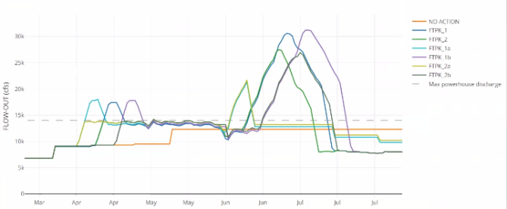
Analysis: Long-Term Population Growth Rate
Spawning Model
Population Metrics
HEC-ResSim
Pallid Sturgeon Demographic Population Model
Long-Term Population Growth Rate
Integrated Temperature, Drift, & Development Model
Compare the outcomes from 7 alternative flows out of Fort Peck dam.

Slide 19
Analysis: Long-Term Population Growth Rate
Spawning Model
Population Metrics
HEC-ResSim
Pallid Sturgeon Demographic Population Model
Long-Term Population Growth Rate
Integrated Temperature, Drift, & Development Model
Obtained from the Eigenanalysis of the Leslie Matrix
Deterministic Model -> Unique Result, No Uncertainty Intervals
Tells us: How fast a population that consistently experiences the given conditions will grow (>1) or decline (<1).
A good metric for a comparison analysis where the relative values of the outcomes are what is important.
Accounts for trade-offs in cueing spawning and retaining drifting free-embryos.
Highlights the importance (or unimportance) of small changes in retention and spawning probabilities.

Slide 20
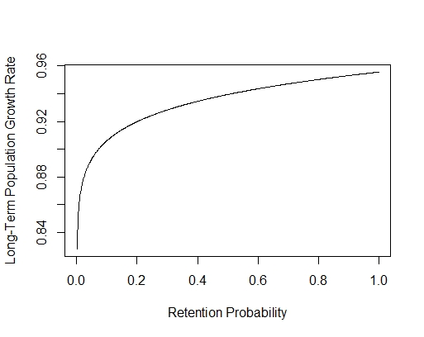
Analysis: Long-Term Population Growth Rate
Highlights the importance (or unimportance) of small changes in retention probability.
Spawning Probability = 0.5

Slide 21
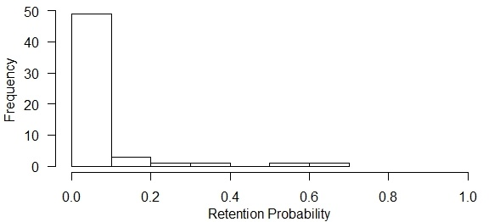
Analysis: Long-Term Population Growth Rate
Highlights the importance (or unimportance) of small changes in retention probability.
Spawning Probability = 0.5

Slide 22
Analysis: Long-Term Population Growth Rate
Spawning Model
Population Metrics
HEC-ResSim
Pallid Sturgeon Demographic Population Model
Long-Term Population Growth Rate
Integrated Temperature, Drift, & Development Model
Obtained from the Eigenanalysis of the Leslie Matrix
Deterministic Model -> Unique Result, No Uncertainty Intervals
Tells us: How fast a population that consistently experiences the given conditions will grow (>1) or decline (<1).
A good metric for a comparison analysis where the relative values of the outcomes are what is important.
Accounts for trade-offs in cueing spawning and retaining drifting free-embryos.
Highlights the importance (or unimportance) of small changes in retention and spawning probabilities.

Slide 23
Results: Long-Term Population Growth Rate
Year | Alt. 1 | Alt. 1a | Alt.1b | Alt. 2 | Alt. 2a | Alt. 2b | No Action
1947 |  |  |  |  |  | 0.8740
1949 |  |  |  |  |  | 0.9456
1966 |  |  | 0.8474 | 0.8439 | 0.8653 | 0.8791
1968 | 0.8171 | 0.8641 |  | 0.8158 | 0.8433
1975 | 0.9070 | 0.8929 | 0.9041 | 0.9034 | 0.9126 | 0.9287 | 0.8831
1980 | 0.8273 |  | 0.8126 | 0.8189 | 0.8442 | 0.8682
1983 | 0.8642 |  | 0.8945 | 0.8386 | 0.8797 | 0.8891
1984 | 0.8501 |  |  | 0.8523 | 0.8851
1985 | 0.8278 | 0.8030 | 0.8961 | 0.8224 | 0.8359 | 0.8548
1986 |  |  |  | 0.8986
1987 |  |  |  | 0.9035 | 0.9264 | 0.9402
1998 | 0.8218 |  | 0.8373 | 0.8197 | 0.8618 | 0.9142
2000 | NA
2011 | 0.8317 | 0.8135 | 0.8416 | 0.8410 | 0.8446 | 0.8425 | 0.8071
2012 | 0.8648 |  |  | 0.8542 | 0.8469
All values in gray boxes are long-term population growth rates under median temperature conditions.
White boxes indicate year and alternative combinations in which the 20kcfs flow criteria could not be met.
Missing years between 1930 and 2012, indicate years in which the 20kcfs flow threshold was not met for any alternative.
NA indicates that we are waiting on retention probability results.

Slide 24
Results: Long-Term Population Growth Rate
Year | Alt. 1 | Alt. 1a | Alt.1b | Alt. 2 | Alt. 2a | Alt. 2b | No Action
1947 |  |  |  |  |  | 0.8740
1949 |  |  |  |  |  | 0.9456
1966 |  |  | 0.8474 | 0.8439 | 0.8653 | 0.8791
1968 | 0.8171 | 0.8641 |  | 0.8158 | 0.8433
1975 | 0.9070 | 0.8929 | 0.9041 | 0.9034 | 0.9126 | 0.9287 | 0.8831
1980 | 0.8273 |  | 0.8126 | 0.8189 | 0.8442 | 0.8682
1983 | 0.8642 |  | 0.8945 | 0.8386 | 0.8797 | 0.8891
1984 | 0.8501 |  |  | 0.8523 | 0.8851
1985 | 0.8278 | 0.8030 | 0.8961 | 0.8224 | 0.8359 | 0.8548
1986 |  |  |  | 0.8986
1987 |  |  |  | 0.9035 | 0.9264 | 0.9402
1998 | 0.8218 |  | 0.8373 | 0.8197 | 0.8618 | 0.9142
2000 | NA
2011 | 0.8317 | 0.8135 | 0.8416 | 0.8410 | 0.8446 | 0.8425 | 0.8071
2012 | 0.8648 |  |  | 0.8542 | 0.8469
All long-term population growth rates indicate a declining population (<1).
Example: If the long-term population growth rate is 0.9034 and the population currently has 10,000 individuals, next year’s population is expected to be 9,034.
Declining growth rates are not equivalent to no recruitment.

Slide 25
Results: Long-Term Population Growth Rate
Year | Alt. 1 | Alt. 1a | Alt.1b | Alt. 2 | Alt. 2a | Alt. 2b | No Action | Top Alt.
1947 |  |  |  |  |  | 0.8740 |  | Alt. 2b
1949 |  |  |  |  |  | 0.9456 |  | Alt. 2b
1966 |  |  | 0.8474 | 0.8439 | 0.8653 | 0.8791 |  | Alt. 2b
1968 | 0.8171 | 0.8641 |  | 0.8158 | 0.8433 |  |  | Alt. 1a
1975 | 0.9070 | 0.8929 | 0.9041 | 0.9034 | 0.9126 | 0.9287 | 0.8831 | Alt. 2b
1980 | 0.8273 |  | 0.8126 | 0.8189 | 0.8442 | 0.8682 |  | Alt. 2b
1983 | 0.8642 |  | 0.8945 | 0.8386 | 0.8797 | 0.8891 |  | Alt. 1b
1984 | 0.8501 |  |  | 0.8523 | 0.8851 |  |  | Alt. 2a
1985 | 0.8278 | 0.8030 | 0.8961 | 0.8224 | 0.8359 | 0.8548 |  | Alt. 1b
1986 |  |  |  | 0.8986 |  |  |  | Alt. 2
1987 |  |  |  | 0.9035 | 0.9264 | 0.9402 |  | Alt 2b
1998 | 0.8218 |  | 0.8373 | 0.8197 | 0.8618 | 0.9142 |  | Alt 2b
2000 | NA |  |  |  |  |  |  | Alt. 1
2011 | 0.8317 | 0.8135 | 0.8416 | 0.8410 | 0.8446 | 0.8425 | 0.8071 | Alt. 2a
2012 | 0.8648 |  |  | 0.8542 | 0.8469 |  |  | Alt. 1
Total Years | 10 | 4 | 7 | 12 | 11 | 10 | 2
Total Top | 2 | 1 | 2 | 1 | 2 | 7 | 0
Alternative 2b flows led to the highest long-term population growth rate in 7 out of 15 years.
Alternative 2 met the flow criteria the most often at 12 out of 15 years.
The No Action alternative only met the flow criteria 2 out of 15 years and had the smallest long-term lambda value both times.
Yearly fluctuations effect the long-term growth rate associated with a particular alternative and the top alternative.
Implications:
All alternatives are better than the No Action alternative.
Adaptive decision making may improve outcomes given reliable information is available—future consideration.

Slide 26
Results: Long-Term Population Growth Rate
Median Water Temperatures
Increasing Long-Term Growth Rate

Slide 27
Results: Long-Term Population Growth Rate
Increasing Long-Term Growth Rate
Water Temperature Variability
Low Water Temperatures
Median Water Temperatures
High Water Temperatures
Generally increasing water temperature, increases the long-term population growth rates.
Increases are typically small (a few thousandths); however, this trend varies by year and alternative.
In the year 2011, temperature changes had a larger impact (a few hundredths) and occasionally particular alternatives experience larger magnitude changes (a few hundredths) in other years (e.g., Alternative 2b in 1947 increasing from low to median temps).
Big Caveat: Inclusion of temperature threshold in the spawning model will likely change results. In particular, it may eliminate spawning opportunities at low temperatures

Slide 28
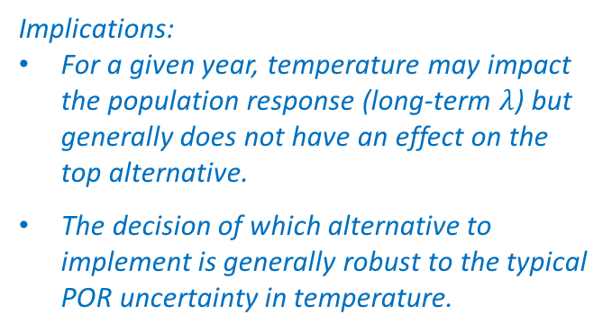
Results: Long-Term Population Growth Rate
Water Temperature Variability
Each entry indicates the top alternative, i.e., the alternative associated with the largest long-term growth rate, during the given year.
Green cells highlight the 2 cases where the top alternative for a given year differs under low temperature conditions from that of median and high temperature conditions.
Year | Low Temp. (-1 s.d.) | Median Temperatures | High Temp. (+1 s.d.)
1947 | 2b | 2b | 2b
1949 | 2b | 2b | 2b
1966 | 2b | 2b | 2b
1968 | 1a | 1a | 1a
1975 | 2b | 2b | 2b
1980 | 2b | 2b | 2b
1983 | 2b | 1b | 1b
1984 | 2a | 2a | 2a
1985 | 1b | 1b | 1b
1986 | 2 | 2 | 2
1987 | 2b | 2b | 2b
1998 | 2b | 2b | 2b
2000 | 1 | 1 | 1
2011 | 2b | 2a | 2a
2012 | 1 | 1 | 1
Implications:
For a given year, temperature may impact the population response (long-term $λ$) but generally does not have an effect on the top alternative.
The decision of which alternative to implement is generally robust to the typical POR uncertainty in temperature.
Big Caveat: Inclusion of temperature threshold in the spawning model will likely change results. In particular, it may eliminate spawning opportunities at low temperatures.

Slide 29
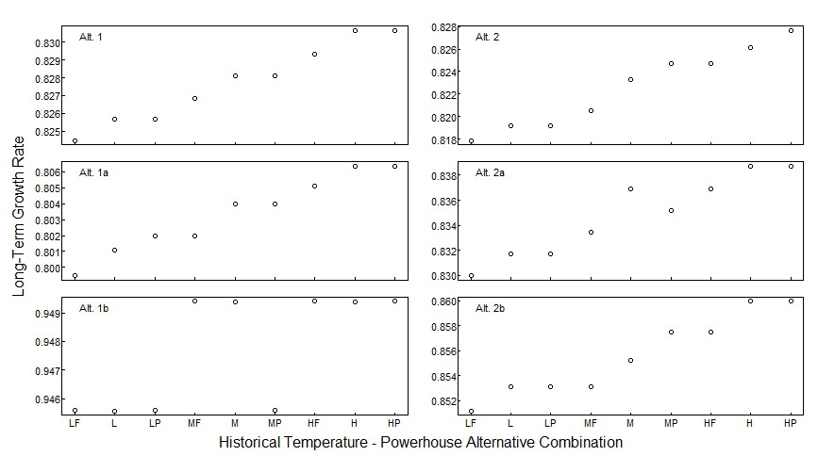
Results: Long-Term Population Growth Rate
Variability in Powerhouse Operations
Standard operations are just as good or better than full powerhouse operations.
Standard operations are typically just as good as peak time operations (however, in some cases they may be better or worse).
*F—maximum powerhouse flow 24/7;
* —max powerhouse flow 12hr & half max flow 12hr at temperature *;
*P—maximum powerhouse flow 6am-10am & 4pm-10pm; half max otherwise
*indicates L, M, or H for low, median, or high water temperatures as taken across the POR

Slide 30
Results: Long-Term Population Growth Rate
Variability in Powerhouse Operations
Within alternative, the differences in the long-term population growth rate due to powerhouse operations is small relative to the differences among alternatives.
Implications:
Alternative flow choice is more important (has a larger effect on the population growth rate) than choice of powerhouse operations.
Caveat: This data is only for one year (1985, the only year ran to obtain retention probabilities). Results in other years could vary.
*F—maximum powerhouse flow 24/7;
* —max powerhouse flow 12hr & half max flow 12hr at temperature *;
*P—maximum powerhouse flow 6am-10am & 4pm-10pm; half max otherwise
*indicates L, M, or H for low, median, or high water temperatures as taken across the POR

Slide 31
Analysis: Sensitivity & Elasticity
Spawning Model
Population Metrics
Spawning Probability
Pallid Sturgeon Demographic Population Model
Long-Term Population Growth Rate
Integrated Temperature, Drift, & Development Model
Retention Probability
Uncertainties in spawning and retention probability inputs would come from the associated models
Sources of uncertainty with respect to the population model come from uncertainties in the model parameterization

Slide 32
Analysis: Sensitivity & Elasticity
Parameter | Summary Notes | Sources
maximum age | • 60 years old | Braaten et al. (2015)
age-specific survivals | • computed from RPMA 2 pallid sturgeon data in the literature for stocked fingerling and wild adults populations | Rotella et al. (2017), Klungle and Baxter (2005), Jaeger et al. (2009), and Braaten et al. (2009)
maturation age | • distribution | Keenlyne and Jenkins (1993), George et al. (2012), and Steffensen et al. (2013)
 | • minimum: 8
 | • maximum: 21
 | • mean: ≈15.5
reproductively-ready period | • distribution generated from data in the literature | DeLonay et al. (2016) and Fuller et al. (2008)
 | • range: 2-5 years
age-specific fecundity | • used an age-length growth model and a length-fecundity model to simulate fecundity at age | Rob Holm, unpublished data
 | • models were fit with RPMA 2 pallid sturgeon PSPAP data and data provided by the hatcheries, respectively
sex ratio | • 0.32 (1 female to every 2.125 males) | Jaeger et al. (2009)
age-0 survival given retention | • 0.000075 (75 in 1 million) | Pine et al. (2001)
 | • ≤0.0004 in gulf sturgeon
Uncertain
Assumes young hatchery & wild fish experience similar survivals
Very little RPMA 2 data available; Molly Webb is analyzing new data
N=28
Age-length growth model being improved
Population estimates from 1 year only
Highly uncertain

Slide 33
Analysis: Sensitivity & Elasticity
Spawning Model
Population Metrics
Spawning Probability
Pallid Sturgeon Demographic Population Model
Long-Term Population Growth Rate
Integrated Temperature, Drift, & Development Model
Retention Probability
Uncertainties in spawning and retention probability inputs would come from the associated models
Sources of uncertainty with respect to the population model come from uncertainties in the model parameterization
Sensitivity and Elasticity Analyses are a way of understanding how changes in parameter values effect the value of long-term population growth rate

Slide 34
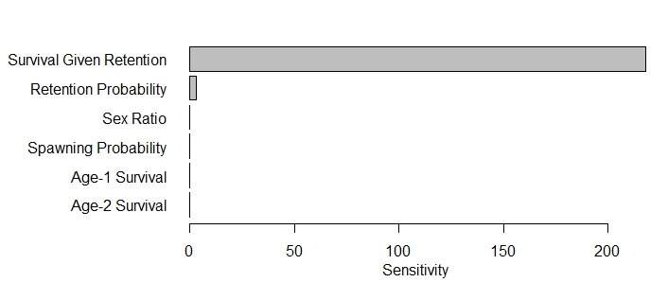
Results: Sensitivities
Sensitivity values indicate the approximate change in the long-term growth rate given a unit change in a parameter value (while all other parameter values remain fixed)
Parameters with sensitivity values of the greatest magnitude effect the model outcomes the most
Age-0 Survival Given Retention
218.258
Retention Probability
3.107
Sex Ratio
0.051
Spawning Probability
0.032
Age-1 Survival
0.026
Age-2 Survival
0.024
Sensitivity
Figure for median retention probability under median temperatures.

Slide 35
Analysis: Sensitivity & Elasticity
Parameter | Summary Notes | Sources
maximum age | • 60 years old | Braaten et al. (2015)
age-specific survivals | • computed from RPMA 2 pallid sturgeon data in the literature for stocked fingerling and wild adults populations | Rotella et al. (2017), Klungle and Baxter (2005), Jaeger et al. (2009), and Braaten et al. (2009)
maturation age | • distribution | Keenlyne and Jenkins (1993), George et al. (2012), and Steffensen et al. (2013)
 | • minimum: 8
 | • maximum: 21
 | • mean: ≈15.5
reproductively-ready period | • distribution generated from data in the literature | DeLonay et al. (2016) and Fuller et al. (2008)
 | • range: 2-5 years
age-specific fecundity | • used an age-length growth model and a length-fecundity model to simulate fecundity at age | Rob Holm, unpublished data
 | • models were fit with RPMA 2 pallid sturgeon PSPAP data and data provided by the hatcheries, respectively
sex ratio | • 0.32 (1 female to every 2.125 males) | Jaeger et al. (2009)
age-0 survival given retention | • 0.000075 (75 in 1 million) | Pine et al. (2001)
 | • ≤0.0004 in gulf sturgeon
Uncertain
Assumes young hatchery & wild fish experience similar survivals
Very little RPMA 2 data available; Molly Webb is analyzing new data
N=28
Age-length growth model being improved
Population estimates from 1 year only
Highly uncertain

Slide 36
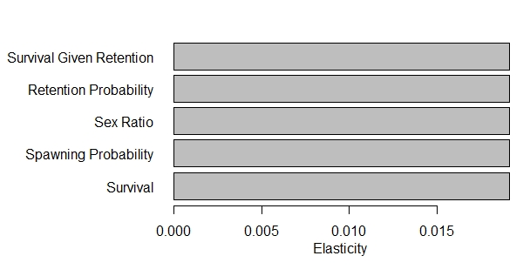
Results: Elasticities
Elasticity values indicate the proportional change in the long-term growth rate given a proportional change in a parameter value (while all other parameter values remain fixed)
Parameters with elasticity values of the greatest magnitude effect the model outcomes the most
Age-0 Survival Given Retention
Retention Probability
Sex Ratio
0.019163
Spawning Probability
Survivals for Age-1 to Age-12
Example:
A percentage change in age-0 survival given retention (0.00000075) is estimated to have the same effect on the long-term population growth rate as a percentage change in age-1 survival (0.0064).
Elasticity
Figure for median retention probability under median temperatures.

Slide 37
Results: Sensitivity & Elasticity
Sensitivity and elasticity analyses are a way of understanding how changes in parameter values effect the value of long-term population growth rate
They are most accurate for small changes in a single parameter
Only a one-parameter sensitivity analysis was performed—results could vary if multiple parameter values are changed simultaneously
From these values we get a sense of what parameters are especially important to population growth and an idea of what parameters it may be best to learn more about and gain more accurate estimations of, if possible
These values do not directly tell us about changes in the top alternative with changes in parameter values, although they may be useful in answering questions of this nature

Slide 38
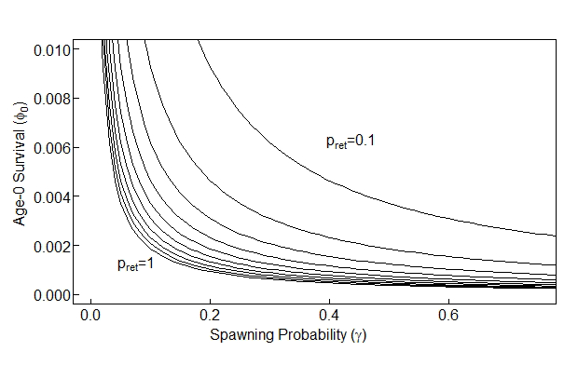
Analysis: Long-Term Growth Decline Boundaries
A “map” of what combinations of spawning probability, retention probability, and age-0 survival given retention will allow for population growth.
This figure is about what values (in terms of retention, spawning, and age-0 survival) would be good to aim for to achieve a growing population, rather than about comparing alternatives.
Age-0 Survival Given Retention
Caveat: Successful recruitment to age-1 resulting from spawning on the Yellowstone River would change these outcomes.

Slide 39
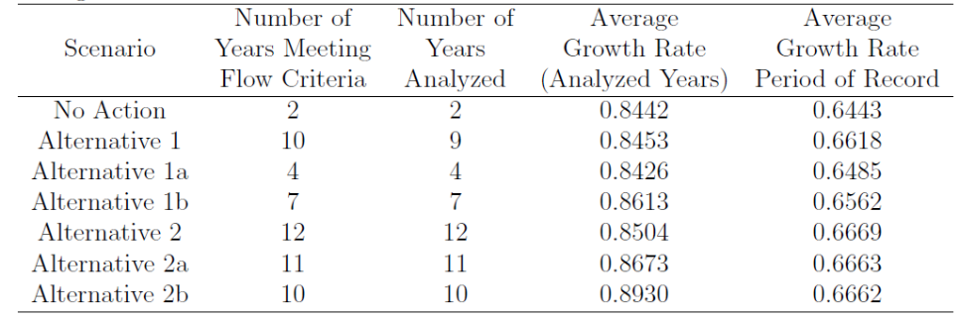
Analysis: Long-Term Population Growth Rate Across POR
A quick way to begin accounting for temporal variability
Accounts for the trade-offs in how well an alternative flow does when it can be implemented and how often the particular flow could be implemented across the POR (1930-2012)
Geometric average of the long-term population growth rates taken across all the years the flow alternative could be implemented
2b is the top alternative

Slide 40
Analysis: Long-Term Population Growth Rate Across POR
A quick way to begin accounting for temporal variability
Accounts for the trade-offs in how well an alternative flow does when it can be implemented and how often the particular flow could be implemented across the POR (1930-2012)
2 is the top alternative
Geometric average of the long-term population growth rates taken across the POR with a population growth rate of 0.64 used for years during which the flow alternative could not be implemented.

Slide 41
Analysis: Long-Term Population Growth Rate Across POR
A quick way to begin accounting for temporal variability
Accounts for the trade-offs in how well an alternative flow does when it can be implemented and how often the particular flow could be implemented across the POR (1930-2012)
2 is the top alternative
Very close to top result.
Caveat: Results of the last column will change depending on the value used in years when flow alternatives cannot be implemented.
2b is the top alternative
Currently addressing this question by projecting populations forward in time under temporal uncertainties.

Slide 42
Methodology: Demographic Population Model
Caveats, Key Assumptions, & Limitations:

Slide 43
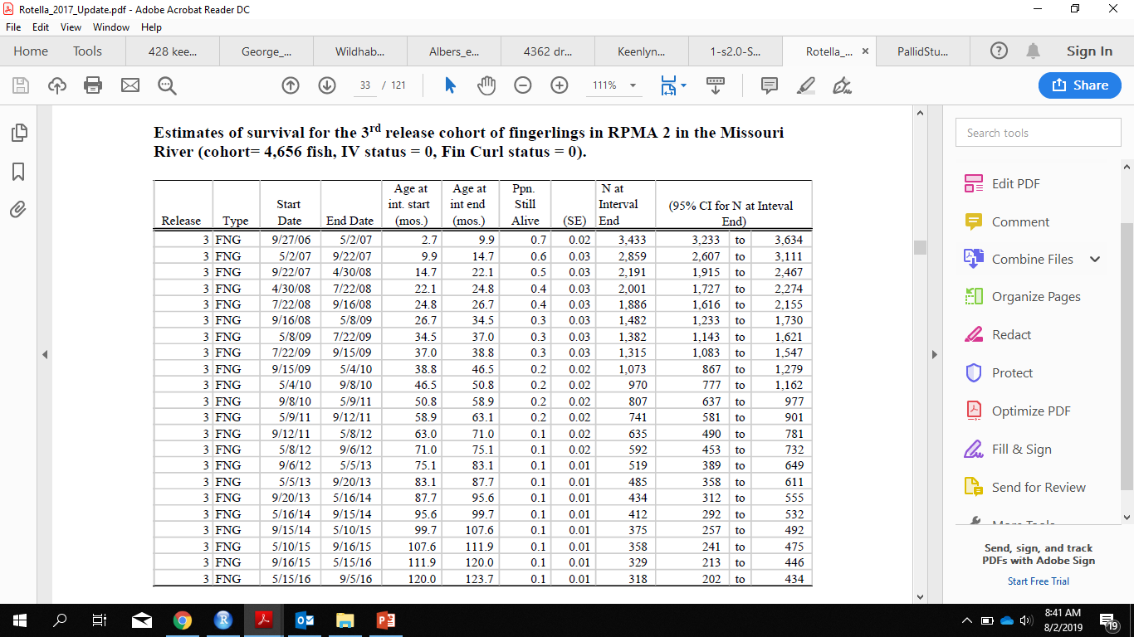
Parameterization Details: Age-Specific Survivals
Compute daily survival over each interval:
Calculate the number of days between Start Date and End Date
Add in N at Interval Start (pull from the previous N at Interval End, with the initial value being the release number, in this case 4,656)
Daily Survival = ((N at Interval End)/(N at Interval Start))^(1/Days)

Slide 44
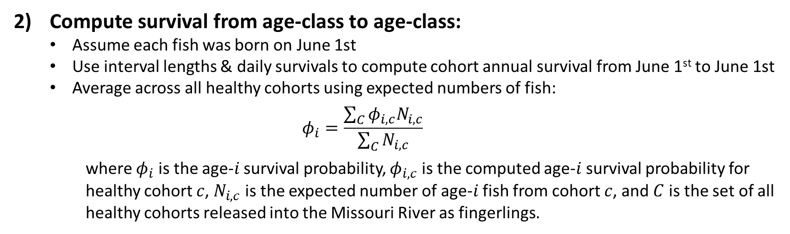
Parameterization Details: Age-Specific Survivals
Compute survival from age-class to age-class:
Assume each fish was born on June 1st
Use interval lengths & daily survivals to compute cohort annual survival from June 1st to June 1st
Average across all healthy cohorts using expected numbers of fish:
$$φ_{i}=\frac{\sum_{C}{φ_{i,c}N_{i,c}}}{\sum_{C}{N_{i,c}}}$$
where $φ_{i}$ is the age-$i$ survival probability, $φ_{i,c}$ is the computed age-$i$ survival probability for healthy cohort $c$, $N_{i,c}$ is the expected number of age-$i$ fish from cohort $c$, and $C$ is the set of all healthy cohorts released into the Missouri River as fingerlings.

Slide 45
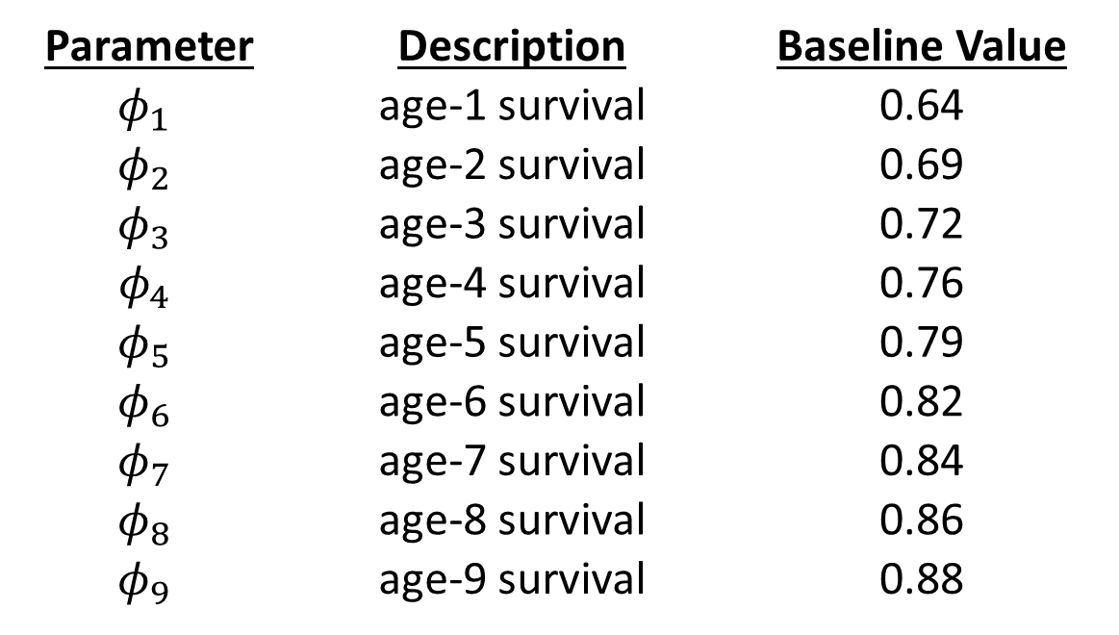
Parameterization Details: Age-Specific Survivals
Parameter | Description | Baseline Value
$$φ_{1}$$ | age-1 survival | 0.64
$$φ_{2}$$ | age-2 survival | 0.69
$$φ_{3}$$ | age-3 survival | 0.72
$$φ_{4}$$ | age-4 survival | 0.76
$$φ_{5}$$ | age-5 survival | 0.79
$$φ_{6}$$ | age-6 survival | 0.82
$$φ_{7}$$ | age-7 survival | 0.84
$$φ_{8}$$ | age-8 survival | 0.86
$$φ_{9}$$ | age-9 survival | 0.88

Slide 46
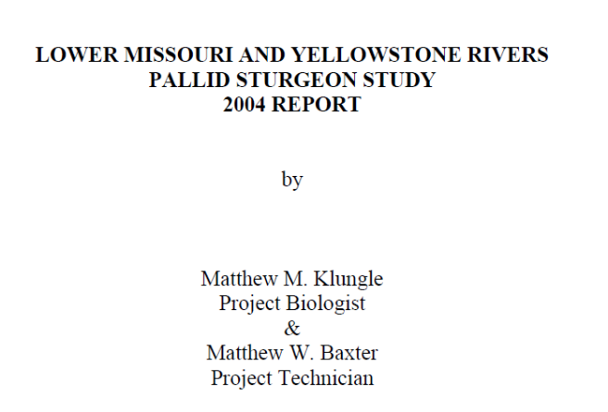
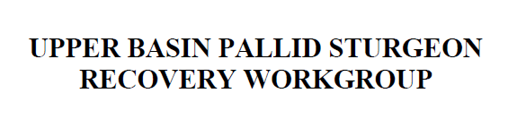

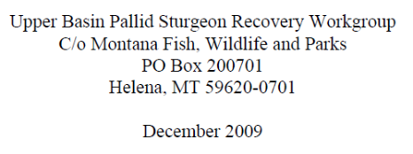

Parameterization Details: Age-Specific Survivals
158 Wild Adults in RPMA 2 in 2004
125 Wild Adults in RPMA 2 in 2008
$$φ_{adult}={\left(\frac{125}{158}\right)}^{1⁄4}≈0.94$$

Slide 47
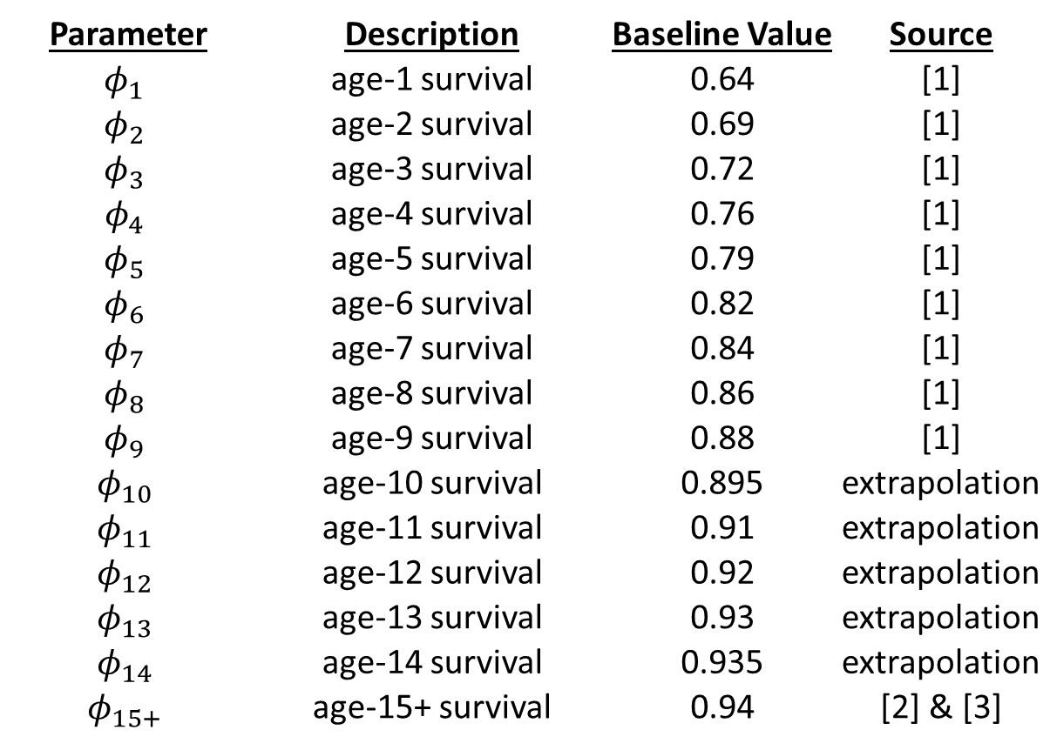
Parameterization Details: Age-Specific Survivals
Parameter | Description | Baseline Value | Source
$$φ_{1}$$ | age-1 survival | 0.64 | [1]
$$φ_{2}$$ | age-2 survival | 0.69 | [1]
$$φ_{3}$$ | age-3 survival | 0.72 | [1]
$$φ_{4}$$ | age-4 survival | 0.76 | [1]
$$φ_{5}$$ | age-5 survival | 0.79 | [1]
$$φ_{6}$$ | age-6 survival | 0.82 | [1]
$$φ_{7}$$ | age-7 survival | 0.84 | [1]
$$φ_{8}$$ | age-8 survival | 0.86 | [1]
$$φ_{9}$$ | age-9 survival | 0.88 | [1]
$$φ_{10}$$ | age-10 survival | 0.895 | extrapolation
$$φ_{11}$$ | age-11 survival | 0.91 | extrapolation
$$φ_{12}$$ | age-12 survival | 0.92 | extrapolation
$$φ_{13}$$ | age-13 survival | 0.93 | extrapolation
$$φ_{14}$$ | age-14 survival | 0.935 | extrapolation
$$φ_{15+}$$ | age-15+ survival | 0.94 | [2] & [3]

Slide 48
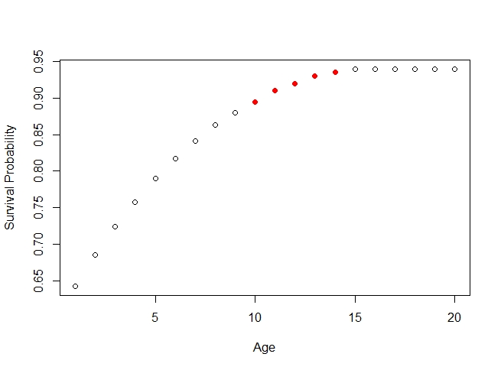
Parameterization Details: Age-Specific Survivals
Computed from Data
Extrapolated

Slide 49
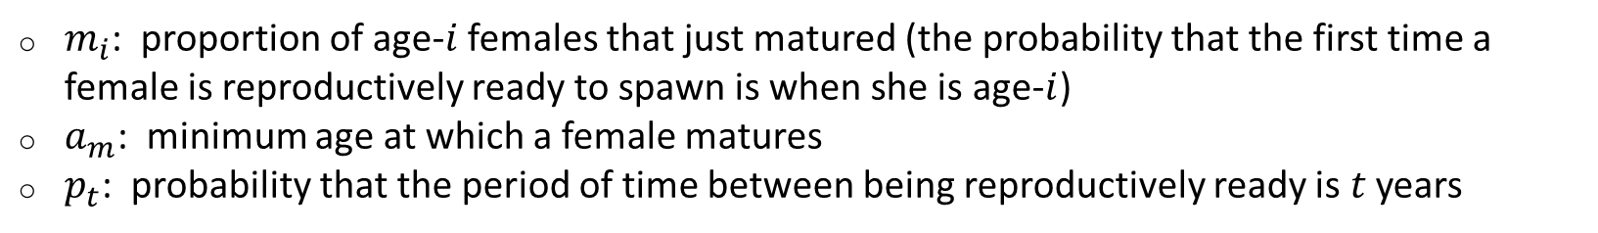
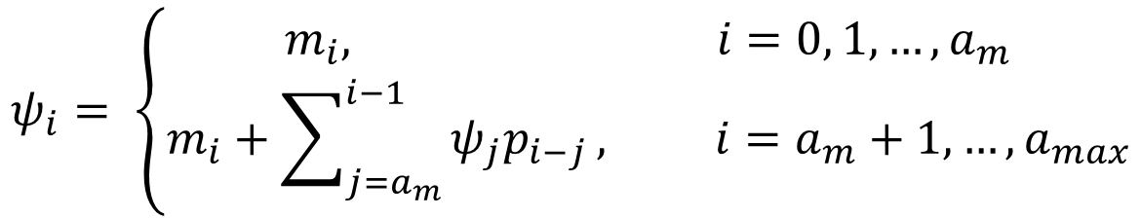
Parameterization Details: Age-Specific Fertilities
$ψ_{i}$: proportion of age-$i$ females that are reproductively ready to spawn
function of maturation and spawning period
$$ψ_{i}= \left\{\begin{aligned}m_{i}, i=0, 1, …, a_{m} \\ m_{i}+\sum_{j=a_{m}}^{i−1}{ψ_{j}p_{i−j}}, i=a_{m}+1, …,a_{max}\end{aligned}\right.$$
$m_{i}$: proportion of age-$i$ females that just matured (the probability that the first time a female is reproductively ready to spawn is when she is age-$i$)
$a_{m}$: minimum age at which a female matures
$p_{t}$: probability that the period of time between being reproductively ready is $t$ years

Slide 50
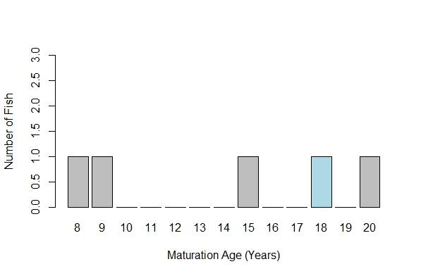
Parameterization Details: Age-Specific Fertilities
Maturation Age
Area of further informational need (DeLonay et al. 2016)
May vary by river region; maturing later farther north (George et al. 2012)
15-20 years old (Keenlyne and Jenkins 1993) and 8-9 years old (George et al. 2012)
Examined pectoral fin ray spawning bands of 9 (3) female pallid sturgeon from throughout the Missouri and Mississippi and 2 females from the lower Mississippi, respectively
Lower River: 9 years-old minimum age at maturity (Steffensen et al. 2013)
Lower River: Mean of 10 years, total variance of 1.0833 (Wildhaber et al. 2017)
(Keenlyne and Jenkins 1993, George et al. 2012)
Stage III at age-17;
ready to spawn next year?
Lower Miss.
SD
LA
ND
Reliability of data?
(Hurley et al. 2004)

Slide 51
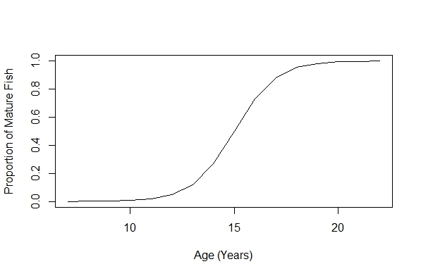
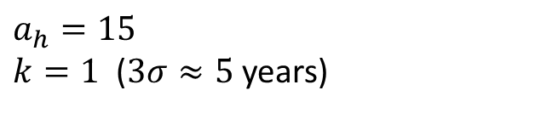
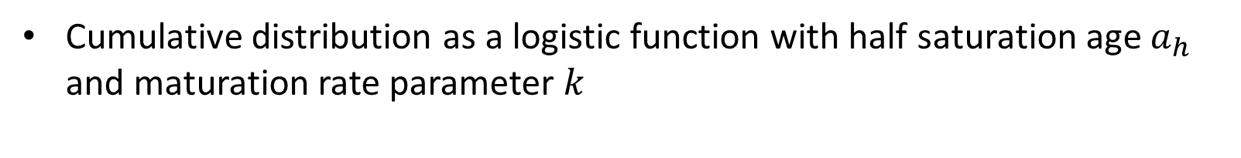
Parameterization Details: Age-Specific Fertilities
Maturation Age
Cumulative distribution as a logistic function with half saturation age $a_{h}$ and maturation rate parameter $k$
$$a_{h}=15$$
$k=1$ ($3σ≈5$years)

Slide 52
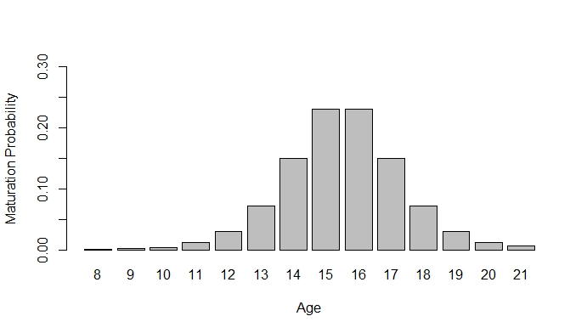
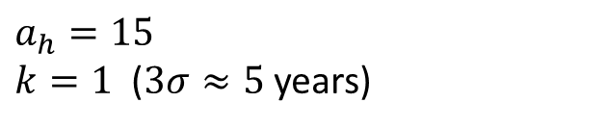
Parameterization Details: Age-Specific Fertilities
Maturation Age
Cumulative distribution as a logistic function with half saturation age $a_{h}$ and maturation rate parameter $k$
$$a_{h}=15$$
$k=1$ ($3σ≈5$years)

Slide 53
Parameterization Details: Age-Specific Fertilities
Period Between Reproductive-Readiness
Spawning Period Data:
2-5 years (DeLonay et al. 2016)
As great as 8-10 years (Dryer & Sandvol 1993, Keenlyne & Jenkins 1993)
Fuller et al. (2007):
2 years: 4
3 years: 3
1 inconclusive: 2 or 4 years
DeLonay et al. (2016):
>1 year: 20 (6 unknown after this point)
=2 years: 4
>2 years: 10 (8 unknown after this point)
>3 years: 2

Slide 54
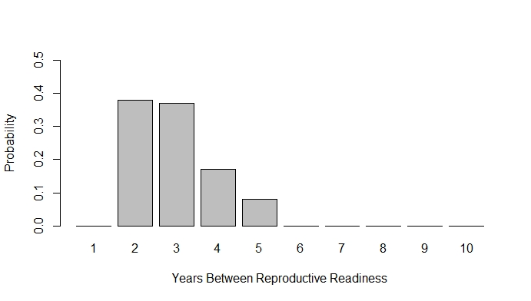
Parameterization Details: Age-Specific Fertilities
Period Between Reproductive-Readiness
Distribution of time periods between 2 and 5 years (DeLonay et al. 2016), constructed by combining known Fuller et al. 2007 and DeLonay et al. 2016 data (excluding unknown data)
Assumes a period of 5 years is half as likely as a period of 4 years

Slide 55
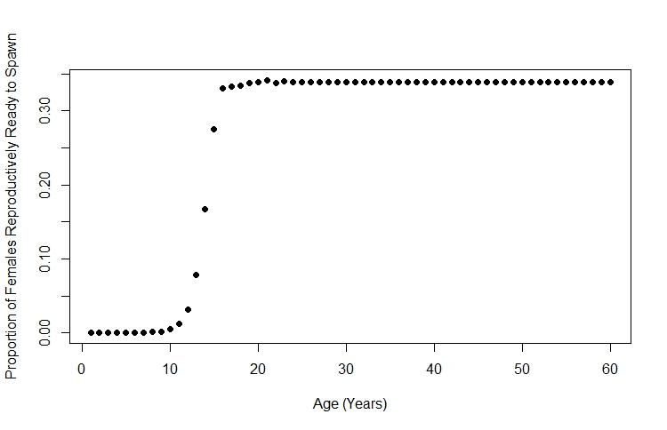
Parameterization Details: Age-Specific Fertilities
Combining Maturation Age and Period Between Reproductive-Readiness: Resulting Age-specific probabilities for reproductively-readiness

Slide 56

Parameterization Details: Age-Specific Fertilities
Sex Ratio
125 Wild Adults in RPMA 2 in 2008
40 Wild Females in RPMA 2 in 2008
$$r=\frac{40}{125}=0.32$$

Slide 57
Parameterization Details: Age-Specific Fertilities
Age-Specific Fecundity (number of eggs per spawning female by age)
Process:
For each age, simulate several lengths from the von Bertalanffy function and distribution of parameters (age-length relationship)
For each length simulate fecundities from the length-fecundity relationship
Use the mean of the fecundities for each age as the number of eggs per spawning female

Slide 58
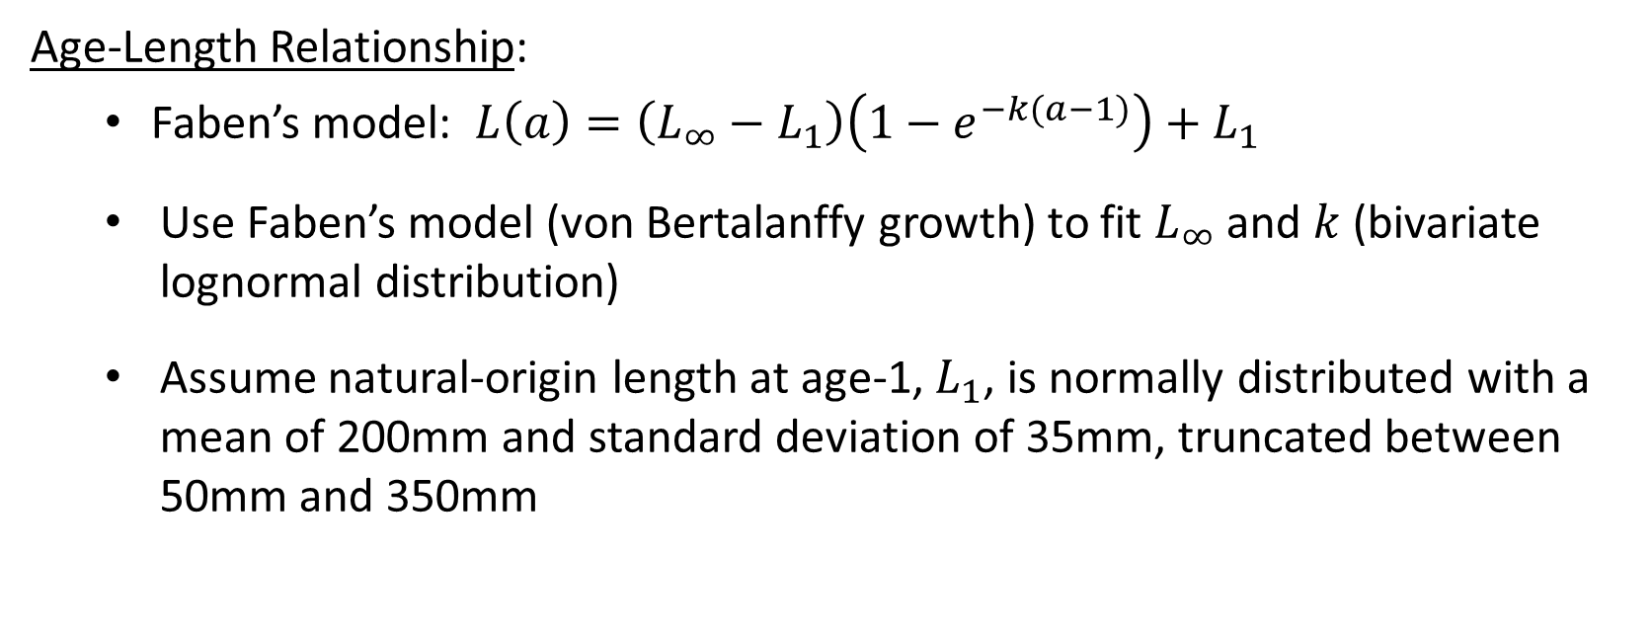
Parameterization Details: Age-Specific Fertilities
Age-Specific Fecundity (number of eggs per spawning female by age)
Age-Length Relationship:
Faben’s model: $L\left(a\right)=\left(L_{∞}−L_{1}\right)\left(1−e^{−k(a−1)}\right)+L_{1}$
Use Faben’s model (von Bertalanffy growth) to fit $L_{∞}$ and $k$ (bivariate lognormal distribution)
Assume natural-origin length at age-1, $L_{1}$, is normally distributed with a mean of 200mm and standard deviation of 35mm, truncated between 50mm and 350mm

Slide 59
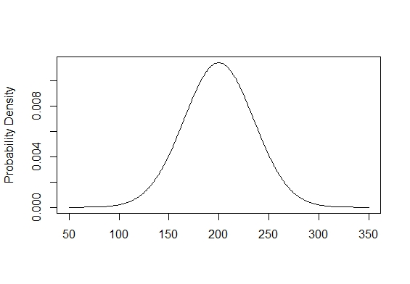

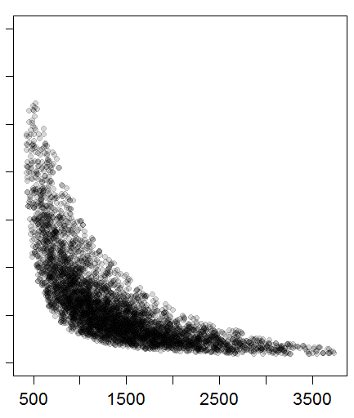


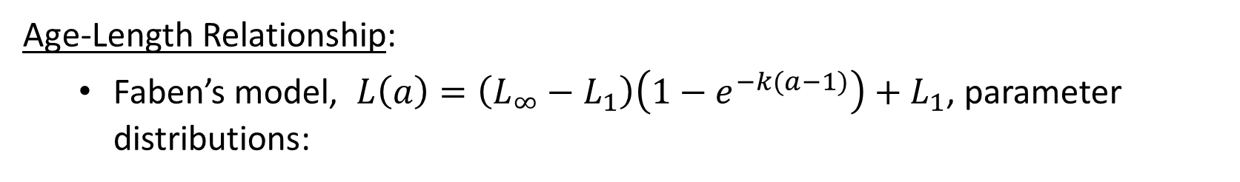

Parameterization Details: Age-Specific Fertilities
Age-Specific Fecundity (number of eggs per spawning female by age)
Age-Length Relationship:
Faben’s model, $L\left(a\right)=\left(L_{∞}−L_{1}\right)\left(1−e^{−k(a−1)}\right)+L_{1}$, parameter distributions:
$$k$$
$$L_{1}$$
$$L_{∞}$$

Slide 60
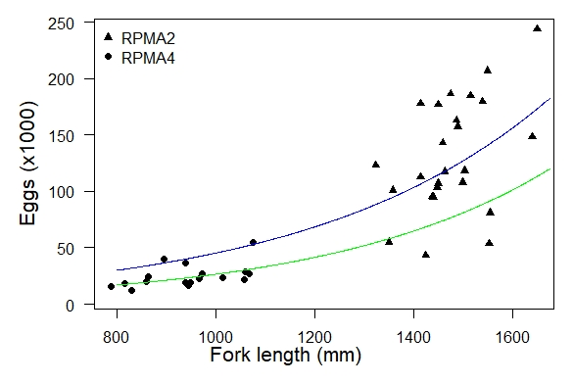
Parameterization Details: Age-Specific Fertilities
Age-Specific Fecundity (number of eggs per spawning female by age)
Length-Fecundity Relationship:
Mean fecundity was fit as an exponential function of fork length with a negative binomial error distribution
25 data points from 24 upper river females were used to obtain RPMA 2 parameter estimates

Slide 61
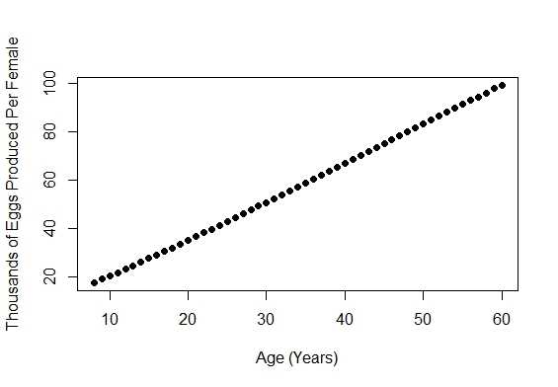
Parameterization Details: Age-Specific Fertilities
Age-Specific Fecundity (number of eggs per spawning female by age)

Slide 62
Analysis: Long-Term Growth Decline Boundaries
A “map” of what combinations of spawning probability, retention probability, and age-0 survival given retention will allow for population growth.
This figure is about what values (in terms of retention, spawning, and age-0 survival) would be good to aim for to achieve a growing population, rather than about comparing alternatives.
Age-0 Survival Given Retention
Caveat: Successful recruitment to age-1 resulting from spawning on the Yellowstone River would change these outcomes.

Slide 63
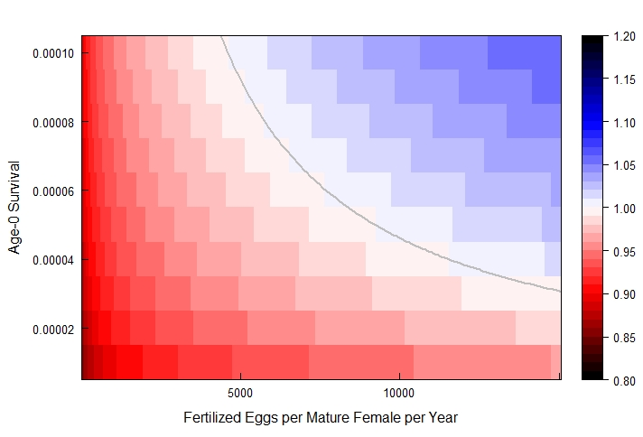


Growth-Decline Boundary Example (different $x$-axis parameter)
growth
Age-0 Survival Given Retention
$λ$ (long-term)
$$p_{ret}=1$$
decline

Slide 64
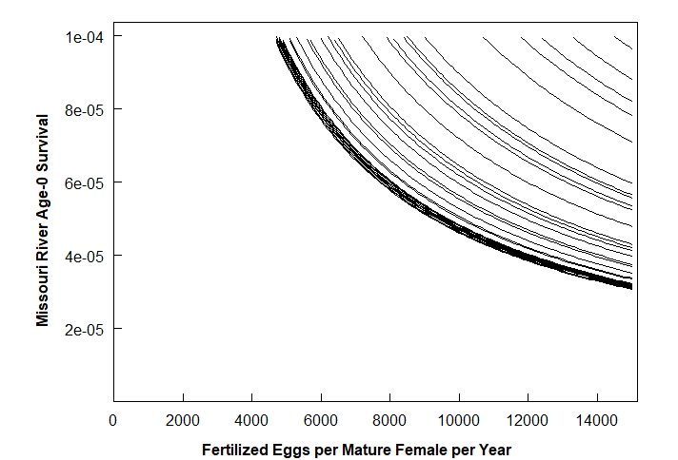



Growth-Decline Boundary Example (different $x$-axis parameter)
$$p_{ret}=0.319$$
$$p_{ret}=0.515$$
Age-0 Survival Given Retention
$$p_{ret}=1$$
$$p_{ret}=0.715$$
For a given retention probability curve, we expect:
Population growth for spawning & survival scenarios to the right/above the curve
Population decline for spawning & survival scenarios to the left/below the curve

Slide 65
Growth-Decline Boundary Example (different $x$-axis parameter)
Say we believe:
Each spawning female produces an average of 30,000 fertilized eggs
About 1/3 of all mature females spawn each year
About 75 out of every one million drifting free embryos survive to age-1, given they did not drift into Lake Sakakawea
Fertilized Eggs per Mature Female per Year : 30,000*(1/3) = 10,000
Missouri River Age-0 Survival: 75/1,000,000 = 0.000075

Slide 66
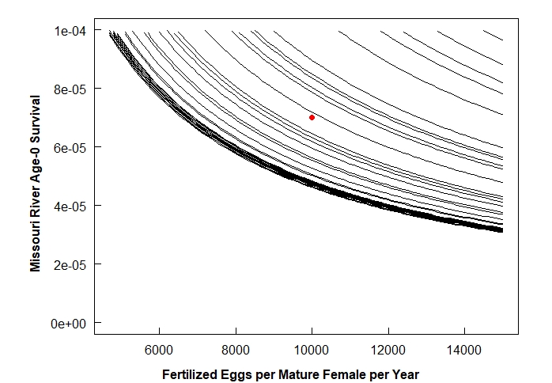




Growth-Decline Boundary Example (different $x$-axis parameter)
$$p_{ret}=0.319$$
$$p_{ret}=0.515$$
$$p_{ret}=1$$
$$p_{ret}=0.715$$
For a given retention probability curve, we expect:
Population growth for spawning & survival scenarios to the right/above the curve
Population decline for spawning & survival scenarios to the left/below the curve

Slide 67


Growth-Decline Boundary Example (different $x$-axis parameter)
$$p_{ret}=0.319$$
$$p_{ret}=0.515$$
Age-0 Survival Given Retention
$$p_{ret}=1$$
$$p_{ret}=0.715$$
For a given retention probability curve, we expect:
Population growth for spawning & survival scenarios to the right/above the curve
Population decline for spawning & survival scenarios to the left/below the curve
EXPLANATION:
Growth
Decline

Slide 68
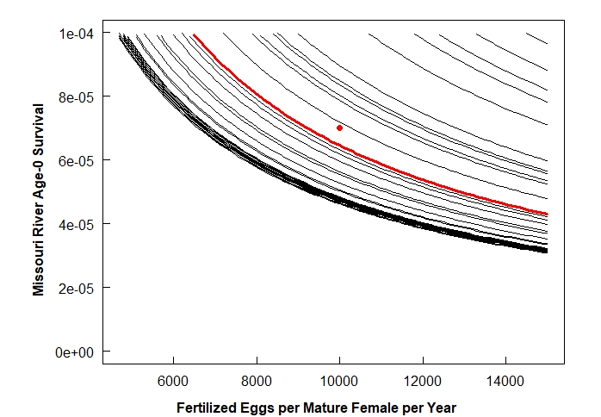



Growth-Decline Boundary Example (different $x$-axis parameter)
$$p_{ret}=0.319$$
$$p_{ret}=0.515$$
Age-0 Survival Given Retention
$$p_{ret}=1$$
$$p_{ret}=0.715$$
As retention probability increases, the spawning and survival scenarios under which population growth is possible expand down and left toward the origin.
EXPLANATION:
Growth
Decline

Slide 69



Growth-Decline Boundary Example (different $x$-axis parameter)
Age-0 Survival Given Retention
$$p_{ret}=0.715$$
}
$$p_{ret}=1$$
Retention Scenarios with Population Growth:
$$p_{ret}>0.7$$

Slide 70
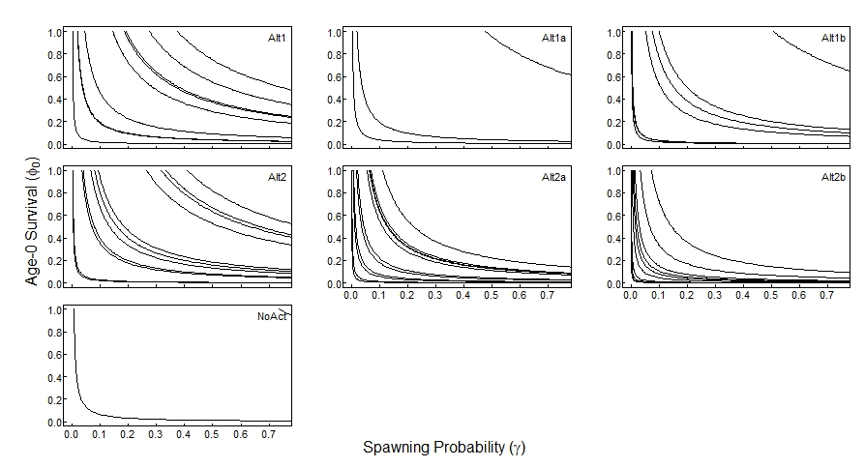
Results: Growth-Decline Boundaries
Age-0 Survival Given Retention
Large variations in the growth-decline boundaries occur within an alternative flow scenario across time.
Alternatives 2a and 2b have relatively less variation than other alternatives during years in which implementation can occur.

Slide 71
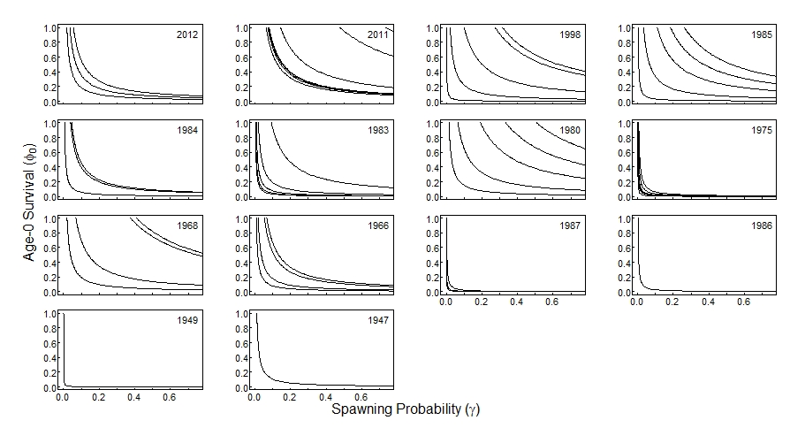
Results: Growth-Decline Boundaries
Age-0 Survival Given Retention
Some years all alternatives perform more similarly (e.g., 1975), while in other years, there are larger discrepancies among alternatives (e.g., 1980, 1985).

Slide 72
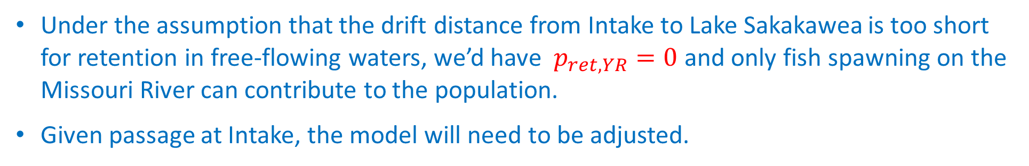




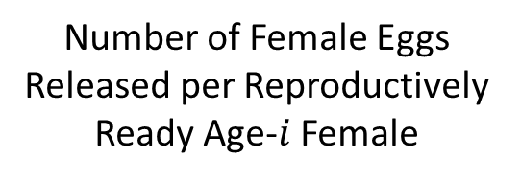

Age-0 Survival Given Retention
Yellowstone & Spawning
Retention Probability
$$F_{i}=ψ_{i}(m_{i},p_{t})∙E_{i}∙r∙γ{∙φ}_{0,R}∙p_{ret}$$
Number of Female Eggs Released per Reproductively Ready Age-$i$ Female
Spawning Probability
Age-$i$ Fertility
$$F_{i, total}=F_{i,MR}+F_{i, YR}$$
$$=ψ_{i}\left(m_{i},p_{t }\right)∙E_{i}∙r∙γ_{MR}{∙φ}_{0,MR}∙p_{ret,MR}$$
$+$ $ψ_{i}\left(m_{i},p_{t }\right)∙E_{i}∙r∙γ_{YR}{∙φ}_{0,YR}∙p_{ret,YR}$
Under the assumption that the drift distance from Intake to Lake Sakakawea is too short for retention in free-flowing waters, we’d have $p_{ret,YR}=0$ and only fish spawning on the Missouri River can contribute to the population.
Given passage at Intake, the model will need to be adjusted.
$$γ_{MR}+γ_{YR}+γ_{atresia}=1$$

Slide 73
Hydrographs for the 7 Alternatives

