Slide 1
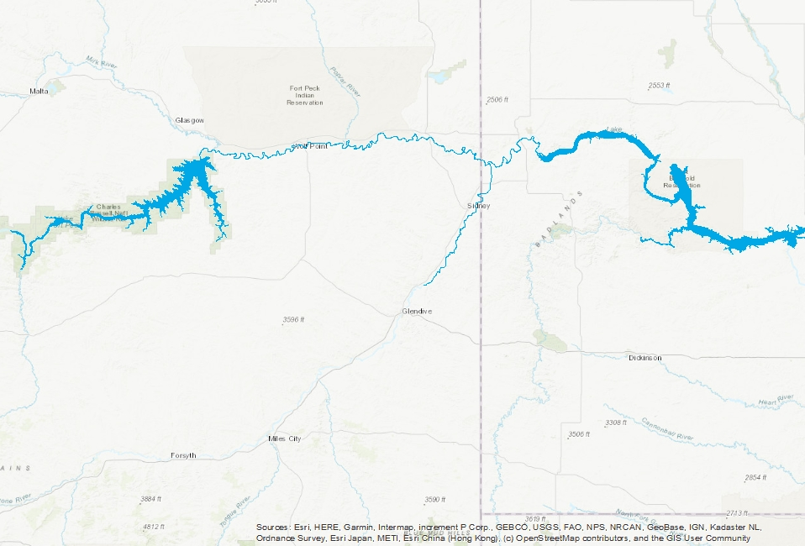
Lake Sakakawea
Missouri River
Fort Peck Reservoir
Yellowstone River
Below Intake Dam

