Slide 1
Fort Peck Flows Update
Presented by Sara Reynolds
Pallid Sturgeon Tech Team Meeting
7/15/2019

Slide 2
Since Last Time:
First attempt at building a “viability box” for drift
Ideas for predicting fish benefits to management flows being considered in the NEPA process

Slide 3
2) Define draft hypothesized biologically viable windows
Viability Box for Drift
From Dave Marmorek, Craig Fischenich, and Graham Long’s “Thoughts on Ft. Peck flow tests” power point:
Hypothesis: there exists a window (shown here as a box but form is unknown) of biologically viable combos of flow, temp, turb for each of a)spawning and b)drift
1) Collate / update + analyze available data on F, T, Turb etc
2) Define hypothesized biologically viable windows
3) Identify desired hydro changes to create windows
4) Consider possible hydro changes to create windows
7) Implement and monitor experiments
5) Predict fish benefits from possible changes using model
6) Define detailed experiments
Temp
Flow
Turbidity

Slide 4
Viability Box for Drift
From Dave Marmorek, Craig Fischenich, and Graham Long’s “Thoughts on Ft. Peck flow tests” power point:
Hypothesis: there exists a window (shown here as a box but form is unknown) of biologically viable combos of flow, temp, and turbidity for each of:
Spawning
Drift
Flow
Temp
Turbidity

Slide 5
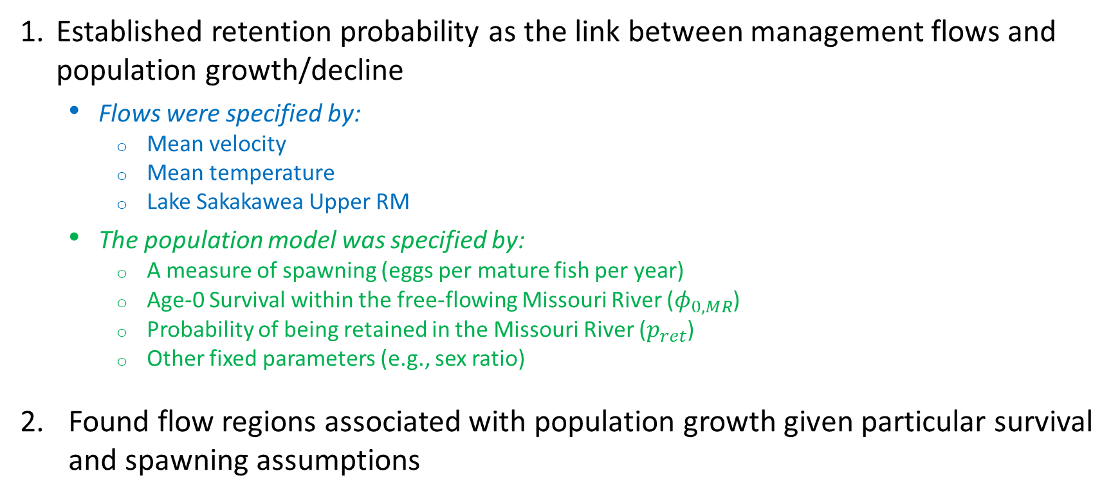
Last TT Presentation:
Established retention probability as the link between management flows and population growth/decline
Flows were specified by:
Mean velocity
Mean temperature
Lake Sakakawea Upper RM
The population model was specified by:
A measure of spawning (eggs per mature fish per year)
Age-0 Survival within the free-flowing Missouri River ($φ_{0,MR}$)
Probability of being retained in the Missouri River ($p_{ret}$)
Other fixed parameters (e.g., sex ratio)
Found flow regions associated with population growth given particular survival and spawning assumptions

Slide 6
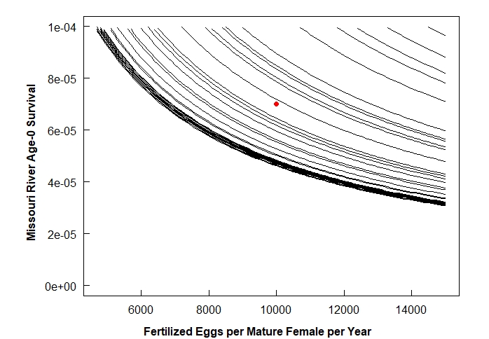




Retention Probability Criteria for Population Growth
$$p_{ret}=0.319$$
$$p_{ret}=0.515$$
$$p_{ret}=1$$
$$p_{ret}=0.715$$
For a given retention probability curve, we expect:
Population growth for spawning & survival scenarios to the right/above the curve
Population decline for spawning & survival scenarios to the left/below the curve

Slide 7


Retention Probability Criteria for Population Growth
$$p_{ret}=0.319$$
$$p_{ret}=0.515$$
$$p_{ret}=1$$
$$p_{ret}=0.715$$
For a given retention probability curve, we expect:
Population growth for spawning & survival scenarios to the right/above the curve
Population decline for spawning & survival scenarios to the left/below the curve
EXPLANATION:
Growth
Decline

Slide 8
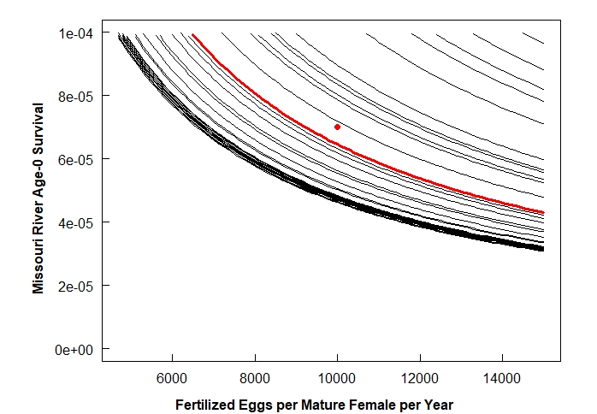



Retention Probability Criteria for Population Growth
$$p_{ret}=0.319$$
$$p_{ret}=0.515$$
$$p_{ret}=1$$
$$p_{ret}=0.715$$
As retention probability increases, the spawning and survival scenarios under which population growth is possible expand down and left toward the origin.
EXPLANATION:
Growth
Decline

Slide 9



Retention Probability Criteria for Population Growth
$$p_{ret}=0.715$$
}
$$p_{ret}=1$$
Retention Scenarios with Population Growth:
$$p_{ret}>0.7$$

Slide 10
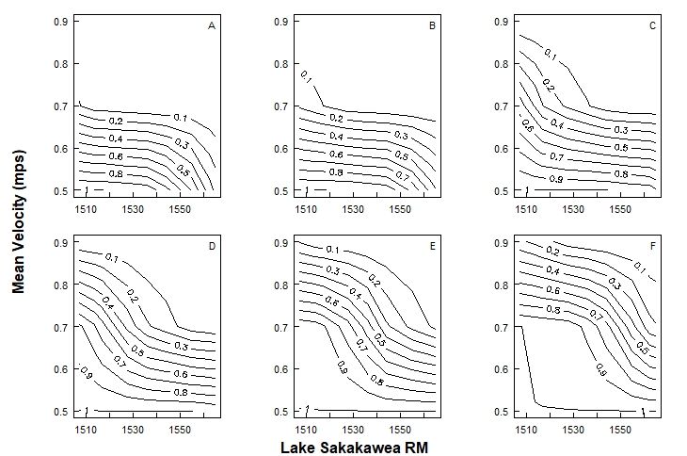







Management Actions that Meet Retention Probability Criteria
$$14℃$$
$$16℃$$
$$18℃$$
$$p_{ret}>0.7$$
This is essentially a viability box with
velocity
temperature
Lake Sak RM
as its axes. (Here we are looking at slices of the box.)
We can get the desired box by using the same approach but changing which variables are fixed.
$$20℃$$
$$22℃$$
$$24℃$$
EXPLANATION:
Growth

Slide 11
Viability Box for Drift
From Dave Marmorek, Craig Fischenich, and Graham Long’s “Thoughts on Ft. Peck flow tests” power point:
Hypothesis: there exists a window (shown here as a box but form is unknown) of biologically viable combos of flow, temp, and turbidity for each of:
Spawning
Drift
Velocity
Flow
We currently do not have a functional relationship between turbidity and age-0 survival.
We expect:
Turbidity = Predation = Survival
As a first approach, we’ll use age-0 survival (within the free flowing Missouri) as a proxy for turbidity.
Temp
Age-0 Survival
Turbidity

Slide 12
Viability Box for Drift
Axis Variable
Model Variables:
Demographic Model
Sex Ratio
Maturation Age
Maximum Age
Age-1+ Survivals
Missouri River Age-0 Survival (proxy for turbidity)
Fertilized Eggs per Mature Female per Year
Drift Model (Simplified)
Average Velocity
Average Temperature
Lake Sakakawea RM
Fixed

Slide 13
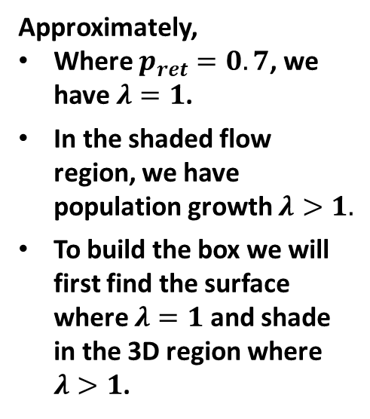
Management Actions that Meet Retention Probability Criteria
$$14℃$$
$$16℃$$
$$18℃$$
$$p_{ret}>0.7$$
Approximately,
Where $p_{ret}=0.7$, we have $λ=1$.
In the shaded flow region, we have population growth $λ>1.$
To build the box we will first find the surface where $λ=1$ and shade in the 3D region where $λ>1$.
$$20℃$$
$$22℃$$
$$24℃$$
EXPLANATION:
Growth

Slide 14
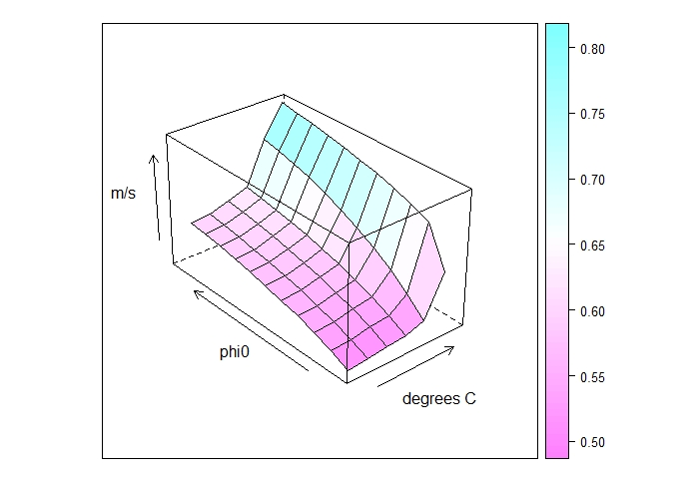
$λ=1$ Surface
Axes:
x – mean temperature (°C)
y – age-0 survival (phi0)
z – mean velocity (m/s)

Slide 15
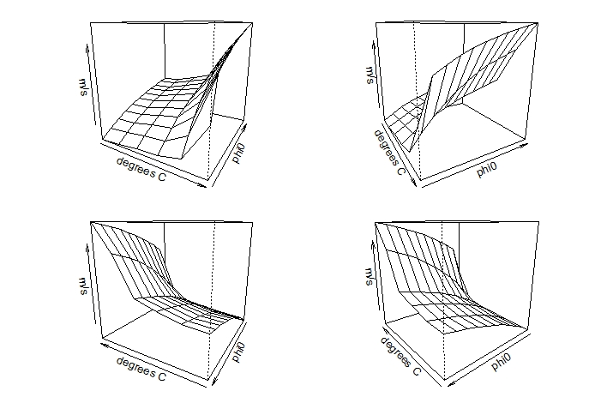
$λ=1$ Surface: Multiple Angles
(3) At both high (top right) and low (bottom right) temperatures, the viable velocity range increases with increasing age-0 survival but with diminishing returns.
(1) At low survivals (phi0), the viable velocity range increases slowly at first and then very rapidly, allowing for higher velocity flows as temperature increases.
(2) The range of viable velocities is much larger at the lowest temperature considered when age-0 survival is high. As temperature increases, a pattern similar to (1) is seen.
Axes:
x – mean
y – age-0 survival
z – mean velocity
temperature (°C)
(phi0)
(m/s)

Slide 16
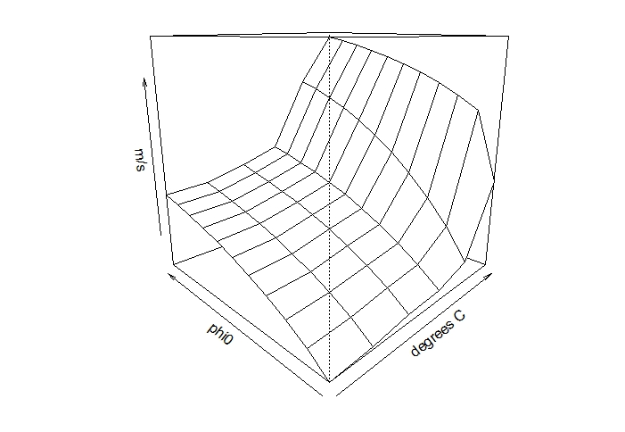
From the Surface to a “Box”
Slower mean velocities will be viable (higher retention probabilities and greater long-term $λ$ values).
Axes:
x – mean temperature (°C)
y – age-0 survival (phi0)
z – mean velocity (m/s)

Slide 17
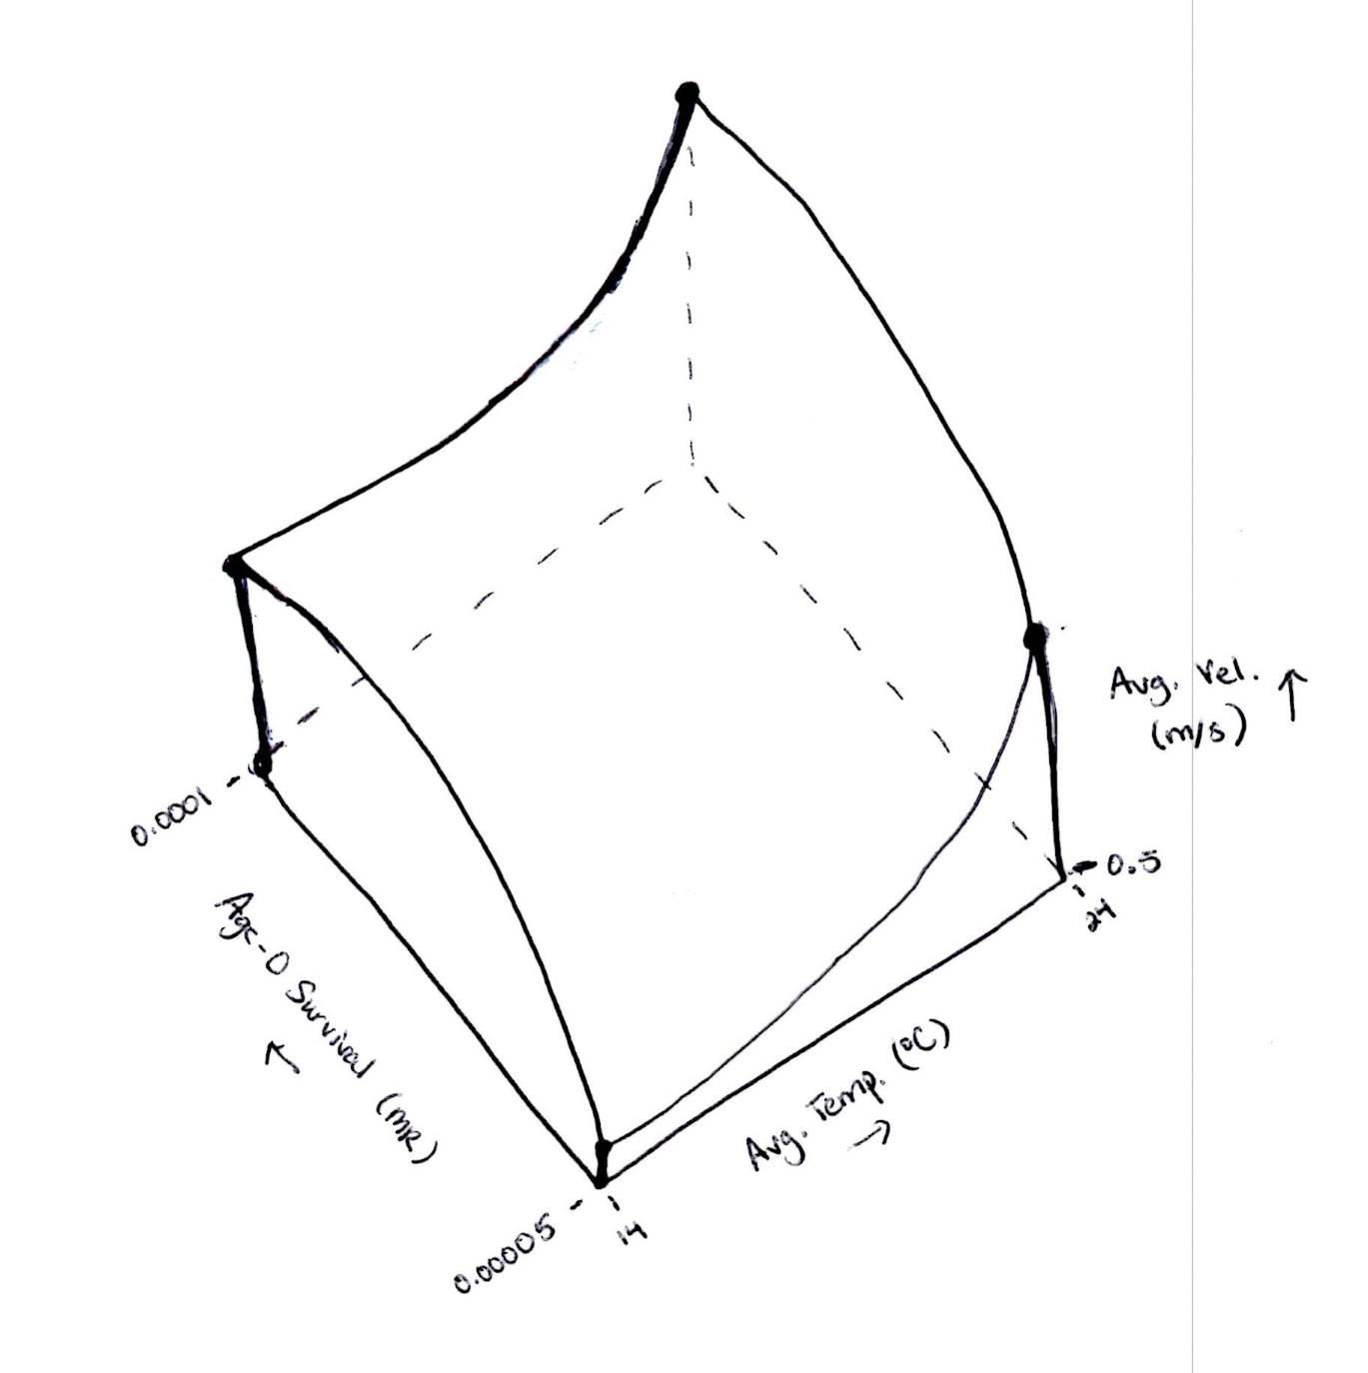
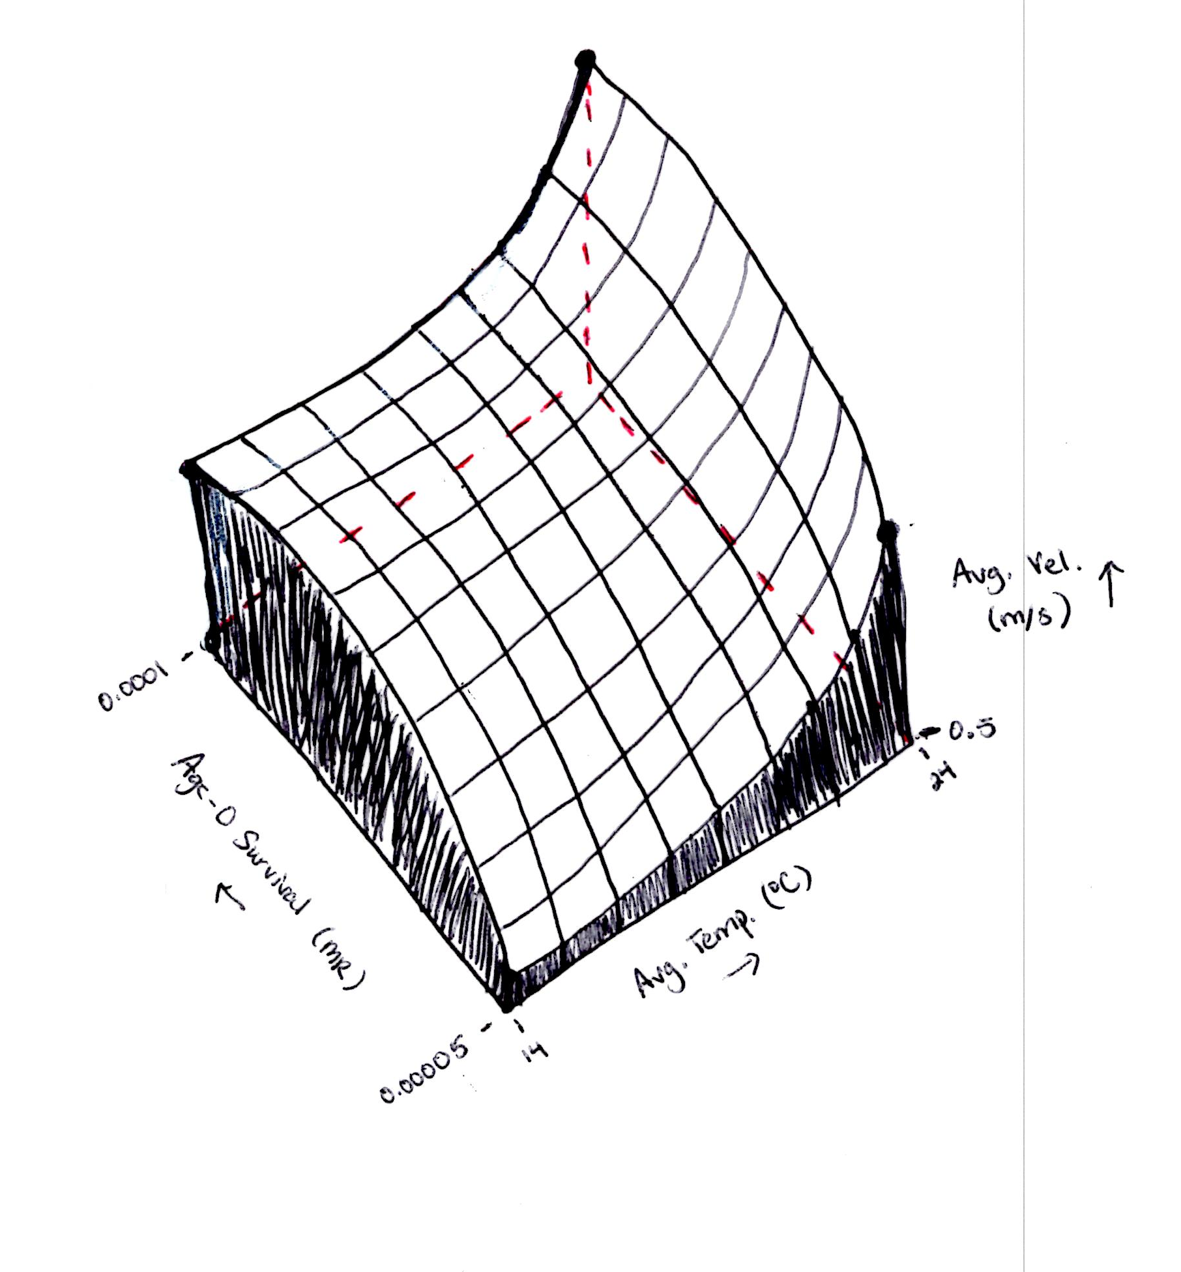
From the Surface to a “Box”
Slower mean velocities will be viable (higher retention probabilities and greater long-term $λ$ values).
(For visualization purposes only. Not to scale.)

Slide 18
Comments
All the many caveats discussed in previous presentations about the drift and population model also apply here.
This approach assumes age-0 survival is independent of velocity and temperature.
The shape of the viability box in terms of turbidity will differ (unless the relationship between turbidity and survival is linear).
The surface is essentially an interpolation of only 18 data points.
Plotting the surface is a bit clunky and currently requires different approaches (code wise) for plotting the box from different vantage points (axes order).
Various uncertain parameters (sex ratio, maturation age, maximum age, age-1+ survivals, number of fertilized eggs per mature female per year, and Lake Sakakawea RM) were fixed to produce the surface and associated viability box. It will be important to see how varying these parameters changes the shape of the box.

Slide 19
Since Last Time:
First attempt at building a “viability box” for drift
Ideas for predicting fish benefits to management flows being considered in the NEPA process

Slide 20
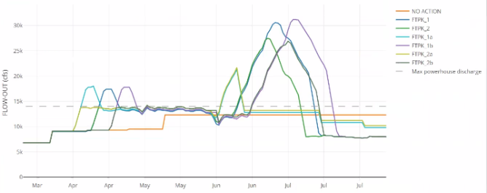
Predicting Fish Benefits
7 Ft. Peck flow strategies under consideration

Slide 21
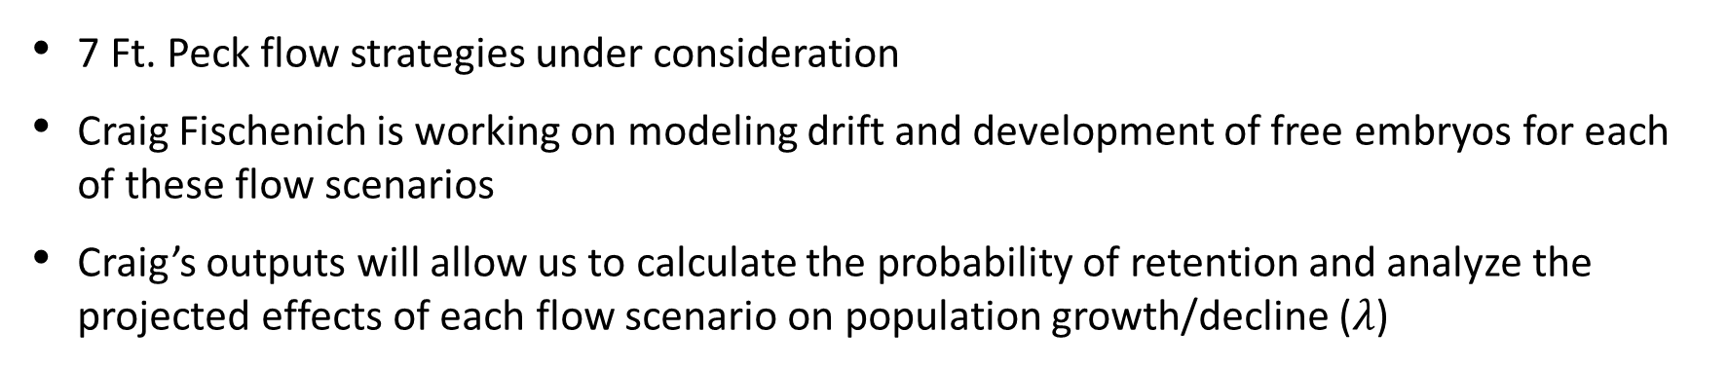
Predicting Fish Benefits
7 Ft. Peck flow strategies under consideration
Craig Fischenich is working on modeling drift and development of free embryos for each of these flow scenarios
Craig’s outputs will allow us to calculate the probability of retention and analyze the projected effects of each flow scenario on population growth/decline ($λ$)

Slide 22
Predicting Fish Benefits
Free Embryo Development Model
HEC-ResSim
Retention Probability
Hydrology
Pallid Sturgeon Demographic Population Model
Age-Specific
Maturation
Age-0
Survival
(Free Flowing River)
Age-Specific
Fertility
Population Metrics
Spawning Frequency
Long-Term Population Growth Rate
Age-Specific
Survival
Age-Specific
Reproduction
Age-Specific
Fecundity
Maximum Age
Sex Ratio

Slide 23
Predicting Fish Benefits – Next Steps
The current model only connects flow with drift. Next step is to connect flow with spawning.
Proposed link: Spawning Frequency

Slide 24
HEC-ResSim
Predicting Fish Benefits – Next Steps
Hydrology
Free Embryo Drift & Development Model
Spawning Model
Spawning Frequency
Retention Probability
Pallid Sturgeon Demographic Population Model
Age-Specific
Maturation
Age-0
Survival
(Free Flowing River)
Age-Specific
Fertility
Population Metrics
Age-Specific
Fecundity
Long-Term Population Growth Rate
Age-Specific
Survival
Age-Specific
Reproduction
Sex Ratio
Maximum Age

Slide 25
Predicting Fish Benefits – Next Steps
The current model only connects flow with drift. Next step is to connect flow with spawning.
Proposed link: Spawning Frequency
In the works & upcoming:
Updated parameterization of the demographic model (literature and data review)
Sensitivity & elasticity analyses
Write-up in USACE approval/certification format
Formally relating turbidity to age-0 survival (planned for this round?)
What levels (if any) of stochasticity are important to incorporate for this first round of analyses?

