Slide 1
Demographic Population Model
Structure & Parameterization
DRAFT presented to Ft. Peck Modelling Team
8/15/2019
Revised 8/23/2019

Slide 2
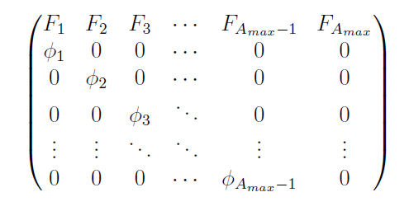
Age-Structured Projection Matrix (Leslie Matrix)

Slide 3
Age-Structured Projection Matrix (Leslie Matrix)
Fertilities

Slide 4
Age-Structured Projection Matrix (Leslie Matrix)
Fertilities
Survivals

Slide 5
Age-Structured Projection Matrix (Leslie Matrix)
Survivals

Slide 6
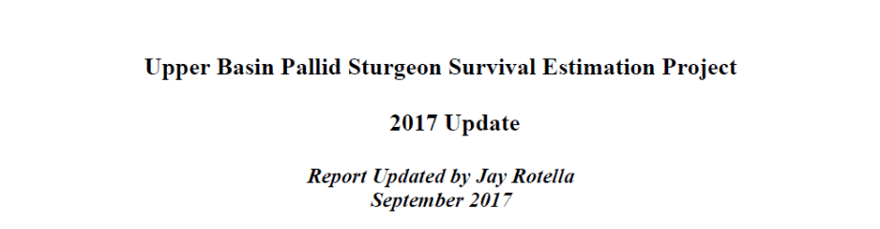

Survivals ($φ_{i}$)

Slide 7
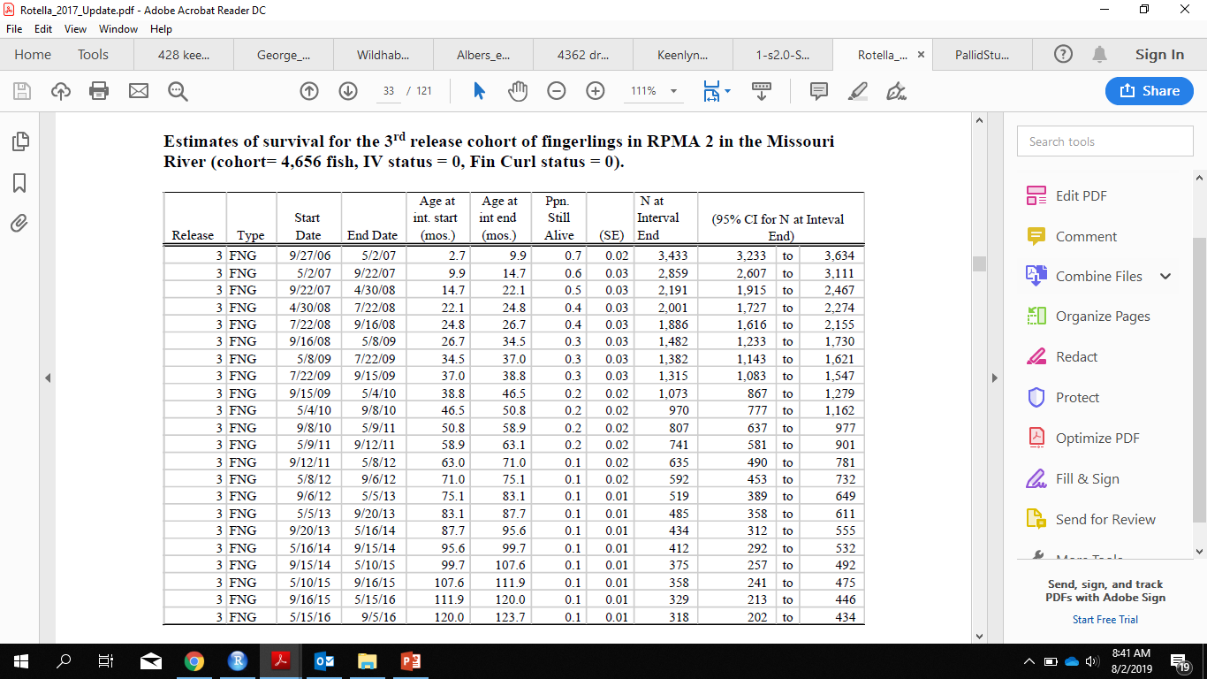
Survivals ($φ_{i}$)
Compute daily survival over each interval:
Calculate the number of days between Start Date and End Date
Add in N at Interval Start (pull from the previous N at Interval End, with the initial value being the release number, in this case 4,656)
Daily Survival = ((N at Interval End)/(N at Interval Start))^(1/Days)

Slide 8
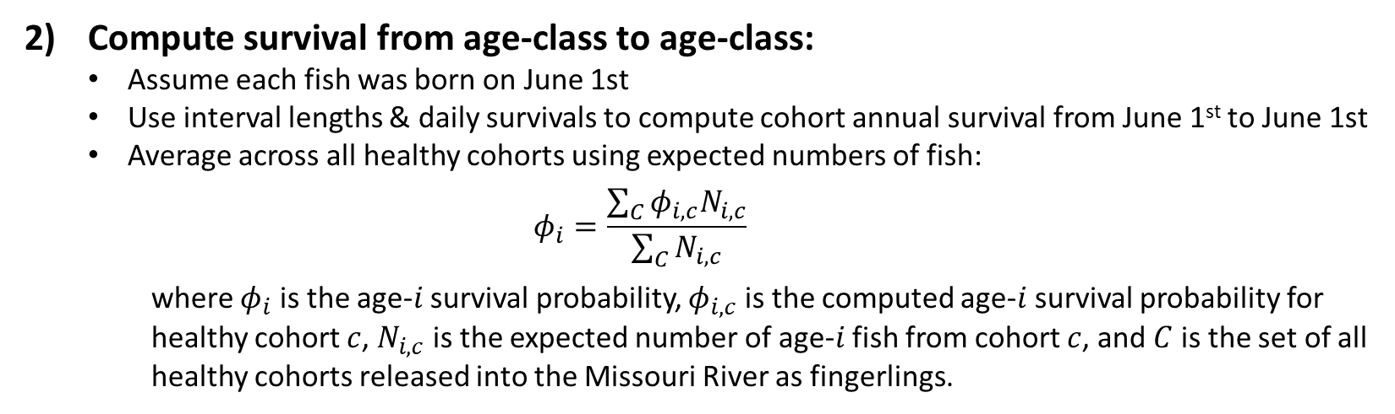
Survivals ($φ_{i}$)
Compute survival from age-class to age-class:
Assume each fish was born on June 1st
Use interval lengths & daily survivals to compute cohort annual survival from June 1st to June 1st
Average across all healthy cohorts using expected numbers of fish:
$$φ_{i}=\frac{\sum_{C}{φ_{i,c}N_{i,c}}}{\sum_{C}{N_{i,c}}}$$
where $φ_{i}$ is the age-$i$ survival probability, $φ_{i,c}$ is the computed age-$i$ survival probability for healthy cohort $c$, $N_{i,c}$ is the expected number of age-$i$ fish from cohort $c$, and $C$ is the set of all healthy cohorts released into the Missouri River as fingerlings.

Slide 9
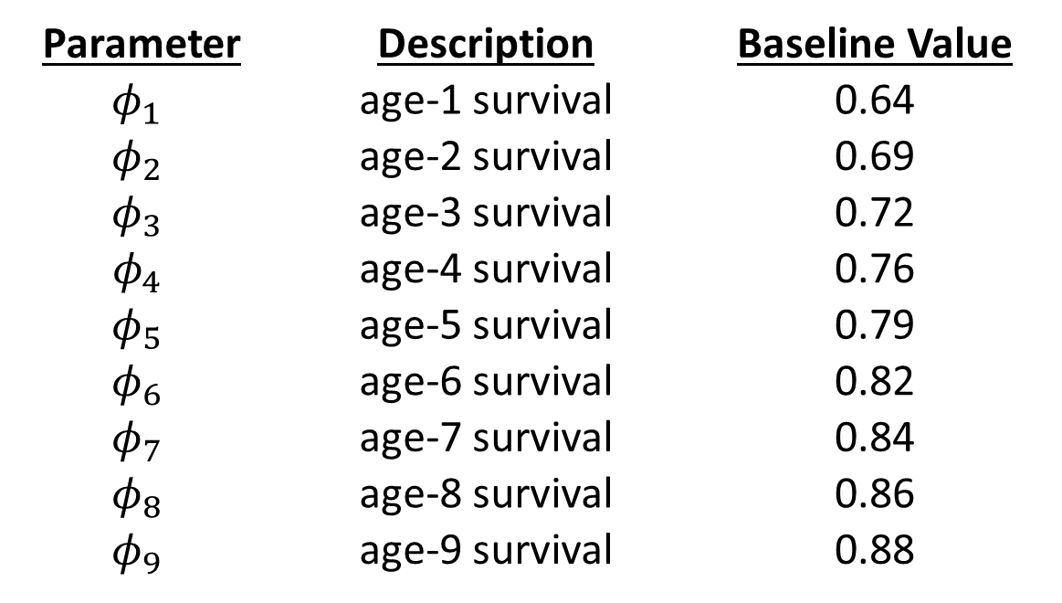
Survivals ($φ_{i}$)
Parameter | Description | Baseline Value
$$φ_{1}$$ | age-1 survival | 0.64
$$φ_{2}$$ | age-2 survival | 0.69
$$φ_{3}$$ | age-3 survival | 0.72
$$φ_{4}$$ | age-4 survival | 0.76
$$φ_{5}$$ | age-5 survival | 0.79
$$φ_{6}$$ | age-6 survival | 0.82
$$φ_{7}$$ | age-7 survival | 0.84
$$φ_{8}$$ | age-8 survival | 0.86
$$φ_{9}$$ | age-9 survival | 0.88

Slide 10
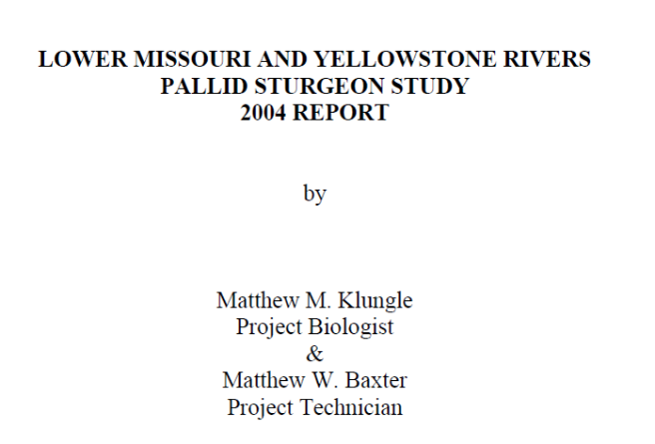
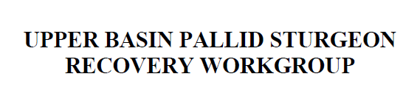

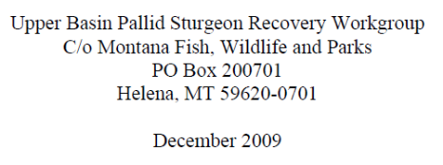

Survivals ($φ_{i}$)
158 Wild Adults in RPMA 2 in 2004
125 Wild Adults in RPMA 2 in 2008
$$φ_{adult}={\left(\frac{125}{158}\right)}^{1⁄4}≈0.94$$

Slide 11
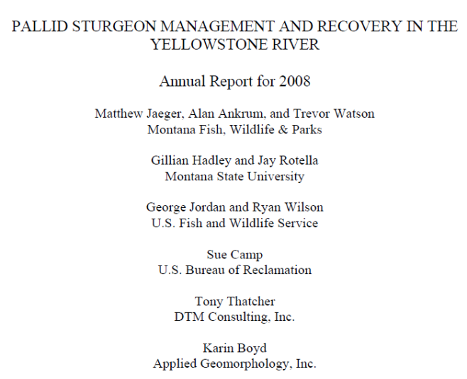
Survivals ($φ_{i}$)
158 Wild Adults in RPMA 2 in 2004
125 Wild Adults in RPMA 2 in 2008
$$φ_{adult}={\left(\frac{125}{158}\right)}^{1⁄4}≈0.94$$

Slide 12
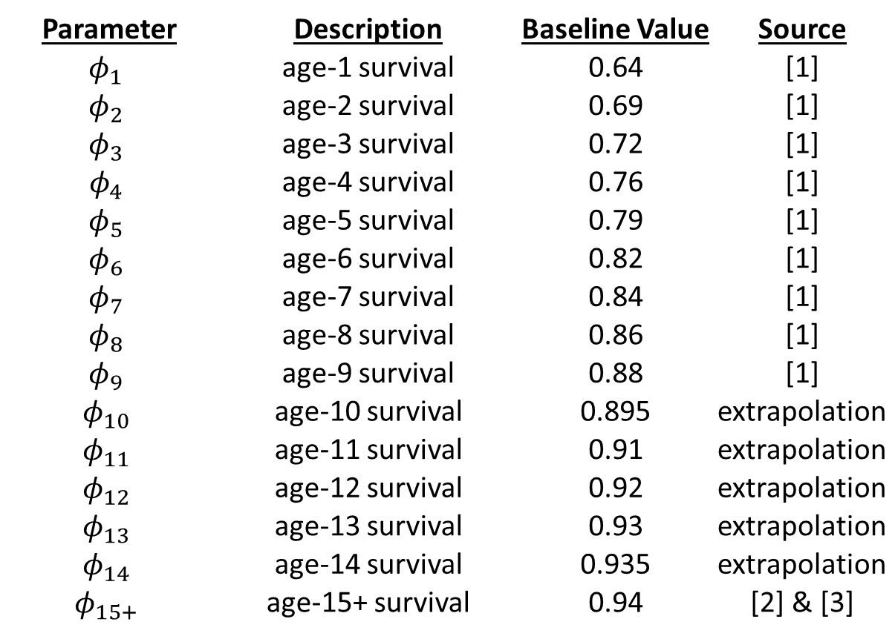
Survivals ($φ_{i}$)
Parameter | Description | Baseline Value | Source
$$φ_{1}$$ | age-1 survival | 0.64 | [1]
$$φ_{2}$$ | age-2 survival | 0.69 | [1]
$$φ_{3}$$ | age-3 survival | 0.72 | [1]
$$φ_{4}$$ | age-4 survival | 0.76 | [1]
$$φ_{5}$$ | age-5 survival | 0.79 | [1]
$$φ_{6}$$ | age-6 survival | 0.82 | [1]
$$φ_{7}$$ | age-7 survival | 0.84 | [1]
$$φ_{8}$$ | age-8 survival | 0.86 | [1]
$$φ_{9}$$ | age-9 survival | 0.88 | [1]
$$φ_{10}$$ | age-10 survival | 0.895 | extrapolation
$$φ_{11}$$ | age-11 survival | 0.91 | extrapolation
$$φ_{12}$$ | age-12 survival | 0.92 | extrapolation
$$φ_{13}$$ | age-13 survival | 0.93 | extrapolation
$$φ_{14}$$ | age-14 survival | 0.935 | extrapolation
$$φ_{15+}$$ | age-15+ survival | 0.94 | [2] & [3]

Slide 13
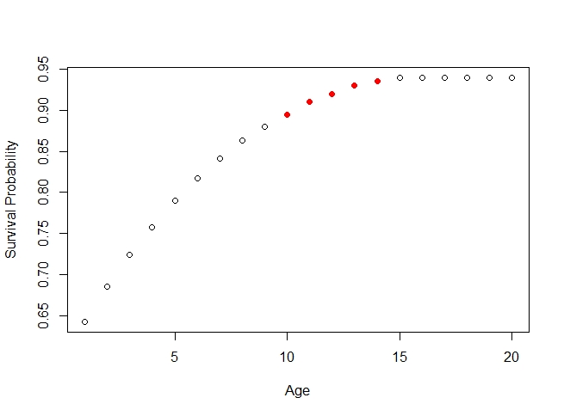
Survivals ($φ_{i}$)
Computed from Data
Extrapolated

Slide 14
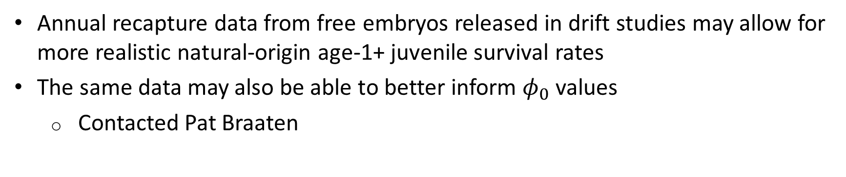

Survival ($φ_{i}$) Notes
Annual recapture data from free embryos released in drift studies may allow for more realistic natural-origin age-1+ juvenile survival rates
The same data may also be able to better inform $φ_{0}$ values
Contacted Pat Braaten

Slide 15
Age-Structured Projection Matrix (Leslie Matrix)
Fertilities
Survivals

Slide 16
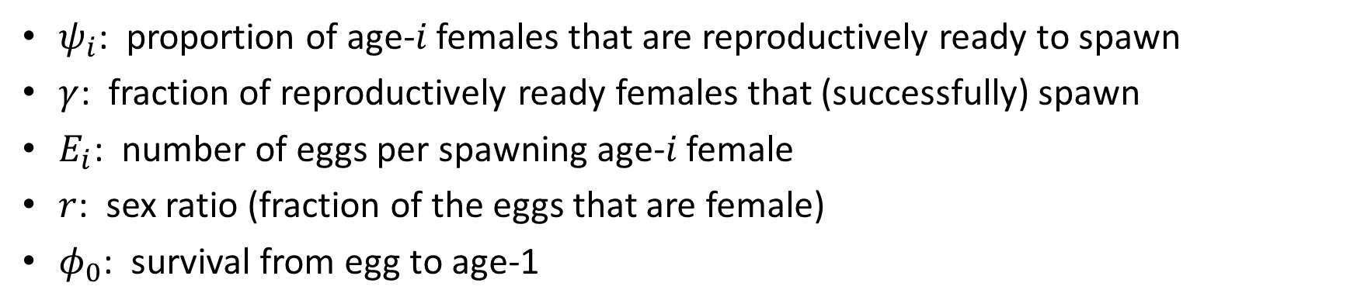

Fertilities ($F_{i}$)
$$F_{i}=ψ_{i}γE_{i}rφ_{0}$$
$ψ_{i}$: proportion of age-$i$ females that are reproductively ready to spawn
$γ$: fraction of reproductively ready females that (successfully) spawn
$E_{i}$: number of eggs per spawning age-$i$ female
$r$: sex ratio (fraction of the eggs that are female)
$φ_{0}$: survival from egg to age-1

Slide 17
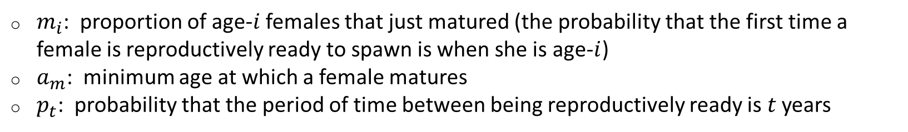
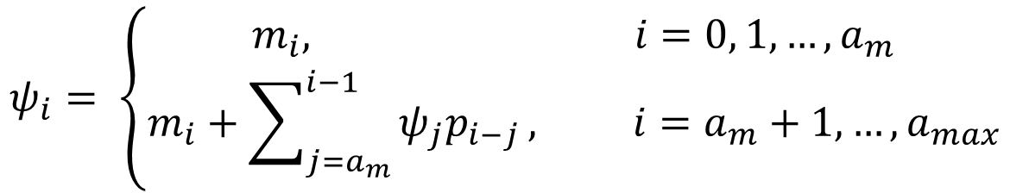
Fertilities ($F_{i}$)
$ψ_{i}$: proportion of age-$i$ females that are reproductively ready to spawn
function of maturation and spawning period
$$ψ_{i}= \left\{\begin{aligned}m_{i}, i=0, 1, …, a_{m} \\ m_{i}+\sum_{j=a_{m}}^{i−1}{ψ_{j}p_{i−j}}, i=a_{m}+1, …,a_{max}\end{aligned}\right.$$
$m_{i}$: proportion of age-$i$ females that just matured (the probability that the first time a female is reproductively ready to spawn is when she is age-$i$)
$a_{m}$: minimum age at which a female matures
$p_{t}$: probability that the period of time between being reproductively ready is $t$ years

Slide 18
Fertilities ($F_{i}$)
$ψ_{i}$: proportion of age-$i$ females that are reproductively ready to spawn
function of maturation and spawning period
Parameterization Ideas (maturation age, spawning period):
Constant age/period
Distribution of ages/periods between some minimum and maximum, based on available data
Some functional form (say for the cumulative distribution) fit to/informed by data, when possible

Slide 19
Fertilities ($F_{i}$)
$ψ_{i}$: proportion of age-$i$ females that are reproductively ready to spawn
function of maturation and spawning period
Summary of Maturation Age Data:
Area of further informational need (DeLonay et al. 2016)
May vary by river region; maturing later farther north (George et al. 2012)
15-20 years old (Keenlyne and Jenkins 1993) and 8-9 years old (George et al. 2012)
Examined pectoral fin ray spawning bands of 9 (3) female pallid sturgeon from throughout the Missouri and Mississippi and 2 females from the lower Mississippi, respectively
9 years-old minimum age at maturity (Steffensen et al. 2013)
Youngest, mature hatchery fish captured during a 4-year lower Missouri River study
Mean of 10 years, total variance of 1.0833 (Wildhaber et al. 2017)
Based on first 13 females: Keenlyne & Jenkins ‘93, George et al. ‘12 and unpublished data

Slide 20
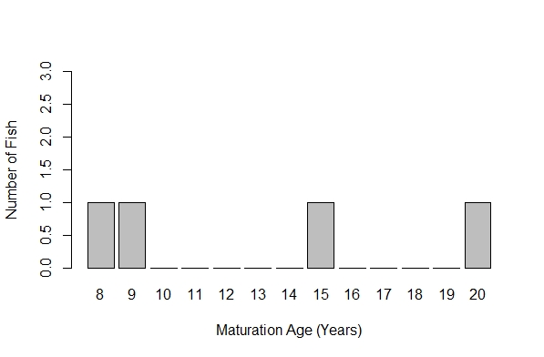
Fertilities ($F_{i}$)
$ψ_{i}$: proportion of age-$i$ females that are reproductively ready to spawn
function of maturation and spawning period
Summary of Maturation Age Data:
Lower Miss.
SD
ND

Slide 21
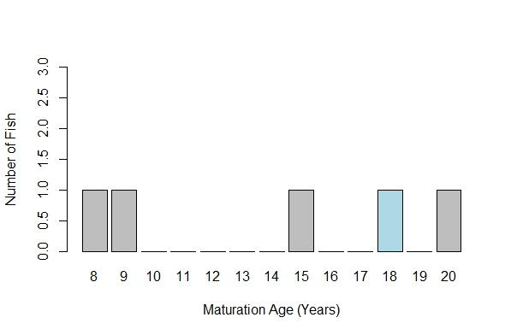
Fertilities ($F_{i}$)
$ψ_{i}$: proportion of age-$i$ females that are reproductively ready to spawn
function of maturation and spawning period
Summary of Maturation Age Data:
Stage III at age-17;
ready to spawn next year?
Lower Miss.
SD
LA
ND
Reliability of data?
(Hurley et al. 2004)

Slide 22
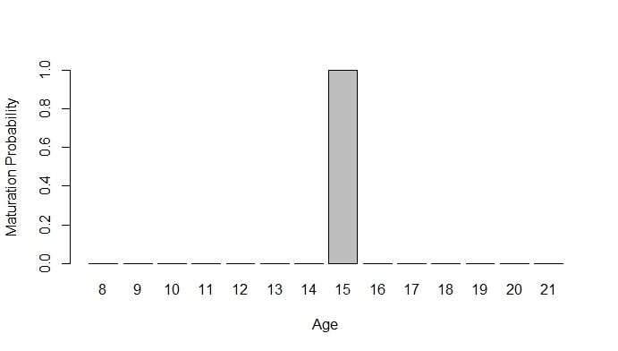
Fertilities ($F_{i}$)
$ψ_{i}$: proportion of age-$i$ females that are reproductively ready to spawn
function of maturation and spawning period
Parameterization Ideas for Maturation Age:
Constant age: all females mature at age 15

Slide 23
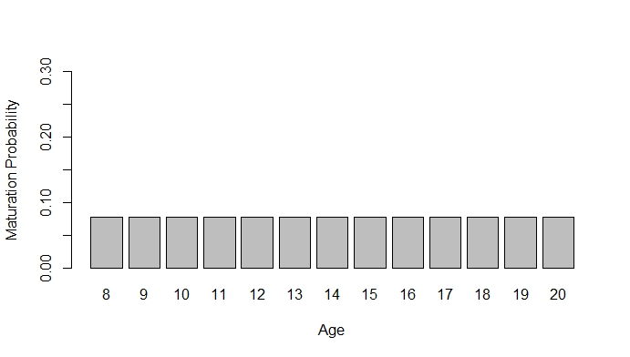
Fertilities ($F_{i}$)
$ψ_{i}$: proportion of age-$i$ females that are reproductively ready to spawn
function of maturation and spawning period
Parameterization Ideas for Maturation Age:
Distribution of ages between some minimum and maximum: Discrete uniform distribution for ages 8-20

Slide 24
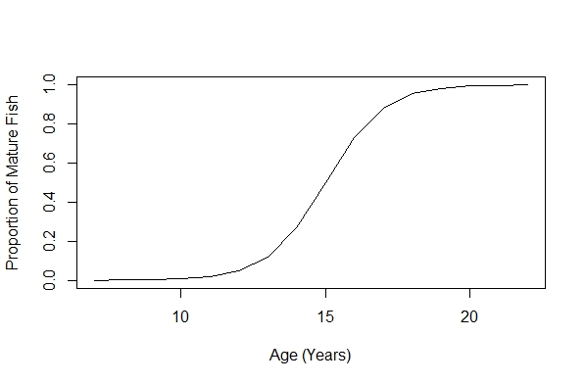
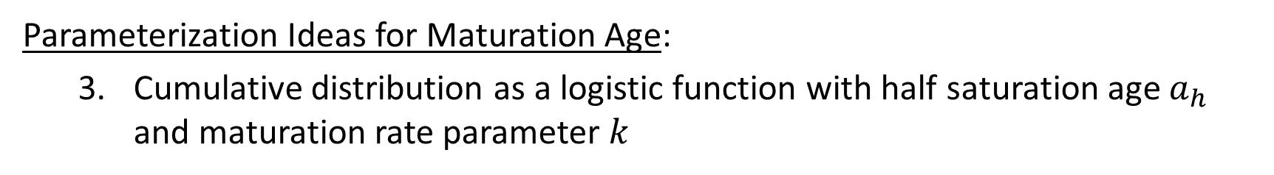
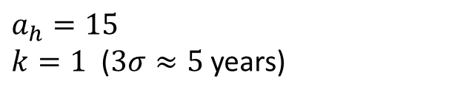
Fertilities ($F_{i}$)
$ψ_{i}$: proportion of age-$i$ females that are reproductively ready to spawn
function of maturation and spawning period
Parameterization Ideas for Maturation Age:
Cumulative distribution as a logistic function with half saturation age $a_{h}$ and maturation rate parameter $k$
$$a_{h}=15$$
$k=1$ ($3σ≈5$years)

Slide 25
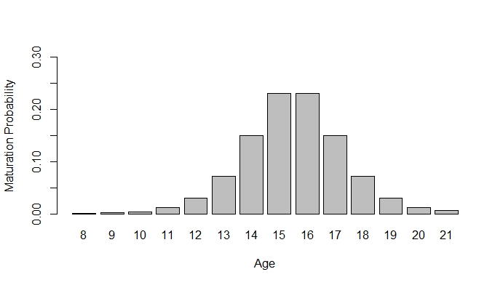
Fertilities ($F_{i}$)
$ψ_{i}$: proportion of age-$i$ females that are reproductively ready to spawn
function of maturation and spawning period
Parameterization Ideas for Maturation Age:
Cumulative distribution as a logistic function with half saturation age $a_{h}$ and maturation rate parameter $k$
$$a_{h}=15$$
$k=1$ ($3σ≈5$years)

Slide 26

Maturation Age ($m_{i}$) Notes
Molly Webb has been collecting blood samples in the upper river over the past 4-5 years – should be able to get better maturation age data from her studies
Contacted Molly

Slide 27
Fertilities ($F_{i}$)
$ψ_{i}$: proportion of age-$i$ females that are reproductively ready to spawn
function of maturation and spawning period
Spawning Period Data:
2-5 years (DeLonay et al. 2016)
As great as 8-10 years (Dryer & Sandvol 1993, Keenlyne & Jenkins 1993)
Fuller et al. (2007):
2 years: 4
3 years: 3
1 inconclusive: 2 or 4 years
DeLonay et al. (2016):
>1 year: 20 (6 unknown after this point)
=2 years: 4
>2 years: 10 (8 unknown after this point)
>3 years: 2

Slide 28
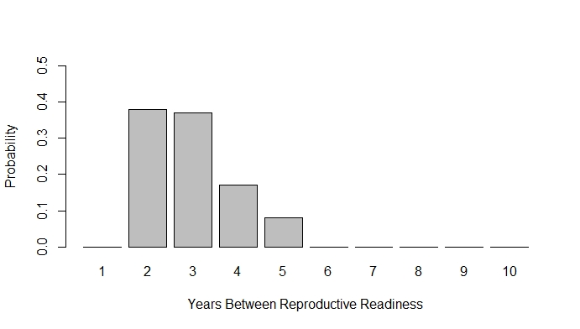

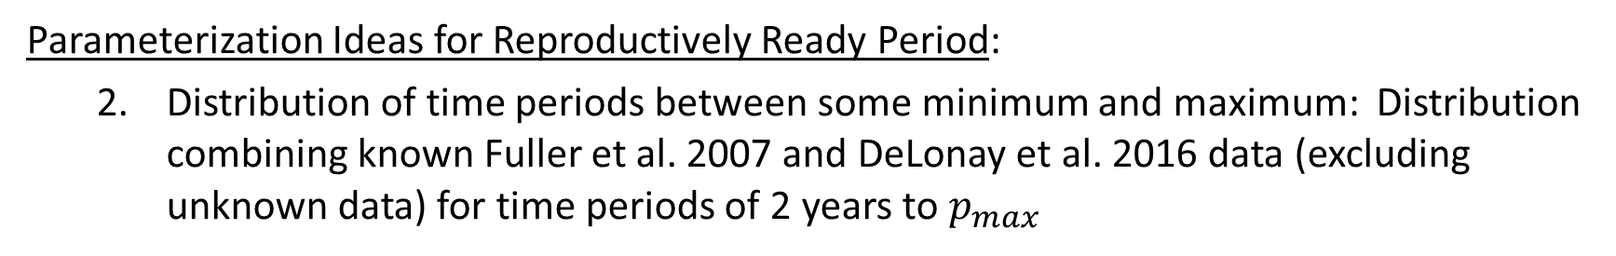
Fertilities ($F_{i}$)
$\psi_i$: proportion of age-$i$ females that are reproductively ready to spawn
function of maturation and spawning period
Parameterization Ideas for Reproductively Ready Period:
Distribution of time periods between some minimum and maximum: Distribution combining known Fuller et al. 2007 and DeLonay et al. 2016 data (excluding unknown data) for time periods of 2 years to $p_{max}$
$$p_{max}=5$$

Slide 29
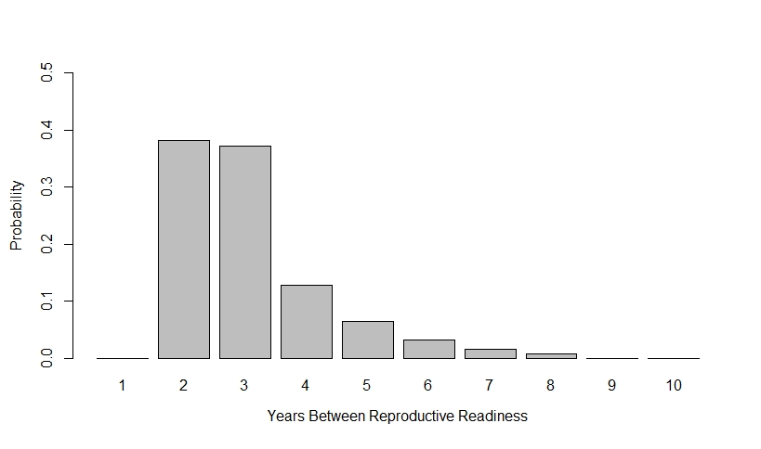

Fertilities ($F_{i}$)
$ψ_{i}$: proportion of age-$i$ females that are reproductively ready to spawn
function of maturation and spawning period
Parameterization Ideas for Reproductively Ready Period:
Distribution of time periods between some minimum and maximum: Distribution combining known Fuller et al. 2007 and DeLonay et al. 2016 data (excluding unknown data) for time periods of 2 years to $p_{max}$
$$p_{max}=8$$

Slide 30
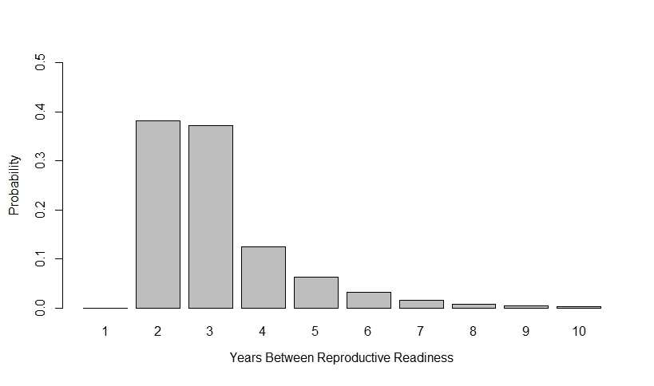

Fertilities ($F_{i}$)
$ψ_{i}$: proportion of age-$i$ females that are reproductively ready to spawn
function of maturation and spawning period
Parameterization Ideas for Reproductively Ready Period:
Distribution of time periods between some minimum and maximum: Distribution combining known Fuller et al. 2007 and DeLonay et al. 2016 data (excluding unknown data) for time periods of 2 years to $p_{max}$
$$p_{max}=10$$

Slide 31
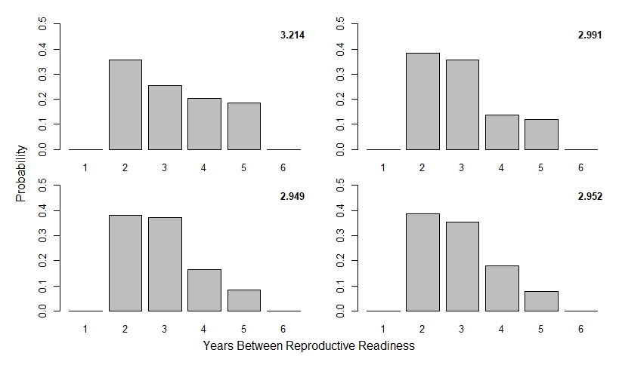
Fertilities ($F_{i}$)
$ψ_{i}$: proportion of age-$i$ females that are reproductively ready to spawn
function of maturation and spawning period
Parameterization Ideas for Reproductively Ready Period:
Distribution of time periods between some minimum and maximum

Slide 32
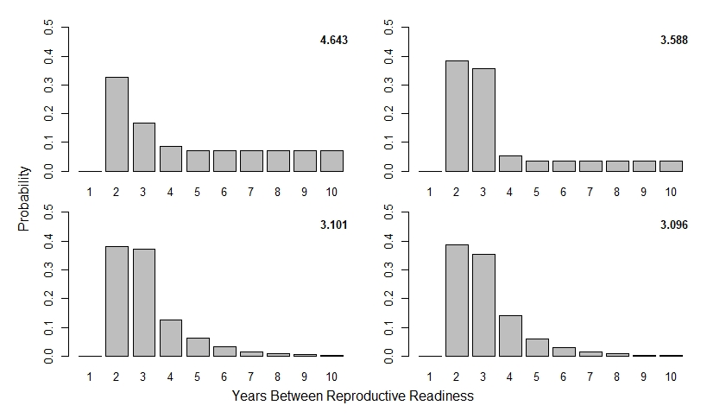
Fertilities ($F_{i}$)
$ψ_{i}$: proportion of age-$i$ females that are reproductively ready to spawn
function of maturation and spawning period
Parameterization Ideas for Reproductively Ready Period:
Distribution of time periods between some minimum and maximum

Slide 33
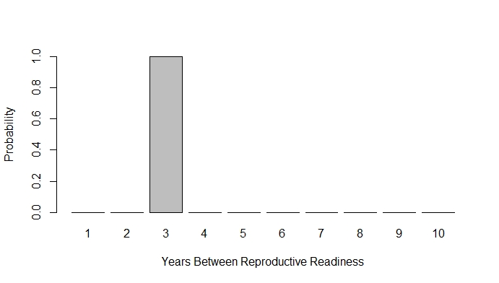
Fertilities ($F_{i}$)
$ψ_{i}$: proportion of age-$i$ females that are reproductively ready to spawn
function of maturation and spawning period
Parameterization Ideas for Reproductively Ready Period:
Constant period: all females are reproductively ready every 3rd year

Slide 34
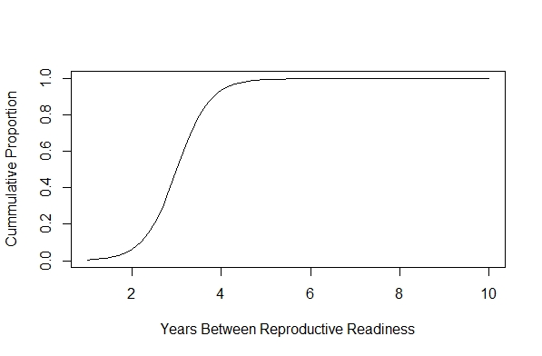
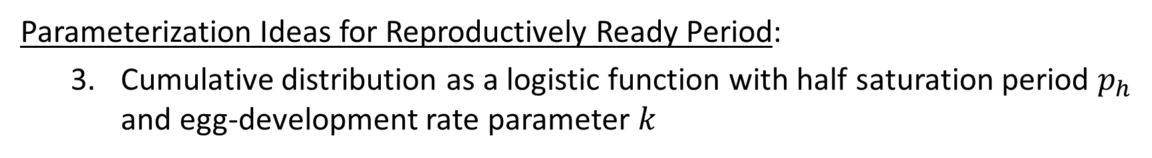
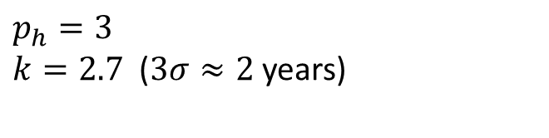
Fertilities ($F_{i}$)
$ψ_{i}$: proportion of age-$i$ females that are reproductively ready to spawn
function of maturation and spawning period
Parameterization Ideas for Reproductively Ready Period:
Cumulative distribution as a logistic function with half saturation period $p_{h}$ and egg-development rate parameter $k$
$$p_{h}=3$$
$k=2.7$ ($3σ≈2$ years)

Slide 35
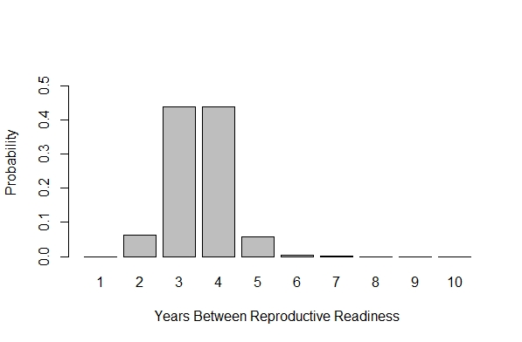
Fertilities ($F_{i}$)
$ψ_{i}$: proportion of age-$i$ females that are reproductively ready to spawn
function of maturation and spawning period
Parameterization Ideas for Reproductively Ready Period:
Cumulative distribution as a logistic function with half saturation period $p_{h}$ and egg-development rate parameter $k$
$$p_{h}=3$$
$k=2.7$ ($3σ≈2$ years)

Slide 36

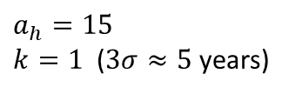


Fertilities ($F_{i}$)
$ψ_{i}$: proportion of age-$i$ females that are reproductively ready to spawn
function of maturation and spawning period
$$m_{i}$$
$$p_{t}$$
$$a_{h}=15$$
$k=1$ ($3σ≈5$years)
$$p_{max}=5$$
&

Slide 37
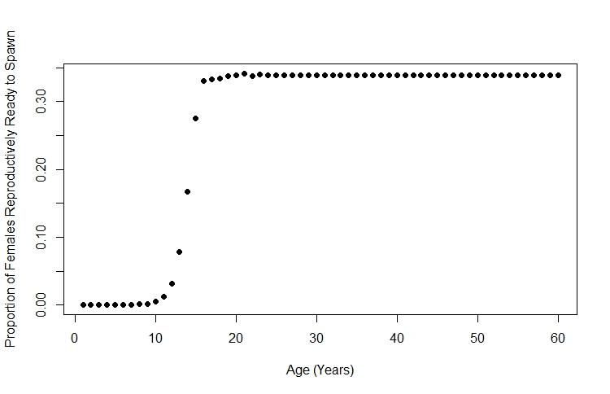
Fertilities ($F_{i}$)
$ψ_{i}$: proportion of age-$i$ females that are reproductively ready to spawn
function of maturation and spawning period

Slide 38

Reproductively Ready Females ($ψ_{i}$) Notes
DM: Obtain results for the simplest case first and then undergo further comparisons
CF: Go with what you expect to be most realistic even if not the simplest
Would we be able to analyze female reproductive period as a time to event analysis? Enough data?
Utilizing different parameterization approaches is a robustness test:
Different approaches may have no effect on management decisions (less risk under the given uncertainties)
It informs whether or not gathering more information on these topics is very important for the decision making process (if there is a drastic effect on management decisions, then reducing uncertainty will be important)

Slide 39

Fertilities ($F_{i}$)
$r$: sex ratio (fraction of the eggs that are female)
125 Wild Adults in RPMA 2 in 2008
40 Wild Females in RPMA 2 in 2008
$$r=\frac{40}{125}=0.32$$

Slide 40
Sex Ratio (r) Notes
Is it likely that biases in sampling would affect estimates of the sex ratio? Thought process behind this question:
Often sex data is obtained during broodstock collection
Delonay et al. 2016 found that mature but non-reproductively ready males, often exhibited movement patterns similar to reproductively ready males, while mature non-reproductively females tended to move less than reproductively ready females
Delonay et al. 2016 also found that males tended to mature earlier and have a shorter spawning period than females
If less mobile and younger females are less likely to be captured during broodstock (e.g., they don’t travel far enough upriver to be in the sampling location) then the ratio of males to females captured could be skewed
Perhaps Molly Webb’s bloodwork data will give a more updated picture of sex ratio as well?

Slide 41
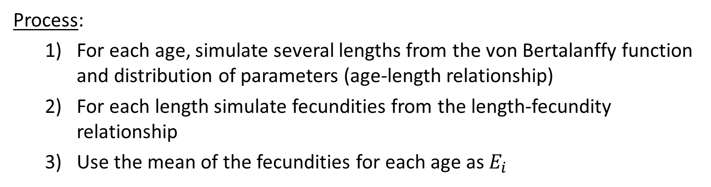
Fertilities ($F_{i}$)
$E_{i}$: number of eggs per spawning age-$i$ female
use length-fecundity relationship + age-length relationship
Process:
For each age, simulate several lengths from the von Bertalanffy function and distribution of parameters (age-length relationship)
For each length simulate fecundities from the length-fecundity relationship
Use the mean of the fecundities for each age as $E_{i}$

Slide 42
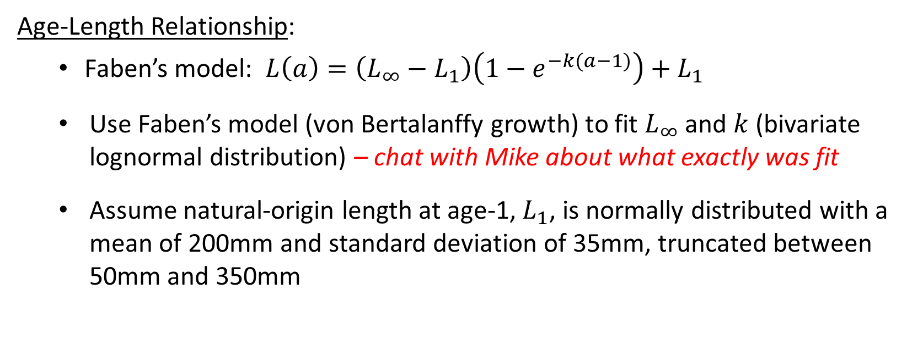
Fertilities ($F_{i}$)
$E_{i}$: number of eggs per spawning age-$i$ female
use length-fecundity relationship + age-length relationship
Age-Length Relationship:
Faben’s model: $L\left(a\right)=\left(L_{∞}−L_{1}\right)\left(1−e^{−k(a−1)}\right)+L_{1}$
Use Faben’s model (von Bertalanffy growth) to fit $L_{∞}$ and $k$ (bivariate lognormal distribution) – chat with Mike about what exactly was fit
Assume natural-origin length at age-1, $L_{1}$, is normally distributed with a mean of 200mm and standard deviation of 35mm, truncated between 50mm and 350mm

Slide 43
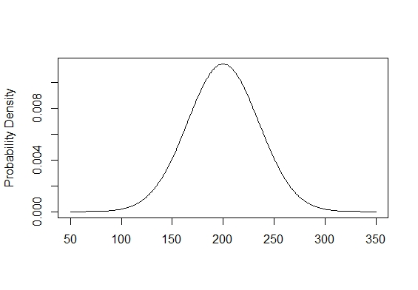

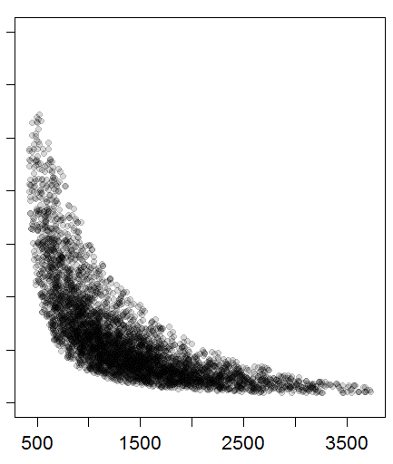


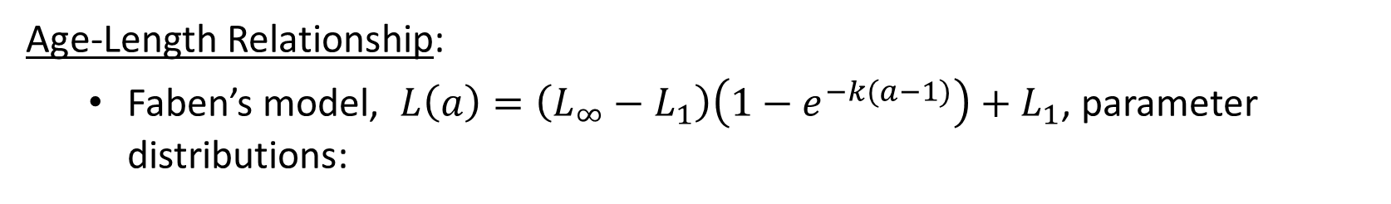

Fertilities ($F_{i}$)
$E_{i}$: number of eggs per spawning age-$i$ female
use length-fecundity relationship + age-length relationship
Age-Length Relationship:
Faben’s model, $L\left(a\right)=\left(L_{∞}−L_{1}\right)\left(1−e^{−k(a−1)}\right)+L_{1}$, parameter distributions:
$$k$$
$$L_{1}$$
$$L_{∞}$$

Slide 44
Fertilities ($F_{i}$)
$E_{i}$: number of eggs per spawning age-$i$ female
use length-fecundity relationship + age-length relationship
Length-Fecundity Relationship:
Mean fecundity was fit as an exponential function of fork length with a negative binomial error distribution
25 data points from 24 upper river females were used to obtain parameter estimates

Slide 45
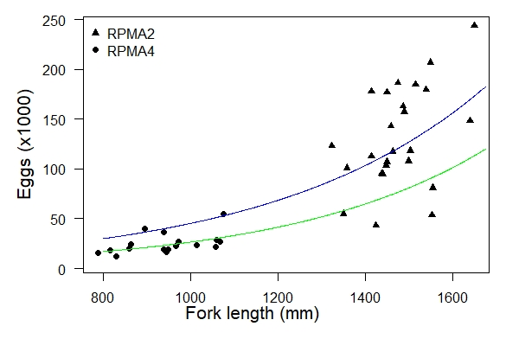
Fertilities ($F_{i}$)
$E_{i}$: number of eggs per spawning age-$i$ female
use length-fecundity relationship + age-length relationship
Length-Fecundity Relationship:

Slide 46
Fertilities ($F_{i}$)
$E_{i}$: number of eggs per spawning age-$i$ female
use length-fecundity relationship + age-length relationship
Process:
For each age, simulate several lengths from the von Bertalanffy function and distribution of parameters (age-length relationship)
For each length simulate fecundities from the length-fecundity relationship
Use the mean of the fecundities for each age as $E_{i}$

Slide 47
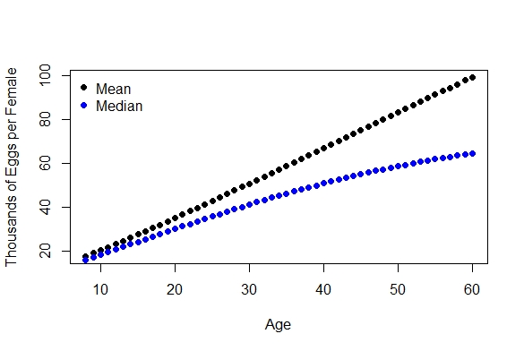
Fertilities ($F_{i}$)
$E_{i}$: number of eggs per spawning age-$i$ female
use length-fecundity relationship + age-length relationship

Slide 48

Number of Eggs ($E_{i}$) Notes
General approach seem reasonable?
Do we expect mean number of eggs produced to be linearly related to age?
Any suggestions or comments?

Slide 49


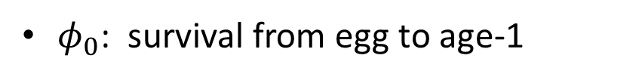


Fertilities ($F_{i}$)
$φ_{0}$: survival from egg to age-1
function of retention and turbidity
Age-0 Survival =
(Missouri River Age-0 Survival)*(Retention Probability)
+ (Lake Sakakawea Age-0 Survival)*(1-Retention Probability)
$$p_{ret}=g(flow, temperature)$$
Determined by drift-development model outputs
$$φ_{0}=φ_{0, MR}{∙p}_{ret}$$
$$+{ φ}_{0,LS}∙(1−p_{ret})$$
$$φ_{0,MR}=f(turbidity)$$
Increasing function of turbidity

Slide 50



Fertilities ($F_{i}$)
$φ_{0,MR}$: survival from egg to age-1 within the free-flowing Missouri River
function of turbidity (predation effects)
Missouri River Age-0 Survival =
(1-Predation Probability)*(MR Survival Given No Predation)
$$φ_{0,MR}=f(turbidity)∙$$
$$φ_{0,max}$$
$$φ_{0,NP}$$
Missouri River Age-0 Survival =
(Scaling Function)*(Missouri River Maximum Age-0 Survival)

Slide 51
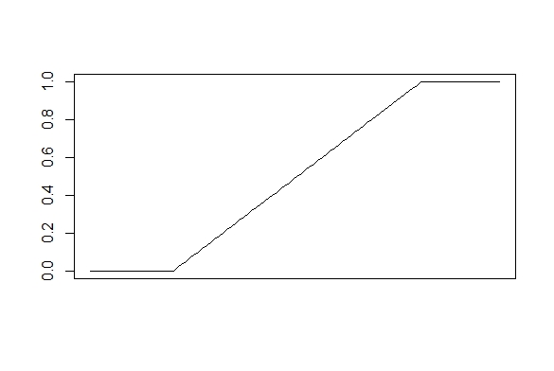


Fertilities ($F_{i}$)
$φ_{0,MR}$: survival from egg to age-1 within the free-flowing Missouri River
$φ_{0,MR}=f(turbidity)∙$ $φ_{0,max}$
$$f(turbidity)$$
lower threshold
upper threshold
Turbidity

Slide 52
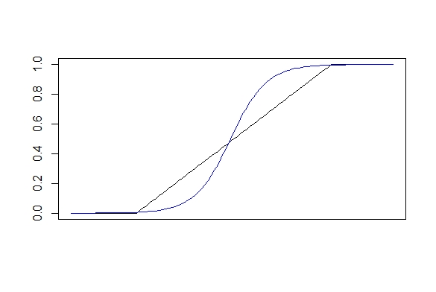
Fertilities ($F_{i}$)
$φ_{0,MR}$: survival from egg to age-1 within the free-flowing Missouri River
$φ_{0,MR}=f(turbidity)∙$ $φ_{0,max}$
$$f(turbidity)$$
lower threshold
upper threshold
Turbidity

Slide 53

Age-0 Survival ($φ_{0}$) Notes
Similar to maturation age and spawning period we could see if various forms of the turbidity function effect the outcomes
Recommended initial function to test?
Other thoughts?
How do the flows out of Fort Peck interact with turbidity? Do high flows create clearer water for further down river?

Slide 54
Fertilities ($F_{i}$)
$$F_{i}=ψ_{i}γE_{i}rφ_{0}$$
$ψ_{i}$: proportion of age-$i$ females that are reproductively ready to spawn
$γ$: fraction of reproductively ready females that (successfully) spawn
$E_{i}$: number of eggs per spawning age-$i$ female
$r$: sex ratio (fraction of the eggs that are female)
$φ_{0}$: survival from egg to age-1

Slide 55
Fertilities ($F_{i}$)
$γ$: fraction of reproductively ready females that (successfully) spawn
relate to spawning flows
Components:
Fraction that spawn in Yellowstone
Fraction that spawn in Missouri
Fraction that reabsorb eggs
Process:
Go to MR instead of YE
Decide to stay there (vs travel back)
Spawn, i.e., do not reabsorb eggs
Effects:
Flows & temps?
Flows, temps, & habitat?
Flows, temps, & habitat?
MR flows > YE flows
This could be high or low, or 1 vs. 0, etc.
0 up to some criteria and then increasing with flow
Spawning cue is available

Slide 56

Fraction of Reproductively Ready Females that Spawn in the Missouri River ($γ$) Notes
??

Slide 57
Other Discussion Notes
??

