Slide 1
Population Model Task 322-1b
Link flow manipulations to predict range of potential population responses under various hypotheses on action effectiveness.
Look at Ft. Peck flows in 2019 (#1 priority for 2019); postpone examination of L. Missouri to 2020.
Current Task 322-1b Analysis
Spatial Extent: UMOR; spawning near confluence with Milk River
Temporal Extent of Management Action: Flow manipulations associated with free-embryo drift
Goal: Identify flow scenarios resulting in population growth under spawning and survival assumptions.

Slide 2
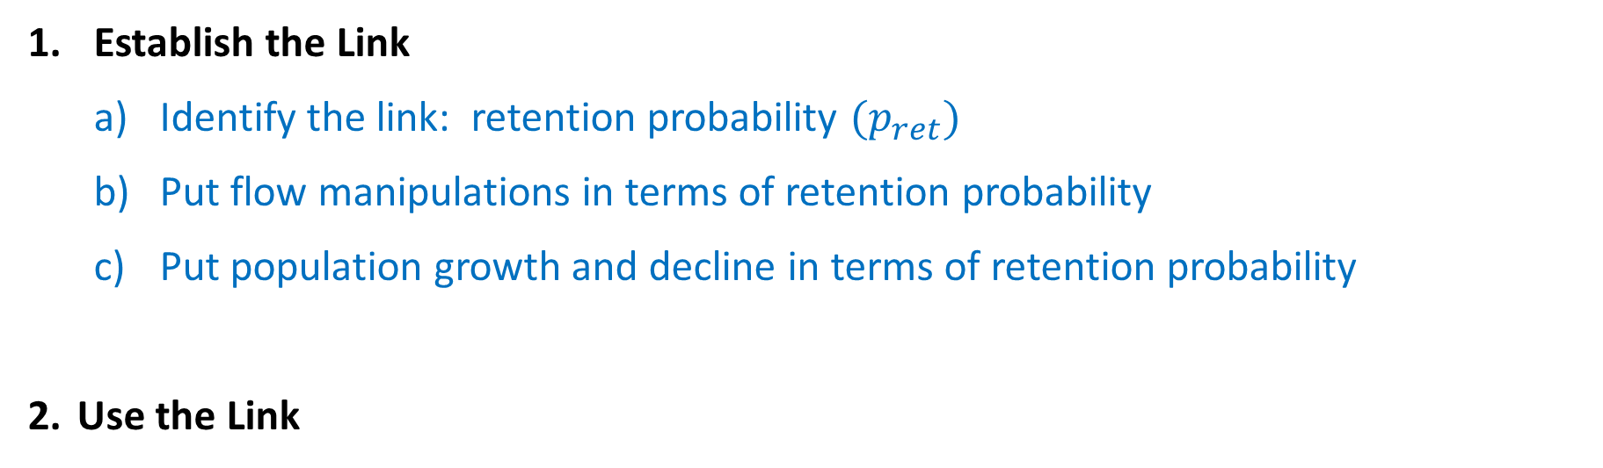
Approach
Link flow manipulations and population growth/decline
Identify flow scenarios resulting in population growth under spawning and survival assumptions
Establish the Link
Identify the link: retention probability $(p_{ret})$
Put flow manipulations in terms of retention probability
Put population growth and decline in terms of retention probability
Use the Link

Slide 3
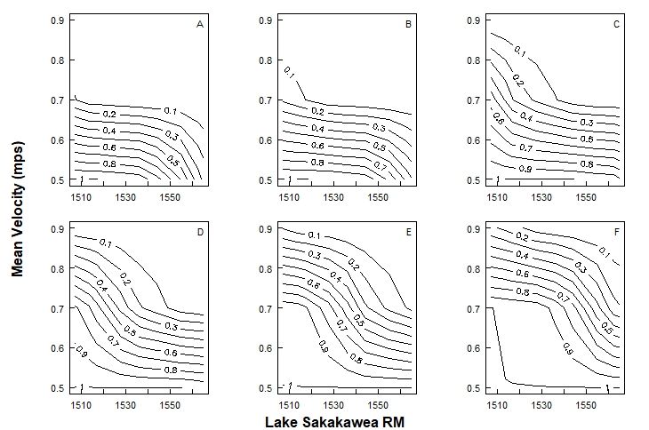






1b) Flow Manipulations in Terms of Retention Probability
Based on data from Erwin et al.
$$14℃$$
$$16℃$$
$$18℃$$
$$20℃$$
$$22℃$$
$$24℃$$

Slide 4
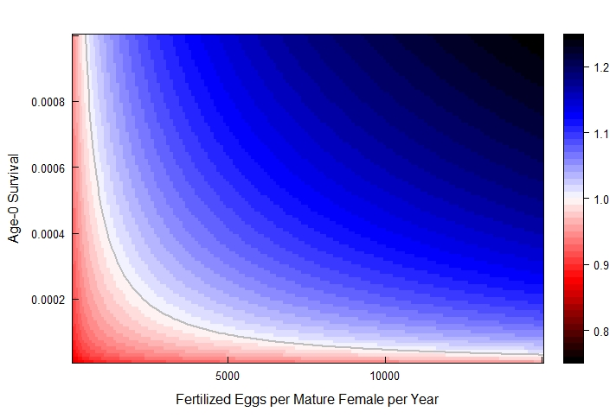

Population Growth/Decline in Terms of $λ$
Demographic model (deterministic)
HOPE
growth
$λ$ (long-term)
decline

Slide 5
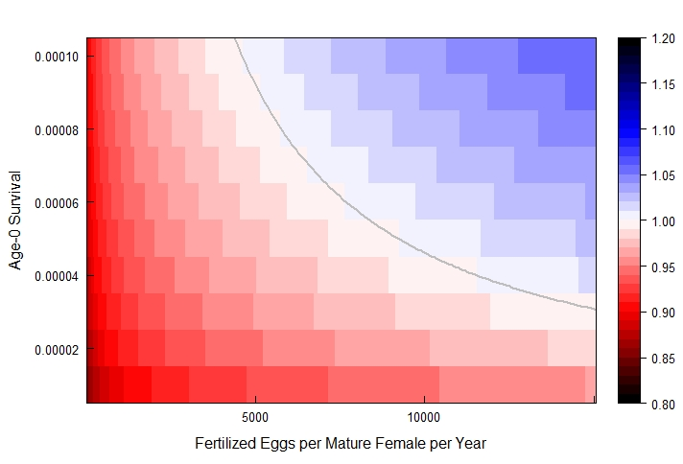

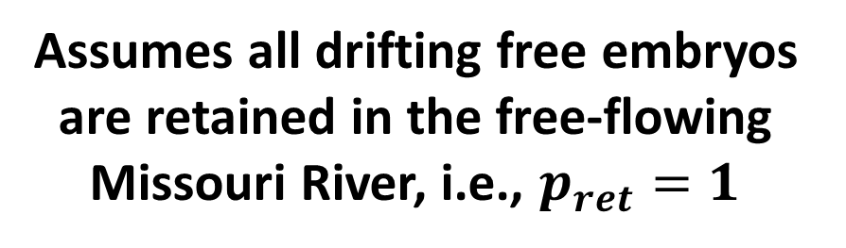
Population Growth/Decline in Terms of $λ$
Demographic model (deterministic)
Very low age-0 survival
growth
$λ$ (long-term)
Assumes all drifting free embryos are retained in the free-flowing Missouri River, i.e., $p_{ret}=1$
decline

Slide 6


Age-0 Survival in Terms of Retention Probability
Today, we’ll consider the scenario where Lake Sakakawea survival is 0, so
Age-0 Survival =
(Missouri River Age-0 Survival)*(Retention Probability)
+ (Lake Sakakawea Age-0 Survival)*(1-Retention Probability)
$$φ_{0}=φ_{0, MR}{∙p}_{ret}$$
$$+{ φ}_{0,LS}∙(1−p_{ret})$$

Slide 7

1c) Population Growth/Decline in Terms of Retention Probability
growth
Missouri River Age-0 Survival
Age-0 Survival
$λ$ (long-term)
$$p_{ret}=1$$
decline

Slide 8
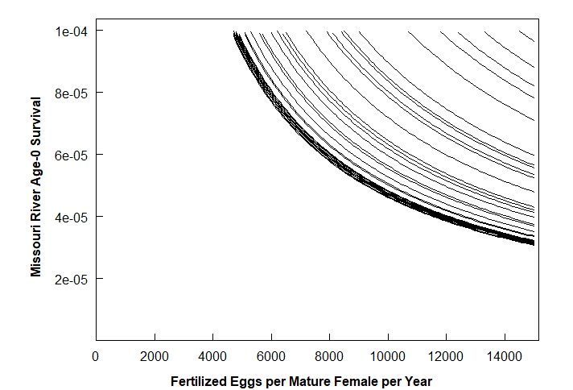



1c) Population Growth/Decline in Terms of Retention Probability
$$p_{ret}=0.319$$
$$p_{ret}=0.515$$
$$p_{ret}=1$$
$$p_{ret}=0.715$$
For a given retention probability curve, we expect:
Population growth for spawning & survival scenarios to the right/above the curve
Population decline for spawning & survival scenarios to the left/below the curve

Slide 9
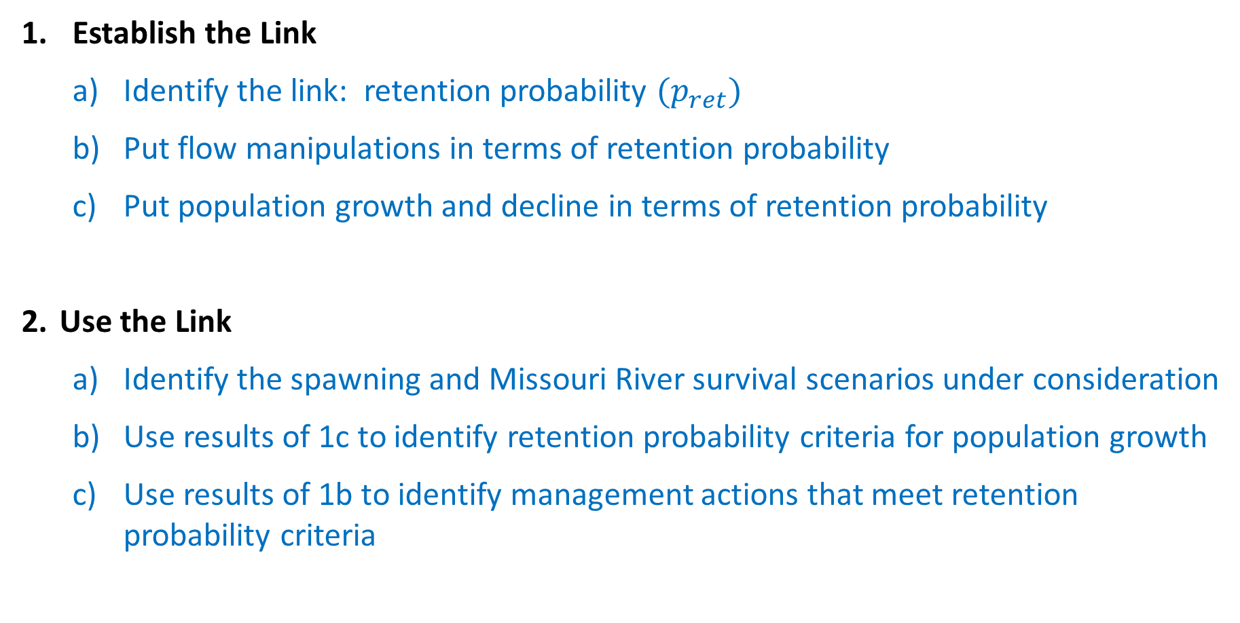
Approach
Establish the Link
Identify the link: retention probability $(p_{ret})$
Put flow manipulations in terms of retention probability
Put population growth and decline in terms of retention probability
Use the Link
Identify the spawning and Missouri River survival scenarios under consideration
Use results of 1c to identify retention probability criteria for population growth
Use results of 1b to identify management actions that meet retention probability criteria

Slide 10
Example: 2a) Spawning and Missouri River Survival
Say we believe:
Each spawning female produces an average of 30,000 fertilized eggs
About 1/3 of all mature females spawn each year
About 75 out of every one million drifting free embryos survive to age-1, given they did not drift into Lake Sakakawea
Fertilized Eggs per Mature Female per Year : 30,000*(1/3) = 10,000
Missouri River Age-0 Survival: 75/1,000,000 = 0.000075

Slide 11
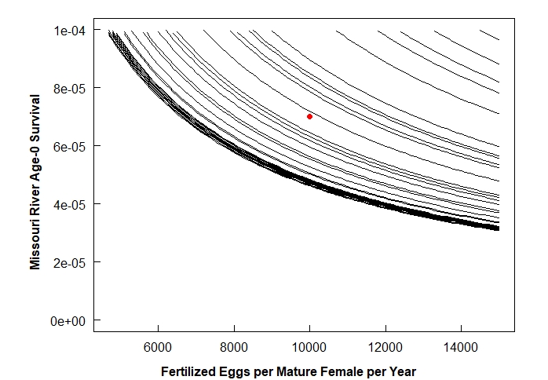




2b) Retention Probability Criteria for Population Growth
$$p_{ret}=0.319$$
$$p_{ret}=0.515$$
$$p_{ret}=1$$
$$p_{ret}=0.715$$
For a given retention probability curve, we expect:
Population growth for spawning & survival scenarios to the right/above the curve
Population decline for spawning & survival scenarios to the left/below the curve

Slide 12


2b) Retention Probability Criteria for Population Growth
$$p_{ret}=0.319$$
$$p_{ret}=0.515$$
$$p_{ret}=1$$
$$p_{ret}=0.715$$
For a given retention probability curve, we expect:
Population growth for spawning & survival scenarios to the right/above the curve
Population decline for spawning & survival scenarios to the left/below the curve
EXPLANATION:
Growth
Decline

Slide 13
2b) Retention Probability Criteria for Population Growth
$$p_{ret}=0.319$$
$$p_{ret}=0.515$$
$$p_{ret}=1$$
$$p_{ret}=0.715$$
As retention probability increases, the spawning and survival scenarios under which population growth is possible expand down and left toward the origin.
EXPLANATION:
Growth
Decline

Slide 14
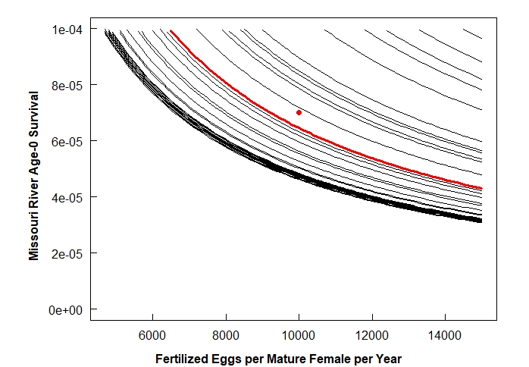



2b) Retention Probability Criteria for Population Growth
$$p_{ret}=0.319$$
$$p_{ret}=0.515$$
$$p_{ret}=1$$
$$p_{ret}=0.715$$
As retention probability increases, the spawning and survival scenarios under which population growth is possible expand down and left toward the origin.
EXPLANATION:
Growth
Decline

Slide 15



2b) Retention Probability Criteria for Population Growth
$$p_{ret}=0.715$$
}
$$p_{ret}=1$$
Retention Scenarios with Population Growth:
$$p_{ret}>0.7$$

Slide 16

2c) Management Actions that Meet Retention Probability Criteria
$$14℃$$
$$16℃$$
$$18℃$$
$$p_{ret}>0.7$$
$$20℃$$
$$22℃$$
$$24℃$$

Slide 17
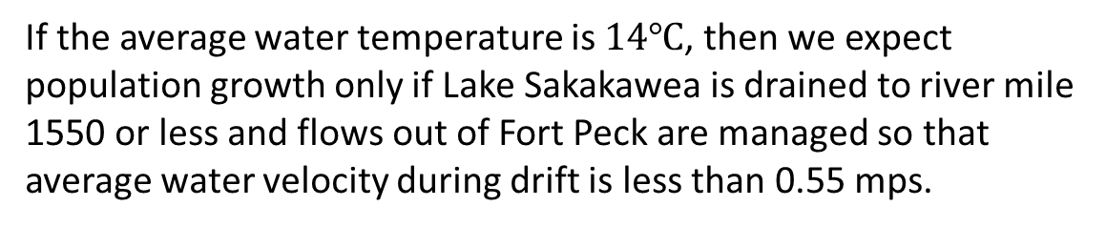
2c) Management Actions that Meet Retention Probability Criteria
$$14℃$$
$$16℃$$
$$18℃$$
$$p_{ret}>0.7$$
If the average water temperature is $14℃$, then we expect population growth only if Lake Sakakawea is drained to river mile 1550 or less and flows out of Fort Peck are managed so that average water velocity during drift is less than 0.55 mps.
$$20℃$$
$$22℃$$
$$24℃$$
EXPLANATION:
Growth
Lake Sakakawea River Mile

Slide 18
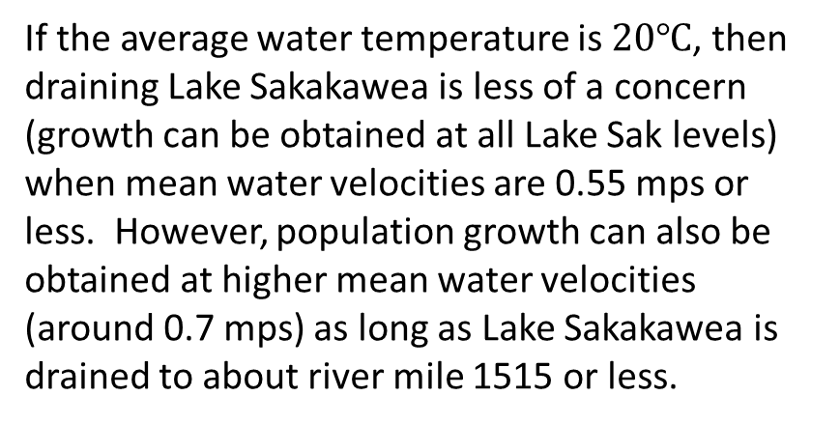
2c) Management Actions that Meet Retention Probability Criteria
$$14℃$$
$$16℃$$
$$18℃$$
$$p_{ret}>0.7$$
If the average water temperature is $14℃$, then we expect population growth only if Lake Sakakawea is drained to river mile 1550 or less and flows out of Fort Peck are managed so that average water velocity during drift is less than 0.55 mps.
$$20℃$$
$$22℃$$
$$24℃$$
If the average water temperature is $20℃$, then draining Lake Sakakawea is less of a concern (growth can be obtained at all Lake Sak levels) when mean water velocities are 0.55 mps or less. However, population growth can also be obtained at higher mean water velocities (around 0.7 mps) as long as Lake Sakakawea is drained to about river mile 1515 or less.
EXPLANATION:
Growth
Lake Sakakawea River Mile

Slide 19
2c) Management Actions that Meet Retention Probability Criteria
$$14℃$$
$$16℃$$
$$18℃$$
$$p_{ret}>0.7$$
$$20℃$$
$$22℃$$
$$24℃$$
EXPLANATION:
Growth

Slide 20
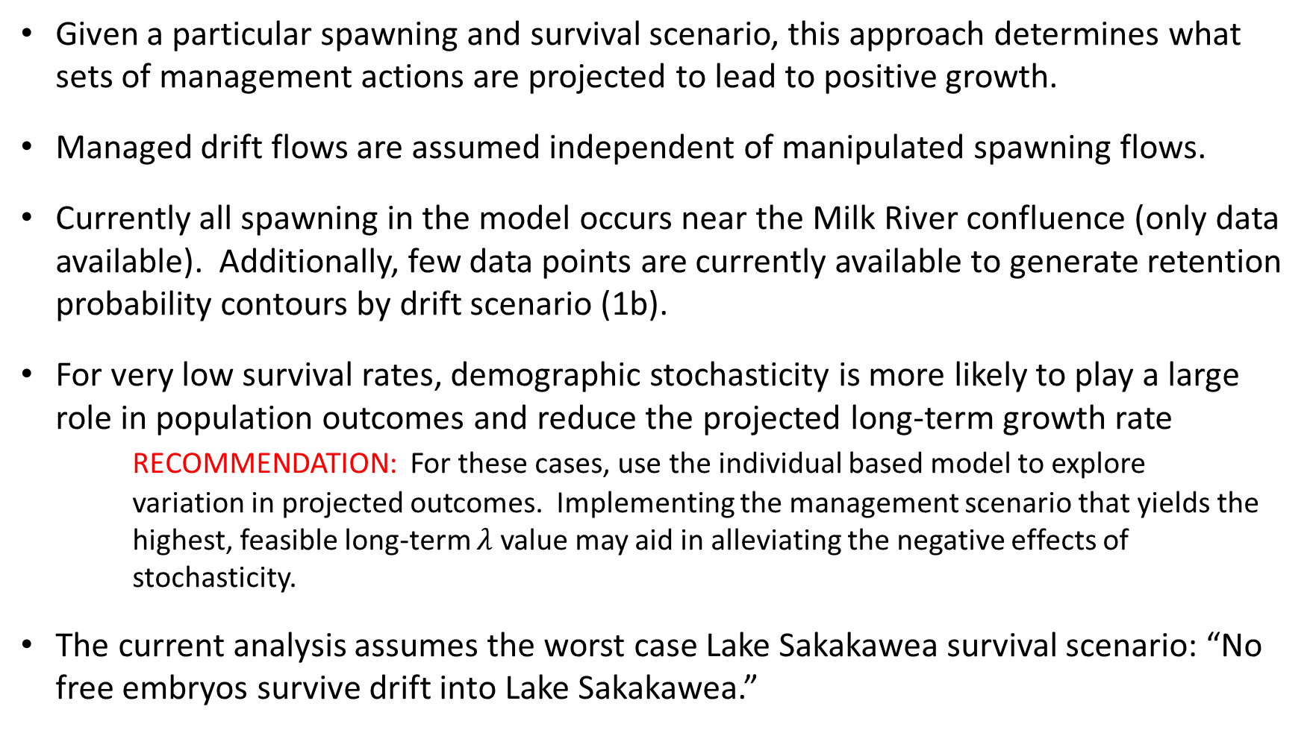
Conclusions and Caveats
Given a particular spawning and survival scenario, this approach determines what sets of management actions are projected to lead to positive growth.
Managed drift flows are assumed independent of manipulated spawning flows.
Currently all spawning in the model occurs near the Milk River confluence (only data available). Additionally, few data points are currently available to generate retention probability contours by drift scenario (1b).
For very low survival rates, demographic stochasticity is more likely to play a large role in population outcomes and reduce the projected long-term growth rate
RECOMMENDATION: For these cases, use the individual based model to explore variation in projected outcomes. Implementing the management scenario that yields the highest, feasible long-term $λ$ value may aid in alleviating the negative effects of stochasticity.
The current analysis assumes the worst case Lake Sakakawea survival scenario: “No free embryos survive drift into Lake Sakakawea.”

Slide 21
Some naive flow questions
The set of management actions projected to lead to population growth can be rather sensitive to relatively small changes in mean velocity.
How difficult is it for a flow manipulation to obtain a target mean velocity? Is there a way to measure the error distribution? Or is this somehow already accounted for in the hydraulic solution?
Does the variance in water velocities have a large effect on the drift results? If so, are water velocity variances expected to be relatively the same for a given flow manipulation from year to year?
Mean velocity = mean river velocity? (or mean drift velocity)
If spawning flow manipulations precede drift flow manipulations, how quickly after switching flow strategies would changes in mean water velocity and temperature occur?
Would it be difficult/time consuming to determine a lower boundary for spawning sites given flow scenarios?

