Slide 1
A First Attempt at a UMOR Viability Box for Drift
Presented by Sara Reynolds
Ft. Peck Fish Modelling Discussion
6/28/2019

Slide 2
2) Define draft hypothesized biologically viable windows
From Dave Marmorek, Craig Fischenich, and Graham Long’s “Thoughts on Ft. Peck flow tests” power point:
Hypothesis: there exists a window (shown here as a box but form is unknown) of biologically viable combos of flow, temp, turb for each of a)spawning and b)drift
1) Collate / update + analyze available data on F, T, Turb etc
2) Define hypothesized biologically viable windows
3) Identify desired hydro changes to create windows
4) Consider possible hydro changes to create windows
7) Implement and monitor experiments
5) Predict fish benefits from possible changes using model
6) Define detailed experiments
Temp
Flow
Turbidity

Slide 3
From Dave Marmorek, Craig Fischenich, and Graham Long’s “Thoughts on Ft. Peck flow tests” power point:
Hypothesis: there exists a window (shown here as a box but form is unknown) of biologically viable combos of flow, temp, and turbidity for each of:
Spawning
Drift
Temp
Flow
Turbidity

Slide 4
From Dave Marmorek, Craig Fischenich, and Graham Long’s “Thoughts on Ft. Peck flow tests” power point:
Hypothesis: there exists a window (shown here as a box but form is unknown) of biologically viable combos of flow, temp, and turbidity for each of:
Spawning
Drift
Temp
We currently do not have a functional relationship between turbidity and age-0 survival.
We expect:
Turbidity = Predation = Survival
Flow
Turbidity

Slide 5
From Dave Marmorek, Craig Fischenich, and Graham Long’s “Thoughts on Ft. Peck flow tests” power point:
Hypothesis: there exists a window (shown here as a box but form is unknown) of biologically viable combos of flow, temp, and turbidity for each of:
Spawning
Drift
Temp
We currently do not have a functional relationship between turbidity and age-0 survival.
We expect:
Turbidity = Predation = Survival
As a first approach, we’ll use age-0 survival (within the free flowing Missouri) as a proxy for turbidity.
Flow
Age-0 Survival

Slide 6
A few caveats to keep in mind when using “Age-0 Survival” as a proxy for “Turbidity”:
Unless the relationship between turbidity and age-0 survival is linear, the shape of the viability box in terms of turbidity will differ (by some transformation) from that presented here.
This approach assumes age-0 survival is independent of velocity and temperature.
In reality turbidity, velocity, and temperature may all interact to effect mortality due to predation, or other aspects of survival.
These relationships would also change the form of the viability box and may warrant further exploration and modelling if expected to be important.

Slide 7
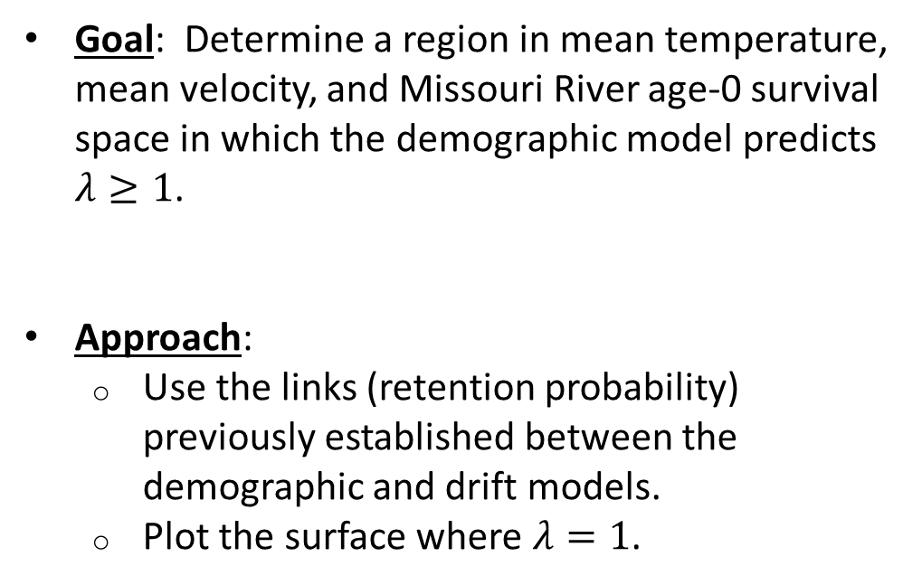
Building the Drift Viability Box
Goal: Determine a region in mean temperature, mean velocity, and Missouri River age-0 survival space in which the demographic model predicts $λ≥1$.
Approach:
Use the links (retention probability) previously established between the demographic and drift models.
Plot the surface where $λ=1$.
Temp
Flow
Age-0 Survival

Slide 8
Model Variables
Demographic Model
Sex Ratio
Maturation Age
Maximum Age
Age-1+ Survivals
Missouri River Age-0 Survival
Fertilized Eggs per Mature Female per Year
Drift Model (Simplified)
Average Velocity
Average Temperature
Lake Sakakawea RM

Slide 9
Model Variables
Axis Variable
Demographic Model
Sex Ratio
Maturation Age
Maximum Age
Age-1+ Survivals
Missouri River Age-0 Survival (proxy for turbidity)
Fertilized Eggs per Mature Female per Year
Drift Model (Simplified)
Average Velocity
Average Temperature
Lake Sakakawea RM
Fixed

Slide 10
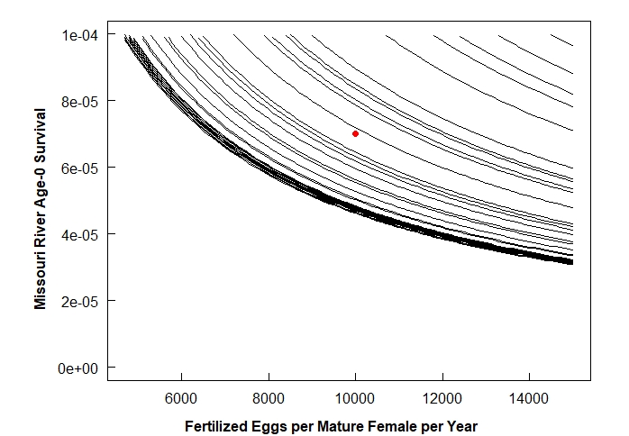




Demographic Model
$$p_{ret}=0.319$$
$$p_{ret}=0.515$$
$$p_{ret}=1$$
$$p_{ret}=0.715$$
For a given retention probability curve, we expect:
Growth: Right/Above Curve
Decline: Left/Below Curve

Slide 11
Demographic Model
$$p_{ret}=0.319$$
$$p_{ret}=0.515$$
Missouri River Age-0 Survival
$$p_{ret}=1$$
$$p_{ret}=0.715$$
Vary Age-0 Survival from 0.00005 to 0.0001.
Fix x-axis variable at 10,000.
Fertilized Eggs per Mature Female per Year

Slide 12
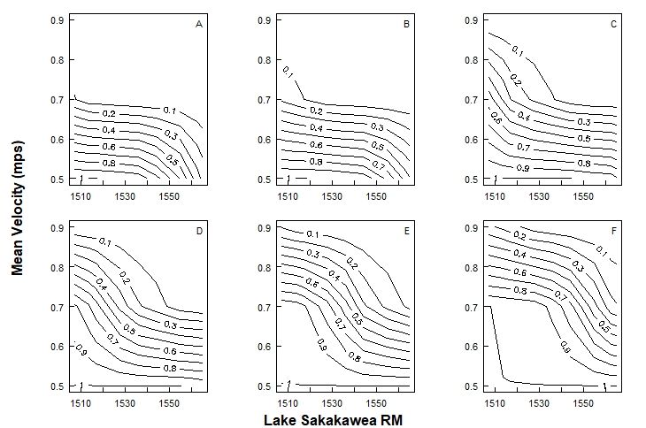






Drift Model
$$14℃$$
$$16℃$$
$$18℃$$
$$20℃$$
$$22℃$$
$$24℃$$

Slide 13






Drift Model
$$14℃$$
$$16℃$$
$$18℃$$
Mean Velocity (mps)
$$20℃$$
$$22℃$$
$$24℃$$
Lake Sakakawea RM

Slide 14
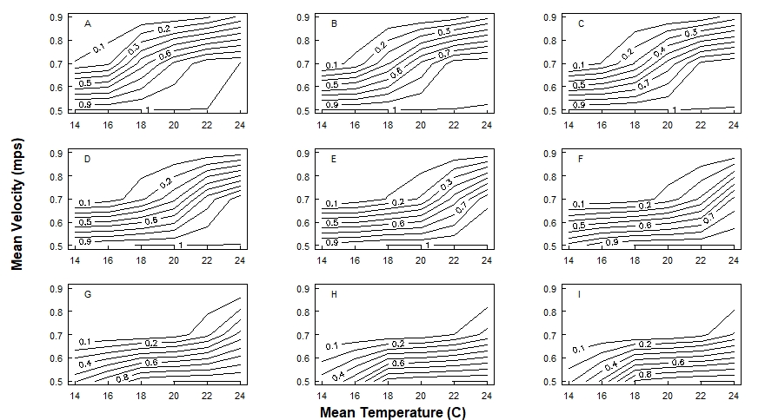
Drift Model
LS RM 1507.01
LS RM 1513.37
LS RM 1516.58
LS RM 1527.40
LS RM 1535.89
LS RM 1544.17
Mean Velocity (mps)
LS RM 1555.04
LS RM 1562.68
LS RM 1564.87
Mean Temperature (C)

Slide 15
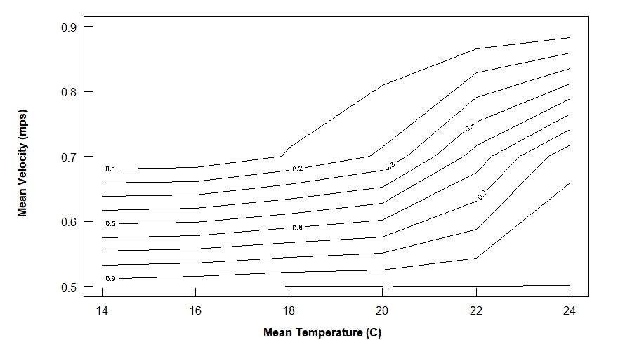
Drift Model

Slide 16
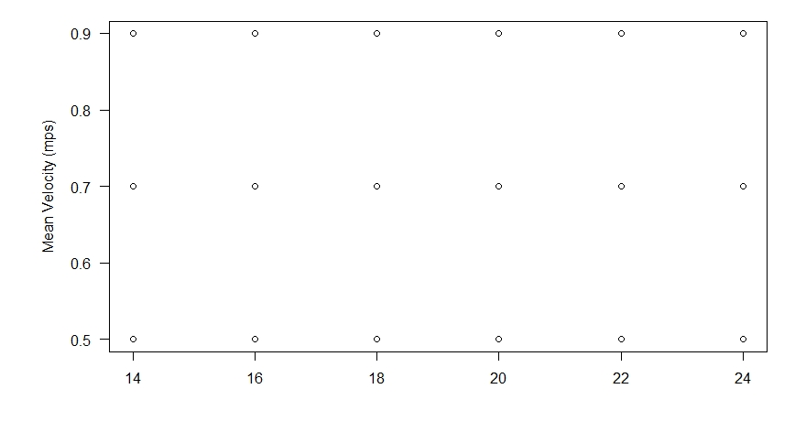
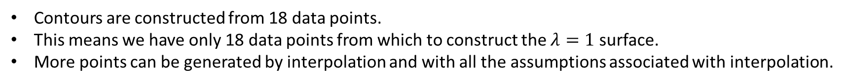
Drift Model
Contours are constructed from 18 data points.
This means we have only 18 data points from which to construct the $λ=1$ surface.
More points can be generated by interpolation and with all the assumptions associated with interpolation.
0
0
0.003
0.005
0.009
0.029
0.009
0.017
0.107
0.215
0.544
0.874
0.956
0.974
1
1
1
1
Mean Temperature (C)

Slide 17
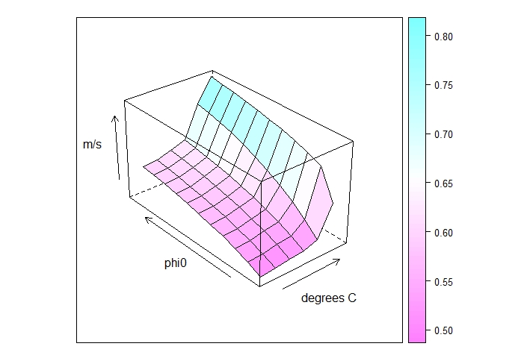
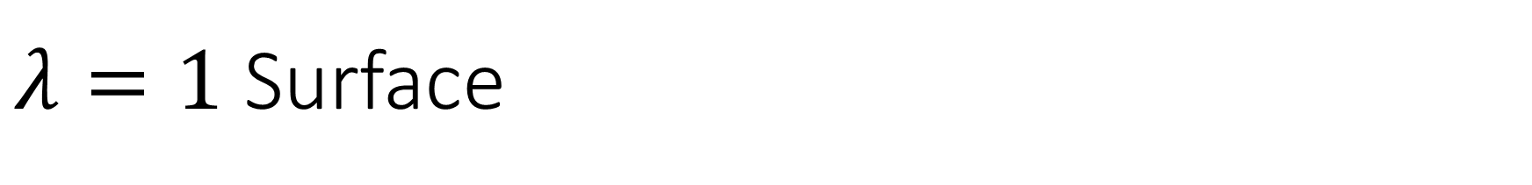
$λ=1$ Surface
Axes:
x – mean temperature (°C)
y – age-0 survival (phi0)
z – mean velocity (m/s)

Slide 18
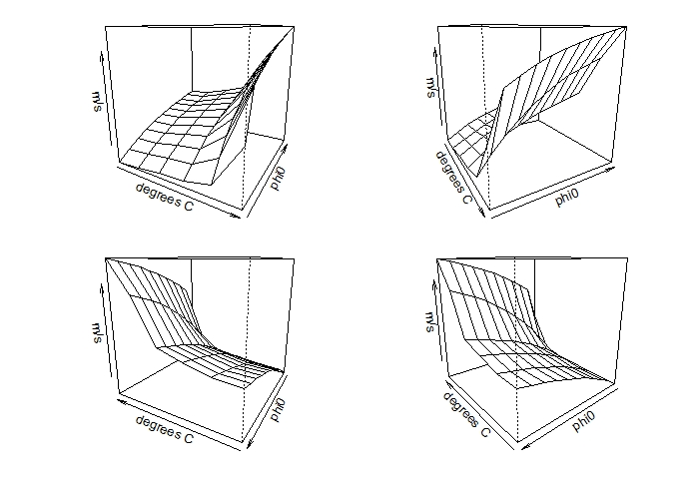
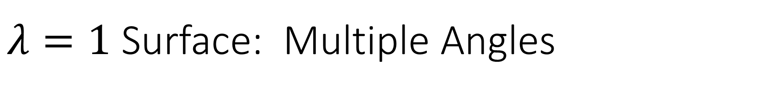
$λ=1$ Surface: Multiple Angles
Axes:
x – mean temperature (°C)
y – age-0 survival (phi0)
z – mean velocity (m/s)

Slide 19
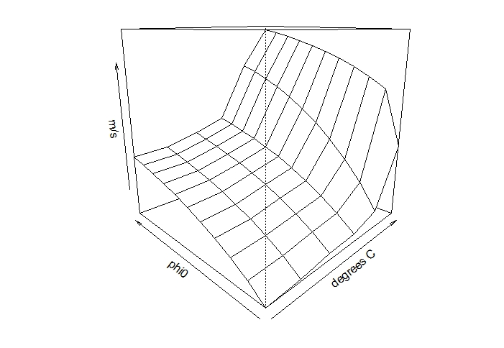
From the Surface to a “Box”
Slower mean velocities will be viable (higher retention probabilities and greater long-term $λ$ values).
Axes:
x – mean temperature (°C)
y – age-0 survival (phi0)
z – mean velocity (m/s)

Slide 20
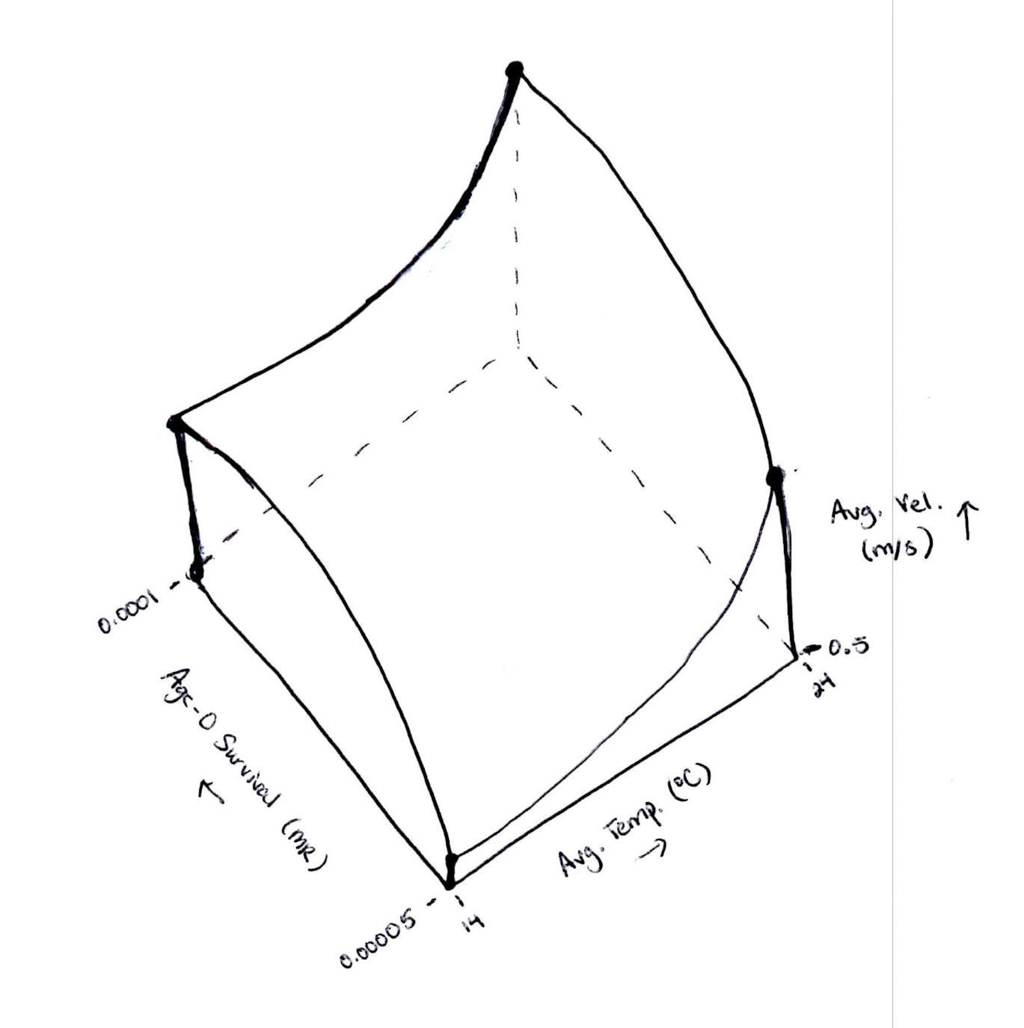
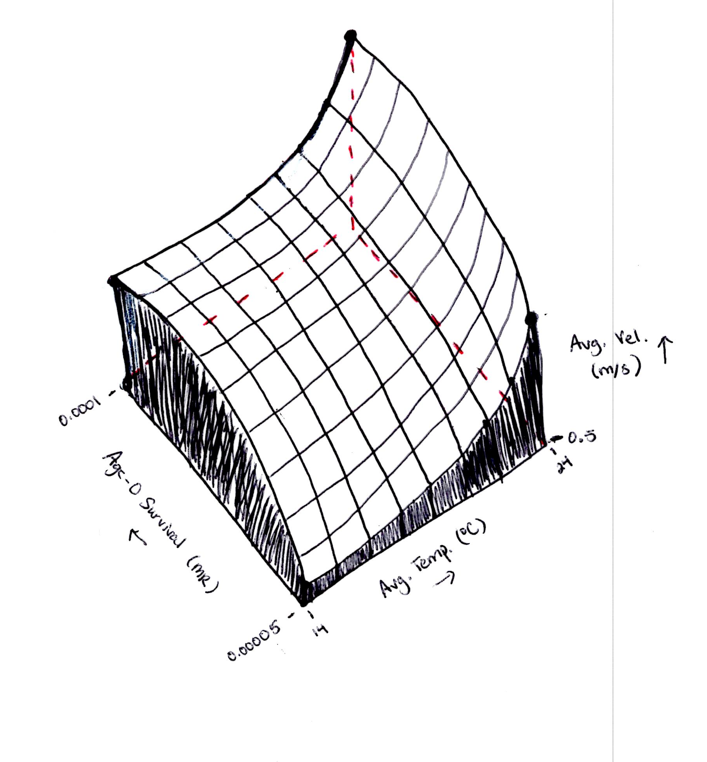
From the Surface to a “Box”
Slower mean velocities will be viable (higher retention probabilities and greater long-term $λ$ values).
(For visualization purposes only. Not to scale.)

Slide 21
Comments
There are many approaches to plotting the box. Some that I attempted in earlier versions of this work did not plot due to lack of data.
Plotting the surface is a bit clunky and requires different approaches (code wise) for plotting vantage points (at least for how I did it in R).
Various uncertain parameters (sex ratio, maturation age, maximum age, age-1+ survivals, number of fertilized eggs per mature female per year, and Lake Sakakawea RM) were fixed to produce the surface and associated viability box. It will be important to see how varying these parameters changes the shape of the box.

