Slide 1
Lower Missouri River Population Model Parameterization
DRAFT 10/11/21

Slide 2
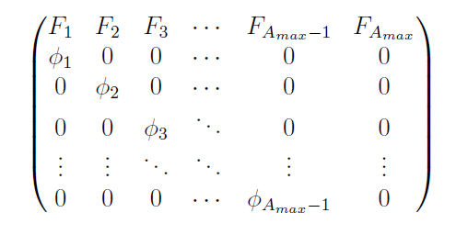
Leslie Matrix Model
maximum age
Age-Specific Fertilities
Age-Specific Survivals

Slide 3
Maximum Age
Currently set at 41
Value typically used by LMR models (e.g., Wildhaber et al. 2017; Steffensen et al. 2013) based on work by Keenlyne et al. (1992)
39 (34-49, 95% CI) given by Hamel et al. 2020
Will look at consequences of varying within between 34-49

Slide 4
Age-Specific Survivals: Approach
For ages 3+, use a growth model to estimate the proportion of each age class that is <600mm, 600-800mm, and >800mm
These proportions combined with survival estimates for juveniles, subadults, and adults give the age-specific survival
All age-2 are assumed juveniles (only transition from age-1 is to juvenile)
All fish ages 3-7 are assumed to be either juveniles or subadults (minimum maturation age is 8)
Minimum age for subadults could also be set based on observations or a minimum probability

Slide 5

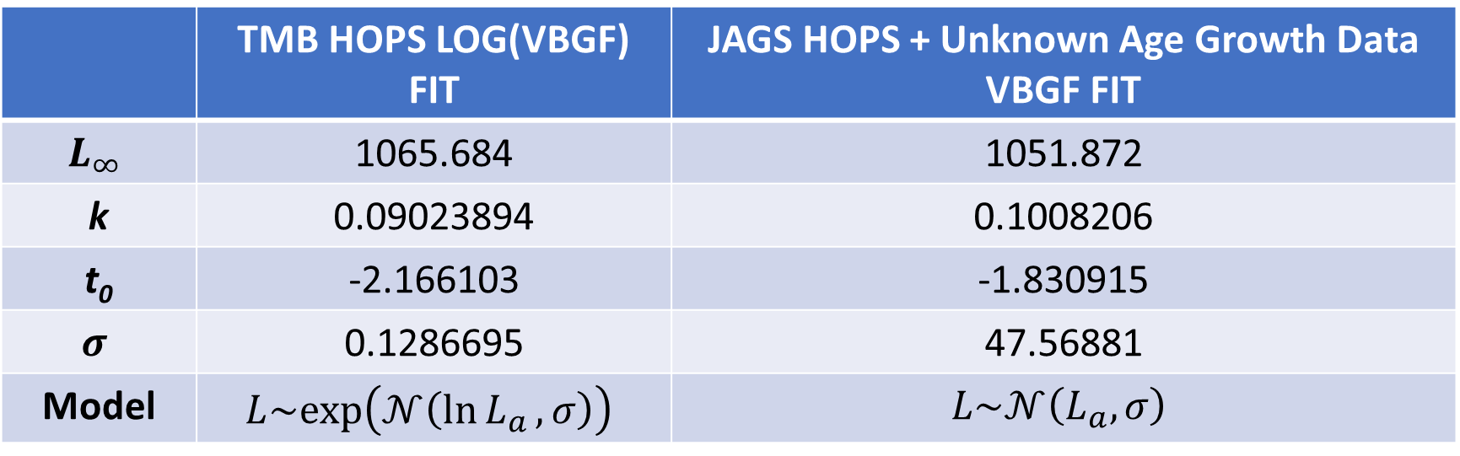
Age-Specific Survivals: Growth Models
 | TMB HOPS LOG(VBGF) FIT | JAGS HOPS + Unknown Age Growth Data VBGF FIT
$$L_{∞}$$ | 1065.684 | 1051.872
k | 0.09023894 | 0.1008206
t₀ | -2.166103 | -1.830915
$$σ$$ | 0.1286695 | 47.56881
Model | $$L\sim exp⁡\left(𝒩\left(\ln{L_{a}},σ\right)\right)$$ | $$L\sim 𝒩\left(L_{a},σ\right)$$
$$L_{a}=L_{∞⁡}\left(1−e^{−k\left(a−t_{0}\right)}\right)$$

Slide 6
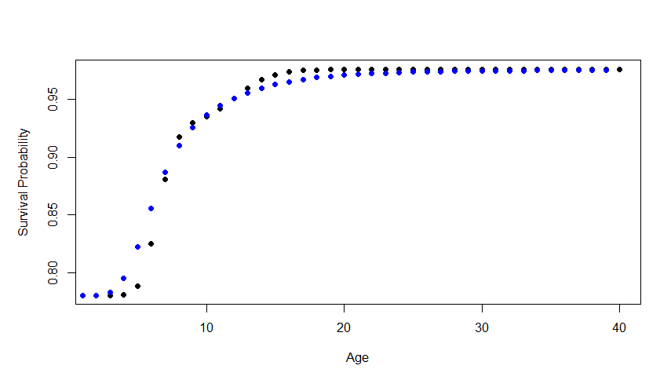
Age-Specific Survivals: Estimates

Slide 7
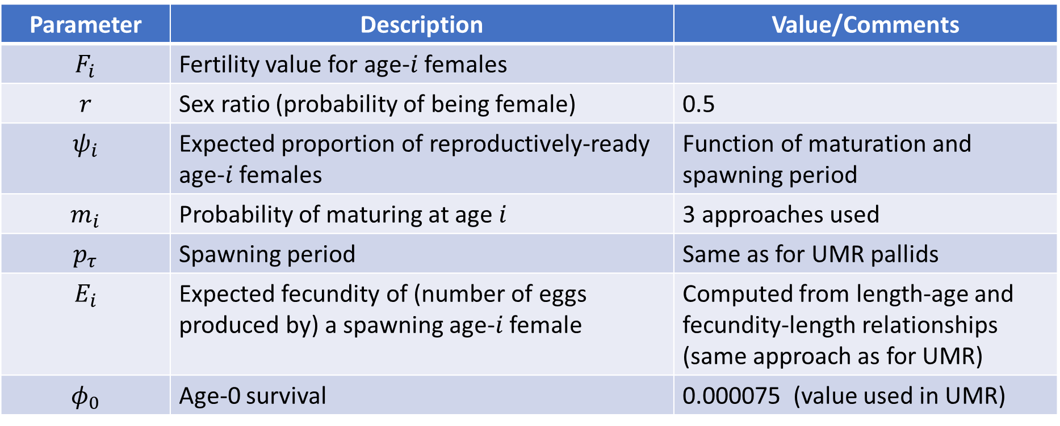
Age-Specific Fertilities: Approach
$$F_{i}=r∙ψ_{i}\left(m_{i} , p_{τ}\right)∙E_{i}∙φ_{0}$$
Parameter | Description | Value/Comments
$$F_{i}$$ | Fertility value for age-$i$ females
$$r$$ | Sex ratio (probability of being female) | 0.5
$$ψ_{i}$$ | Expected proportion of reproductively-ready age-$i$ females | Function of maturation and spawning period
$$m_{i}$$ | Probability of maturing at age $i$ | 3 approaches used
$$p_{τ}$$ | Spawning period | Same as for UMR pallids
$$E_{i}$$ | Expected fecundity of (number of eggs produced by) a spawning age-$i$ female | Computed from length-age and fecundity-length relationships (same approach as for UMR)
$$φ_{0}$$ | Age-0 survival | 0.000075 (value used in UMR)

Slide 8
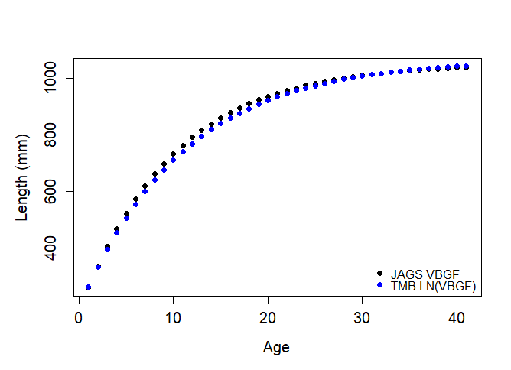
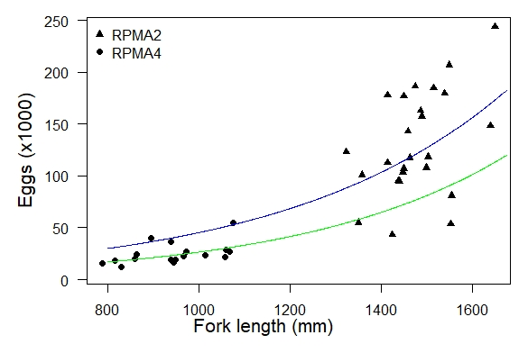
Age-Specific Fertilities
Age-Specific Fecundity (number of eggs per spawning female)
Length-age relationship(s)
Fecundity-length relationship (green)

Slide 9
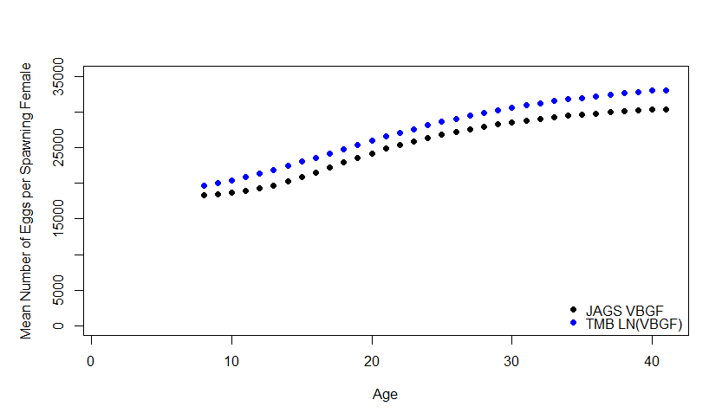
Age-Specific Fertilities
Age-Specific Fecundity (number of eggs per spawning female)

Slide 10
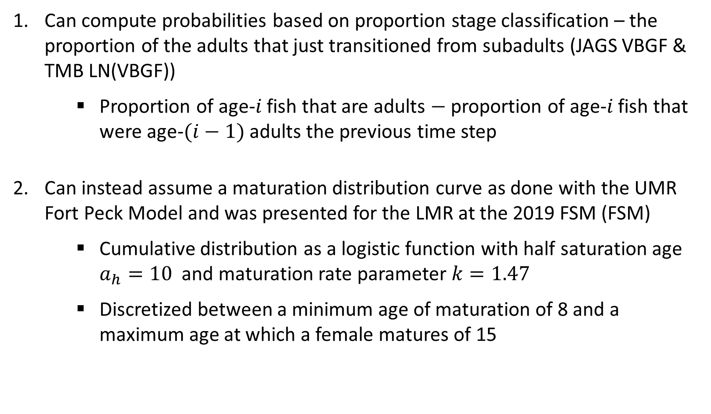
Age-Specific Fertilities
Maturation Age
Can compute probabilities based on proportion stage classification – the proportion of the adults that just transitioned from subadults (JAGS VBGF & TMB LN(VBGF))
Proportion of age-$i$ fish that are adults $−$ proportion of age-$i$ fish that were age-$(i−1)$ adults the previous time step
Can instead assume a maturation distribution curve as done with the UMR Fort Peck Model and was presented for the LMR at the 2019 FSM (FSM)
Cumulative distribution as a logistic function with half saturation age $a_{h}=10$ and maturation rate parameter $k=1.47$
Discretized between a minimum age of maturation of 8 and a maximum age at which a female matures of 15

Slide 11
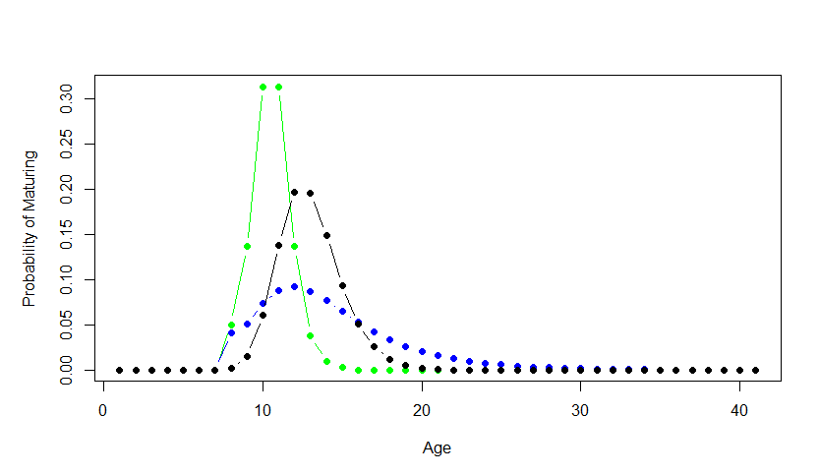
Age-Specific Fertilities
Maturation Age

Slide 12
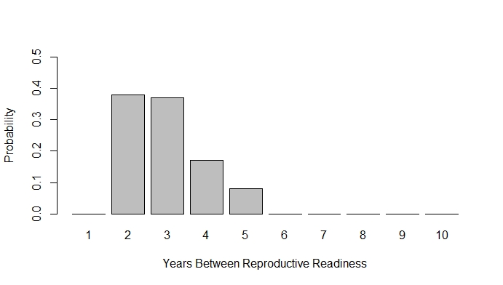
Age-Specific Fertilities
Spawning Period
Distribution of time periods between 2 and 5 years (DeLonay et al. 2016), constructed by combining known Fuller et al. 2007 and DeLonay et al. 2016 data (excluding unknown data)
Assumes a period of 5 years is half as likely as a period of 4 years

Slide 13
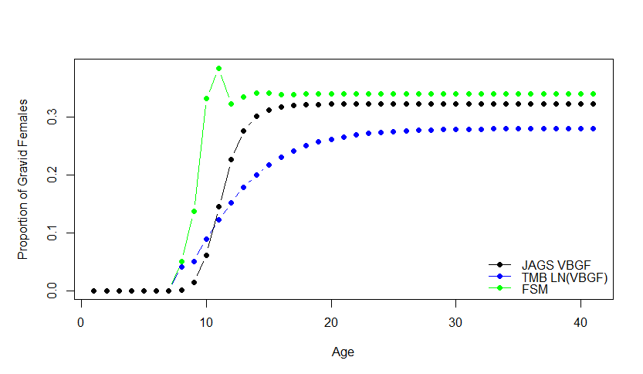
Age-Specific Fertilities
Expected proportion of females that are reproductively ready to spawn

Slide 14
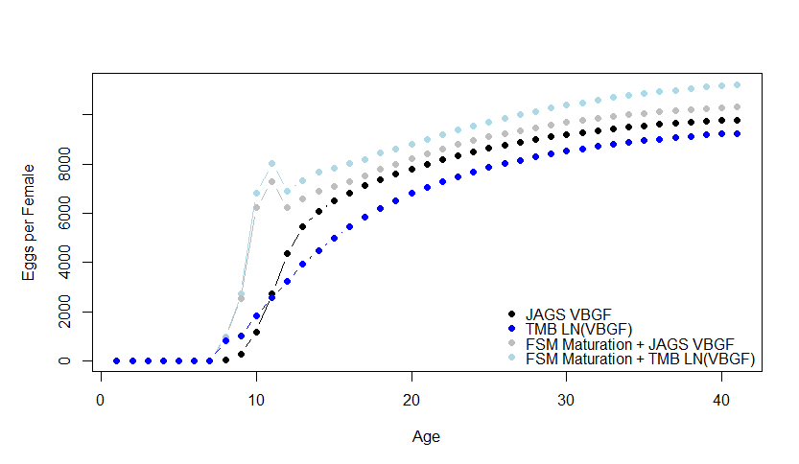
Age-Specific Fertilities
Expected eggs per female by age

