Slide 1
Lower Missouri River Population Model Parameterization
DRAFT 10/11/21

Slide 2
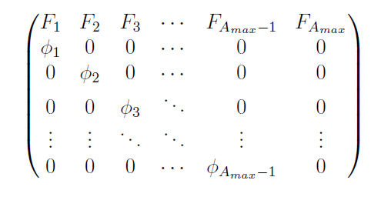
Leslie Matrix Model
maximum age
Age-Specific Fertilities
Age-Specific Survivals

Slide 3
Maximum Age
Currently set at 41
Value typically used by LMR models (e.g., Wildhaber et al. 2017; Steffensen et al. 2013) based on work by Keenlyne et al. (1992)
39 (34-49, 95% CI) given by Hamel et al. 2020
Will look at consequences of varying within between 34-49

Slide 4
Age-Specific Survivals: Approach
For ages 3+, use a growth model to estimate the proportion of each age class that is <600mm, 600-800mm, and >800mm
These proportions combined with survival estimates for juveniles, subadults, and adults give the age-specific survival
All age-2 are assumed juveniles (only transition from age-1 is to juvenile)
All fish ages 3-7 are assumed to be either juveniles or subadults (minimum maturation age is 8)
Minimum age for subadults could also be set based on observations or a minimum probability
Maximum ages for remaining in the juvenile or subadult stages could also be specified

Slide 5

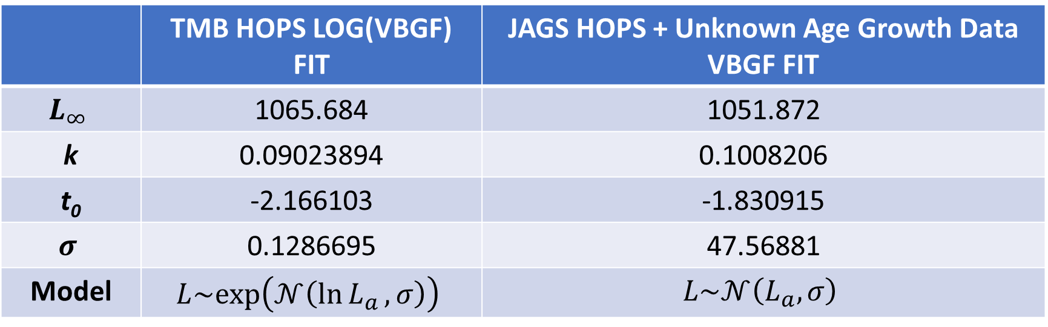
Age-Specific Survivals: Growth Models
 | TMB HOPS LOG(VBGF) FIT | JAGS HOPS + Unknown Age Growth Data VBGF FIT
$$L_{∞}$$ | 1065.684 | 1051.872
k | 0.09023894 | 0.1008206
t₀ | -2.166103 | -1.830915
$$σ$$ | 0.1286695 | 47.56881
Model | $$L\sim exp⁡\left(𝒩\left(\ln{L_{a}},σ\right)\right)$$ | $$L\sim 𝒩\left(L_{a},σ\right)$$
$$L_{a}=L_{∞⁡}\left(1−e^{−k\left(a−t_{0}\right)}\right)$$

Slide 6
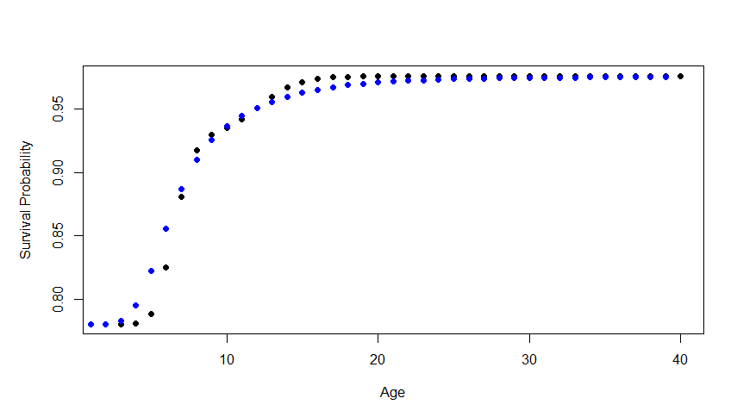
Age-Specific Survivals: Estimates

Slide 7
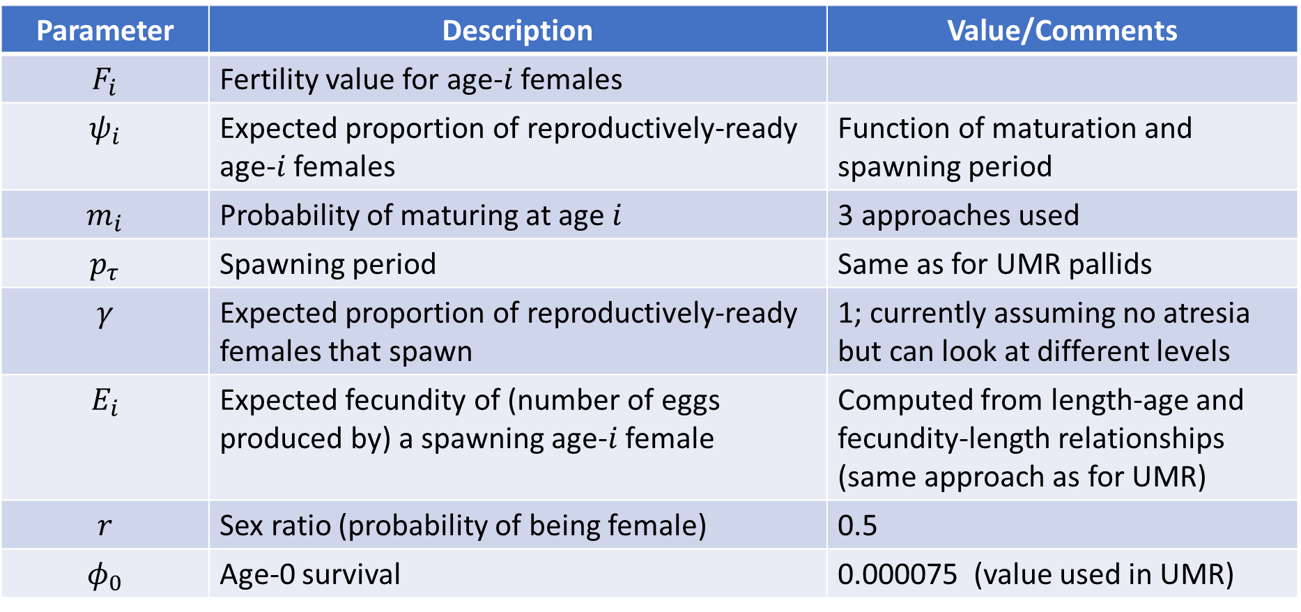
Age-Specific Fertilities: Approach
$$F_{i}=ψ_{i}\left(m_{i} , p_{τ}\right)∙γ∙E_{i}∙r∙φ_{0}$$
Parameter | Description | Value/Comments
$$F_{i}$$ | Fertility value for age-$i$ females
$$ψ_{i}$$ | Expected proportion of reproductively-ready age-$i$ females | Function of maturation and spawning period
$$m_{i}$$ | Probability of maturing at age $i$ | 3 approaches used
$$p_{τ}$$ | Spawning period | Same as for UMR pallids
$$γ$$ | Expected proportion of reproductively-ready females that spawn | 1; currently assuming no atresia but can look at different levels
$$E_{i}$$ | Expected fecundity of (number of eggs produced by) a spawning age-$i$ female | Computed from length-age and fecundity-length relationships (same approach as for UMR)
$$r$$ | Sex ratio (probability of being female) | 0.5
$$φ_{0}$$ | Age-0 survival | 0.000075 (value used in UMR)

Slide 8
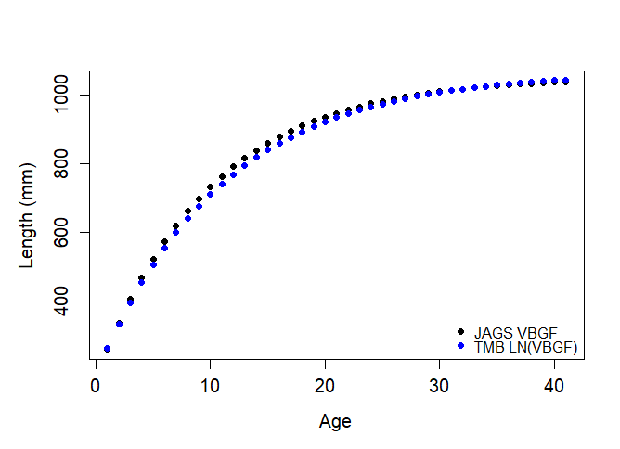
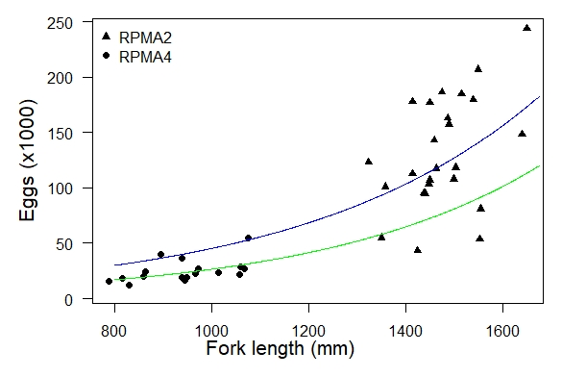
Age-Specific Fertilities
Age-Specific Fecundity (number of eggs per spawning female)
Length-age relationship(s)
Fecundity-length relationship (green)

Slide 9
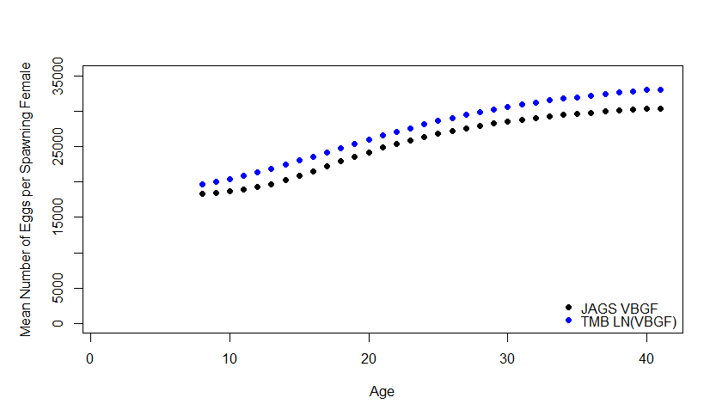
Age-Specific Fertilities
Age-Specific Fecundity (number of eggs per spawning female)

Slide 10
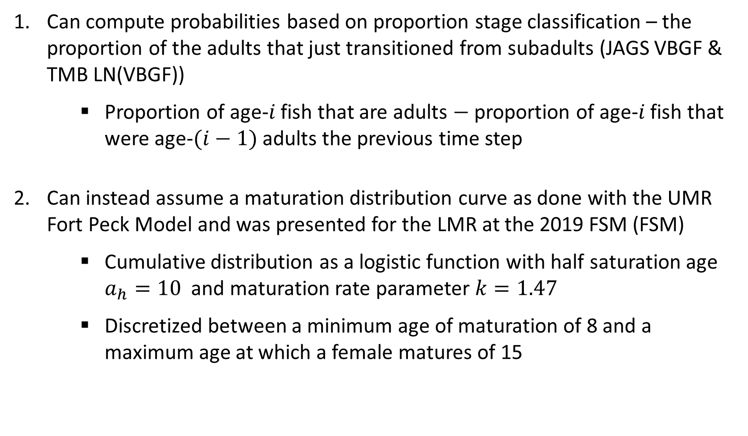
Age-Specific Fertilities
Maturation Age
Can compute probabilities based on proportion stage classification – the proportion of the adults that just transitioned from subadults (JAGS VBGF & TMB LN(VBGF))
Proportion of age-$i$ fish that are adults $−$ proportion of age-$i$ fish that were age-$(i−1)$ adults the previous time step
Can instead assume a maturation distribution curve as done with the UMR Fort Peck Model and was presented for the LMR at the 2019 FSM (FSM)
Cumulative distribution as a logistic function with half saturation age $a_{h}=10$ and maturation rate parameter $k=1.47$
Discretized between a minimum age of maturation of 8 and a maximum age at which a female matures of 15

Slide 11
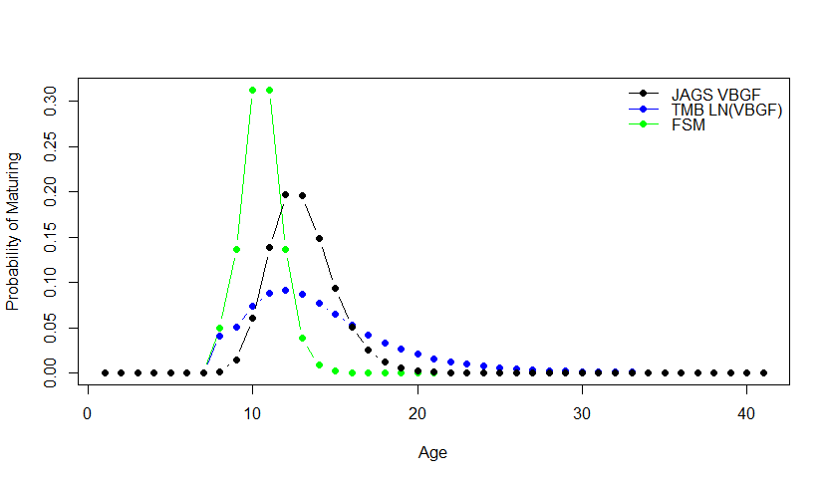
Age-Specific Fertilities
Maturation Age

Slide 12
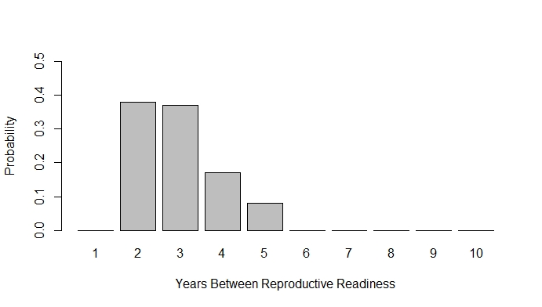
Age-Specific Fertilities
Spawning Period
Distribution of time periods between 2 and 5 years (DeLonay et al. 2016), constructed by combining known Fuller et al. 2007 and DeLonay et al. 2016 data (excluding unknown data)
Assumes a period of 5 years is half as likely as a period of 4 years

Slide 13
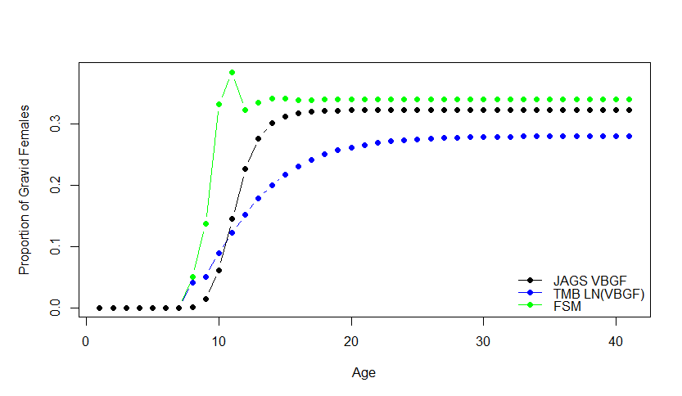
Age-Specific Fertilities
Expected proportion of females that are reproductively ready to spawn

Slide 14
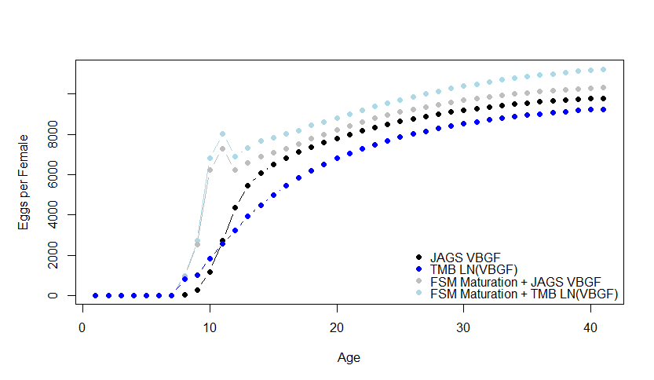
Age-Specific Fertilities
Expected eggs per female by age: $ψ_{i}\left(m_{i} , p_{τ}\right)∙γ∙E_{i}$

Slide 15
Lower Missouri River Population Model Analyses
DRAFT 10/13/21

Slide 16
Model Analyses
Sensitivity analyses
Age-0 survival needed for stability
Growth-decline boundary in terms of age-0 and age-1 survival
Add in maturation age?
Harvest analyses
Stocking analyses

Slide 17
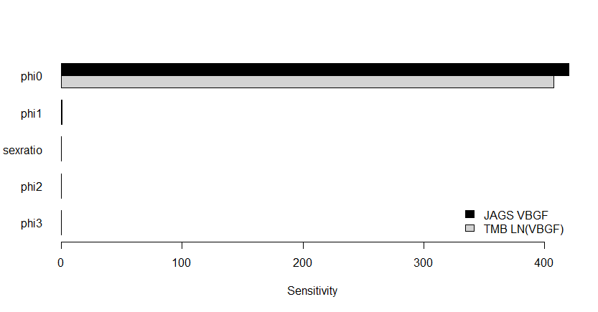
Sensitivity Analyses
One-way sensitivity values: change in long-term lambda with a unit parameter change

Slide 18
Sensitivity Analyses
One-way sensitivity values: change in long-term lambda with a unit parameter change
Most sensitive parameter (phi0: age-0 survival) is also the most uncertain!

Slide 19
Sensitivity Analyses
One-way sensitivity values: change in long-term lambda with a unit parameter change
Most sensitive parameter (phi0: age-0 survival) is also the most uncertain!
Upper River drift study survival estimates and Lower River free-embryo releases aim to reduce uncertainty in this parameter.

Slide 20
Sensitivity Analyses
One-way elasticity values: proportional change in long-term lambda with a proportional change in a parameter value
Parameter | Elasticity Value JAGS VBGF | Elasticity Value TMB ln(VBGF)
Maximum Age | 0.081456 | 0.089307
Age-0 thru Age-7 Survivals Sex Ratio | 0.033442 | 0.032743
*Note: Due to the discrete nature of the maximum age parameter, its elasticity value was computed from an average rate of change as compared to all
other values which were computed from an instantaneous rate of change.

Slide 21
Sensitivity Analyses
One-way elasticity values: proportional change in long-term lambda with a proportional change in a parameter value
Parameter | Elasticity Value JAGS VBGF | Elasticity Value TMB ln(VBGF)
Maximum Age | 0.081456 | 0.089307
Age-0 thru Age-7 Survivals Sex Ratio | 0.033442 | 0.032743
*Note: Due to the discrete nature of the maximum age parameter, its elasticity value was computed from an average rate of change as compared to all
other values which were computed from an instantaneous rate of change.

Slide 22
Age-0 Survival Required For Stability
Baseline parameter values
JAGS VBGF Baseline Parameters | TMB LN(VBGF) Baseline Parameters
0.000384 | 0.000507

Slide 23
Age-0 Survival Required For Stability
Baseline parameter values
JAGS VBGF Baseline Parameters | TMB LN(VBGF) Baseline Parameters
0.000384 | 0.000507
Within the Pine et al. (2001) estimate of 0.0000-0.0004 for gulf sturgeon.
Stabilizing age-0 survivals might be reasonably attainable for the Lower Missouri River pallid sturgeon population.

Slide 24
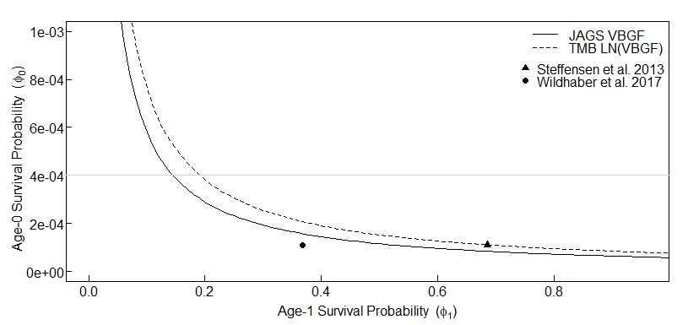
Growth-Decline Boundaries
Age-0 and Age-1 Survival Combinations Above and to the Right of the Curves Support Population Growth (assuming baseline parameter values for all other variables)
Age-0 Survival Upper Bound (Pine et al. 2001)

Slide 25
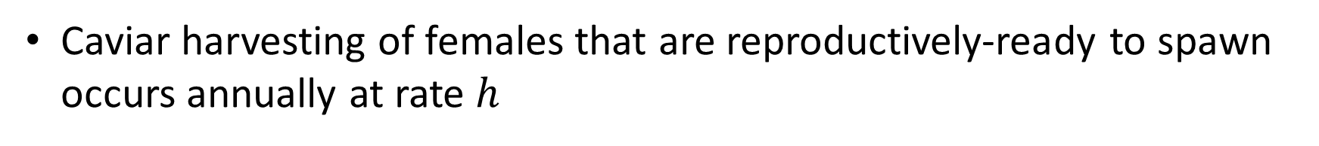
Harvest Analyses
Assumptions
Caviar harvesting of females that are reproductively-ready to spawn occurs annually at rate $h$

Slide 26
Stocking Analyses
TBD

