Slide 1
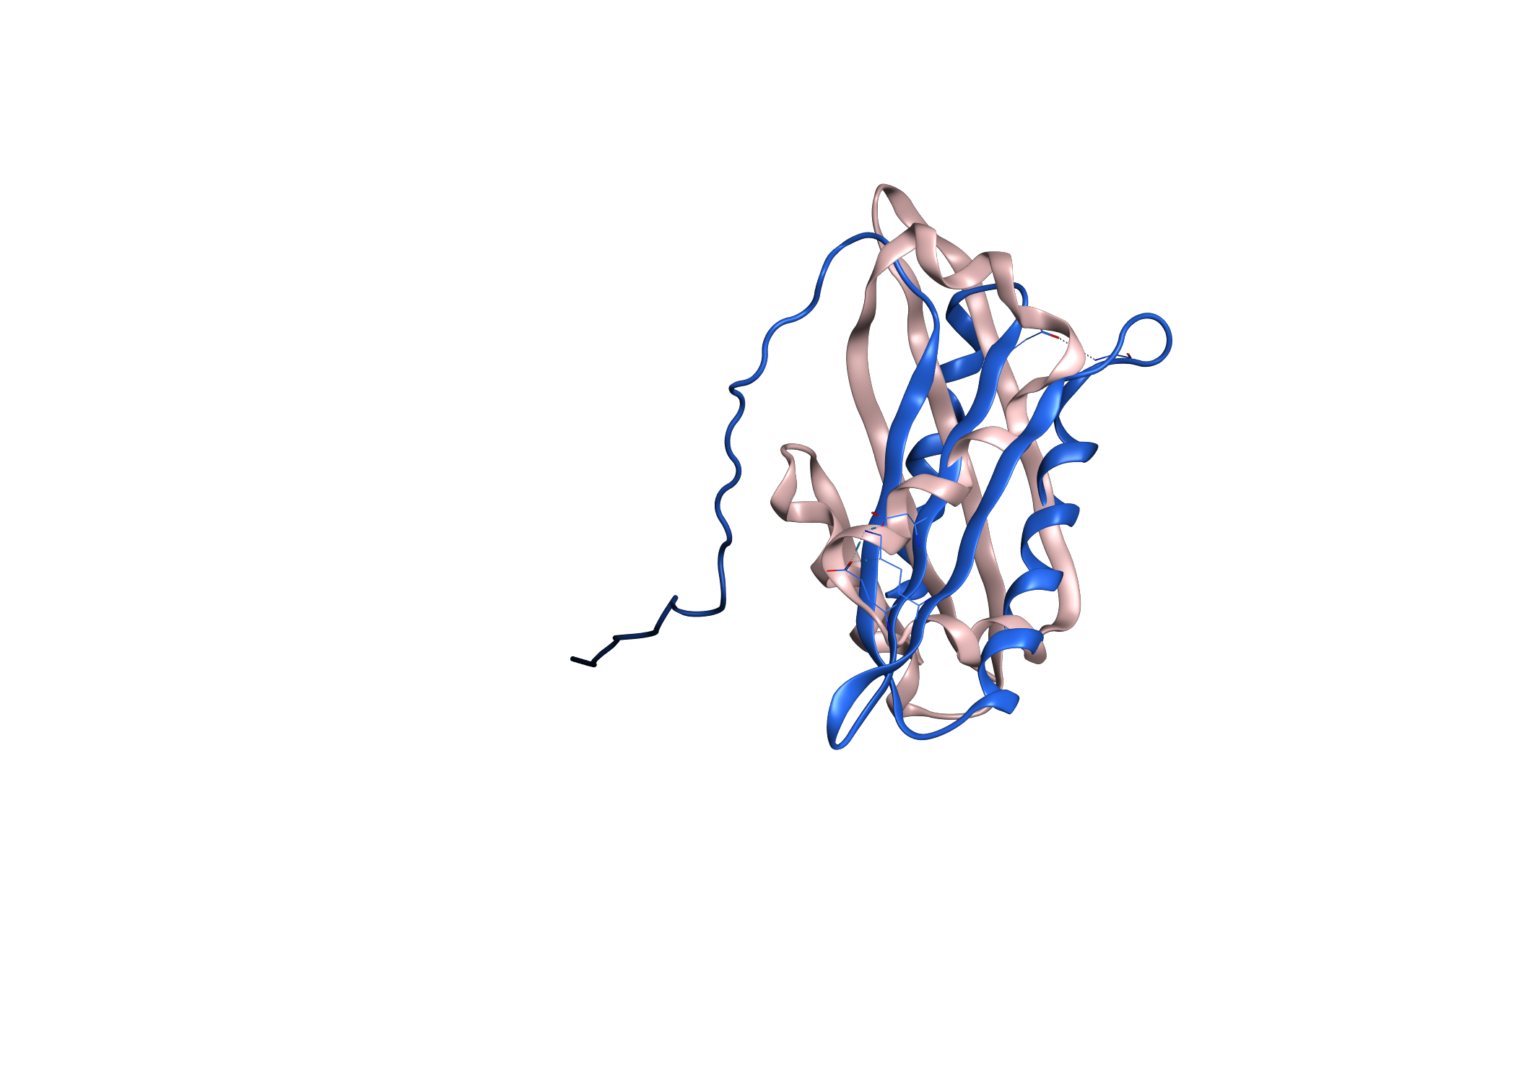
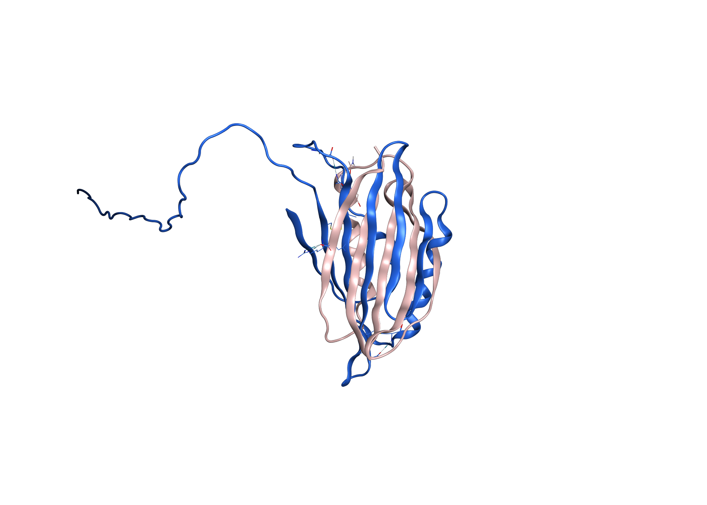
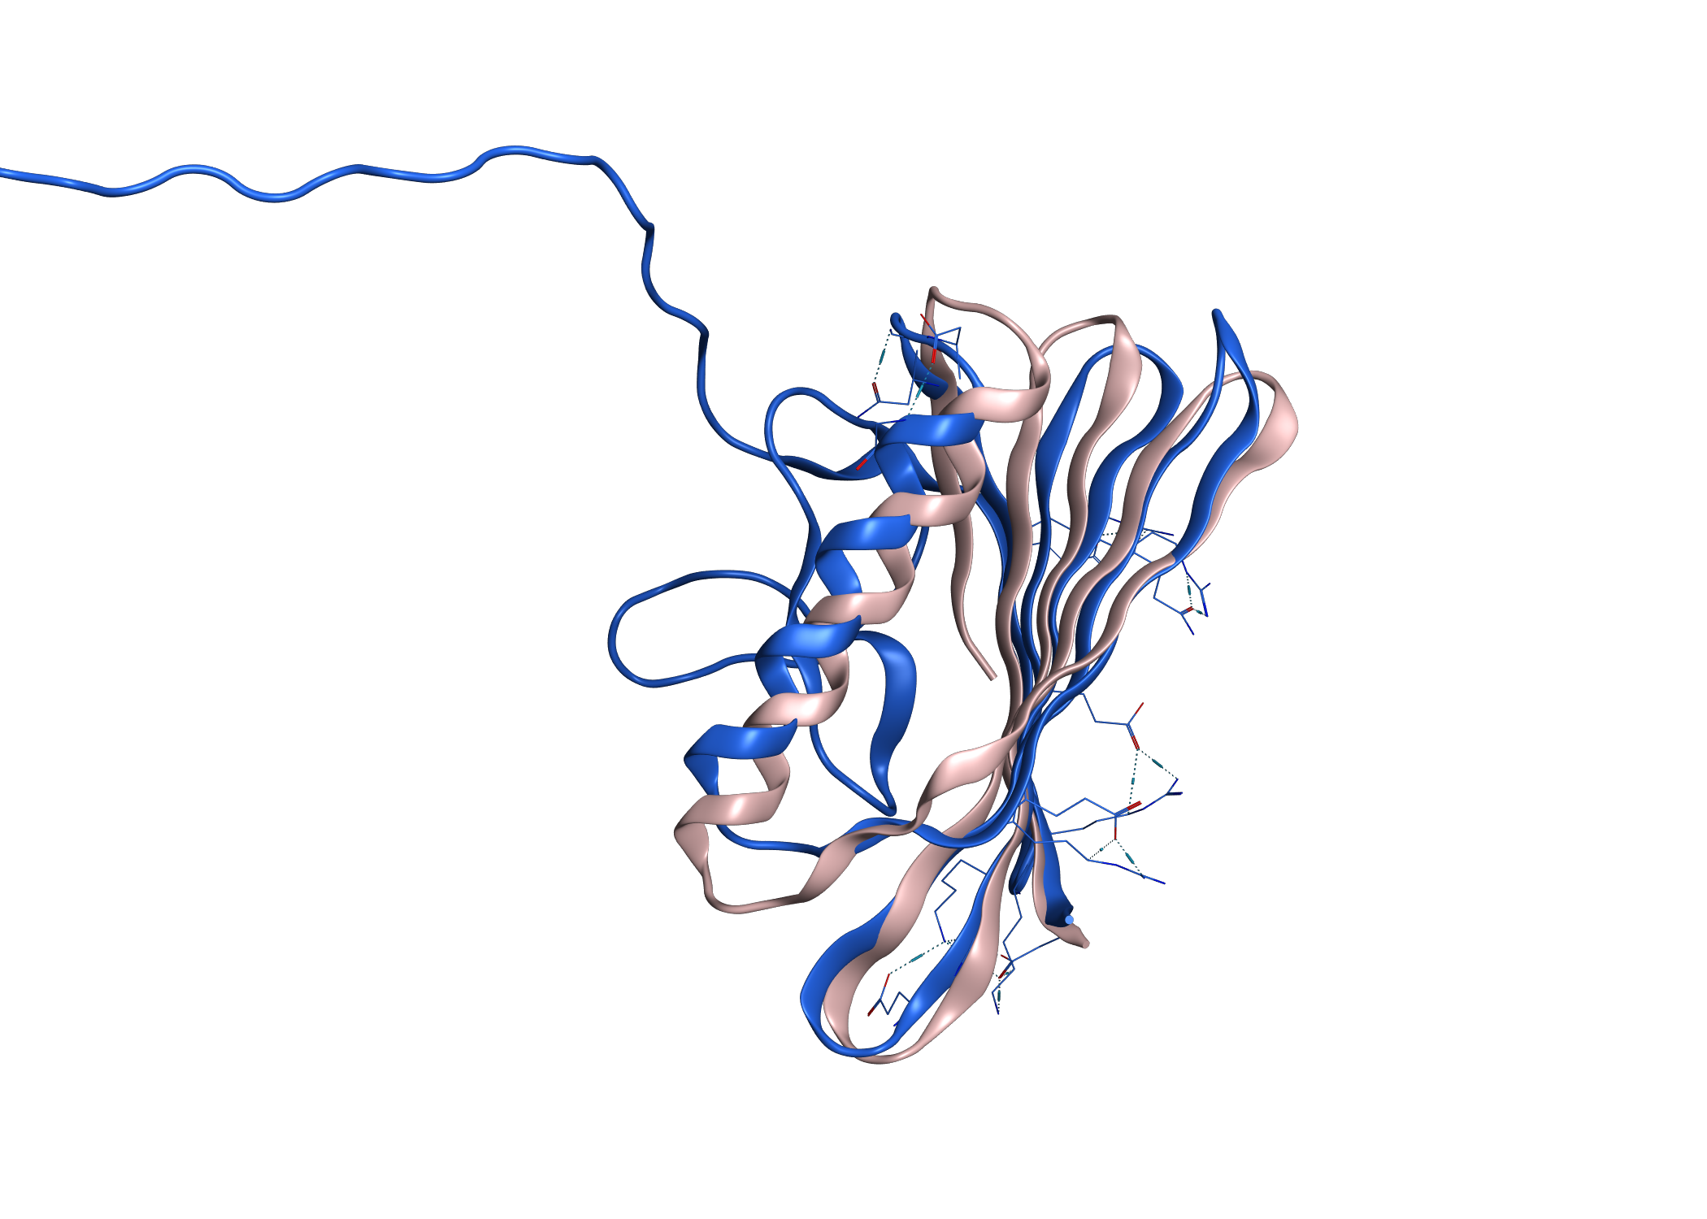
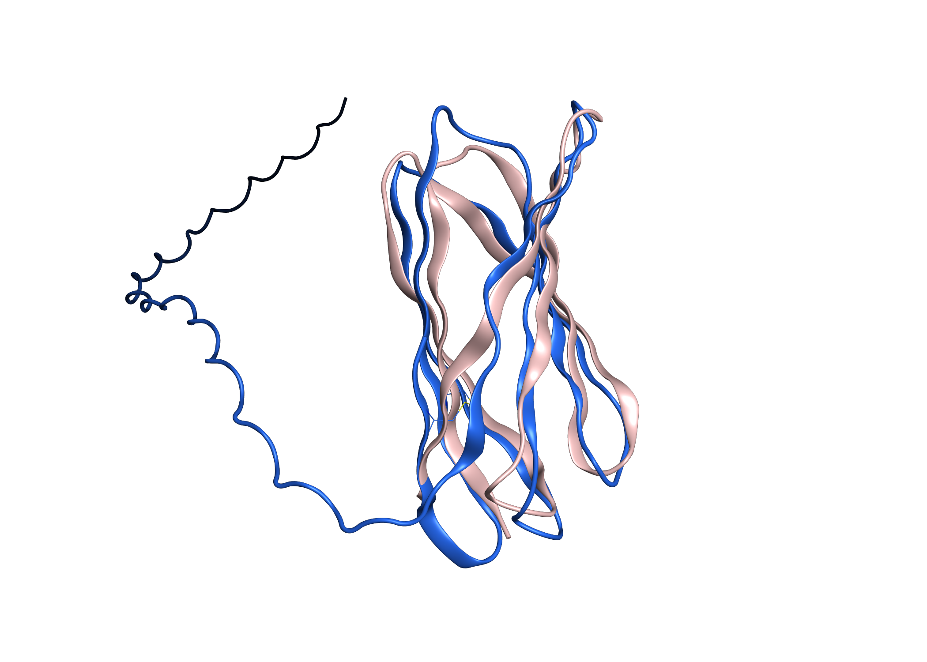
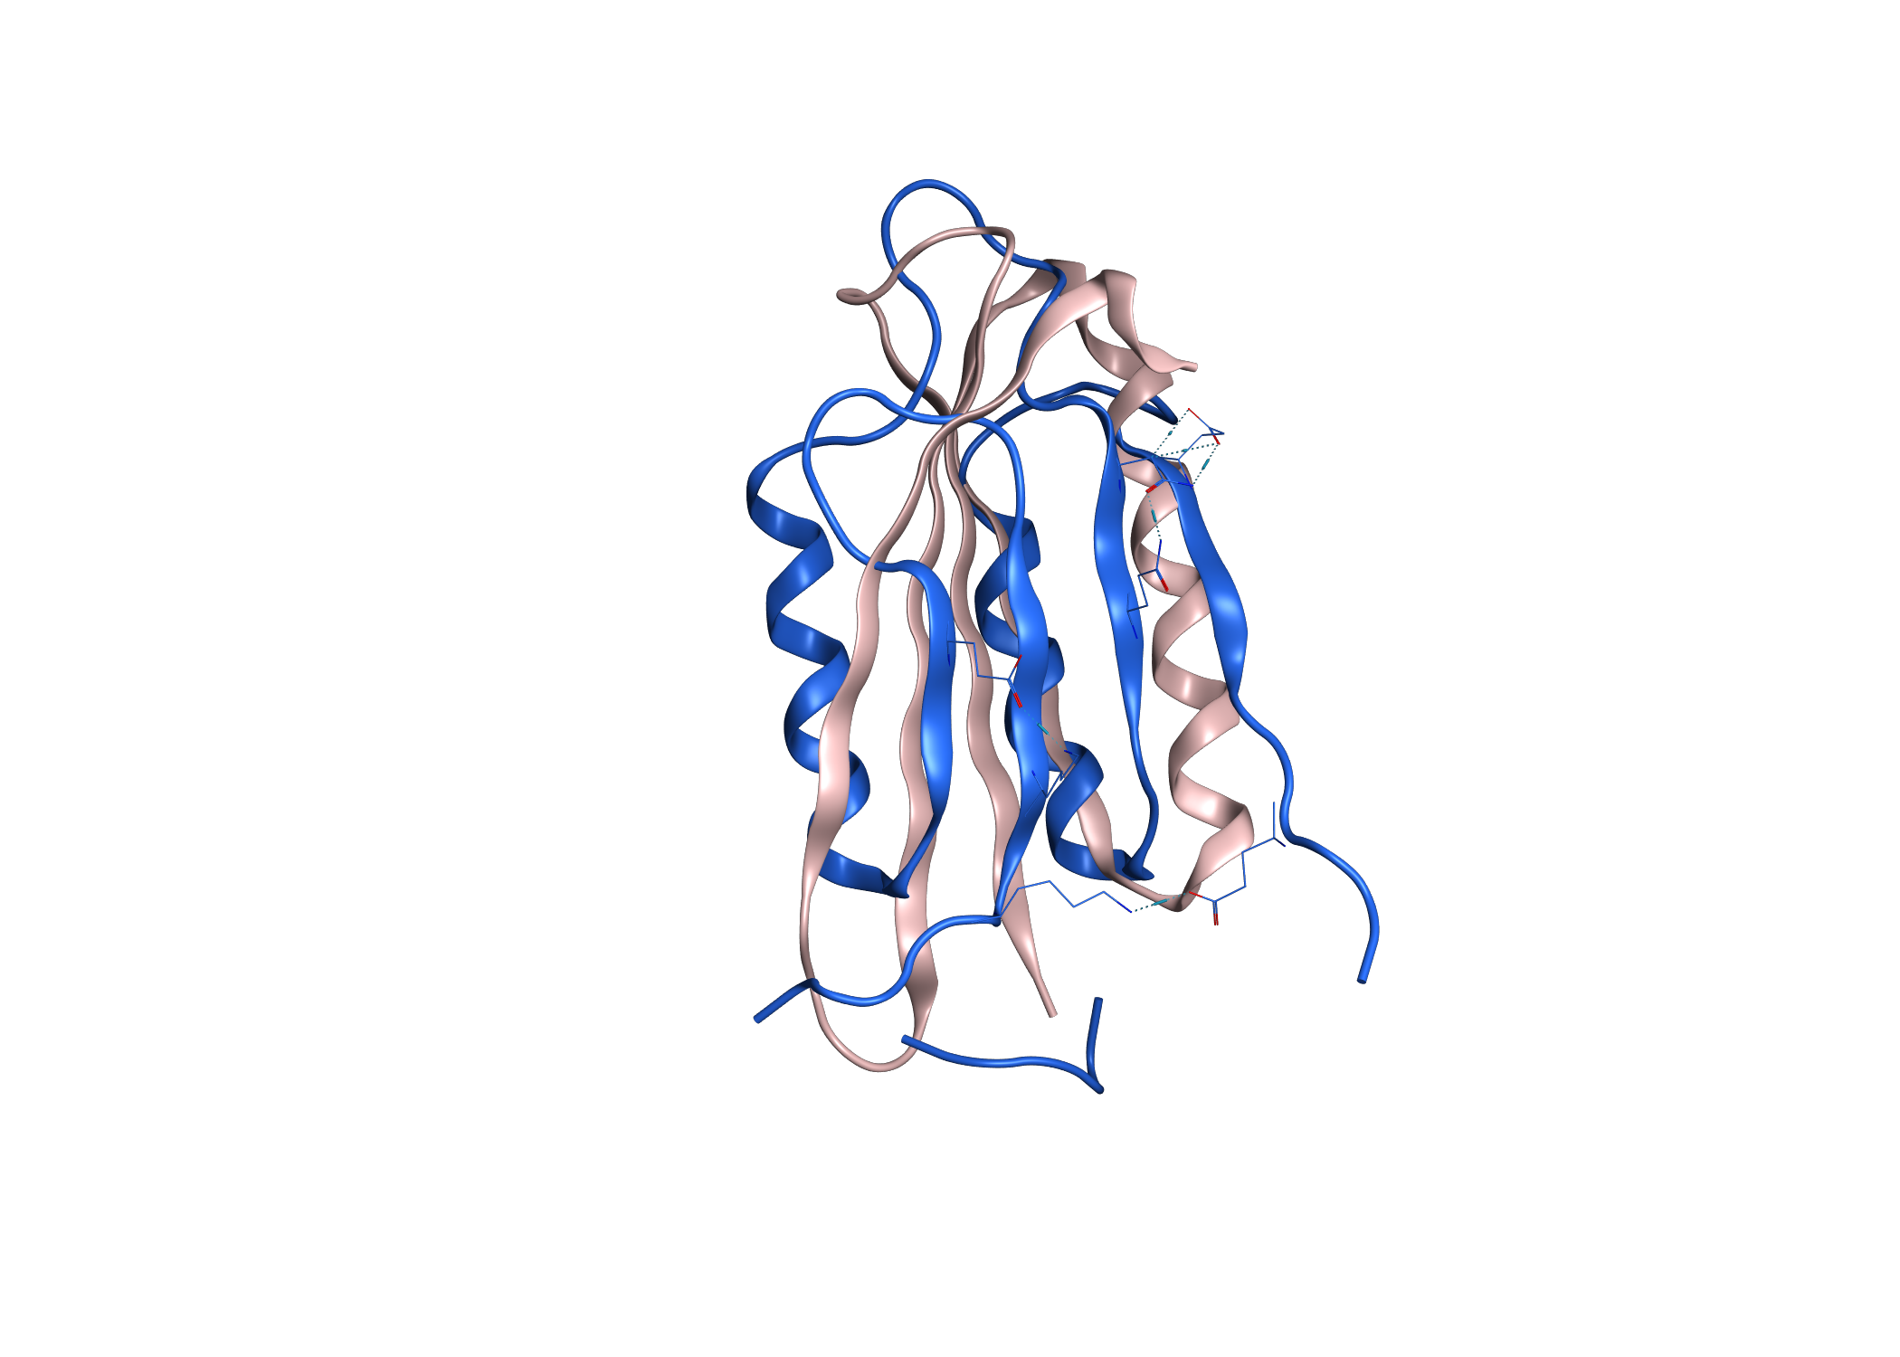
Rank 1
RMSD: 15.04
No hits from Blast P
Rank 2
RMSD: 12.62
No hits from Blast P
Rank 3
RMSD: 2.62
No hits from Blast P
Rank 4
RMSD: 3.01
No hits from Blast P
Rank 4
RMSD: 9.6
No hits from Blast P

