Slide 1

Online Learning application
By Sreytouch Lang(Jessica)

Slide 2
Technologies For Development
Languages: React (ReactJS and React Native) and NodeJS (ExpressJS)
Database: MongoDB
Database UI: MongoDB compass
Authentication: JWT
Testing: Jest
Deployment: Docker, AWS
Testing tool: Postman
GitHub: Coding Management
CI/CD: Project Pipeline and auto-deployment

Slide 3
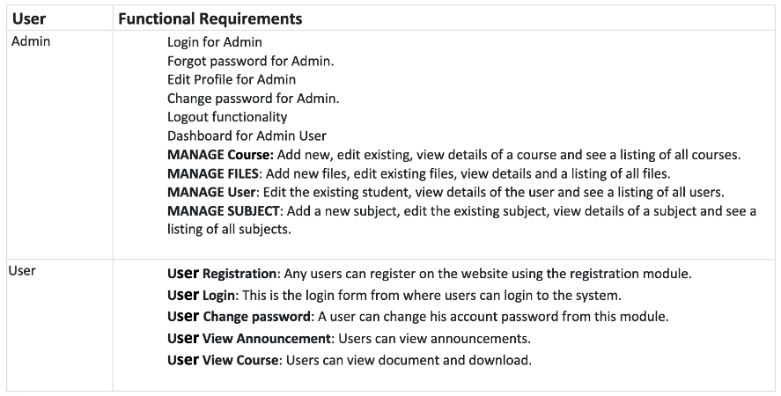
Proposed Modules

Slide 4
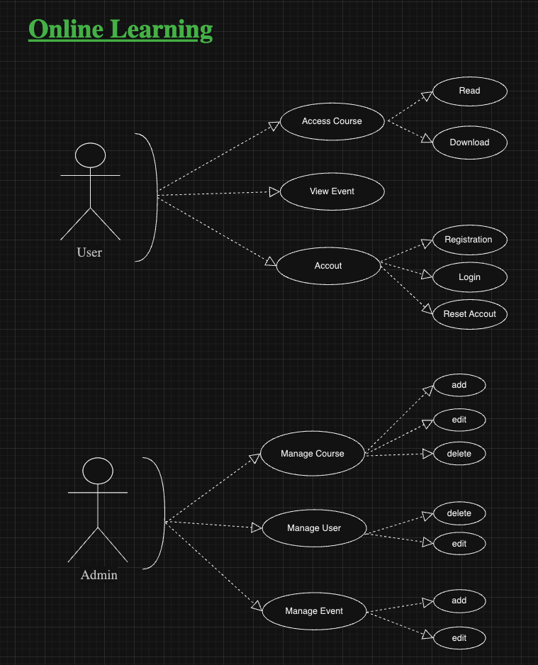
Use Case Diagram

Slide 5
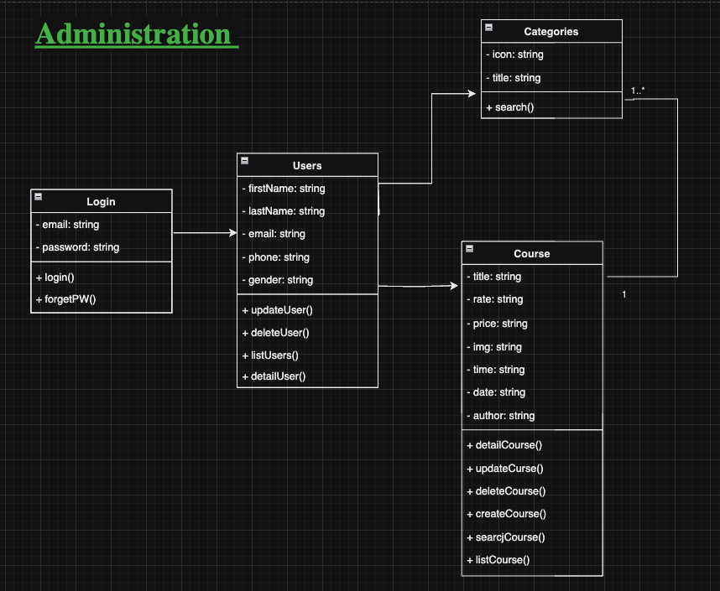
UML

Slide 6
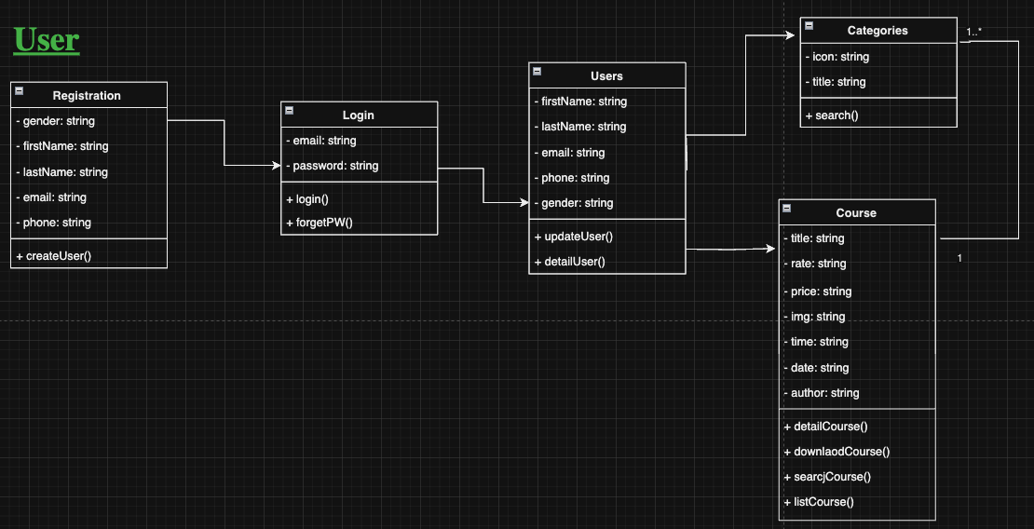
UML

Slide 7
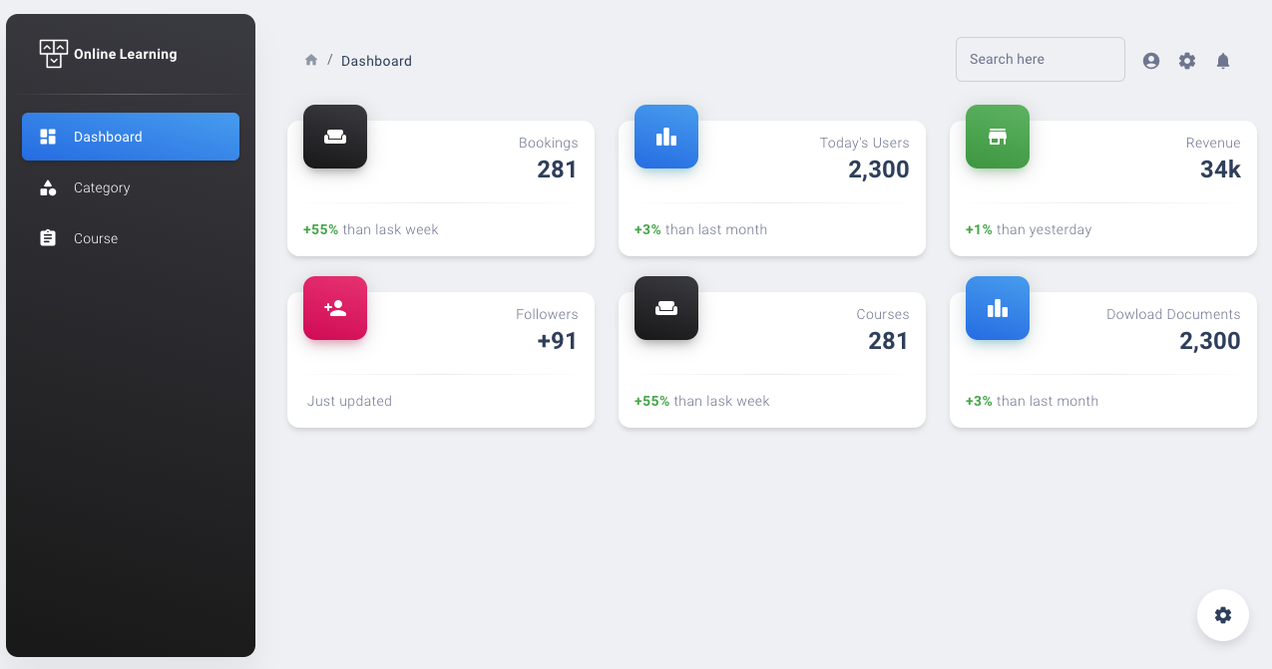
Web Application

Slide 8
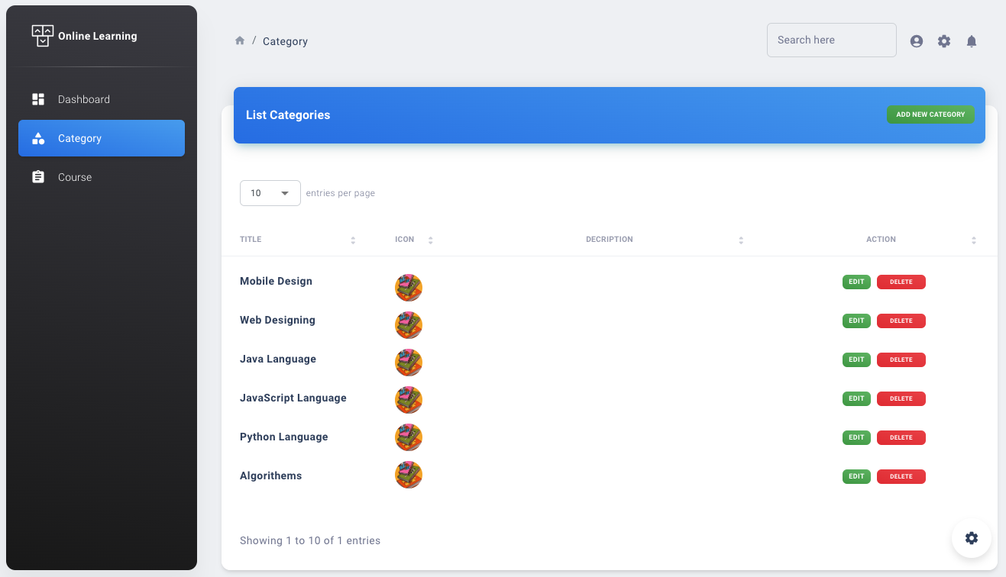
Category Page

Slide 9
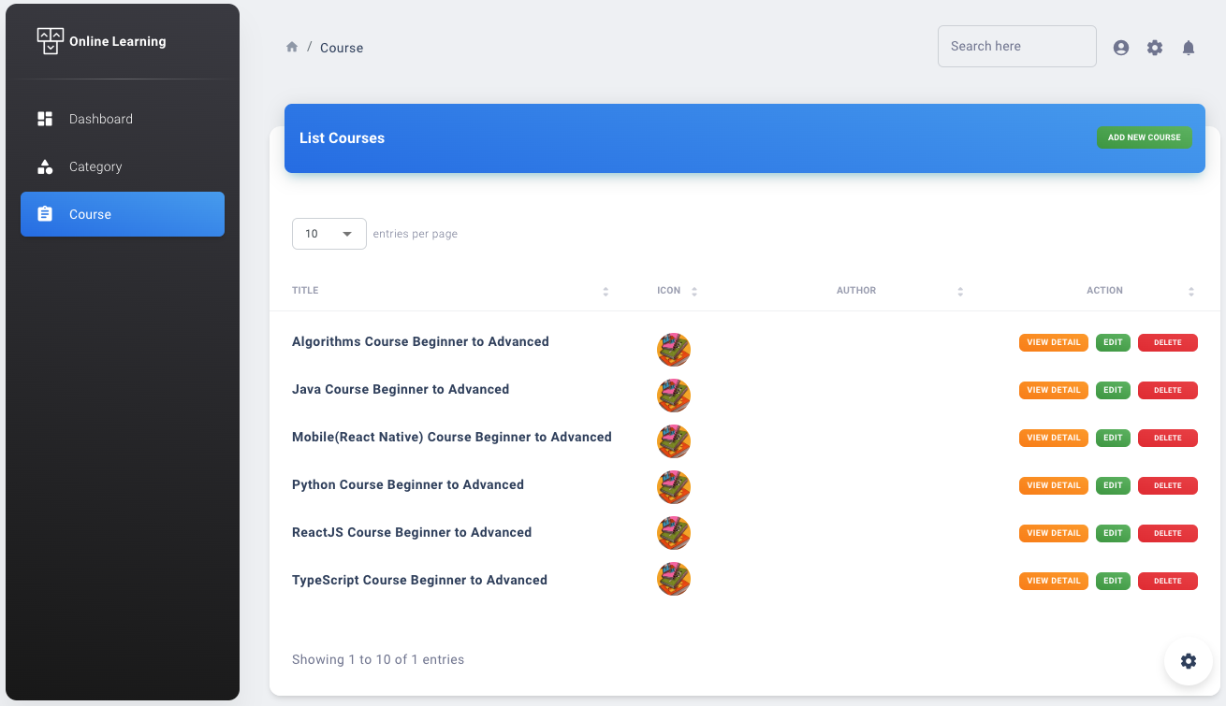
Course Page

Slide 10
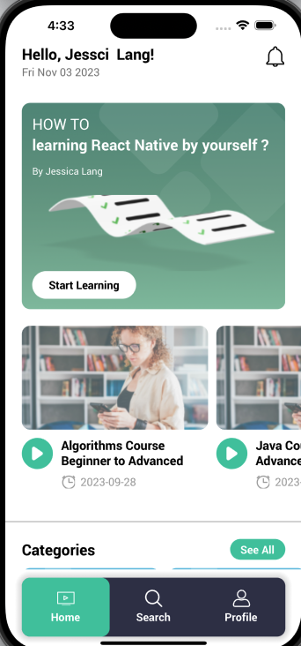
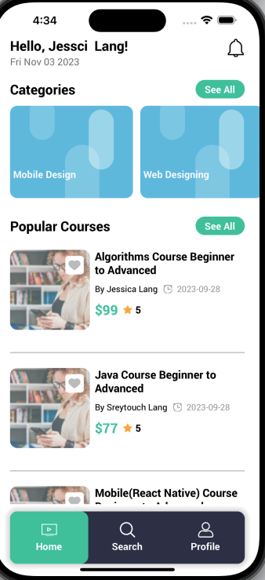
Mobile Application

Slide 11
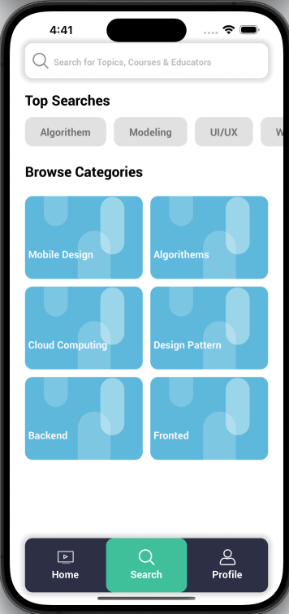
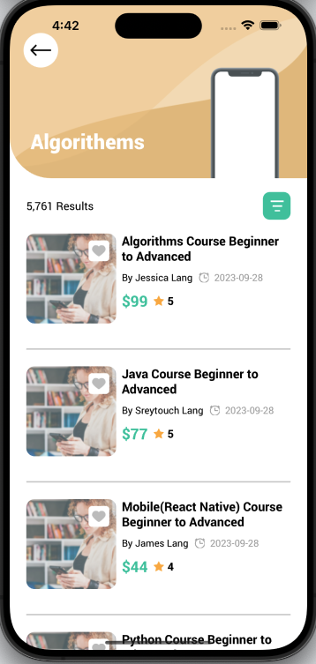
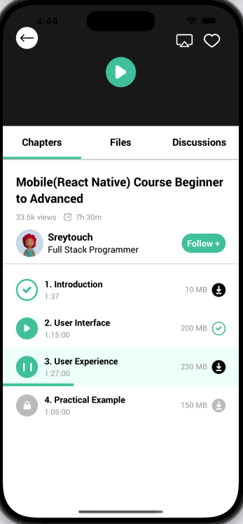
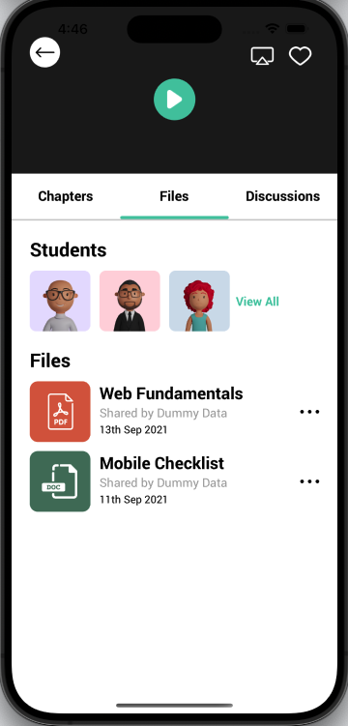

Slide 12
