Slide 1
SkyLab
An extensible workflow web applicaton for HPC on the cloud
VINCENT PAUL L. CARPIO, KATRINA JOY M. ABRIOL-SANTOS, JOSEPH ANTHONY C. HERMOCILLA

Slide 2
Background
Most scientific applications require high performance computing (HPC) which needs CPU intensive computations and large data storage
The cloud could be a cheaper alternative for running HPC applications instead of using physical clusters but it is yet to be on par in terms of performance

Slide 3
Background
Peak-Two Cloud (P2C)
Openstack-based private cloud on top of commodity hardware targeted for scientific and high-performance computing
vCluster
Tool for automatic configuration and deployment of MPI cluster on demand
p2c-tools
Utility for configuring tools with MPI clusters

Slide 4
Objectives
allow users to execute HPC tools via web interface;
enable developers to easily extend it to support additional HPC tools;
enable users to share their instantiated clusters; and
support displaying of results using third party tools

Slide 5
Currently supported tools
AutoDock 4
AutoDock Vina
DOCK6
Quantum ESPRESSO
GAMESS
Ray
IMPI

Slide 6
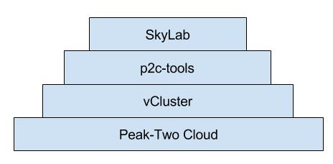
SkyLab is built on…

Slide 7
Bootup
Load tools
Search for toolsets in modules directory
Initialize cluster management
Start MPIThreadManager
Initialize task queues
Enqueue unfinished tasks to their respective cluster ‘s task queues
Spawn MPIThreads for each active cluster
Initialize event listeners
Tasks are executed according to priority
Create or update toolset DB entries

Slide 8
MPI cluster management
MPIThreadManager
Handles the SSH connection to the main node where vCluster commands can be invoked
Spawns an MPIThread for each active cluster
MPIThread
Handles the SSH connection to its assigned cluster
Manages task queueing and execution
Utilizes p2c-tools commands

Slide 9
Toolset
__init__.py
forms.py
executables.py
install.py
views.py
Contains tool classes extending P2CToolGeneric class
Contains Django form classes for subtools
Contains install_to_db function which creates/updates database entries related with the toolset/subtools
Contains Django views for subtools

Slide 10
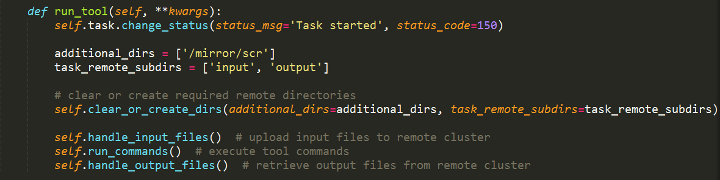
Toolset
run_tool method implementation for GAMESS

Slide 11
Task execution
MPIThread gets the first task in its task queue
Calls the assigned executable class with given parameters
Initialize required directories
Send input files to cluster
Execute task commands
Retrieve output files from cluster
Serve output files

Slide 12
Results

Slide 13
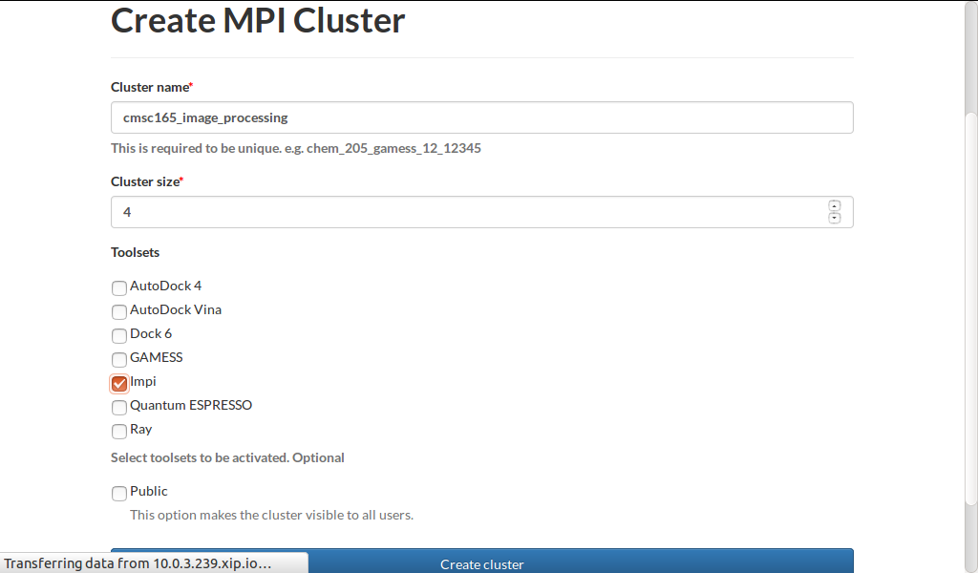
MPI cluster creation

Slide 14
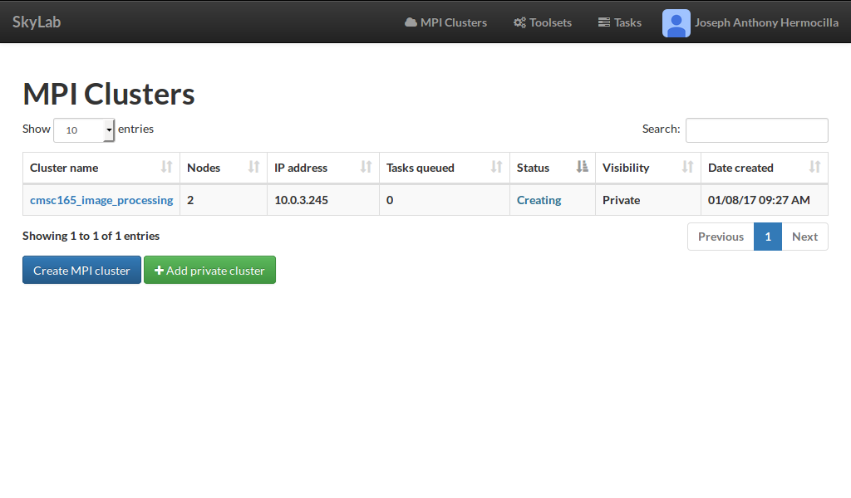
MPI cluster monitoring

Slide 15
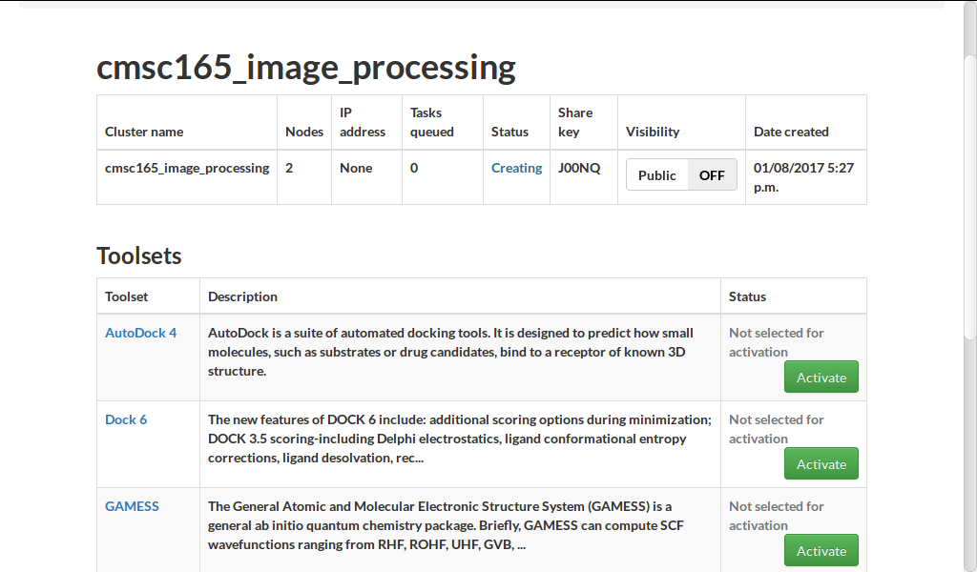
MPI cluster management

Slide 16
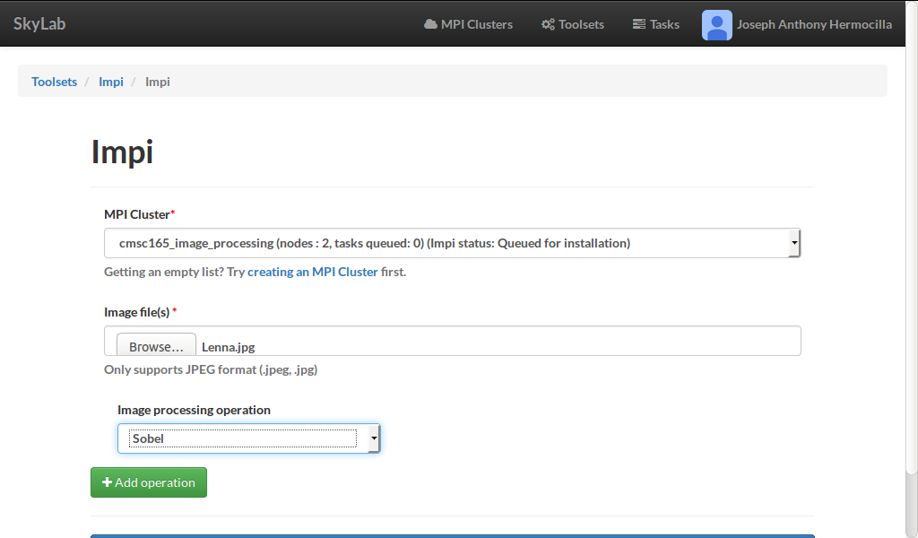
Task submission
IMPI task submission form

Slide 17
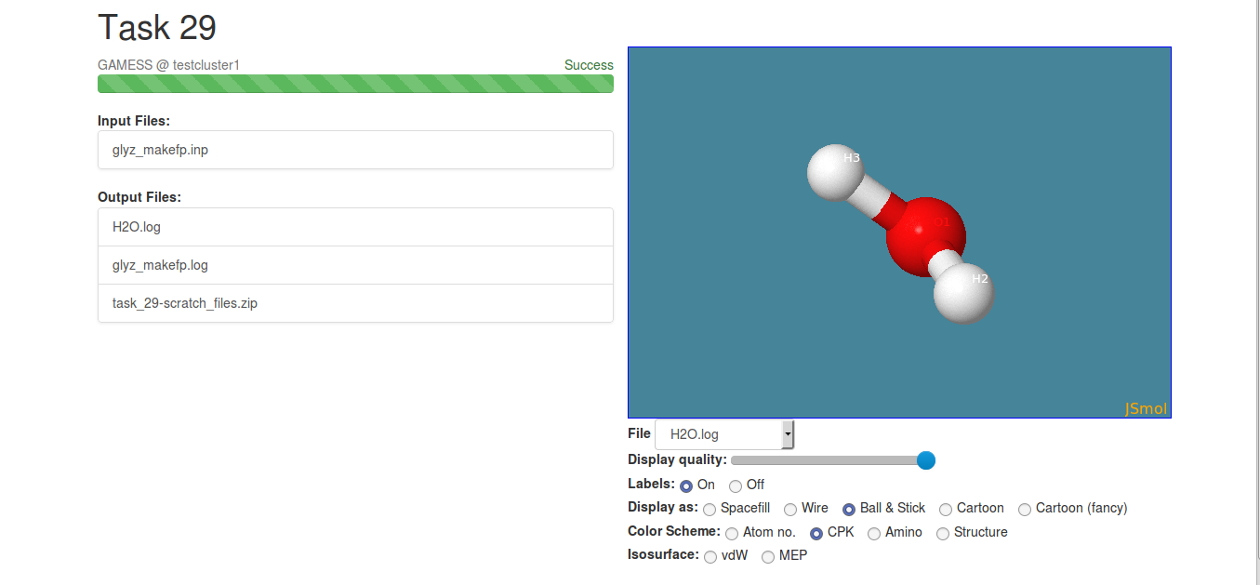
Task output
Sample output of GAMESS task rendered with JSmol

Slide 18
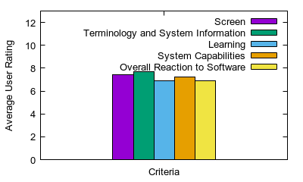
Evaluation

Slide 19
Conclusion and Future Work
conclusion

