Slide 1
Mlflow – plataform for complete machine learning lifecycle
Sergio Marinho da Silva
Thamys Abrahao

Slide 2
Outline – introduction to mlflow How to Use Mlflow tracking
Overview of ML development challenges
Concepts and Motivations
How Mlflow tackles these
MLFlow components
MLFlow tracking
How to use Mlflow tracking APIs
Explore Mlflow UI

Slide 3
Traditional software vs. Machine Learning
Traditional Software
Goal: meet a functional specification
Quality depends only on code
Machine Learning
Goal: optimize metric (e.g., accuracy, recall, precision)
Quality depends on input data and tuning parameters

Slide 4
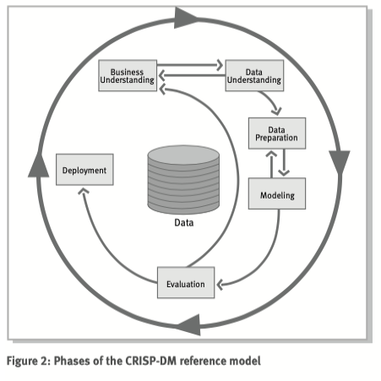
Machine Learning Lifecycle
Source: CRISP-DM step-by-step miniing guide, SPSS

Slide 5
Introducing mlflow
Open machine learning platform
Works with popular ML library & language
Runs the same way anywhere (cloud/local)

Slide 6
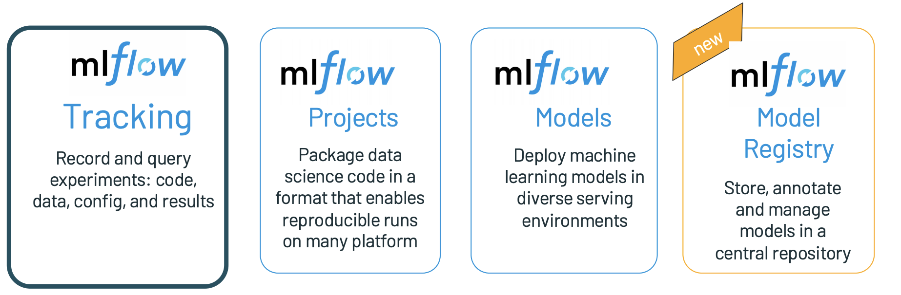
Mlflow components

Slide 7
Key Concepts in Mlflow tracking
Parameters: key-value inputs to your code
Metrics: numeric values (can update over time)
Tags and Notes: information about a run
Artifacts: files, data and models
Source: what code ran?
Version: what of the code?
Run: an instance of code that runs by Mlflow
Experiment: {run,…,run}

Slide 8
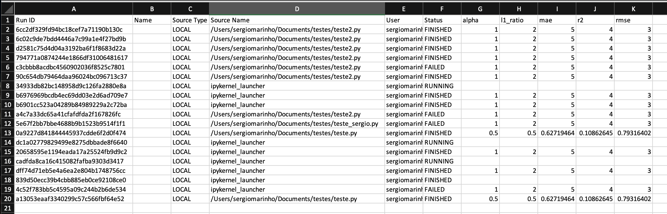
Mlflow overview
List of experiments and results

Slide 9
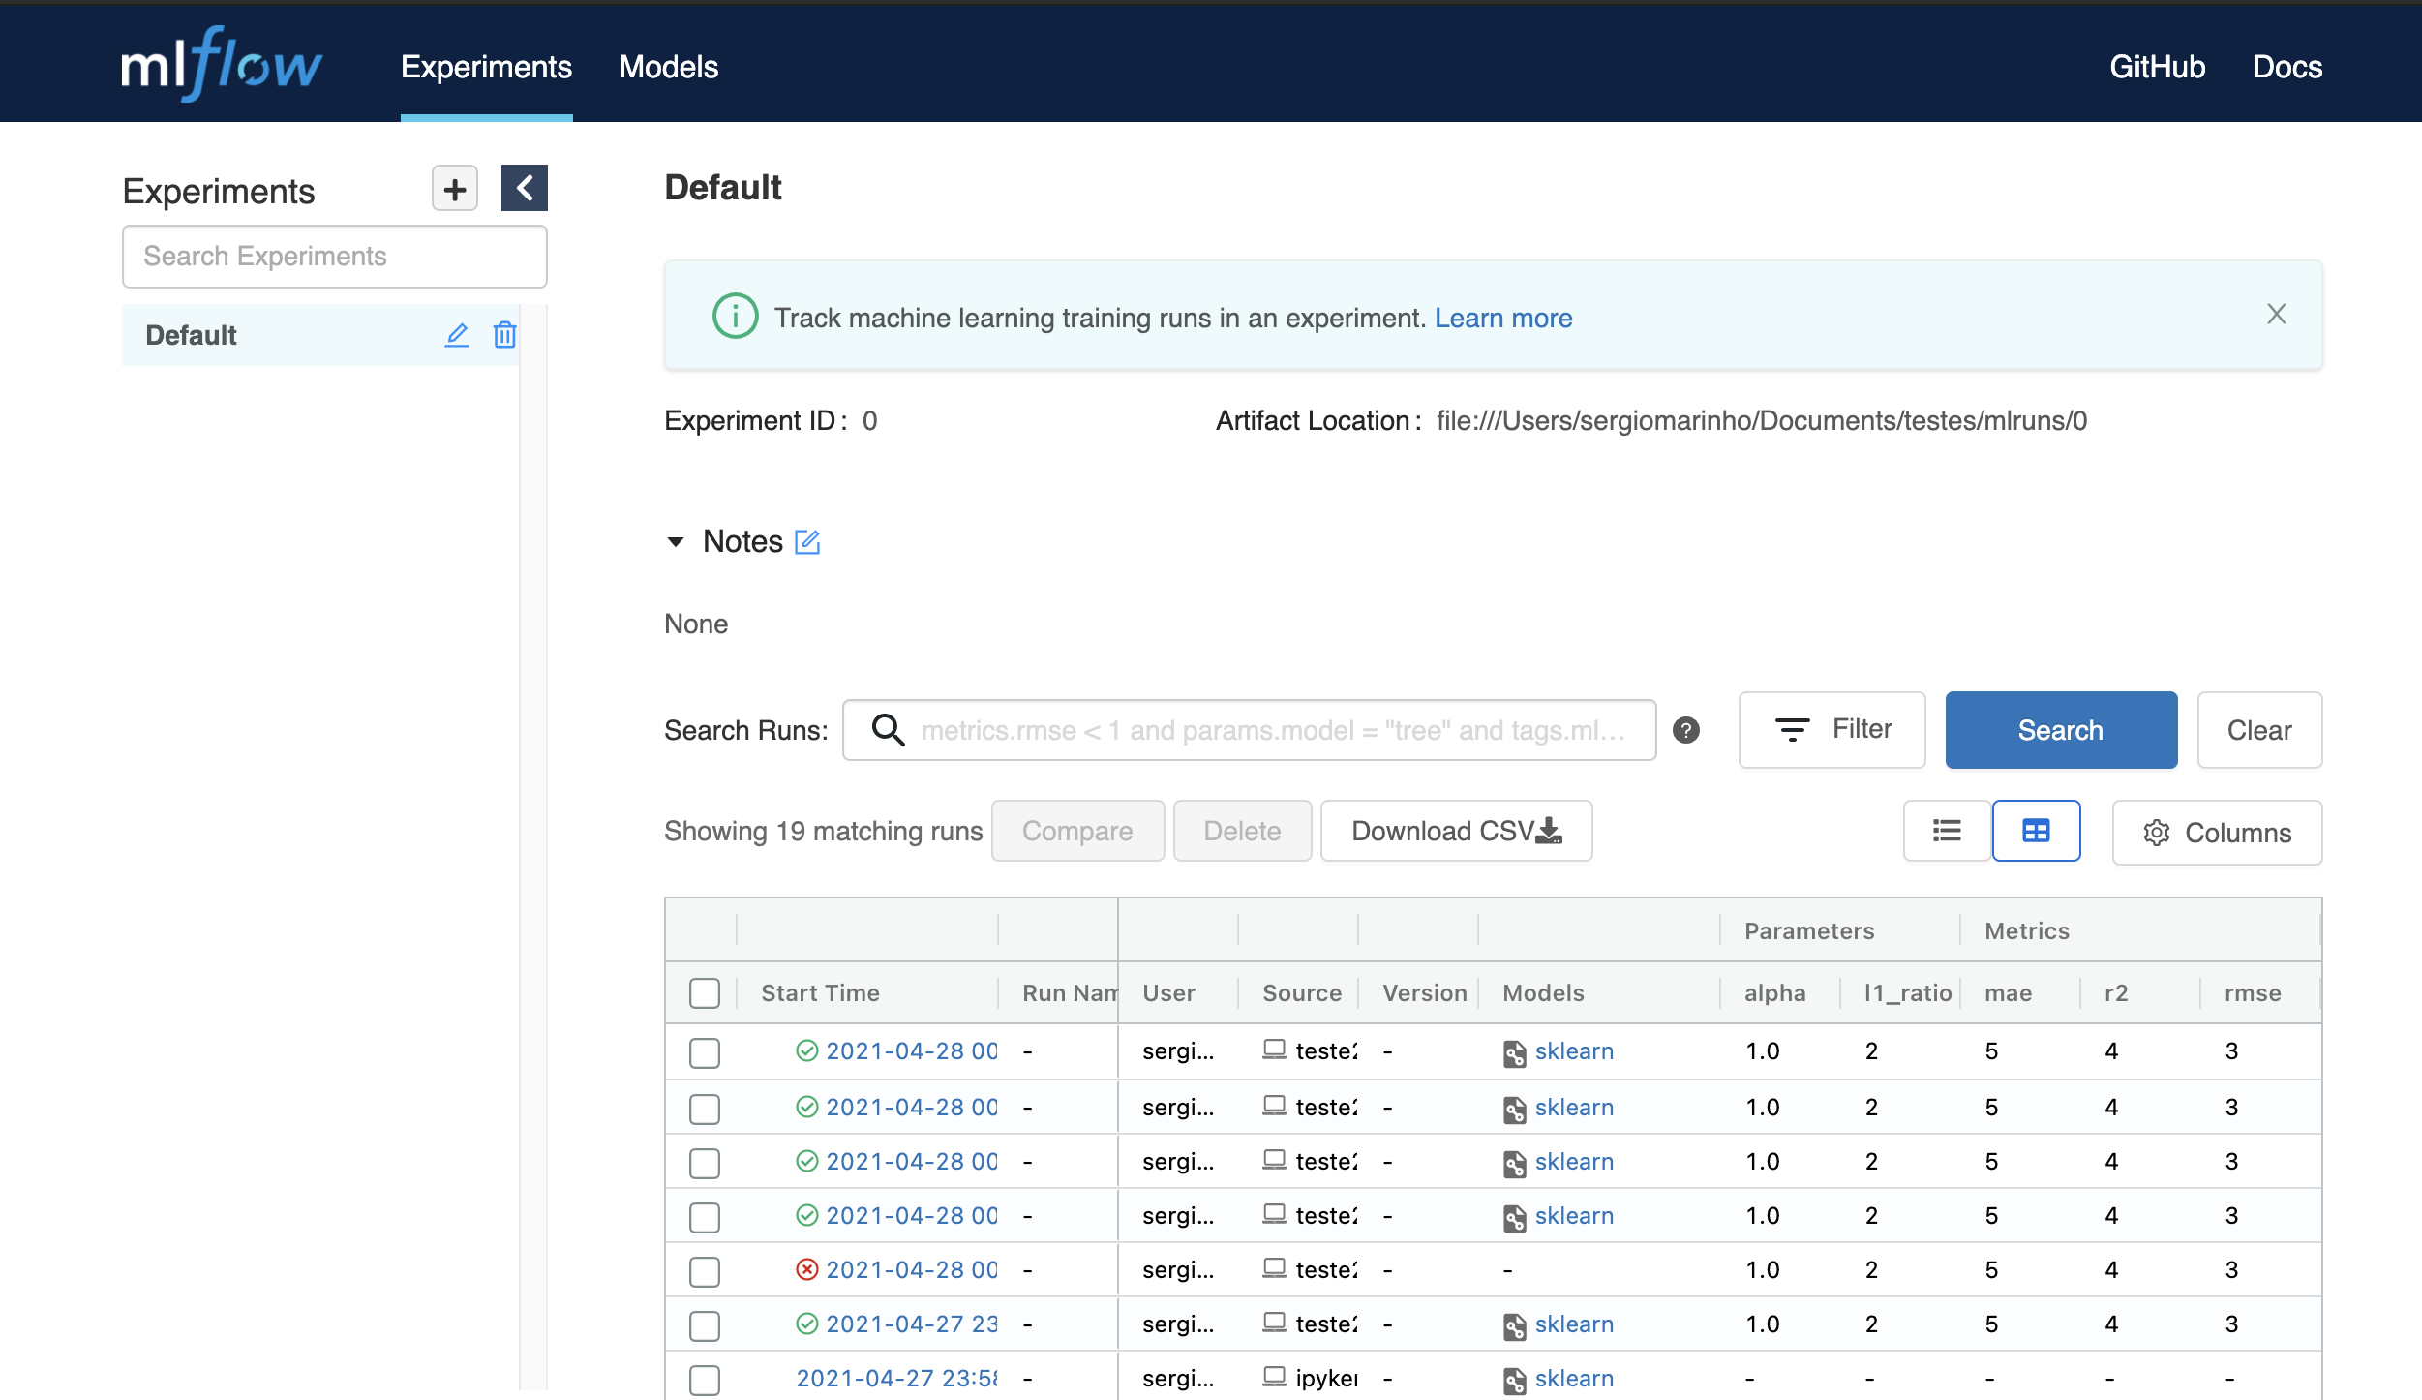
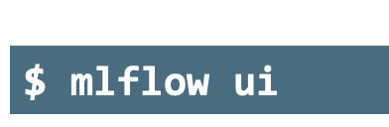
Mlflow overview
Just type in terminal:
Use it to generate a list of results
List of executed projects

Slide 10
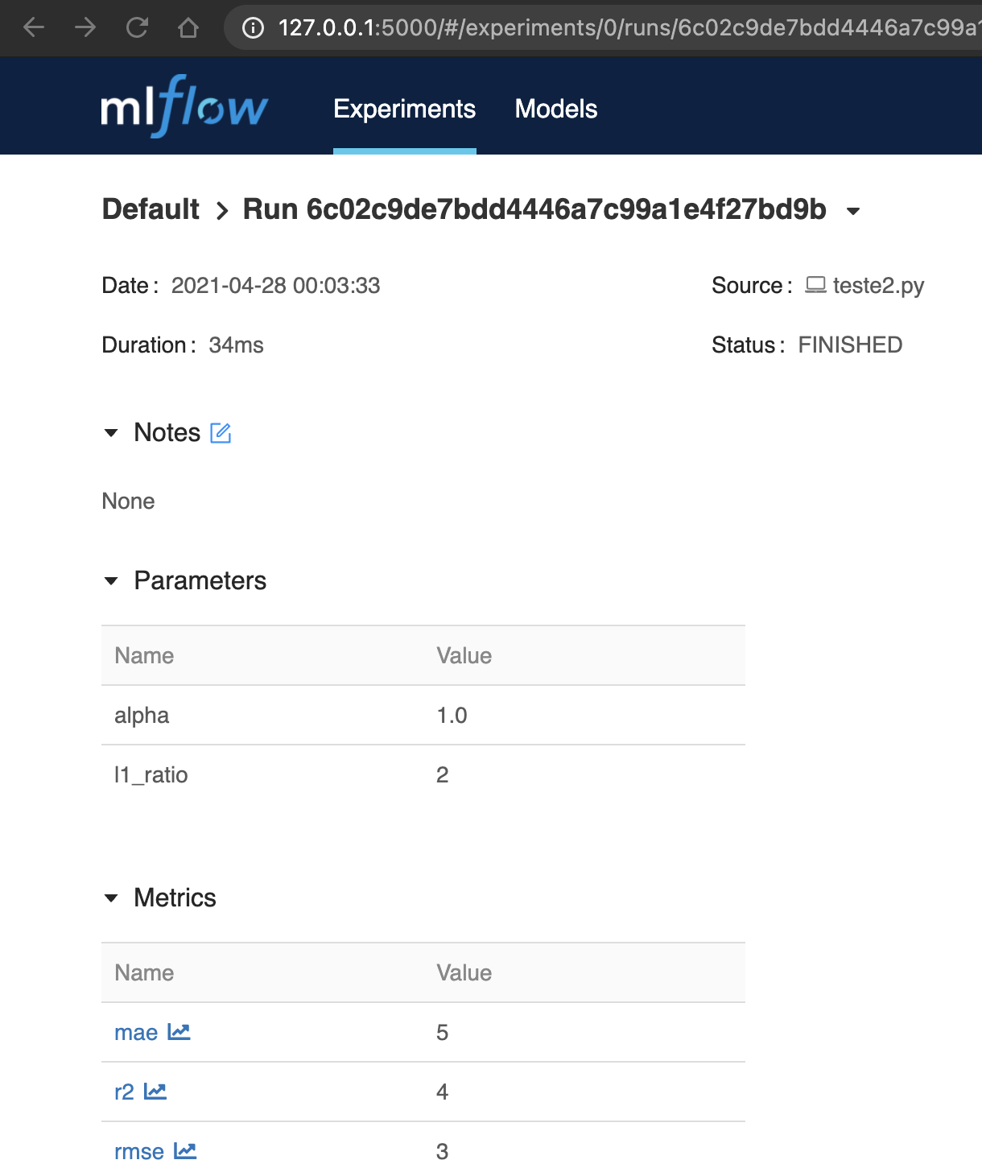
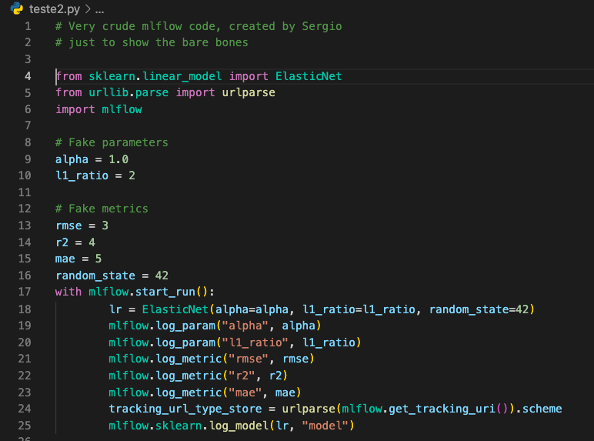
Very crude example

Slide 11
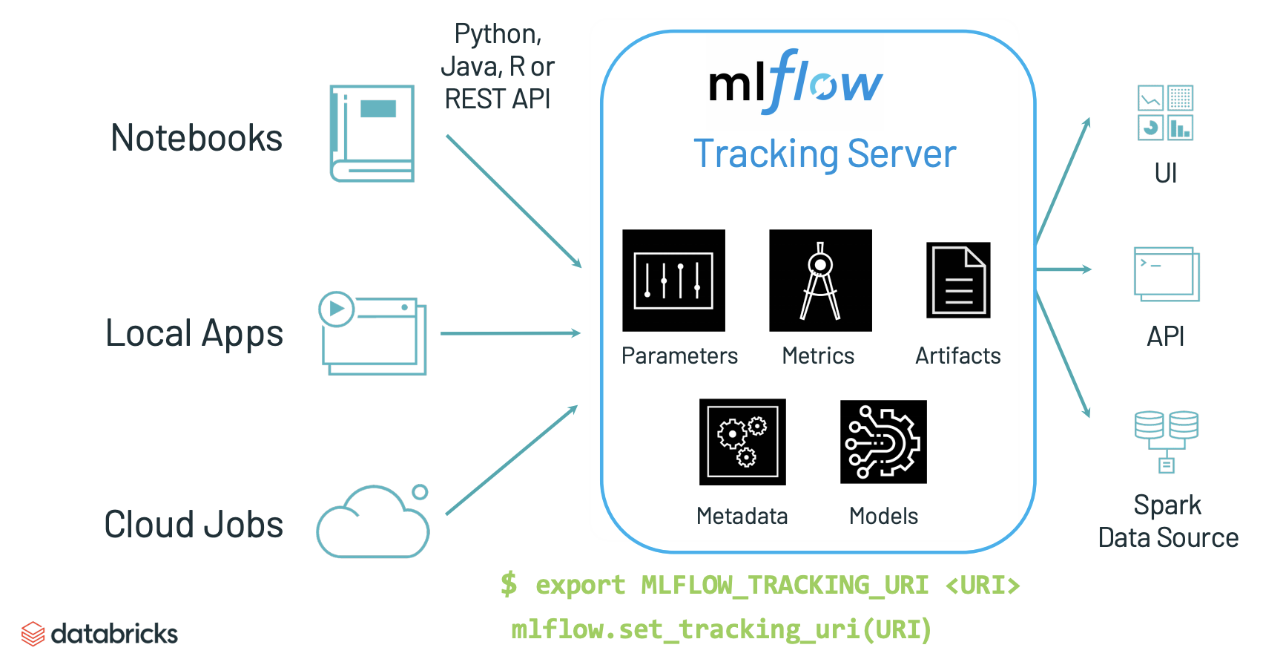
Mlflow tracking

Slide 12
In a nutshell:
pip install mlflow to get started
Find docs & examples at mlflow.org
Peruse code and contribute at MLflow Github
http://dbricks.co/mlflow-tutorials

Slide 13
References:
https://www.mlflow.org/docs/latest/tutorials-and-examples/tutorial.html
https://docs.databricks.com/applications/mlflow/index.html
https://medium.com/swlh/my-perspective-on-eda-for-the-titanic-dataset-38a4ecc94500
https://www.aws.training/Details/eLearning?id=27200
https://www.youtube.com/watch?v=x3cxvsUFVZA

