Slide 1
Unit Test with VS code
A very crude presentation
by Sergio Marinho da Silva
2021 Aug 28

Slide 2
References
Visual Studio Code homepage: python test
https://code.visualstudio.com/docs/python/testing
Youtube: Corey Schafer: unit test in python
https://www.youtube.com/watch?v=6tNS--WetLI&t=1231s
Youtube: Socratica: Unit Tests in python
https://www.youtube.com/watch?v=1Lfv5tUGsn8&t=296s

Slide 3
TL;DR: 1
Unit Tests are separate python scripts that allow you to quickly validate critical points of your project
VS Code can recognize your test scripts and allow quick visualization of critical moments

Slide 4
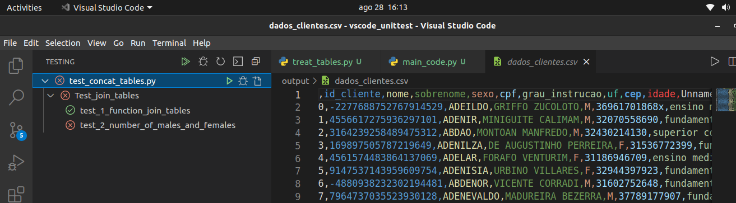
TL;DR 2
Results of the tests:
X = test failed
OK: test passed
Final result: hard to see if all results are correct

Slide 5
How this class will be:
Fake project: join tables
Tests: apply red light → green light:
Always assure your test can fail!
You can run the test on terminal (last slide) or on vs code (focus of the course)

Slide 6
Take into consideration:
VS Code test is extremelly sensitive!
Any wrong step will make the tests disappear from the test bar!
Always proceed while verifying the results!

Slide 7
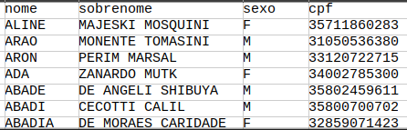
Part 1: the “project”
Our client will send us tables periodically
We need to concatenate the tables in one file
Clients table

Slide 8
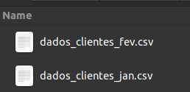
Part 2: joining the tables
1: concatenate dados_clientes
Create function that concatenates tables

Slide 9
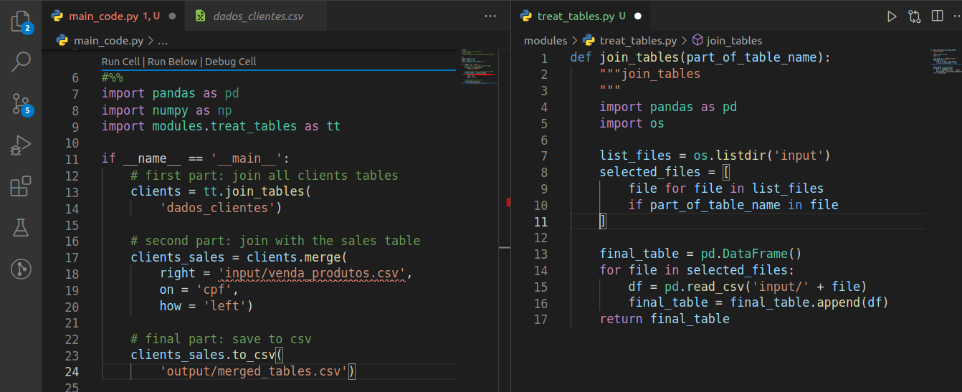
The code (continue on VS code)
Pipeline:
Run the code
Find issues
Fix issues
Create tests for issues
Rinse and repeat

Slide 10
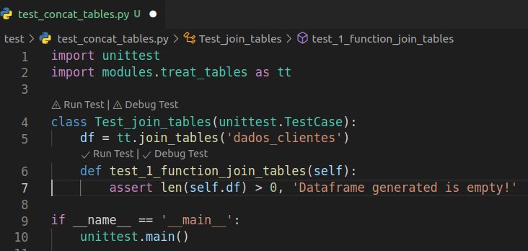
Unit test script file (read at your own leisure)
Steps followed here:
Create file
Name starting with test
File in the test folder
Import unittest and modules
→ do not use sys.path!
→ if module.py in MODULES folder,
Use import MODULES.module
Create class with argument unittest.TestCase
Create functions beginning with word ‘test’
Create assertions inside test functions
Call unittest.main(): only if calling script
* I’m ignoring unittests functions on purpose

Slide 11
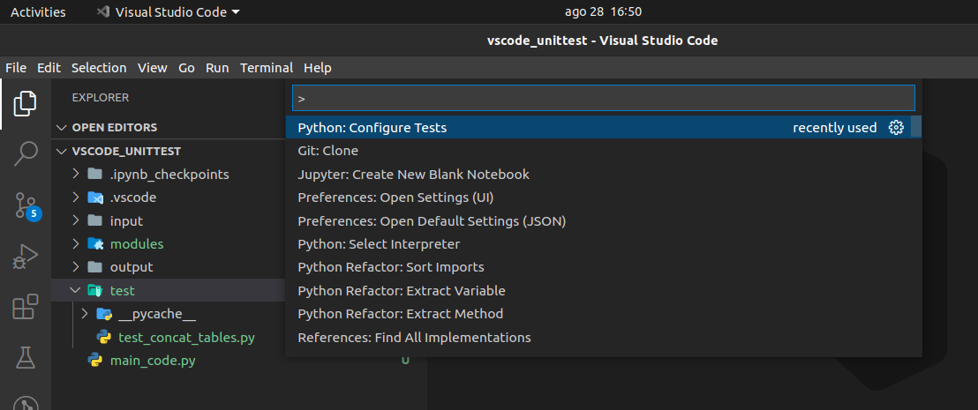
Configuring VS code for unit test (read at your own leisure)
Steps followed here:
Open the project folder
Create test (or tests) folder
Ctrl shift p
Python configure tests
> unittest > test > test*.py

Slide 12
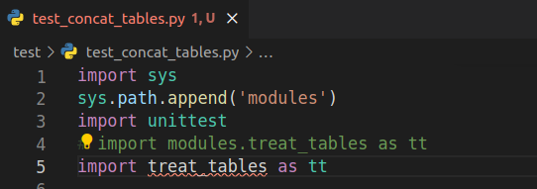
Final comment: running test_concat_tables.py
- Add to the beginning
of the code:
import os
os.chdir(‘..’)
Run from project folder
python3 test/test_concat_tables.py

