Slide 1
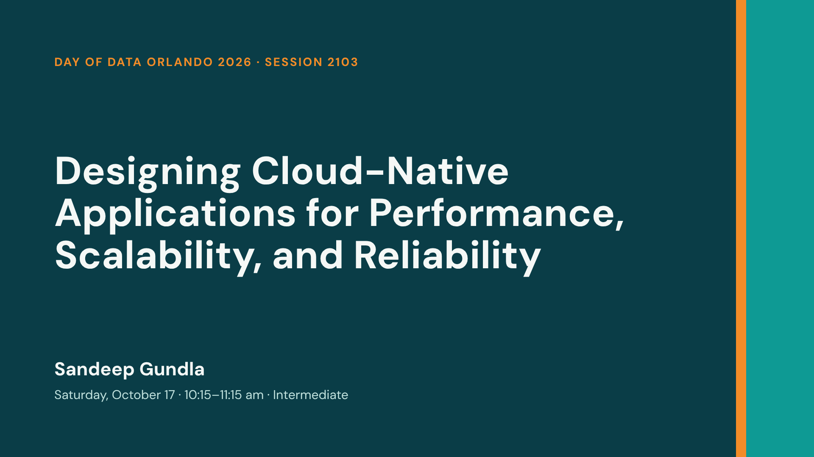
Notes:
Welcome everyone. Today is a working session: you will see each technique in running code, and you can follow along on your own laptop (Windows or Mac) with Docker. Everything is in the GitHub repo on the last slide. Quick plan: sponsors, then four short demos (database, caching, resilience, scale-out), then trade-offs and questions.

Slide 2
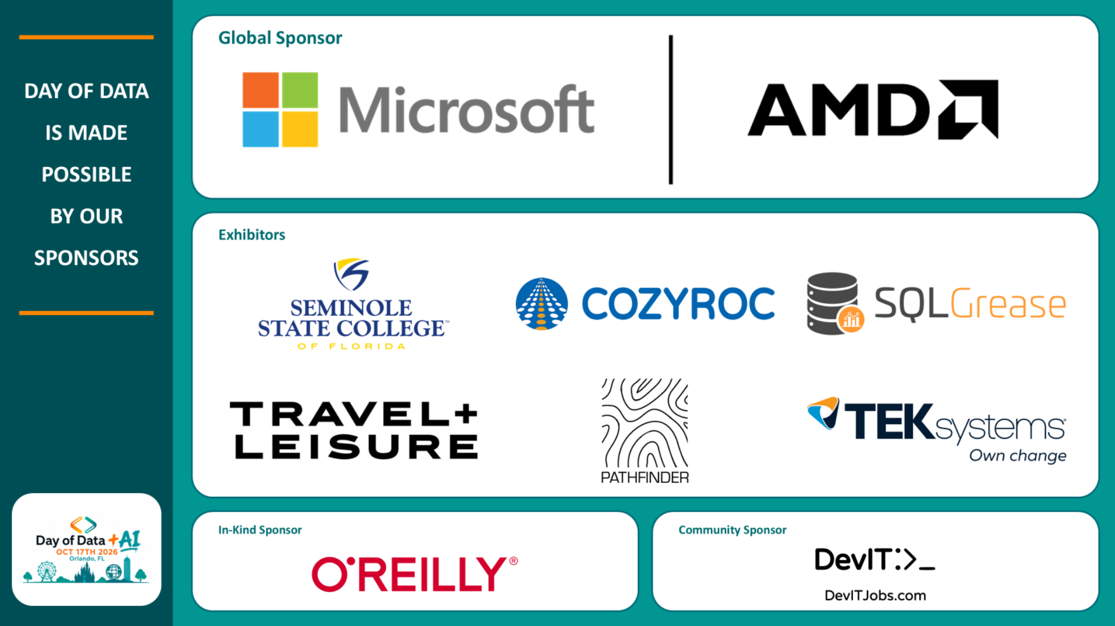
Notes:
Thank the sponsors and the SQL Orlando volunteers. Day of Data is free because of them. Visit the exhibitors in the first-floor foyer, and remember each sponsor visit earns a raffle ticket.

Slide 3
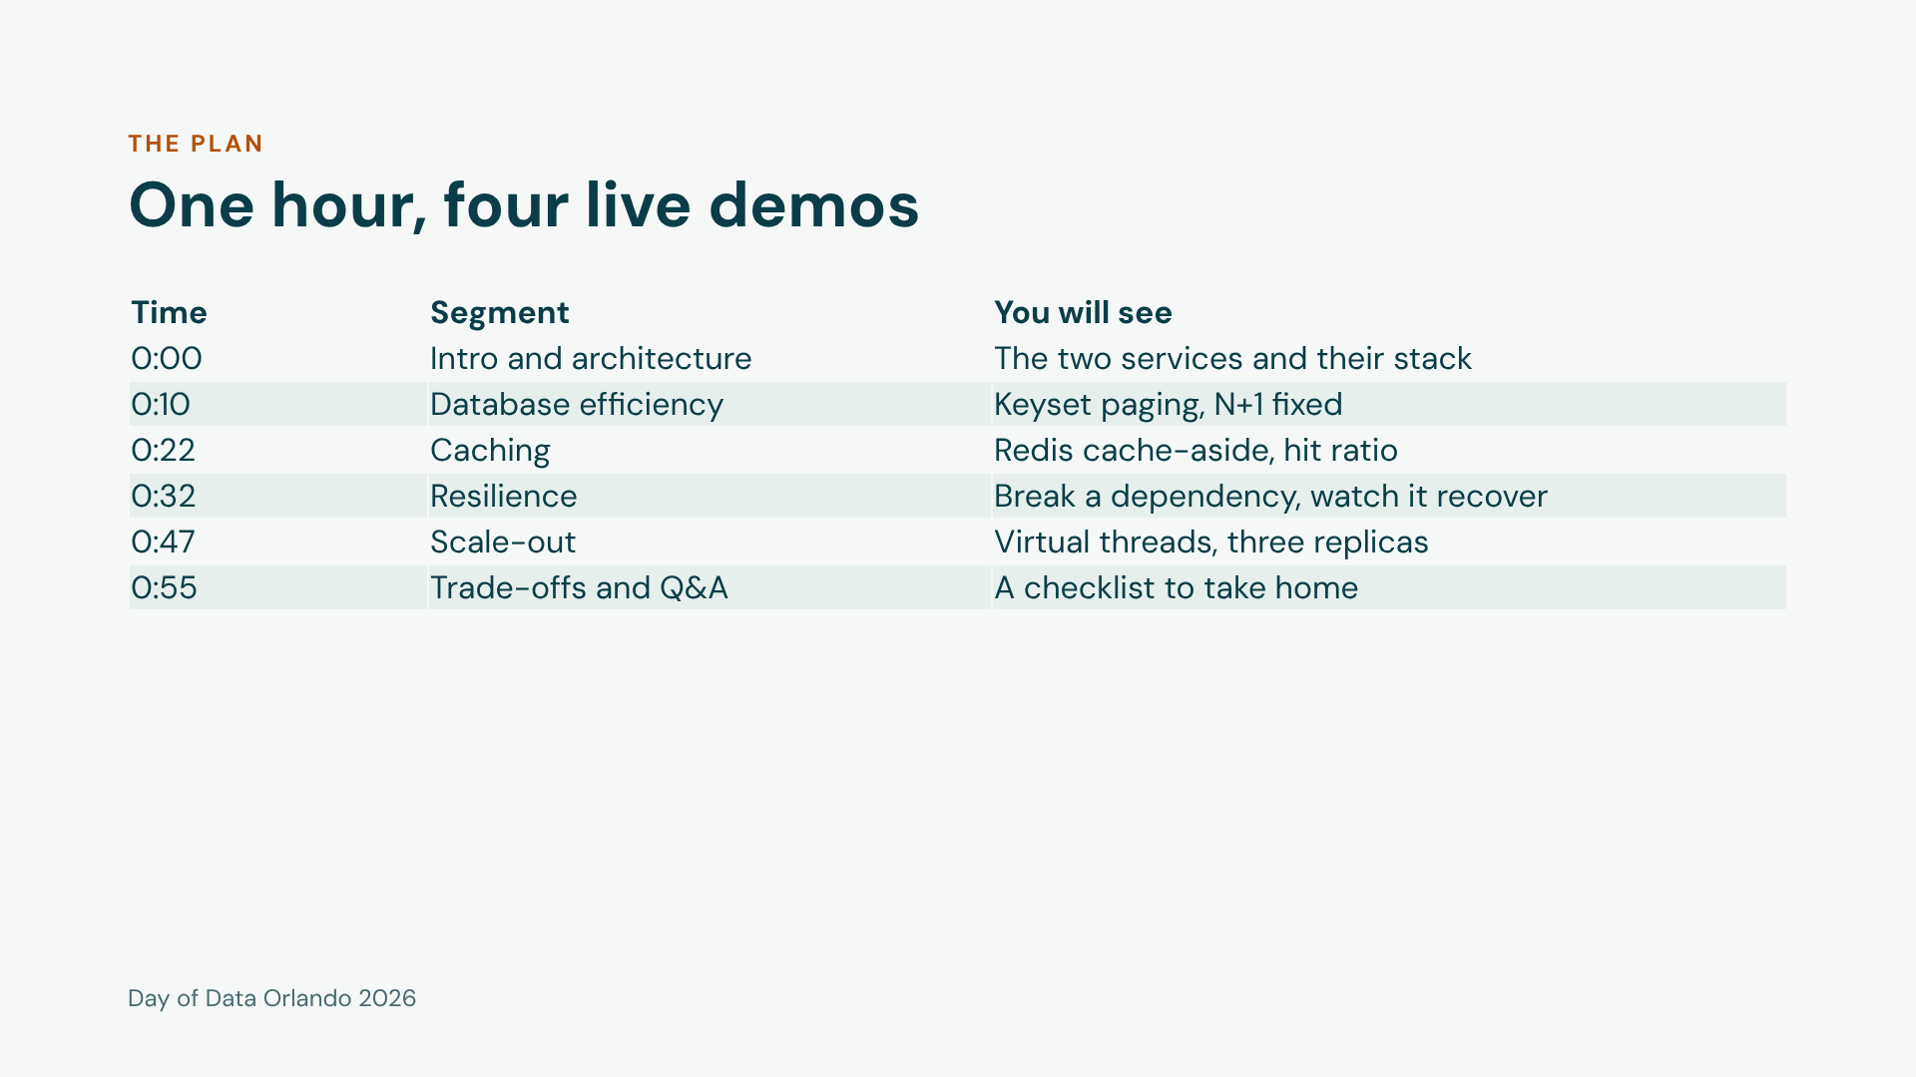
Notes:
Walk through the table quickly. Stress that this is a working session: the same repo and commands run on Windows and Mac, and the runbook has every step. If we run late, the scale-out segment is the one we shorten.

Slide 4
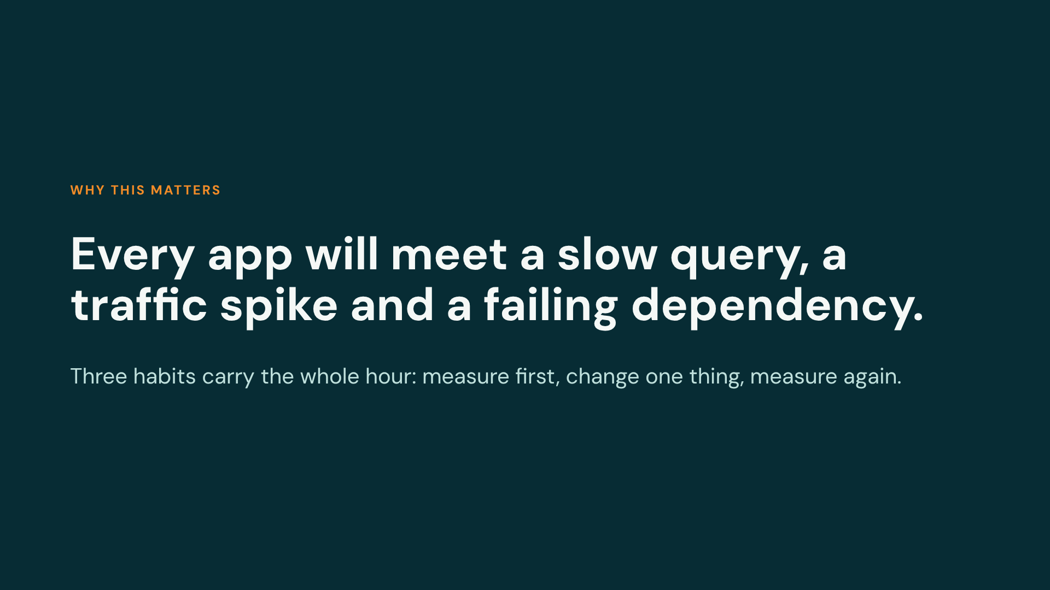
Notes:
Set the frame. Performance, scalability and reliability are different problems with different fixes, but they share one discipline: you cannot improve what you do not measure. Every demo today starts with a number and ends with a number.

Slide 5
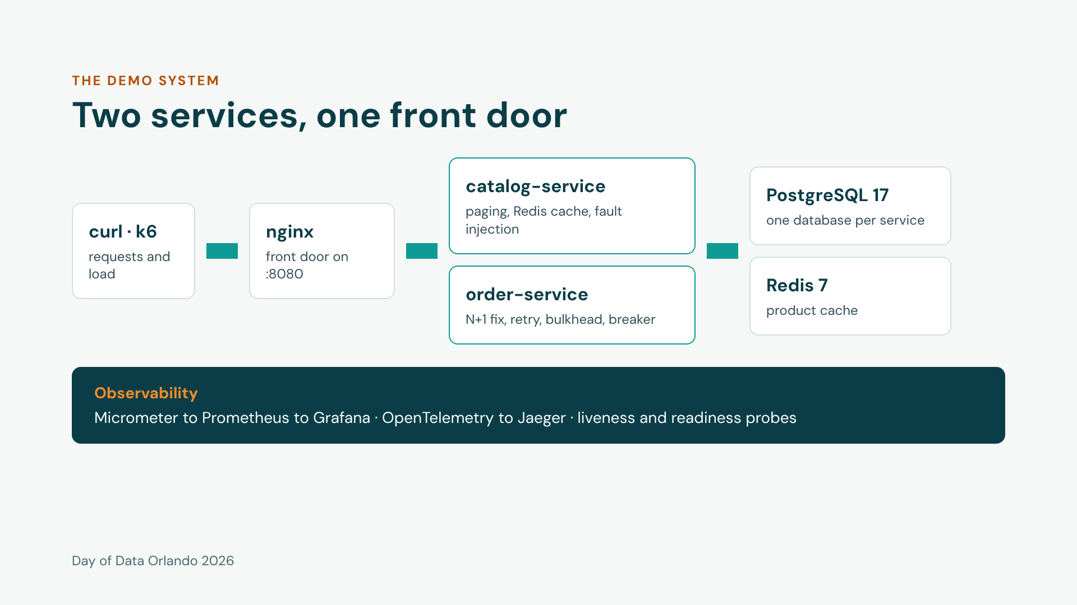
Notes:
Two small services so every idea is easy to see. Catalog owns products: half a million rows, a Redis cache, and a chaos switch we will use later. Orders owns orders and calls the catalog for prices, which makes it the natural place to show resilience. Everything runs from one Docker Compose file, so Windows and Mac behave the same.

Slide 6
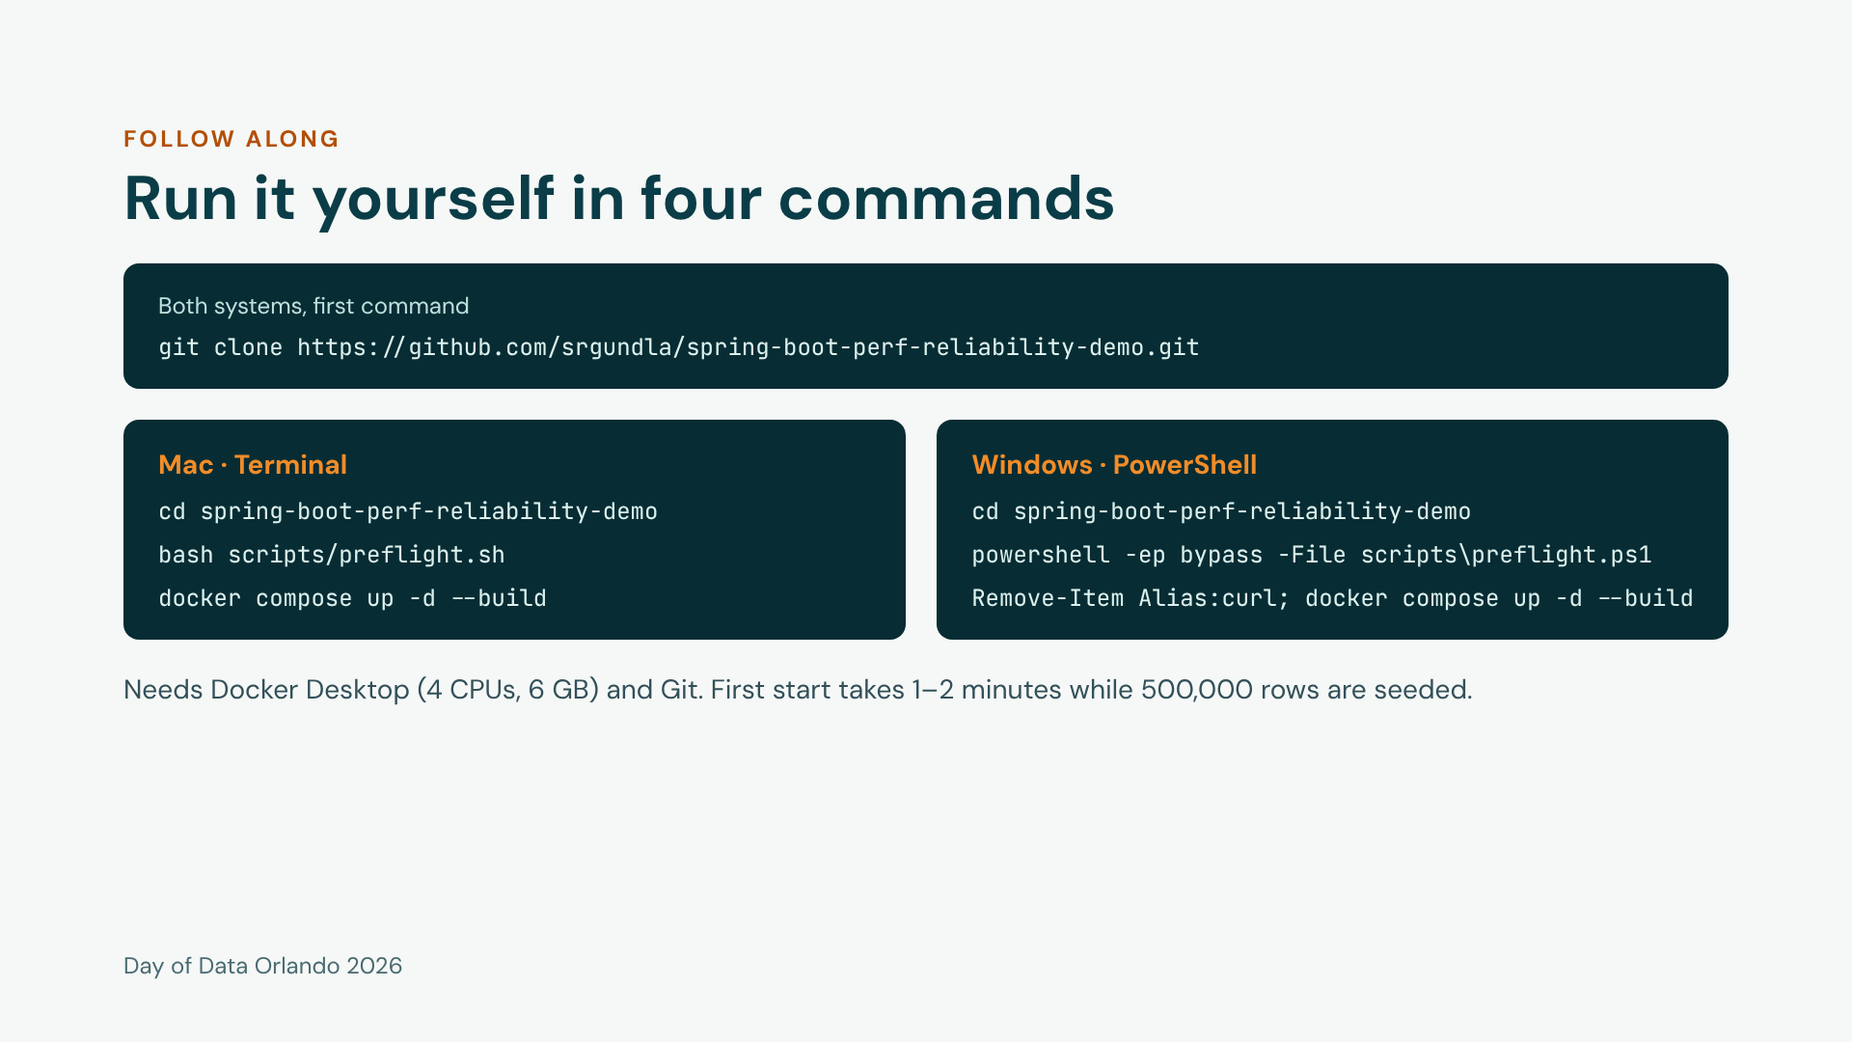
Notes:
Anyone who prepared at home can just run the last command. On wifi, do not pull images now. Windows note: PowerShell aliases curl to Invoke-WebRequest, so remove the alias once per window and every curl command in the runbook works unchanged. If the preflight complains about execution policy, run it with powershell -ExecutionPolicy Bypass -File. The full runbook is docs/SESSION-RUNBOOK.md in the repo.

Slide 7
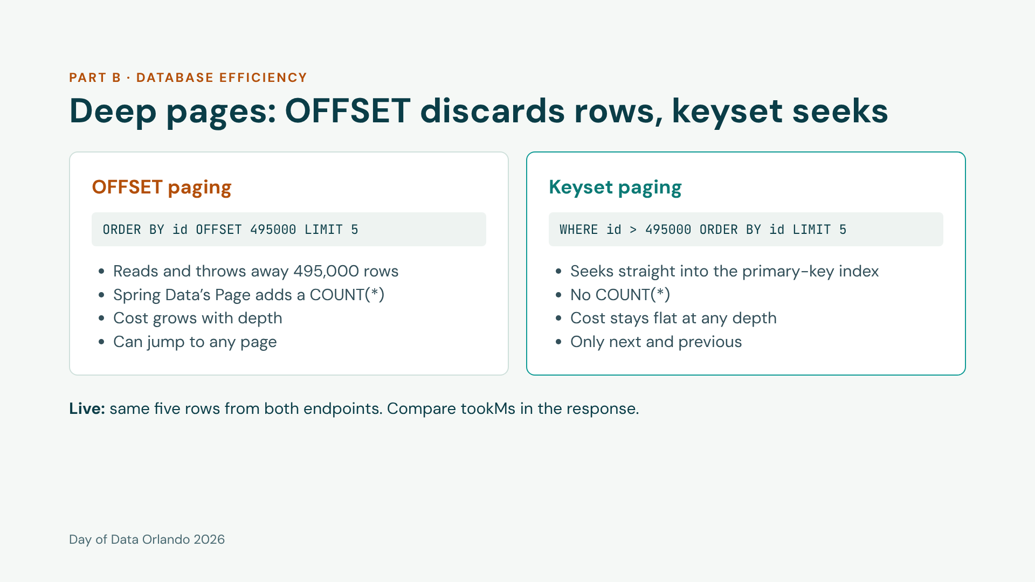
Notes:
The products table has 500,000 rows. Show the shallow page first (page 1) so nobody thinks OFFSET is always bad, then page 99000. The ratio matters more than the absolute numbers on a laptop. Code: ProductRepository, findAllByOrderByIdAsc versus findNextPage. Trade-off to say out loud: keyset gives you next and previous, not page 7,000.

Slide 8
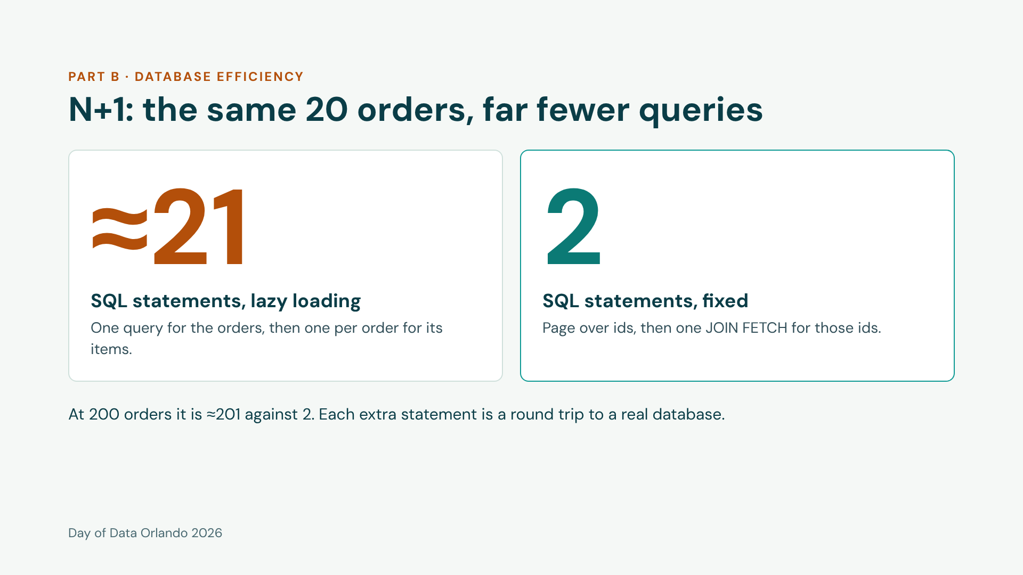
Notes:
Run /orders/api/orders/slow?size=20 then /fast?size=20 and read sqlStatements, the first field in the response. Expect about 21 and 2; confirm the exact numbers live and change the slide if they differ. The fix is in two steps so pagination stays in SQL: JOIN FETCH on a collection combined with paging forces Hibernate to page in memory. Code: OrderQueryService and OrderRepository.

Slide 9
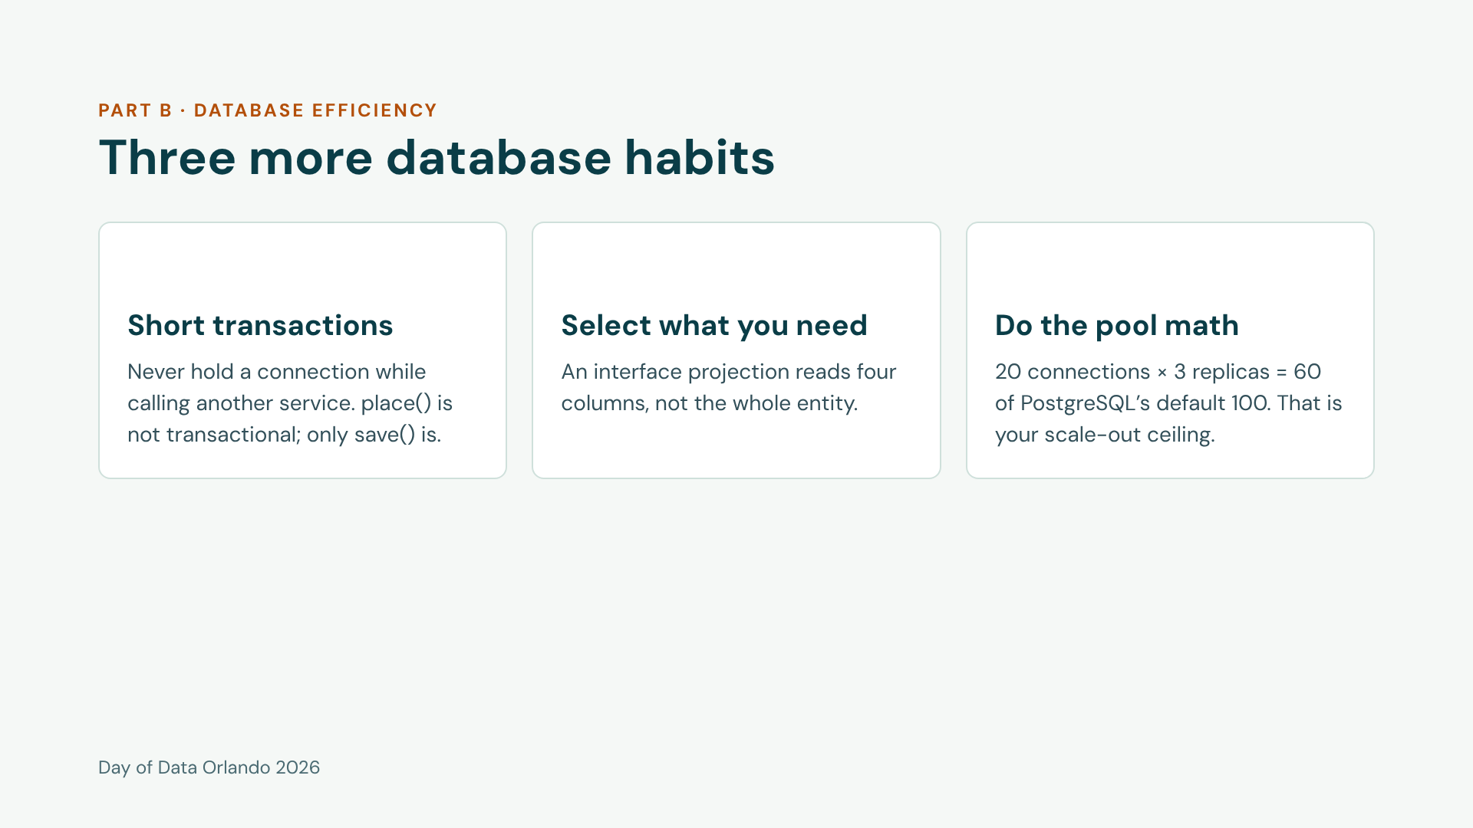
Notes:
Three quick points, one sentence each. The transaction point is the one people forget: with open-in-view off and no class-level @Transactional, the connection is only checked out for the save. Pool math: Grafana shows active and pending connections; pending greater than zero is the first sign the database is the bottleneck.

Slide 10
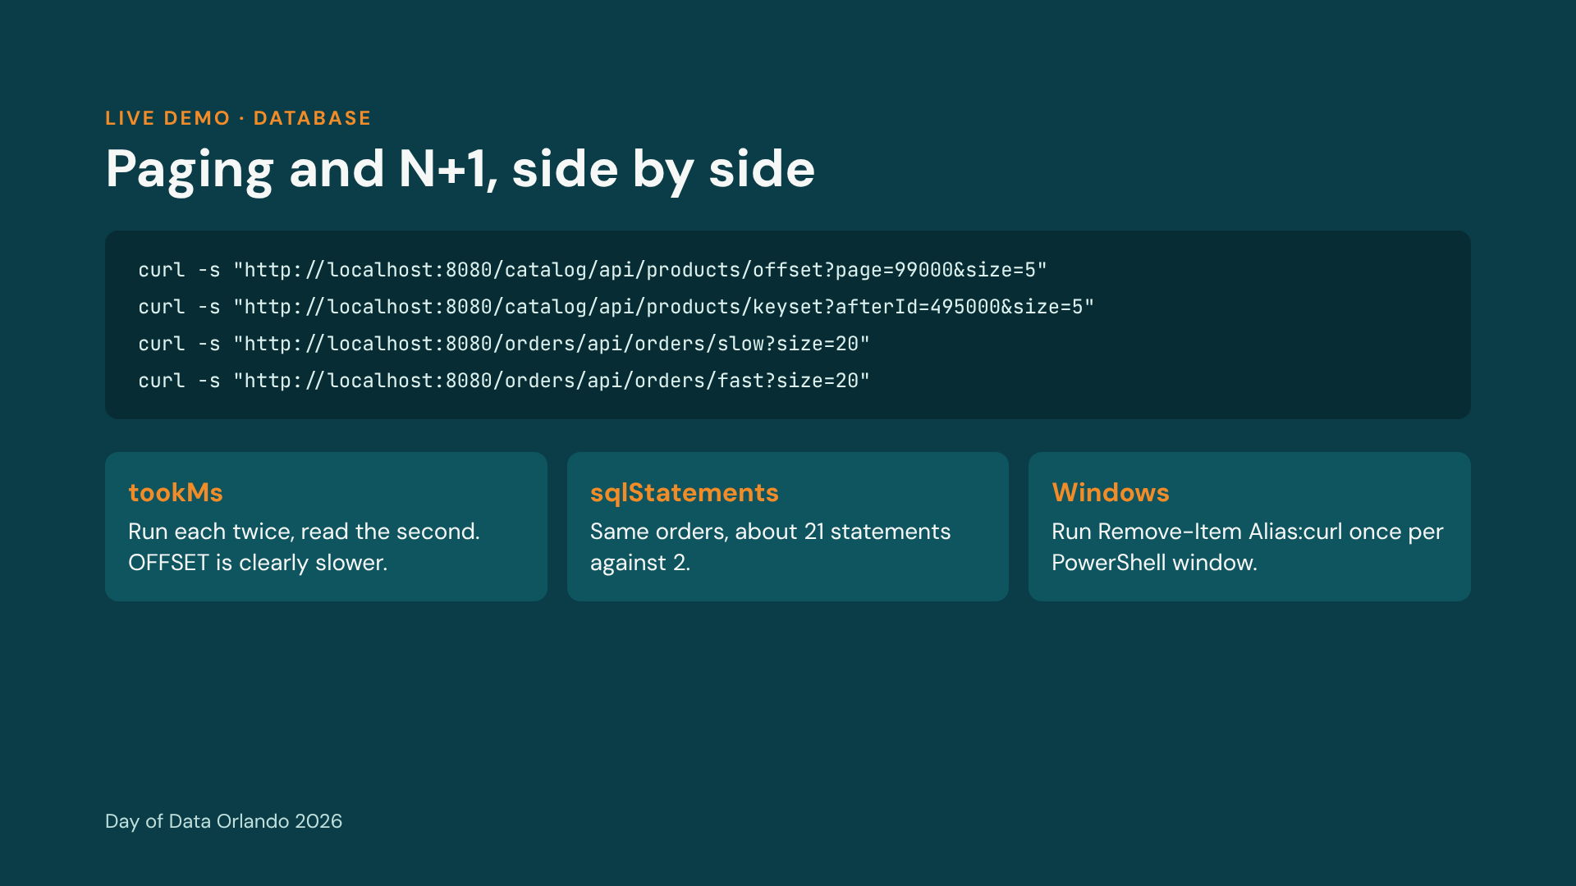
Notes:
Switch to the terminal. Runbook section B. Warm each call once before reading the number. Same commands on Windows and Mac. If the stack is not up, the fallback is the slides before this one plus the runbook output.

Slide 11
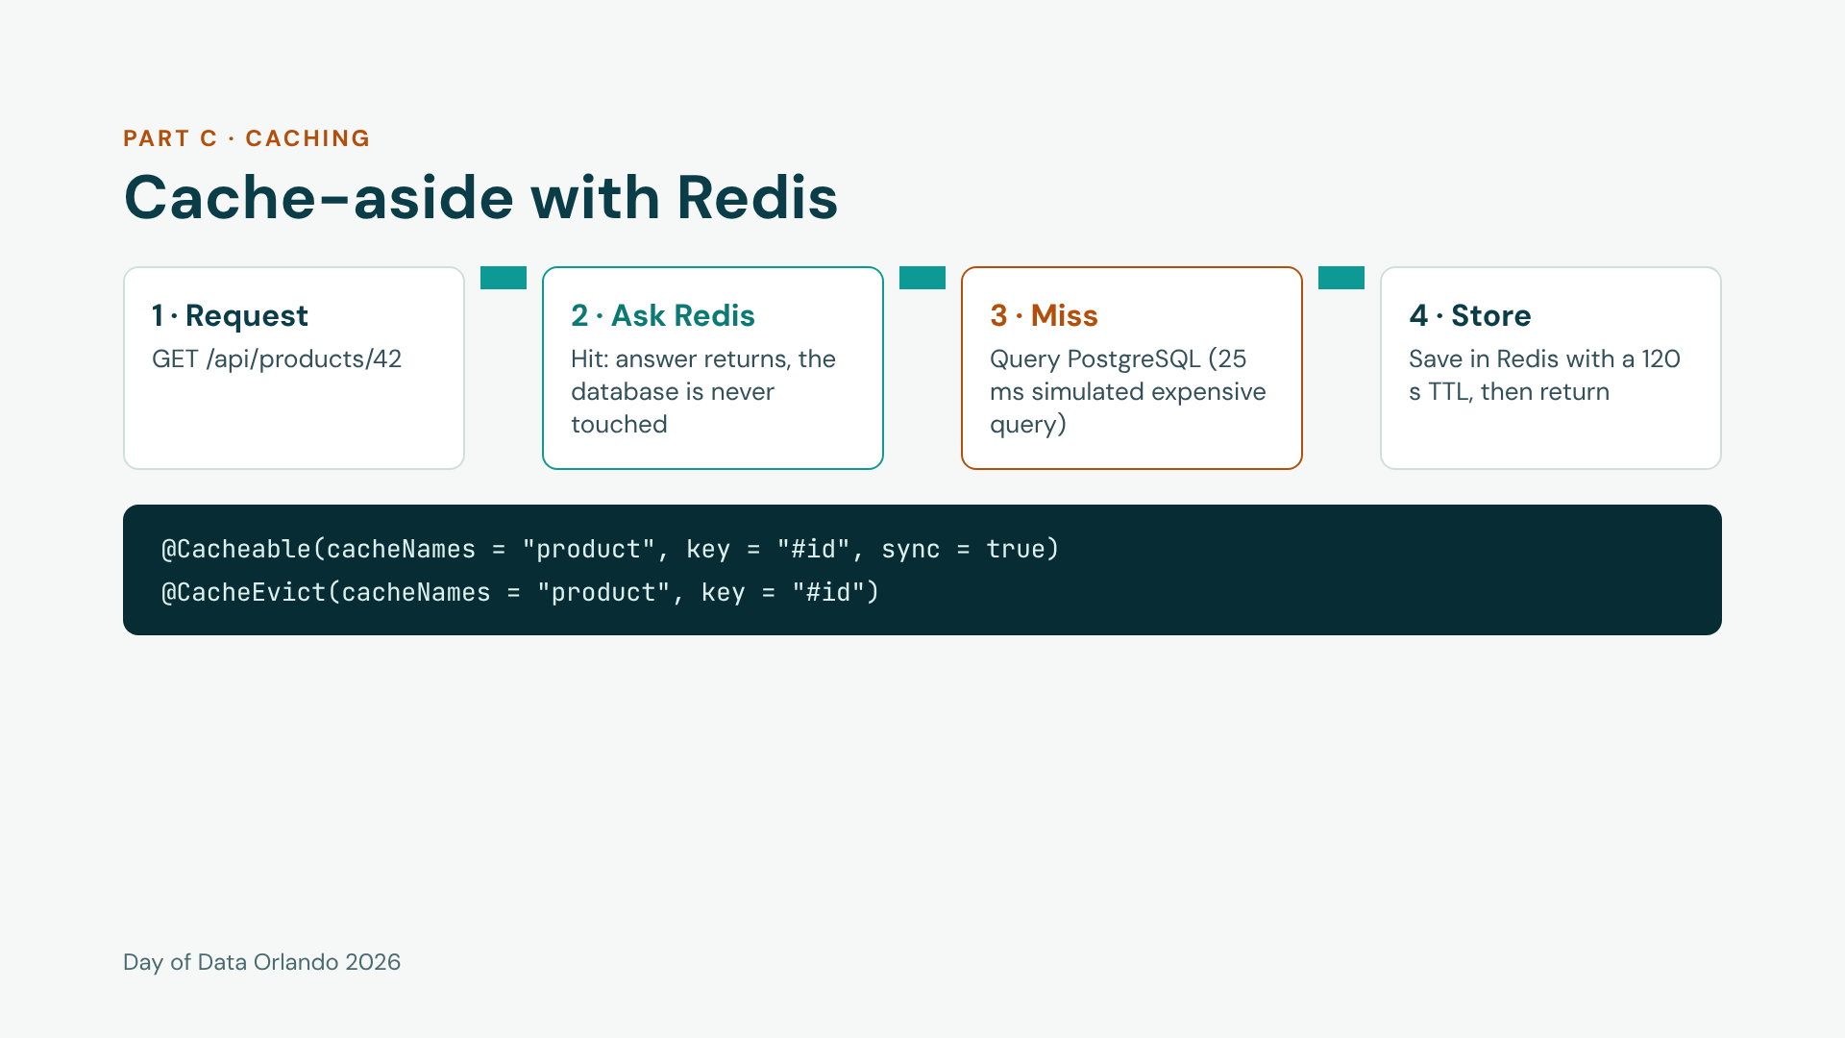
Notes:
Honesty point first: a primary-key lookup on a laptop is about 1 ms, so the database path includes a 25 ms pg_sleep standing in for an expensive join or aggregation. Say that out loud. Then walk the four steps. The cache is cache-aside: the application owns the logic and PostgreSQL stays the source of truth. Code: ProductService.

Slide 12
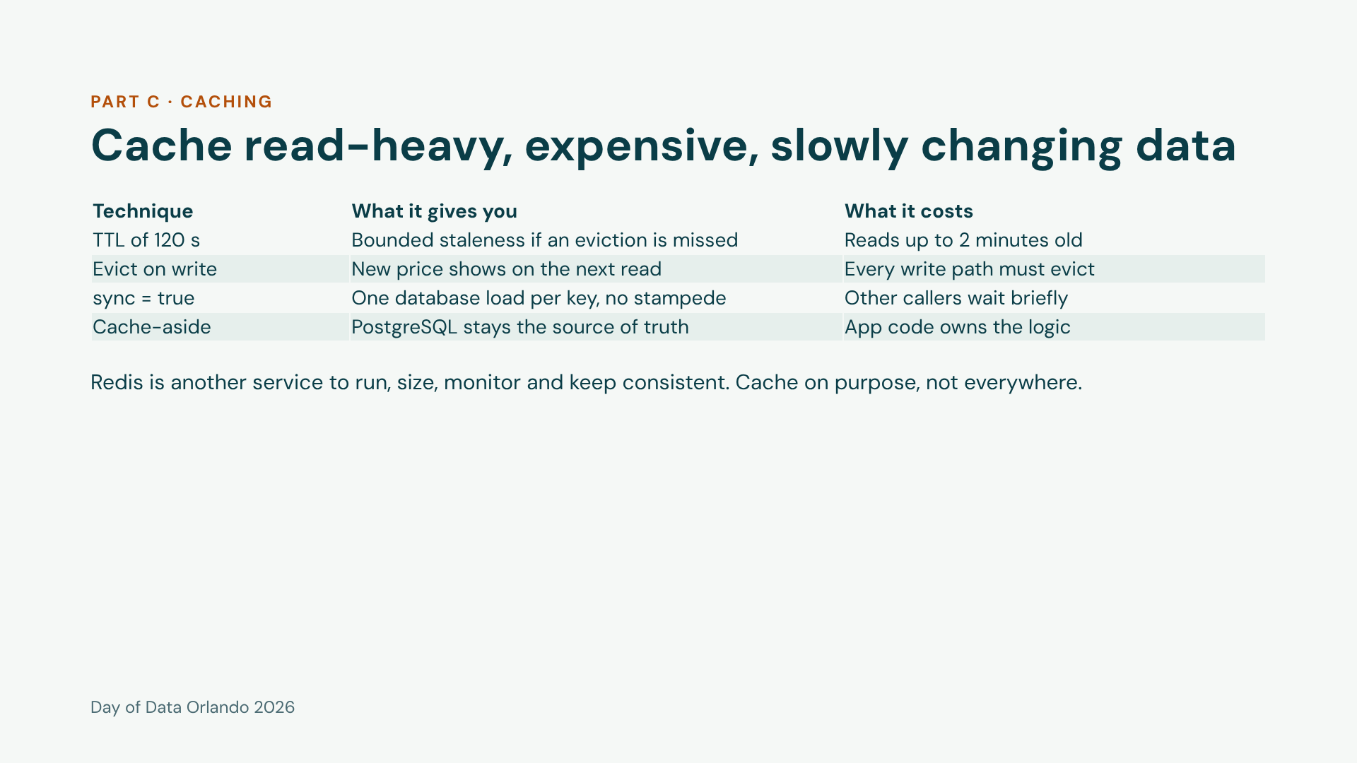
Notes:
sync=true is the stampede protection: when a thousand requests miss on the same key at the same moment, one goes to the database and the rest wait for its result. The TTL is a safety net for stale data, not the main invalidation strategy. Close with the cost line: a cache is not free.

Slide 13
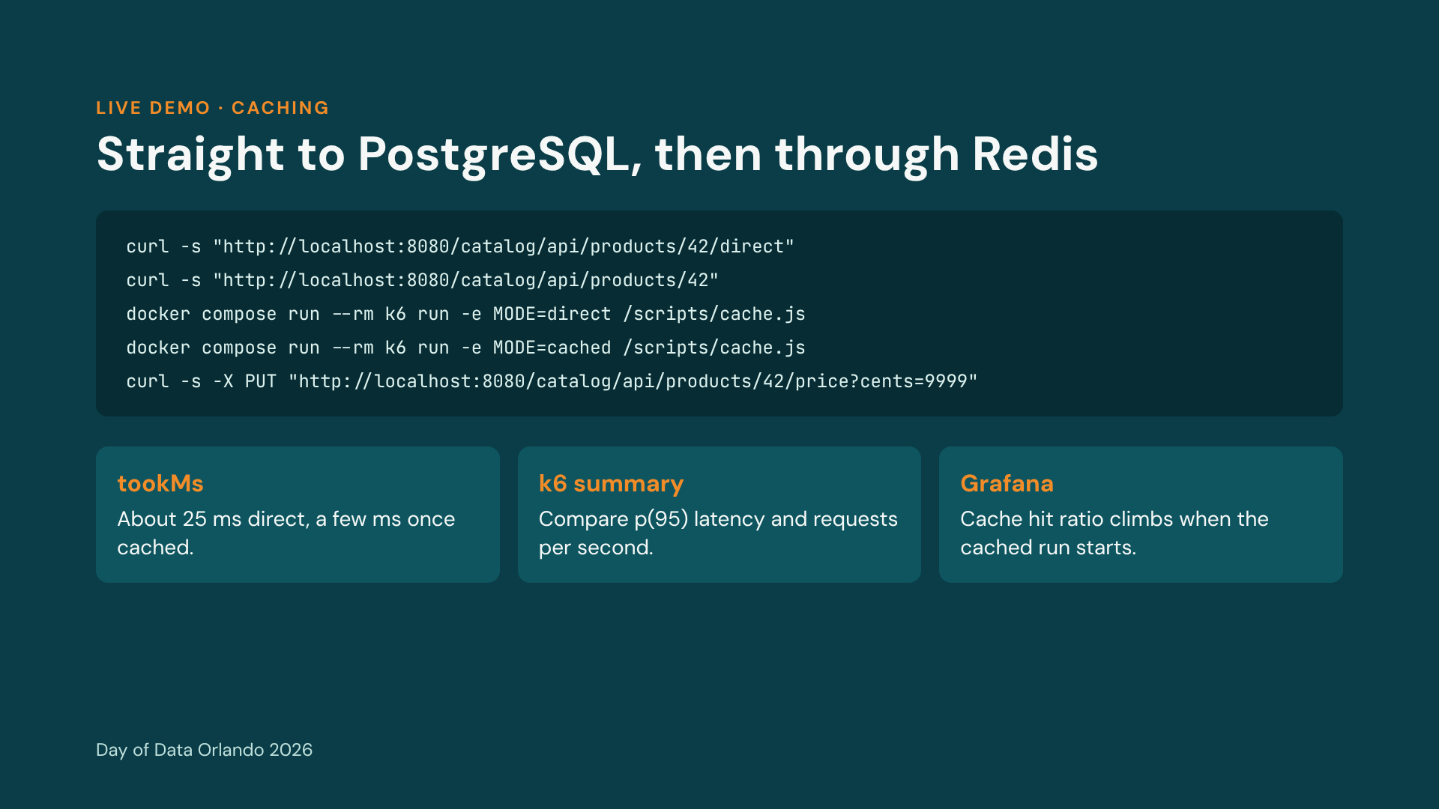
Notes:
Runbook section C. Each k6 run is 40 seconds; start the second one with Grafana already on screen so the audience sees the hit-ratio and latency panels move. The last command updates the price and evicts the key: read product 42 before and after to show the new priceCents of 9999. Expect the first read after the PUT to be a miss.

Slide 14
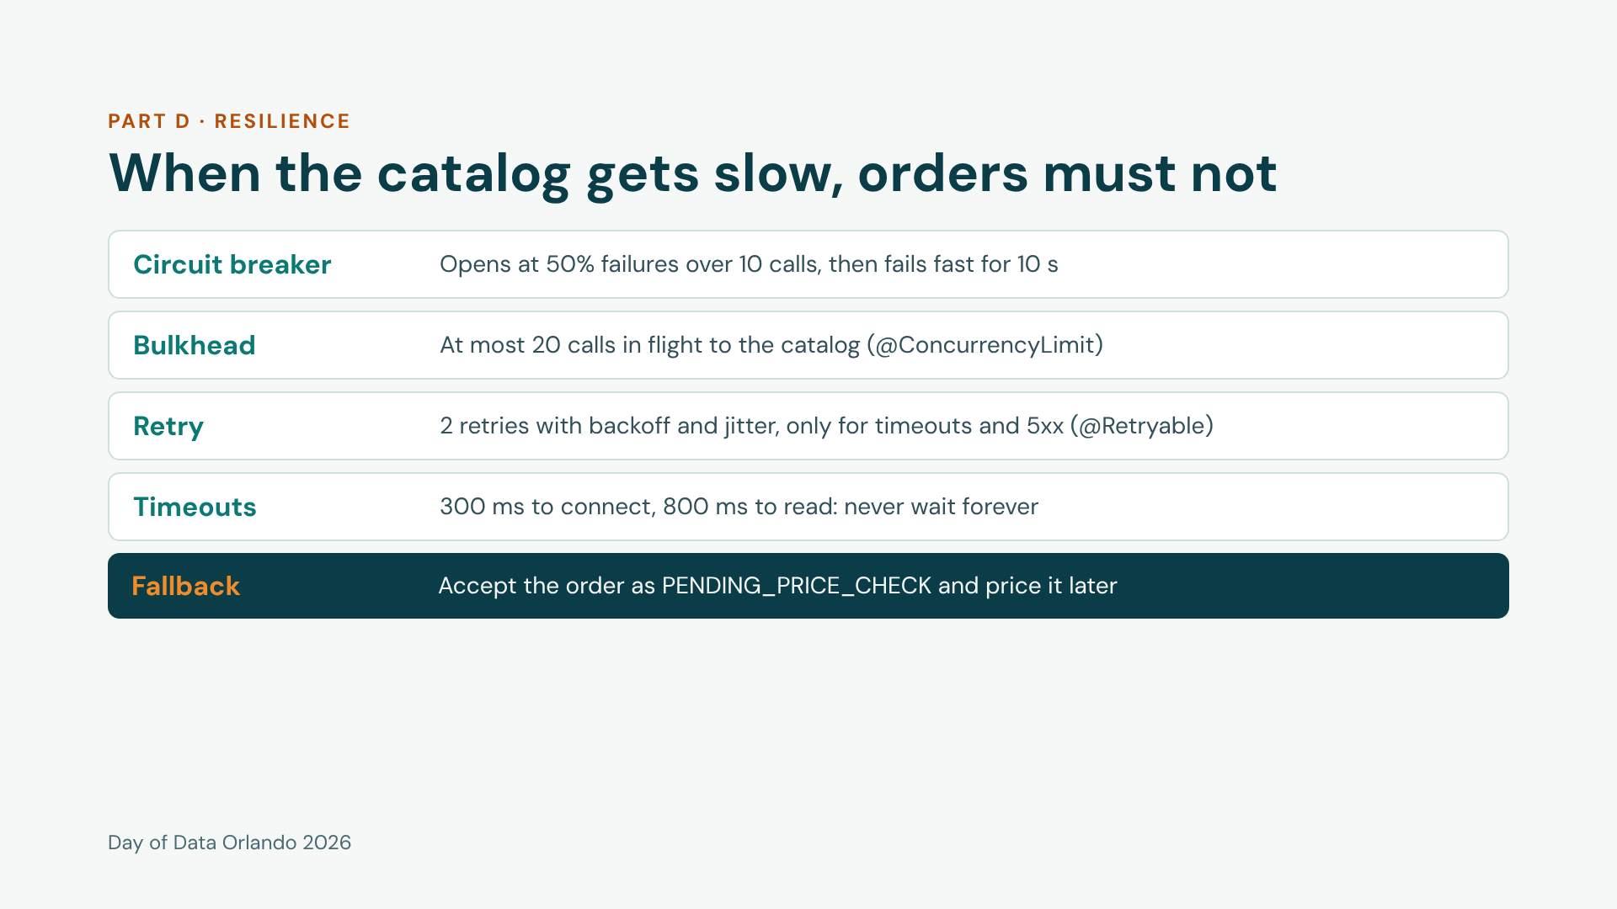
Notes:
Read the layers top to bottom in call order: the breaker wraps the bulkhead, which wraps the retry, which wraps the HTTP call with its timeouts. Retry and the concurrency limit are built into Spring Framework 7; Spring has no circuit breaker, so that one piece is the plain Resilience4j library. The fallback is a business decision, not a technical one: ask the business whether an order without a confirmed price is acceptable. Code: CatalogClient, CatalogHttp, CatalogBreaker.

Slide 15
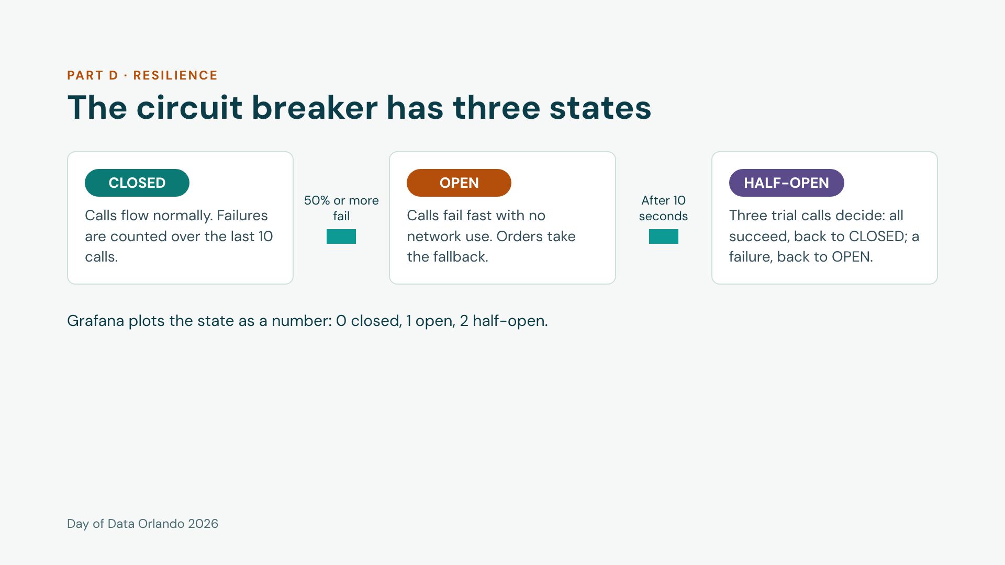
Notes:
Short slide, set up the demo. The breaker converts a slow failure into a fast, predictable one. A 404 from the catalog does not count as a failure: that is the caller's mistake, not evidence the catalog is unhealthy. Settings and a unit test are in CatalogBreaker and CatalogBreakerTest.

Slide 16
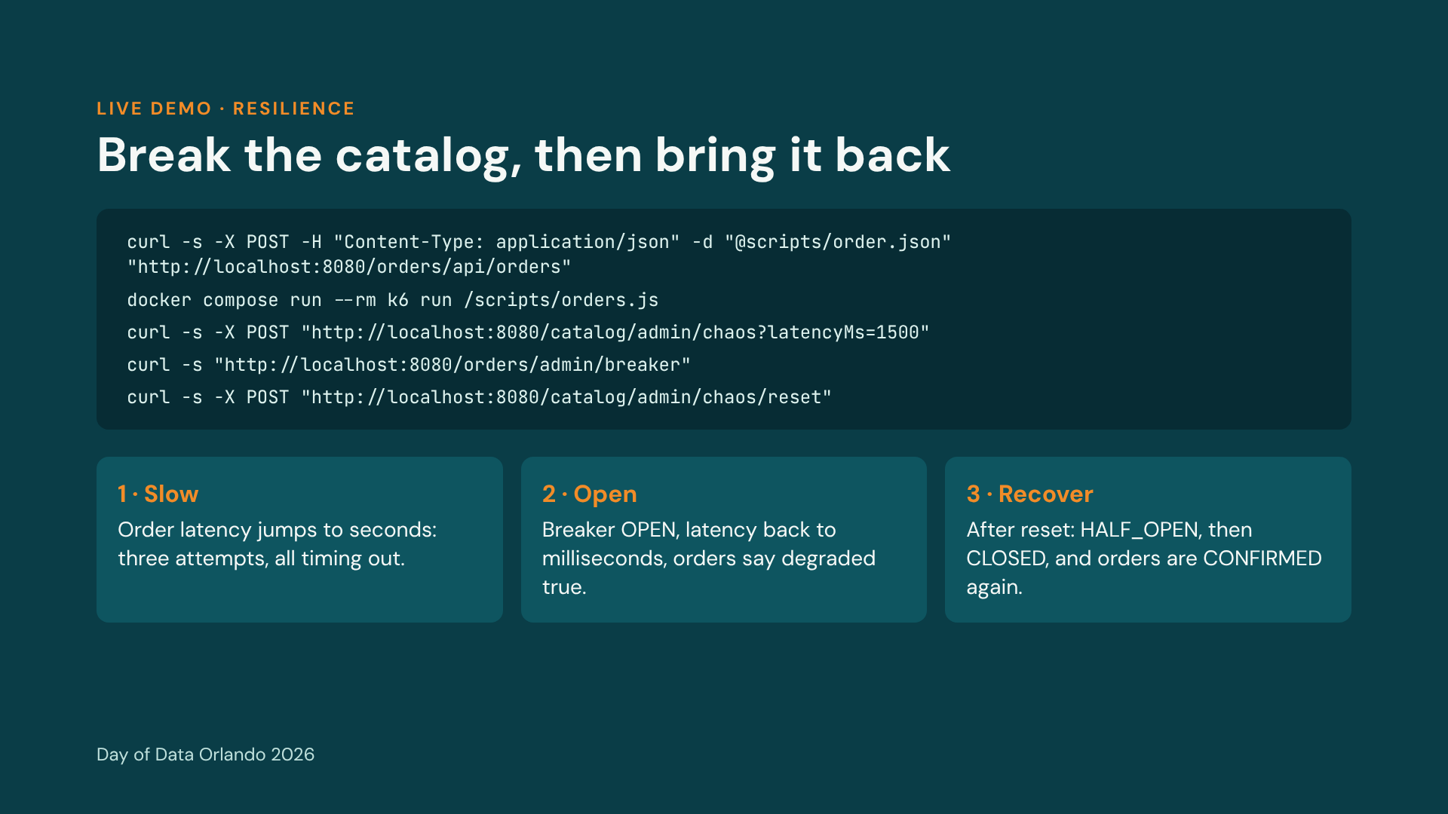
Notes:
Runbook section D. Run the k6 orders script in a second terminal and leave Grafana visible. Inject the latency, narrate the first 20 to 30 seconds, poll the breaker endpoint, place one order by hand to show degraded true, then open Jaeger for the trace before resetting. After the reset the breaker stays open for 10 seconds, then half-open for three trial calls. Optional variant if time allows: errorRate=0.6 instead of latency. Retries multiply load on a struggling service, which is why the bulkhead and jitter exist.

Slide 17
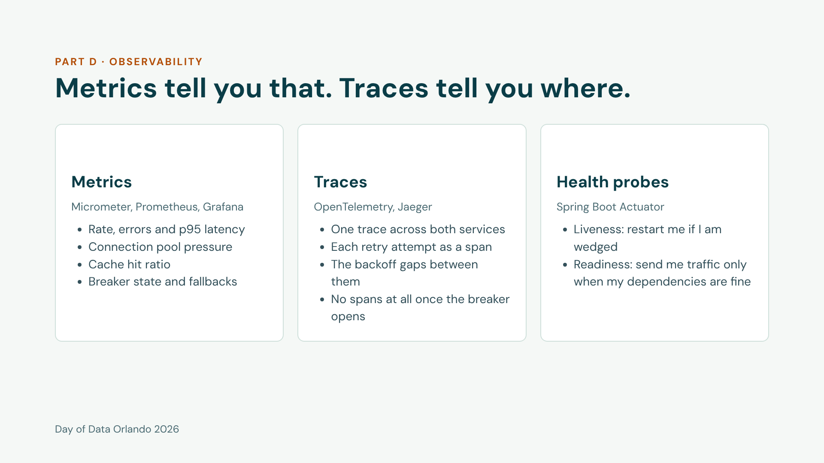
Notes:
Use this slide just before opening Jaeger in the resilience demo. Show a slow trace from before the breaker opened: the order request, three outbound attempts with gaps between them. Then a fast trace from after it opened: no outbound spans. Mention that sampling is set to 100% for the demo; in production sample, 10 percent is the Spring Boot default.

Slide 18
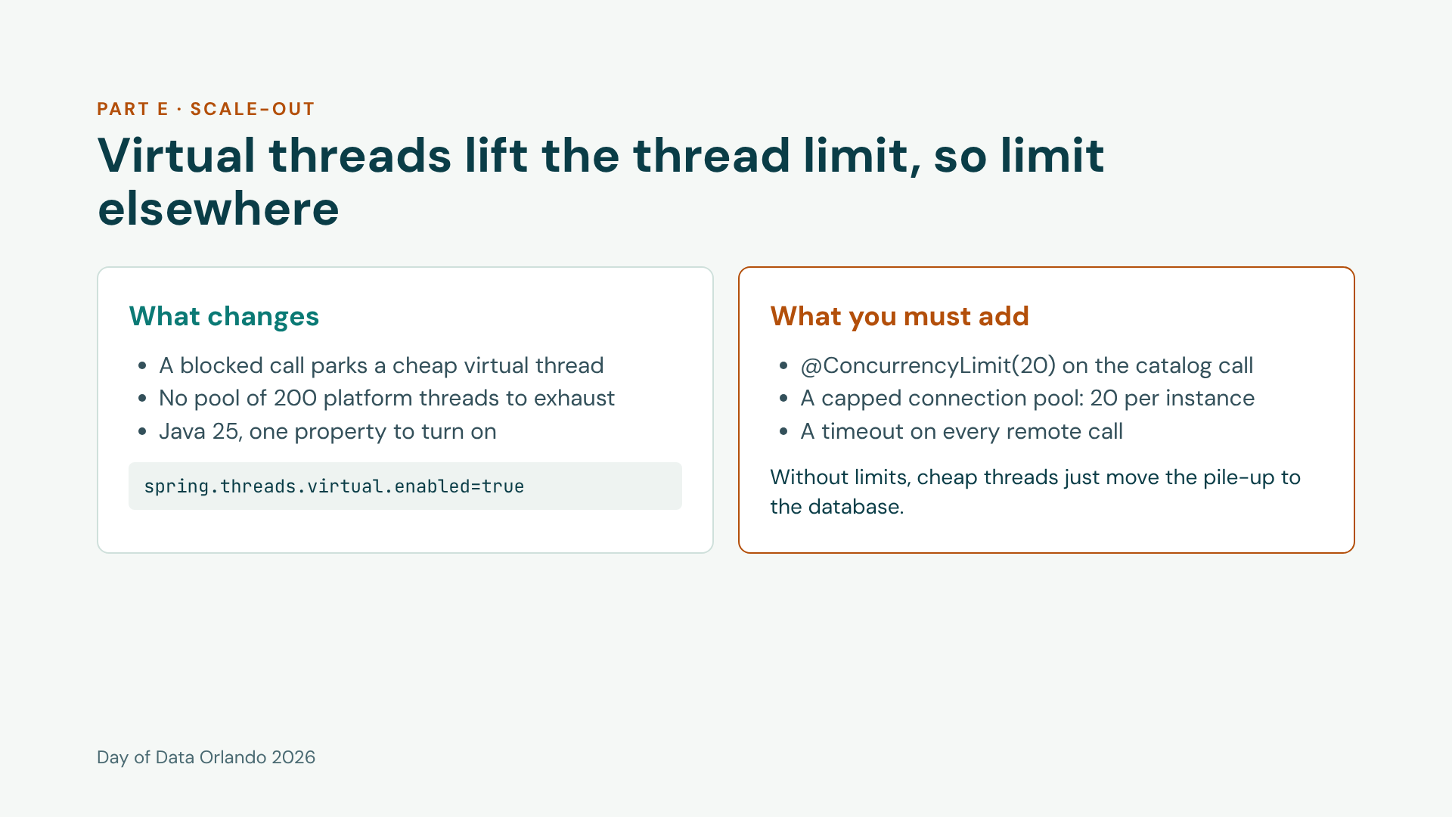
Notes:
Two-minute talk-through while a load test runs; show the JVM live threads panel. Optional A/B: restart both services with VIRTUAL_THREADS=false (the runbook has the Mac and Windows syntax) and repeat. The point is not that virtual threads are faster for everything, it is that blocking code becomes cheap, and cheap threads need explicit limits somewhere else.

Slide 19
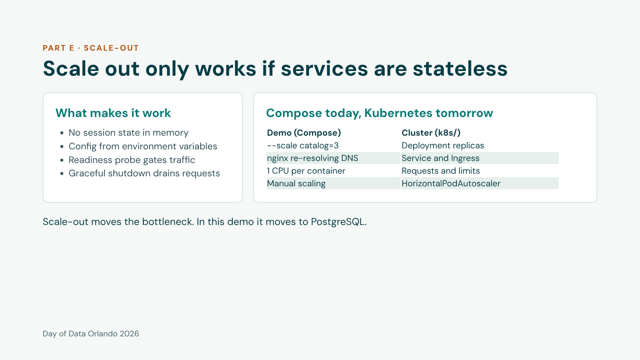
Notes:
Stateless means any replica can serve any request, because state lives in PostgreSQL and Redis. The k8s folder in the repo has Deployments with startup, liveness and readiness probes, resource limits, a preStop hook, a HorizontalPodAutoscaler at 65 percent CPU and a PodDisruptionBudget. They are reference manifests, not part of the live demo.

Slide 20
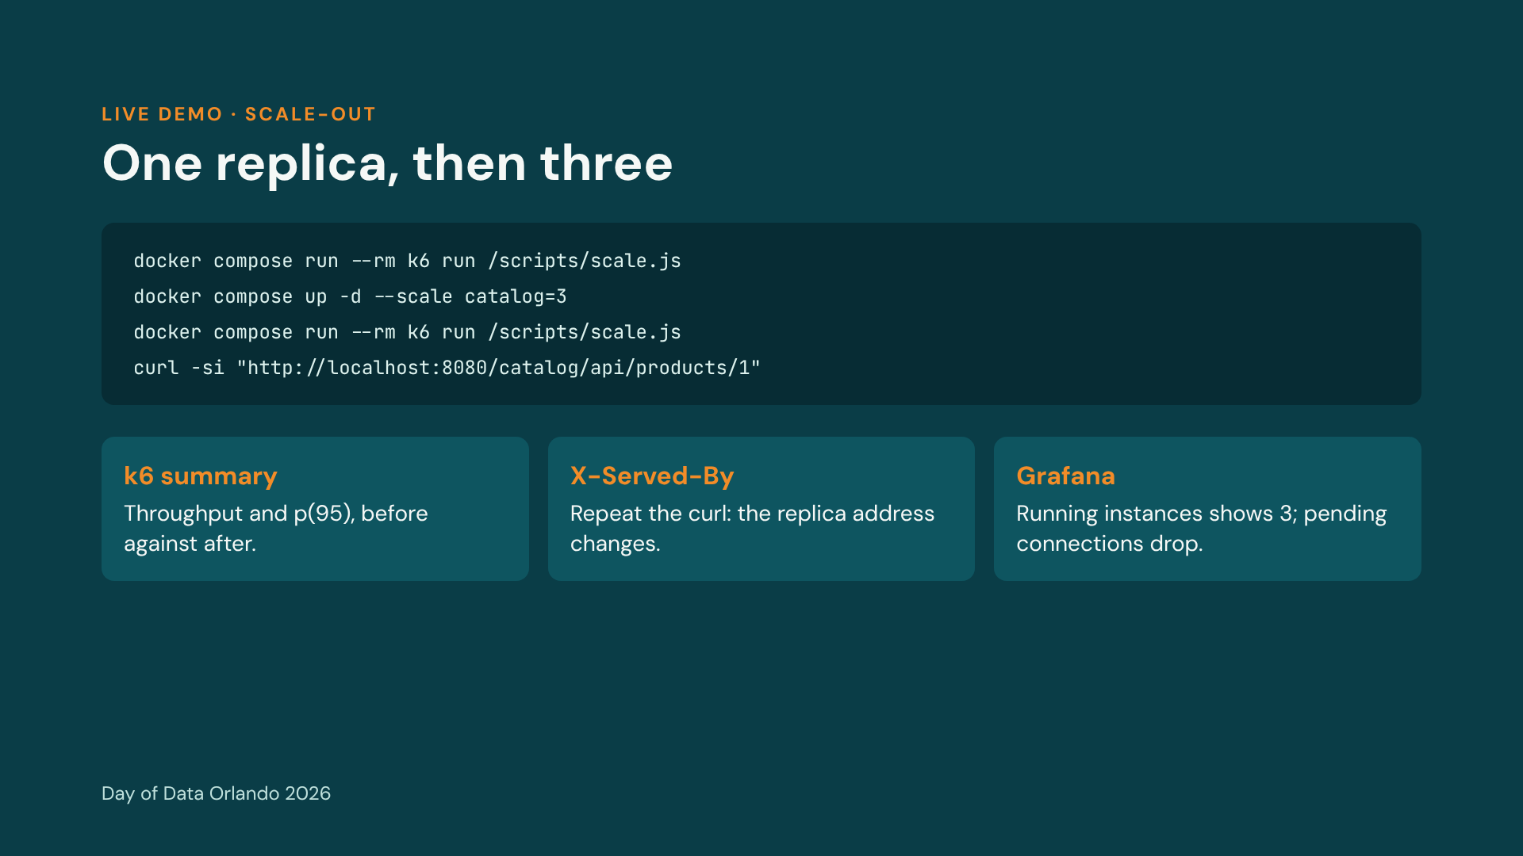
Notes:
Runbook section E. If you are behind, this is the segment to cut: say the story, show the Grafana screenshot from rehearsal, and give it as homework. Wait about 5 seconds after scaling so nginx re-resolves DNS. When finished, scale back with docker compose up -d --scale catalog=1. On Windows, filter the header with Select-String x-served-by instead of grep.

Slide 21
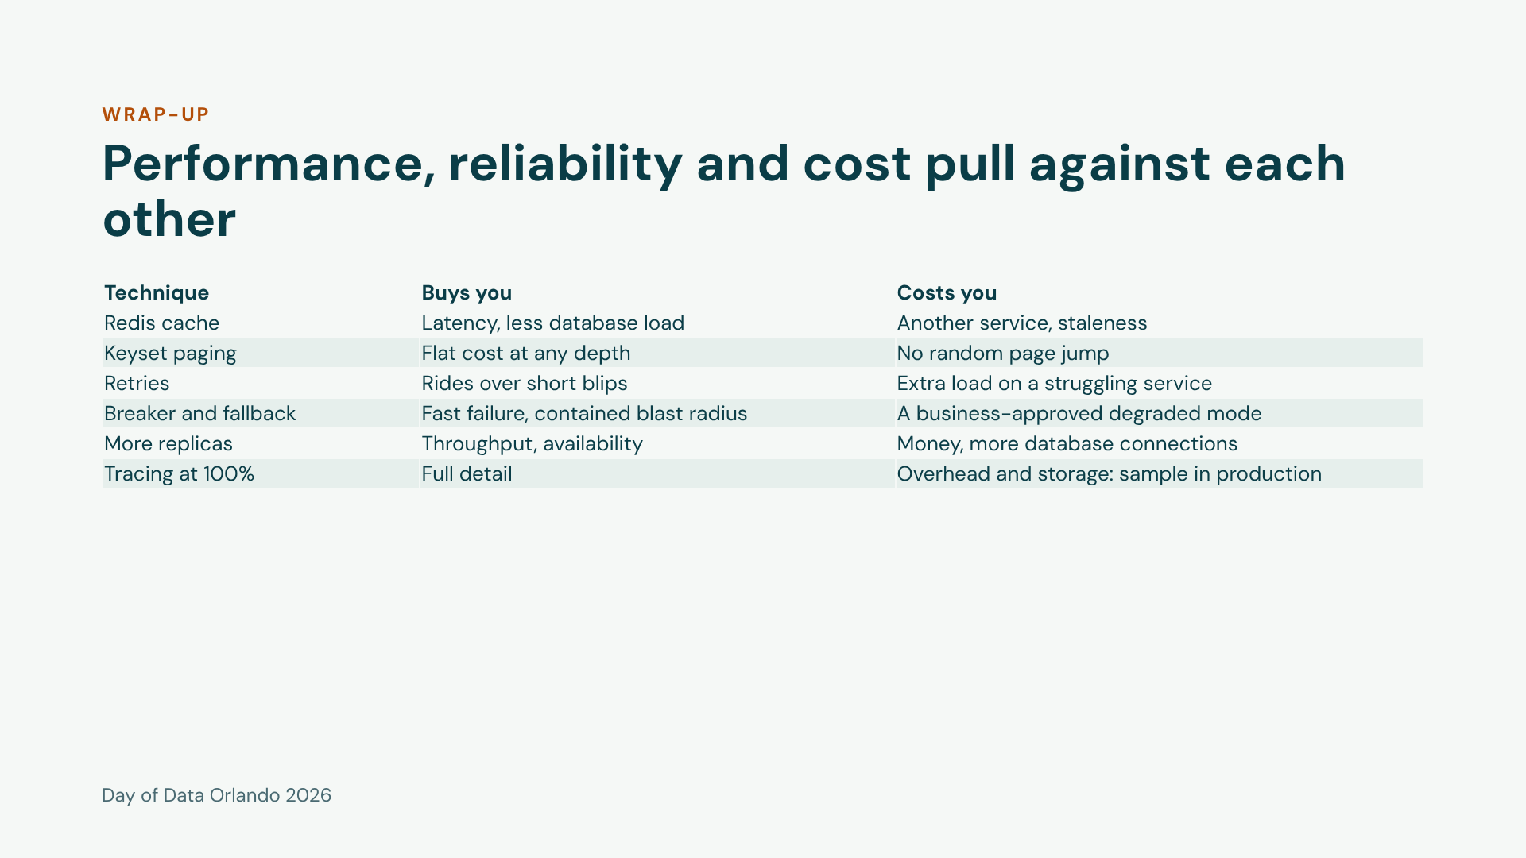
Notes:
Every technique today bought something and cost something. The skill is choosing on purpose, using the measurements you gathered first. Do not read the table row by row; pick the two or three the audience reacted to during the demos.

Slide 22
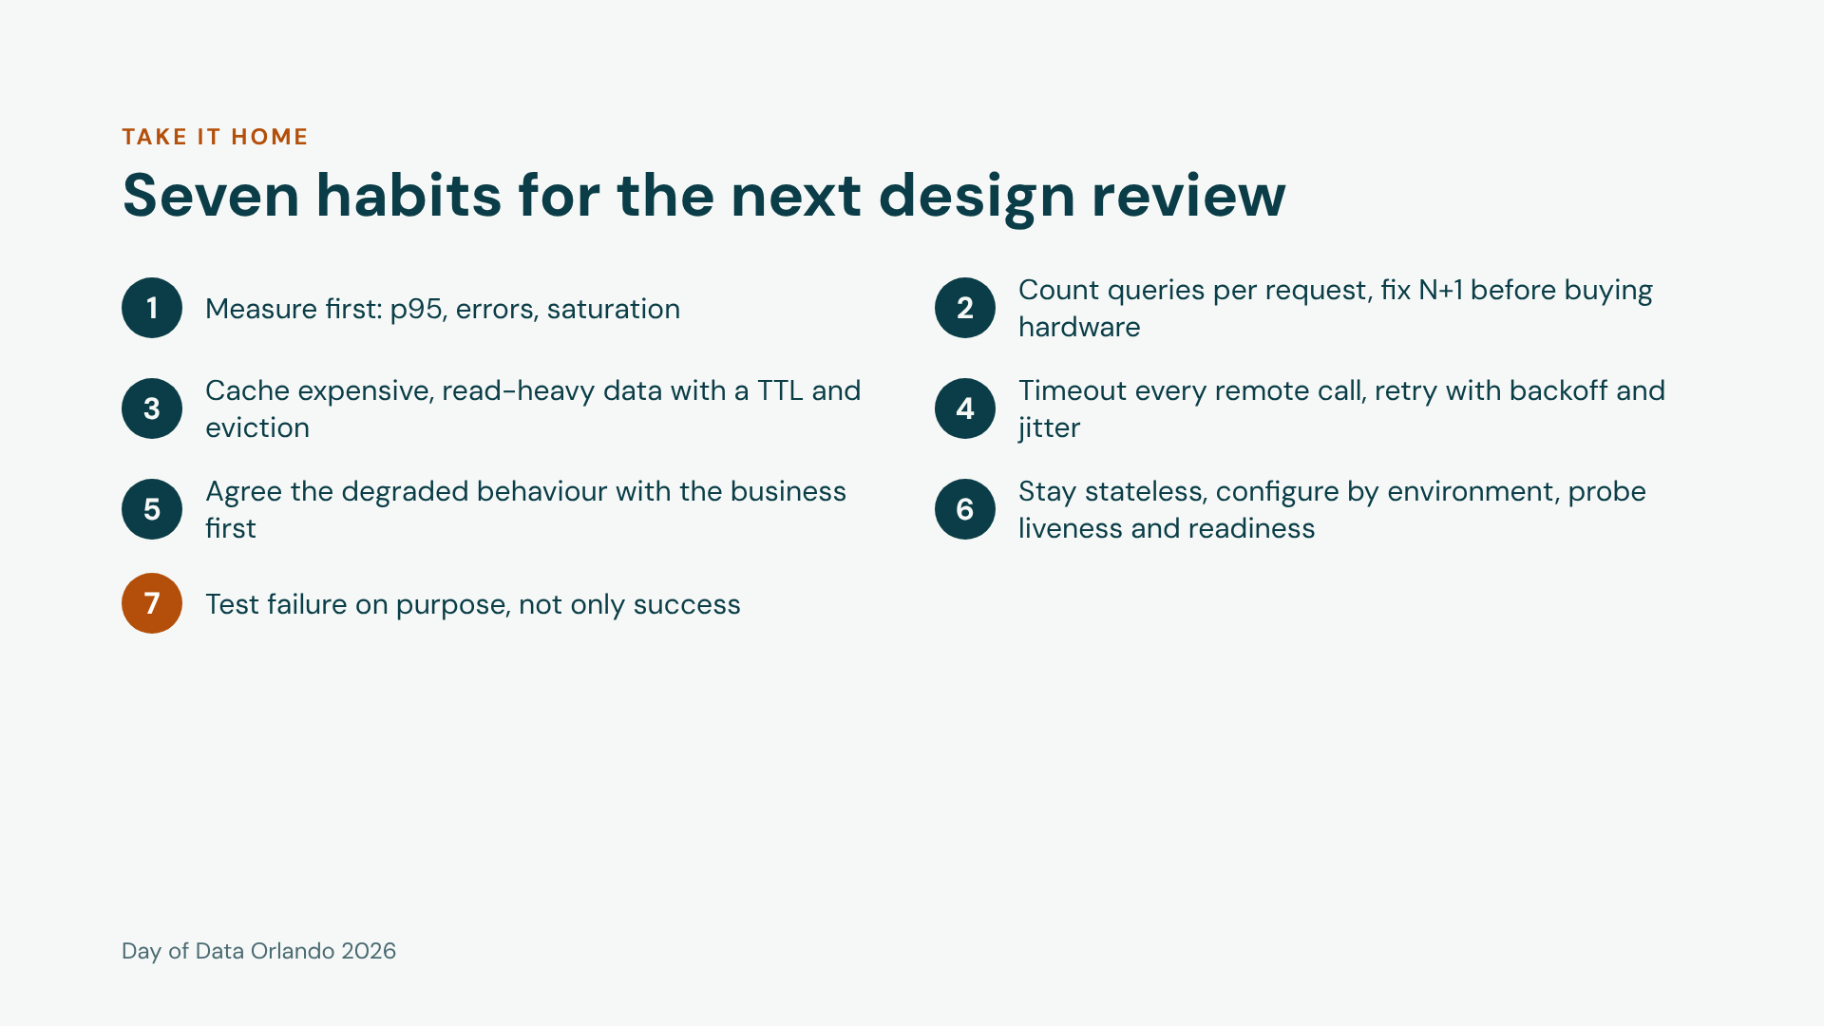
Notes:
Leave this slide up during questions. Each habit maps to a demo from the hour: 1 to the dashboard, 2 to N+1, 3 to caching, 4 and 5 and 7 to the resilience demo, 6 to scale-out.

Slide 23
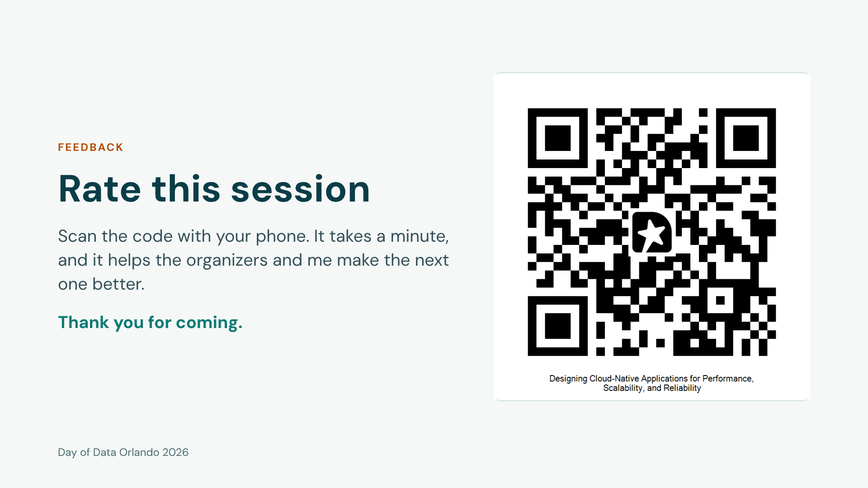
Notes:
Put this slide up before taking questions, or leave it on screen while people pack up. The QR code opens the session feedback page. Before presenting, scan it once with your own phone to confirm it opens the right page.

Slide 24
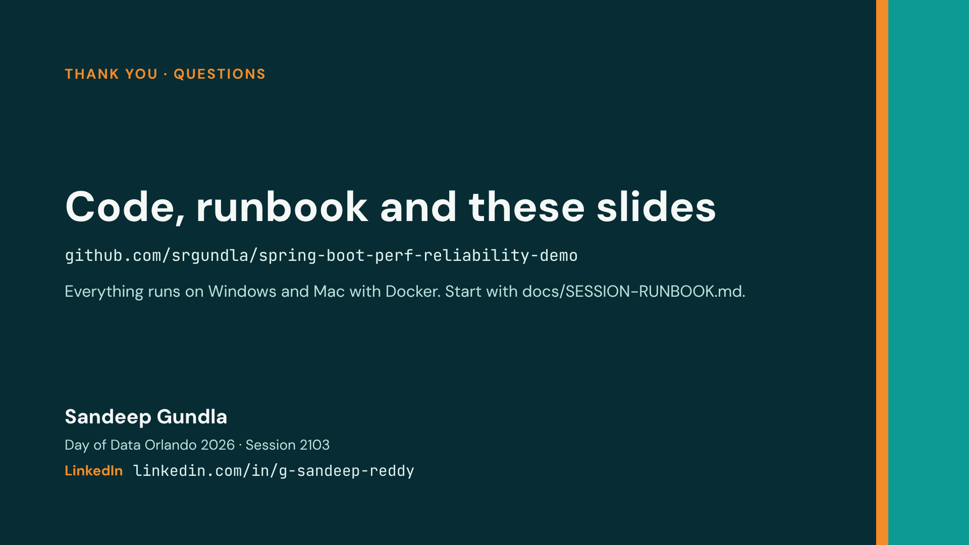
Notes:
Invite questions. Mention that the repo has the runbook, the Kubernetes manifests and the k6 scripts, and that the first build downloads about 1.5 GB so it is best done on good wifi. Invite people to connect on LinkedIn.

