Slide 1
Project 7
Sam Hardin
Sawyer Goodsel
Matthew Gilbert
Chunyan Li

Slide 2
Overview
Motivation
Dashboard
Data Extraction and Codebase
Benefit

Slide 3
Why Static Code Analysis
Many good commercial runtime profilers
Visualizing code thumbprints can give quick overall impression
Help identify areas to work on

Slide 4
Demo

Slide 5
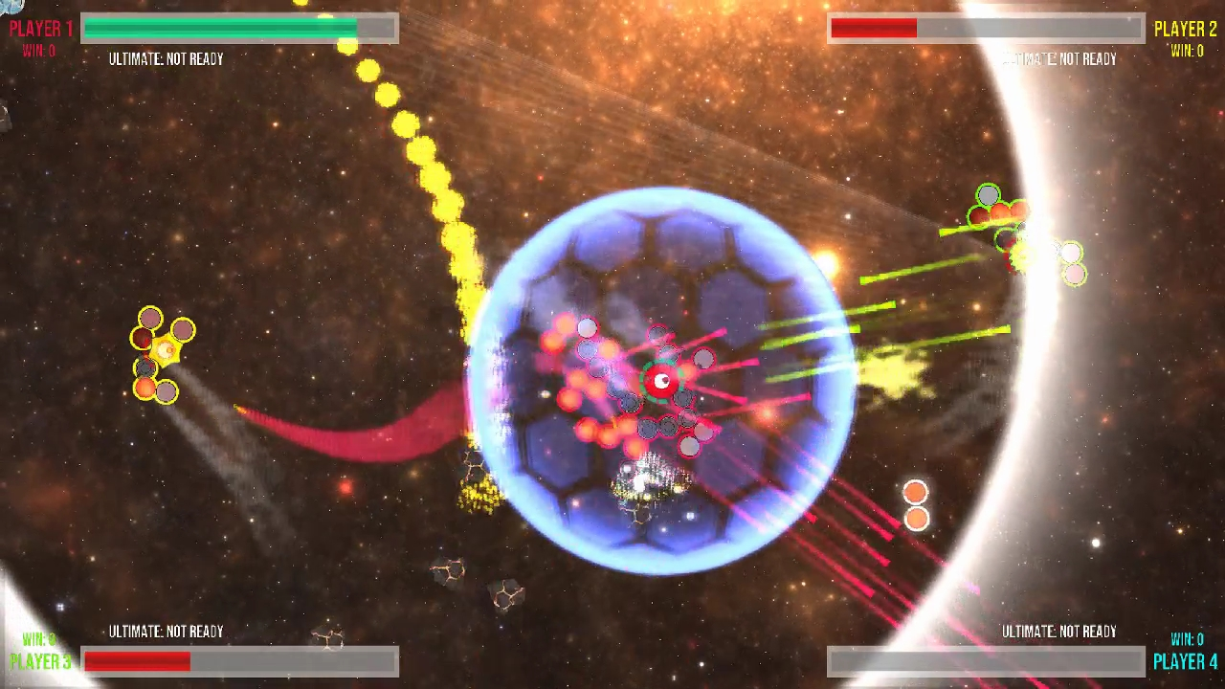
Codebase: Arcade Game Merge

Slide 6
Data
Keywords
Code versus comments
File size

Slide 7
Application
Identify outliers
Provide a unique visual representation of codebase

Slide 8
Future Work
Abstract Syntax Tree
Term Frequency – Inverse Document Frequency

Slide 9
Thank you

