Slide 1
Project 7

Slide 2
Motivation
Dashboard
Data Extraction and Codebase
Benefit

Slide 3
Why Static Code Analysis

Slide 4
Dashboard

Slide 5
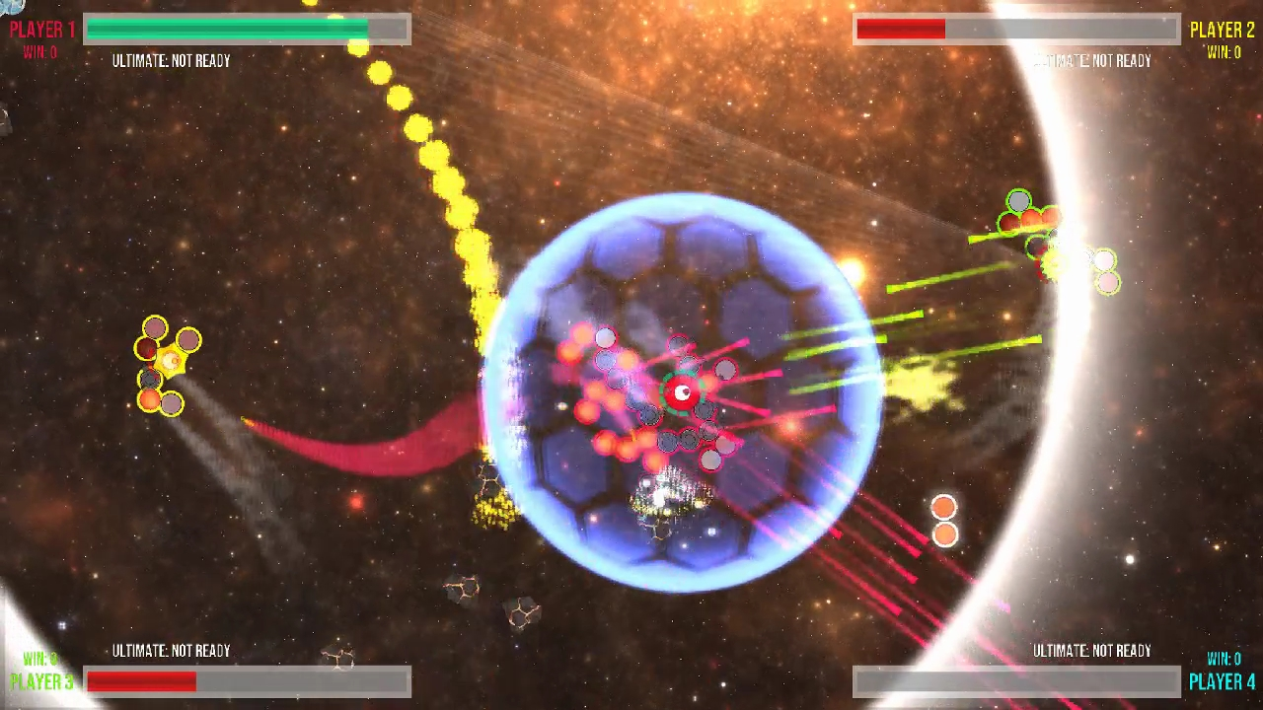
Codebase: Arcade Game Merge

Slide 6
Data

Slide 7
Application

Slide 8
Thank you

