Slide 1
Handling Churn in a DHT
USENIX Annual Technical Conference
June 29, 2004
Sean Rhea, Dennis Geels,
Timothy Roscoe, and John Kubiatowicz
UC Berkeley and Intel Research Berkeley

Slide 2
What’s a DHT?
Distributed Hash Table
  Peer-to-peer algorithm to offering put/get interface
  Associative map for peer-to-peer applications
More generally, provide lookup functionality
  Map application-provided hash values to nodes
  (Just as local hash tables map hashes to memory locs.)
  Put/get then constructed above lookup
Many proposed applications
  File sharing, end-system multicast, aggregation trees
Notes:
Existing systems means Gnutella
Think of the ID as the hash value used by a traditional hash table
Think of the node that the ID is hashed to as the memory location mapped to in a traditional hash table
In the same way that Perl is based around hash tables, assumption is that generalized hash table functionality would be just as useful in peer-to-peer applications
First trick is then to perform this mapping from hash values to nodes, call it lookup

Slide 3
How Does Lookup Work?
Source
Assign IDs to nodes
  Map hash values to node with closest ID
Leaf set is successors and predecessors
  All that’s needed for correctness
Routing table matches successively longer prefixes
  Allows efficient lookups
111…
0…
110…
Response
10…
Lookup ID
Notes:
Each node is assigned an ID randomly
IDs are arranged into a ring by numerical order, top ID wraps around to 0
Each node maintains two sets of neighbors, its leaf set and routing table
Leaf set is immediate predecessor and successor
Routing table neighbors resolve successively longer matching prefixes of node’s own ID
Lookup queries are routed greedily to node with closest matching ID (numerically, not lexigraphically)
Response is sent directly to querying node
Lookup handled differently in other DHTs; see Gummadi et al.’s SIGCOMM paper for details

Slide 4
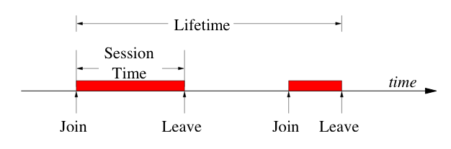
Why Focus on Churn?
  Chord is a “scalable protocol for lookup in a dynamic peer-to-peer system with frequent node arrivals and departures”
  -- Stoica et al., 2001
Authors | Systems Observed | Session Time
SGG02 | Gnutella, Napster | 50% < 60 minutes
CLL02 | Gnutella, Napster | 31% < 10 minutes
SW02 | FastTrack | 50% < 1 minute
BSV03 | Overnet | 50% < 60 minutes
GDS03 | Kazaa | 50% < 2.4 minutes
Notes:
So we want to focus on lookup, but why churn?
At the very least, we know that churn is prevalent in deployed P2P systems, and it’s pretty bad
Many other DHT applications might see lighter churn, or may not work at all under churn, but why not shoot for the moon?
After all, DHTs were once proposed as being able to help build better P2P systems, and can only assume this includes file-sharing systems, the one clearly successful P2P application

Slide 5
A Simple lookup Test
Start up 1,000 DHT nodes on ModelNet network
  Emulates a 10,000-node, AS-level topology
  Unlike simulations, models cross traffic and packet loss
  Unlike PlanetLab, gives reproducible results
Churn nodes at some rate
  Poisson arrival of new nodes
  Random node departs on every new arrival
  Exponentially distributed session times
Each node does 1 lookup every 10 seconds
  Log results, process them after test

Slide 6
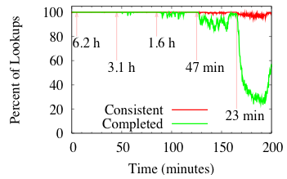
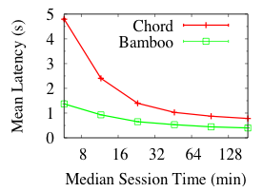
Early Test Results
Tapestry (the OceanStore DHT) falls over completely
  Worked great in simulations, but not on more realistic network
  Despite sharing almost all code between the two
And the problem isn’t limited to Tapestry:
Notes:
Built OceanStore on Tapestry, worked well as long as there were no failures, but not so well otherwise
Decided to generate a DHT benchmark as a metric of success
Once started benchmarking with node failures and arrivals (called churn), nothing worked, not Tapestry, not Chord, and not Pastry!
Started building Bamboo to handle churn
At the same time, other DHTs were improving, too. See the paper for their current performance numbers.
Rather that study benchmark results, decided to focus on why some implementations did well while others didn’t.
Used Bamboo because we had it handy, and we understood the code
To limit the scope of the study, decided to focus only on lookup functionality
At any rate, correct, quick lookups are necessary to get other functionality to handle churn

Slide 7
Handling Churn in a DHT
Forget about comparing different impls.
  Too many differing factors
  Hard to isolate effects of any one feature
Implement all relevant features in one DHT
  Using Bamboo (similar to Pastry)
Isolate important issues in handling churn
  Recovering from failures
  Routing around suspected failures
  Proximity neighbor selection

Slide 8
Recovering From Failures
For correctness, maintain leaf set during churn
  Also routing table, but not needed for correctness
The Basics
  Ping new nodes before adding them
  Periodically ping neighbors
  Remove nodes that don’t respond
Simple algorithm
  After every change in leaf set, send to all neighbors
  Called reactive recovery

Slide 9
The Problem With Reactive Recovery
Under churn, many pings and change messages
  If bandwidth limited, interfere with each other
  Lots of dropped pings looks like a failure
Respond to failure by sending more messages
  Probability of drop goes up
  We have a positive feedback cycle (squelch)
Can break cycle two ways
  Limit probability of “false suspicions of failure”
  Recovery periodically

Slide 10
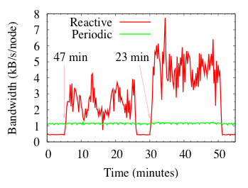
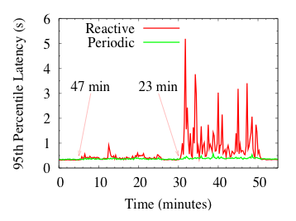
Periodic Recovery
Periodically send whole leaf set to a random member
  Breaks feedback loop
  Converges in O(log N)
Back off period on message loss
  Makes a negative feedback cycle (damping)

Slide 11
Routing Around Failures
Being conservative increases latency
  Original next hop may have left network forever
  Don’t want to stall lookups
DHT has many possible routes
  But retrying too soon leads to packet explosion
Goal:
  Know for sure that packet is lost
  Then resend along different path

Slide 12
Calculating Good Timeouts
Use TCP-style timers
  Keep past history of latencies
  Use this to compute timeouts for new requests
Works fine for recursive lookups
  Only talk to neighbors, so history small, current
Recursive
Iterative
In iterative lookups, source directs entire lookup
  Must potentially have good timeout for any node
Notes:
Mention that all implementations actually use UDP, since there’s no access to TCP’s internal information about timeouts, estimated latencies, etc.

Slide 13
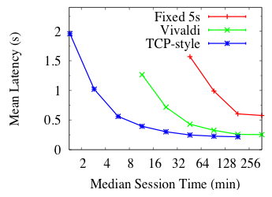
Virtual Coordinates
Machine learning algorithm to estimate latencies
  Distance between coords. proportional to latency
  Called Vivaldi; used by MIT Chord implementation
Compare with TCP-style under recursive routing
  Insight into cost of iterative routing due to timeouts

Slide 14
Proximity Neighbor Selection (PNS)
For each neighbor, may be many candidates
  Choosing closest with right prefix called PNS
  One of the most researched areas in DHTs
  Can we achieve good PNS under churn?
Remember:
  leaf set for correctness
  routing table for efficiency?
Insight: extend this philosophy
  Any routing table gives O(log N) lookup hops
  Treat PNS as an optimization only
  Find close neighbors by simple random sampling
Notes:
Mention that there’s no point in finding a close neighbor who’s about to die

Slide 15
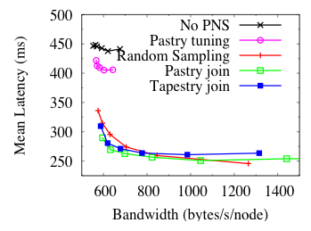
PNS Results
(very abbreviated--see paper for more)
Random sampling almost as good as everything else
  24% latency improvement free
  42% improvement for 40% more b.w.
  Compare to 68%-84% improvement by using good timeouts
Other algorithms more complicated, not much better

Slide 16
Related Work
Liben-Nowell et al.
  Analytical lower bound on maintenance costs
Mahajan et al.
  Simulation-based study of Pastry under churn
  Automatic tuning of maintenance rate
  Suggest increasing rate on failures!
Other simulations
  Li et al.
  Lam and Liu
Zhuang
  Cooperative failure detection in DHTs
Dabek et al.
  Throughput and latency improvements w/o churn

Slide 17
Future Work
Continue study of iterative routing
  Have shown virtual coordinates good for timeouts
  How does congestion control work under churn?
Broaden methodology
  Better network and churn models
Move beyond lookup layer
  Study put/get and multicast algorithms under churn

Slide 18
Conclusions/Recommendations
Avoid positive feedback cycles in recovery
  Beware of “false suspicions of failure”
  Recover periodically rather than reactively
Route around potential failures early
  Don’t wait to conclude definite failure
  TCP-style timeouts quickest for recursive routing
  Virtual-coordinate-based timeouts not prohibitive
PNS can be cheap and effective
  Only need simple random sampling

Slide 19
For code and more information: bamboo-dht.org

