Slide 1

A Public DHT Service
Sean Rhea, Brighten Godfrey, Brad Karp,
John Kubiatowicz, Sylvia Ratnasamy,
Scott Shenker, Ion Stoica, and Harlan Yu
UC Berkeley and Intel Research
August 23, 2005

Slide 2
Two Assumptions
Most of you have a pretty good idea how to build a DHT
Many of you would like to forget

Slide 3
My talk today:
How to avoid building one
Notes:
Mean “building” in both the sense of implementing a DHT, and in the sense of deploying one.

Slide 4
DHT Deployment Today
PAST
(MSR/
Rice)
i3
(UCB)
Overnet
(open)
CFS
(MIT)
OStore
(UCB)
pSearch
(HP)
Coral
(NYU)
PIER
(UCB)
Chord
DHT
Pastry
DHT
Tapestry
DHT
CAN
DHT
Kademlia
DHT
Chord
DHT
Bamboo
DHT
Kademlia
DHT
  Every application deploys its own DHT
  (DHT as a library)
IP
connectivity

Slide 5
DHT Deployment Tomorrow?
PAST
(MSR/
Rice)
i3
(UCB)
Overnet
(open)
CFS
(MIT)
OStore
(UCB)
pSearch
(HP)
Coral
(NYU)
PIER
(UCB)
Chord
DHT
Pastry
DHT
Tapestry
DHT
CAN
DHT
Kademlia
DHT
Chord
DHT
Bamboo
DHT
Kademlia
DHT
DHT
indirection
OpenDHT: one DHT, shared across applications
(DHT as a service)
IP
connectivity

Slide 6
Two Ways To Use a DHT
The Library Model
  DHT code is linked into application binary
  Pros: flexibility, high performance
The Service Model
  DHT accessed as a service over RPC
  Pros: easier deployment, less maintenance

Slide 7
The OpenDHT Service
200-300 Bamboo [USENIX’04] nodes on PlanetLab
  All in one slice, all managed by us
Clients can be arbitrary Internet hosts
  Access DHT using RPC over TCP
Interface is simple put/get:
  put(key, value) — stores value under key
  get(key) — returns all the values stored under key
Running on PlanetLab since April 2004
  Building a community of users

Slide 8
OpenDHT Applications
Application | Uses OpenDHT for
Croquet Media Manager | replica location
DOA | indexing
HIP | name resolution
DTN Tetherless Computing Architecture | host mobility
Place Lab | range queries
QStream | multicast tree construction
VPN Index | indexing
DHT-Augmented Gnutella Client | rare object search
FreeDB | storage
Instant Messaging | rendezvous
CFS | storage
i3 | redirection

Slide 9
OpenDHT Benefits
OpenDHT makes applications
  Easy to build
    Quickly bootstrap onto existing system
  Easy to maintain
    Don’t have to fix broken nodes, deploy patches, etc.
Best illustrated through example

Slide 10
An Example Application:
The CD Database
Compute Disc
Fingerprint
Recognize Fingerprint?
Album & Track Titles

Slide 11
An Example Application:
The CD Database
Type In Album and
Track Titles
Album & Track Titles
No Such Fingerprint

Slide 12
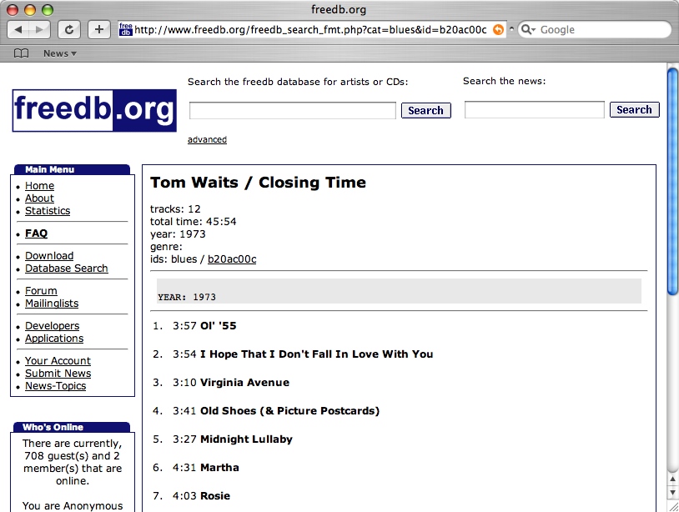
Picture of FreeDB

Slide 13
A DHT-Based FreeDB Cache
FreeDB is a volunteer service
  Has suffered outages as long as 48 hours
  Service costs born largely by volunteer mirrors
Idea: Build a cache of FreeDB with a DHT
  Add to availability of main service
  Goal: explore how easy this is to do

Slide 14
Cache Illustration
DHT
DHT
New Albums
Disc Fingerprint
Disc Info
Disc Fingerprint

Slide 15
Building a FreeDB Cache Using the Library Approach
Download Bamboo/Chord/FreePastry
Configure it
Register a PlanetLab slice
Deploy code using Stork
Configure AppManager to keep it running
Register some gateway nodes under DNS
Dump database into DHT
Write a proxy for legacy FreeDB clients

Slide 16
Building a FreeDB Cache Using the Service Approach
Dump database into DHT
Write a proxy for legacy FreeDB clients
We built it
  Called FreeDB on OpenDHT (FOOD)

Slide 17
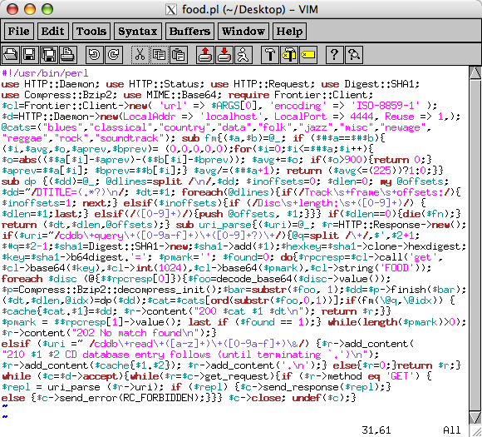
food.pl

Slide 18
Building a FreeDB Cache Using the Service Approach
Dump database into DHT
Write a proxy for legacy FreeDB clients
We built it
  Called FreeDB on OpenDHT (FOOD)
  Cache has ↓ latency, ↑ availability than FreeDB

Slide 19
Talk Outline
Introduction and Motivation
Challenges in building a shared DHT
  Sharing between applications
  Sharing between clients
Current Work
Conclusion

Slide 20
Is Providing DHT Service Hard?
Is it any different than just running Bamboo?
  Yes, sharing makes the problem harder
OpenDHT is shared in two senses
  Across applications → need a flexible interface
  Across clients → need resource allocation

Slide 21
Sharing Between Applications
Must balance generality and ease-of-use
  Many apps (FOOD) want only simple put/get
  Others want lookup, anycast, multicast, etc.
OpenDHT allows only put/get
  But use client-side library, ReDiR, to build others
  Supports lookup, anycast, multicast, range search
  Only constant latency increase on average
  (Different approach used by DimChord [KR04])

Slide 22
Sharing Between Clients
Must authenticate puts/gets/removes
  If two clients put with same key, who wins?
  Who can remove an existing put?
Must protect system’s resources
  Or malicious clients can deny service to others
  The remainder of this talk

Slide 23
Protecting Storage Resources
Resources include network, CPU, and disk
  Existing work on network and CPU
  Disk less well addressed
As with network and CPU:
  Hard to distinguish malice from eager usage
  Don’t want to hurt eager users if utilization low
Unlike network and CPU:
  Disk usage persists long after requests are complete
Standard solution: quotas
  But our set of active users changes over time

Slide 24
Fair Storage Allocation
Our solution: give each client a fair share
  Will define “fairness” in a few slides
Limits strength of malicious clients
  Only as powerful as they are numerous
Protect storage on each DHT node separately
  Global fairness is hard
  Key choice imbalance is a burden on DHT
  Reward clients that balance their key choices

Slide 25
Two Main Challenges
Making sure disk is available for new puts
  As load changes over time, need to adapt
  Without some free disk, our hands are tied
Allocating free disk fairly across clients
  Adapt techniques from fair queuing

Slide 26
Making Sure Disk is Available
Can’t store values indefinitely
  Otherwise all storage will eventually fill
Add time-to-live (TTL) to puts
  put (key, value) → put (key, value, ttl)
  (Different approach used by Palimpsest [RH03])

Slide 27
Making Sure Disk is Available
TTLs prevent long-term starvation
  Eventually all puts will expire
Can still get short term starvation:
Client A arrives
fills entire of disk
Client B arrives
asks for space
Client A’s values
start expiring
B Starves
time

Slide 28
Making Sure Disk is Available
Stronger condition:
  Be able to accept r_{min} bytes/sec new data at all times
max
Sum must be < max capacity
Reserved for future
puts. Slope = r_{min}
space
TTL
size
Candidate put
0
time
now
max

Slide 29
Making Sure Disk is Available
Stronger condition:
Be able to accept r_{min} bytes/sec new data at all times
max
max
space
TTL
space
TTL
size
size
0
time
0
time
now
max
now
max

Slide 30
Making Sure Disk is Available
Formalize graphical intuition:
f(τ) = B(t_{now}) - D(t_{now}, t_{now}+ τ) + r_{min} × τ
To accept put of size x and TTL l:
f(τ) + x < C for all 0 ≤ τ < l
This is non-trivial to arrange
  Have to track f(τ) at all times between now and max TTL?
Can track the value of f efficiently with a tree
  Leaves represent inflection points of f
  Add put, shift time are O(log n), n = # of puts

Slide 31
Fair Storage Allocation
Queue full:
reject put
Per-client
put queues
Wait until can
accept without
violating r_{min}
Store and
send accept
message
to client
Select most
under-
represented
Not full:
enqueue put
The Big Decision: Definition of “most under-represented”

Slide 32
Defining “Most Under-Represented”
Not just sharing disk, but disk over time
  1-byte put for 100s same as 100-byte put for 1s
  So units are bytes × seconds, call them commitments
Equalize total commitments granted?
  No: leads to starvation
  A fills disk, B starts putting, A starves up to max TTL
Client A arrives
fills entire of disk
Client B arrives
asks for space
B catches up
with A
Now A Starves!
time

Slide 33
Defining “Most Under-Represented”
Instead, equalize rate of commitments granted
  Service granted to one client depends only on others putting “at same time”
Client A arrives
fills entire of disk
Client B arrives
asks for space
B catches up
with A
A & B share
available rate
time

Slide 34
Defining “Most Under-Represented”
Instead, equalize rate of commitments granted
  Service granted to one client depends only on others putting “at same time”
Mechanism inspired by Start-time Fair Queuing
  Have virtual time, v(t)
  Each put gets a start time S(p_{c}^{i}) and finish time F(p_{c}^{i})
  F(p_{c}^{i}) = S(p_{c}^{i}) + size(p_{c}^{i}) × ttl(p_{c}^{i})
  S(p_{c}^{i}) = max(v(A(p_{c}^{i})) - ε, F(p_{c}^{i-1}))
  v(t) = maximum start time of all accepted puts

Slide 35
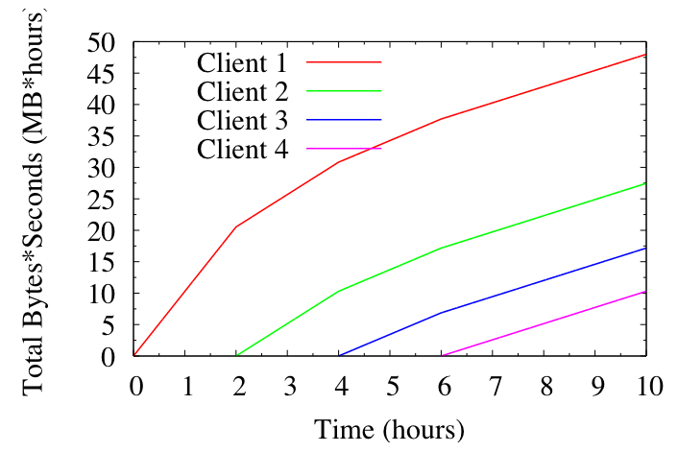
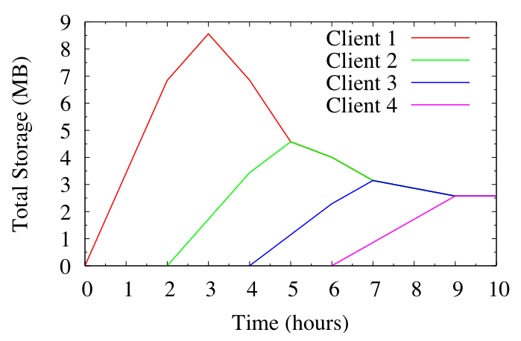
Fairness with Different Arrival Times

Slide 36
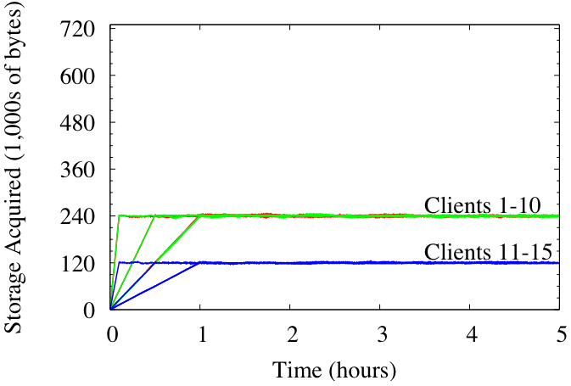
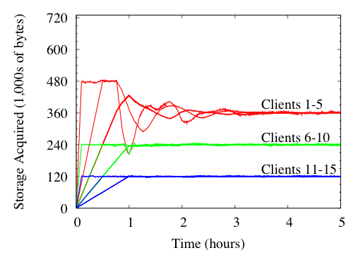
Fairness With Different Sizes and TTLs

Slide 37
Talk Outline
Introduction and Motivation
Challenges in building a shared DHT
  Sharing between applications
  Sharing between clients
Current Work
Conclusion

Slide 38
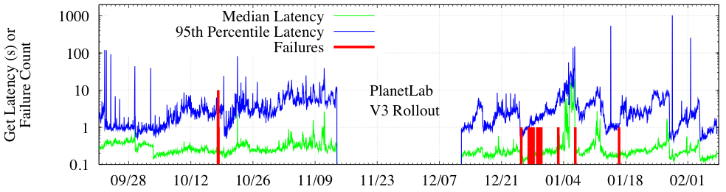
Current Work: Performance
Only 28 of 7 million values lost in 3 months
  Where “lost” means unavailable for a full hour
On Feb. 7, 2005, lost 60/190 nodes in 15 minutes to PL kernel bug, only lost one value

Slide 39
Current Work: Performance
Median get latency ~250 ms
  Median RTT between hosts ~ 140 ms
But 95th percentile get latency is atrocious
  And even median spikes up from time to time

Slide 40
The Problem: Slow Nodes
Some PlanetLab nodes are just really slow
  But set of slow nodes changes over time
  Can’t “cherry pick” a set of fast nodes
  Seems to be the case on RON as well
  May even be true for managed clusters (MapReduce)
Modified OpenDHT to be robust to such slowness
  Combination of delay-aware routing and redundancy
  Median now 66 ms, 99th percentile is 320 ms (using 2X redundancy)

Slide 41
Conclusion
Focusing on how to use a DHT
  Library model: flexible, powerful, often overkill
  Service model: easy to use, shares costs
  Both have their place, we’re focusing on the latter
Challenge: Providing for sharing
  Across applications → flexible interface
  Across clients → fair resource sharing
Up and running today

Slide 42
To try it out:
(code at http://opendht.org/users-guide.html)
$ ./find-gateway.py | head -1
planetlab5.csail.mit.edu
$ ./put.py http://planetlab5.csail.mit.edu:5851/ Hello World 3600
Success
$ ./get.py http://planetlab5.csail.mit.edu:5851/ Hello
World

Slide 43
Identifying Clients
For fair sharing purposes, a client is its IP addr
  Spoofing prevented by TCP’s 3-way handshake
Pros:
  Works today, no registration necessary
Cons:
  All clients behind NAT get only one share
  DHCP clients get more than one share
Future work: authentication at gateways

