Slide 1
Fixing the Embarrassing Slowness of OpenDHT on PlanetLab
Sean Rhea, Byung-Gon Chun,
John Kubiatowicz, and Scott Shenker
UC Berkeley (and now MIT)
December 13, 2005

Slide 2
Distributed Hash Tables (DHTs)
Same interface as a traditional hash table
  put(key, value) — stores value under key
  get(key) — returns all the values stored under key
Built over a distributed overlay network
  Partition key space over available nodes
  Route each put/get request to appropriate node

Slide 3
DHTs: The Hype
High availability
  Each key-value pair replicated on multiple nodes
Incremental scalability
  Need more storage/tput? Just add more nodes.
Low latency
  Recursive routing, proximity neighbor selection, server selection, etc.

Slide 4
DHTs: The Hype
Promises of DHTs realized only “in the lab”
  Use isolated network (Emulab, ModelNet)
  Measure while PlanetLab load is low
  Look only at median performance
Our goal: make DHTs perform “in the wild”
  Network not isolated, machines shared
  Look at long term 99th percentile performance
  (Caveat: no outright malicious behavior)

Slide 5
Why We Care
Promise of P2P was to harness idle capacity
  Not supposed to need dedicated machines
Running OpenDHT service on PlanetLab
  No control over what else is running
  Load can be really bad at times
  Up 24/7: have to weather good times and bad
  Good median performance isn’t good enough

Slide 6
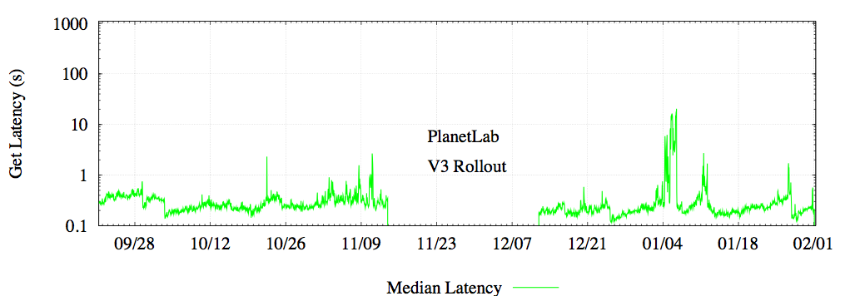
Original OpenDHT Performance
Long-term median get latency < 200 ms
  Matches performance of DHASH on PlanetLab
  Median RTT between hosts ~ 140 ms

Slide 7
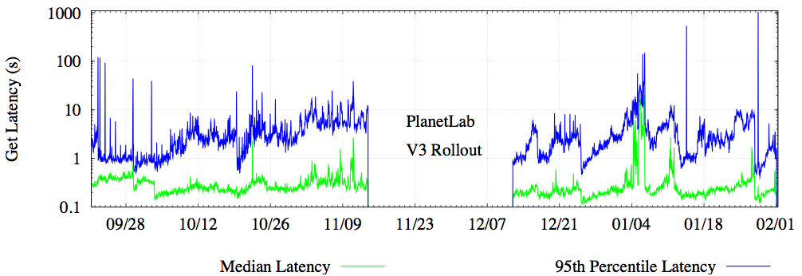
Original OpenDHT Performance
But 95th percentile get latency is atrocious!
  Generally measured in seconds
  And even median spikes up from time to time

Slide 8
Talk Overview
Introduction and Motivation
How OpenDHT Works
The Problem of Slow Nodes
Algorithmic Solutions
Experimental Results
Related Work and Conclusions

Slide 9
OpenDHT Partitioning
responsible for these keys
Assign each node an identifier from the key space
Store a key-value pair (k,v) on several nodes with IDs closest to k
Call them replicas for (k,v)
id = 0xC9A1…

Slide 10
OpenDHT Graph Structure
Overlay neighbors match prefixes of local identifier
Choose among nodes with same matching prefix length by network latency
0xED
0xC0
0x41
0x84

Slide 11
Performing Gets in OpenDHT
Client sends a get request to gateway
Gateway routes it along neighbor links to first replica encountered
Replica sends response back directly over IP
client
gateway
get(0x6b)
0x41
get(0x6b)
get
response
0x6c

Slide 12
Robustness Against Failure
If a neighbor dies, a node routes through its next best one
If replica dies, remaining replicas create a new one to replace it
client
0xC0
0x41
0x6c

Slide 13
The Problem of Slow Nodes
What if a neighbor doesn’t fail, but just slows down temporarily?
  If it stays slow, node will replace it
  But must adapt slowly for stability
Many sources of slowness are short-lived
  Burst of network congestion causes packet loss
  User loads huge Photoshop image, flushing buffer cache
In either case, gets will be delayed

Slide 14
Flavors of Slowness
At first, slowness may be unexpected
  May not notice until try to route through a node
  First few get requests delayed
Can keep history of nodes’ performance
  Stop subsequent gets from suffering same fate
  Continue probing slow node for recovery

Slide 15
Talk Overview
Introduction and Motivation
How OpenDHT Works
The Problem of Slow Nodes
Algorithmic Solutions
Experimental Results
Related Work and Conclusions

Slide 16
Two Main Techniques
Delay-aware routing
  Guide routing not just by progress through key space, but also by past responsiveness

Slide 17
Delay-Aware Routing
30 ms
Gateway
30 ms
Best next
hop
30 ms
Replicas

Slide 18
Delay-Aware Routing
30 ms
Gateway
50 ms
30 ms
About
the same?
Replicas

Slide 19
Delay-Aware Routing
30 ms
Gateway
500 ms
30 ms
Best next
hop
Replicas

Slide 20
Two Main Techniques
Delay-aware routing
  Guide routing not just by progress through key space, but also by past responsiveness
  Cheap, but must first observe slowness
Added parallelism
  Send each request along multiple paths

Slide 21
Naïve Parallelism
Gateway
sudden
delay
Replicas

Slide 22
Multiple Gateways
(Only client replicates requests.)
Client
sudden
delay
Gateways
Replicas

Slide 23
Iterative Routing
(Gateway maintains p concurrent RPCs.)
Client
Gateways
sudden
delay
Replicas

Slide 24
Two Main Techniques
Delay-aware routing
  Guide routing not just by progress through key space, but also by past responsiveness
  Cheap, but must first observe slowness
Added parallelism
  Send each request along multiple paths
  Expensive, but handles unexpected slowness

Slide 25
Talk Overview
Introduction and Motivation
How OpenDHT Works
The Problem of Slow Nodes
Algorithmic Solutions
Experimental Results
Related Work and Conclusions

Slide 26
Experimental Setup
Can’t get reproducible numbers from PlanetLab
  Both available nodes and load change hourly
  But PlanetLab is the environment we care about
Solution: run all experiments concurrently
  Perform each get using every mode (random order)
  Look at results over long time scales:
  6 days; over 27,000 samples per mode

Slide 27
Delay-Aware Routing
Mode | Latency (ms) |  | Cost
 | 50th | 99th | Msgs | Bytes
Greedy | 150 | 4400 | 5.5 | 1800
Delay-Aware | 100 | 1800 | 6.0 | 2000
Latency drops by 30-60%
Cost goes up by only ~10%

Slide 28
Multiple Gateways
# of Gateways | Latency (ms) |  | Cost
 | 50th | 99th | Msgs | Bytes
1 | 100 | 1800 | 6.0 | 2000
2 | 70 | 610 | 12 | 4000
3 | 57 | 440 | 17 | 5300
Latency drops by a further 30-73%
But cost doubles or worse

Slide 29
Iterative Routing
# of Gateways | Mode |  |  | Cost
 |  | 50th | 99th | Msgs | Bytes
1 | Recursive | 100 | 1800 | 6.0 | 2000
3 |  | 57 | 440 | 17 | 5300
1 | 3-way Iterative | 120 | 790 | 15 | 3800
2 |  | 76 | 360 | 27 | 6700
Parallel iterative not as cost effective as just using multiple gateways

Slide 30
Talk Overview
Introduction and Motivation
How OpenDHT Works
The Problem of Slow Nodes
Algorithmic Solutions
Experimental Results
Related Work and Conclusions

Slide 31
Related Work
Google MapReduce
  Cluster owned by single company
  Could presumably make all nodes equal
  Turns out it’s cheaper to just work around the slow nodes instead
Accordion
  Another take on recursive parallel lookup
Other related work in paper

Slide 32
Conclusions
Techniques for reducing get latency
  Delay-aware routing is a clear win
  Parallelism very fast, but costly
  Iterative routing not cost effective
OpenDHT get latency is now quite low
  Was 150 ms on median, 4+ seconds on 99th
  Now under 100 ms on median, 500 ms on 99th
  Faster than DNS [Jung et al. 2001]

Slide 33
Thanks!
For more information: http://opendht.org/

