Slide 1
Pond: the OceanStore Prototype
Sean Rhea, Patrick Eaton,
Dennis Geels, Hakim Weatherspoon, Ben Zhao, and John Kubiatowicz
{srhea,eaton,geels,hweather,ravenben,kubitron}@cs.berkeley.edu
University of California, Berkeley

Slide 2
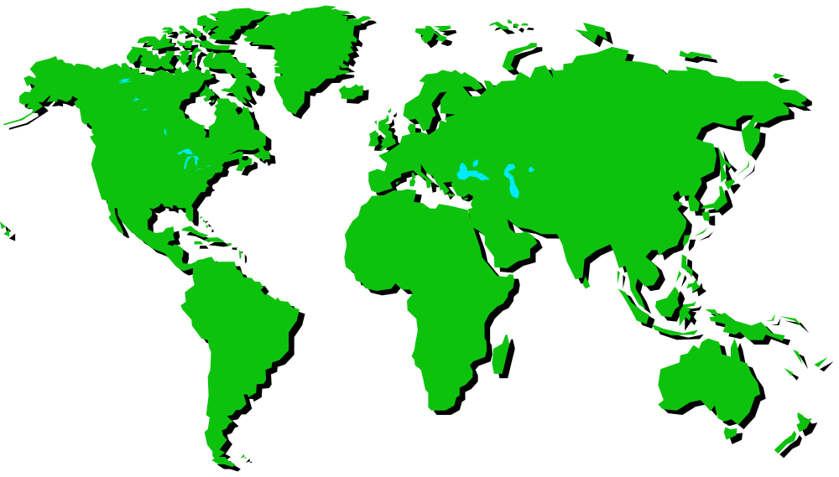





The OceanStore “Vision”
me
HotOS
Attendee
Paul Hogan

Slide 3
The Challenges
Maintenance
  Many components, many administrative domains
  Constant change
  Must be self-organizing
  Must be self-maintaining
  All resources virtualized—no physical names
Security
  High availability is a hacker’s target-rich environment
  Must have end-to-end encryption
  Must not place too much trust in any one host

Slide 4
Talk Outline
Introduction
System Overview
  Tapestry
  Erasure codes
  Byzantine agreement
  Putting it all together
Implementation and Deployment
Performance Results
Conclusion

Slide 5
The Technologies: Tapestry
Tapestry performs
Distributed Object Location and Routing
From any host, find a nearby…
  replica of a data object
Efficient
  O(log N ) location time, N = # of hosts in system
Self-organizing, self-maintaining

Slide 6
The Technologies: Tapestry (con’t.)
HotOS
Attendee
Paul Hogan

Slide 7
The Technologies: Erasure Codes
More durable than replication for same space
The technique:
W
X
f
Y
Z
W
f ⁻¹
Z

Slide 8
The Technologies: Byzantine Agreement
Guarantees all non-faulty replicas agree
  Given N =3f +1 replicas, up to f may be faulty/corrupt
Expensive
  Requires O(N ²) communication
Combine with primary-copy replication
  Small number participate in Byzantine agreement
  Multicast results of decisions to remainder

Slide 9
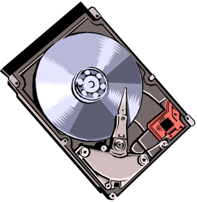


Putting it all together: the Path of a Write
Archival Servers
(for durability)
HotOS
Attendee
Primary Replicas
Other
Researchers
Secondary
Replicas
(soft state)

Slide 10
Talk Outline
Introduction
System Overview
Implementation and Deployment
Performance Results
Conclusion

Slide 11
Prototype Implementation
All major subsystems operational
  Self-organizing Tapestry base
  Primary replicas use Byzantine agreement
  Secondary replicas self-organize into multicast tree
  Erasure-coding archive
  Application interfaces: NFS, IMAP/SMTP, HTTP
Event-driven architecture
  Built on SEDA
280K lines of Java (J2SE v1.3)
  JNI libraries for cryptography, erasure coding

Slide 12
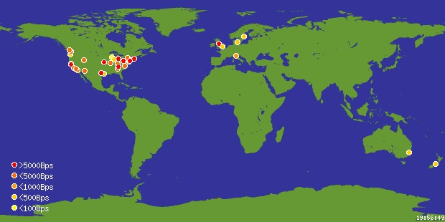
Deployment on PlanetLab
http://www.planet-lab.org
  ~100 hosts, ~40 sites
  Shared .ssh/authorized_keys file
Pond: up to 1000 virtual nodes
  Using custom Perl scripts
  5 minute startup
Gives global scale for free
Notes:
Plug planetlab
Mention slowdown at 10x virtualization

Slide 13
Talk Outline
Introduction
System Overview
Implementation and Deployment
Performance Results
  Andrew Benchmark
  Stream Benchmark
Conclusion

Slide 14
Performance Results: Andrew Benchmark
Built a loopback file server in Linux
  Translates kernel NFS calls into OceanStore API
Lets us run the Andrew File System Benchmark
Andrew
Benchmark
Loopback
Server
Pond
Pond
Daemon
API
fwrite syscall
NFS Write
Msg to Primary
Linux Kernel
Network

Slide 15
Performance Results: Andrew Benchmark
Ran Andrew on Pond
  Primary replicas at UCB, UW, Stanford, Intel Berkeley
  Client at UCB
  Control: NFS server at UW
 |  | OceanStore
Phase | NFS | 512 | 1024
I | 0.9 | 2.8 | 6.6
II | 9.4 | 16.8 | 40.4
III | 8.3 | 1.8 | 1.9
IV | 6.9 | 1.5 | 1.5
V | 21.5 | 32.0 | 70.7
Total | 47.0 | 54.9 | 120.3
(times in milliseconds)
Pond faster on reads: 4.6x
  Phases III and IV
  Only contact primary when cache older than 30 seconds
But slower on writes: 7.3x
  Phases I, II, and V
  Only 1024-bit are secure
  512-bit keys show CPU cost

Slide 16
Closer Look: Write Cost
Byzantine algorithm adapted from Castro & Liskov
  Gives fault tolerance, security against compromise
  Fast version uses symmetric cryptography
Pond uses threshold signatures instead
  Signature proves that f +1 primary replicas agreed
  Can be shared among secondary replicas
  Can also change primaries w/o changing public key
Big plus for maintenance costs
  Results good for all time once signed
  Replace faulty/compromised servers transparently

Slide 17
Closer Look: Write Cost
Small writes
  Signature dominates
  Threshold sigs. slow!
  Takes 70+ ms to sign
  Compare to 5 ms for regular sigs.
Phase | 4 kB write | 2 MB write
Validate | 0.3 | 0.4
Serialize | 6.1 | 26.6
Apply | 1.5 | 113.0
Archive | 4.5 | 566.9
Sign Result | 77.8 | 75.8
Large writes
  Encoding dominates
  Archive cost per byte
  Signature cost per write
(times in milliseconds)

Slide 18
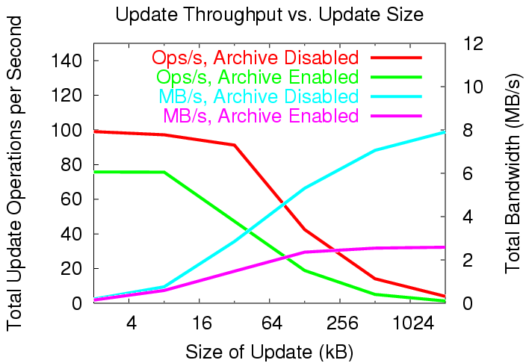
Closer Look: Write Cost
(run on cluster)

Slide 19
Closer Look: Write Cost
Throughput in the wide area:
Primary location | Client location | Tput (MB/s)
Cluster | Cluster | 2.59
Cluster | PlanetLab | 1.22
Bay Area | PlanetLab | 1.19
(archive on)
Wide Area Throughput
  Not limited by signatures
  Not limited by archive
  Not limited by Byzantine process bandwidth use
  Limited by client-to-primary replicas bandwidth

Slide 20
Talk Outline
Introduction
System Overview
Implementation and Deployment
Performance Results
  Andrew Benchmark
  Stream Benchmark
Conclusion

Slide 21
Closer look: Dissemination Tree
Archival Servers
HotOS
Attendee
Primary Replicas
Other
Researchers
Secondary
Replicas

Slide 22
Closer look: Dissemination Tree
Self-organizing application-level multicast tree
  Connects all secondary replicas to primary ones
  Shields primary replicas from request load
  Save bandwidth on consistency traffic
Tree joining heuristic (“first-order” solution):
  Connect to closest replica using Tapestry
    Take advantage of Tapestry’s locality properties
  Should minimize use of long-distance links
  A sort of poor man’s CDN
Notes:
Tapestry with optimizations

Slide 23
Performance Results: Stream Benchmark
Goal: measure efficiency of dissemination tree
  Multicast tree between secondary replicas
Ran 500 virtual nodes on PlanetLab
  Primary replicas in SF Bay Area
  Other replicas clustered in 7 largest PlanetLab sites
Streams writes to all replicas
  One content creator repeatedly appends to one object
  Other replicas read new versions as they arrive
  Measure network resource consumption
Notes:
Inner ring in Bay Area
Readers in England

Slide 24
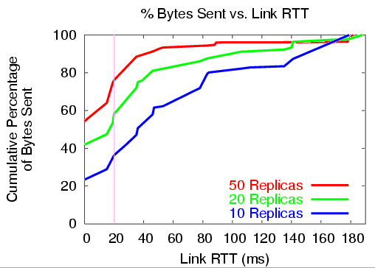
Performance Results: Stream Benchmark
Dissemination tree uses network resources efficiently
  Most bytes sent across local links as second tier grows
Acceptable latency increase over broadcast (33%)
Notes:
Explain axis, CDF
Tag, latency

Slide 25
Related Work
Distributed Storage
  Traditional: AFS, CODA, Bayou
  Peer-to-peer: PAST, CFS, Ivy
Byzantine fault tolerant storage
  Castro-Liskov, COCA, Fleet
Threshold signatures
  COCA, Fleet
Erasure codes
  Intermemory, Pasis, Mnemosyne, Free Haven
Others
  Publius, Freenet, Eternity Service, SUNDR

Slide 26
Conclusion
OceanStore designed as a global-scale file system
Design meets primary challenges
  End-to-end encryption for privacy
  Limited trust in any one host for integrity
  Self-organizing and maintaining to increase usability
Pond prototype functional
  Threshold signatures more expensive than expected
  Simple dissemination tree fairly effective
  A good base for testing new ideas

Slide 27
More Information and Code Availability
More OceanStore work
  Overview: ASPLOS 2000
  Tapestry: SPAA 2002
More papers and code for Pond available at
http://oceanstore.cs.berkeley.edu

