Slide 1

TX’ME!
By:-
k.Pavan kalyan
Ch.Karthik dattu
E.chandu

Slide 2
introduction
Our project is an example of chat application which is basically based on public chatting (message is broadcast to all connected users)
It is made of two application
Clint application which runs on user’s Pc
Server application which runs on any Pc on the network
To start chatting client should get connected to server

Slide 3
Modules
Server Modules:-
A server is a specially equipped computer connected to the internet that allows users with chat clients to converse with one another via typed messages in real time.
Client Module:-
A client is a software program that allows users to connect to chat servers and communicate with other users via a chat room.

Slide 4
FRONT END
HTML
PHP
CSS

Slide 5





*
DATABASE

Slide 6
*
Chat server aggregates message from all users and sends to all clients
Other user’s clients display aggregated message from chat server
Chat clients send user’s
message to server

Slide 7

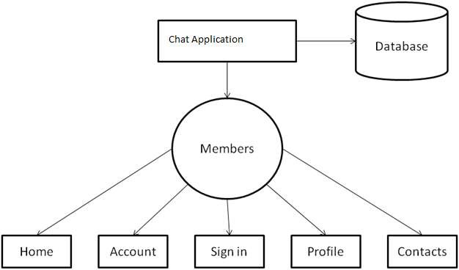
* 1 Level DFD

Slide 8





*

