Slide 1
Title - "Healthcare Analytics: Predicting Disease by Symptoms“
CPSC 531-03 Advanced Database Management
Sri Datta Venga S

Slide 2
Problem Statement –
If a person has been observing a few symptoms and is unsure of the sickness he or she is dealing with, this will lead to a variety of diseases in the future. To avoid this and to learn about the condition in the early phases of the symptoms, this disease prediction will be extremely beneficial to a wide range of individuals, including children, teens, adults, and elderly citizens. Preventive measures can be taken by the individual or can seek for professional medical advice in order to get the proper treatment required to treat the ailment.

Slide 3
Proposed Approach –
Selecting the relevant dataset.
Loading the data into Hadoop Cluster(Dataproc).
Analyzing the data using PySpark.
Visualize the analyzed data.

Slide 4
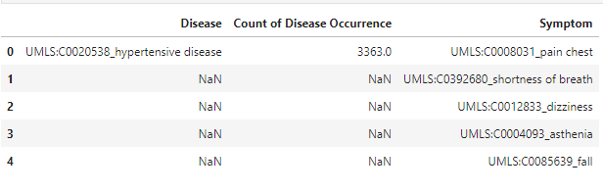
Dataset
The Dataset is chosen from Kaggle. The attributes of the dataset include Disease, Count of Disease Occurrence and Symptoms. After preprocessing the complete dataset, we will be using one of them as training, and other is for testing the model using machine learning algorithm. Every sickness has a clinical manifestations that can be used to forecast the condition.

Slide 5
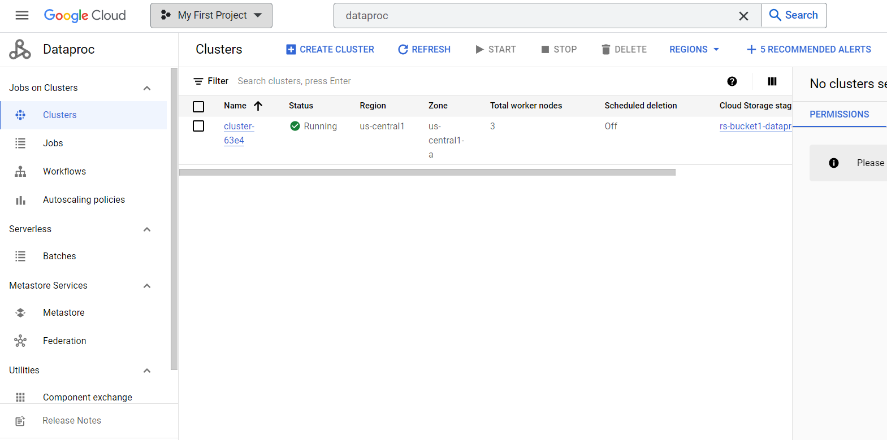
Dataproc-Google Cloud Services
Dataproc is fully managed big data cluster or big data as service provider.

Slide 6
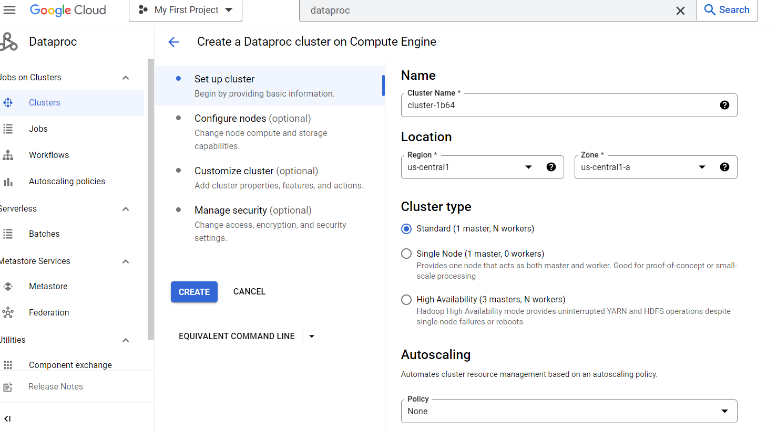
1-Creating a cluster.

Slide 7
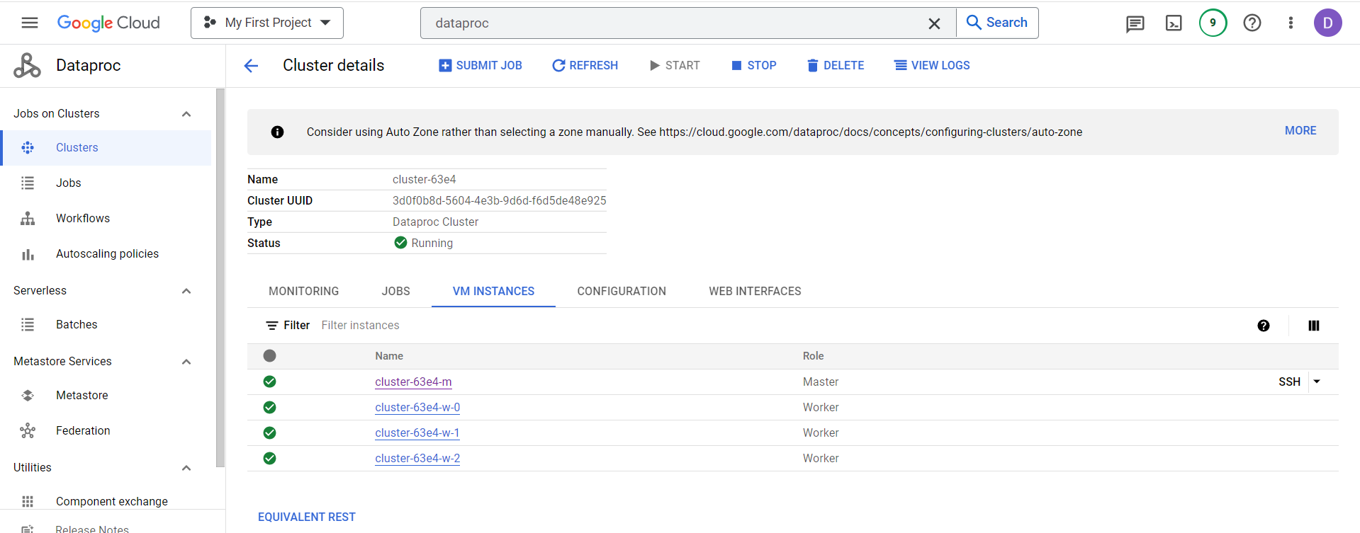
Our project has 3 worker node Hadoop cluster.

Slide 8
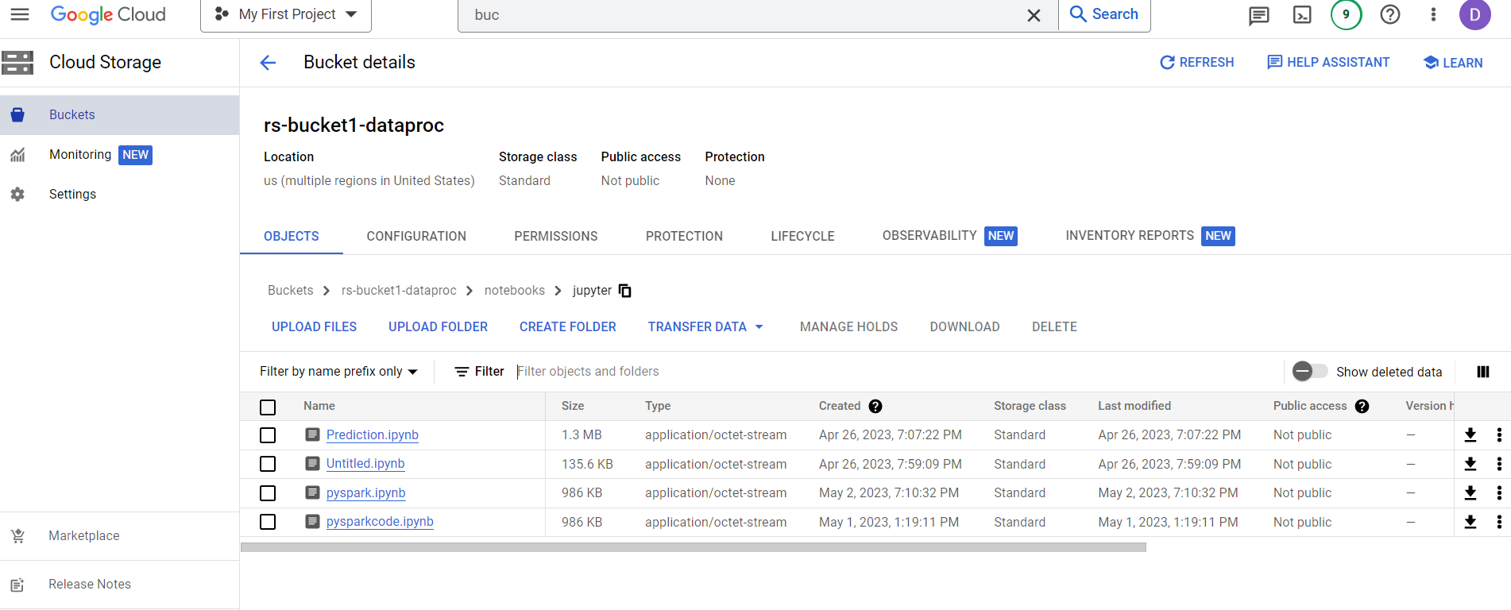
Creating google storage bucket
We create bucket to save pyspark code and dataset to process the data.

Slide 9
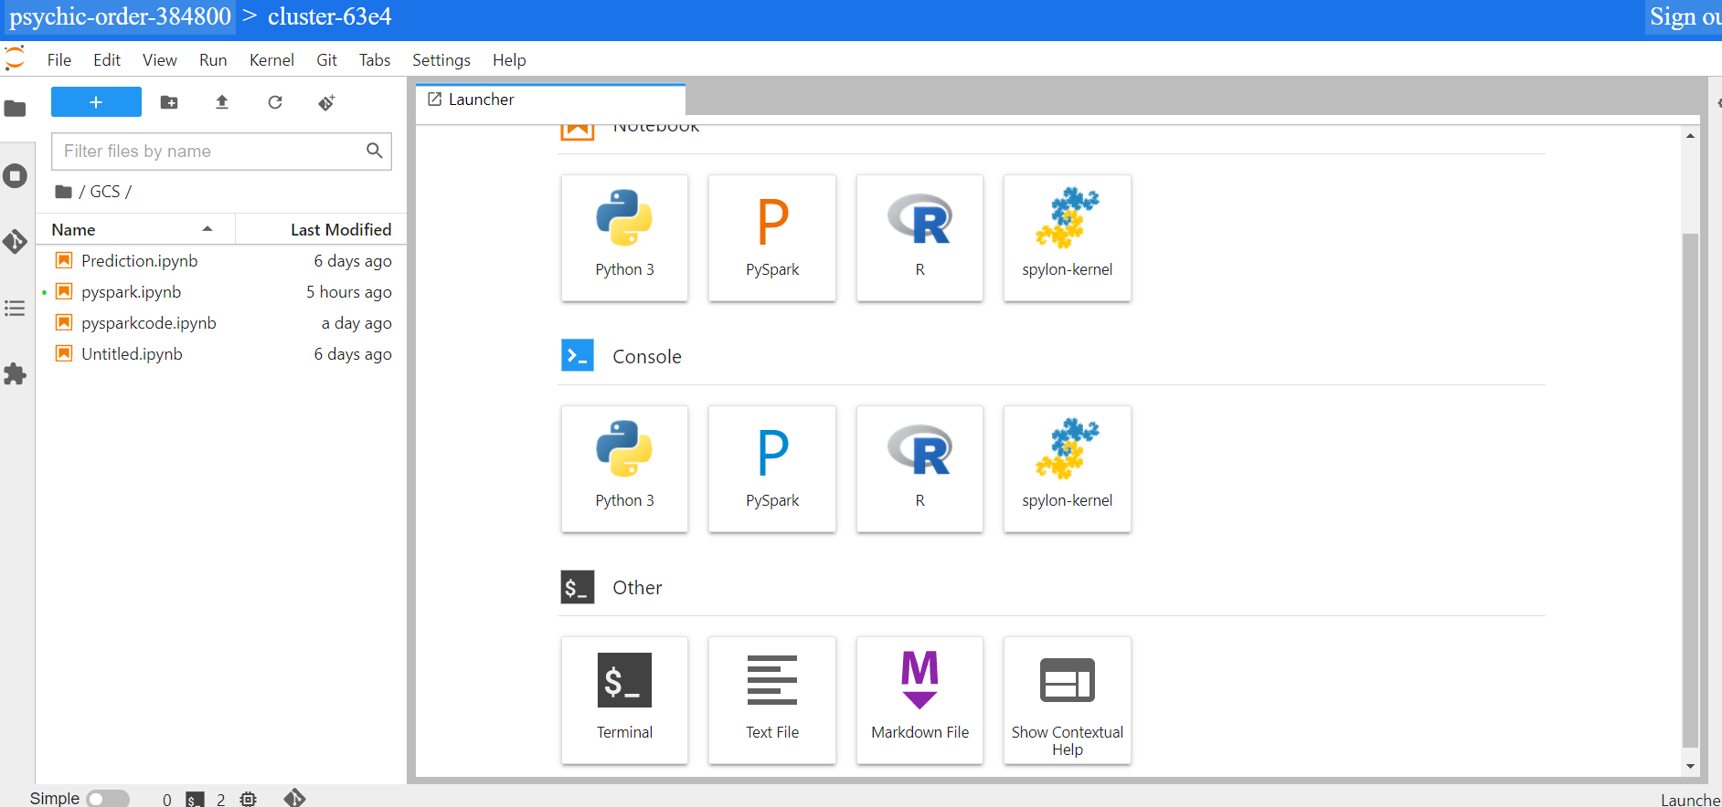
We started setting up the Hadoop cluster and then we connected our Hadoop cluster through jupyter notebook interface.

Slide 10
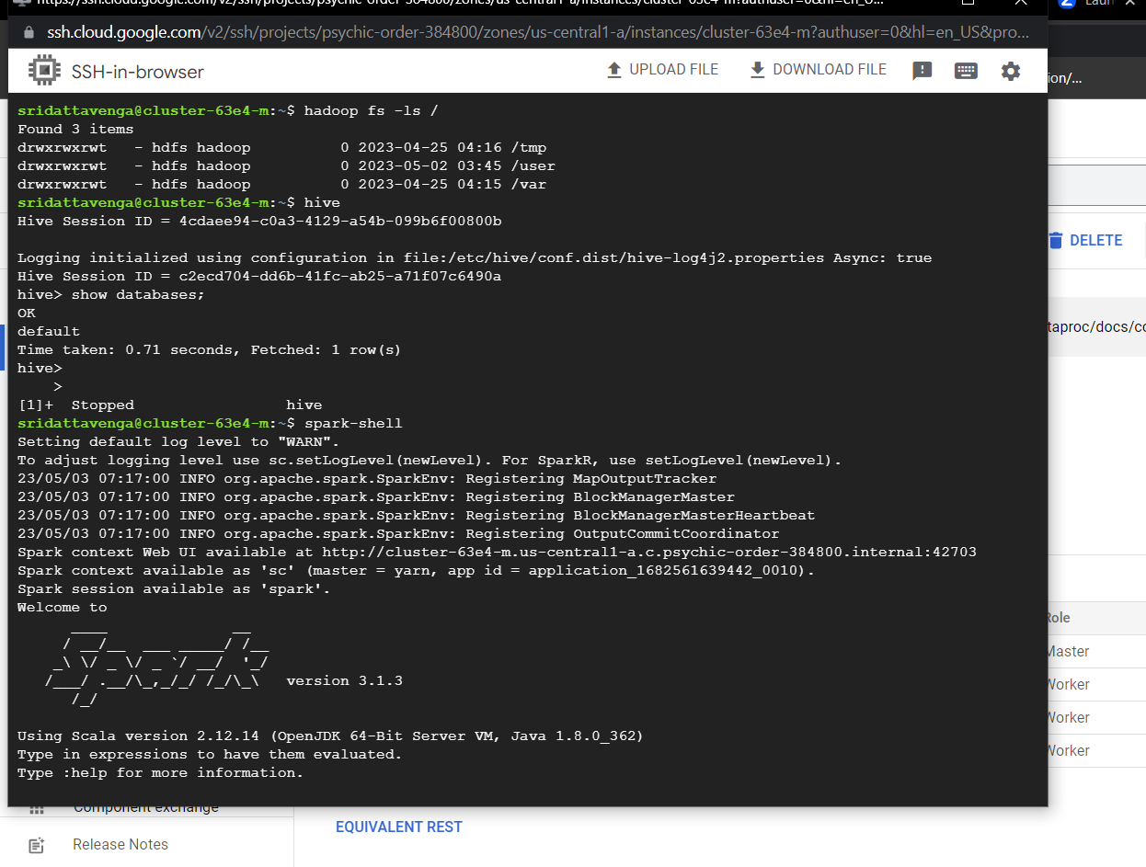

Slide 11
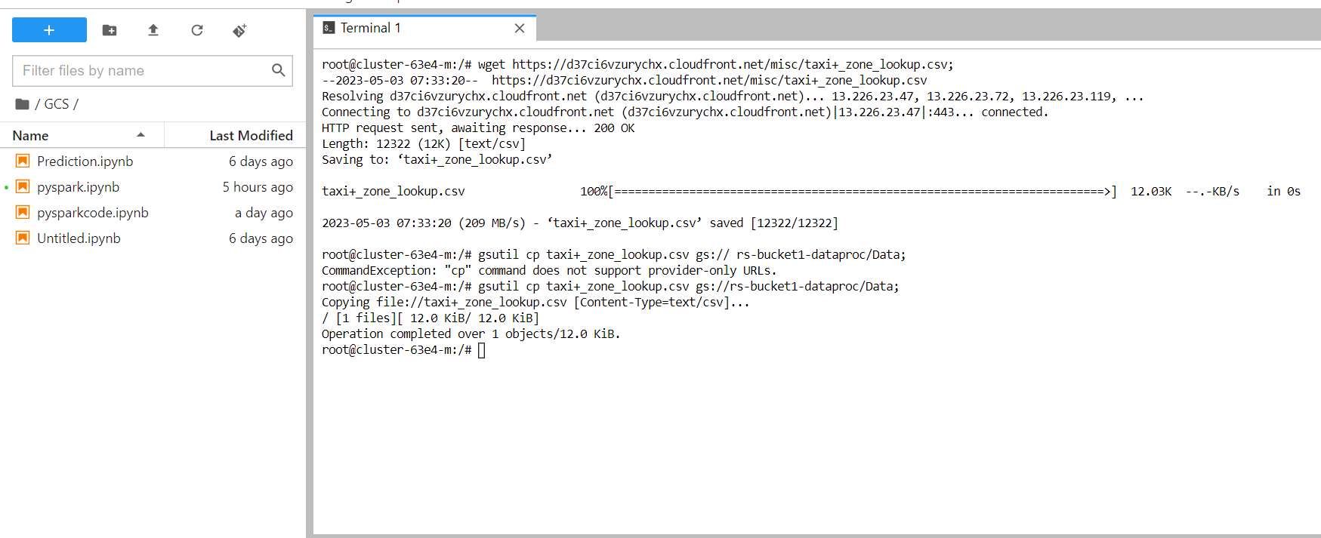
Now, we have to import dataset from internet into Hadoop cluster on google cloud on dataproc and then to process data with jupyter notebook. To import dataset from internet on to our Hadoop cluster from Hadoop cluster to google storage bucket. We use two commands . 1,wget https://d37ci6vzurychx.cloudfront.net/misc/taxi+_zone_lookup.csv; 2, gsutil cp taxi+_zone_lookup.csv gs:// rs-bucket1-dataproc/Data;

Slide 12
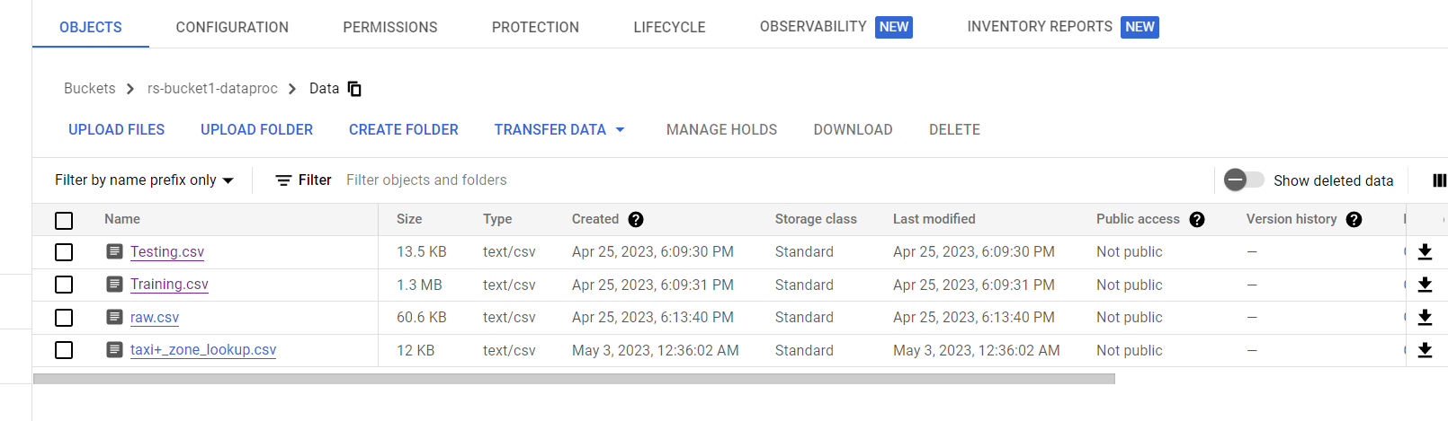

Slide 13

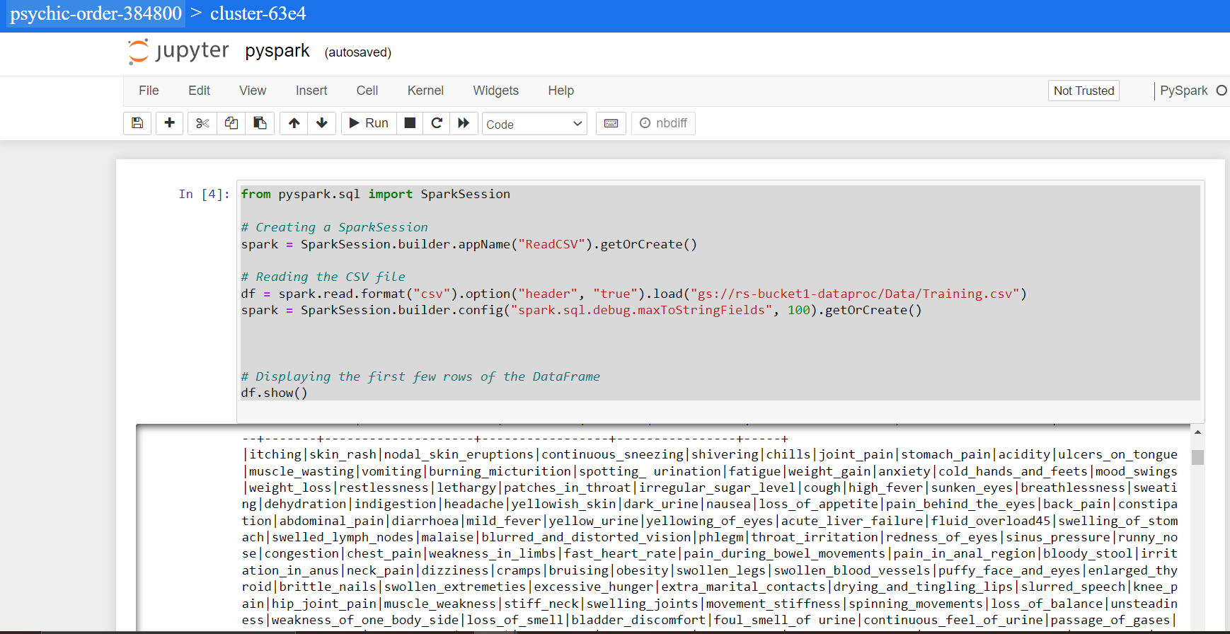
Analyzing data using pyspark through jupyter notebook interface.
PySpark code to read a CSV file stored in Google Cloud Storage and load it into a DataFrame.

Slide 14
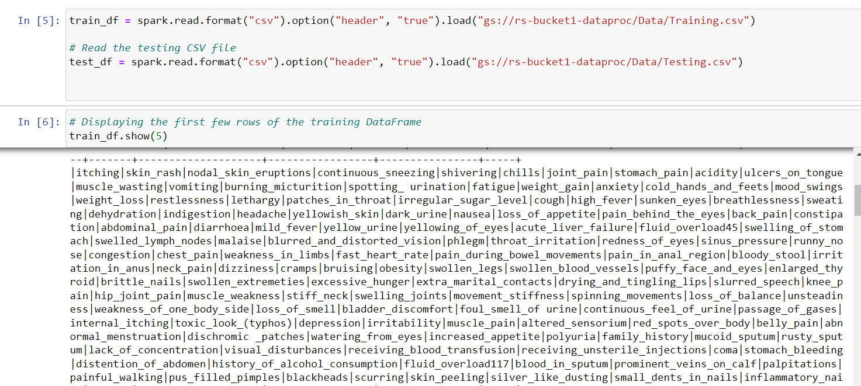

Slide 15
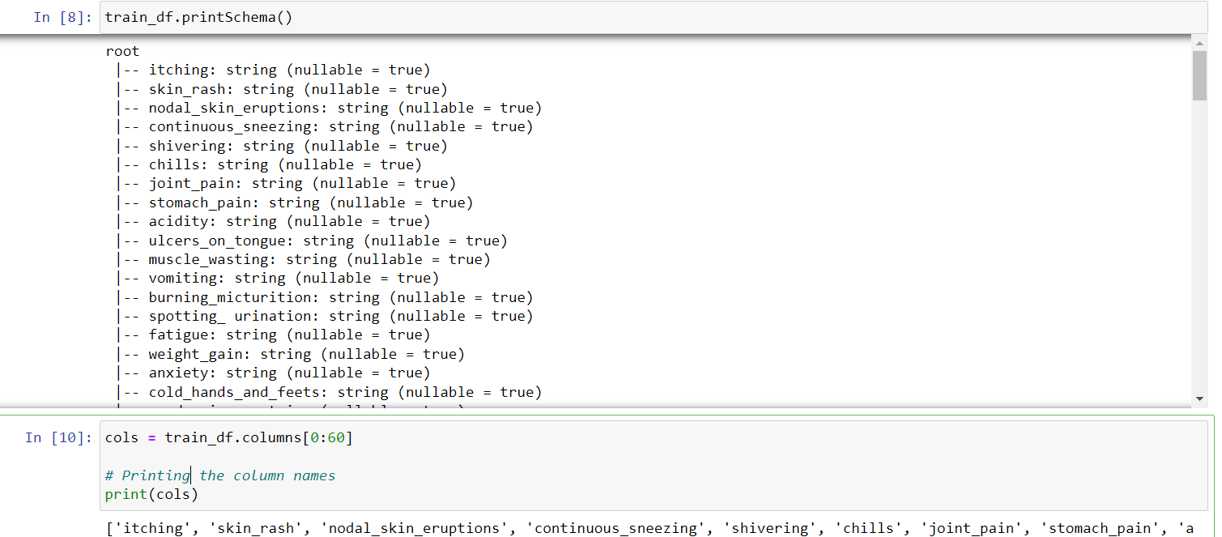
The printSchema() method to display the schema of the train_df DataFrame. The schema defines the structure of the DataFrame, including the names and types of its columns.

Slide 16
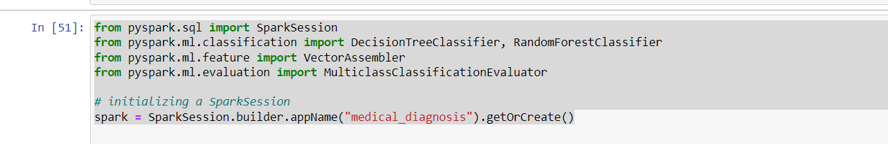
VectorAssembler is a PySpark ML feature that allows you to combine multiple columns of a DataFrame into a single vector column. It takes a list of column names as input and creates a new DataFrame with an additional column, where each row of the new column is a vector containing the values from the input columns.

Slide 17
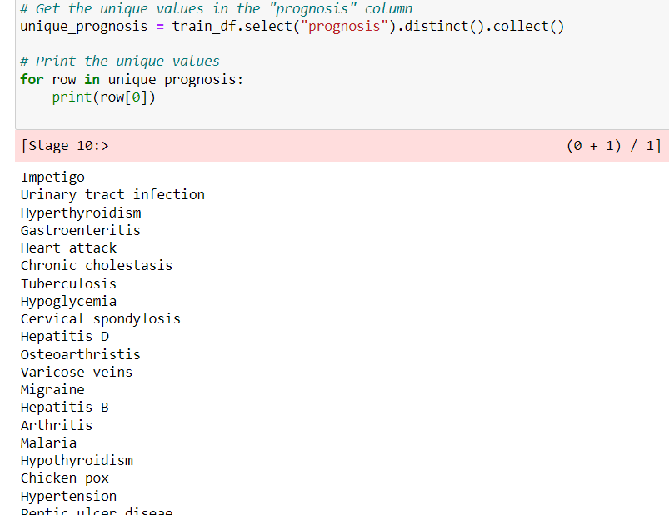
The "prognosis" column from a DataFrame train_df and find the distinct values in that column using the distinct() method. The collect() method is used to retrieve the result as a list of Row objects.

Slide 18
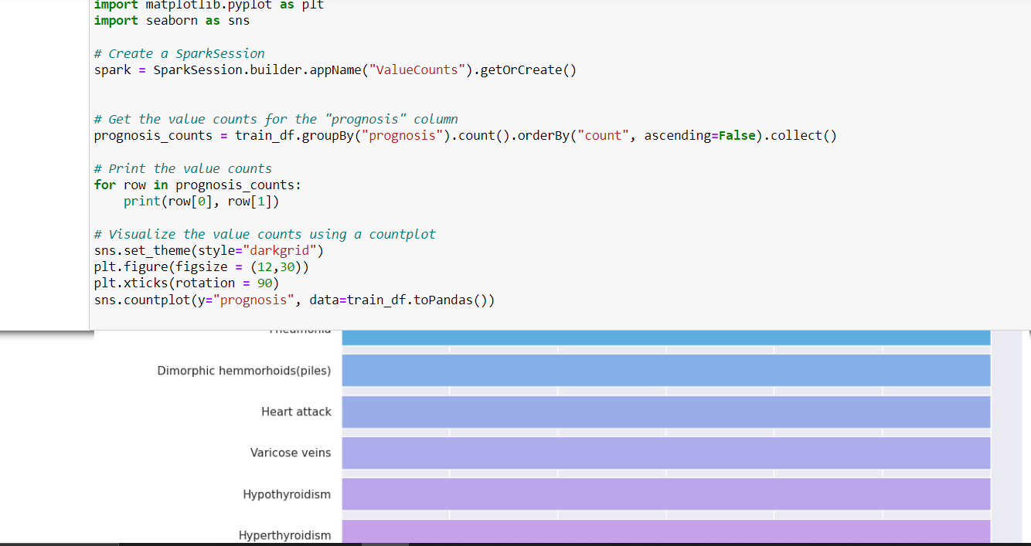
Matplotlib is a data visualization library for creating static, interactive, and animated visualizations. It provides a wide range of visualization tools such as line plots, scatter plots, bar charts, histograms, and many more. Matplotlib is a powerful library for creating high-quality visualizations with customizable options.

Slide 19
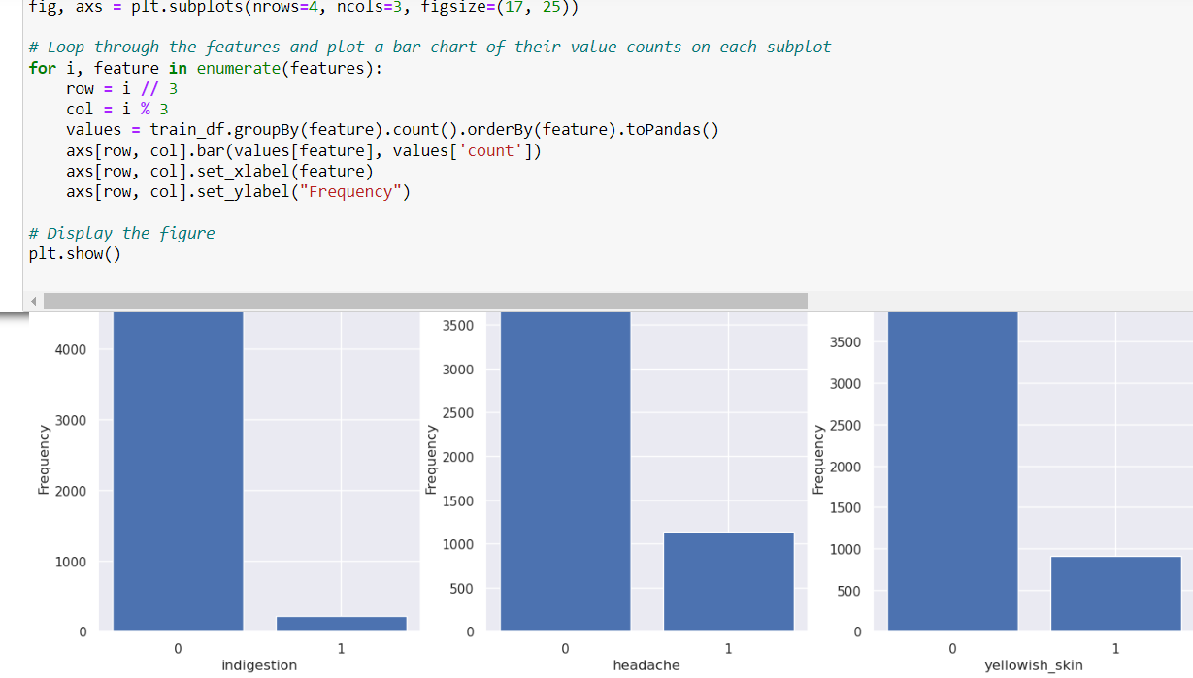

Slide 20
k-nearest neighbors (KNN) algorithm
we're using the k-nearest neighbors (KNN) algorithm to classify the diseases based on the symptoms provided.
First, we import the KNeighborsClassifier class from the sklearn.neighbors module. Then, we create an instance of this class with a parameter n_neighbors set to 5. This means that the KNN algorithm will classify each data point based on the 5 closest neighbors to it.
Next, we split the training and testing data into separate data frames, with the x_train and x_test data frames containing all columns except the "prognosis" column, which is used as the target variable in our classification. The y_train and y_test data frames contain only the "prognosis" column.
We then fit the KNN algorithm to the training data using the fit() method. Finally, we use the predict() method to make predictions on the testing data, and print out the first 20 predictions. We also calculate the accuracy of the model using the score() method, which compares the predicted values to the actual values in the testing data set. In this case, the accuracy is 1.0, indicating that the model is predicting the correct diagnosis for all the cases in the testing data set.

Slide 21
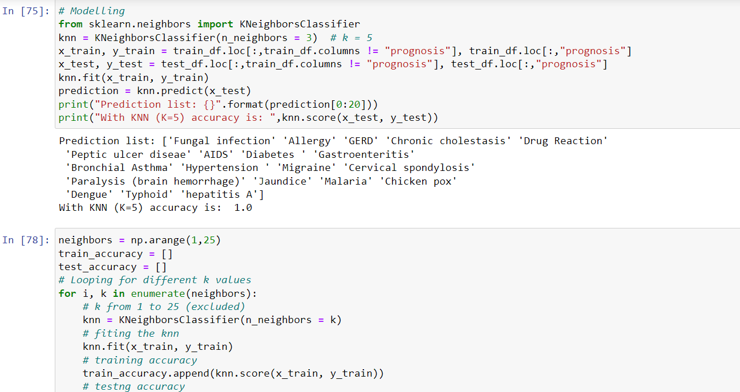

Slide 22
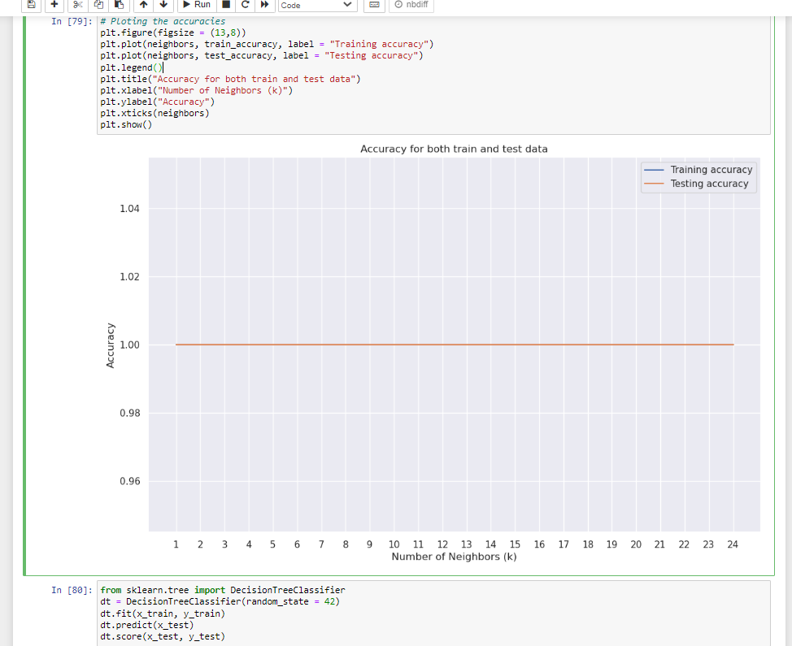

Slide 23
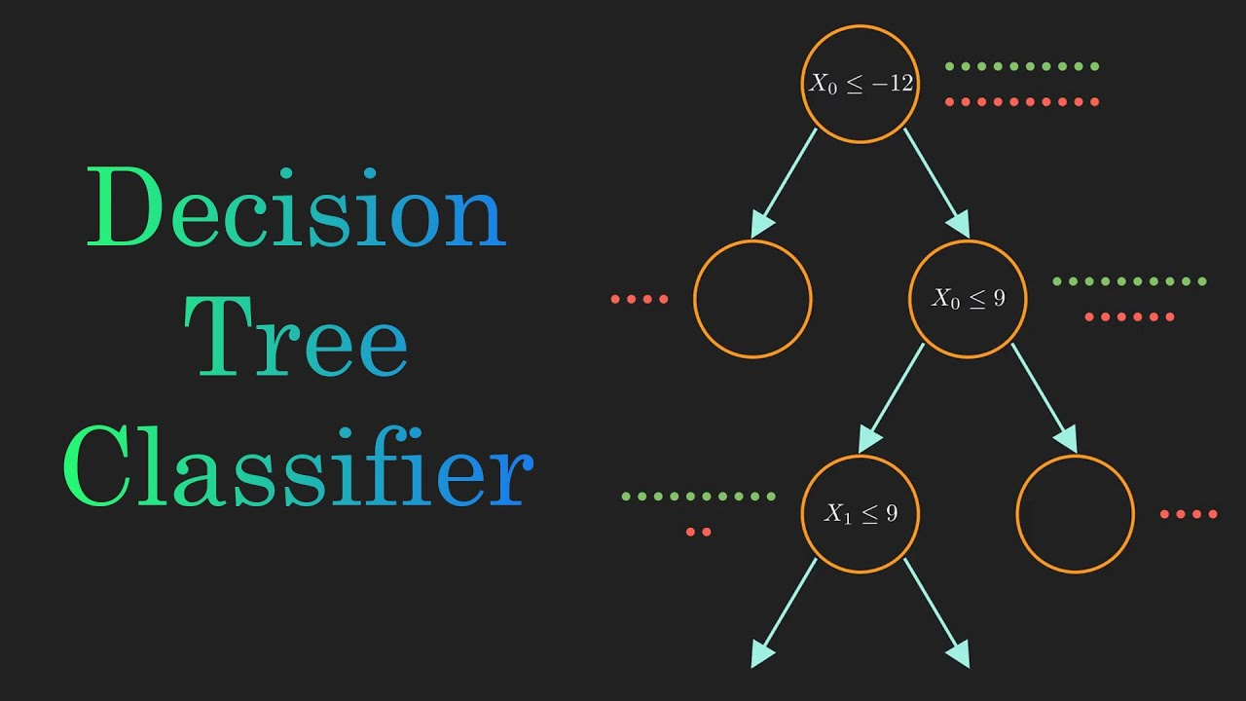
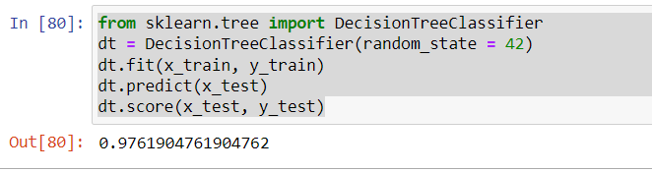
A Decision Tree Classifier is another type of machine learning algorithm used for classification tasks. The accuracy of the decision tree classifier on the test data is 0.9761904761904762, which means that it correctly predicted the diagnosis of 97.6% of the patients in the test set.

Slide 24
Thank You

